Slide 1
FastMDXplora Test Run
FastMDXplora v2.0.1.dev21+g0c273923c.d20260627
System: 1L2Y

Slide 2
Workflow
Full FastMDXplora workflow: setup, simulation, analysis, and report.

Slide 3
Setup
System preparation phase outputs:
- test_run\setup
Parameter manifest: setup_parameters.json

Slide 4
Simulation
Molecular dynamics simulation phase outputs:
- test_run\simulation
Parameter manifest: simulation_parameters.json

Slide 5
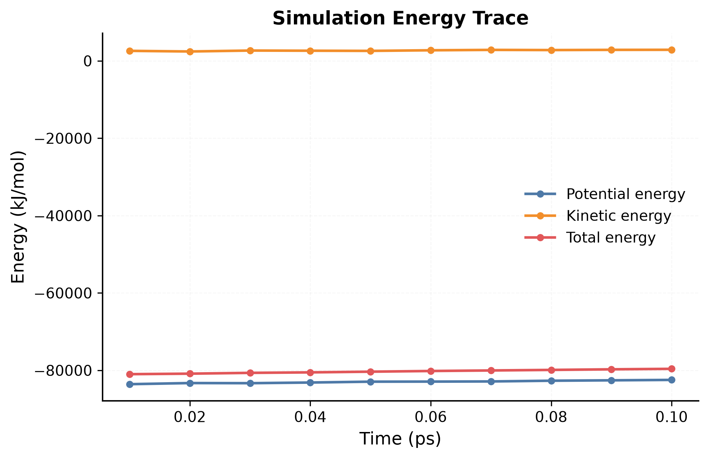
Simulation Energy Trace
Generated from simulation/energy.csv
Potential, kinetic, and total energy over time provide a quick diagnostic of simulation stability. Large discontinuities, runaway values, or sudden jumps may indicate unstable integration settings or problematic system preparation.

Slide 6
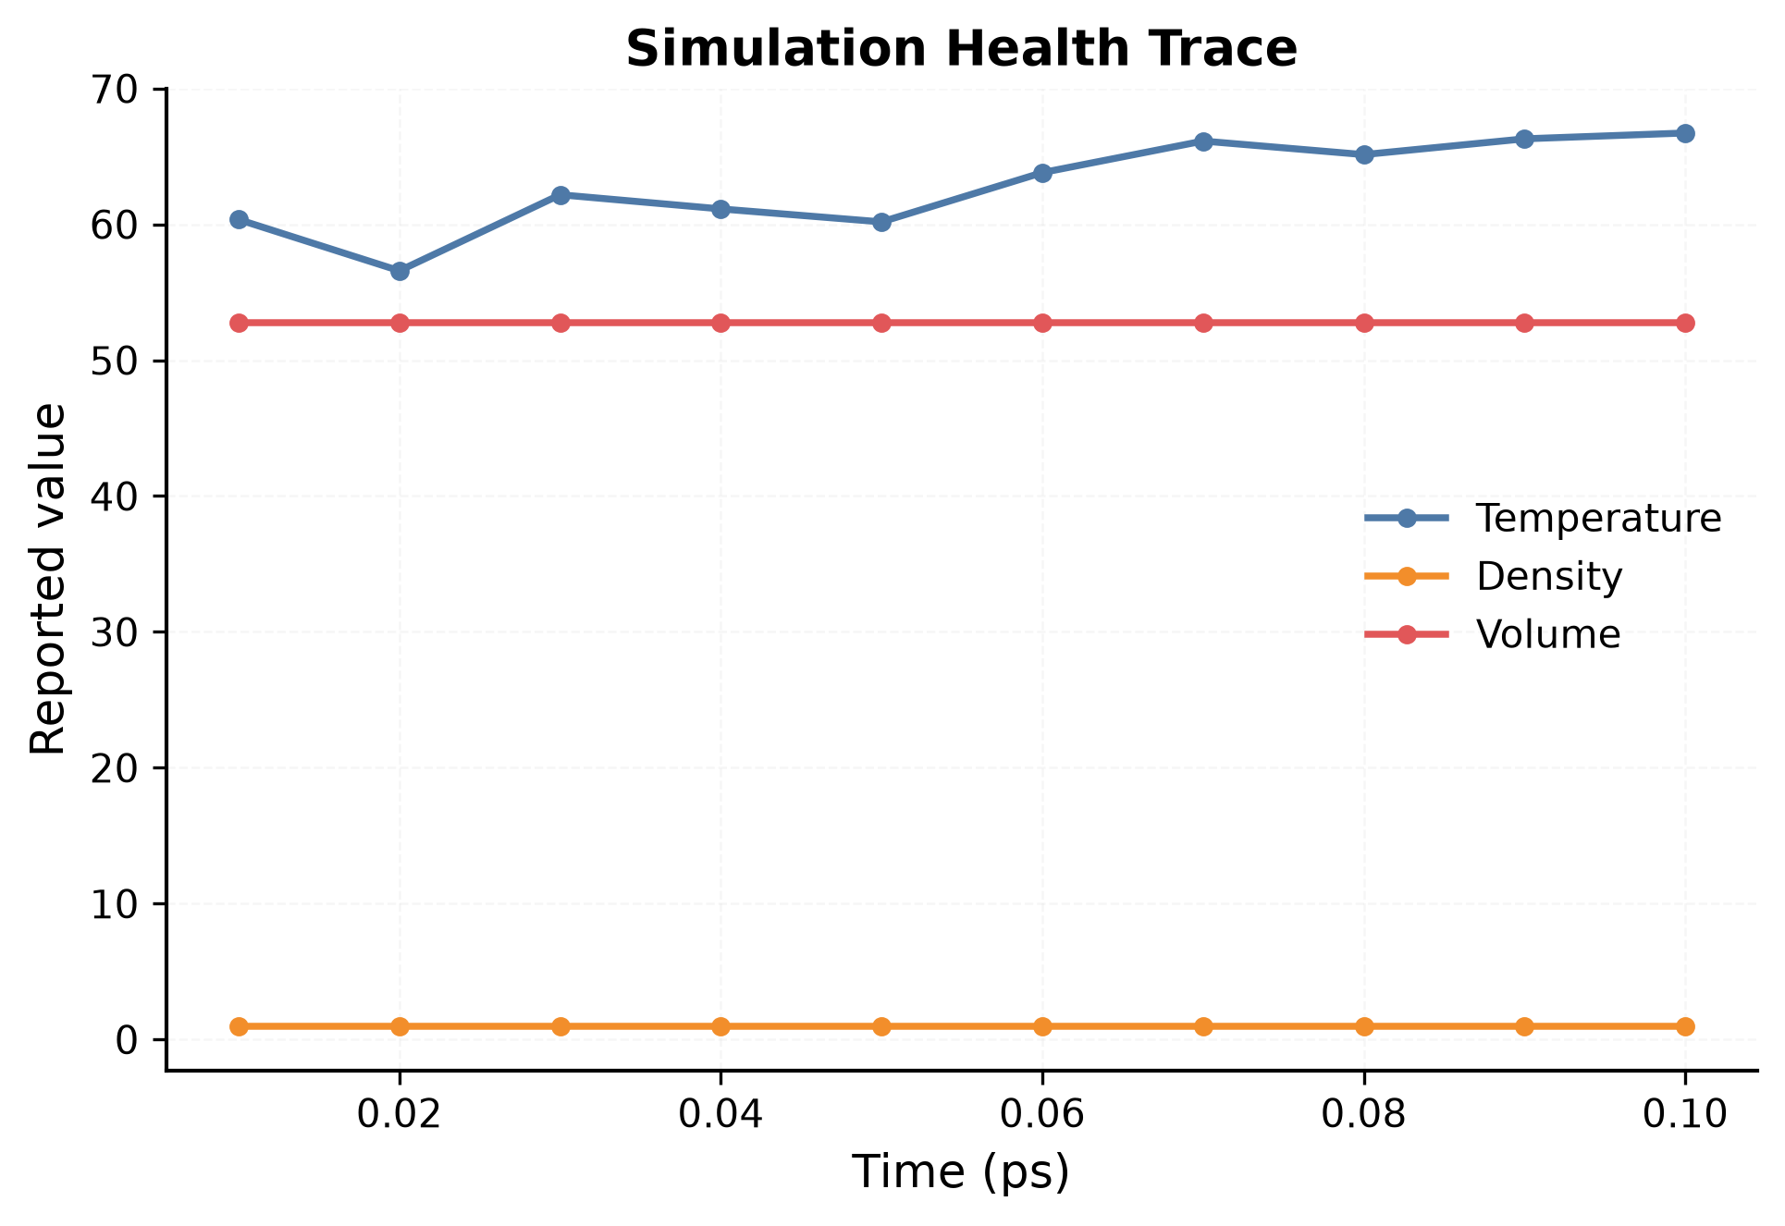
Simulation Health Trace
Generated from simulation/energy.csv
Temperature, density, and volume traces summarize ensemble health. Stable temperature and gradually stabilizing density or volume are useful indicators that equilibration and production settings behaved as expected.

Slide 7
Analysis
Trajectory analyses performed in this session:
- rmsd (ok)
- rg (ok)
Trajectory: 10 frames, 1618 residues

Slide 8
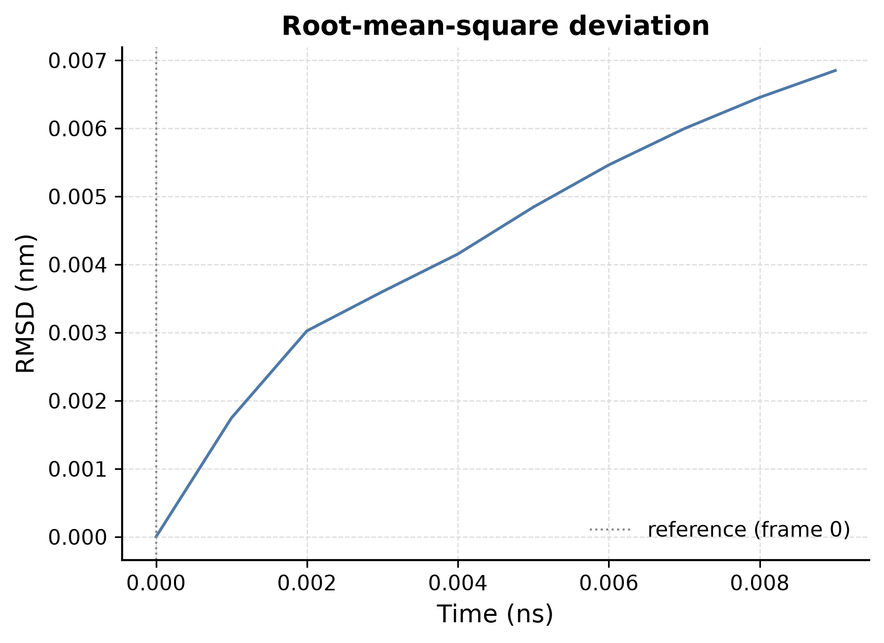
RMSD
RMSD tracks structural deviation from the reference conformation. A plateau suggests the system reached a relatively stable structural state, while large drift may indicate ongoing conformational change.

Slide 9
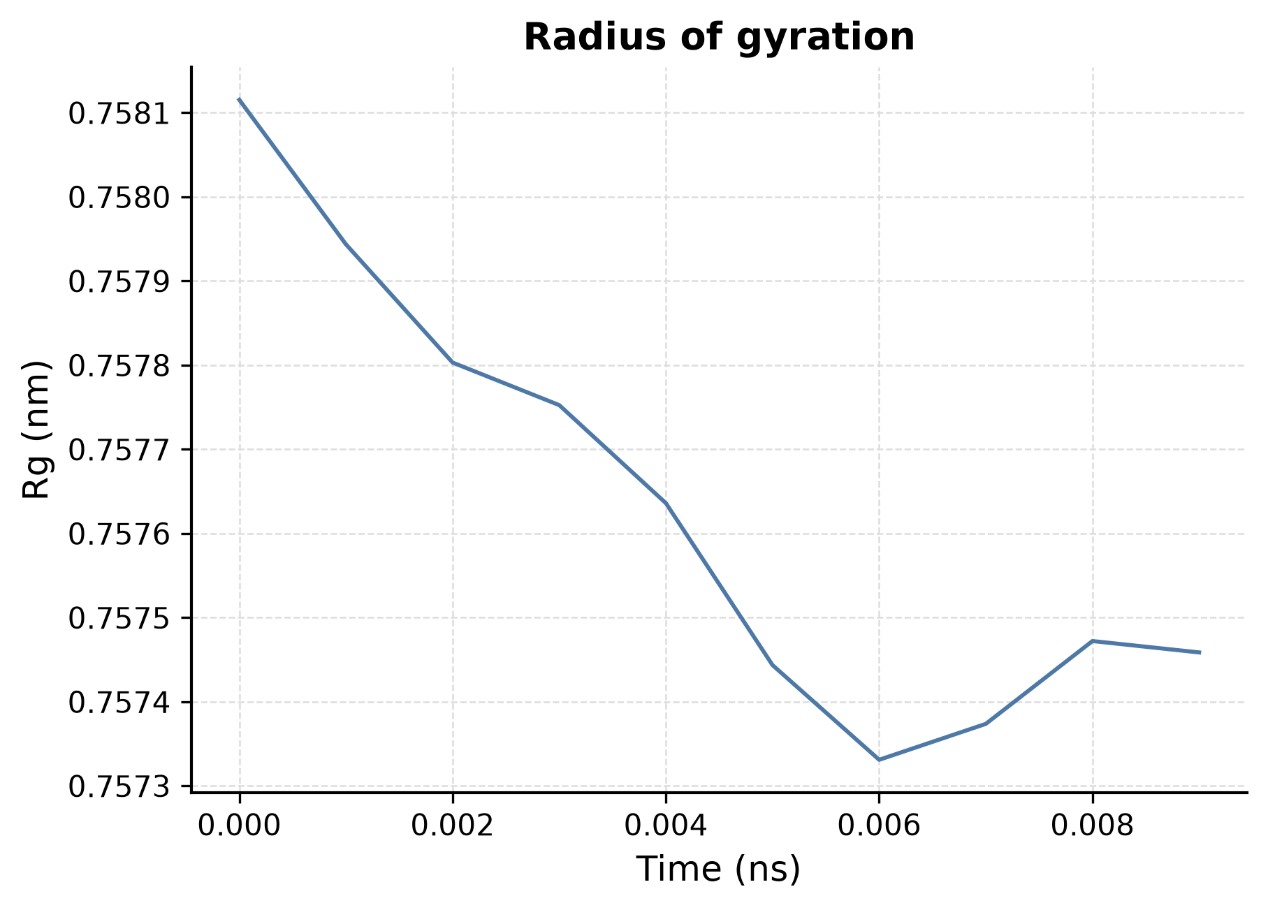
RG
Radius of gyration tracks global molecular compactness over time. Stable values suggest the system maintains a consistent overall size, while large shifts may indicate compaction or expansion.

Slide 10
Citation
If you use FastMDXplora in your work, please cite:
Aina, A.; Kwan, D. FastMDAnalysis: Software for Automated Analysis of Molecular Dynamics Trajectories. J. Comput. Chem. 2026, 47, e70350. DOI: 10.1002/jcc.70350

