Slide 1
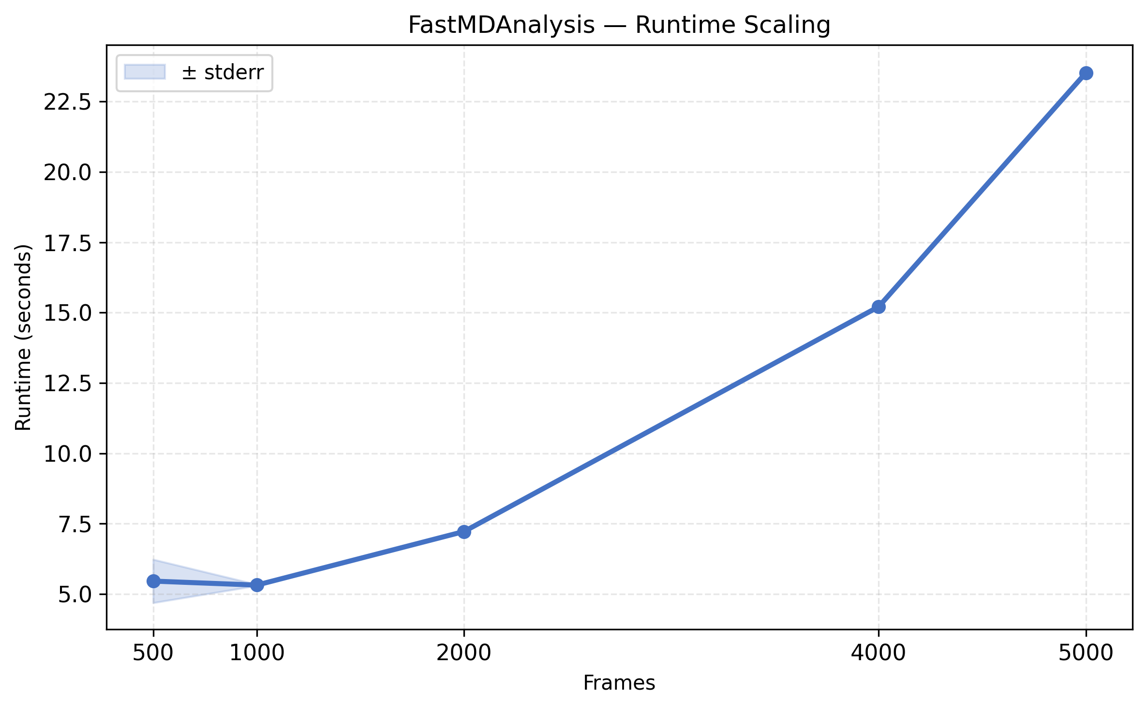
FastMDAnalysis Runtime Scaling

Slide 2
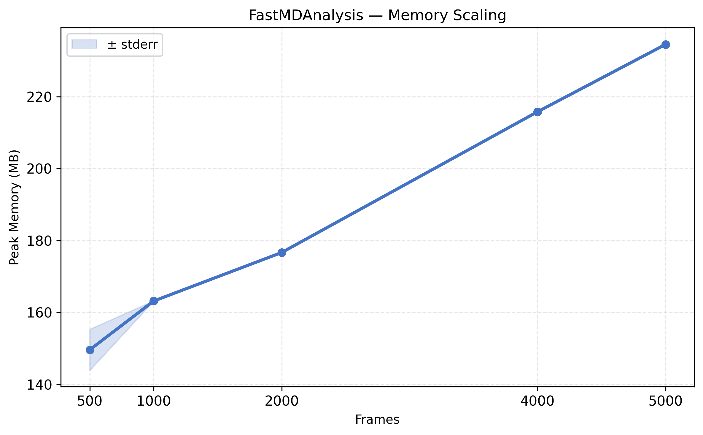
FastMDAnalysis Memory Scaling

Slide 3
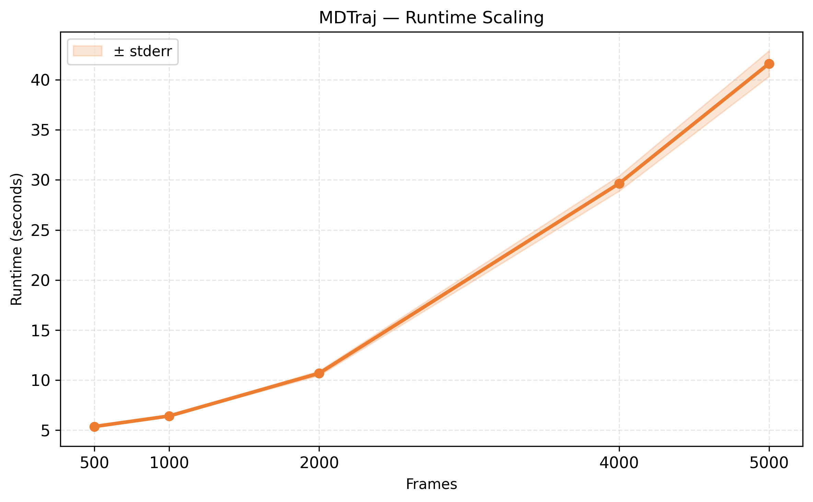
MDTraj Runtime Scaling

Slide 4
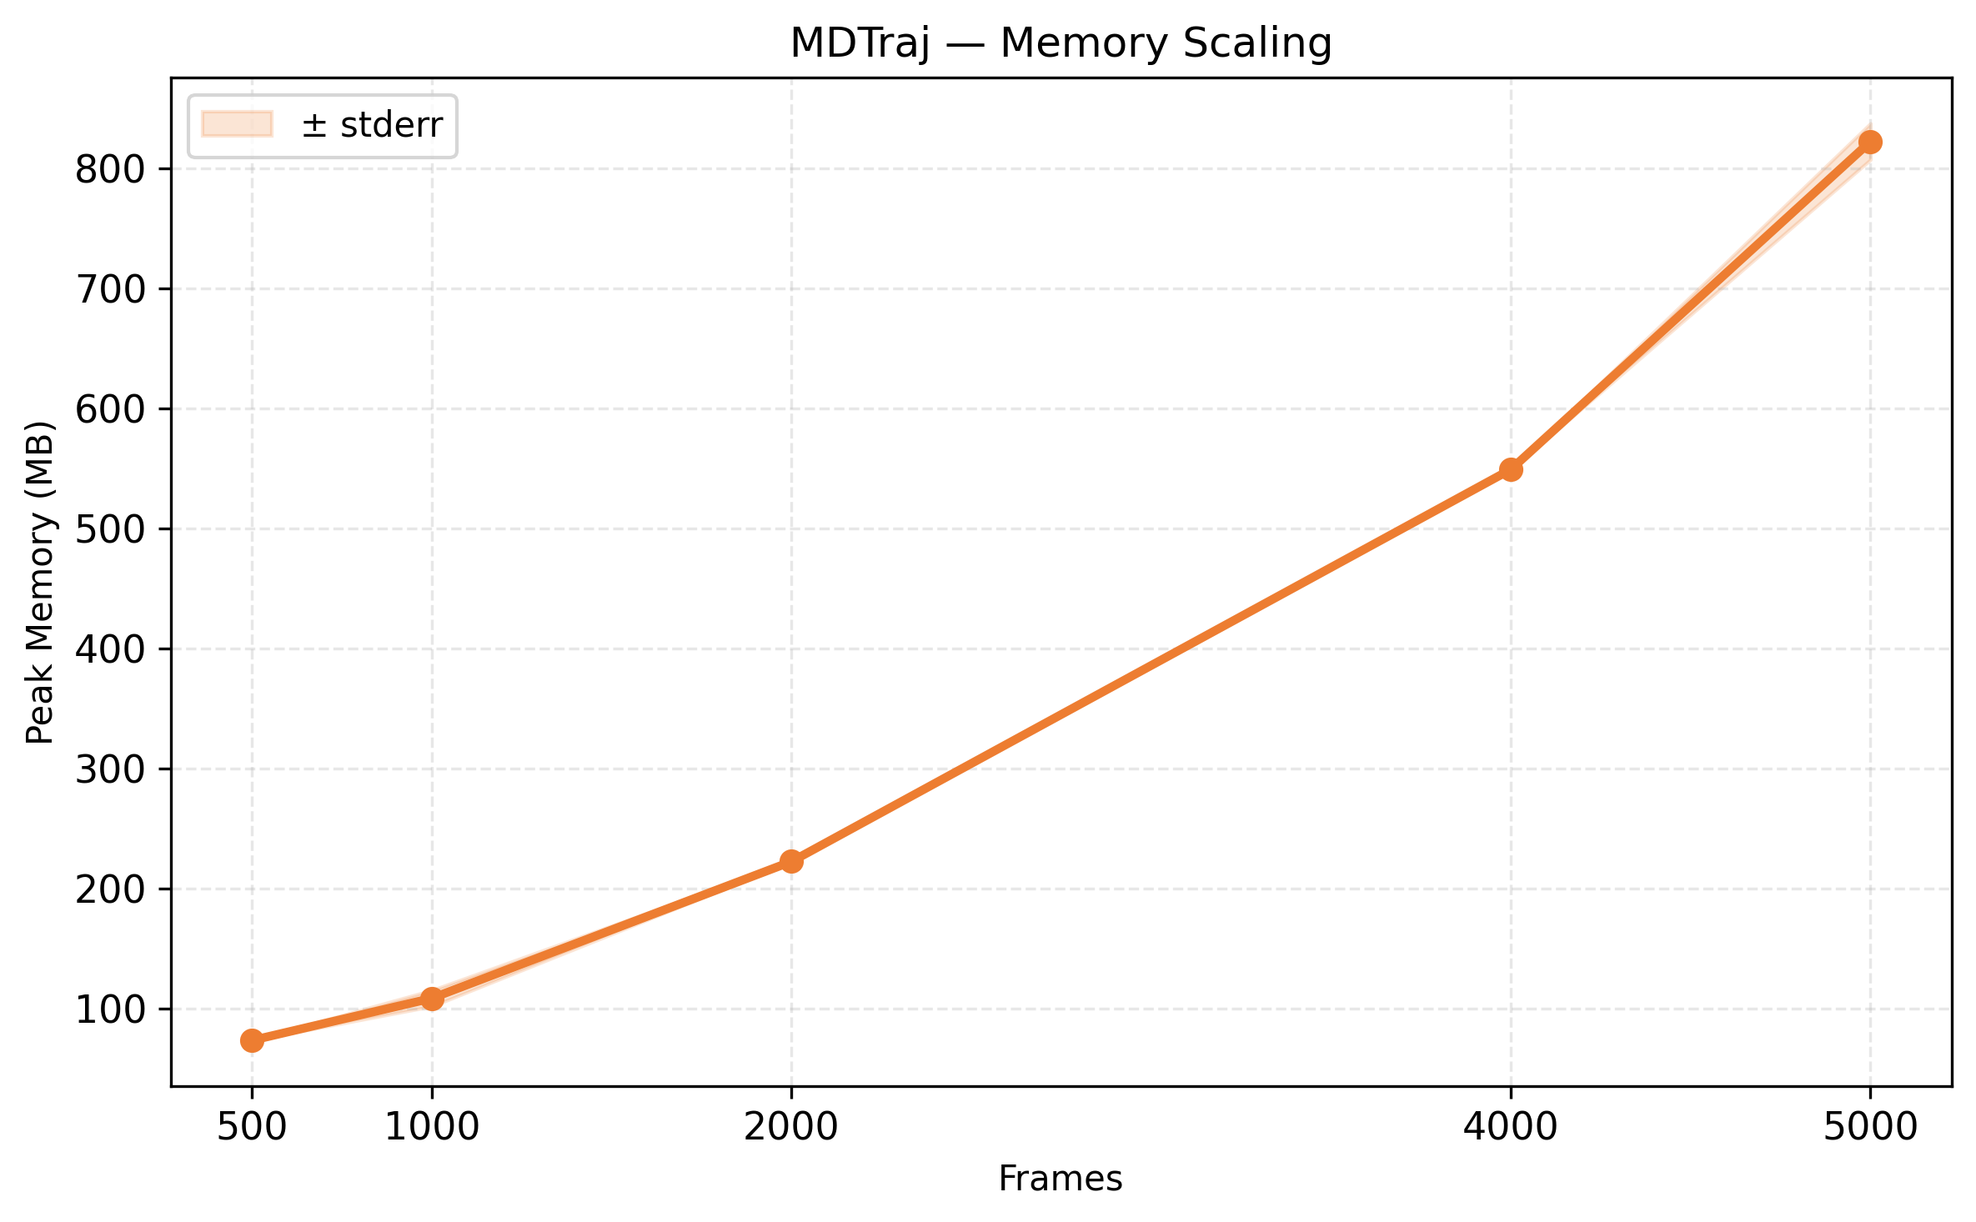
MDTraj Memory Scaling

Slide 5
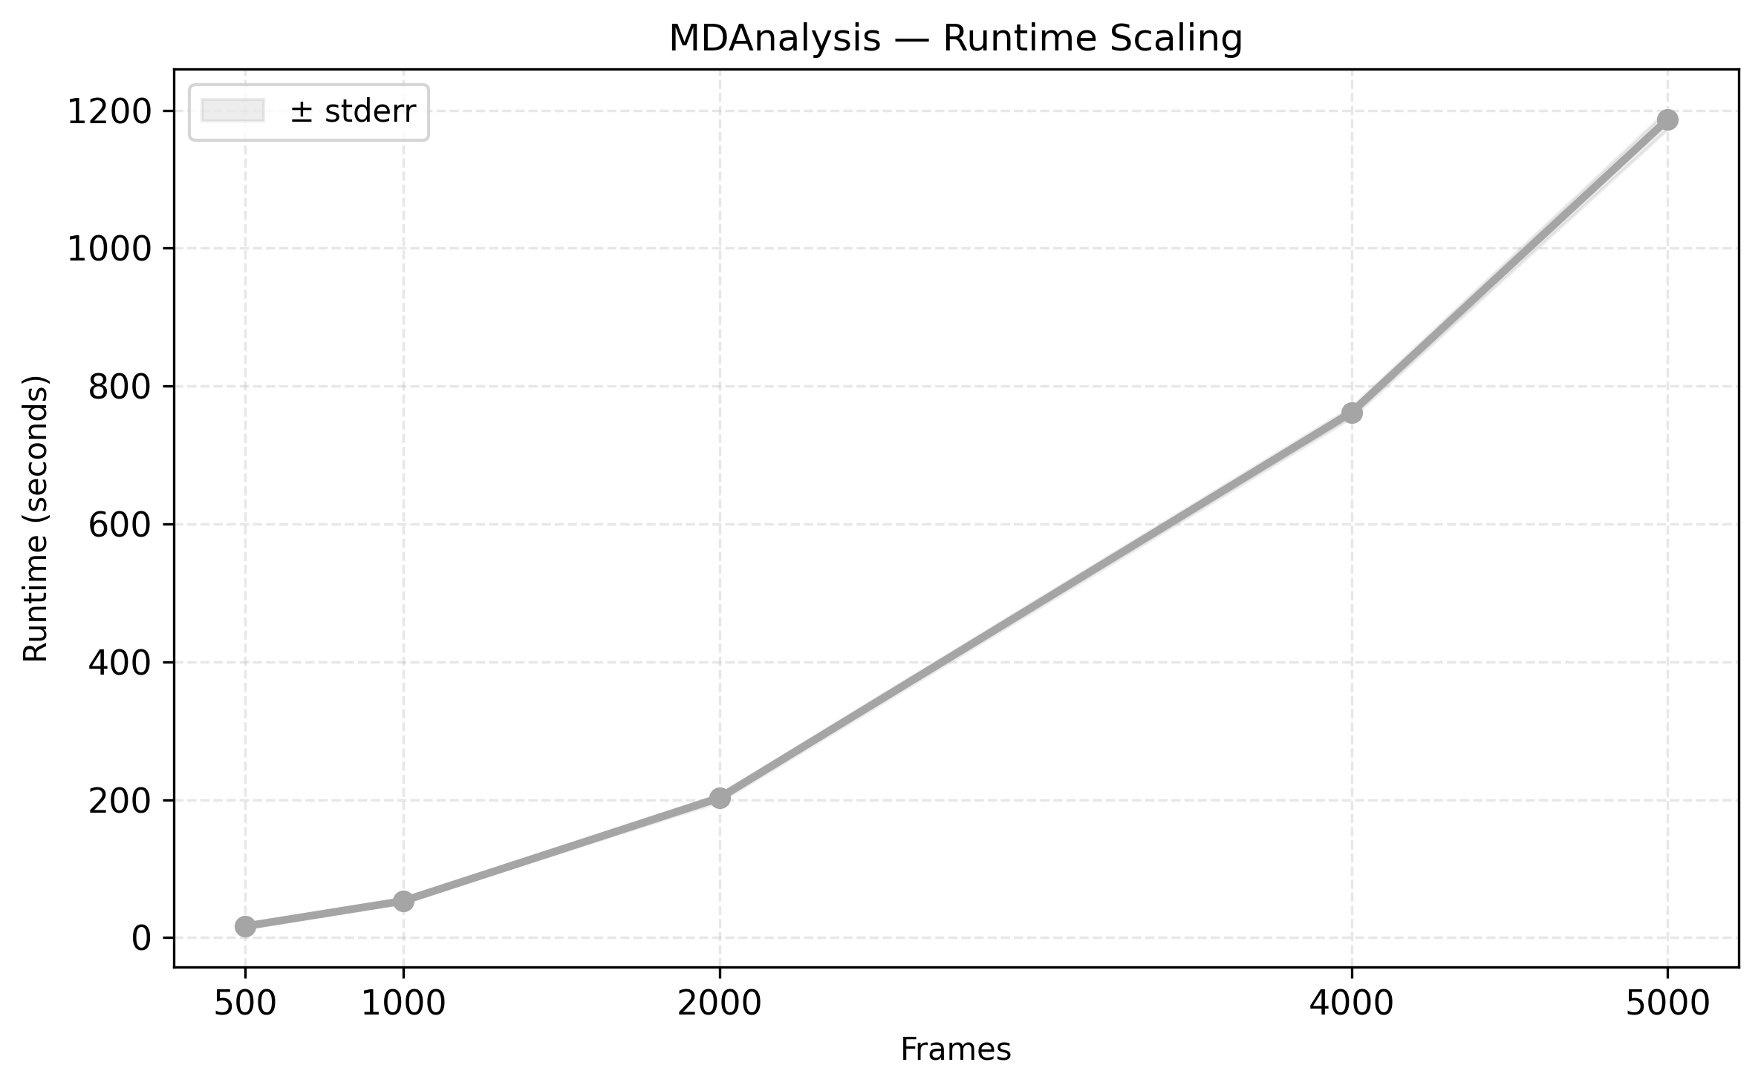
MDAnalysis Runtime Scaling

Slide 6
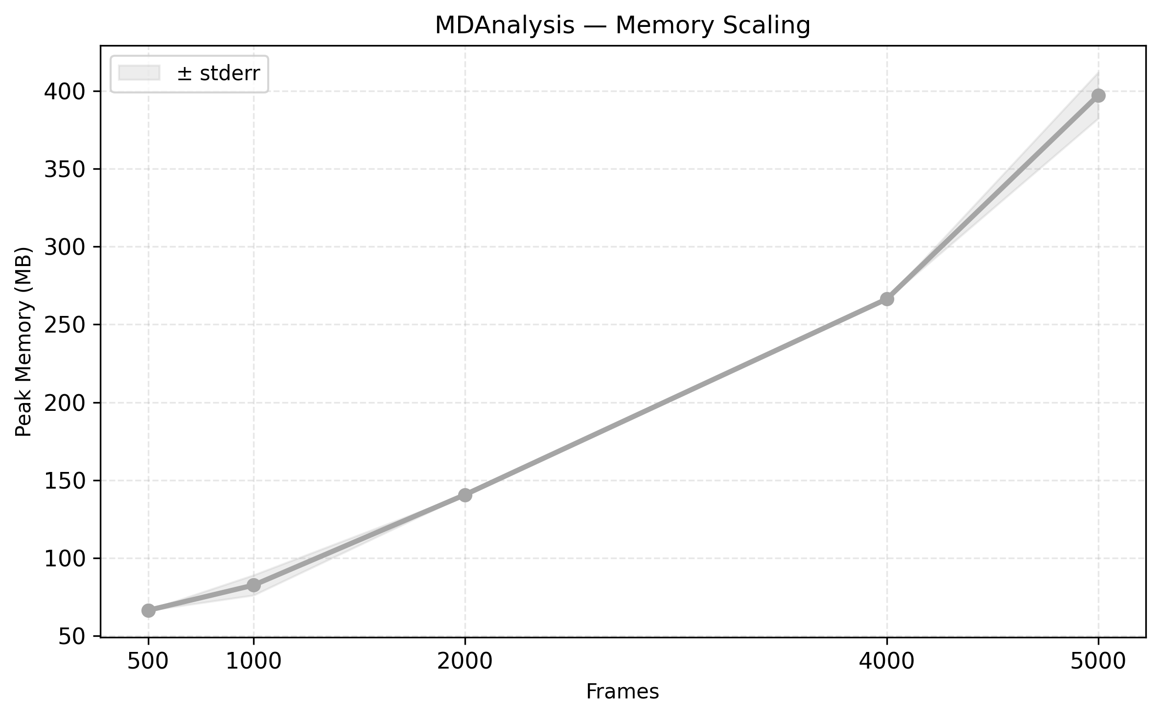
MDAnalysis Memory Scaling

Slide 7
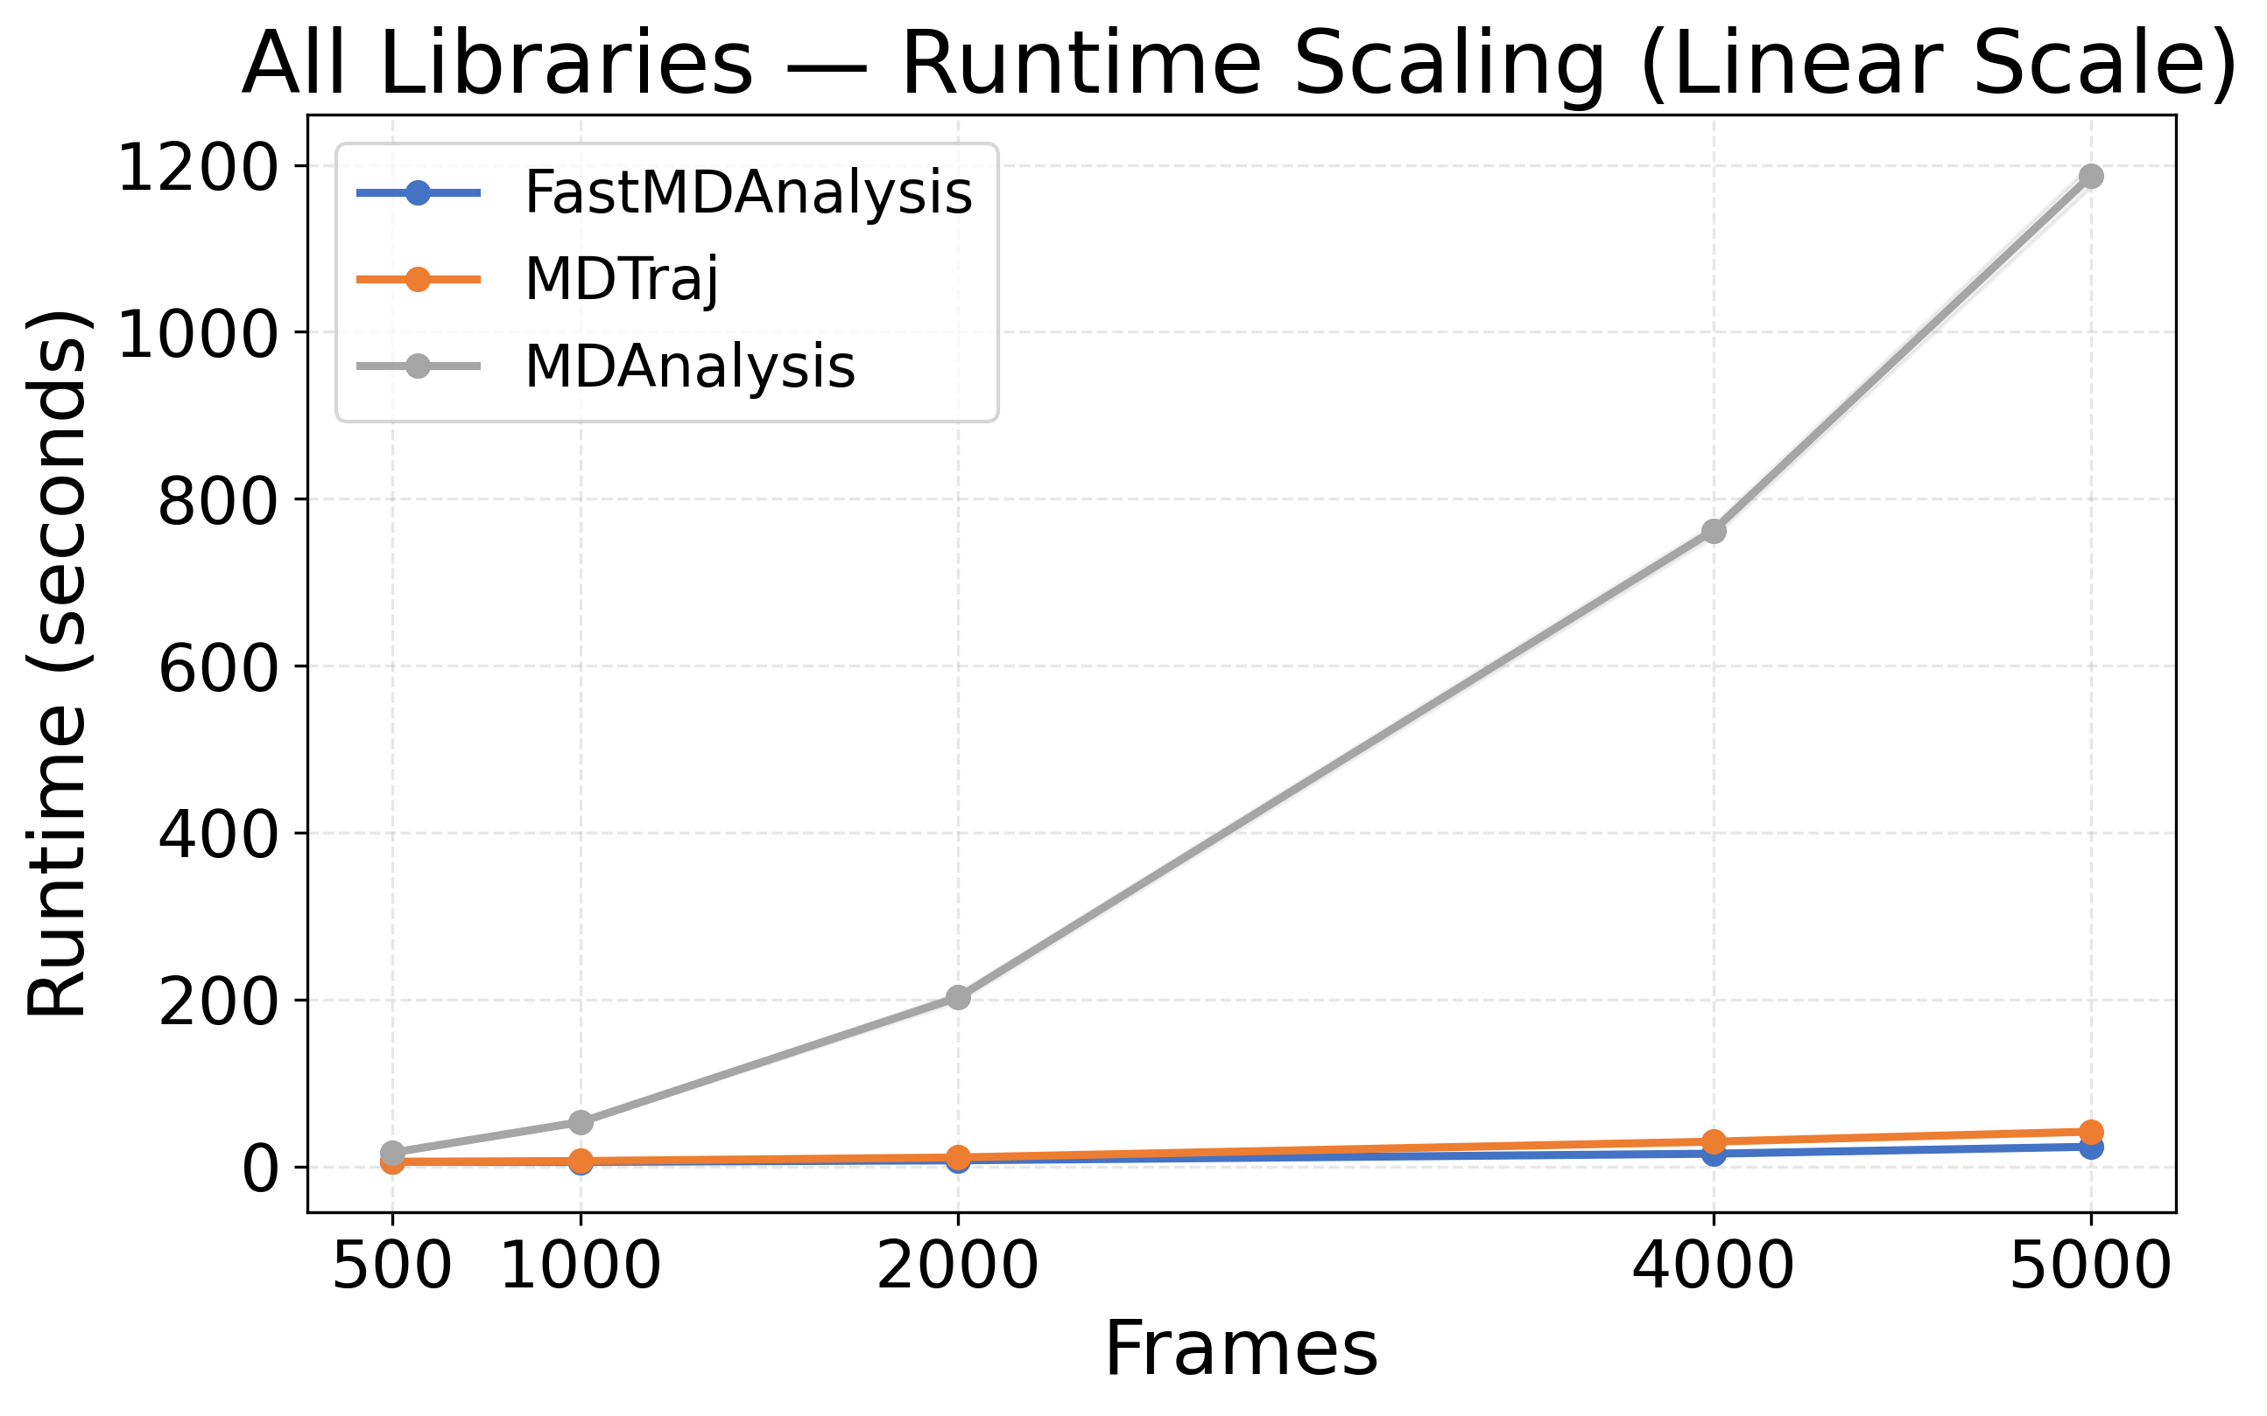
Combined Runtime Scaling (Linear)

Slide 8
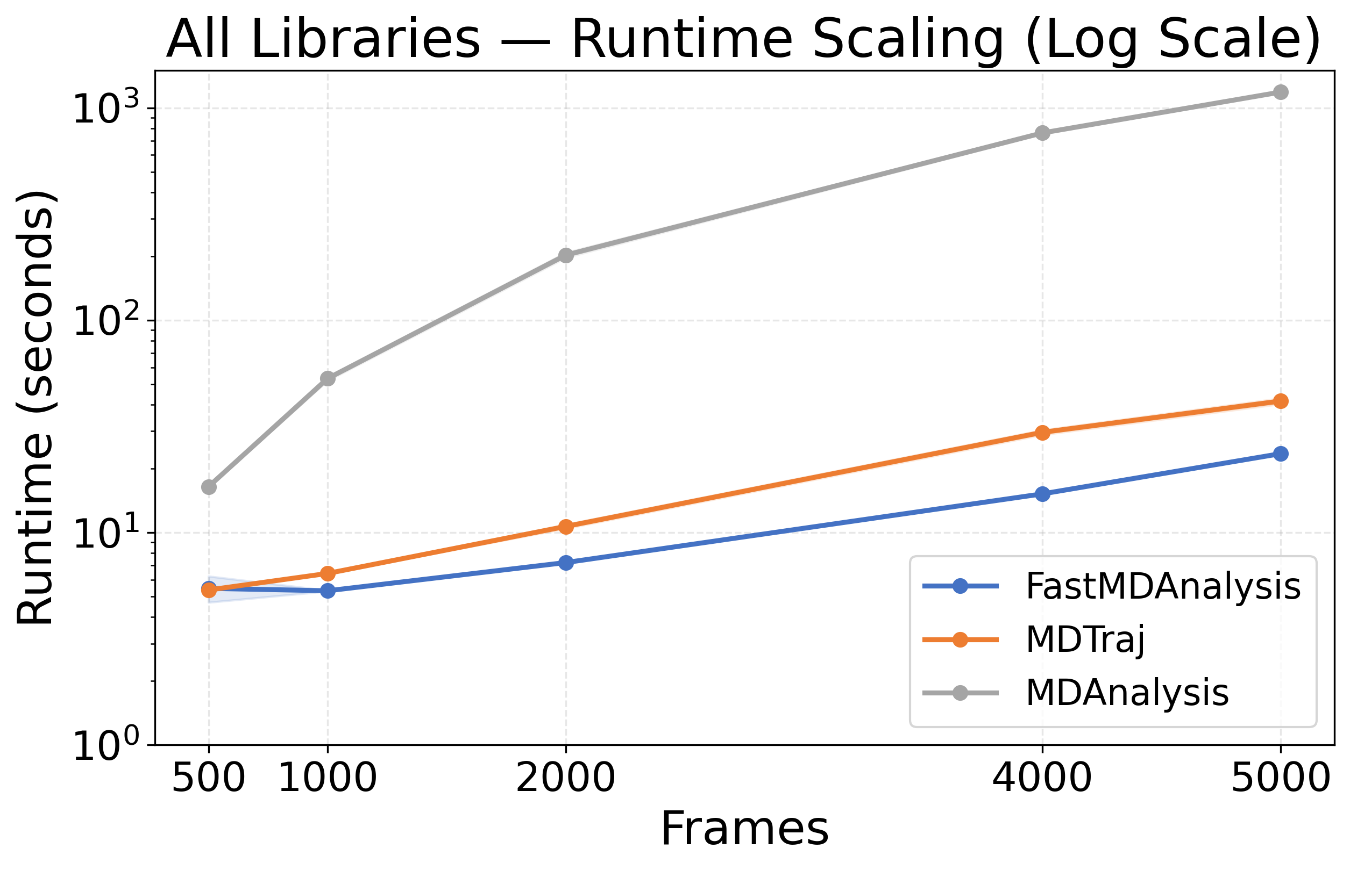
Combined Runtime Scaling (Log)

Slide 9
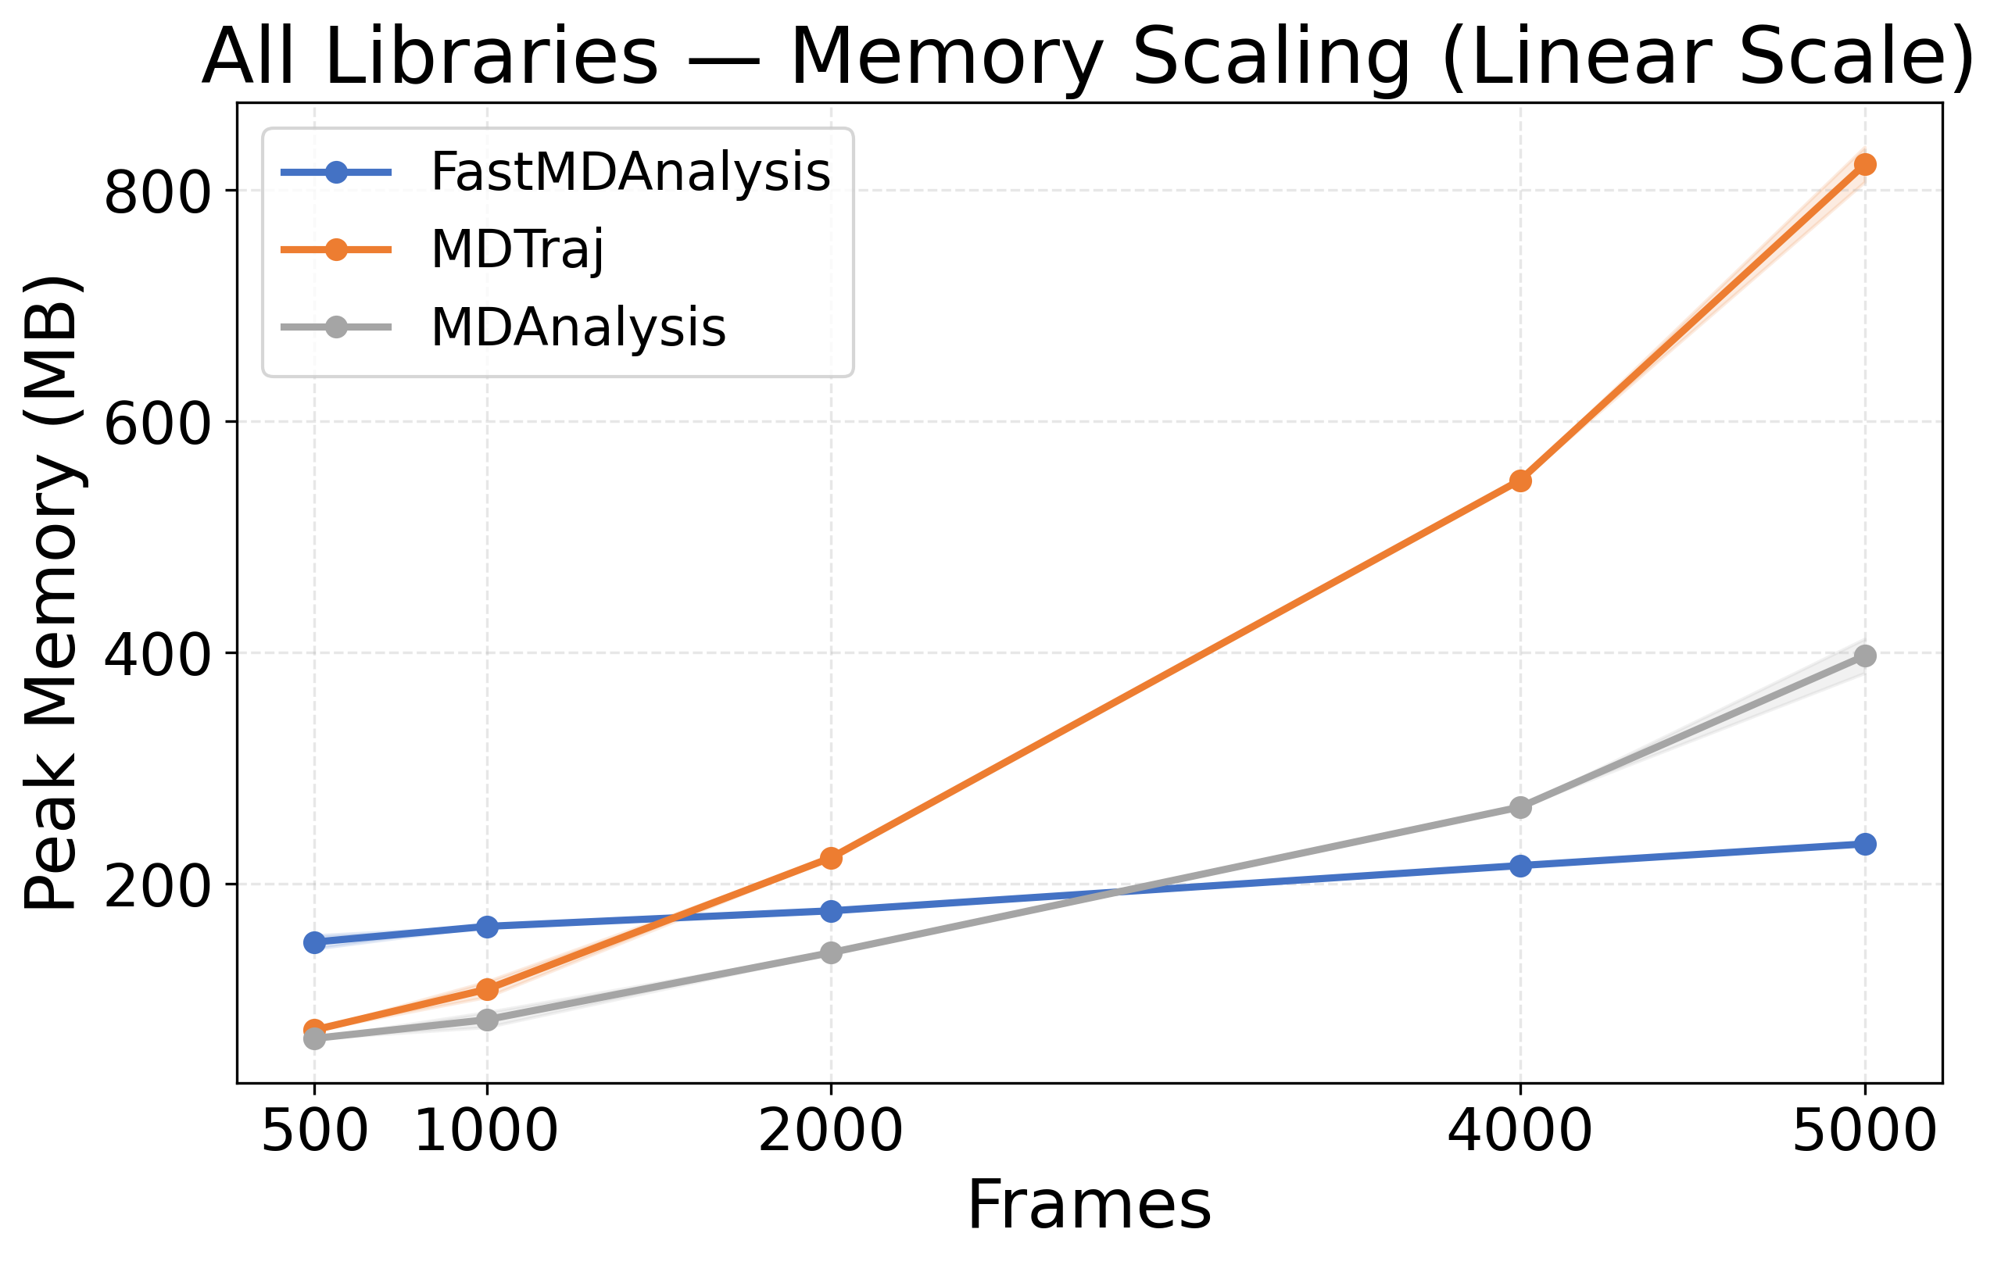
Combined Memory Scaling (Linear)

Slide 10
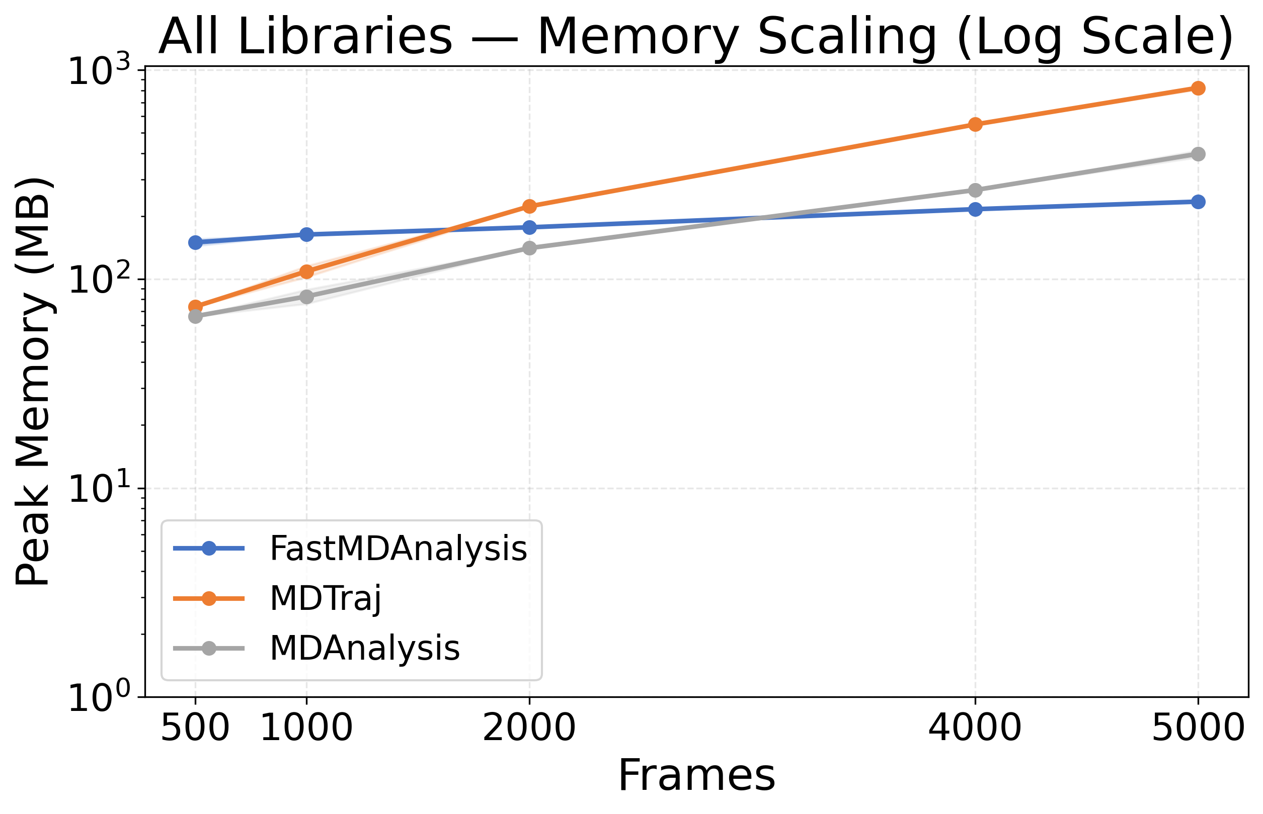
Combined Memory Scaling (Log)

Slide 11
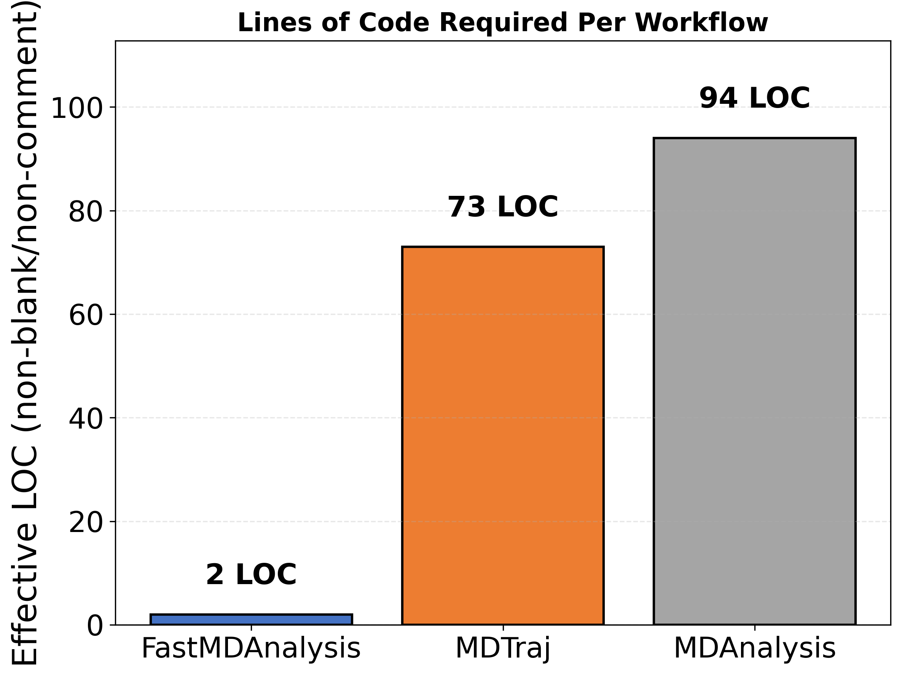
Lines of Code Comparison

