Slide 1
Advanced Generative Chatbot Study
Jonathan Agustin
Eric Barnes
Massimillano Repupilli
23 October 2023
Notes:
Let’s get started. Welcome to our research project entitled “Advanced Generative Chatbot Study.”

Slide 2
Chatbots are Everywhere!
Generative AI has become ubiquitous
Many Fortune 500 companies use chatbots
Rapid development of AI models
Notes:
Chatbots are ubiquitous, from small businesses to tech giants. Fueling this surge is generative AI and its ability to produce natural, context-aware conversations. Advances in deep learning have led to more sophisticated AI models that can mimic human interaction. We aimed to develop a conversational agent using transformer networks like Bert, fine-tuned on the squad dataset, to create an engaging question answering chatbot. Generative AI chatbots are reshaping customer service, allowing businesses to transform how they interact with customers.

Slide 3
Project Overview: 3 Models & 1 Dataset
Leveraged HuggingFace transformers Compared BERT, DistilBERT, RoBERTa
Used 2nd version of Stanford Question Answering Dataset (SQuADv2)
Notes:
The project aimed to evaluate and compare the effectiveness of Bert, Distilbert, and Roberta in understanding and processing language. By training and testing these systems on real-world tasks, the goal was to identify their practical applications and limitations. We used HuggingFace transformers to initialize and compare three state-of-the-art transformer-based neural network architectures. We trained these systems to answer questions from a dataset called Squad. Then, we compared how well they did by looking at words in a sentence, and generated metrics to understand effectiveness.

Slide 4
Our Project is All Open Source
Repository https://github.com/aai520-group6/project
BERT https://huggingface.co/aai520-group6/bert-finetuned-uncased-squad_v2
DistilBERT https://huggingface.co/aai520-group6/distilbert-finetuned-uncased-squad_v2
RoBERTa https://huggingface.co/aai520-group6/roberta-finetuned-uncased-squad_v2
Notes:
To enable further research and transparency, our complete methodology, training code, configuration details, and evaluation results are available in a GitHub repository. Publishing the trained models on HuggingFace Hub allows us to share these powerful question answer chatbots with the wider research community. The Hub provides inference APIs, allowing researchers to easily use the models in demos and applications.

Slide 5
Background Research The Fascinating World of Transformers
Innovative self-supervised learning strategy
Masks words in sentence and guesses them
Predict if two sentences relate
Deeper understanding of language
Notes:
Bert is innovative because it learns by guessing missing words and deciding if sentence pairs are associated with each other. This way of training helps Bert grasp language patterns and relationships and selectively prepares it for complex tasks like question-answering or translation.

Slide 6
Stanford Question Answering Dataset (SQuAD)
The second version of SQuAD has unanswerable questions (answer not provided to model)
Analogy: Telling someone to meet at the secret hiding spot without telling them where it is
100K+ answerable / 50K+ unanswerable questions
Preprocessing required
Notes:
We used the second version of the squad dataset for training, which features over a hundred thousand questions from Wikipedia articles, and fifty thousand unanswerable ones designed to challenge the models. Imagine being asked to meet at the secret location, when you haven’t been told where it is. You wouldn’t have the answer. That’s what an unanswerable question is. The models need to identify when no answer is available. Training on this dataset enhances awareness of one’s knowledge base and prevents hallucinations. For pre-training, we employed standard preprocessing like tokenization, sequence truncation, and adding segment markers.

Slide 7
Model Initialization, Preprocessing, & Training
Initialized BERT, DistilBERT, RoBERTa
Used HuggingFace transformers
Finetuned on SQuADv2
Trained on Google Colab
Compared metrics
Notes:
We started model development by initializing Bert, Distilbert, and Roberta with HuggingFace Transformers, using its pretrained models. We then fine-tuned them on the squad dataset, adjusting specific layers for our task. Training was sped up using Google Colab's cloud GPUs. Post-training, we assessed the models on key metrics, revealing each one's strengths and areas for enhancement.

Slide 8
Evaluation
Validated models on SQuADv2
Measured over a dozen metrics
Focused on Exact Match and F1 Score
Analyzed answerable questions
Evaluated unanswerable questions
Notes:
After training Bert, Distilbert, and Roberta on the squad dataset, we used its validation set to evaluate their performance, focusing on the Exact Match and F1 Score metrics. We found challenges with unanswerable questions, especially highlighted by Roberta’s relative success. This analysis underscores the importance of detailed evaluations in identifying model shortcomings and guiding future enhancements, complementing human judgment in assessing conversational qualities.

Slide 9
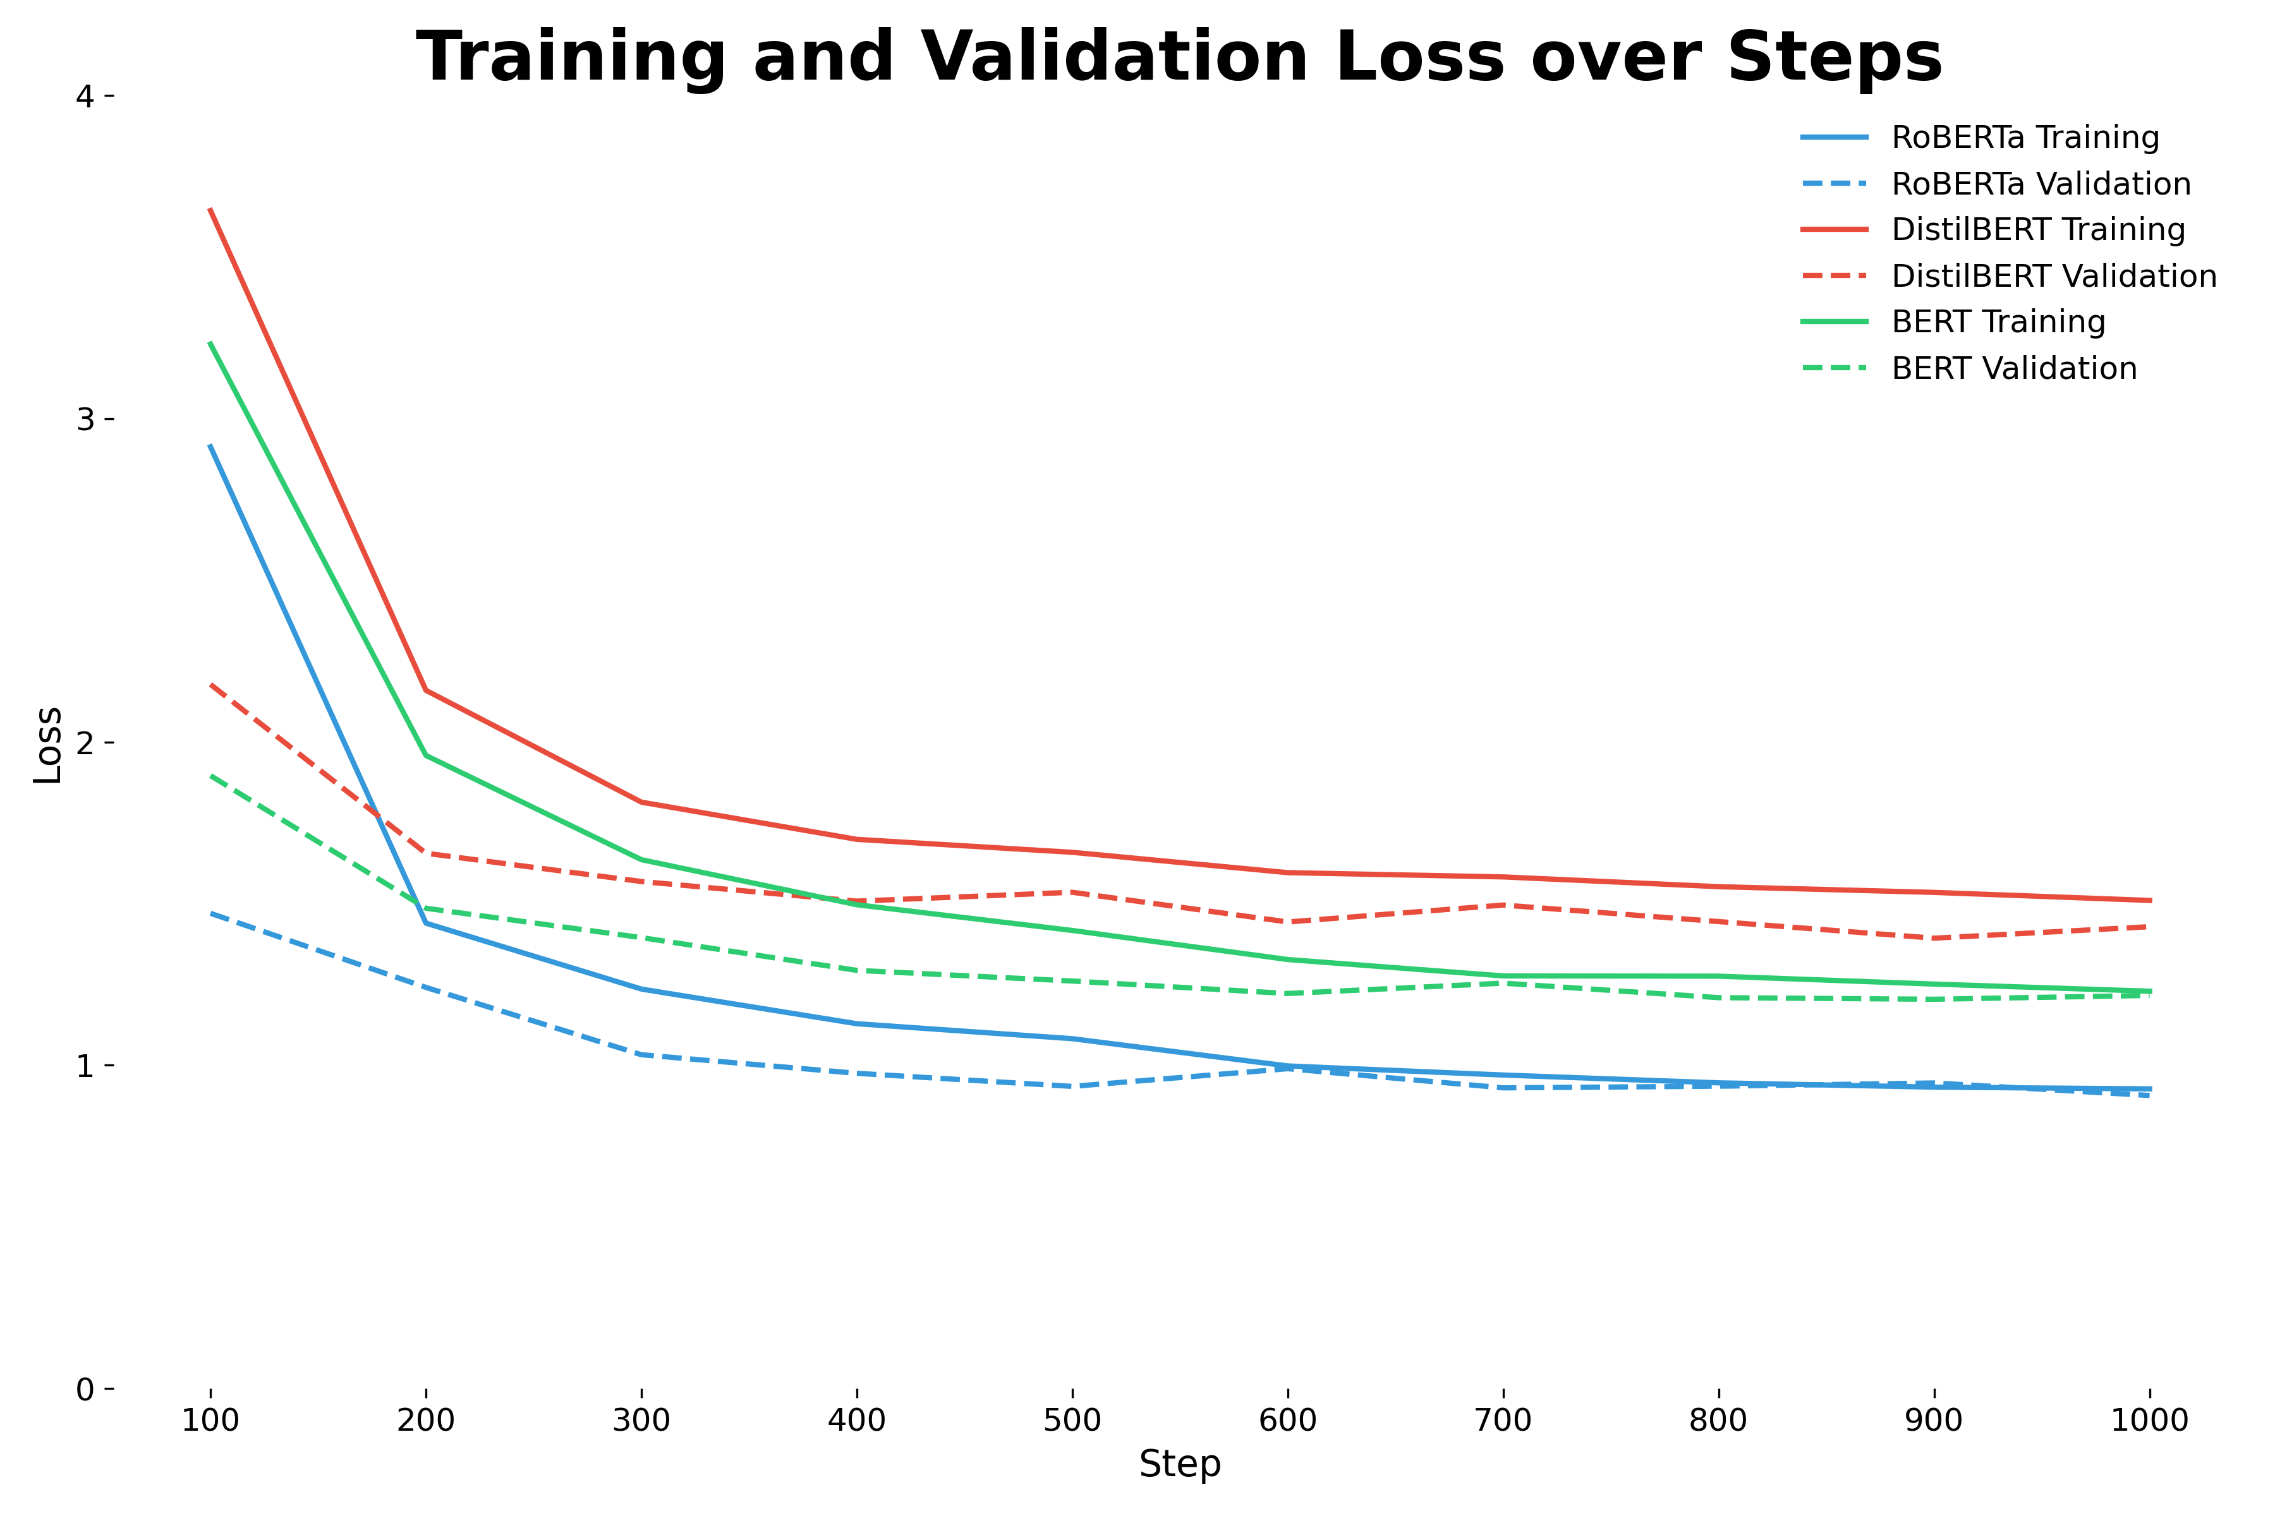
Notes:
The graph tracks training and validation loss for Bert, Distilbert, and Roberta during squad training. While all models showed reduced training loss, Roberta was the most efficient, though each model hinted at overfitting as validation losses increased after minimizing. This data is crucial for understanding model behavior and optimizing performance.

Slide 10
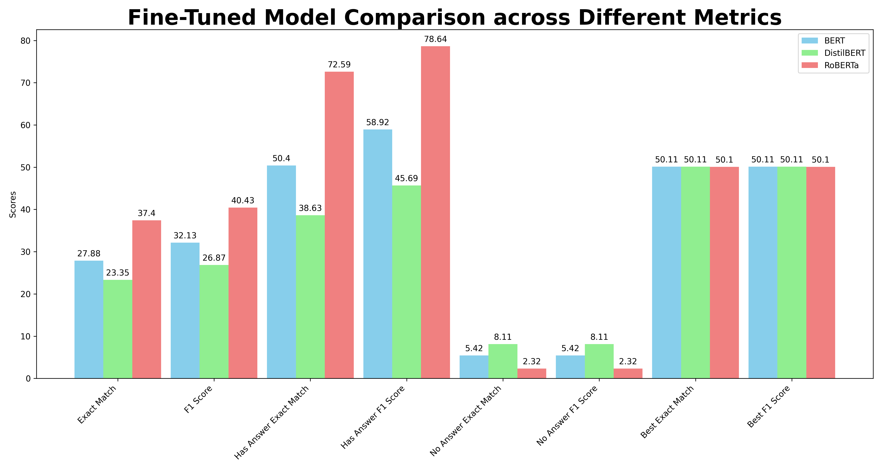
Notes:
This chart shows the performance of Bert, Distilbert, and Roberta on the squad version two validation set. Roberta led in overall scores and on answerable questions, highlighting its superior context understanding. All models found unanswerable questions challenging, with Roberta lagging behind BERT and Distilbert when no answer was available.

Slide 11
Discussion
Successfully developed 3 Q&A chatbots
Published code & models on GitHub and HuggingFace
High performance on answerable questions
Poor performance on unanswerable questions
Out-of-Memory problems mitigated with checkpointing
Notes:
The evaluation results revealed that Roberta achieved the highest scores overall on the squad question answering task. This demonstrates the strength of Roberta pretraining procedure for extractive question answering. As mentioned, all three models exhibited significant difficulty with unanswerable questions. Their low performance highlights issues in determining when responses are not supported by the context. We theorize enhanced training strategies could improve discerning unsupported answers. For example, training on datasets with more unanswerable examples may help. Model architectures better equipped for nuanced text comprehension also show promise. On the technical side, we faced challenges like GPU memory limits and session timeouts on Colab. Checkpointing and saving models frequently helped mitigate these issues.

Slide 12
Conclusion and Recommendations
Low scores for unanswerable questions
Continue work on answerability detection
Enable explainability for model introspection
Notes:
Our project achieved strong results in extractive question answering when an answer is supported by the context. An area needing significant improvement is detecting when a question is unanswerable based on a given passage. For future work, we recommend focusing on this answerability detection through enhanced model architectures and training strategies. Testing conversational user engagement beyond extractive QA evaluation is also important. Our open-source approach aims to advance this critical area of artificial intelligence.

Slide 13



Contributions
Jonathan Agustin
Eric Barnes
Massimillano Repupilli
Video
Report
PowerPoint
Each team member independently trained and evaluated all models.
23 October 2023
Notes:
Everyone equally contributed to the project. Jon created the video presentation to summarize our work. Eric authored the in-depth project report, providing a comprehensive written record of the background, approach, and results. Max developed the presentation slides, condensing our work into clear, visual overviews. Additionally, all team members independently trained, evaluated, and analyzed the machine learning models, while collaborating on the methodology and outcomes. Through both individual efforts in their roles and joint collaboration, our team made significant progress in conversational AI research. Leveraging everyone's unique strengths complemented by group work resulted in a robust project with broad impact.

