Slide 1
Diabetic Readmission Risk Prediction
Jonathan Agustin
Zach Robertson
Lisa Vo
Notes:
Welcome to our presentation on Diabetic Readmission Risk Prediction. We are excited to share our machine learning system designed to predict hospital readmissions among diabetic patients.

Slide 2
Introduction
Healthcare Challenge: High Readmission Rates in Diabetic Patients
Objective: Predict 30-day readmission risk to enable proactive interventions
Goal: Reduce readmission rates and improve patient outcomes
Notes:
Hospital readmissions, especially within 30 days of discharge, pose a significant challenge for healthcare systems worldwide. Diabetic patients are particularly vulnerable due to the complexity of managing this chronic condition. Our objective is to develop a machine learning system that can accurately predict the likelihood of a diabetic patient being readmitted within 30 days. By identifying high-risk patients, healthcare providers can implement proactive interventions to reduce readmission rates and improve overall patient outcomes.

Slide 3
Business Use Case
Financial Impact: High costs associated with readmissions
Patient Impact: Negative effects on health and quality of life
Solution: Machine learning system to identify high-risk patients
Notes:
Readmissions not only strain hospital resources but also negatively impact patients' health and quality of life. Each readmission can cost hospitals thousands of dollars, and frequent hospital stays can lead to poorer patient outcomes. Our machine learning system aims to identify patients at high risk of readmission so that targeted interventions can be administered, ultimately reducing costs and enhancing patient care.

Slide 4
System Architecture
Components
Technologies
Data Ingestion
Data Engineering
Feature Engineering
Model Training
Deployment
DVC (Data Version Control)
Feast (Feature Store)
AutoGluon (Automated ML)
Notes:
This slide illustrates our system architecture. Our pipeline consists of multiple components that work together seamlessly. We use Python for all our development. Data Version Control, or DVC, helps us manage our datasets and models efficiently. Feast serves as our feature store, ensuring consistency between training and serving. AutoGluon is utilized for automated machine learning, allowing us to train high-performing models with minimal effort. The architecture is designed to be scalable and maintainable.

Slide 5
Data Sources
Dataset: Diabetes 130-US hospitals for years 1999-2008
Size: Over 100,000 patient records
Features: Demographics, medical history, lab results, medications, hospitalization details
Notes:
Our dataset is sourced from the UCI Machine Learning Repository, containing over 100,000 patient records from 130 US hospitals. The dataset includes a rich set of features such as patient demographics, medical histories, laboratory results, medications, and details about hospitalizations. This comprehensive data provides a solid foundation for building a robust predictive model.

Slide 6
Data Engineering
Data Ingestion: Automated using custom scripts
Data Cleaning: Handling missing values and duplicates
Preprocessing: Standardization and normalization
Notes:
Effective data engineering is crucial for preparing the dataset for modeling. We developed custom scripts for data ingestion, ensuring that data is consistently and correctly loaded into our system. Missing values and duplicates are handled during the data cleaning process to maintain data integrity. We also applied standardization and normalization techniques to numerical features, which helps improve model performance.

Slide 7
Feature Engineering with Feast
Feature Store: Managed using Feast Feature Groups: Patient Demographics Medical History Current Visit Data Derived Features Benefits: Consistency, reusability, version control
Notes:
We use Feast as our feature store to manage and serve features consistently across training and inference. Features are organized into groups such as patient demographics, medical history, current visit data, and derived features. This organization enhances reusability and maintains consistency. Version control of features ensures that the same feature definitions are used throughout the system, supporting reproducibility and collaboration among team members.

Slide 8
Model Training and Evaluation
Models Used:
Logistic Regression
AutoGluon (AutoML) Neural Network
Hyperparameter Tuning: Optuna for optimization
Evaluation Metrics: Accuracy, Precision, Recall, F1-Score, ROC-AUC
Notes:
We experimented with different models, including a logistic regression model and advanced models using AutoGluon. Hyperparameter tuning was conducted using Optuna to optimize model performance. The models were evaluated based on accuracy, precision, recall, F1-score, and ROC-AUC to ensure they met our performance criteria.

Slide 9
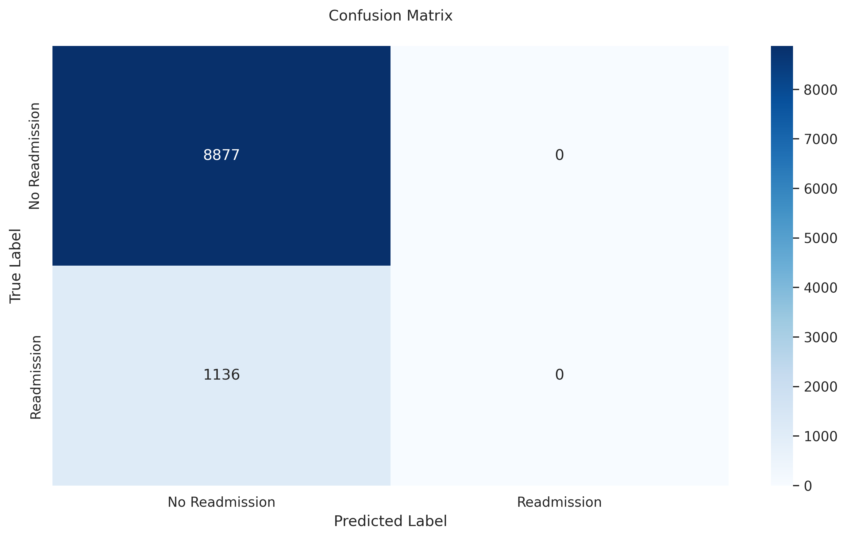
Model Performance
Best Model: AutoGluon
Accuracy: 68.30%
ROC-AUC: 72.09%
Notes:
Our best-performing model was the AutoGluon TabularPredictor, achieving an accuracy of 68.30% and an ROC-AUC of 72.09%. These metrics indicate that the model has a good balance between sensitivity and specificity. The confusion matrix and ROC curve, displayed here, provide further insights into the model's performance.

Slide 10
Model Deployment
Deployment Strategy:
Containerization with Docker
RESTful API using FastAPI
Hosting: Can be deployed on cloud platforms or on-premises
Scalability: Designed for handling varying loads
Notes:
For deployment, we containerize our application using Docker, ensuring a consistent environment across different systems. We implemented a RESTful API using FastAPI, making our model accessible for inference through standard HTTP requests. The deployment strategy is flexible, allowing for hosting on cloud platforms like AWS or on-premises servers, and is designed to scale according to demand.

Slide 11
CI/CD Pipeline
Automation: Implemented with GitHub Actions Stages: Code Version Control (Git) Continuous Integration with Tests Model Training and Evaluation Continuous Deployment Tools: DVC for data and model versioning
Notes:
Our Continuous Integration and Continuous Deployment pipeline is automated using GitHub Actions. The process begins with code commits, triggering automated tests to ensure code quality. If tests pass, the pipeline proceeds to model training and evaluation using the latest data and code. Successful models are then deployed automatically. DVC plays a crucial role in versioning our data and models, enabling reproducibility and consistent deployments.

Slide 12
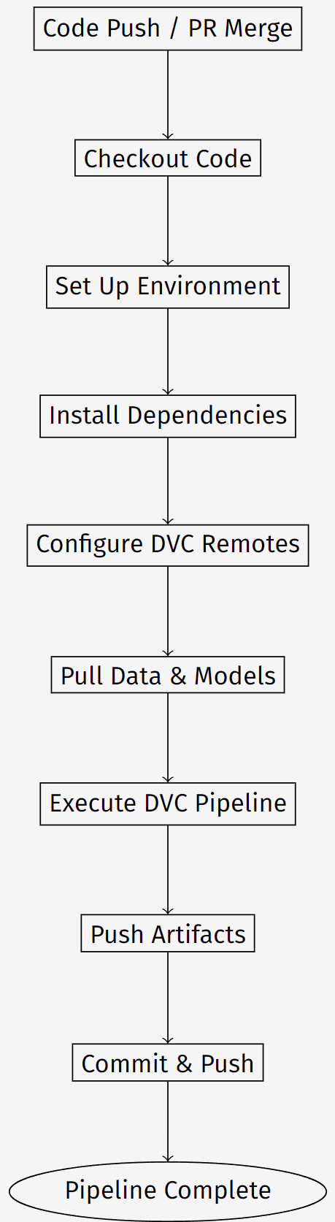
CI/CD Pipeline Diagram
Notes:
Here is a visual representation of our CI/CD pipeline. It outlines each stage, from code commit to deployment. The integration of GitHub Actions with DVC allows us to automate the pipeline while managing data and model versions effectively.

Slide 13
Model Monitoring with DVC and DVC Studio
Metrics Tracking: Training loss, accuracy, ROC-AUC
Visualization: DVC Studio dashboards
Alerts: Notifications for performance degradation
Notes:
Model monitoring is essential to ensure continued performance. Using DVC Live, we log key metrics during training. DVC Studio provides an interactive dashboard to visualize these metrics over time. We have set up alerts to notify us if there is any significant drop in performance, allowing us to take prompt corrective actions.

Slide 14
Feature Store Monitoring
Data Consistency Checks: Ensuring training and serving data align
Data Drift Detection: Monitoring for shifts in data distributions
Automated Retraining: Triggered when significant drift occurs
Notes:
We monitor our feature store to ensure that the data used during model serving remains consistent with the training data. By detecting data drift—changes in the statistical properties of the input data—we can identify when the model may need retraining. This proactive approach helps maintain model accuracy over time.

Slide 15
Model Registry with DVC
Model Versioning: Managed by DVC
Metadata Tracking: Performance metrics, hyperparameters, dataset versions
Benefits: Traceability, reproducibility, compliance
Notes:
Our model registry is implemented using DVC, which allows us to version models along with their associated metadata. We track performance metrics, hyperparameters, and dataset versions for each model iteration. This practice ensures full traceability and reproducibility, which are essential for compliance in healthcare settings and for facilitating continuous improvement.

Slide 16
Batch Inferencing
Use Case: Predicting readmission risk for a batch of patients
Process:
Input: Batch of patient data
Output: Risk scores and categories
Result: Identification of high-risk patients
Notes:
We input a batch of patient records into our deployed model. The model processes this data and outputs readmission risk scores for each patient. Patients are then categorized into high, medium, or low risk, enabling healthcare providers to focus their attention on those who need it most.

Slide 17
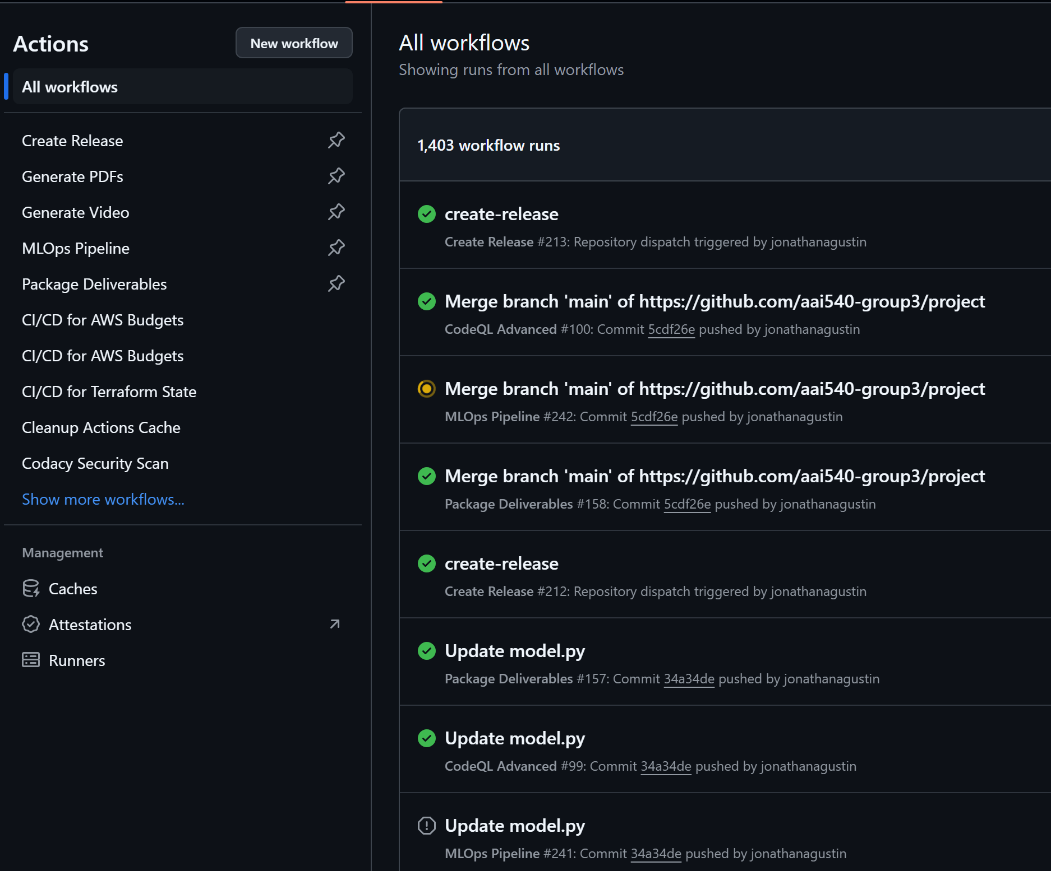
Infrastructure Monitoring
Monitoring Tools: GitHub Actions for pipeline monitoring DVC Live for real-time metrics logging Key Metrics: Pipeline execution status Stage runtimes and logs Data and model version tracking
Notes:
To ensure our deployed model and API are running smoothly, we use infrastructure monitoring tools like Prometheus and Grafana. We track metrics such as API latency, request throughput, and error rates. This monitoring allows us to detect and address issues promptly, maintaining high availability and performance for end-users.

Slide 18
Challenges and Future Improvements
Challenges Faced
Future Work
Data Imbalance
Ensuring Data Privacy
Scalability Concerns
Implementing Explainable AI techniques
Integrating real-time data sources
Expanding to other chronic conditions
Notes:
Throughout the project, we encountered challenges such as data imbalance, which we mitigated using techniques like SMOTE. Ensuring data privacy was critical, leading us to implement stringent security measures. Scalability was also a concern as our system needs to handle increasing amounts of data. For future improvements, we're looking into incorporating explainable AI to provide transparency in model decisions, integrating real-time data sources for up-to-date predictions, and extending our approach to other chronic conditions.

Slide 19
Ethical and Regulatory Considerations
Data Privacy Compliance: Adhering to HIPAA regulations
Bias Mitigation: Regular audits for fairness across demographics
Transparency: Providing insights into model decision-making
Notes:
Ethical considerations are paramount in healthcare applications. We comply with HIPAA regulations to protect patient data. Our models are regularly audited to detect and mitigate any biases, ensuring fairness across different demographic groups. Implementing explainable AI techniques will enhance transparency, helping healthcare professionals understand and trust the model's predictions.

Slide 20
Conclusion
Impact: Enhancing healthcare through predictive analytics
Scalability: Architecture designed for growth
Collaboration: Emphasis on teamwork and continuous improvement
Notes:
To conclude, our machine learning system has the potential to significantly impact healthcare by predicting hospital readmissions among diabetic patients. Our scalable architecture and collaborative approach position us well for future enhancements and broader applications. We are committed to continuous improvement and excited about the possibilities ahead.

Slide 21
Thank You
Questions and Discussion
File an Issue at our GitHub Repository: https://github.com/aai540-group3/project
Notes:
Thank you for your attention. We're now ready to take any questions you might have about our presentation. If you'd like to explore our project further or report any issues, you can find us on the above GitHub link. We appreciate your interest and look forward to the discussion.

