Slide 1
Missionaries And Cannibals_Flow Chart and Pseudocode
Presented to: dr. nadeem ashraf
Presented by: aaima ghalib; Roll # S2023266115

Slide 2
Contents
FlowChart
Pseudocode-Main Function
Game State, Game Instructions and Current Game State
Functions: check_game_over() and action()
Function: Updated Game State()
Function: is_action_valid(action)- I
Function: is_action_valid(action)- II

Slide 3
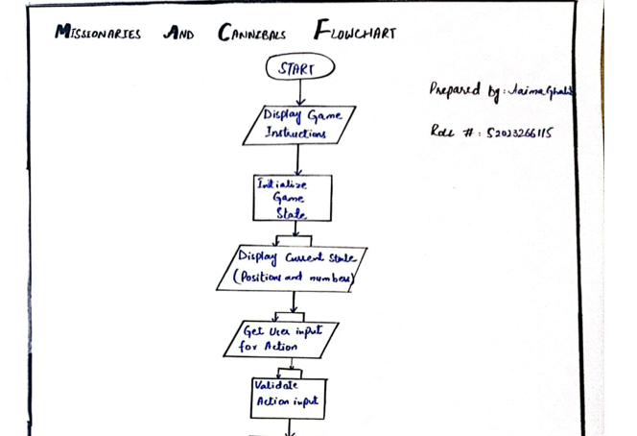
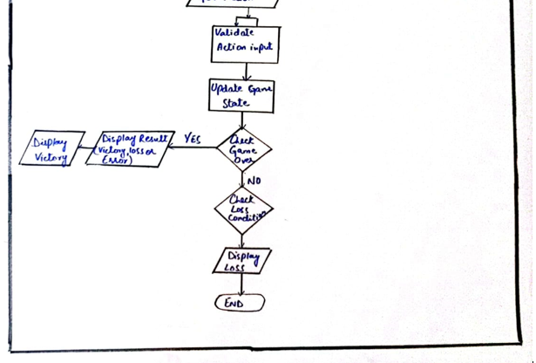
Flowchart

Slide 4
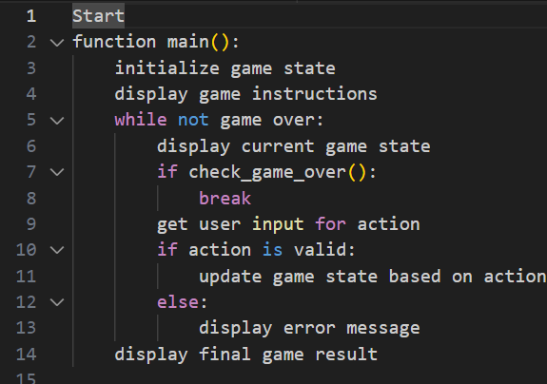
Pseudocode-Main Function

Slide 5
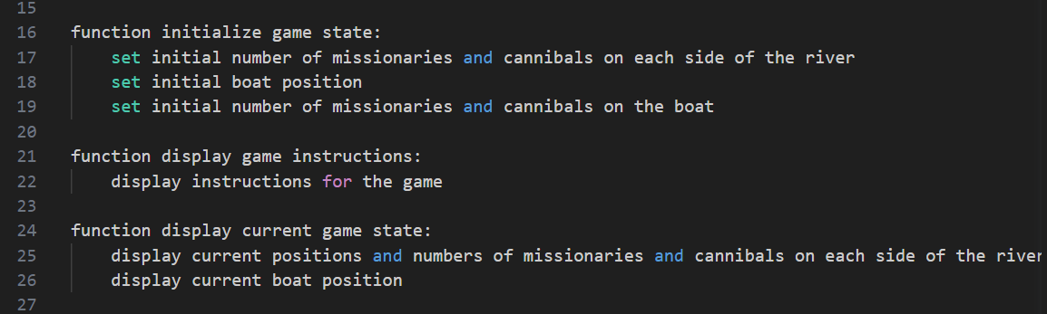
Game State, Game Instructions and Current Game State

Slide 6
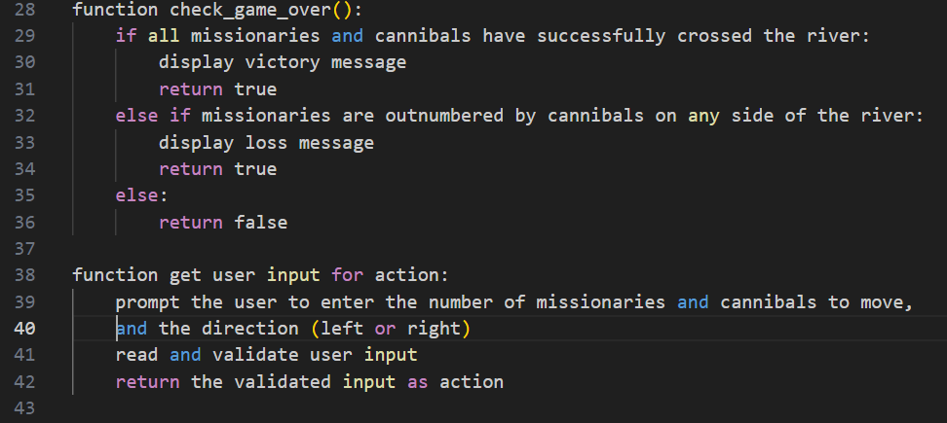
Functions: check_game_over() and action()

Slide 7
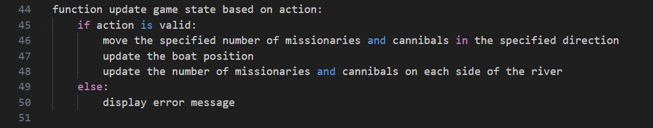
Function: Updated Game State()

Slide 8
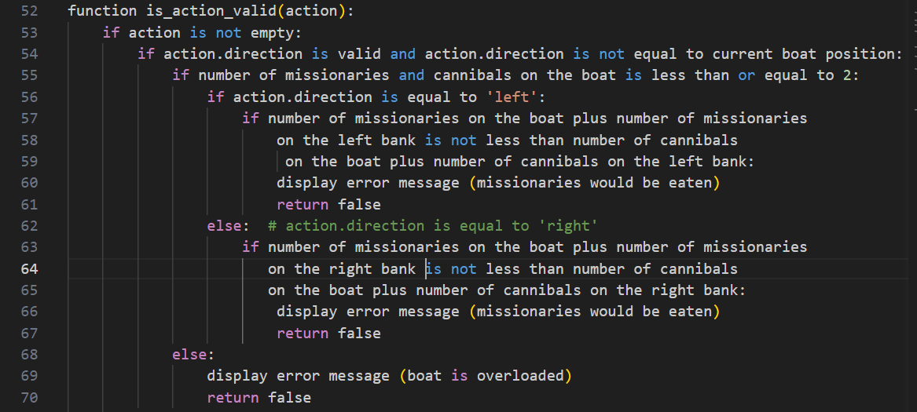
Function: is_action_valid(action)- I

Slide 9
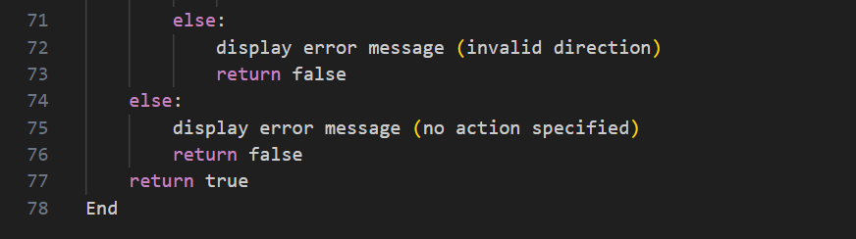
Function: is_action_valid(action)- II

Slide 10


