Slide 1
Team Project Proposal
Team member : 15146312 Park, Gangmin
17102054 Ahn, Ingyun

Slide 2
Table of Contents
Service
Idea
Marketplace
Comparison
Implementation issue
Schedule

Slide 3






Idea
too many messenger app..

Slide 4
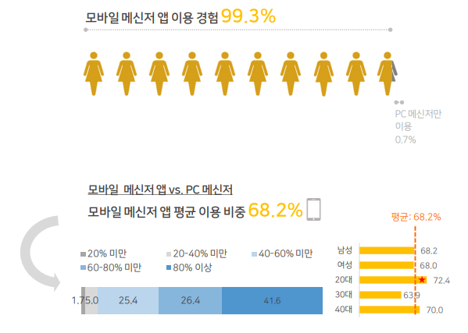
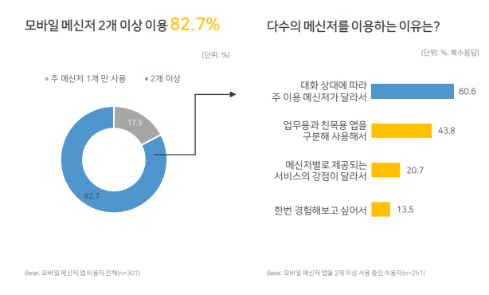
Idea
Experience using mobile messengers
Use more than two mobile messenger
Use Messenger differently depending on
the conversation partner
Business and social usage are distinguish
Percentage of Mobile Messenger and PC Messenger
DMC MEDIA

Slide 5
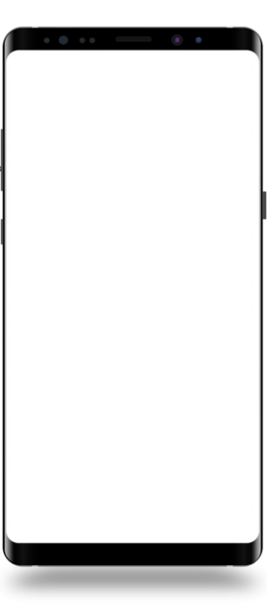
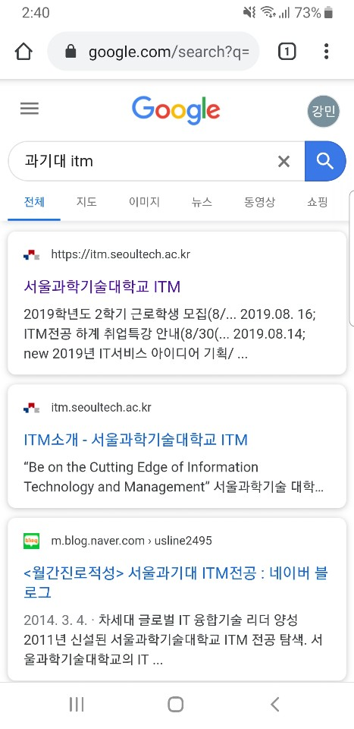
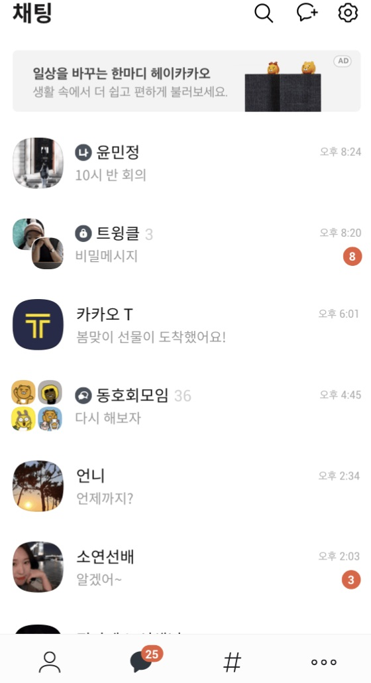
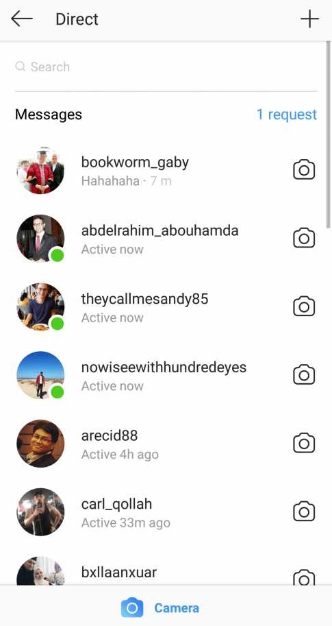
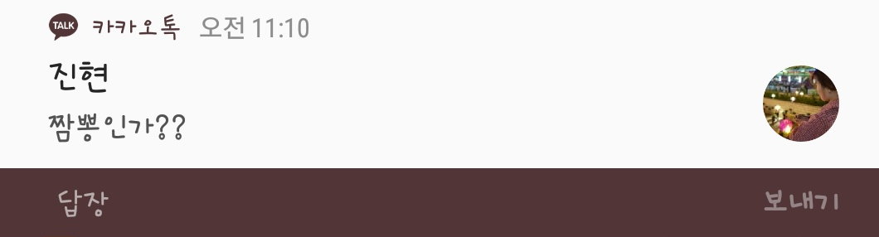
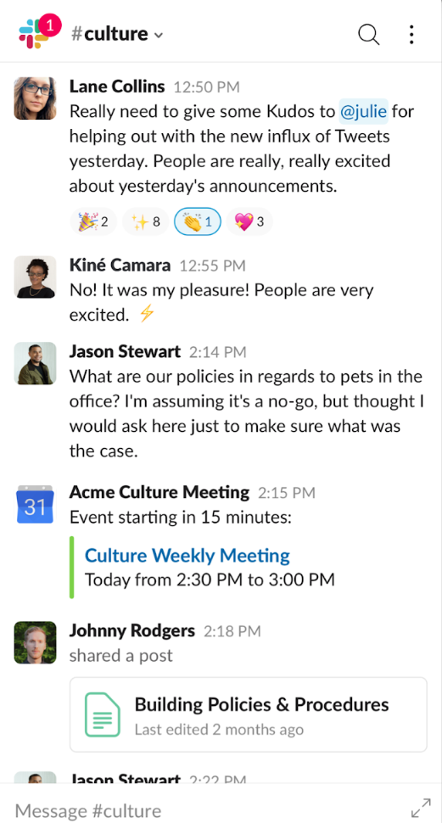




Idea
Facebook
slack
Gangmin
Ingyun
Ingyun : Have you had lunch?
Gangmin : Hello
Gangmin : Bye
REPLY
REPLY
1
2
3

Slide 6

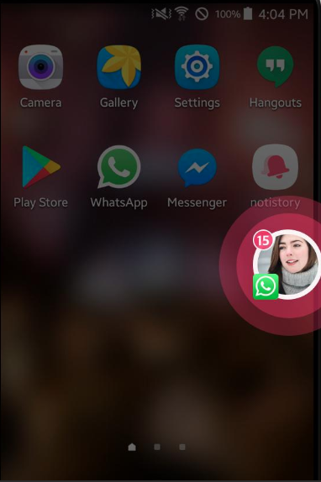
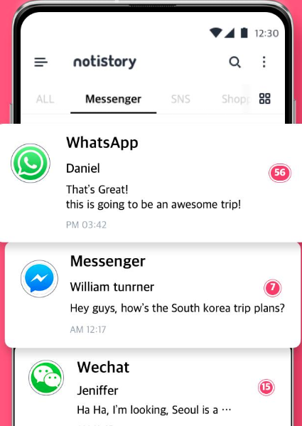

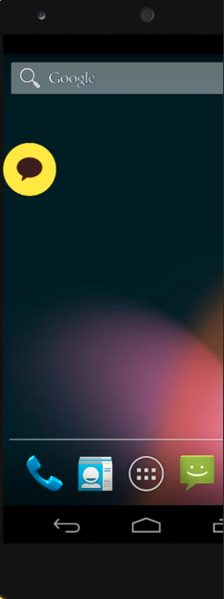
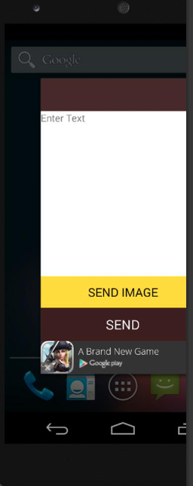

Marketplace
“Notistory”
Receive notifications from other apps
and inform them to users through floating alerts.
“KakaoTalk simple reply”
By using floating view, you can receive message
and reply simply and faster.

Slide 7
Comparison
Our app
Notistory
Overlay View for chatting.
Fast read and reply.
No contents view, only alerting.
Take all alerts, but have to enter the app.

Slide 8
Comparison
Our app
KakaoTalk simple reply
Apply all message service
Show chat history
Apply only KakaoTalk
Only show recent chat

Slide 9
Implementation Issue
Floating
Overlay
Notification
Badge
Chat log
Fast Reply

Slide 10
Schedule
Gantt chart, implementation plan
PROJECT TIMELINE 11~12.2019
“Work contents”
Idea:
UI design, implementation issue
Implementation(1): Floating and Overlay
Implementation(2): Notification and Badge
Implementation(3): Chat log and Fast Reply
Week | 1 | 2 | 3 | 4 | 5 | 6 | 7 | 8
Idea discussion
Implementation(1)
Implementation (2)
Implementation (3)

