Slide 1
Check point
Team member : 15146312 Park, Gangmin
17102054 Ahn, Ingyun

Slide 2
Table of Contents
Explain each Action and Source code
Future plan

Slide 3
Ingyun’s part

Slide 4
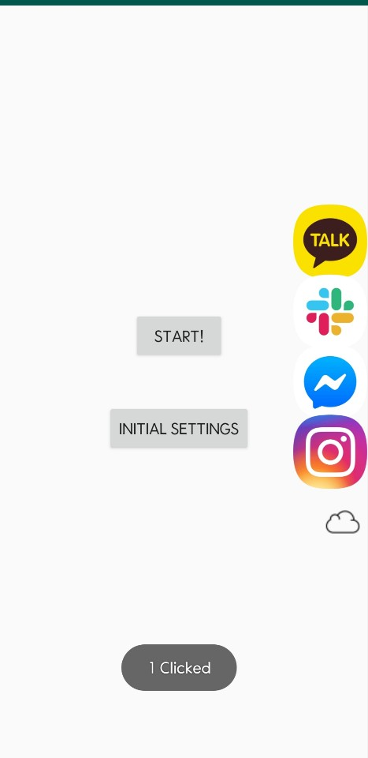
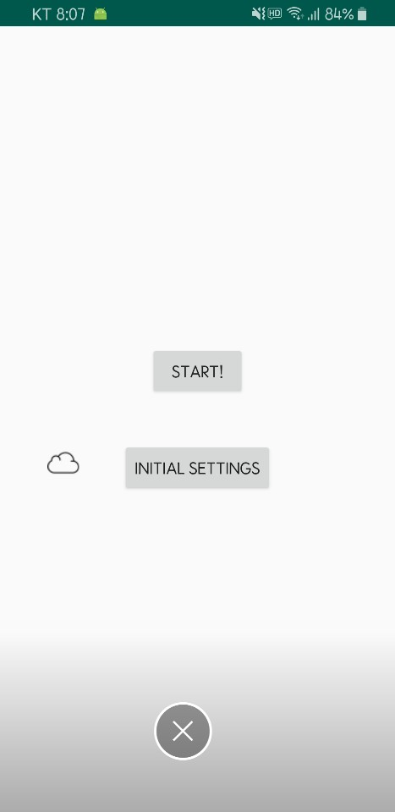
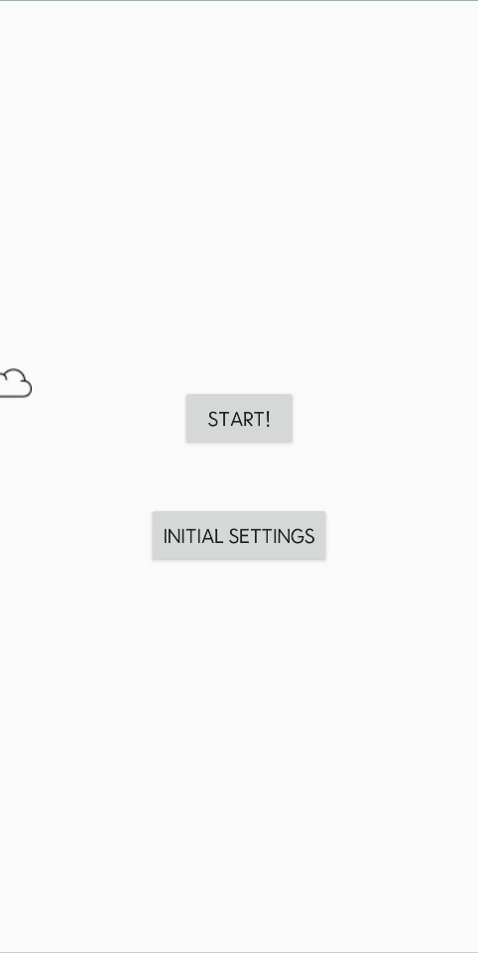
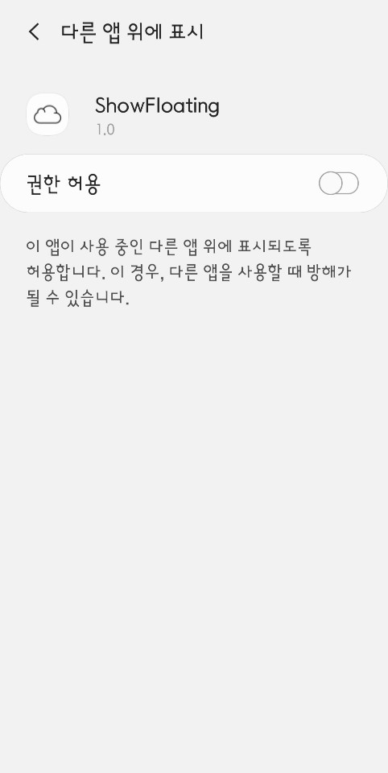
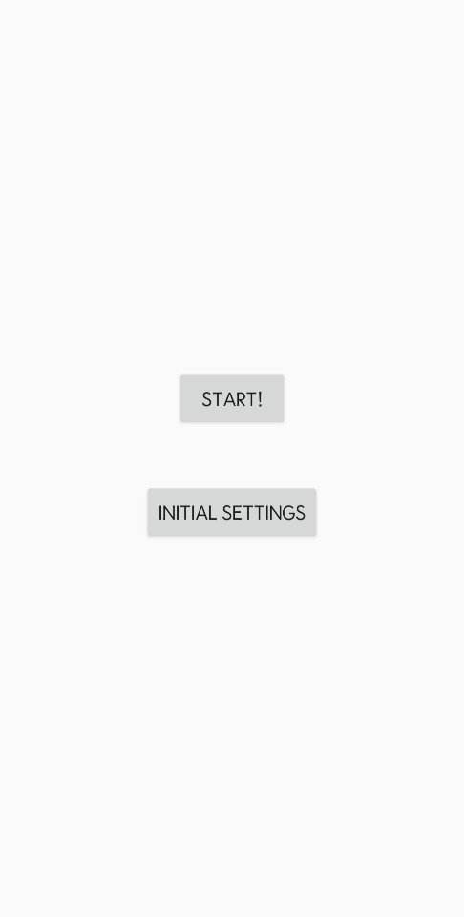
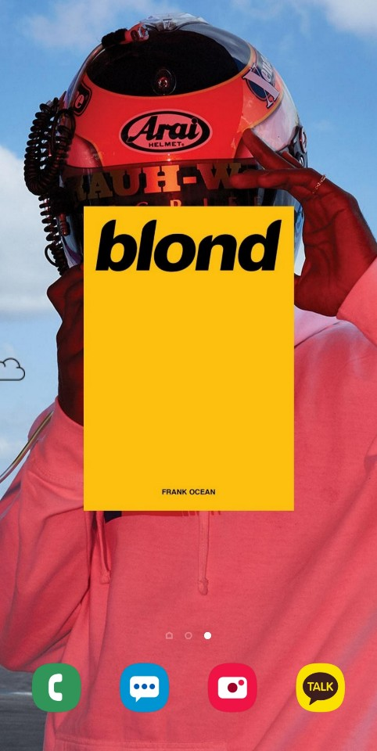
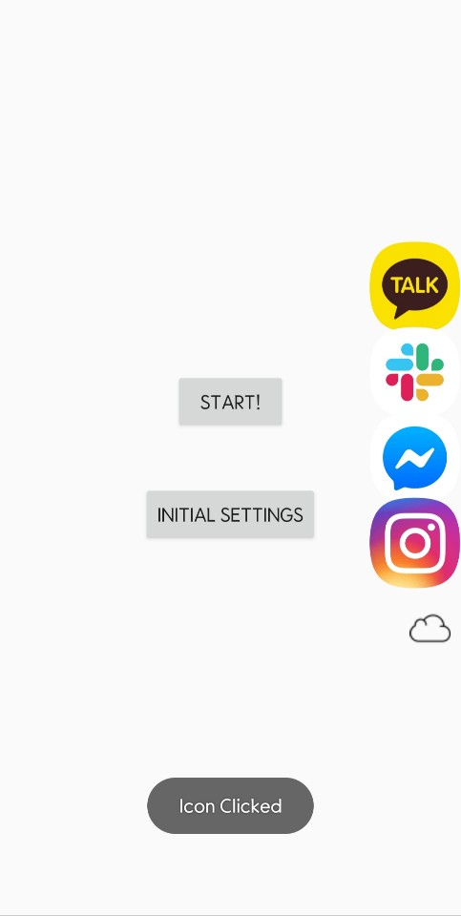
Make Floating View
When the main Floating view is clicked
Other float views containing messenger’s icon from package name is added to window.
Start from MainActivity
FloatingViewControlFragment.class is attached.
Button for START the FloatingService.
And the first float view disappears for convenience
So there is a sub-main float views to make main view visible and others disappear
When click the button
1) Check the SDK Version, TargetAPI is Marshmallow
2) By startActivityForResult(),
Get the Overlay permission from android.Settings.
3) If get this permission, by onActivityResult(),
it does startService() the ChatheadService.class
Each messenger float views are able to click for Gangmin’s pop-up window action.
When floating view is dragged to down-side
It can be destroyed.
When ChatheadService.class is started
Whole float views are created in background.
By using WindowManager object, the view is added on window and other float views are same.

Slide 5
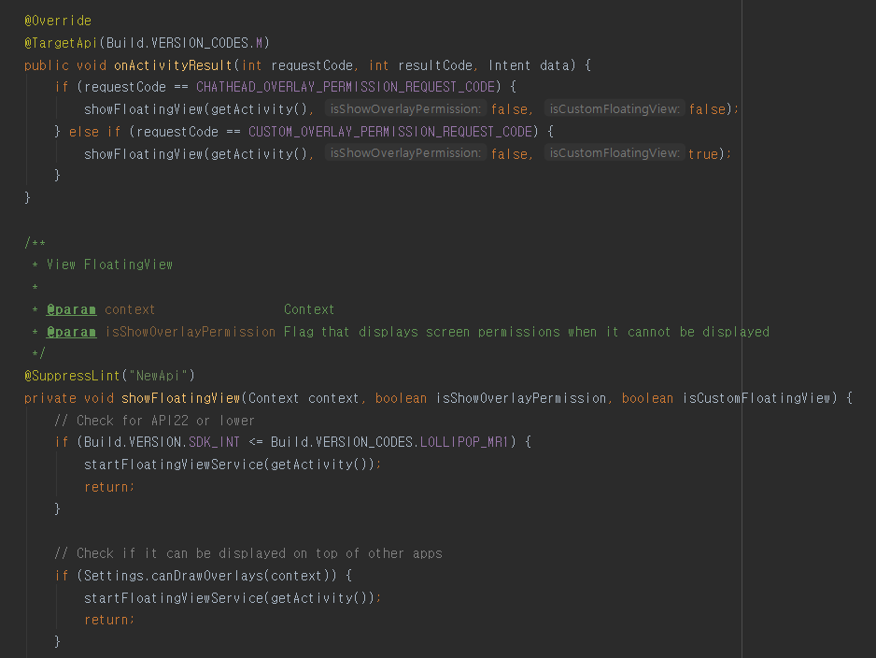
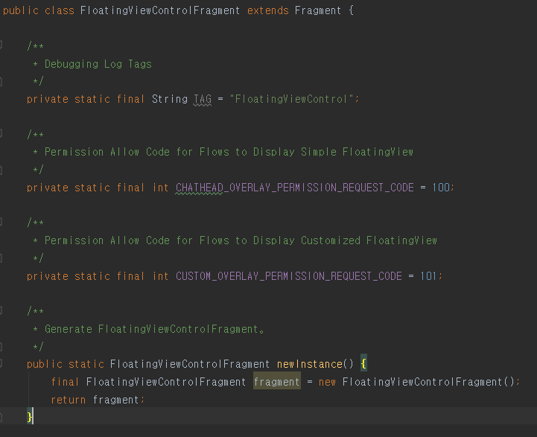
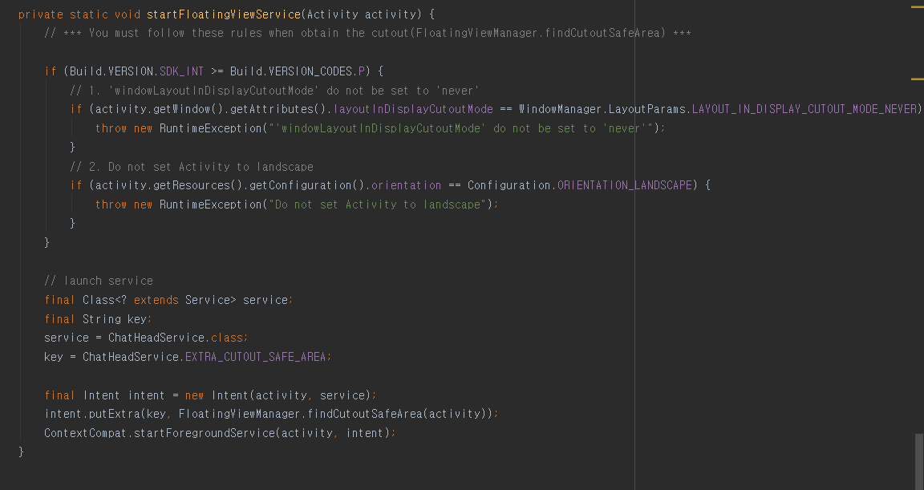
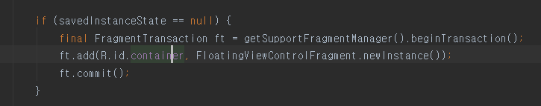
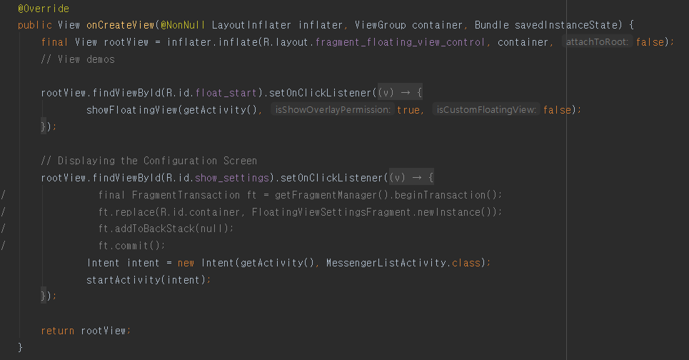
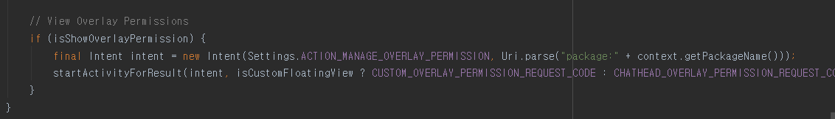
1. Source code

Slide 6
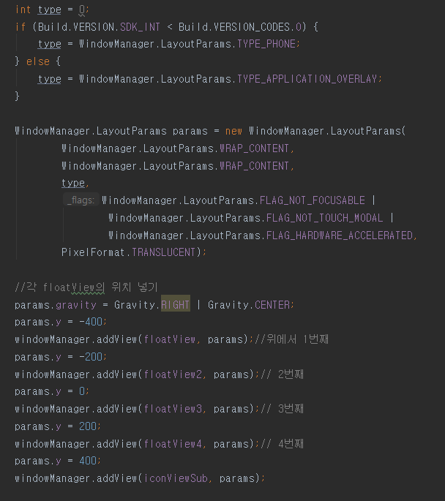
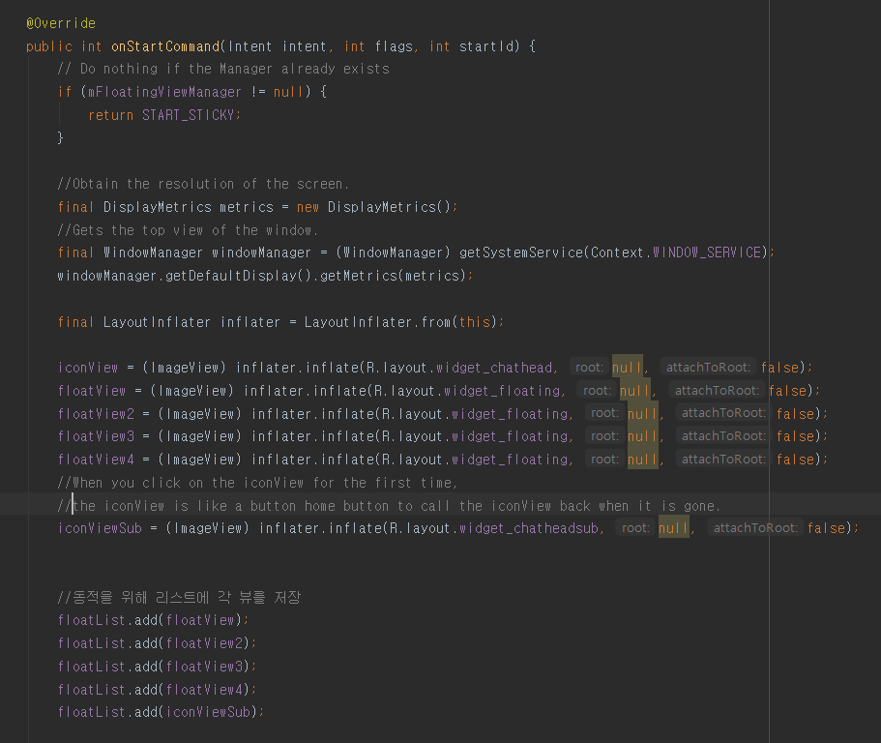
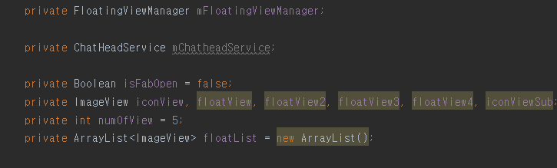
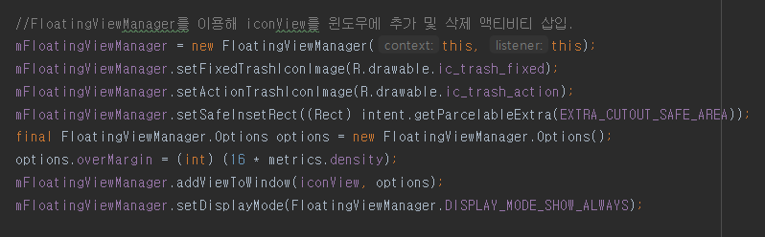
1. Source code

Slide 7
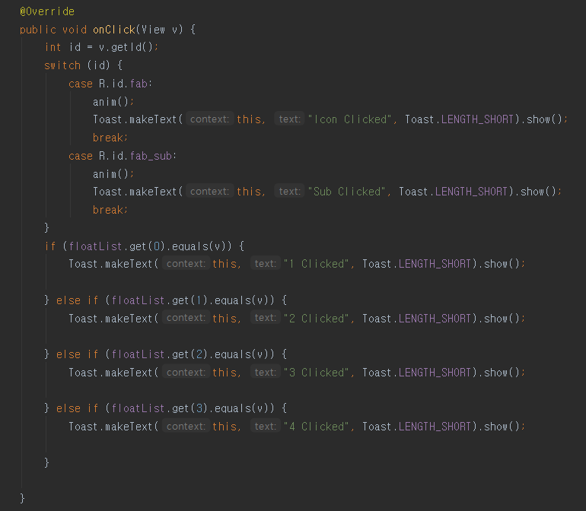
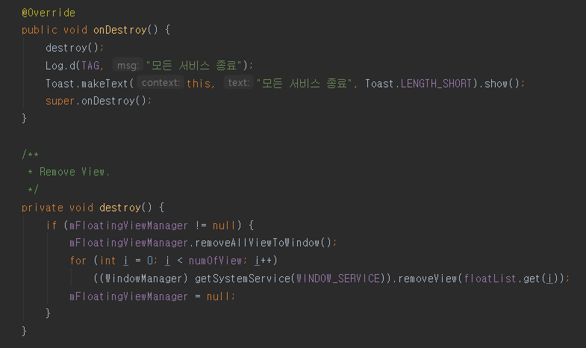
1. Source code

Slide 8
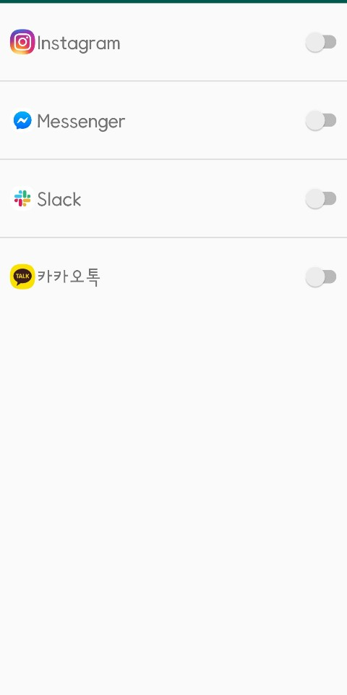
2. Initial Setting
When initial setting button clicked
There are 4 messengers.
Each of the four messengers will be equipped with a switch button to dynamically change the app configuration.

Slide 9
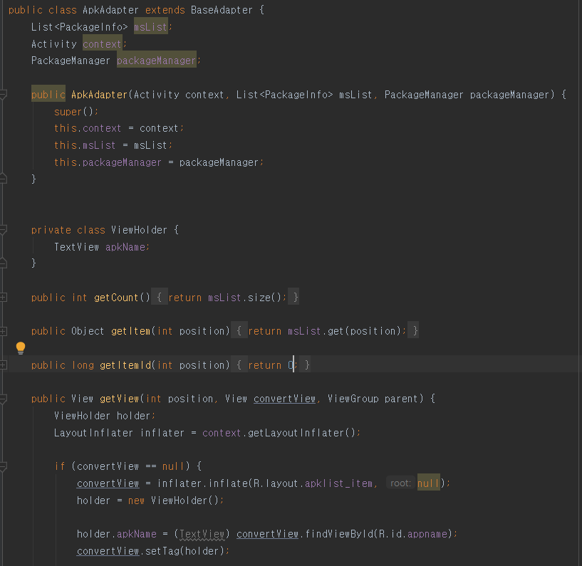
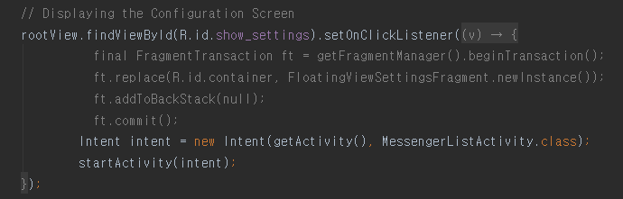
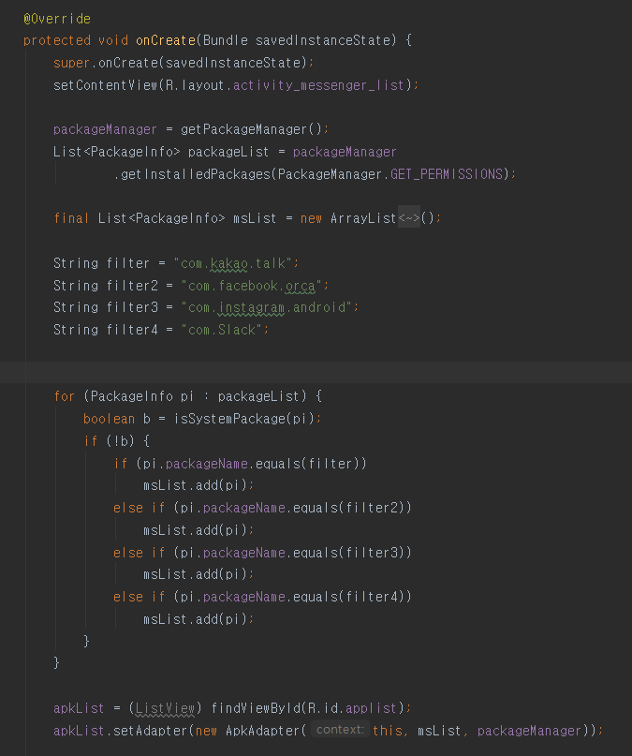
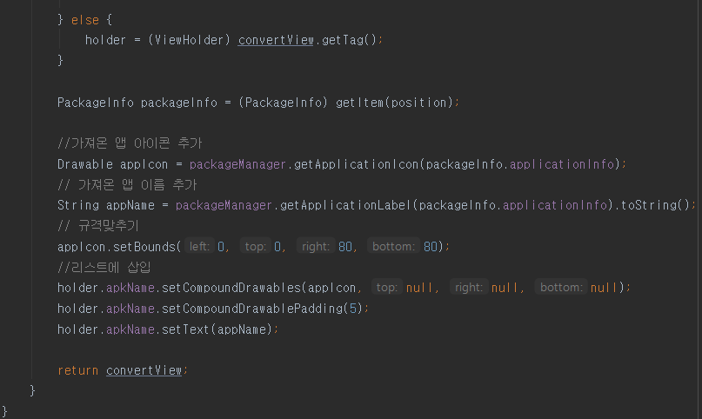
2. Source code

Slide 10
Gangmin’s part

Slide 11
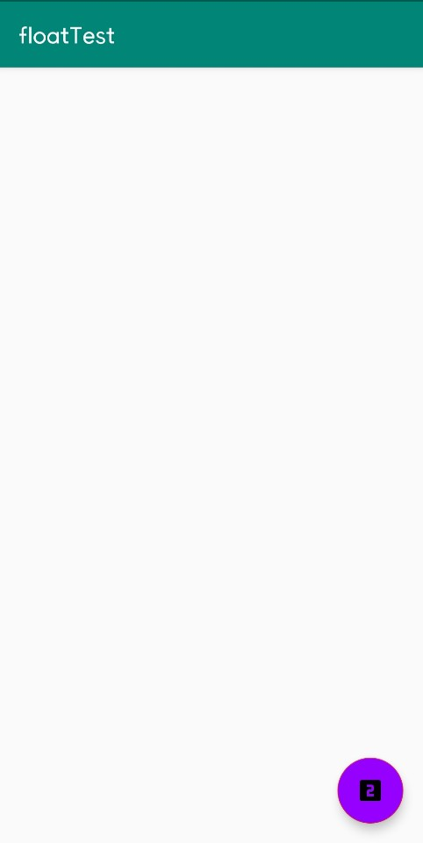
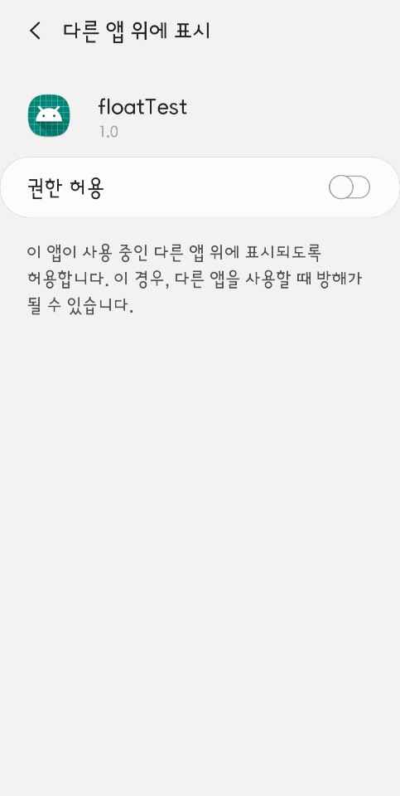
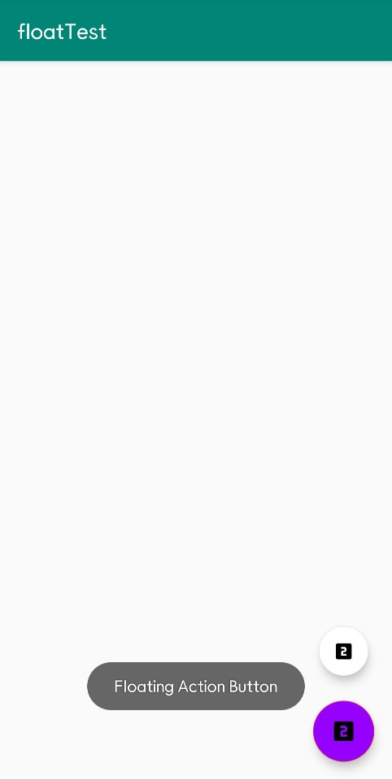
1. Make Floating View
Start from MainActivity
Floating Button for getting other float views.
When click the Floating Button
Check SDK version >= Marshmallow
2. By startActivityForResult(),
Get the Overlay permission from android.Settings.
3. If get this permission, by onActivityResult(),
it does startService() on PopupWindow.class
After get Overlay permission
Other float views are shown up using animation effect.
Each float view is separated by a package name

Slide 12
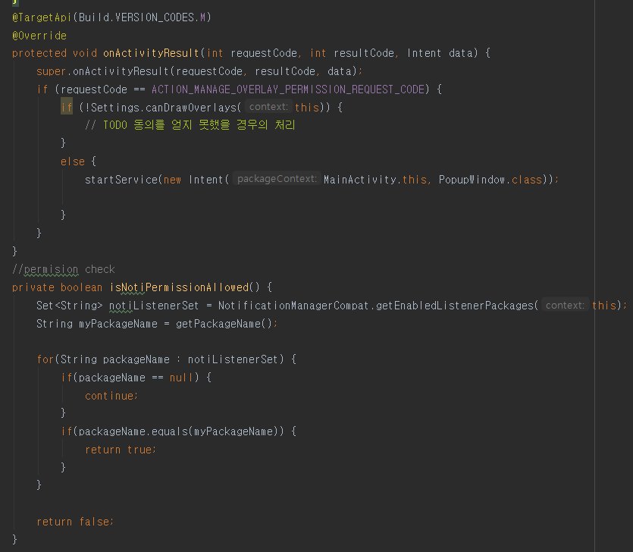
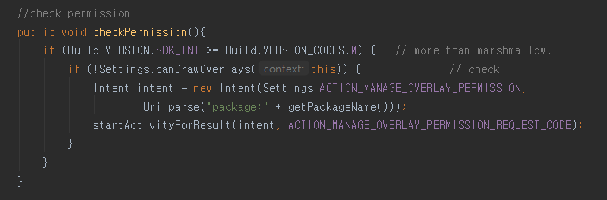
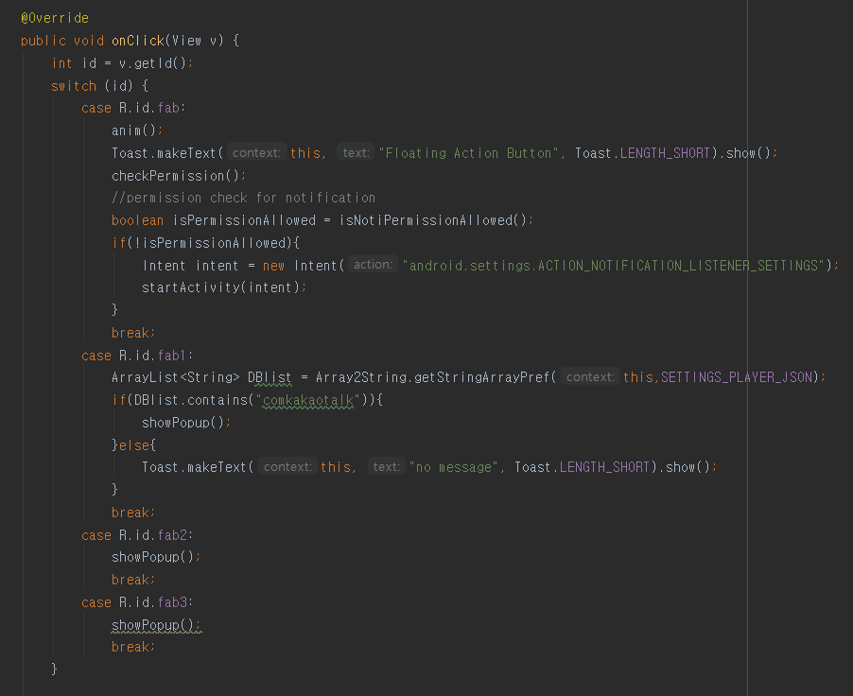
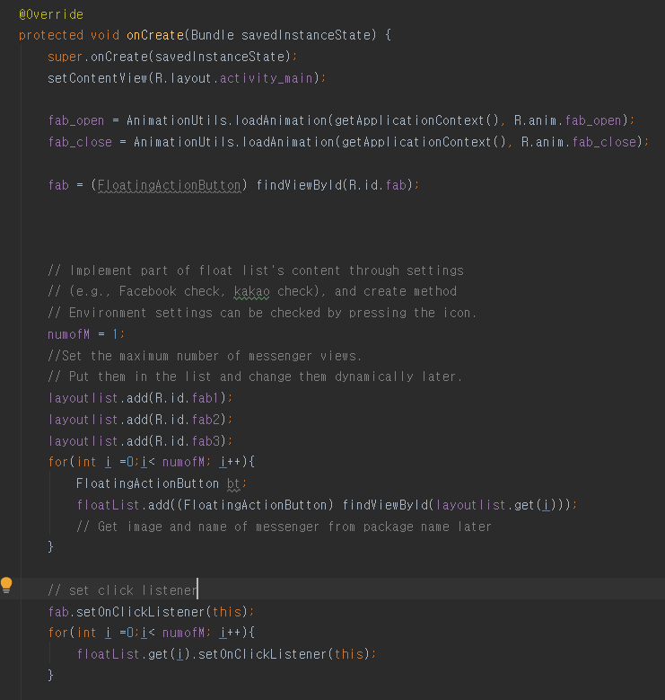
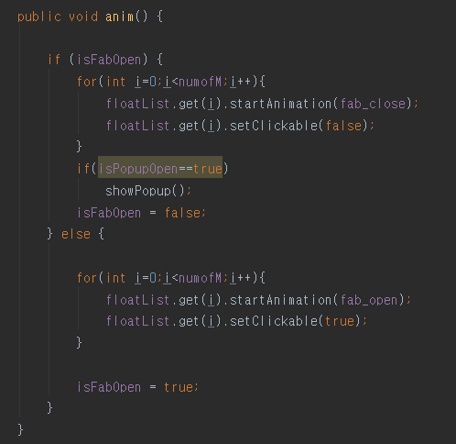
1. Source code

Slide 13
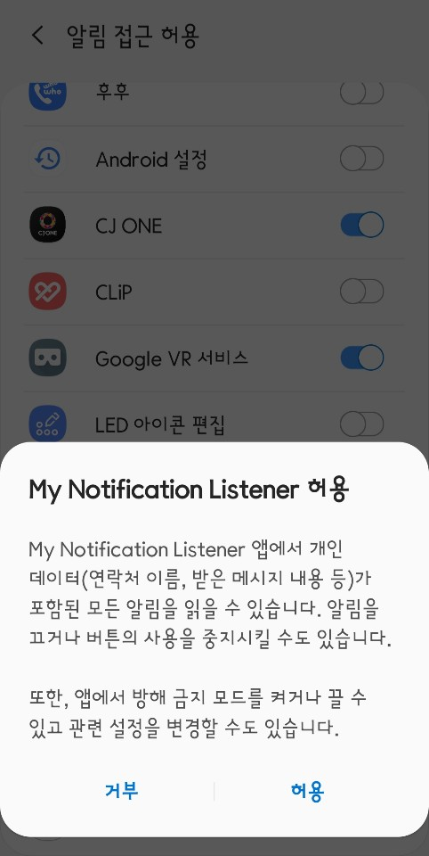
2. Receive Message
Declare MyNotificationListener.class
Create table with chatlog by generating MyDBHandler.class object, and in MySQLiteOpenHelper creates the database
Using Broadcast Receiver, delivery the contents of message notification stored in Myhandler to the whole current process.
MainActivity.class and PopupWindow.class are received these notification by onReceive() method.

Slide 14
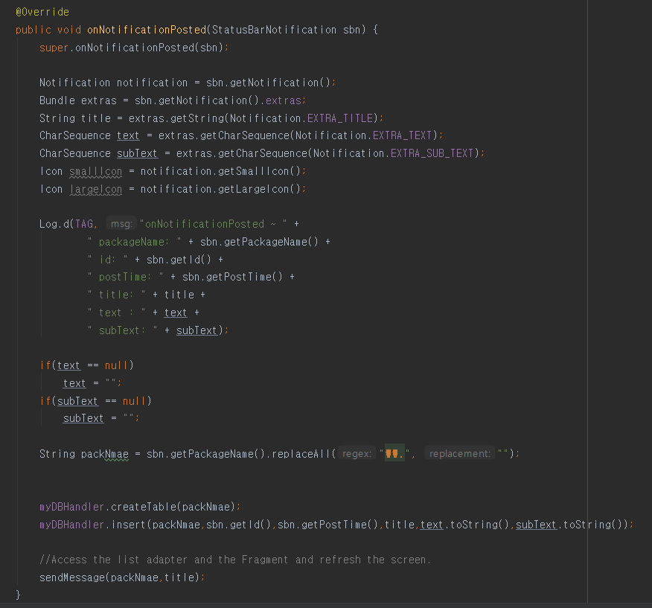

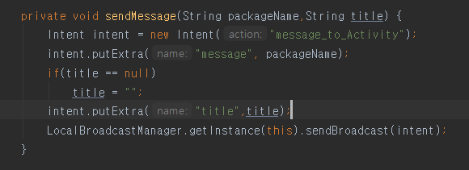
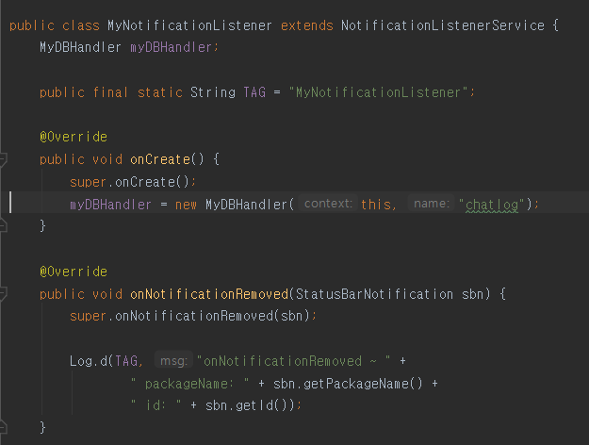
2. Source code

Slide 15
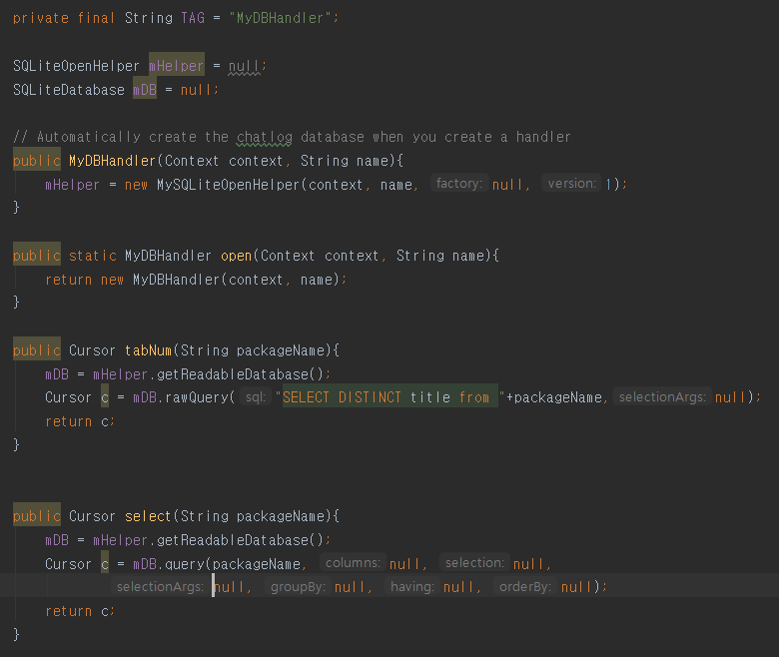
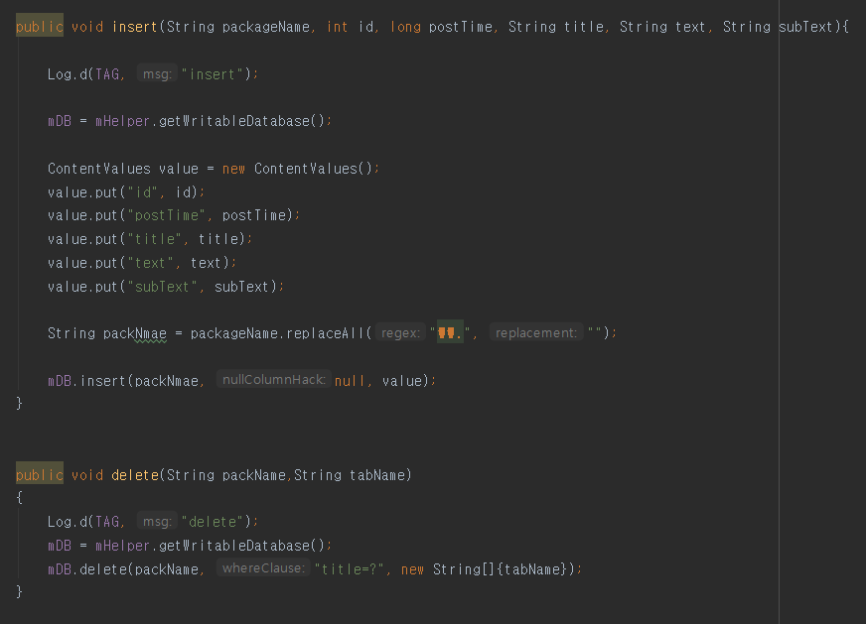
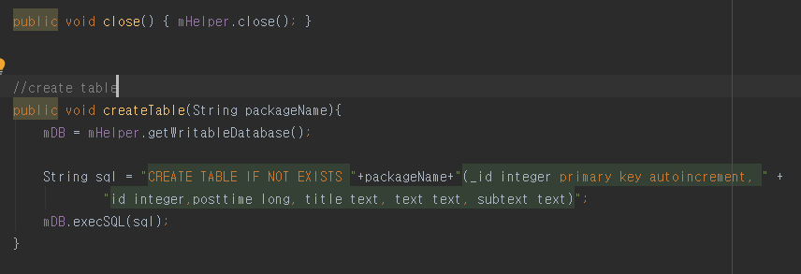
2. Source code

Slide 16
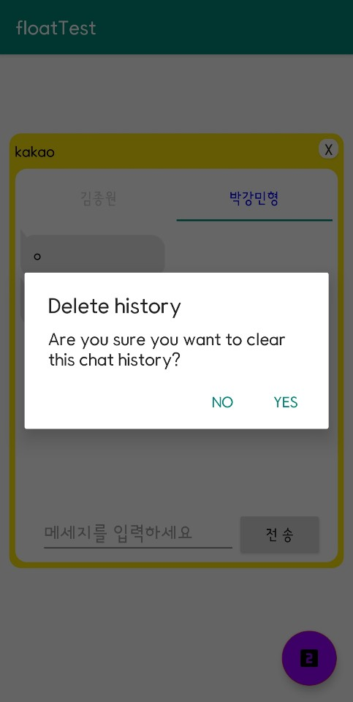
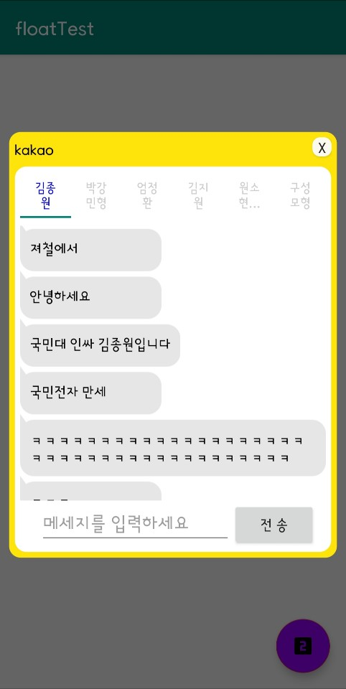
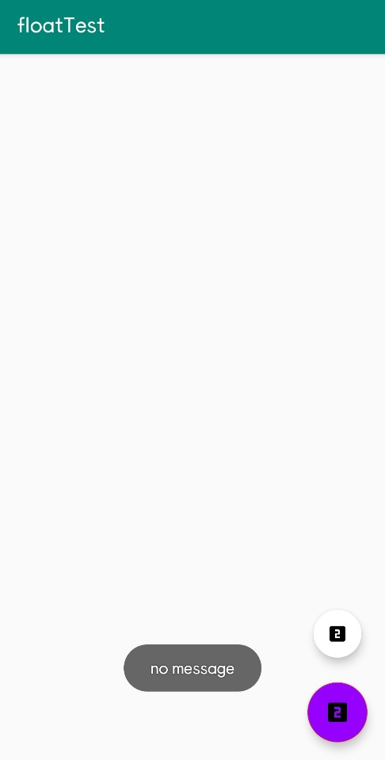
3. Show Message
In ChatFragment.class, it use MyDBHandler.class to select the table corresponding to package name for updating list.
At first, check the DBlist which contains the message notification ordered.
If it is null, there’s a Toast message.
MainActivity.class receives broadcast notification.
And by declaring Array2String.class object, it saves the messages as ArrayList to update the float view in the order of the messages.
Each chat is located by ChatAdapter, Like
Receive “Left-side”, Send “Right-side”, Date “middle”
When PopupWindow.class is successfully created
When tab is long clicked,
Users can delete that chat history
showPopup() function does startActivity() the PopupWindow.class
Chat pop-up of the corresponding package name will show up.
Each tab name is getting from MyDBHandler.class which has DataBase table of chatlog.
Also, the message windows are settled below by PagerAdapter.class The chats are attached on Pager, PopupWindow.class as Fragment.

Slide 17
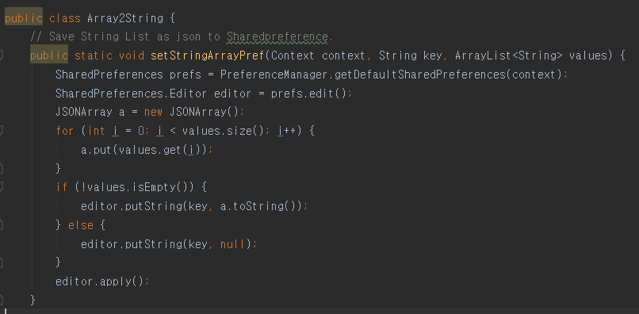
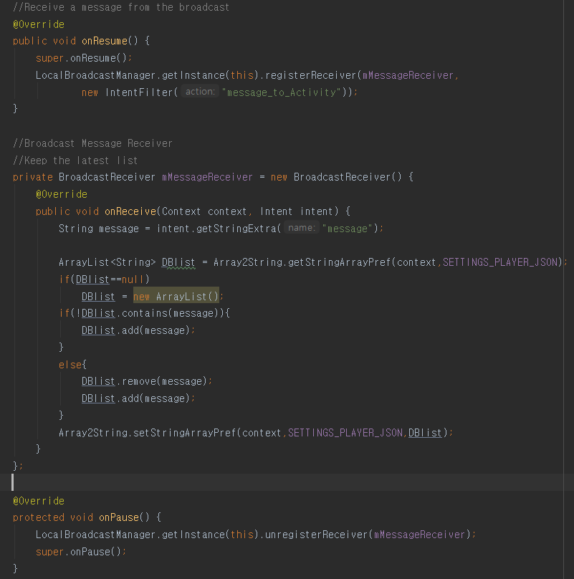
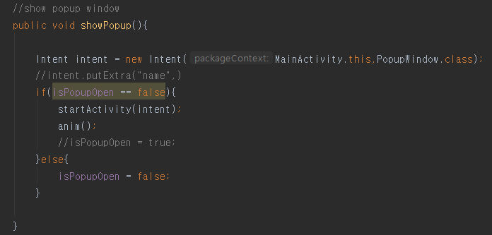
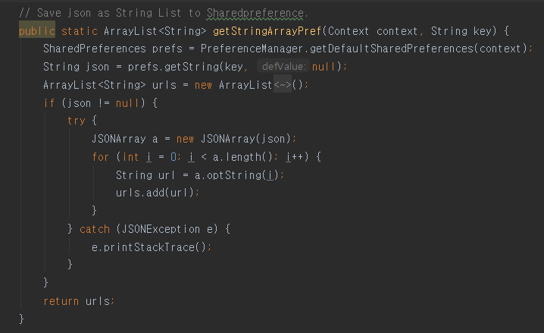
3. Source code

Slide 18
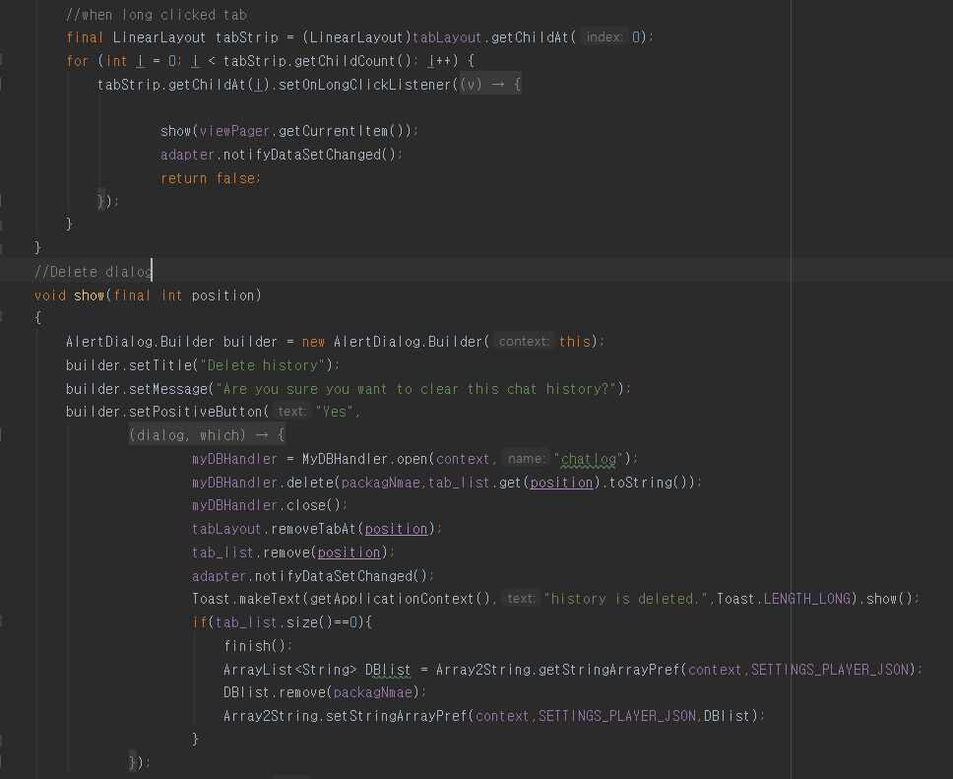
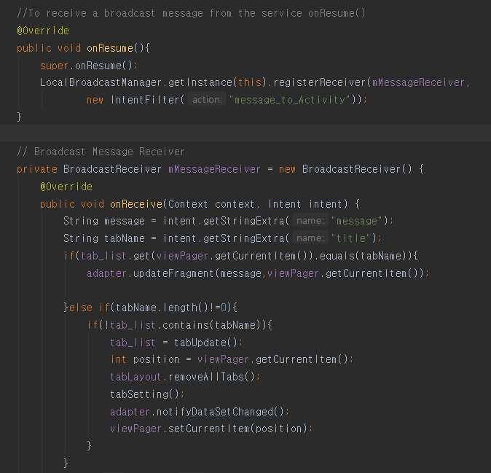
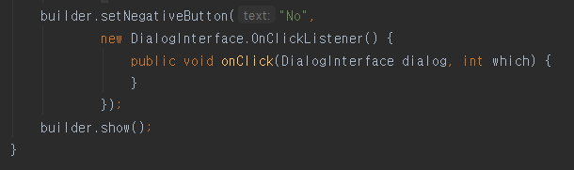
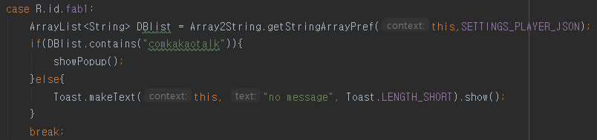




3. Source code

Slide 19
4. Chat Environment
In PopupWindow.class, the viewPager object is declared for chat view.
tabSetting() function declares PagerAdapter.class object.
In viewPager, the tab_layout is filled by PagerAdapater, getting tab_list and package name for matching from Broadcast Receiver.
In PagerAdapter.class, there’s a ChatFragment.class object attached on this view. This object calls MyDBHandler.class for getting the chatlog and ChatAdapter.class for filling the chat messages on view.
ChatAdapter.class indicates the message’s position

Slide 20





4. Source code

Slide 21





4. Source code

Slide 22
5. Structure DataBase
In MyDBHandler.class, there is a MySQLiteOpenHelper.class object with getWritableDatabase() method for creating Database before creating table.
SQLiteDataBase is onCreate.
And MyDBHandler creates the table and inserts contents getting from Broadcast Receiver and Notification Listener.

Slide 23





5. Source code

Slide 24
Future Plan
1. Combine code, Ingyun's and Gangmin’s.
2. Construct other messenger and views.
3. Add function, Notification badge and reply.

