Slide 1
Regression Review

Slide 2
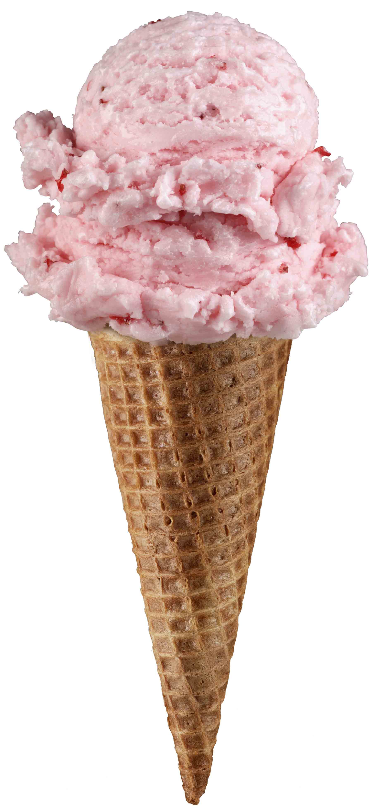
Linear Regression for continuous outcomes
#
= $β$ + ($β$*temperature) + ($β$*day) + ($β$*price) + error
Some linear combination of temperature values, day of the week dummy variables and price estimate the number of cones that will sell.
Notes:
What should we expect the beta signs to be? Whats the relationship the information has with ice cream sales?
Temp goes up? Sales go up. Temp goes down? Sales go down. Positive relationship
Price goes up? Sales go down. Price goes down? Sales go up. Negative relationship

Slide 3

The linear combination equation captures information
outcome
coefficients
constant
error (noise)
predictors

Slide 4
#
= $6$ + 0.$25$*temperature + $3$*satudray_dummy + -0.5*price
Beta-Naught | Temperature | Satuday_dummy | Price | Best Fit Prediction
6 | 0.25 * 80 degrees | 3 * 1 | -0.5 * 5 | 26.5
6 | 0.25 * 88 | 3 * 0 | -0.5 * 2 | 27

Slide 5
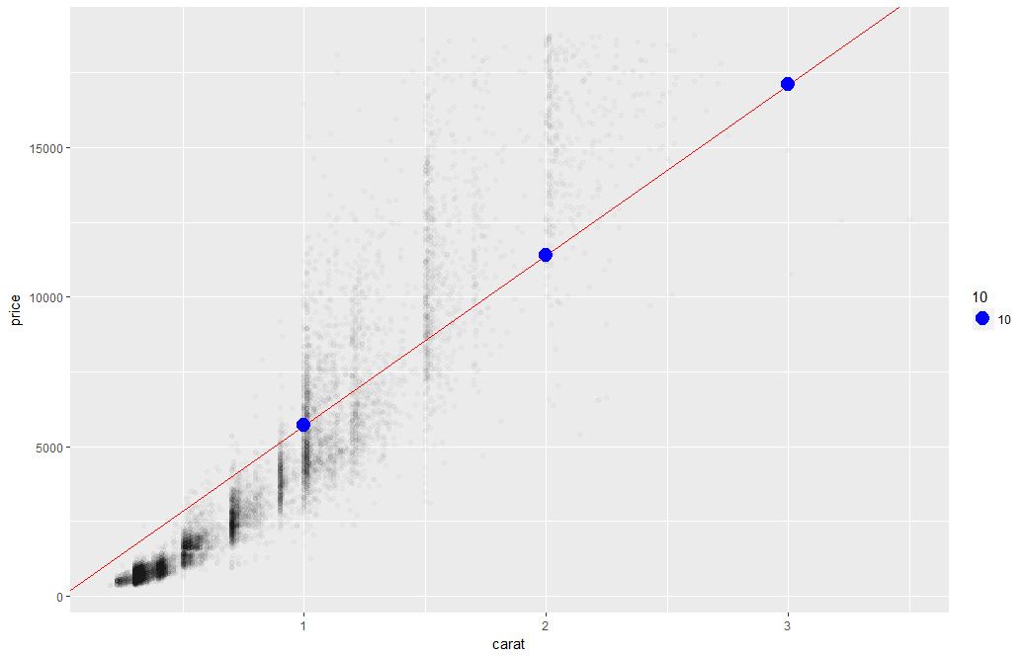
What’s really going on?
Errors between a prediction and actual.
Notice some are negative and some are positive

Slide 6
So what is really going on?
The algorithm is optimizing the inputs and weights (beta’s) to minimize the sum of squared errors.
This is called “ordinary least squares (OLS).

Slide 7
Let’s Practice
Open AA_Review_Regression.R

