Slide 1
Agenda
Start | End | Item
 |  | What is Forecasting?
 |  | Naïve Forecasting Methods
 |  | Time Series Decomposition
 |  | HoltWinters Forecasting
 |  | Appendix

Slide 2
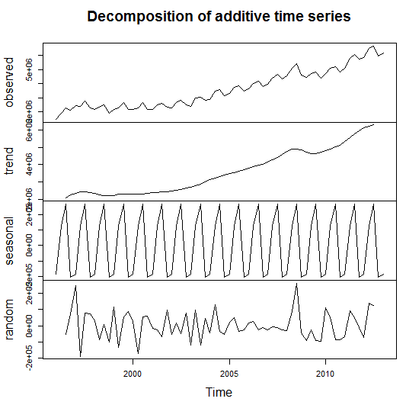
Time Series Decomposition
Decompose a time series into
Trend
Seasonal
Random (noise)
De-Season Data
Helps understand the underlying characteristics of a time series
Sometimes applying a forecast or model to the random component can improve accuracy

Slide 3
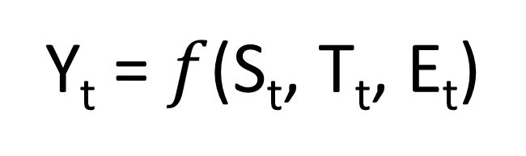
Time Series Decomposition
Y_{t} = $f$(S_{t}, T_{t}, E_{t})
Data at a specific time period (t) is equal to a mix* of seasonal values, trend values and whatever is left at the same time period.
Where (Math-speak version):
Y_{t} = data at period t
S_{t} = seasonal component at period t
T_{t} = trend component at period t
E_{t} = remainder or residual component at period t

Slide 4
Time Series Decomposition
Y_{t} = $f$(S_{t}, T_{t}, E_{t})
Data at a specific time period (t) is equal to a mix* of seasonal values, trend values and whatever is left at the same time period.
Additive – Y_{t}= Seasonal effect + Trend + Residual
An additive model assumes that the difference between each time period is approximately the same
For example, Jan trend is +100, so next Jan trend would add another +100.
Multiplicative - Y_{t}= Seasonal effect X Trend X Residual
A multiplicative model assumes changes are proportional and not constant.
For example Jan season is +100 as part of a 1,000 total (10%). The next Jan the total is 1500, and the seasonal adjustment would be 150 (10%).
Notes:
Additive – Every quarter the business grows by $10M
Multiplicative – Every quarter the business grows by 10%

Slide 5
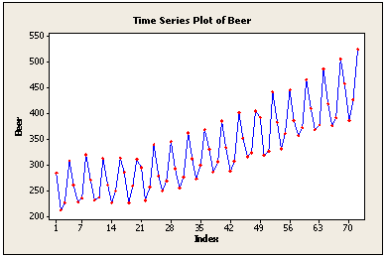
Time Series Decomposition
Additive
Use additive models if the seasonality (repeating pattern) is similar.
Peak to trough looks the same, so additive is ok.
Notes:
Amplitude changes

Slide 6
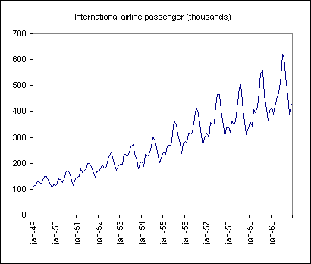
Time Series Decomposition
Multiplicative
Use multiplicative if the seasonality grows larger over time but is still the same proportion of the total
The peak to trough looks exaggerated over time
Notes:
Amplitude changes

Slide 7
Time Series Decomposition – Side by Side
Additive
Multiplicative
Use additive models if the seasonality (repeating pattern) is similar.
Use multiplicative if the seasonality grows larger over time but is still the same proportion of the total
Notes:
Amplitude changes

Slide 8
Summary – Time Series Decomposition
Separates Trend, Seasonal and Random components of a time series
Components are combined by
Additive – adding components is appropriate if the seasonal pattern is consistent
Multiplicative – multiplying components is appropriate if the seasonal pattern changes over time but it proportional to the time series.
TSD can help you understand the data and can be done as part of EDA
Each component can be forecasted separately to (sometimes) improve accuracy then each forecast can be combined to arrive at a final forecast
De-seasoning data is possible by subtracting (additive TSD) or dividing (multiplicative TSD) it out of the time series – see the impact of an event from expected seasonal or trend changes; quantifies impact

Slide 9
Open E_TimeSeriesDecompositionAMZN.R

Slide 10
Agenda
Start | End | Item
 |  | What is Forecasting?
 |  | Naïve Forecasting Methods
 |  | Time Series Decomposition
 |  | HoltWinters Forecasting
 |  | Appendix

Slide 11
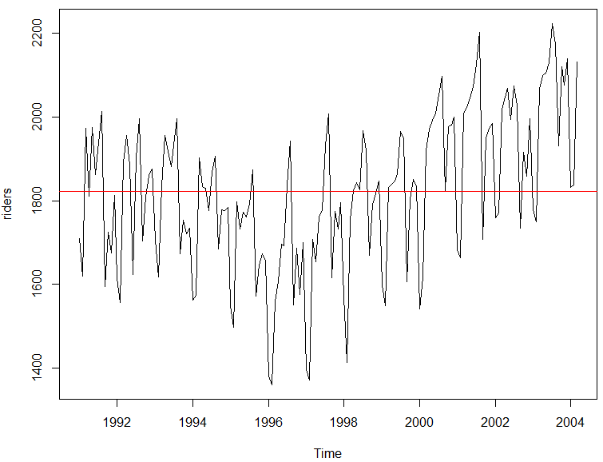
But first averages…
Mean Average – good for population summary
Add all values and divide by population
mean(riders)
[1] 1822.197
Each record has the same weight.
Number | Value
1 | 10
2 | 20
3 | 30
4 | 40
5 | 50
10+20+30+40+50
=30
5

Slide 12
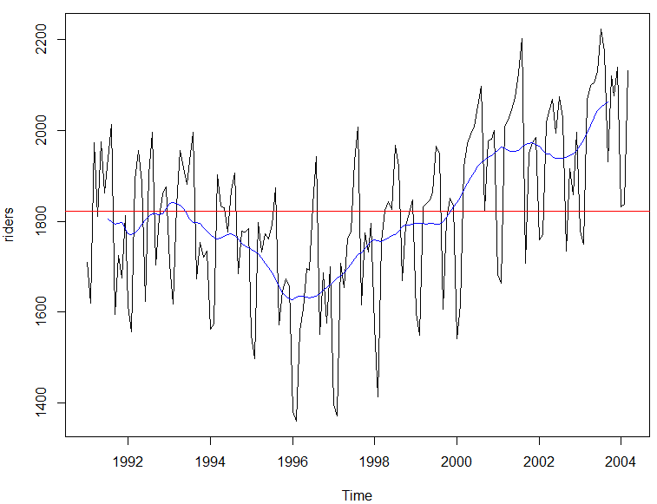
But first averages…
Centered Moving Average – smooths seasonality
Add all values and divide by population in the window
ma(riders, order =12)
Records in the window have the same weight.
Number | Value
1 | 10
2 | 20
3 | 30
4 | 40
5 | 50
t = 3
10+20+30
=15
3
…
30+40+50
=40
3
Descriptive because it uses values from the future so not good for forecasting.

Slide 13
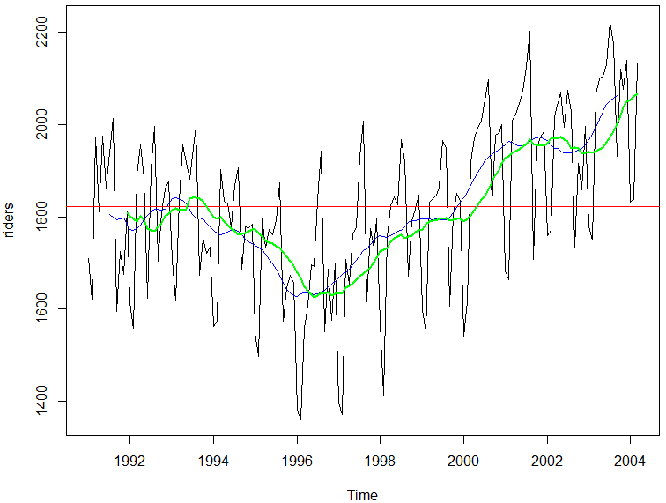
But first averages…
Trailing Moving Average – smooths seasonality
Add all values and divide by population in the window
rollmean(riders, k = 12, align = 'right'
Records in the window have the same weight.
Number | Value
1 | 10
2 | 20
3 | 30
4 | 40
5 | 50
t = 3
10+20+30
=20
3
20+30+40
=30
3
Uses preceding window values so ok for forecasts but lags for trend and seasonal.

Slide 14
But first averages…
Exponential Smoothing
Older records in the window have the diminishing weight
α is a parameter between 0 and 1.
0 = more weight is given to observations from the more distant past
Approaching 1= more weight given to recent
1 = all weight given to the most recent (same as a true Naïve forecast)
Values are weighted so their impact diminishes in the average the farther back.

Slide 15
Open F_HoltWintersWMT.R
HW applies exponential smoothing to level, trend and seasonality individually then combines them.

