Slide 1
Holt Winters Catch up

Slide 2
Agenda
Start | End | Item
 |  | Quick Review
 |  | HoltWinters Forecasting

Slide 3
Main ideas
Forecast future values of a time series
Distinction between forecasting (main focus) and describing/explaining
Before forecasting understand “periodicity”
Four components of time series (meta-data):
Level
Trend
Seasonality
Noise
Time series data is great for enrichment and engineering e.g. “event flags” but can be modeled as a standalone vector due to the meta data “inside” the vector.

Slide 4
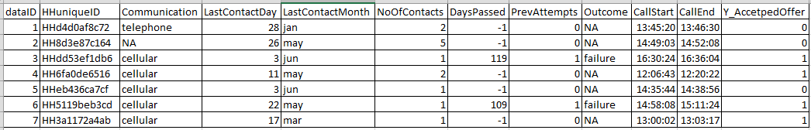
Difference between ML Data Setup & Time Series Data
ML Data Frame
Observations
Attributes for each observation
Each record is a standalone observation of a phenomena you are trying to predict, classify or cluster.
Records have defined attributes for each data row.
Notice time is not interacting between rows (or it had not better be) but is present at the observational row.

Slide 5
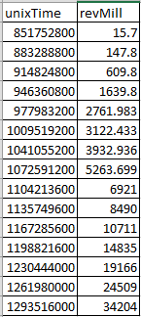
Difference between ML Data Setup & Time Series Data
Time Series Data
Data is typically (not always) in a single vector with each value being in sequence to the next.
Attributes may not be present because temporal information is held “within” the vector due to the relatedness of each record.
Observations
Attribute

Slide 6
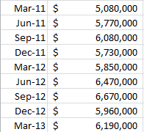
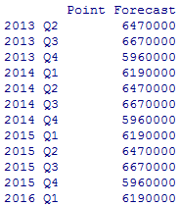

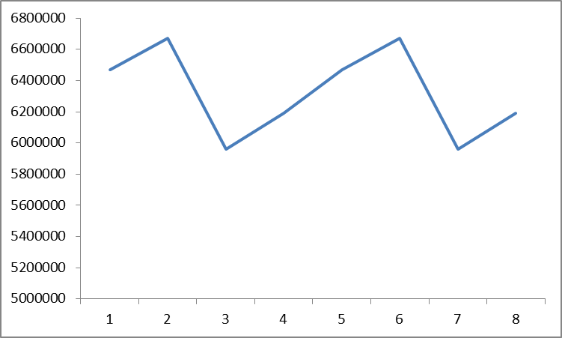
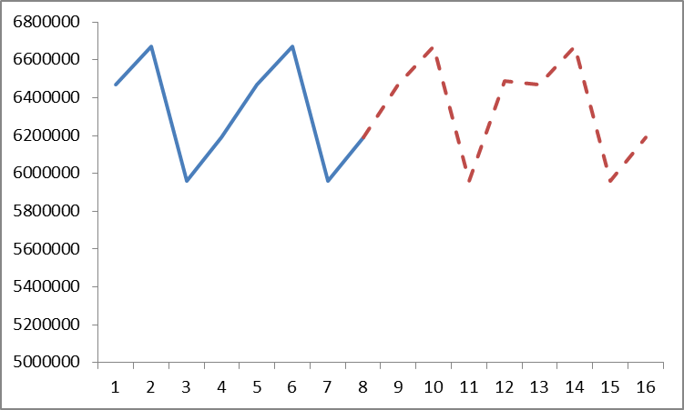
What is forecasting?
Forecasting is the process of applying mathematical tools on time series data to create future time series values, doesn’t have to explain the reason for observed changes.
Actual Time Series
Future Forecasted Values
Times Series Data > Forecast Methodology> Future Values

Slide 7
The data inside the time series data
Level – an average of the observations “steady state”
Trend – are values increasing, decreasing or stationary
Seasonality – is there a repeating pattern in the periodicity
Noise – unexplained values or “residuals” from adding “trend”, “seasonality” and “level” together. Basically its what left, and unaccounted for.

Slide 8
Time Series Partitioning is not random
Random partitioning would leave holes in the data, which causes problems
Forecasting methods assume regular sequential data
Instead of random selection, divide data into two parts
Train on early data
Validate on later data
Performance can be assessed against the “naïve benchmark” & historical accuracy naïve forecast is simply the most recent value in the time series
Temporal Data Points
Training Data
Validation
Sub-setting data with regard to time is called “out of time” sampling.

Slide 9
Summary
Focus is to predict (not describe/explain)
Four components
Level
Trend
Seasonality
Noise
Partition data by dividing into early/late

Slide 10
Agenda
Start | End | Item
 |  | Quick Review
 |  | HoltWinters Forecasting

Slide 11
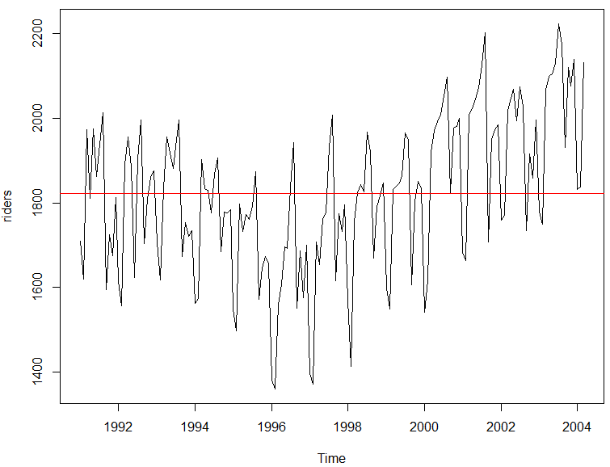
But first averages…
Mean Average – good for population summary
Add all values and divide by population
mean(riders)
[1] 1822.197
Each record has the same weight.
Number | Value
1 | 10
2 | 20
3 | 30
4 | 40
5 | 50
10+20+30+40+50
=30
5

Slide 12
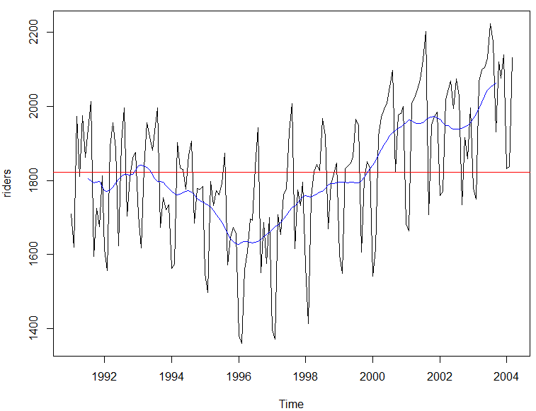
But first averages…
Centered Moving Average – smooths seasonality
Add all values and divide by population in the window
ma(riders, order =12)
Records in the window have the same weight.
Number | Value
1 | 10
2 | 20
3 | 30
4 | 40
5 | 50
t = 3
10+20+30
=15
3
…
30+40+50
=40
3
Descriptive because it uses values from the future so not good for forecasting.

Slide 13
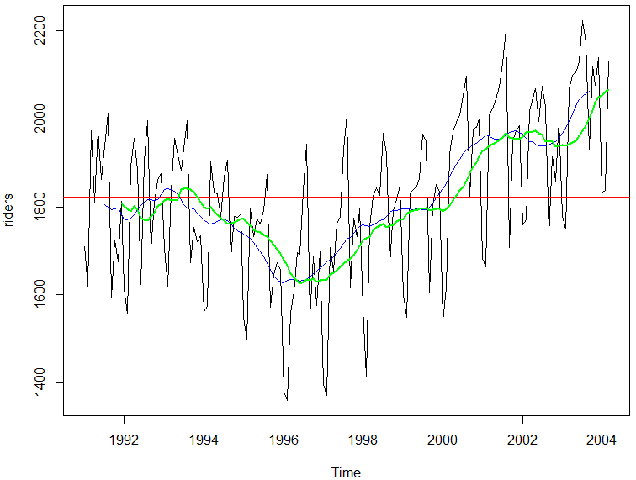
But first averages…
Trailing Moving Average – smooths seasonality
Add all values and divide by population in the window
rollmean(riders, k = 12, align = 'right'
Records in the window have the same weight.
Number | Value
1 | 10
2 | 20
3 | 30
4 | 40
5 | 50
t = 3
10+20+30
=20
3
20+30+40
=30
3
Uses preceding window values so ok for forecasts but lags for trend and seasonal.

Slide 14
But first averages…
Exponential Smoothing
Older records in the window have the diminishing weight
α is a parameter between 0 and 1.
0 = more weight is given to observations from the more distant past
Approaching 1= more weight given to recent
1 = all weight given to the most recent (same as a true Naïve forecast)
Values are weighted so their impact diminishes in the average the farther back.

Slide 15
Open F_HoltWintersWMT.R
HW applies exponential smoothing to level, trend and seasonality individually then combines them.
RENAMED ZZZ_HoltWintersWMT.R

