Slide 1
Automating Reports
Flexdashboard
Use R Markdown to publish a group of related data visualizations as a dashboard.
Support for a wide variety of components including htmlwidgets; base, ggplot2
Flexible and easy to specify row and column-based layouts.

Slide 2

Awesome. No more old cars!
No more bad requests, I work in a hospital now. Its all doctors so I am sure they are data fluent.

Slide 3

Let’s make some routine reports
Dale! I am freaking out!!!
I need a report on my desk each Monday that details our diabetic patient results.

Slide 4

Use Case for Report Automation
cool.
Making routine reports is boring
Routine reports waste analytical talents’ time
We need to automate Dale’s misery!

Slide 5
Multiple Methods
R library(officer)
https://davidgohel.github.io/officer/
Docx and pptx
Flexible though clunky
Uses any static image ggplot etc
Easily allows for themes
R Studio Presentation “PowerPoint”
https://support.rstudio.com/hc/en-us/articles/360004672913-Rendering-PowerPoint-Presentations-with-RStudio
Requires knowledge of markdown
Last semester we used library officer but this time the markdown version.

Slide 6
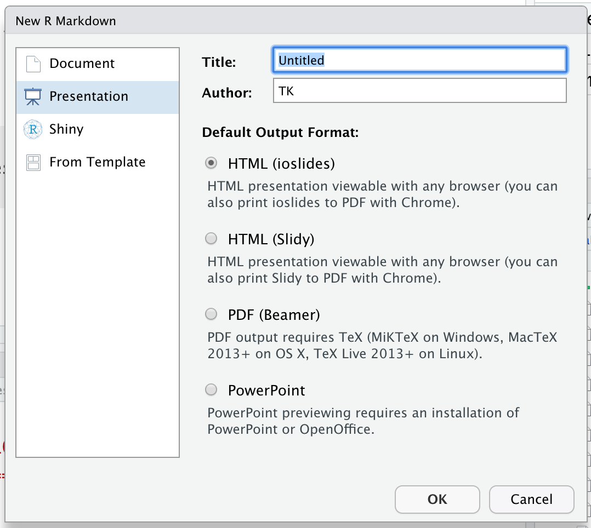
Making powerpoints
ZZ_example_pptx.Rmd
File
New File
New Markdown
Select Presentation
Select PowerPoint
https://support.rstudio.com/hc/en-us/articles/360004672913-Rendering-PowerPoint-Presentations-with-RStudio

Slide 7

Automating Reports w/FlexDashboard
But Dale, I need more interesting pictures. PowerPoint gives me a headache.
Use R Markdown to publish a group of related data visualizations as a dashboard.
Support for a wide variety of components including htmlwidgets; base, ggplot2
Flexible and easy to specify row and column-based layouts.

Slide 8
fine.
Let’s add some dynamic reporting!

Slide 9
Let’s practice!
F_flexdashboard.rmd

Slide 10

I don’t even work here, but this is exciting.
Yeah!
Pretty.
Go Diabetes Patients.
I knew Dale could do it.

