Slide 2
CONTENT
Introduction
Problem Statement
Approach
CNN Architecture
Training
Results
Improvements & Discussion

Slide 3
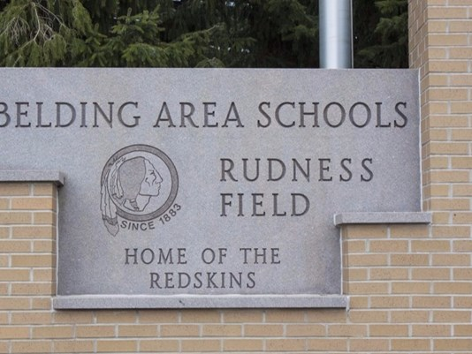
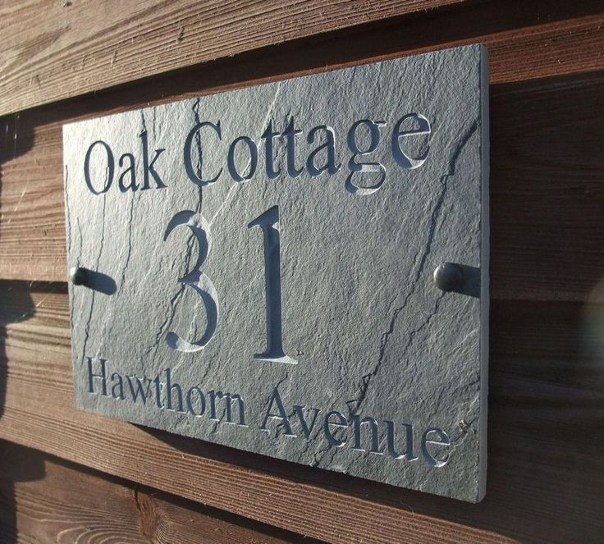
Introduction
The ability to automatically transcribe address from the images and find the location on maps

Slide 4
Some complexities associated multi character recognition:
Lighting
Shadows
Resolution
Orientation
Font size, range and colours ,etc.
Due to these complexities, we focus on recognizing the multi-digit numbers from street view images

Slide 5
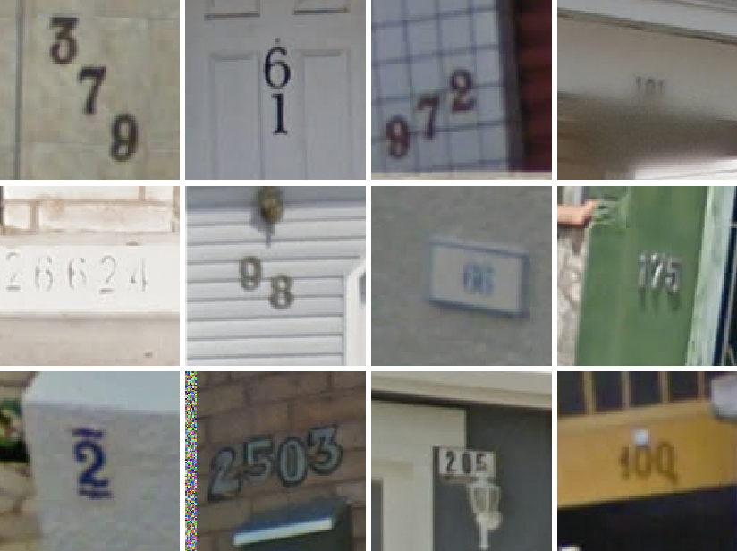

Problem Statement
Identifying the multi-digit number in the given street view image.
Digit sequence $S= s_{1},s_{2},...,s_{n}.$ , n = length of the sequence.
Accuracy: number of correctly predicted sequences
Assumption: length of the sequence is atmost 5

Slide 6

Approach
$P\left(S=s | X\right)=P\left(L=n | X\right)Π_{i=1}^{n}P(S_{i}=s_{i}|X)$
$S$ is a collection of $N$ random variables $S_{1},…,S_{N}$
$L$ = length of the sequence and can take 7 values (0,…,5, and “more than 5”), X is the input image
To train the model, we maximize $\log{P(S|X)}$ and back propagating using optimizers
Probability of each $S_{i}$and $L$ can be obtained by assigning softmax layer for each one.

Slide 7

CNN ARCHITECTURE
Architecture consists of
8 convolution layers with max pooling $[2×2]$ and normalization
Zero padding on the input to all convolution layers
One locally connected hidden layer of size ___
Two densely connected hidden layers of size ____
6 softmax layers for each $S_{i}$ and $L$

Slide 8
Tensorboard picture

Slide 9
training
Trained the model using _____ image data
Learning rate of ____ with Gradient descent optimizer
Used dropout of 0.2 after each layer

Slide 10
Results
Got validation accuracy of ___ with loss value ____
Loss curve

Slide 11

Improvements
Can be trained with optimal weights initialization by using standard deviation of $1/√N$ where $N$ is number of training samples
Number of training samples can be increased by using data augmentation techniques like translating, Gaussian noise, and slight roation etc.

