Slide 1
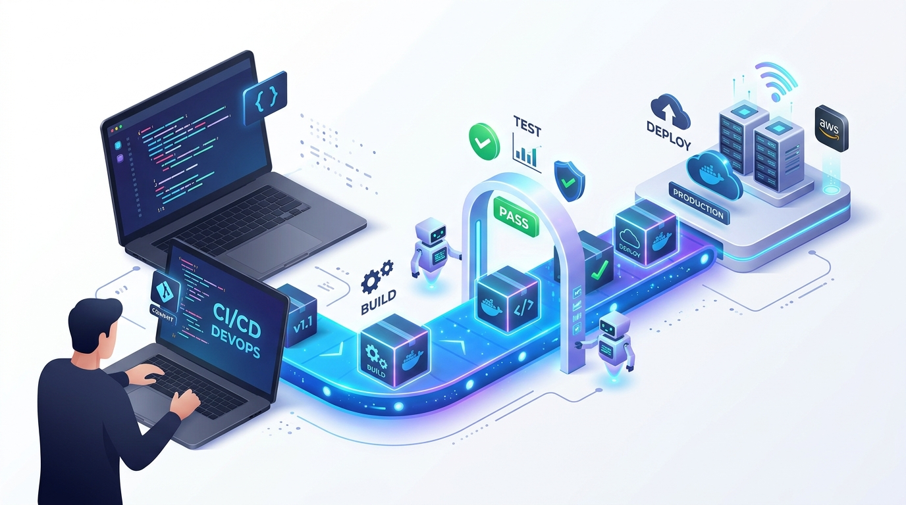
CI/CD: From Manual Software Delivery
A Complete 20-Slide Masterclass on Continuous Integration, Delivery, and GitHub Actions
COURSE CREATOR & INSTRUCTOR
AAJERA BANU S (She/Her)
AWS & Networking Trainer at LIVEWIRE Salem
Redis Certified Associate Cloud Operator
Ex-Cloud Engineer Intern at Codec Technologies India
DevOps & Cloud Enthusiast specializing in Docker containerization, Jenkins & GitHub Actions CI/CD pipelines, Terraform, and AWS ECS Fargate microservices.
DevOps CI/CD Conveyor: Git Commit -> Test -> Docker -> AWS
CI/CD Masterclass • Presented by Aajera Banu S (AWS & Networking Trainer at LIVEWIRE Salem) • Food Delivery Analogy

Slide 2
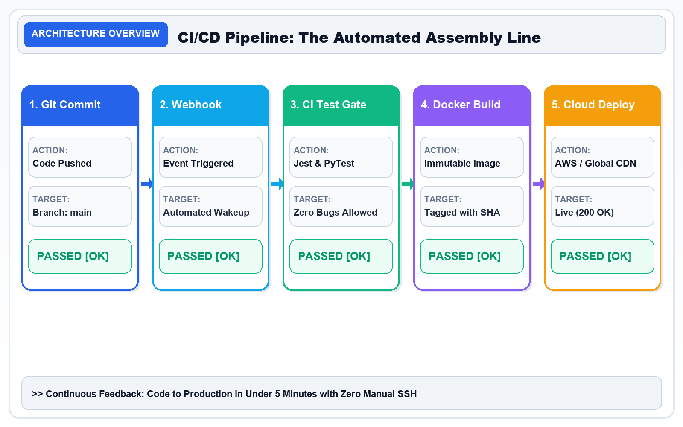
SLIDE 01 / 20 • FOUNDATIONS
Slide 1 — CI/CD: From Manual Work to Automated Software Delivery
Introduction to Continuous Integration and Continuous Delivery/Deployment
CORE CURRICULUM & PRINCIPLES
• Continuous Integration (CI): Developers merge code changes into the shared branch multiple times a day. Every commit triggers automated builds and tests, catching defects in < 10 minutes.
• Continuous Delivery (CDel): The application is continuously packaged and deployed to staging environments. Release to production is kept ready as a 1-click human business decision.
• Continuous Deployment (CDep): Every passing commit is automatically deployed directly to production cloud servers with zero human intervention.
• Business Impact: According to DORA (DevOps Research & Assessment), elite CI/CD teams deploy 208x more frequently and recover from downtime 2,604x faster.
Architecture Diagram: CI/CD Pipeline Flow: Code Commit ➔ Webhook Trigger ➔ Automated Tests ➔ Docker Package ➔ Live Cloud Deploy (200 OK).
KEY TAKEAWAY: CI/CD turns software delivery into a repeatable, automated process.

Slide 3
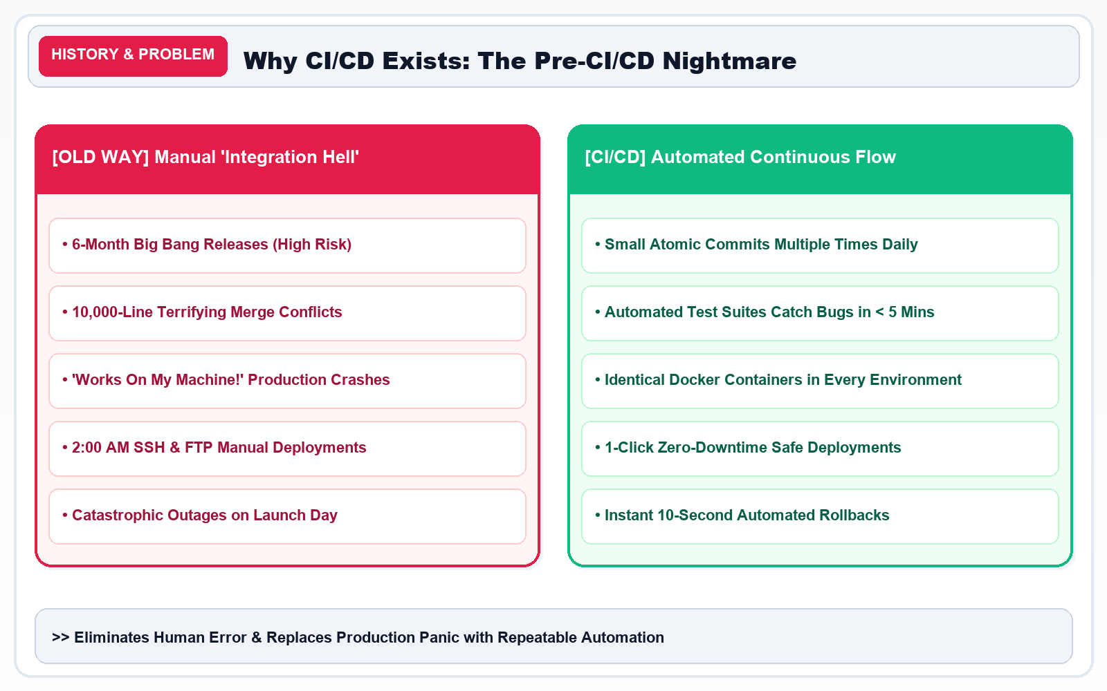
SLIDE 02 / 20 • THE PROBLEM
Slide 2 — Traditional Software Development: The Manual Era
What Happens Before CI/CD? The High-Risk Manual Delivery Process
CORE CURRICULUM & PRINCIPLES
• The 6-Month 'Big Bang' Release: Teams wrote code in isolated branches for months. Merging resulted in 'Integration Hell' with thousands of conflicting code lines.
• The 'Works on My Machine' Trap: A feature worked on the developer's MacBook, but immediately crashed on Linux production servers due to missing packages or different OS libraries.
• Late-Night Production Panic: Releases were scheduled at 2:00 AM on weekends. Engineers manually ran SSH commands and SQL scripts, leading to multi-hour downtime.
Architecture Diagram: Manual Delivery 'Integration Hell' vs. Automated CI/CD Continuous Flow Comparison.
KEY TAKEAWAY: Manual delivery can work for small hobby projects, but becomes unmanageable as applications and teams scale.

Slide 4
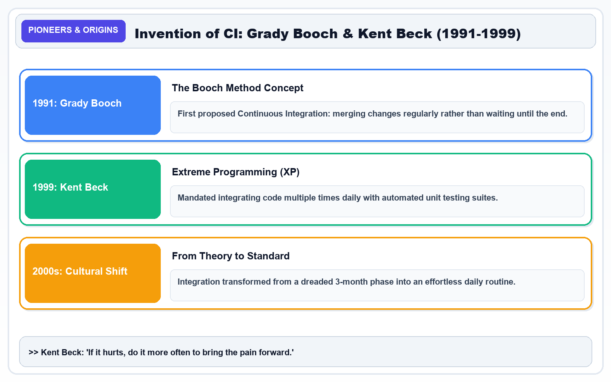
SLIDE 03 / 20 • HISTORY & ORIGINS
Slide 3 — The History and Evolution of CI/CD
Who Introduced CI/CD? A Decades-Long Evolution of Engineering Practices
CORE CURRICULUM & PRINCIPLES
* 1990s — Continuous Integration Emerges: Kent Beck established Continuous Integration as a core practice of Extreme Programming (XP), mandating daily code merges.
* 2000 — CI Documented & Codified: Martin Fowler and Matthew Foemmel published seminal papers describing practical automated build-and-test workflows.
* 2001+ — First Automated CI Tools: ThoughtWorks engineers created CruiseControl, the first open-source daemon automating scheduled builds and test runs.
* 2010s — Continuous Delivery Book: Jez Humble and David Farley published 'Continuous Delivery', extending automation from code compilation to cloud production releases.
* Modern — Cloud-Native CI/CD Mainstream: Jenkins, GitLab CI, and GitHub Actions bring native, serverless workflow automation to millions of developers worldwide.
Architecture Diagram: Historical Evolution: Grady Booch (1991), Kent Beck XP (1999) to Modern CI/CD.
KEY TAKEAWAY: CI/CD is an evolution of collaborative engineering practices, not an invention attributable to one individual.

Slide 5
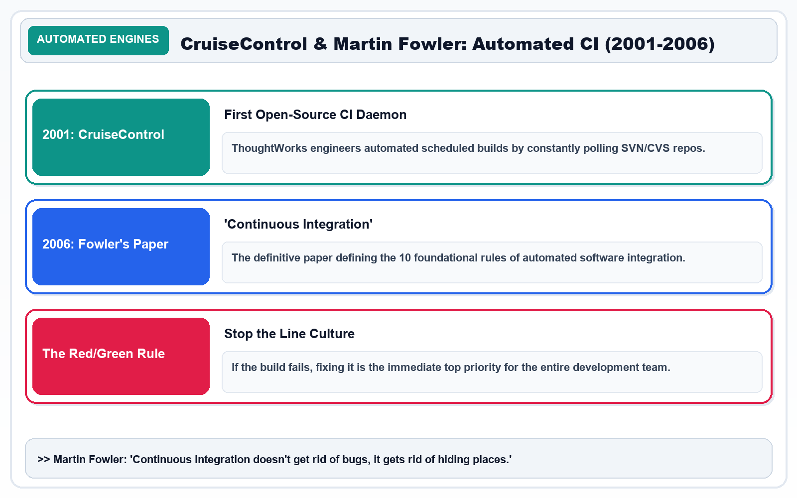
SLIDE 04 / 20 • TRANSFORMATION
Slide 4 — From Manual Releases to Automated Delivery
What Changed After CI/CD? The Paradigm Shift in Velocity & Reliability
CORE CURRICULUM & PRINCIPLES
• Build Phase: Automated clean build triggered on code push
• Testing: Instant automated test suites run on every commit
• Deployment: Automated zero-downtime pipeline deployment
• Bug Detection: Detected within minutes; build fails immediately
• Team Stress: Routine, predictable, non-event daytime releases
Architecture Diagram: Before vs. After Transformation: Shifting from 6-month manual release panic to automated daily non-event deployments.
KEY TAKEAWAY: CI/CD reduces repetitive manual friction, allowing teams to ship higher-quality software with complete confidence.

Slide 6
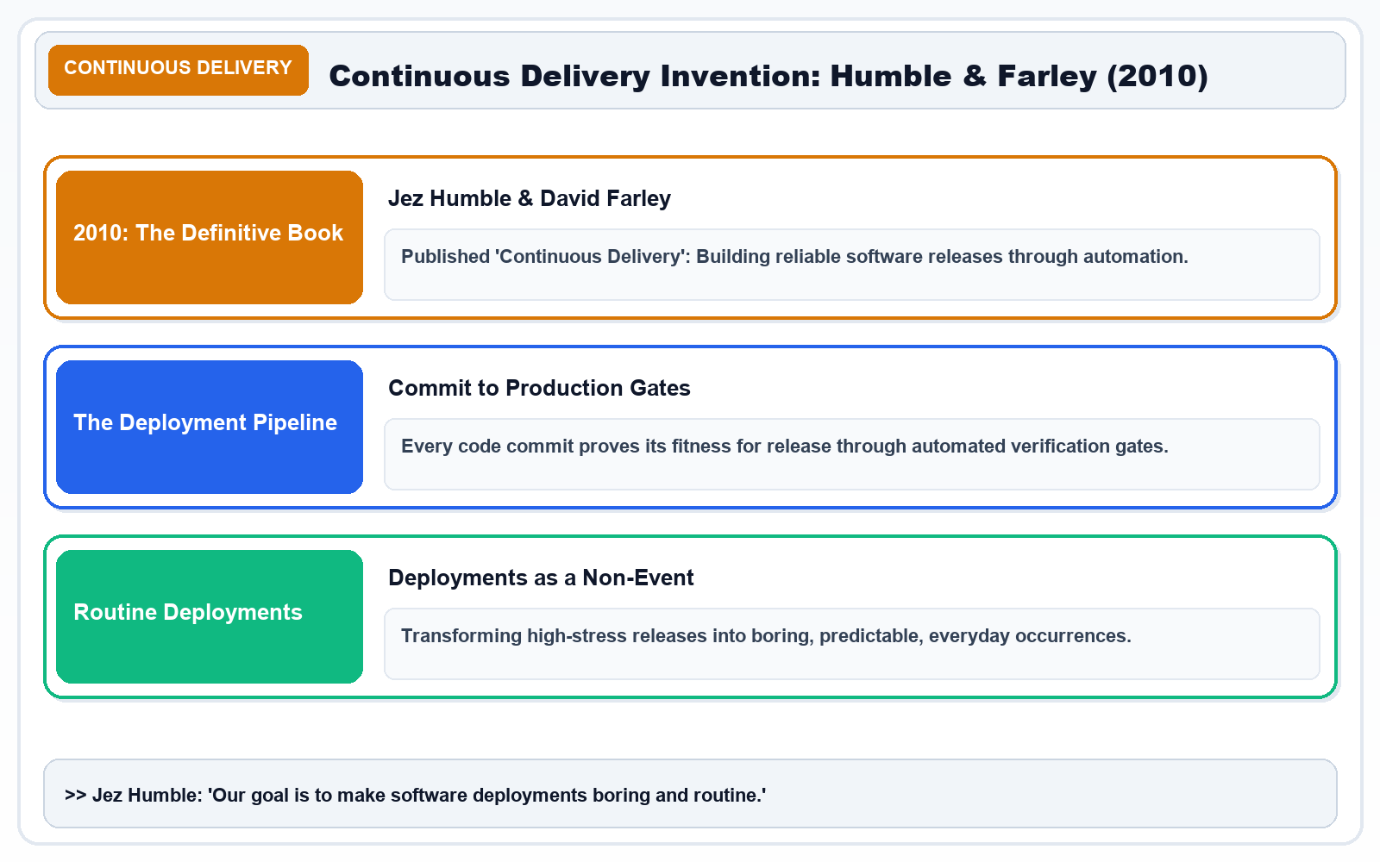
SLIDE 05 / 20 • CORE CONCEPTS
Slide 5 — Understanding CI, Continuous Delivery, and Continuous Deployment
What Is CI/CD? Dissecting the Three Core Stages of the Pipeline
CORE CURRICULUM & PRINCIPLES
• Continuous Integration (CI): Developers regularly merge code into a shared repository. Every commit automatically triggers clean builds, linters, and unit test suites to detect regressions early.
• Continuous Delivery (CD): After passing all automated checks and staging dry-runs, the software artifact is packaged and ready to deploy. Release to production requires a 1-click human approval.
• Continuous Deployment (CD): Every qualifying change that passes all automated test gates is deployed directly to production cloud servers with zero human intervention.
Architecture Diagram: CI, Continuous Delivery, and Continuous Deployment: Validating, Packaging, and Autonomous Cloud Rollout.
KEY TAKEAWAY: CI validates changes; Continuous Delivery prepares software for release; Continuous Deployment puts it into production automatically.

Slide 7
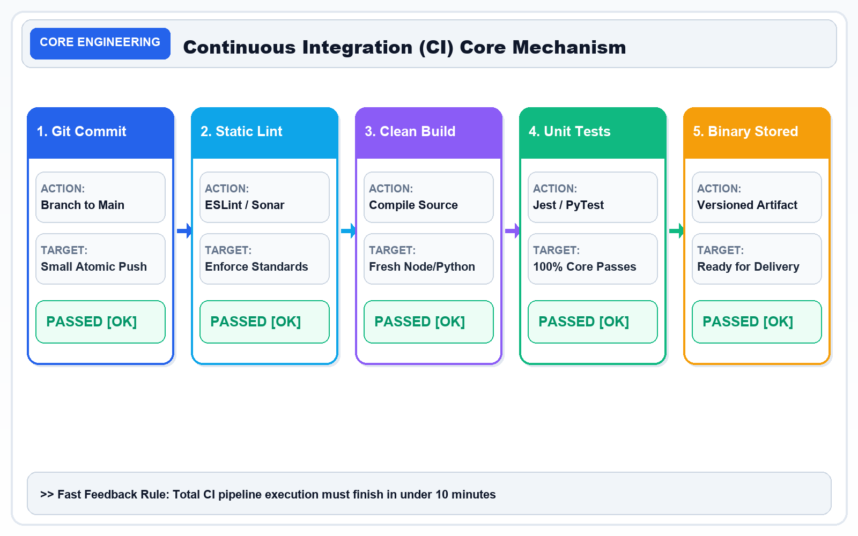
SLIDE 06 / 20 • VERSION CONTROL
Slide 6 — Git: Tracking Every Change in the Code
What Is Git? The Distributed Foundation of Version Control
CORE CURRICULUM & PRINCIPLES
• Git is a distributed version control system that records changes to files over time.
• It enables multiple software engineers to work concurrently on the same codebase without overwriting each other's work.
• Every developer has a full, cryptographic copy of the repository history locally on their machine.
Architecture Diagram: Git Version Control: Cryptographic snapshot commits, lightweight branching, and mainline collaboration.
KEY TAKEAWAY: Git manages code history and team collaboration. It is the necessary starting point for CI/CD.

Slide 8
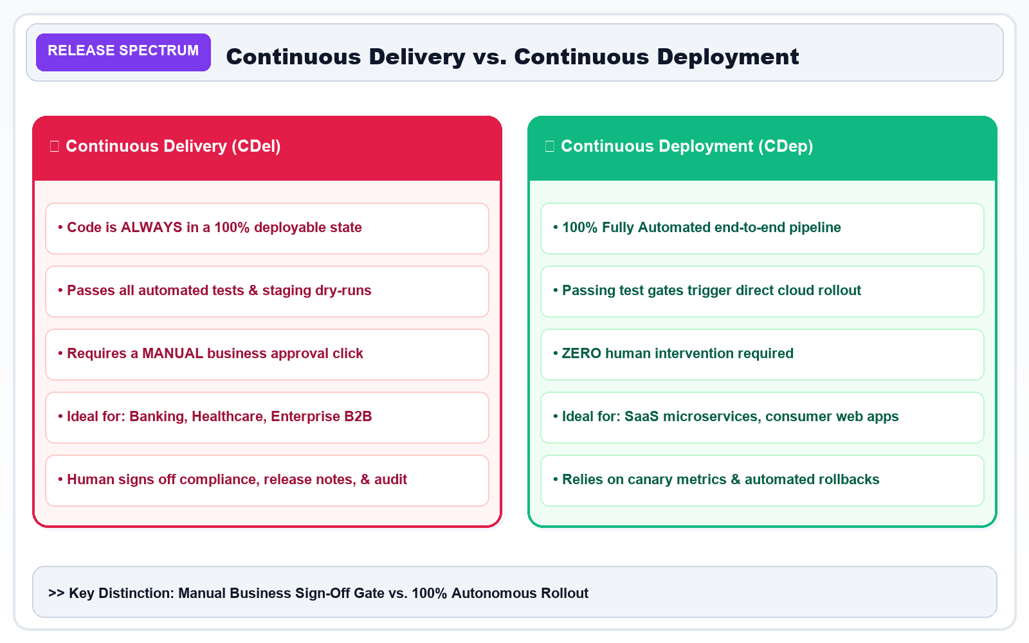
SLIDE 07 / 20 • PLATFORMS
Slide 7 — GitHub: A Central Place for Code and Collaboration
What Is GitHub? The Cloud Collaboration Platform for Modern Teams
CORE CURRICULUM & PRINCIPLES
• GitHub is a cloud-based hosting platform for Git repositories, serving over 100 million developers globally.
• It provides the centralized remote hub where distributed teams store code, discuss features, and automate workflows.
Architecture Diagram: Git vs. GitHub Comparison: Distributed Local Revision Control vs. Central Collaboration & CI/CD Hub.
KEY TAKEAWAY: Git manages versions locally; GitHub hosts repositories centrally and connects code directly to automation engines.

Slide 9
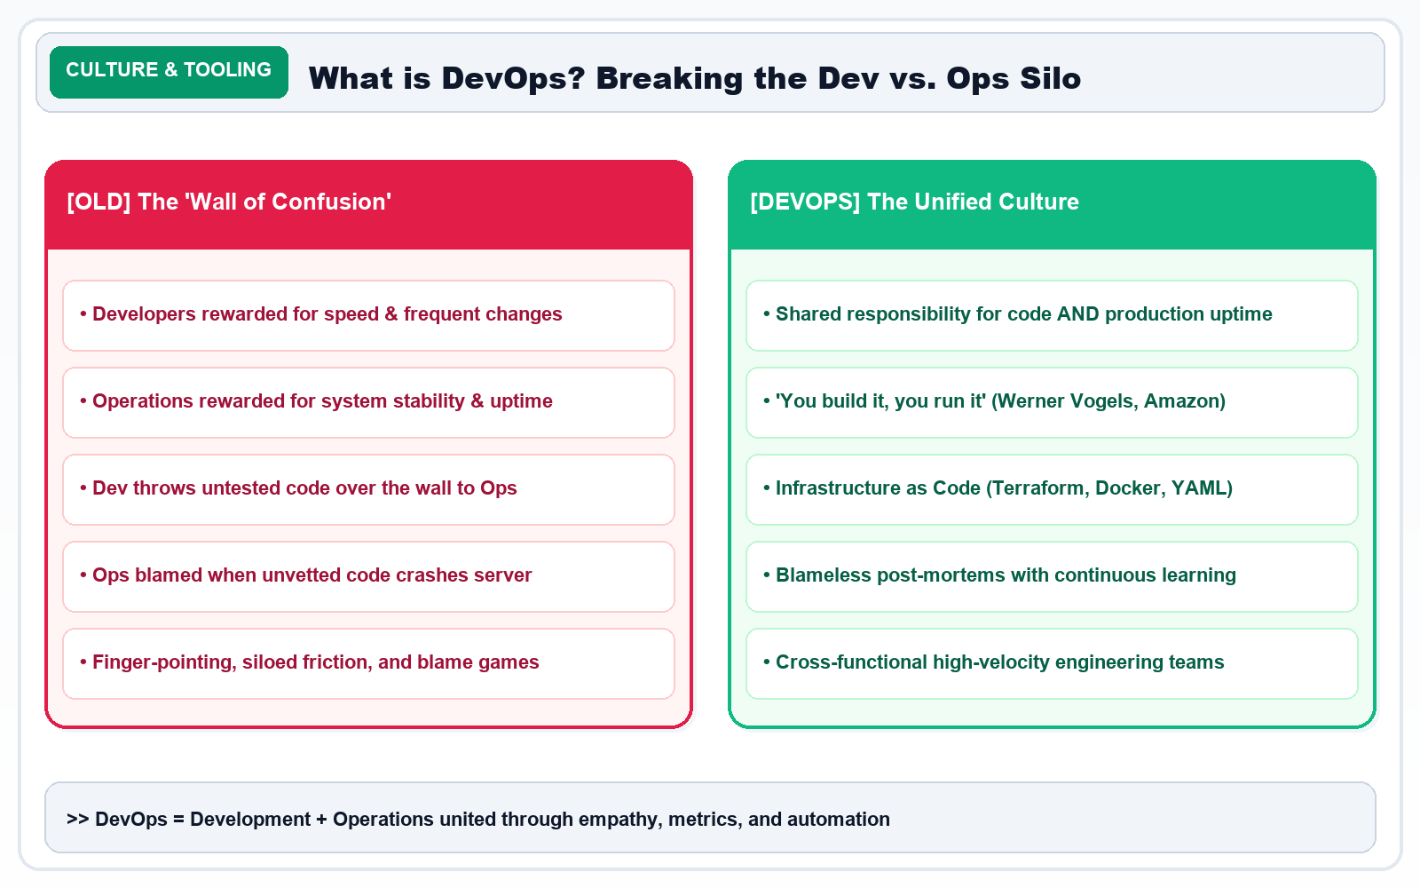
SLIDE 08 / 20 • ECOSYSTEM
Slide 8 — CI/CD Tool Ecosystem: Specialized Tools for Every Stage
What Tools Are Used for CI/CD? Combining Specialized Tools into One Pipeline
CORE CURRICULUM & PRINCIPLES
Architecture Diagram: CI/CD Tool Ecosystem: Specialized tools coordinated across Version Control, CI, Docker, AWS, and Monitoring.
KEY TAKEAWAY: CI/CD is a coordinated process combining specialized tools across the entire software delivery lifecycle.

Slide 10
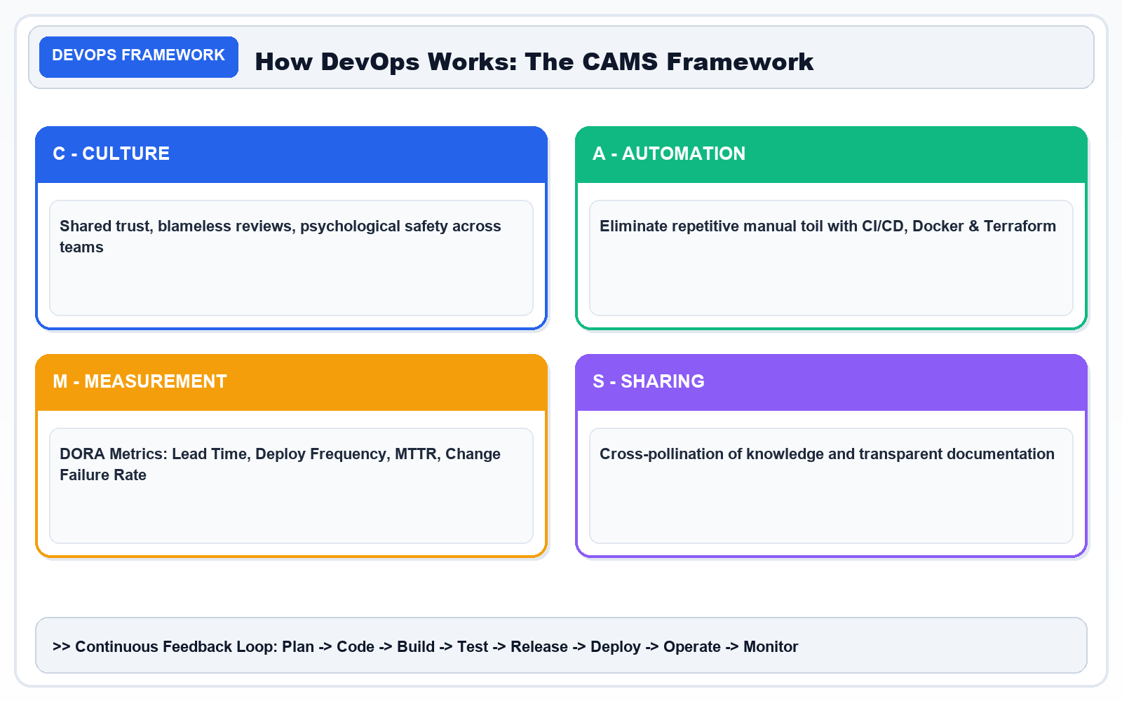
SLIDE 09 / 20 • GITHUB ACTIONS
Slide 9 — Why Choose GitHub Actions for Our CI/CD Project?
The Practical Advantage of Native, Serverless Repository Automation
CORE CURRICULUM & PRINCIPLES
Architecture Diagram: Why GitHub Actions: Native Repo Integration, Ephemeral Runners, Marketplace Actions & Zero Infra Maintenance.
KEY TAKEAWAY: GitHub Actions is the ideal platform because it eliminates infrastructure overhead by bringing code, review, and automation together.

Slide 11
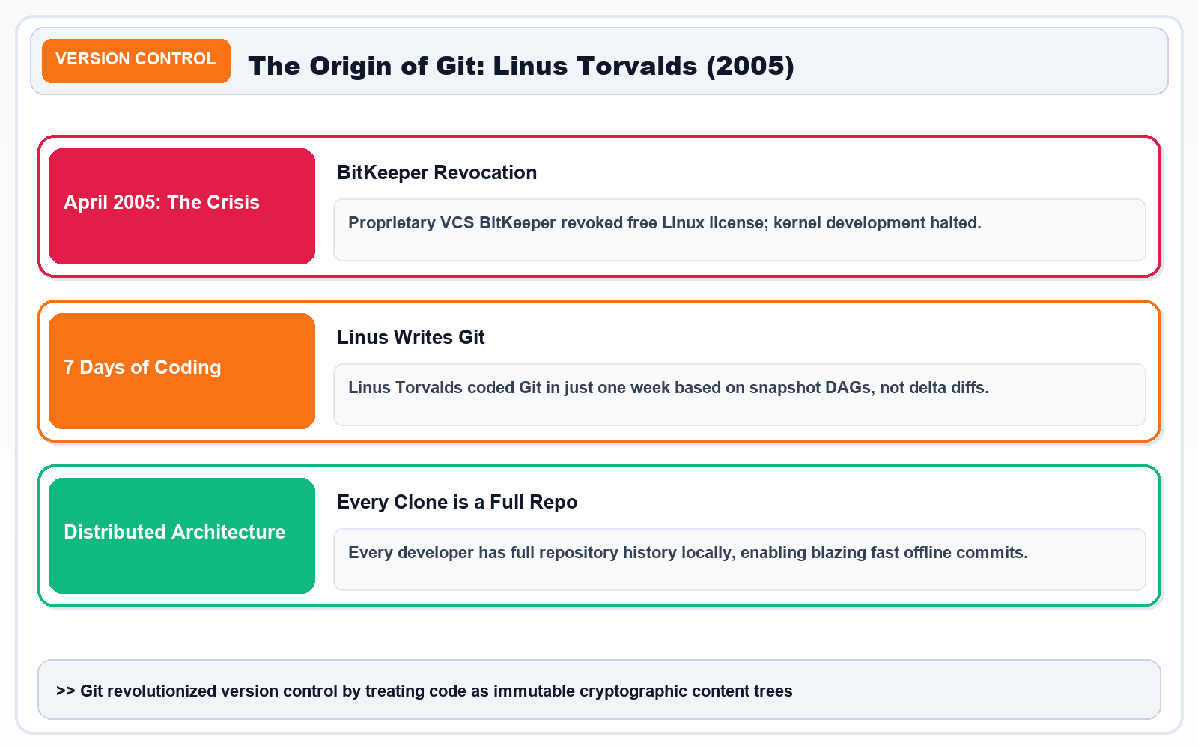
SLIDE 10 / 20 • GITHUB ACTIONS
Slide 10 — GitHub Actions: The Automation Engine
What Is GitHub Actions? The Core Architecture & Key Components
CORE CURRICULUM & PRINCIPLES
• GitHub Actions is an event-driven automation platform built directly into GitHub.
• Workflows are declared in YAML files stored inside the `.github/workflows/` directory of the repository.
• When a developer pushes code, GitHub automatically detects the event, spins up a fresh runner, executes jobs, and reports results.
Architecture Diagram: GitHub Actions Architecture: Event Triggers ➔ Ephemeral Runner VMs ➔ Parallel Jobs ➔ Sequential Step Execution.
KEY TAKEAWAY: GitHub Actions executes the automation rules you define in YAML using ephemeral, secure cloud runners.

Slide 12
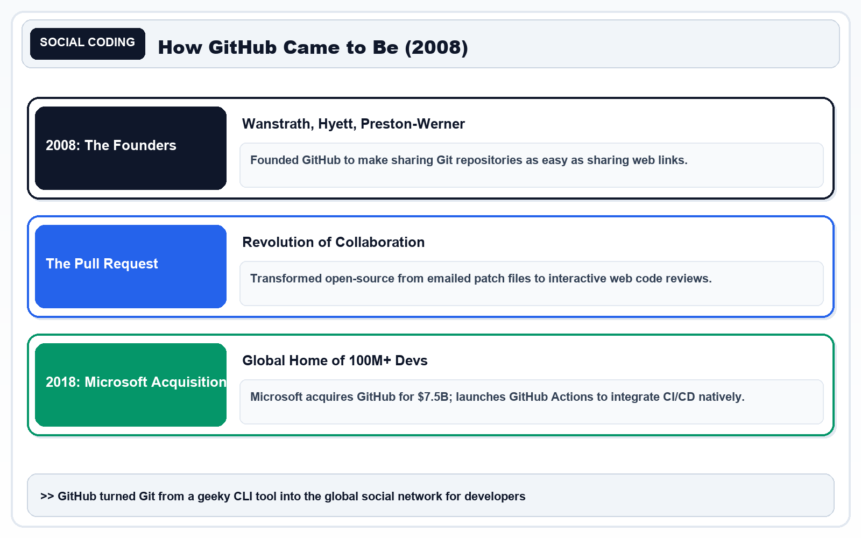
SLIDE 11 / 20 • EXECUTION LIFECYCLE
Slide 11 — How Does GitHub Actions Work? From Code Push to Execution
Step-by-Step Lifecycle: What Happens When a Developer Commits Code
CORE CURRICULUM & PRINCIPLES
Architecture Diagram: GitHub Actions Lifecycle: Event Trigger ➔ Runner Spin-Up ➔ Checkout ➔ Test Execution ➔ Status Report.
KEY TAKEAWAY: A trigger starts the workflow; the runner executes its jobs and steps in an isolated, clean sandbox.

Slide 13
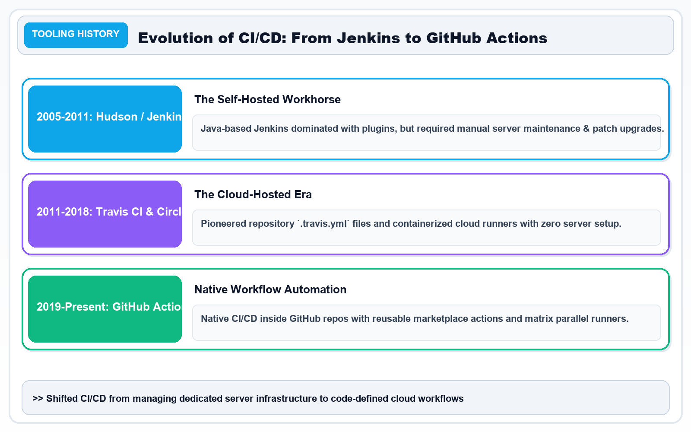
SLIDE 12 / 20 • WORKFLOW SYNTAX
Slide 12 — Understanding the GitHub Actions Workflow File
Our First CI/CD Workflow: Deconstructing the YAML Syntax Line by Line
CORE CURRICULUM & PRINCIPLES
Architecture Diagram: GitHub Actions YAML Anatomy: Events, Permissions, Jobs, Ephemeral Runners & Sequential Steps.
KEY TAKEAWAY: YAML configuration files are human-readable blueprints that tell cloud runners exactly how to build and verify your software.

Slide 14
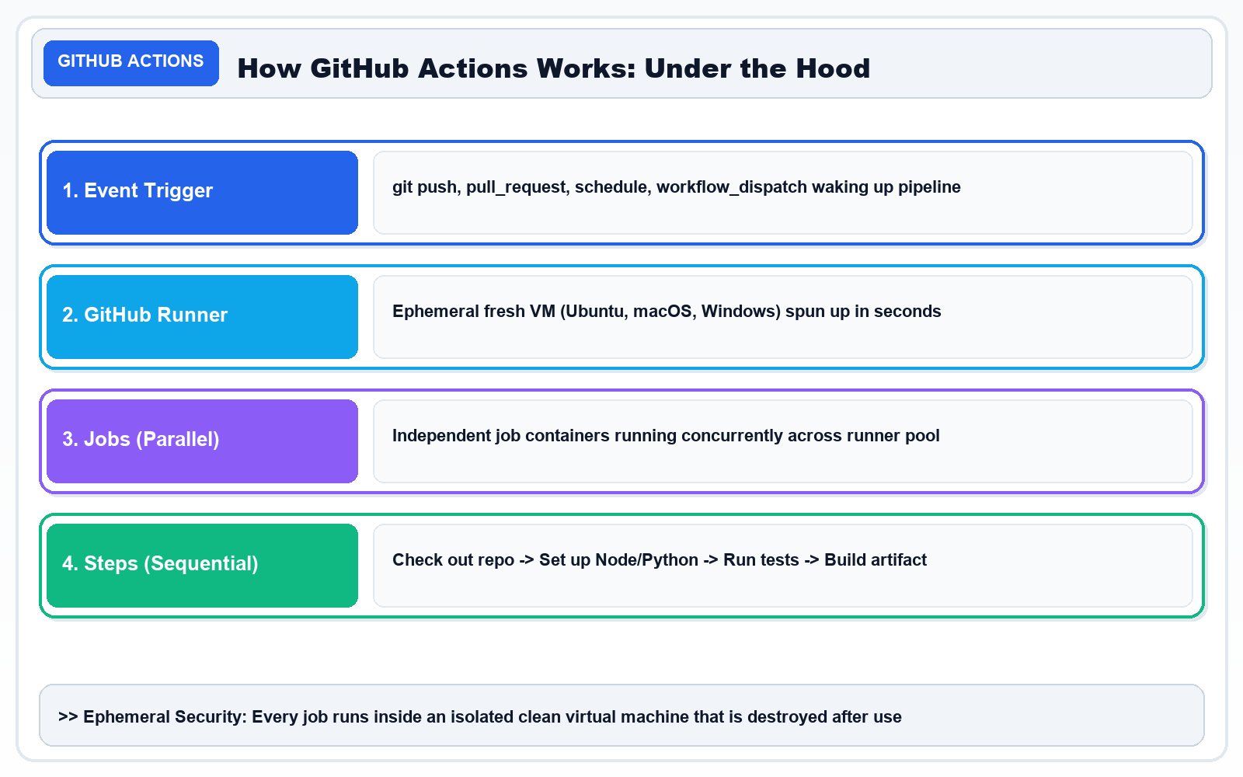
SLIDE 13 / 20 • CI PIPELINE
Slide 13 — What Happens When We Push Code? The Complete CI Pipeline
Tracing a Real Code Change: Rapid Feedback Loops & Defect Prevention
CORE CURRICULUM & PRINCIPLES
Architecture Diagram: Real Code Push Tracing: Push Event ➔ Fast Feedback Loop ➔ Automated Guardrails Block Defective Code.
KEY TAKEAWAY: CI gives developers rapid feedback within minutes, stopping broken code before it progresses toward production.

Slide 15
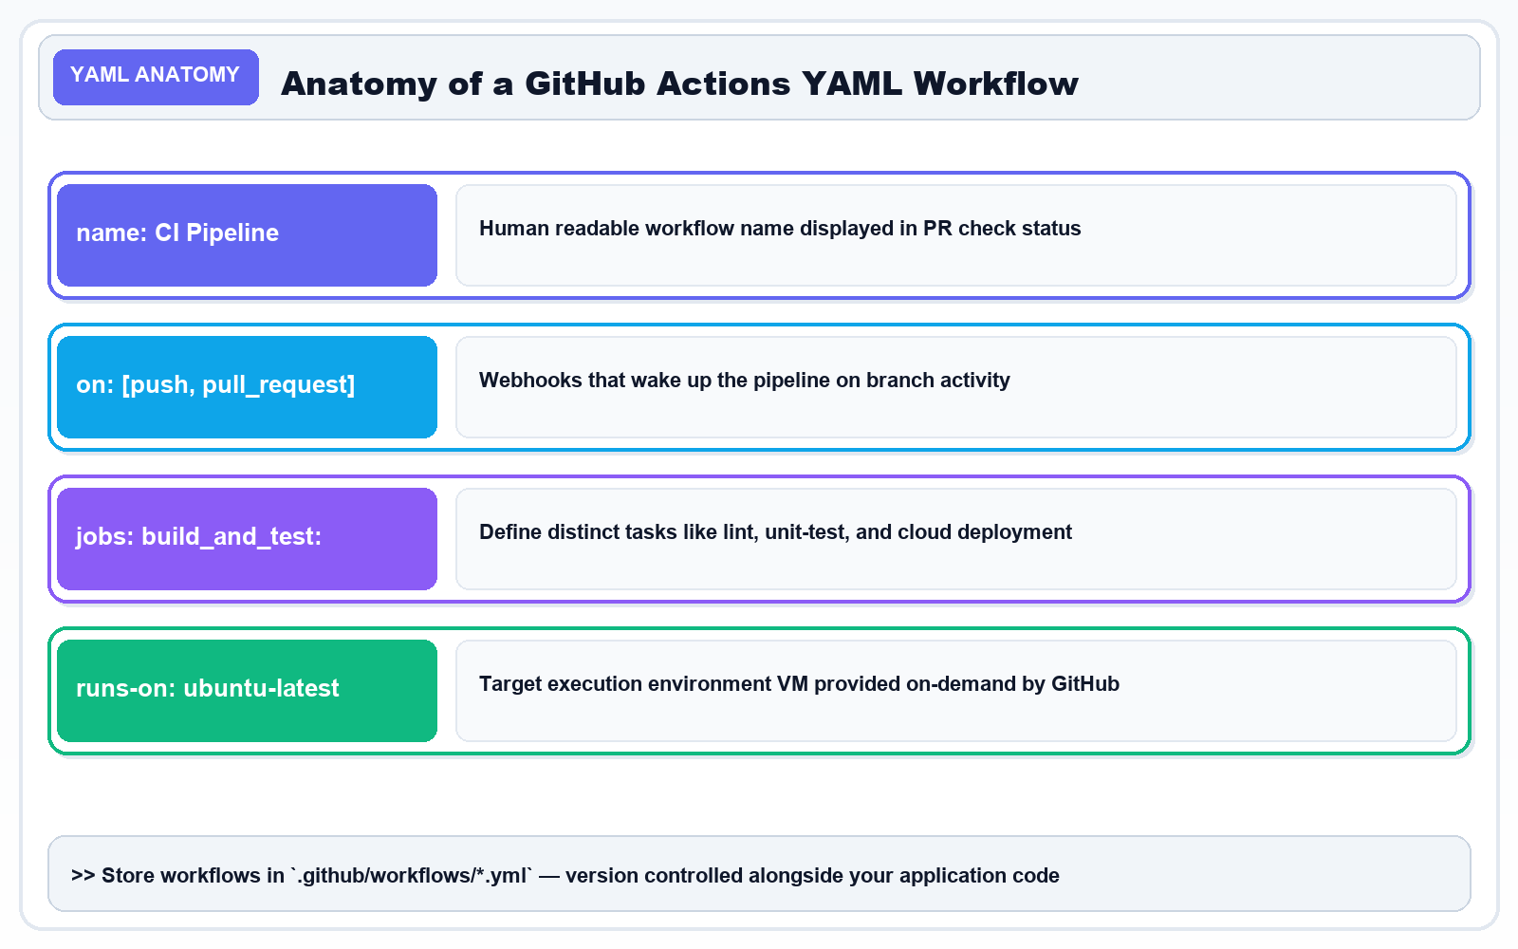
SLIDE 14 / 20 • PIPELINE STAGES
Slide 14 — The Four Major Stages of Delivery: Build, Test, Package, Deploy
The Universal Pipeline Progression from Source Code to Production
CORE CURRICULUM & PRINCIPLES
Architecture Diagram: The 4 Major Delivery Stages: 1. Build (Cook) ➔ 2. Test (Inspect) ➔ 3. Package (Bento Box) ➔ 4. Deploy (Deliver).
KEY TAKEAWAY: A reliable CI/CD pipeline enforces progressive trust: Build ➔ Test ➔ Package ➔ Deploy.

Slide 16
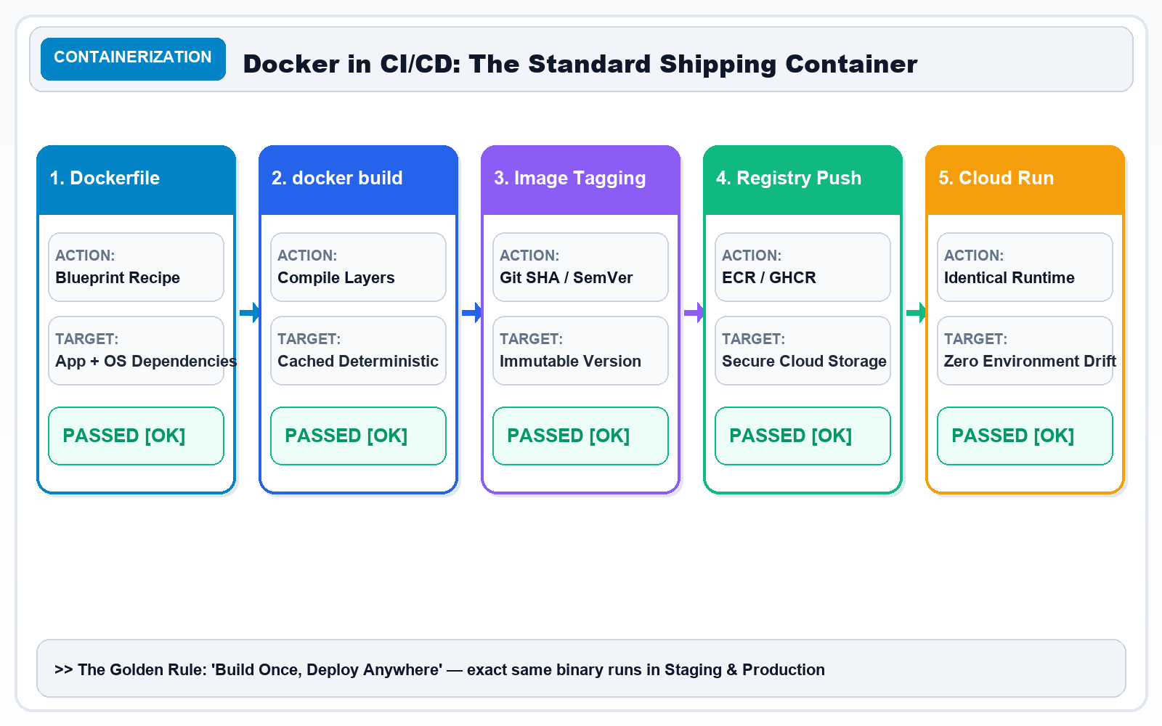
SLIDE 15 / 20 • CONTAINERIZATION
Slide 15 — Docker and Container Images: Packaging Our Application
Curing 'Works on My Machine' by Standardizing the Packaging Layer
CORE CURRICULUM & PRINCIPLES
• Docker packages an application, its runtime dependencies, libraries, and system tools into an immutable container image.
• This eliminates the infamous 'Works on my machine' bug: if a container runs on your laptop, it runs identically on staging and production.
Architecture Diagram: Docker Containerization: Packaging code, libraries, and OS into standardized immutable images.
KEY TAKEAWAY: Docker creates immutable, portable packages; cloud platforms provide the infrastructure to run them.

Slide 17
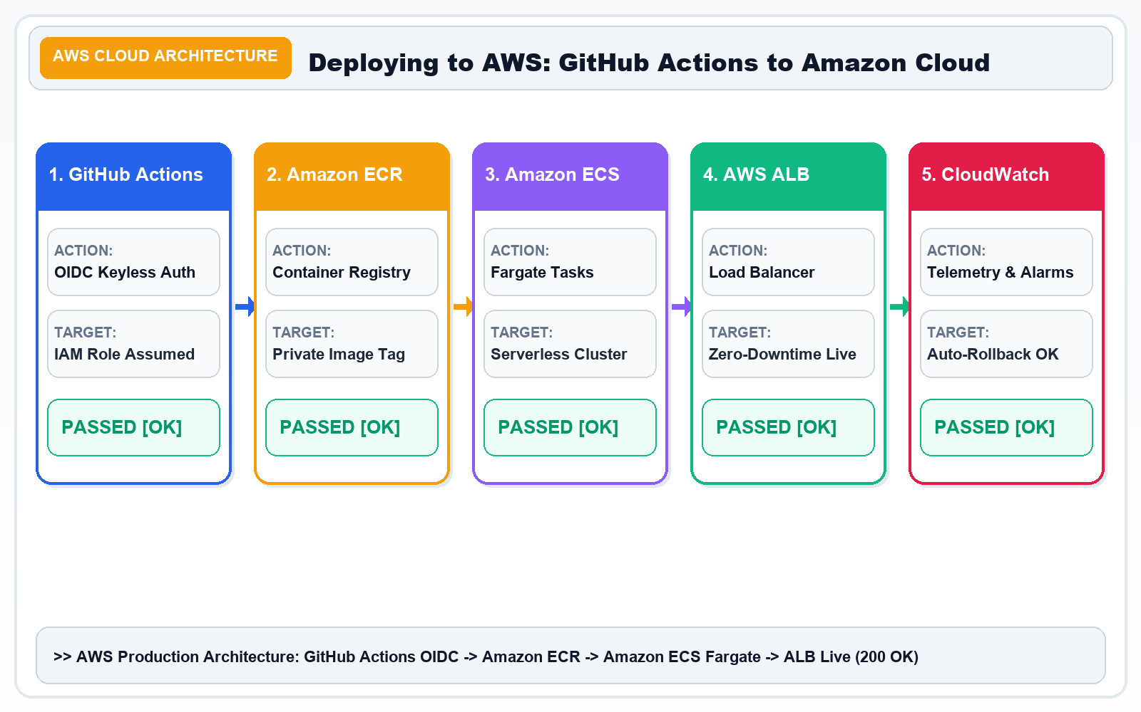
SLIDE 16 / 20 • CLOUD DEPLOYMENT
Slide 16 — Deploying to AWS: From GitHub Actions to the Cloud
Publishing Container Images to Amazon ECR and Running on Amazon ECS
CORE CURRICULUM & PRINCIPLES
• AWS Cloud Infrastructure: Provides high-availability compute, container orchestration, and automated auto-scaling for modern microservices.
• Keyless OIDC Authentication: GitHub Actions assumes an IAM Role via OpenID Connect (OIDC), eliminating the dangerous need for stored static access keys.
• Amazon ECR (Elastic Container Registry): Private, encrypted Docker image registry that automatically scans every container image for CVE vulnerabilities on push.
• Amazon ECS (Elastic Container Service): Serverless container orchestration using AWS Fargate that launches and manages tasks without managing EC2 servers.
• Application Load Balancer (ALB): Distributes traffic across multi-AZ container tasks, conducts continuous /health checks, and shifts traffic with zero downtime.
Architecture Diagram: AWS Cloud Architecture: GitHub Actions OIDC ➔ Amazon ECR Registry ➔ Amazon ECS Fargate ➔ ALB Load Balancer (200 OK).
KEY TAKEAWAY: GitHub Actions automates the deployment process; cloud providers supply the scalable hosting infrastructure.

Slide 18
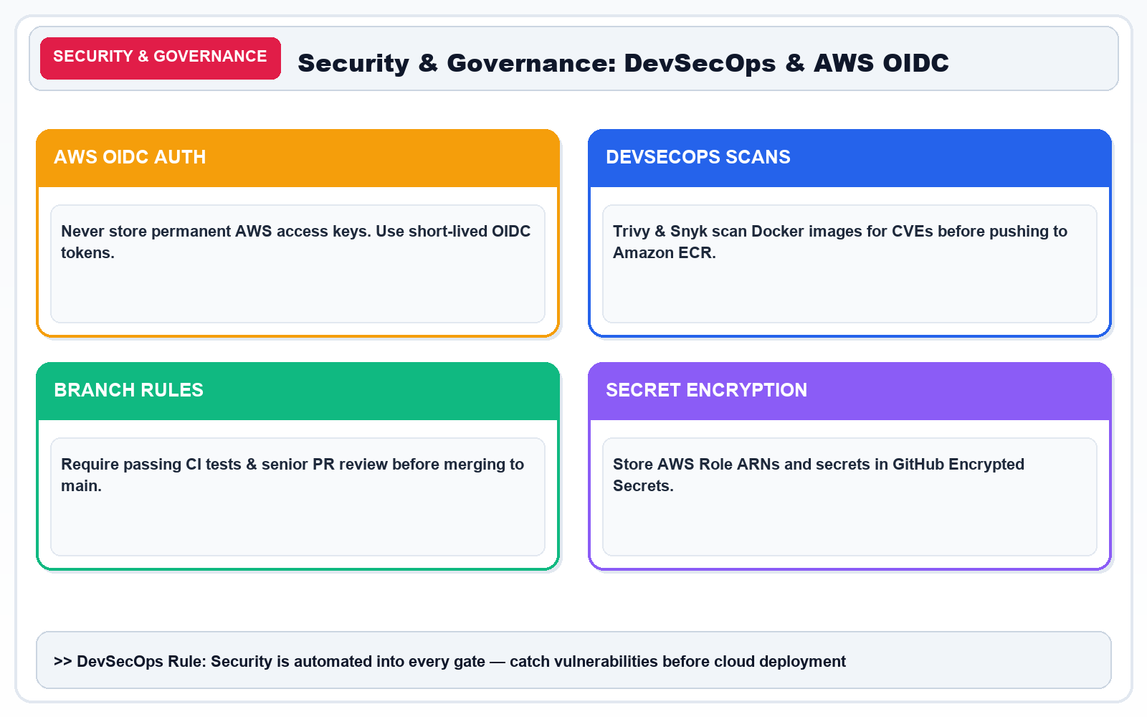
SLIDE 17 / 20 • SECURITY & GOVERNANCE
Slide 17 — Security and Approval in CI/CD: Automate Safely, Not Just Quickly
DevSecOps: Principle of Least Privilege, Secret Protection, and Release Gates
CORE CURRICULUM & PRINCIPLES
Architecture Diagram: DevSecOps & AWS OIDC Security: Least-Privilege, Ephemeral Tokens, and Automated Container Scans.
KEY TAKEAWAY: Automate safely, not just quickly. Security checks and approval gates protect production from catastrophic leaks.

Slide 19
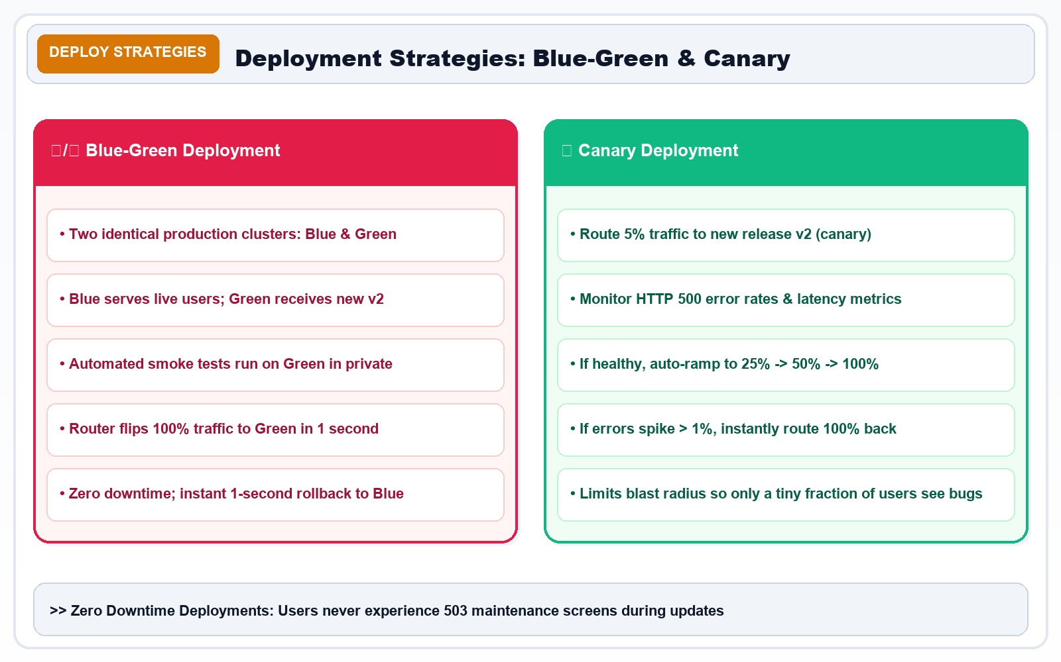
SLIDE 18 / 20 • RESILIENCE & SRE
Slide 18 — Failure Handling, Monitoring, and Rollback
What Happens When a Pipeline Fails? Embracing Failure Systematically
CORE CURRICULUM & PRINCIPLES
Architecture Diagram: Deployment Strategies: Blue-Green Instant Cutover vs. Canary Progressive Traffic Shifting.
KEY TAKEAWAY: A reliable pipeline detects failures instantly, stops unsafe rollouts, and supports rapid recovery.

Slide 20
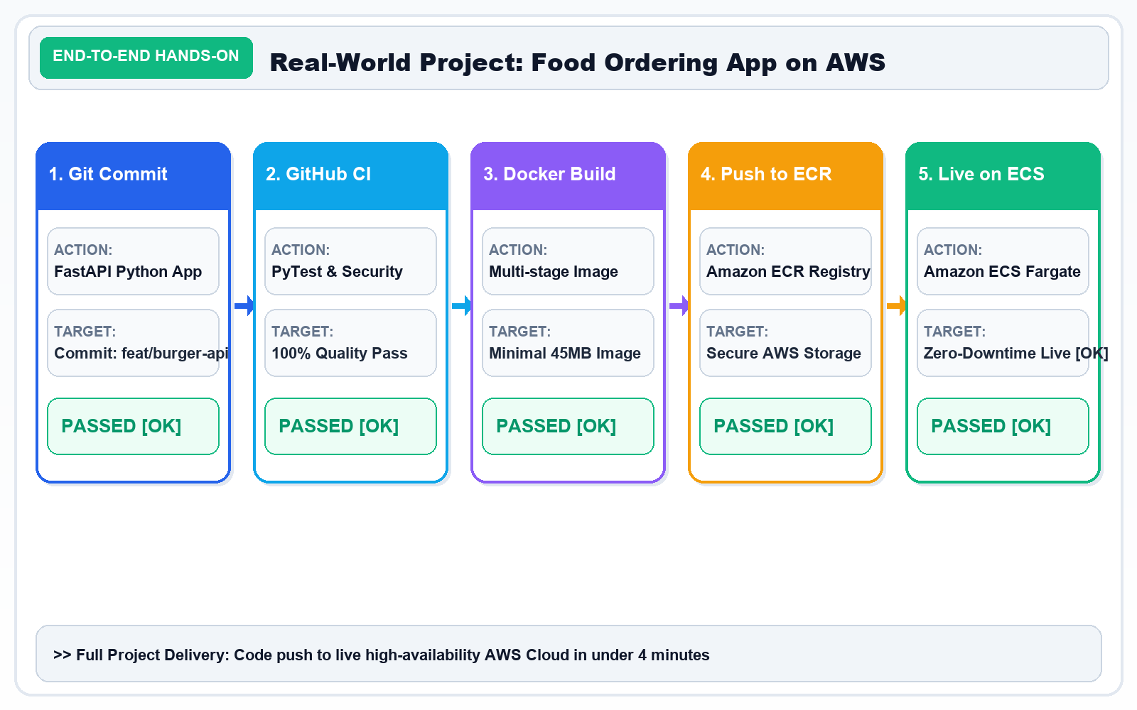
SLIDE 19 / 20 • HANDS-ON ARCHITECTURE
Slide 19 — Real-World Project: Automated Food Ordering Application
Build Your First End-to-End CI/CD Pipeline on GitHub Actions, Docker & AWS
CORE CURRICULUM & PRINCIPLES
• End-to-End Real World Pipeline: From Git commit to live production cloud on AWS in under 4 minutes.
• Automated CI Gates: Code linting, type-checking, and 80%+ test coverage enforced before any container image is compiled.
• Immutable Packaging: Docker multi-stage build creates a tiny, secure container image pushed directly to Amazon ECR.
• Zero-Downtime Deployment: Amazon ECS rolls out new tasks using rolling updates or blue-green switching via the Application Load Balancer.
• SRE Telemetry & Observability: AWS CloudWatch tracks latency and 5xx error rates, triggering automated rollbacks if any defects emerge.
Architecture Diagram: End-to-End Real-World Project: Automated Food Ordering App pipeline running on GitHub Actions, Docker, and AWS.
KEY TAKEAWAY: This end-to-end project combines code, CI/CD, containers, AWS cloud infrastructure, and monitoring into a complete production system.

Slide 21
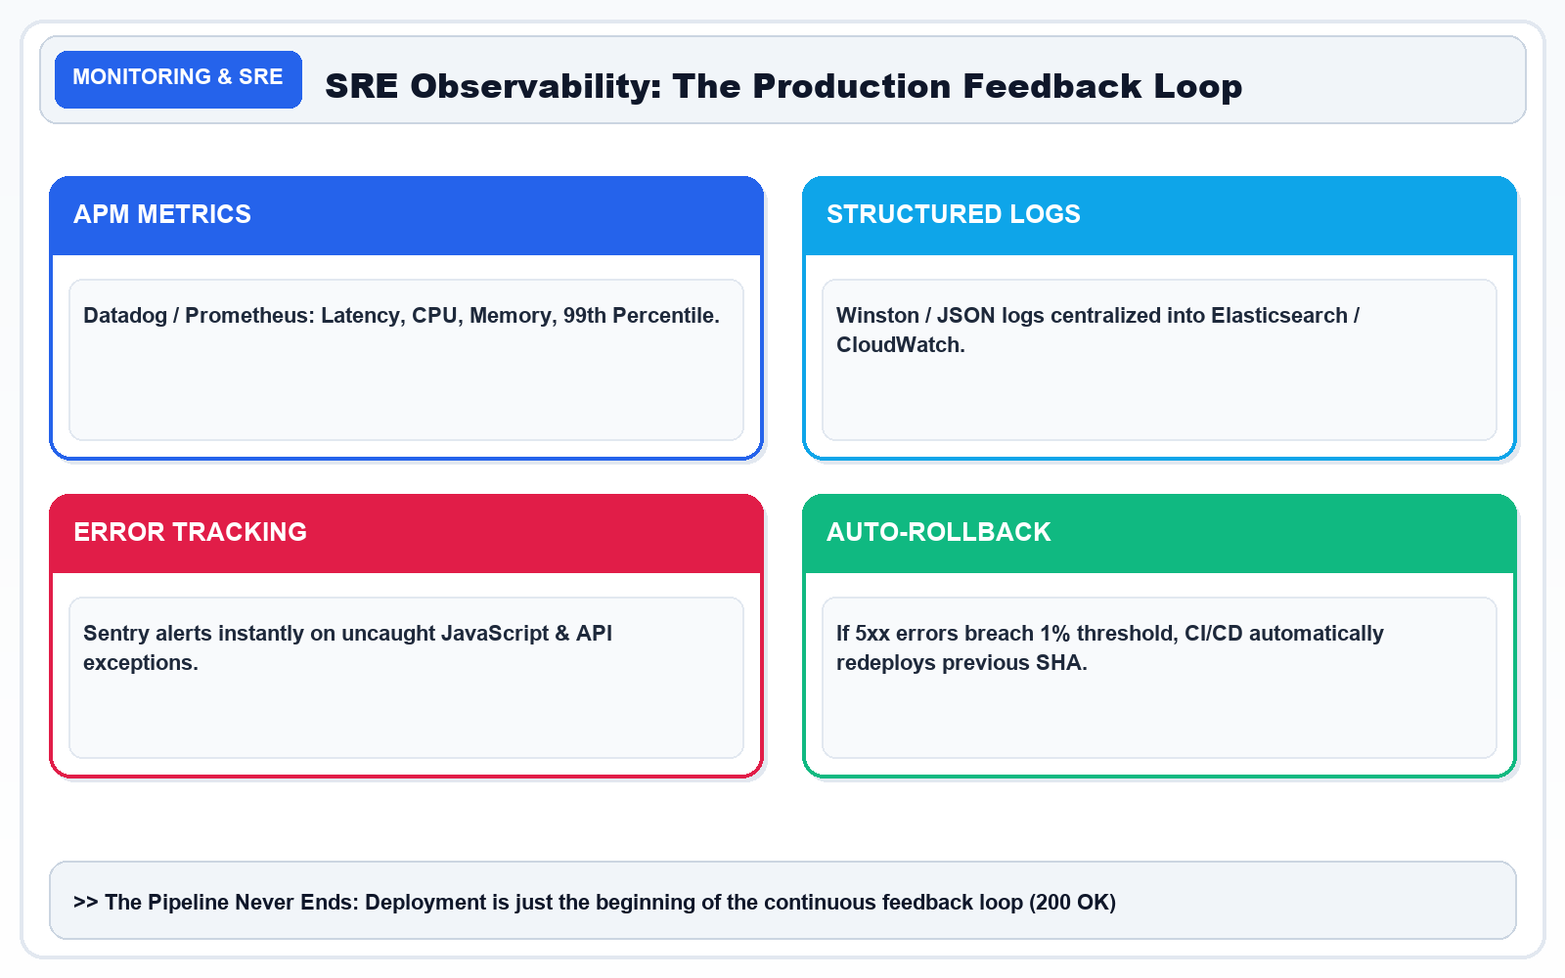
SLIDE 20 / 20 • MASTERY & SUMMARY
Slide 20 — From Beginner to CI/CD Practitioner: One Code Push, Automated Delivery
Final Summary & Next Steps: Mastering the Continuous Delivery Mindset
CORE CURRICULUM & PRINCIPLES
Architecture Diagram: Mastery Summary: The Complete DevOps & CI/CD Conveyor Belt from Git Commit to Production Monitoring.
KEY TAKEAWAY: Mastering CI/CD transforms you into a high-impact engineer capable of delivering reliable software at scale.

