Slide 1
DEVOPS & CLOUD ARCHITECTURE MASTERCLASS
Software Deployment Masterclass: Manual vs. Automated CI/CD
From High-Risk 2:00 AM Manual FTP/SSH Scripts to Zero-Downtime Automated Kubernetes & GitOps Delivery
INSTRUCTOR & INDUSTRY TRACK RECORD
Kerthik — Project Manager & Cloud DevOps Architect
• [Current Leadership Role] Project Manager at TNQ: Directing enterprise software delivery, high-velocity engineering roadmaps, and agile release velocity.
• [Founder & Architecture] Building OrivianLabs: Empowering software engineers with production DevOps, Kubernetes, and AWS Cloud Systems Fellowships.
• [DevOps Roots] Ex-DevOps Engineer at SentinelFox: Architected high-availability CI/CD pipelines, Dockerized microservices, and zero-downtime cloud infrastructure.

Slide 2
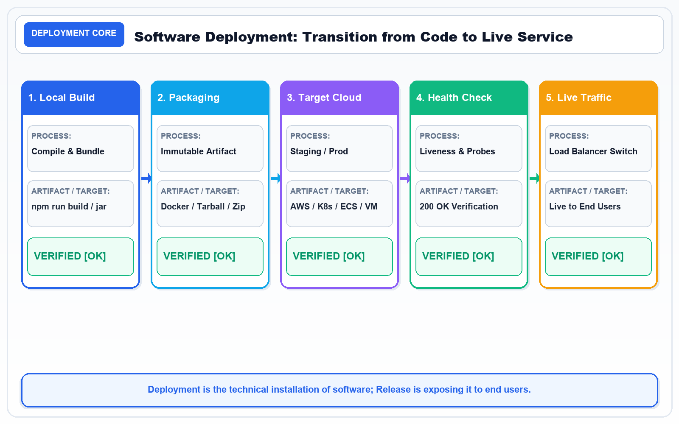
SLIDE 1 OF 10 • DEPLOYMENT CORE • DEPLOYMENT MASTERCLASS
1. Software Deployment: The Critical Final Mile
How Code Transitions from Developer Repositories into Live UserFacing Services
KEY CONCEPTS & ARCHITECTURE
• Software deployment is the operational process of transferring built artifacts into live execution environments.
• Covers artifact compilation, environment provisioning, database migrations, runtime configuration, and service startup.
• Crucial Distinction: 'Deployment' is technical installation onto servers; 'Release' is exposing features to customers.
• The Modern Benchmark: Zerodowntime, fully automated, versioncontrolled, and instantly reversible.
Architecture Diagram: Continuous Deployment Path: Local Build > Container Package > Cloud Target > Health Checks > Live Traffic (200 OK).
KEY TAKEAWAY: Deployment is the single highestrisk event in software engineering—mastering automation eliminates release anxiety.

Slide 3
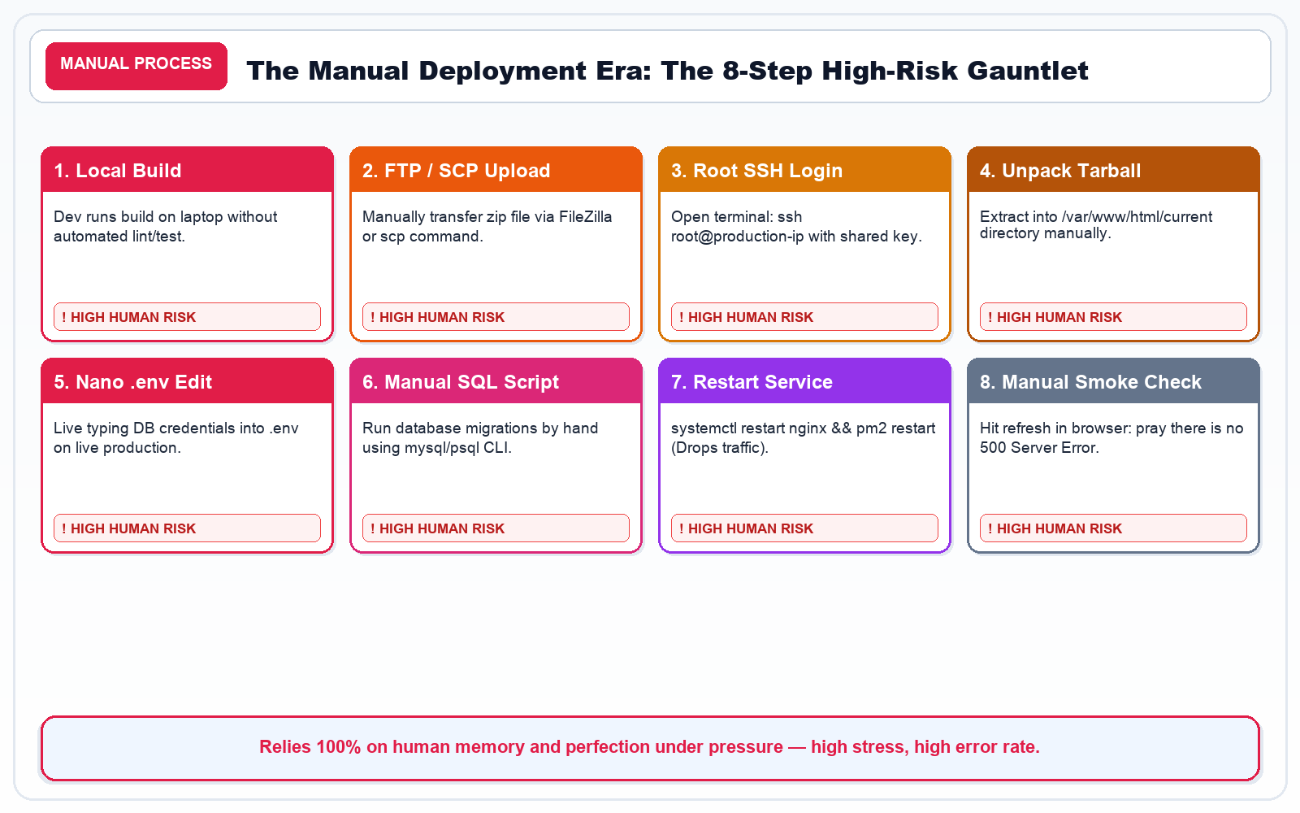
SLIDE 2 OF 10 • MANUAL PROCESS • DEPLOYMENT MASTERCLASS
2. The Manual Deployment Era: The 8Step Gauntlet
The Risky, MultiHour Release Ceremony Before DevOps Automation
KEY CONCEPTS & ARCHITECTURE
• Step 1 & 2: Local build on developer laptop followed by manual FTP/SCP zip transfer to servers.
• Step 3 & 4: Root terminal SSH login (`ssh root@prod`) and manual tarball extraction into web directories.
• Step 5 & 6: Live nano/vim edits of production `.env` files and manual execution of SQL database migrations.
• Step 7 & 8: Manual service restart (`systemctl restart nginx && pm2 restart all`) dropping active user requests.
Architecture Diagram: The 8Step Manual Gauntlet: High human friction, zero automated audit trail, and frequent outages.
KEY TAKEAWAY: Manual deployment relies 100% on human perfection under stress—an inevitable recipe for production failure.

Slide 4
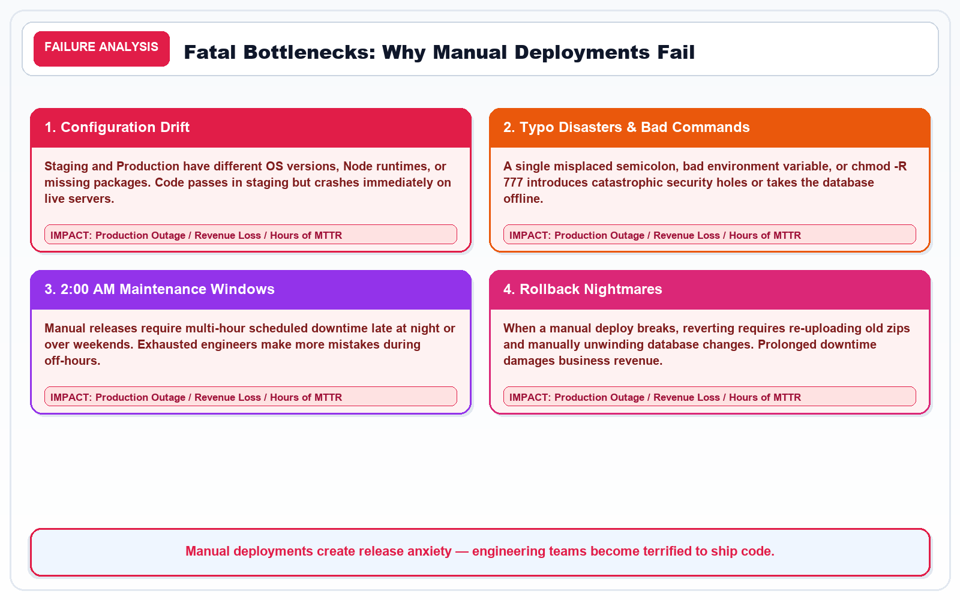
SLIDE 3 OF 10 • FAILURE ANALYSIS • DEPLOYMENT MASTERCLASS
3. Fatal Bottlenecks: Why Manual Deployments Fail
Downtime, Rollback Nightmares, Configuration Drift, and Team Burnout
KEY CONCEPTS & ARCHITECTURE
• Configuration Drift: Staging OS or Node versions differ from prod; code works on dev machines but fails live.
• Typo Disasters: A single misplaced semicolon, bad path, or `chmod R 777` introduces catastrophic security leaks.
• 2:00 AM Maintenance Windows: Engineers deploy late at night during weekends, leading to sleep deprivation and errors.
• Rollback Paralysis: Reverting broken releases requires reuploading old zips and manual database reversals.
Architecture Diagram: The 4 Pillars of Manual Release Failure: Drift, Typos, 2 AM Downtime, and Rollback Nightmares.
KEY TAKEAWAY: Manual deployments don't just cause downtime—they create release fear that paralyzes business velocity.

Slide 5
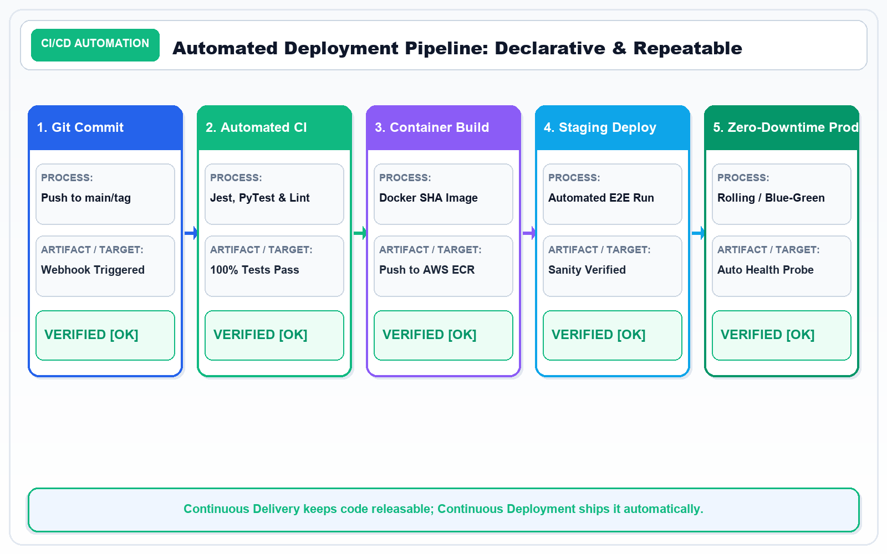
SLIDE 4 OF 10 • CI/CD AUTOMATION • DEPLOYMENT MASTERCLASS
4. Automated Deployment Pipeline: Declarative & Repeatable
Transforming Fragile Manual Steps into Repeatable, VersionControlled Automation
KEY CONCEPTS & ARCHITECTURE
• Git Webhook Trigger: Code commit to `main` branch or release tag triggers automated CI/CD execution.
• Automated Test Gate: Unit, integration, and security scans run in isolated runner environments.
• Immutable Containerization: Application packaged into Docker image tagged with Git commit SHA256.
• Continuous Delivery vs Deployment: CDel keeps software continuously deployable; CDep ships automatically to prod.
Architecture Diagram: Modern CI/CD Flow: Trigger > Automated Tests > Docker Build > Staging Verification > ZeroDowntime Prod.
KEY TAKEAWAY: Automated pipelines turn deployments into boring, predictable, everyday nonevents.

Slide 6
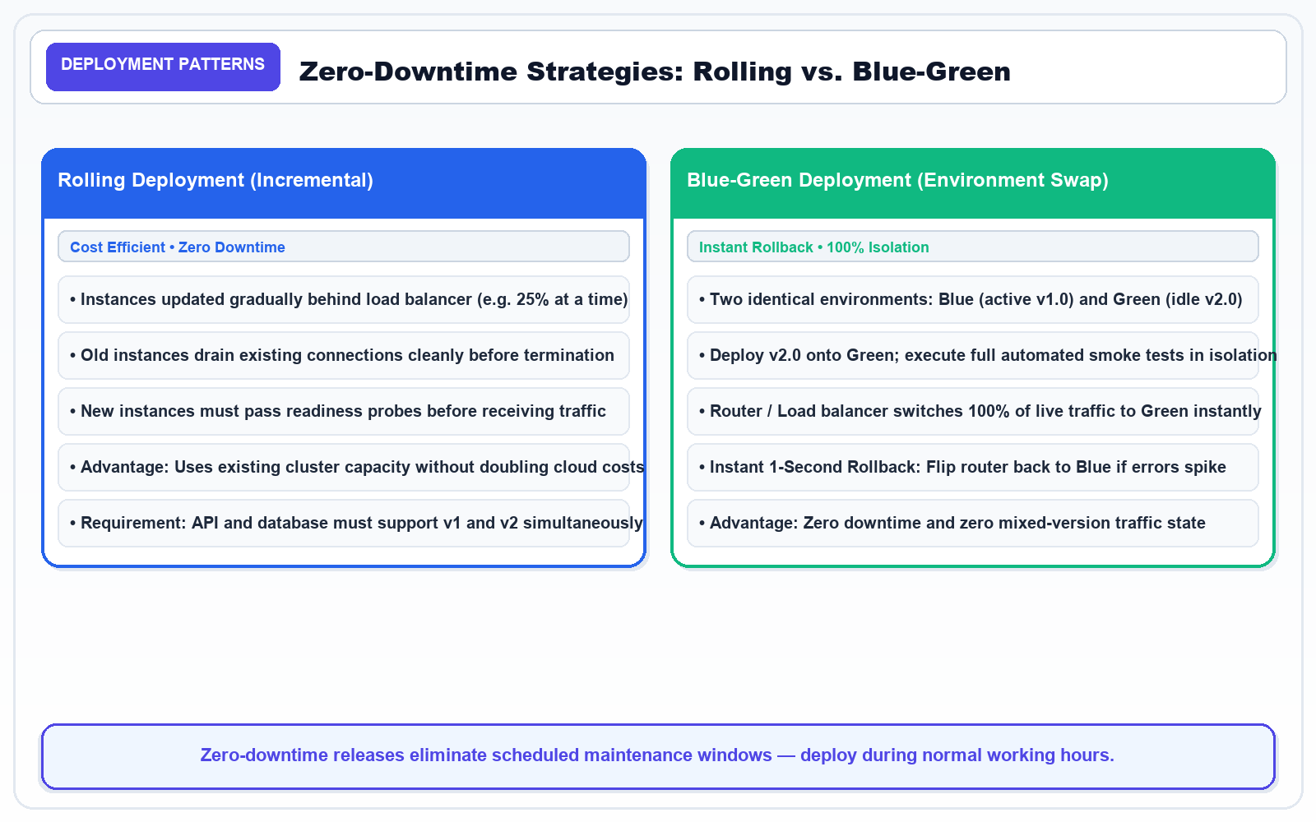
SLIDE 5 OF 10 • DEPLOYMENT PATTERNS • DEPLOYMENT MASTERCLASS
5. ZeroDowntime Strategies: Rolling vs. BlueGreen
Updating Production Services Without Dropping a Single Live User Request
KEY CONCEPTS & ARCHITECTURE
• Rolling Deployment: Updates instances gradually (e.g. 25% at a time) behind load balancer without doubling hardware costs.
• Connection Draining: Old instances finish active HTTP requests while new instances pass readiness health probes.
• BlueGreen Deployment: Two identical environments; Blue runs live v1.0, Green deploys v2.0 in complete isolation.
• 1Second Rollback: Router flips 100% traffic instantly to Green; if errors spike, flips back to Blue with zero data loss.
Architecture Diagram: Rolling (Incremental capacity upgrade) vs. BlueGreen (Complete isolated environment flip).
KEY TAKEAWAY: Zerodowntime releases eliminate weekend maintenance—teams comfortably deploy during normal office hours.

Slide 7
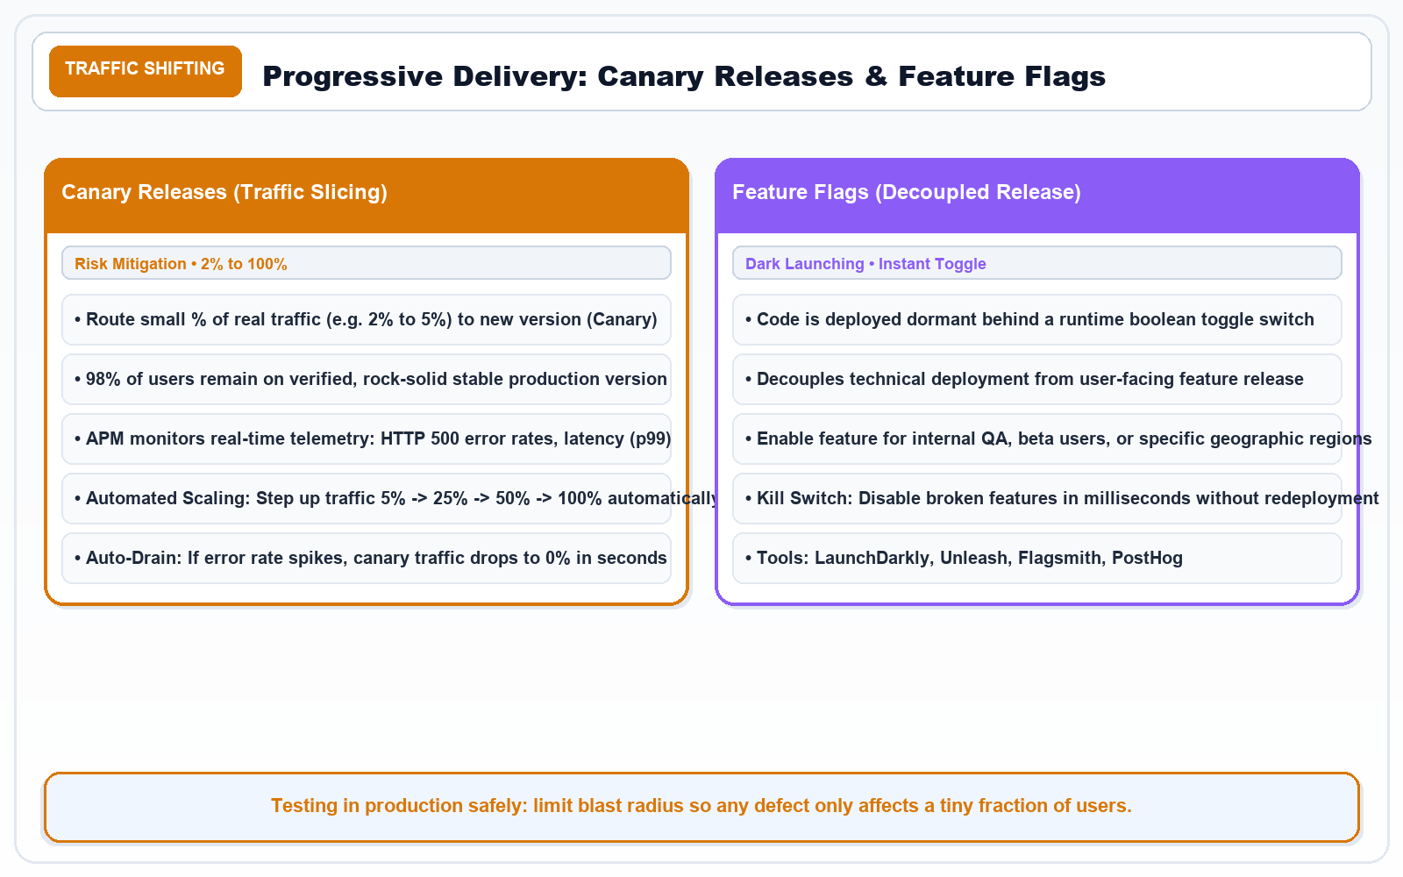
SLIDE 6 OF 10 • TRAFFIC SHIFTING • DEPLOYMENT MASTERCLASS
6. Progressive Delivery: Canary Releases & Feature Flags
Safely Exposing New Code to Real Production Traffic in Increments
KEY CONCEPTS & ARCHITECTURE
• Canary Releases: Route 2% to 5% of real user traffic to new canary instance while 95% remains on rocksolid stable version.
• Automated Telemetry: APM monitors HTTP 500 error rates, p99 latency, and CPU metrics before stepping traffic up.
• AutoDrain: If error rate spikes, canary traffic drops to 0% in seconds, protecting 98% of users from experiencing bugs.
• Feature Flags: Decouple deployment from release; deploy code dark and toggle features via runtime boolean switches.
Architecture Diagram: Canary Traffic Slicing (2% > 25% > 100%) and Feature Flag Dark Launching Architecture.
KEY TAKEAWAY: Progressive delivery shifts testing into production safely, reducing blast radius to near zero.

Slide 8
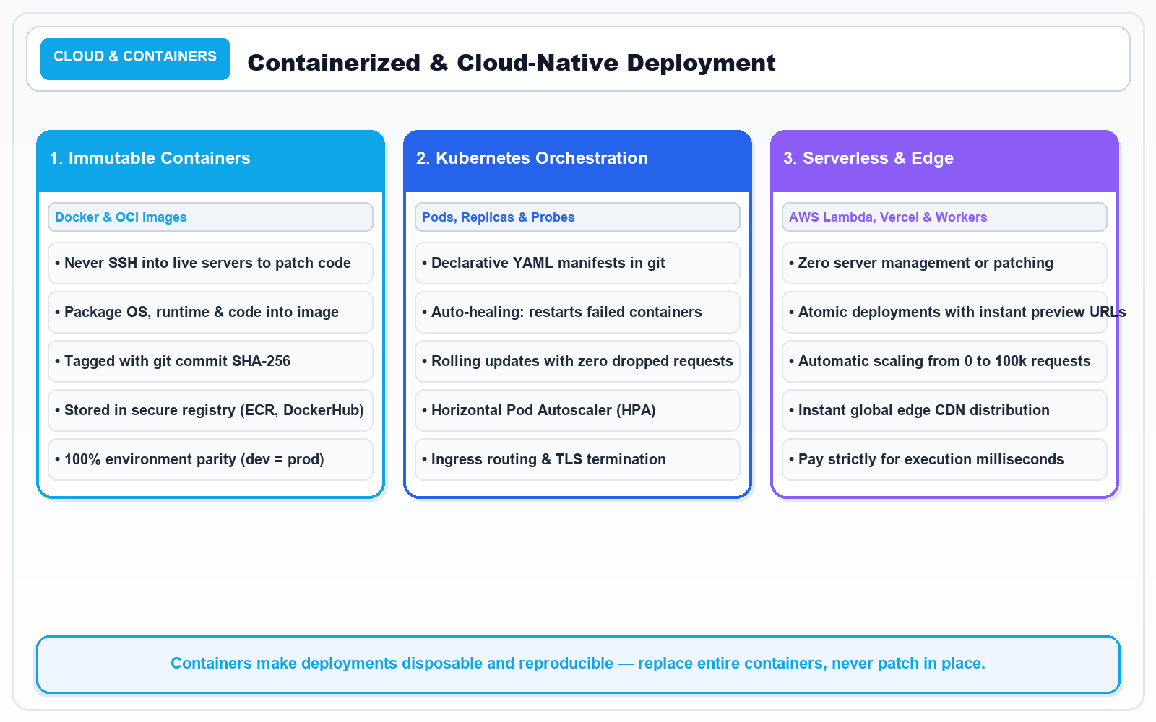
SLIDE 7 OF 10 • CLOUD & CONTAINERS • DEPLOYMENT MASTERCLASS
7. Containerized & CloudNative Deployment
Immutable Infrastructure: Replacing Fragile Servers with Ephemeral Containers
KEY CONCEPTS & ARCHITECTURE
• Immutable Infrastructure: Never patch live servers in place; build a new Docker image and replace containers entirely.
• Secure Container Registries: AWS ECR, Docker Hub, and GitHub Packages store signed, vulnerabilityscanned images.
• Kubernetes Orchestration: Declarative YAML manifests, selfhealing pod restarts, and horizontal autoscaling.
• Serverless & Edge Platforms: AWS Lambda, Vercel, and Cloudflare Workers offer atomic deploys with zero server maintenance.
Architecture Diagram: The 3 Pillars: Immutable Docker Images, Kubernetes Orchestration, and Serverless Edge Delivery.
KEY TAKEAWAY: Containers guarantee environment parity: the exact image tested in staging executes identically in production.

Slide 9
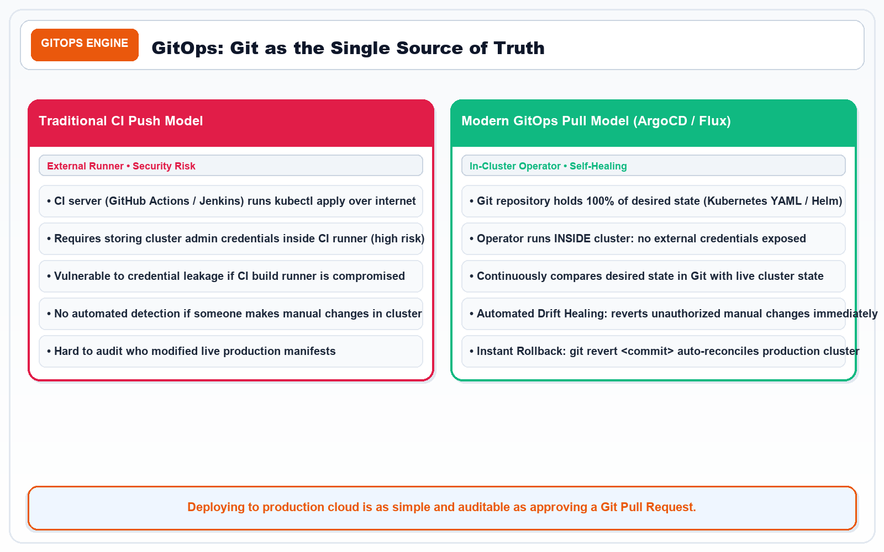
SLIDE 8 OF 10 • GITOPS ENGINE • DEPLOYMENT MASTERCLASS
8. GitOps: Git as the Single Source of Truth
Declarative Cloud Delivery, Automated Drift Detection, and SelfHealing Infrastructure
KEY CONCEPTS & ARCHITECTURE
• Traditional CI Push Model: CI server holds cluster credentials and runs `kubectl apply`—a security risk if compromised.
• GitOps Pull Model (ArgoCD / Flux): Incluster operator pulls changes from Git without exposing cluster credentials.
• Automated Drift Healing: If someone manually alters a pod via `kubectl`, ArgoCD immediately reconciles it back to Git state.
• Instant 1Click Rollback: Running `git revert <commit>` autoreconciles production cloud clusters across all regions.
Architecture Diagram: Traditional Push vs. Modern InCluster GitOps Pull Model with Continuous Drift Reconciliation.
KEY TAKEAWAY: Deploying to production cloud with GitOps is as safe, reviewed, and auditable as approving a Git Pull Request.

Slide 10
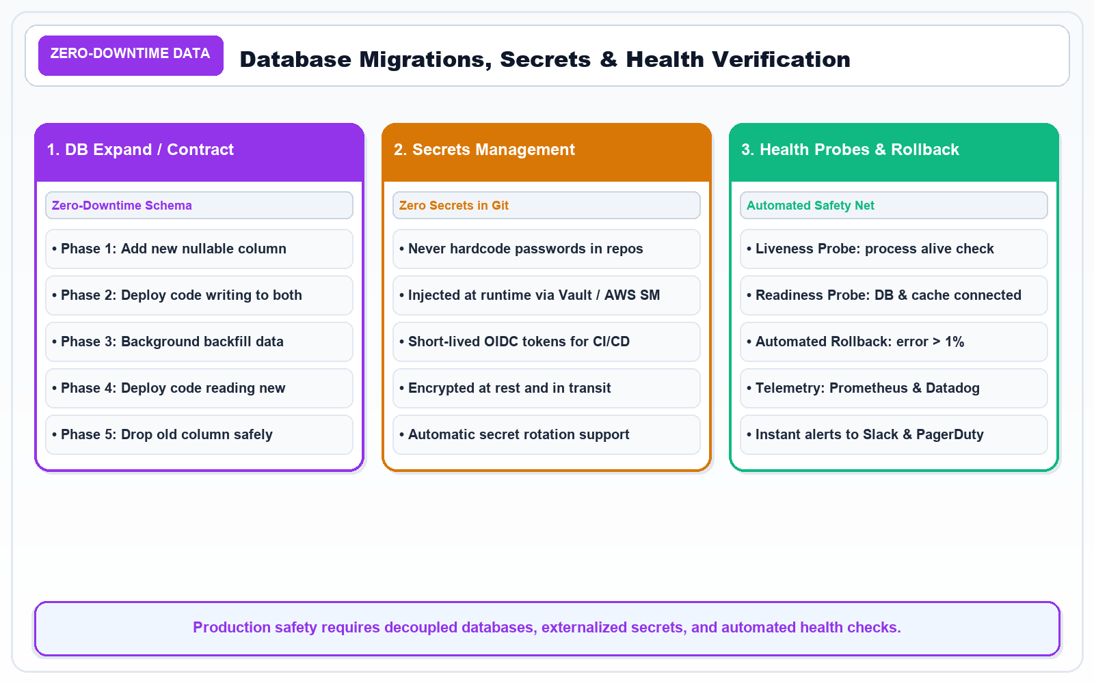
SLIDE 9 OF 10 • ZERODOWNTIME DATA • DEPLOYMENT MASTERCLASS
9. Database Migrations, Secrets & Health Verification
Solving the Toughest Challenges in Automated ZeroDowntime Deployment
KEY CONCEPTS & ARCHITECTURE
• ExpandandContract Pattern: Add nullable column > deploy code reading both > backfill data > drop old column.
• Secrets Externalization: Never store credentials in Git; inject at runtime via HashiCorp Vault, AWS Secrets Manager, or OIDC.
• Liveness vs Readiness Probes: Liveness restarts crashed processes; Readiness checks DB connectivity before routing traffic.
• Automated Rollback Triggers: If HTTP 5xx errors exceed 1% for 60 seconds, pipeline autorolls back without human delay.
Architecture Diagram: ExpandandContract ZeroDowntime Database Pattern & Health Probe Rollback Triggers.
KEY TAKEAWAY: Production safety requires decoupled databases, externalized secrets, and automated health checks.

Slide 11
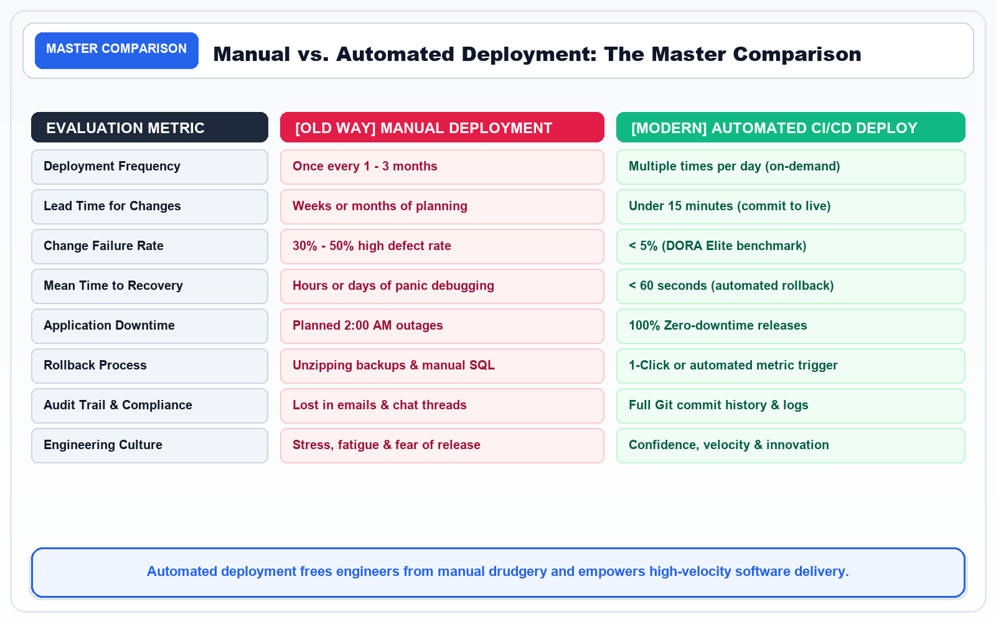
SLIDE 10 OF 10 • MASTER COMPARISON • DEPLOYMENT MASTERCLASS
10. Manual vs. Automated Deployment: The Master Comparison
Metrics, Cultural Transformation, and Golden Rules for Production Excellence
KEY CONCEPTS & ARCHITECTURE
• Release Frequency: Manual (1x per 3 months) vs. Automated (multiple times per day ondemand).
• Lead Time for Changes: Manual (weeks/months of planning) vs. Automated (< 15 minutes from commit to production).
• Change Failure Rate: Manual (30% 50% defect rate) vs. Automated (< 5% elite DORA standard).
• Mean Time to Recovery (MTTR): Manual (hours/days of outage) vs. Automated (< 60 seconds instant rollback).
Architecture Diagram: 8Dimension Comparison Matrix: Manual Delivery Breakdown vs. Modern CI/CD Automated Excellence.
KEY TAKEAWAY: Automating deployment is not just a tooling change—it is a cultural revolution that enables fearless innovation.

