Slide 1

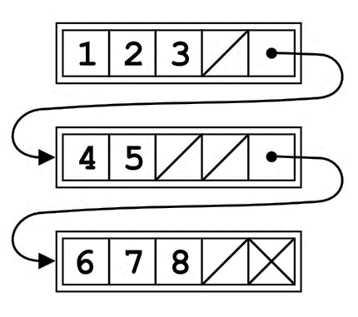
Introduction to Unrolled Linked List
AAKANKSH N
USN: 1RV22CS002

Slide 2
NEED FOR UNROLLED LINKED LIST
We need unrolled linked list to overcome some disadvantages of traditional linked list such as
Memory
Each node carries both the data and a pointer to the next node, leading to increased memory consumption.
The allocation of space for pointers, in proportion to the actual data, contributes to the overall inefficiency of memory utilization.
Cache Misses
As each node only contains a single element along with a pointer to the next node, accessing elements sequentially may require frequent jumps to non-contiguous memory locations

Slide 3
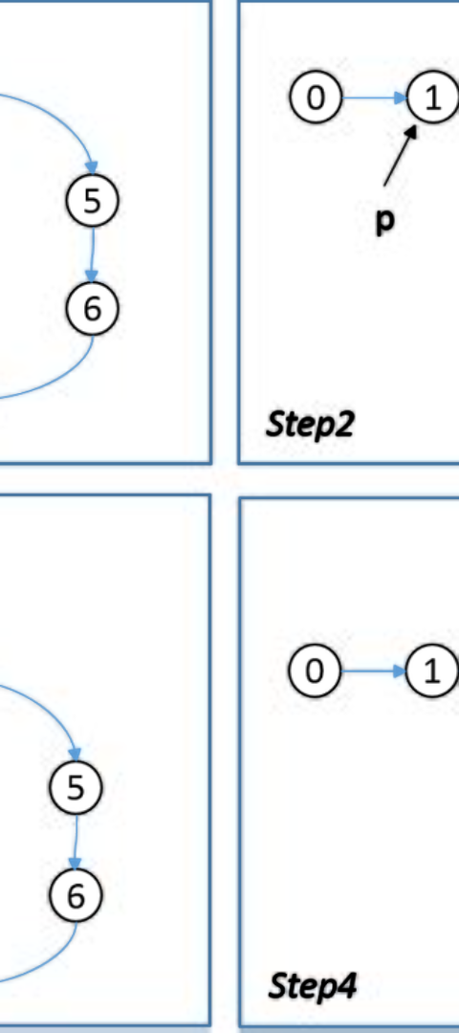
What is an Unrolled Linked List?
An unrolled linked list is a variation of linked lists where each node contains an array of elements rather than a single element. This enables more efficient usage of memory and faster access times.
1
Node Structure
2
Memory Efficiency
Each node contains a fixed number of elements and a reference to the next node.
Reduces memory overhead by storing multiple elements in a single node.
3
Performance
Improves access times by reducing the number of nodes needed to access a specific element.

Slide 4
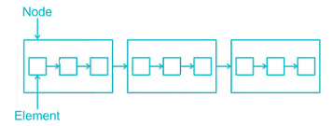
Advantages of Unrolled Linked List
Memory Optimization
Efficient Traversal
Improved Cache Performance
Minimizes the number of nodes traversed to access specific elements, resulting in faster operations.
Reduces the amount of space needed to store the same elements compared to traditional linked lists.
Enhances cache performance due to better locality of reference.

Slide 5
Structure of a NODE and Threshold
1
Node Structure
Each node in the unrolled linked list contains
1.An array of elements
2. A reference to the next node.
2
Threshold
capacity
1
2
struct Node
{
int numElements;
int array[maxElements];
struct Node *next;
};
Here , threshold gives the number of array elements that can be filled inside each node
NODE
10
20
30
40
50
60
NULL

Slide 6
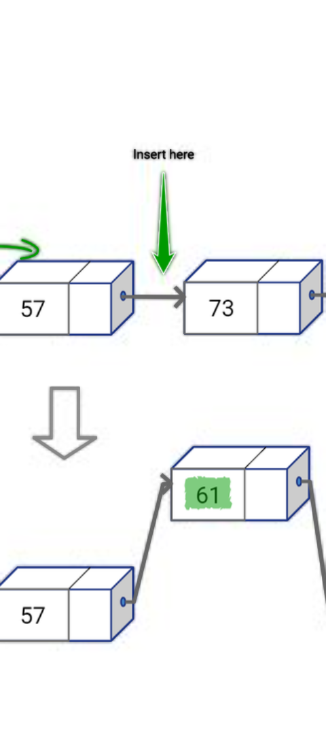




Operations on Unrolled Linked List
Insertion
Addition of new elements by adjusting references and redistributing elements within nodes.
Searching
Searching for the element by traversing through the linked list .
Deletion
Removal of elements by redistributing data and adjusting references without
leaving gaps

Slide 7
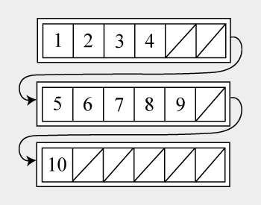
INSERTION OF ELEMENTS
1
Creation of node
The program should be run to check if there is a node created ,
if no nodes are found or if all nodes are full new node must be created
2
Check if the node is full
Each array element is checked to make sure that the node is .
3
Add element to either new node or current node
Implement methods to add or remove elements from the unrolled linked list.

Slide 8
INSERTION OF ELEMENTS
else {
// Create a new node if the current node is full
NODE new_node = createNode();
int mid = last->numElements / 2;
// Move the final half of last->data into new_node->data
new_node->numElements = last->numElements - mid;
for (int i = mid, j = 0; i < last->numElements; i++, j++) {
new_node->data[j] = last->data[i];
}
// Update last
last->numElements = mid;
last->next = new_node;
last = new_node;
// Insert the new element into the new node
last->data[last->numElements++] = newElement;
}
}
typedef struct node {
int data[NODE_SIZE];
int numElements;
struct node* next;
} *NODE;
void insertElement(NODE* head, NODE* last, int newElement) {
if (head == NULL) {
// Insert the first element into the first node
head = createNode();
head->data[0] = newElement;
last = head;
} else if (last->numElements < NODE_SIZE) {
// Insert into the current node if there is space
last->data[last->numElements++] = newElement;
}

Slide 9
SEARCHING FOR AN ELEMENT
STEP 1 : Start with the first node of the list and remember its address.
STEP2: Check each element in the node’s array one by one and compare it with the element you are looking for.
STEP 3: If you find a match, stop and return true, meaning the element is found in the list.
STEP 4: If you don’t find a match, move to the next node of the list and remember its address.
STEP 5: Repeat steps 2 to 4 until you reach the end of the list or find a match.
STEP 6: If you reach the end of the list without finding a match, stop and return false, meaning the element is not found in the list.

Slide 10
SEARCHING OF ELEMENTS
bool search(struct Node* head, int element) {
// Traverse the list from head to tail
struct Node* current = head;
while (current != NULL) {
// Search for the element in the current node's array
for (int i = 0; i < current->numElements; i++) {
if (current->array[i] == element) {
return true; // Element found
}
}
// Move to the next node
current = current->next;
}
return false; // Element not found
}

Slide 11
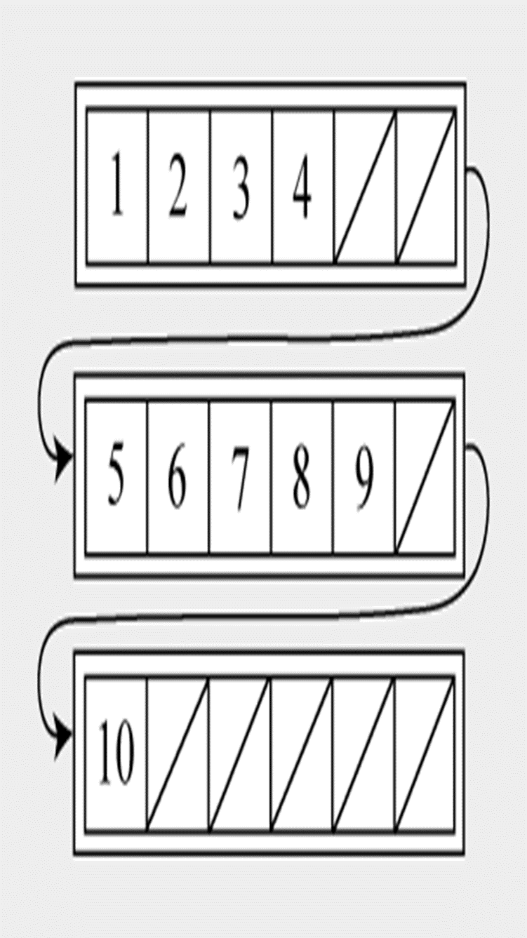
DELETION OF ELEMENT
STEP 1:Traverse the list from head to tail using a pointer current.
STEP 2:For each node, search for the element in the node’s array using a loop.
STEP 3:If the element is found, delete it from the array by swapping it with the last element and reducing the number of elements by one.
STEP 4:If the array becomes empty, delete the node from the list by updating the previous node’s next pointer and freeing the memory for the node.
STEP 5:Return true if the element is deleted, or false if the element is not found or the list is empty.

Slide 12
DELETION OF ELEMENT
// If the array becomes empty, delete the node from the list
if (current->numElements == 0) {
if (prev == NULL) {
// The first node is empty, update the head pointer
head = current->next;
} else {
// The middle or last node is empty, update the prev pointer
prev->next = current->next;
}
// Free the memory for the node
free(current);
}
return true; // Element deleted
}
// Move to the next node
prev = current;
current = current->next;
}
bool delete(struct Node* head, int element) {
// Traverse the list from head to tail
struct Node* current = head;
struct Node* prev = NULL;
while (current != NULL) {
// Search for the element in the current node's array
for (int i = 0; i < current->numElements; i++) {
if (current->array[i] == element) {
current->array[i] = current->array[current->numElements - 1]; // Swap with the last element
current->numElements--; // Reduce the number of elements by one
return false; // Element not found or list is empty
}

Slide 13
Time complexity of Searching in Unrolled Linked List
Time complexity is less because :
The array size is fixed and small (5 in your example), so the number of elements to check in each node’s array is bounded by a constant. This means that the time complexity of searching in the array is O(1), which is negligible compared to the time complexity of traversing the nodes, which is O(sqrt(n)).
O(√n)
Efficient search operations due to reduced number of nodes accessed.

Slide 14
THANK YOU!!

