Slide 1
Topic: File Sorting Application
Submitted To: Mr. Jugendra Dongre Sir
Submitted By: Aakanksha Solanki
Roll No. : IC-2K16-01

Slide 2
Introduction:

Slide 3
This application is used to sort files of any folder of your computer system according to their extensions and will place them into their specific folders by creating different new folders.

Slide 4

Technology Used:
Python

Slide 5
Why Python??
Python is a high level language which is easy to understand and is portable. Its large and robust standard library makes Python score over other programming languages. The standard library allows you to choose from a wide range of modules according to your precise needs. Each module further enables you to add functionality to the Python application without writing additional code.

Slide 6
Objective and Scope:
This application is based on a real life problem which all of us face during operating our computer systems. While working on different types of files user may find it difficult to search a particular type of file. So this application is used to sort files of your computer system according to their extensions (.jpg, .mp3, .mp4, .txt, etc) and then will place it accordingly into their specific folders. So it will help the user to get all images, audios, videos, text file and other documents in their respective folders separately.

Slide 7
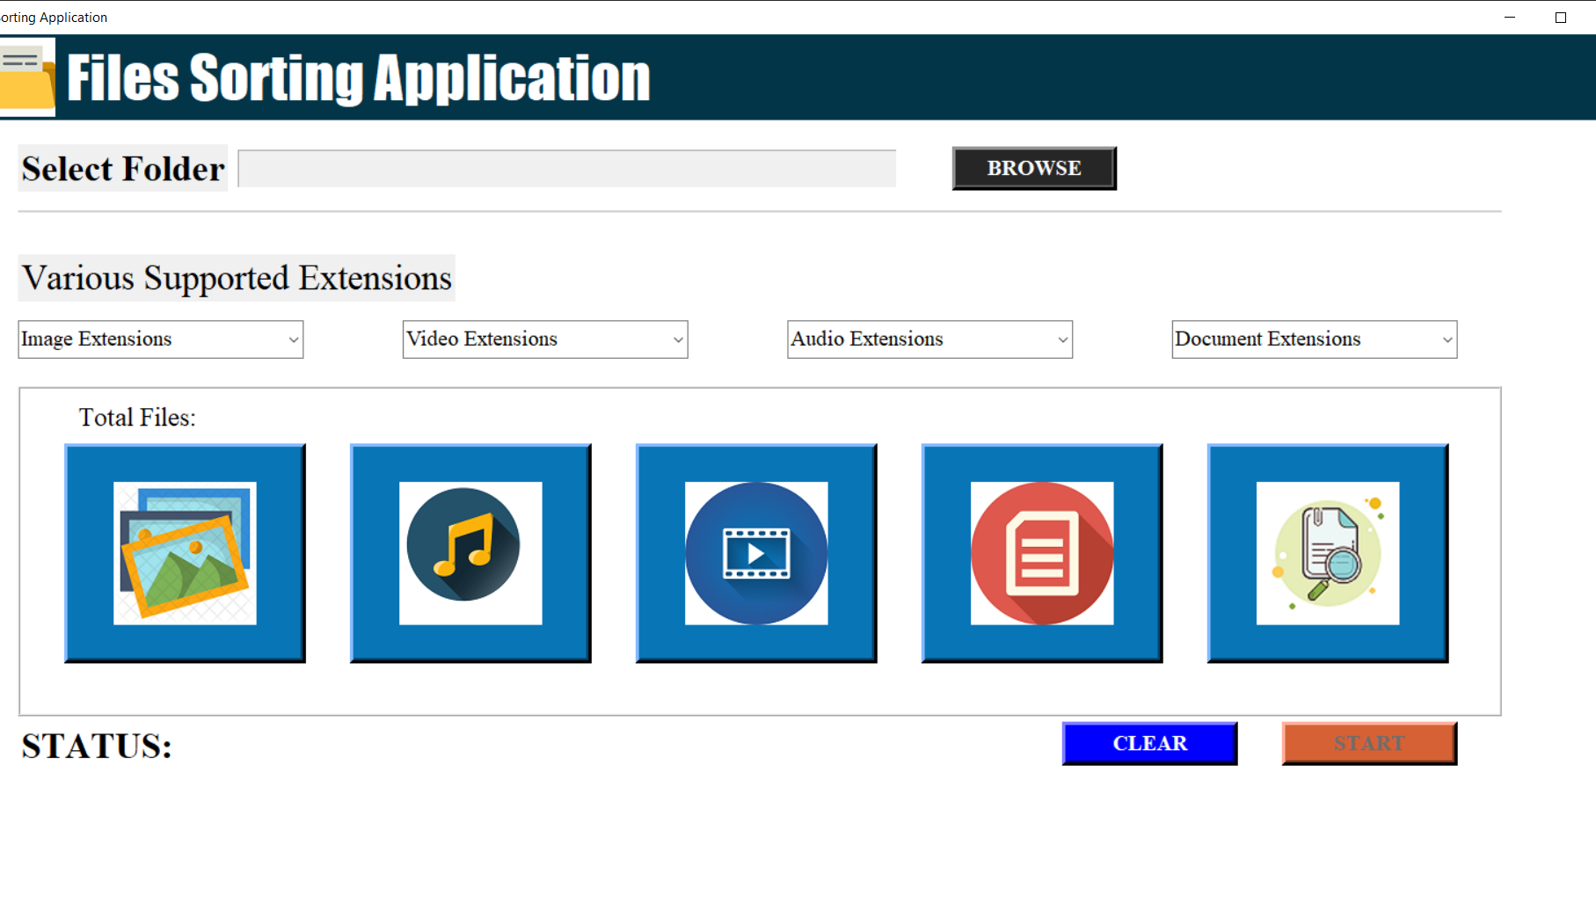

Slide 8
Process Description:
As soon as the user runs the application, that application will welcome the user by greeting him or her.

Slide 9
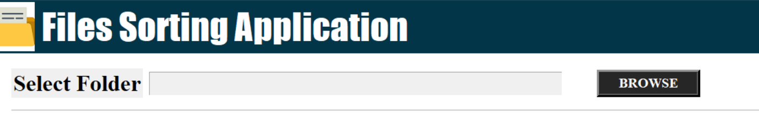
2. It firstly ask user for the path of the folder which he/she wants to sort, The user can select the path of the folder by clicking on the browse button.

Slide 10
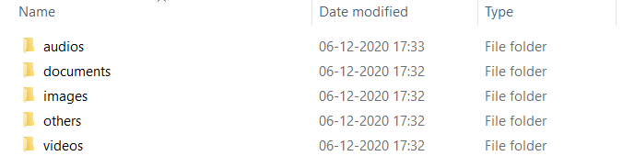
After the start button is clicked by user, the application will create some new folders like Images, Audios, Videos, Documents, etc into the given folder .

Slide 11
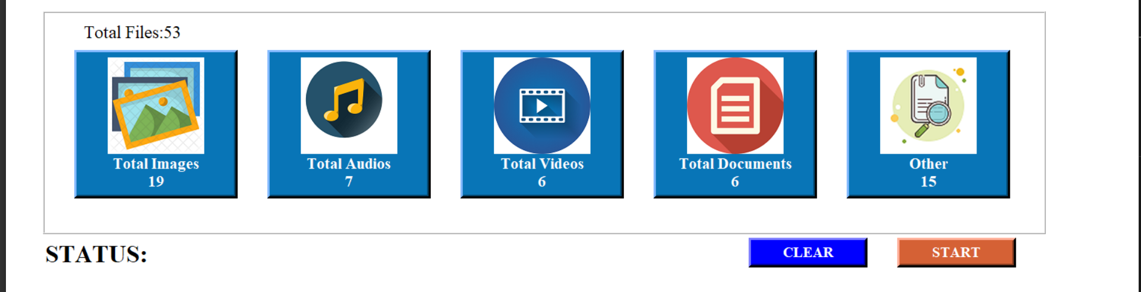
4. After creating different folders, it will calculate and tell the user about the total number of files and total number of images, audios, videos and documents that were present in the given folder.

Slide 12
5. Now user needs to click on the start button which will enable only after the user gives the path. After the user clicks on the start button the files moves into their respective folders according to their extensions. After all the files have moved successfully a popup success message appears on the screen and application tells us the status about total files moved files and left files.

Slide 13
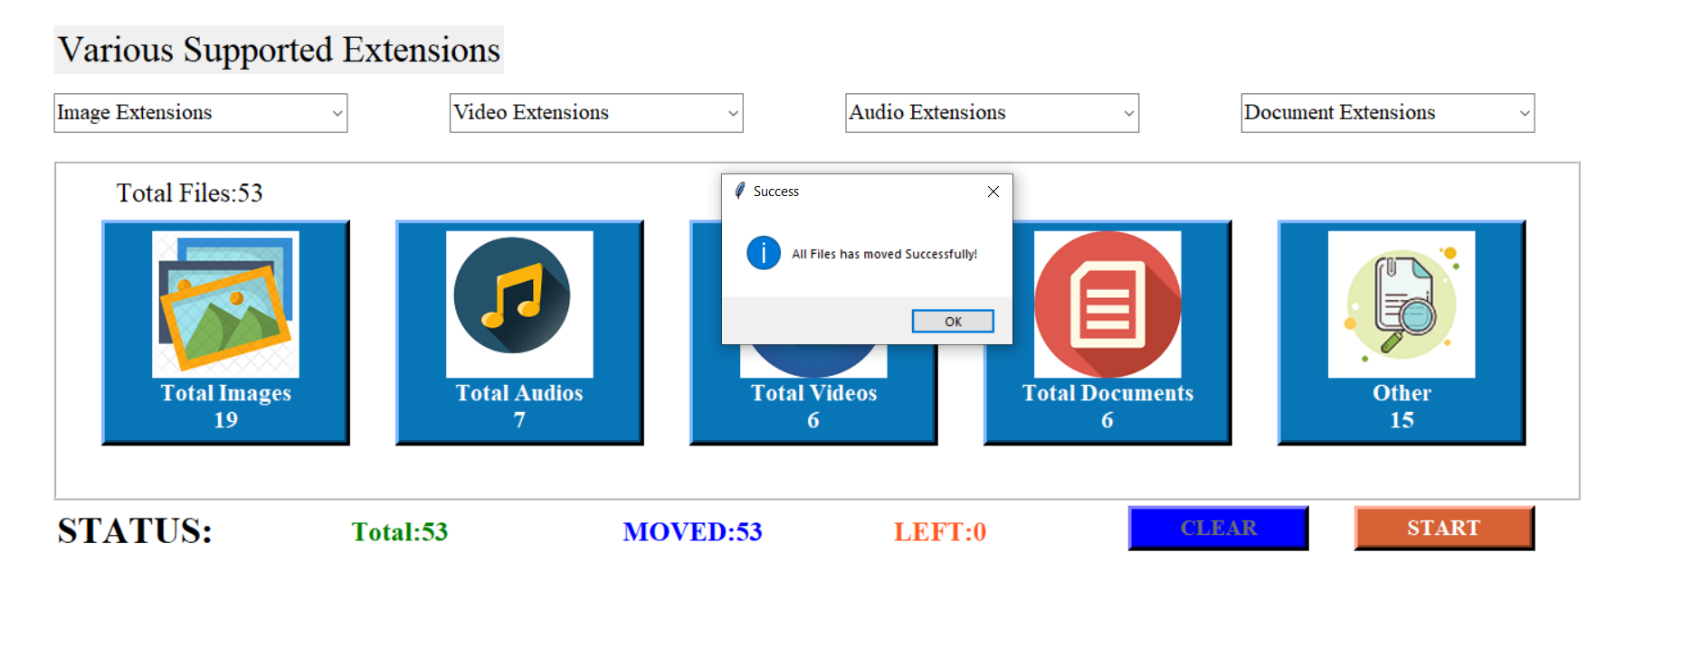

Slide 14
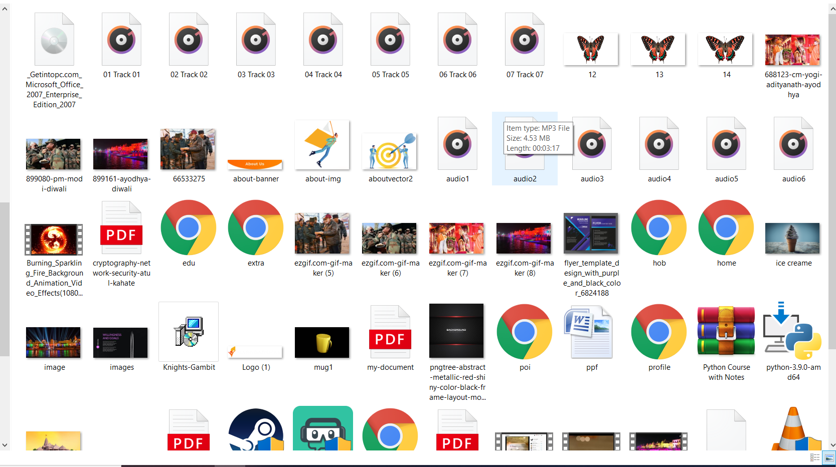
Before

Slide 15
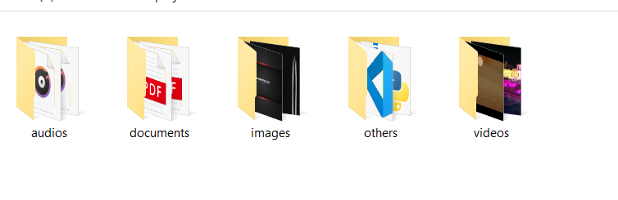
After:

Slide 16
Thank You

