Slide 1
NachOS Network Drivers
Aakanksha Agarwal (121002)
Priya Shah (121037)

Slide 2
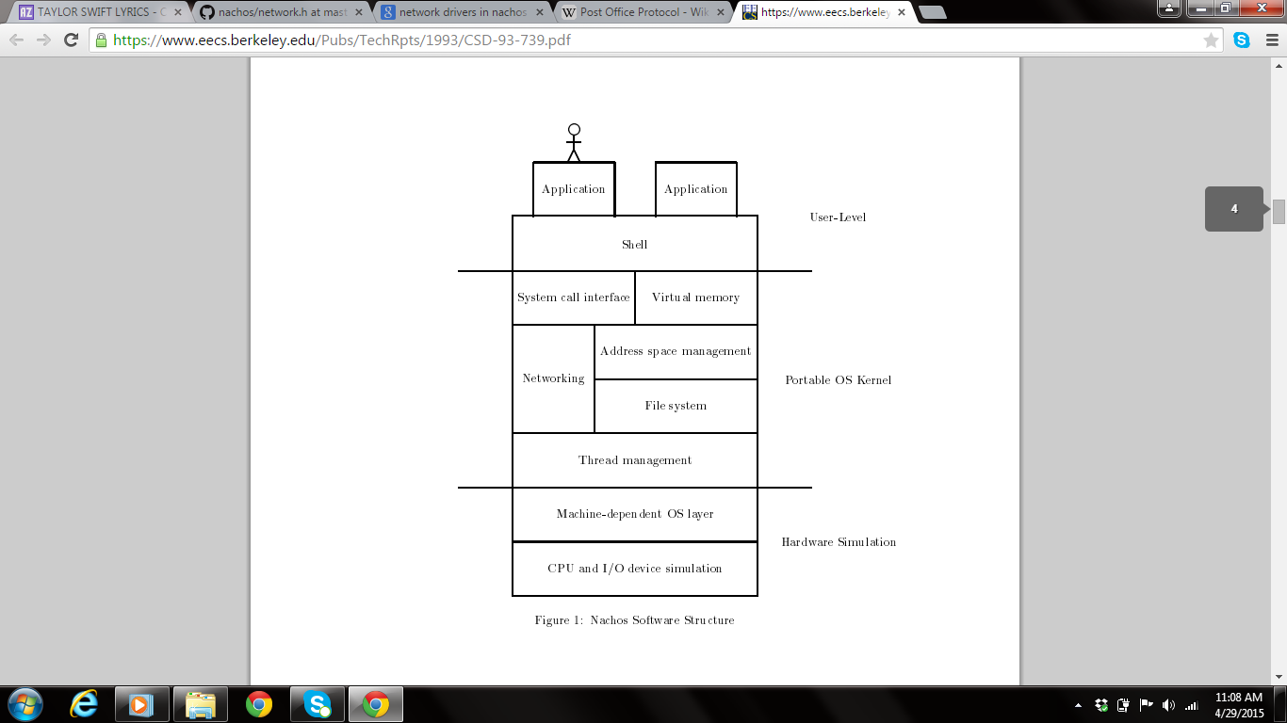
Overview:
Software level
Hardware level
1) UNIX process -> uniprocessor
workstation
2)network of workstations
3) socket Send and Receives

Slide 3
Post Office Protocol:
Application layer internet standard protocol
Purpose of POP

Slide 4
Networking in Nachos:
Phase 1:
1) post.h – post office and mailbox
2) post.cc – mail message definition and implementation
3) nettest.cc – application to test communication between host id 0 and host id 1
Phase 2: Pre-requisites

Slide 5
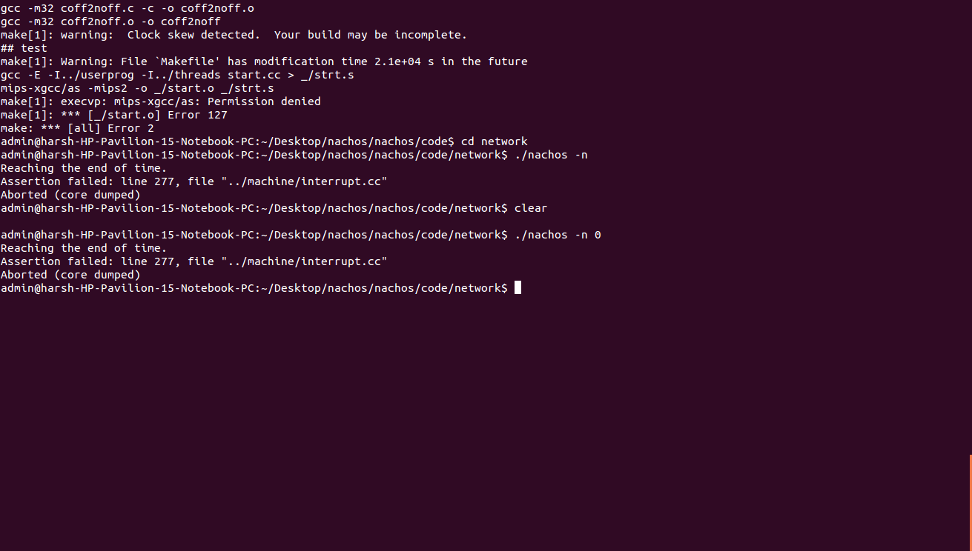
Phase 3: Testing and Demo
1) –n (takes value between 0 and 1)

Slide 6
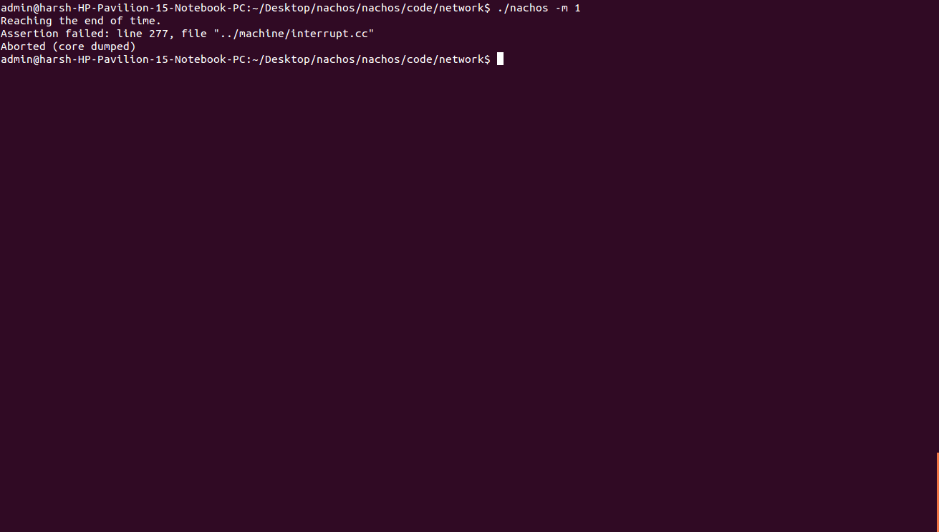
2) –m (0 & 1 hardcoded)

Slide 7
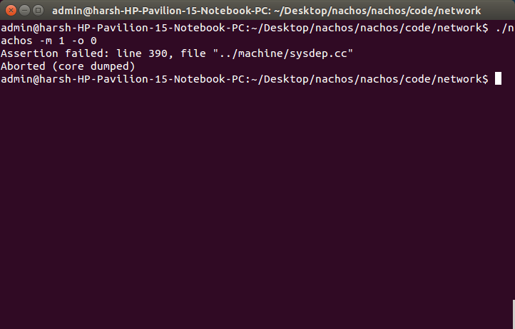
3) –o (0 & 1 hardcoded)

Slide 8
THANK YOU

