Slide 1
Data Cleaning AND Learning
Intern Tasks February month-2026
By: Aakanksha Pednekar

Slide 2
Introduction
Data monitoring , understanding and cleaning are the important steps for data analysis.
Real-world datasets contain missing values, errors, and wrong formats.
In this tasks, multiple datasets were used to practice data cleaning.
Different tools like Excel, Python, R language, and Power BI were applied.

Slide 3
Objectives
To understand common data issues in real datasets.
To identify and fix logical and structural data errors.
To handle missing values and inconsistent formats.
To clean data using different tools and methods.
To create pipeline .

Slide 4
Manual and Missing Data Tasks
Task 1 - Manual Audit & Logic Check
Data was checked using Excel without using any formulas or code.
Logical errors like Negative Price , Order Shipped Before Placed.
Task 2 -Missing Data Trap (Titanic Dataset)
Python Pandas was used to identify missing values.
Values like NA , null were normalized using valid conditions.

Slide 5
Logic and Language-Based Tasks
Task III - Logic & Outlier Detection (Housing Prices)
Data points that were logically impossible were identified.
Examples - negative house prices. Also , where bathrooms were more than bedrooms were detected.
Task IV - The R Language Challenge(Iris Dataset)
Iris dataset was cleaned using R language only.
Data types and missing values were checked in R.

Slide 6
The Regex and encoding Time zones
Task V -The Regex (Text Scraping)
Cleaned text data using regular expressions.
Split combined columns into separate columns.
Examples : Phone numbers containing + / - symbols.
Creating different columns for user name and domain for email , to filter it by domain.
Task VI - Encoding & Time zones (Global Sales)
Text was decoded and re-encoded properly.
Mixed date formats (DD/MM and MM/DD) were converted into a single standard date format.
There were various Time zones which later converted into one format.

Slide 7
Task VII - Visual Data Quality Audit (Superstore Dataset)
Power BI dashboard was created to check data quality issues such as missing values , invalid data and possible errors.
Measures were created for Null Revenue and Zero Revenue.
This helped to identify possible data entry errors and incomplete records.
Visuals helped quickly identify problem columns.

Slide 8
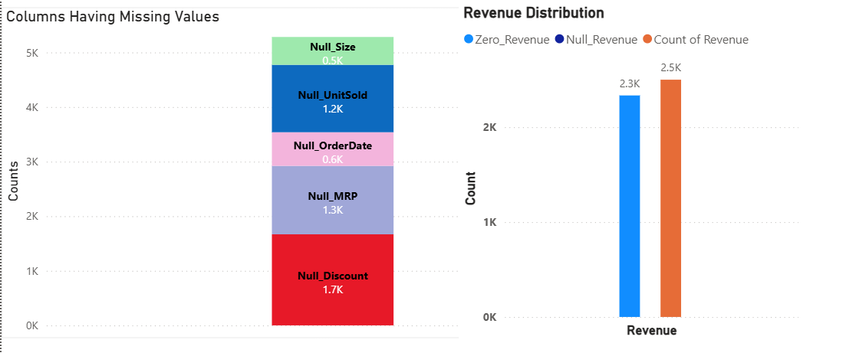
Task VII - Visual Data Quality Audit (Power BI)

Slide 9
Advanced Data Tasks
Task VIII - The Uncleanable JSON
Created a nested JSON file containing employee details with lists and missing values.
Used Python JSON library to read and process the JSON file.
Flattened nested structures and converted the data into a structured CSV file.
Task IX : The Pipeline (Data Preparation)
Ten raw CSV files were created using Python Script.
All CSVs were merged vertically into one dataset.
Missing and incorrect values were fixed using Pandas.

Slide 10
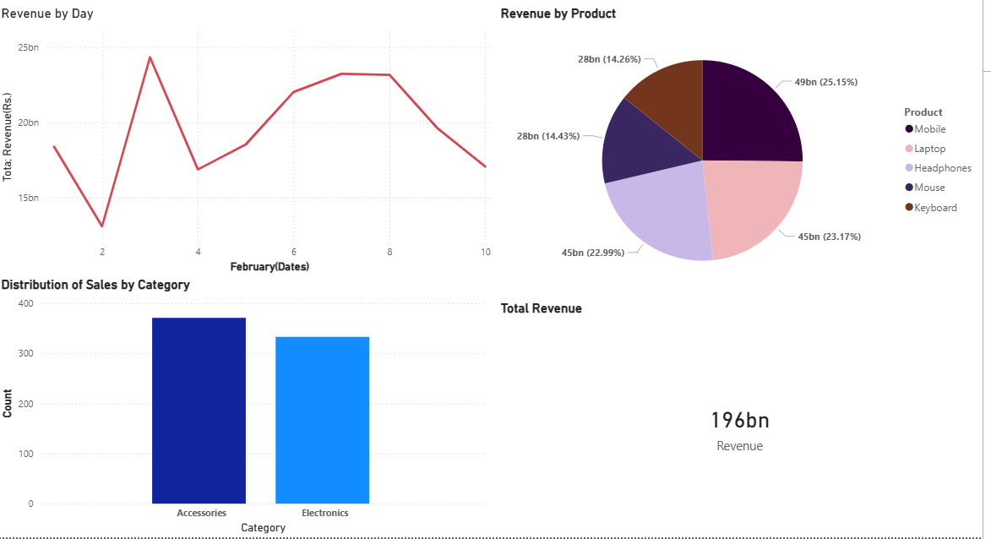

Slide 11
Conclusion
This tasks helped me understand that data cleaning is the foundation of data analysis.
I learned how to identify logical errors, handle missing values, standardize formats, and use tools like Excel, Python, R, and Power BI to improve data quality.
Clean data ensures accurate analysis and better decision-making.

Slide 12
Thank you !

