Slide 1

Streaming Term Indicator using Raspberry Pi and Twitter Developer
By :
Aakansha Garg
Associate Systems Enginner

Slide 2
Aim of the project
The goal in this experiment is to enable LED lights to flash when a specific hashtag appears on the Twitter website.
USE CASES
1. Whenever the user enters a specific comment on the twitter about the Cisco Products, admin can know comments did the user entered.
2. Using flash of LED, admin can know whether the user entered positive or negative comments and if anything requires an immediate attention based on real time streaming of the terms

Slide 3

Using Raspberry with Twitter
There are millions of people using Twitter today to interact with the rest of the world.
The Raspberry Pi is a low cost, credit-card sized computer that plugs into a computer monitor or TV, and uses a standard keyboard and mouse
In this project, the popular social media platform’s developer API along with a Raspberry Pi is utilized to build a term indicator.

Slide 4
Components Required
Raspberry Pi
Power Adapter
LED
Breadboard
Jumper Wire

Slide 5
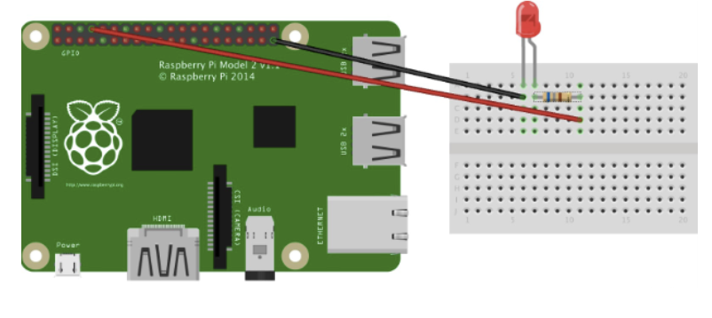
Steps
Twitter Application
Start the application process on the Twitter API homepage(https://developer.twitter.com/en/apps)
Click on the create app and get the credentials and the key to use the Twitter Application(Consumer Key ,Consumer Secret ,Access Token ,Access Token Secret)
Other steps with Raspberry and the code
3. Connect with the Twitter app and connect the raspberry pi as shown in diagram and run the python code

Slide 6
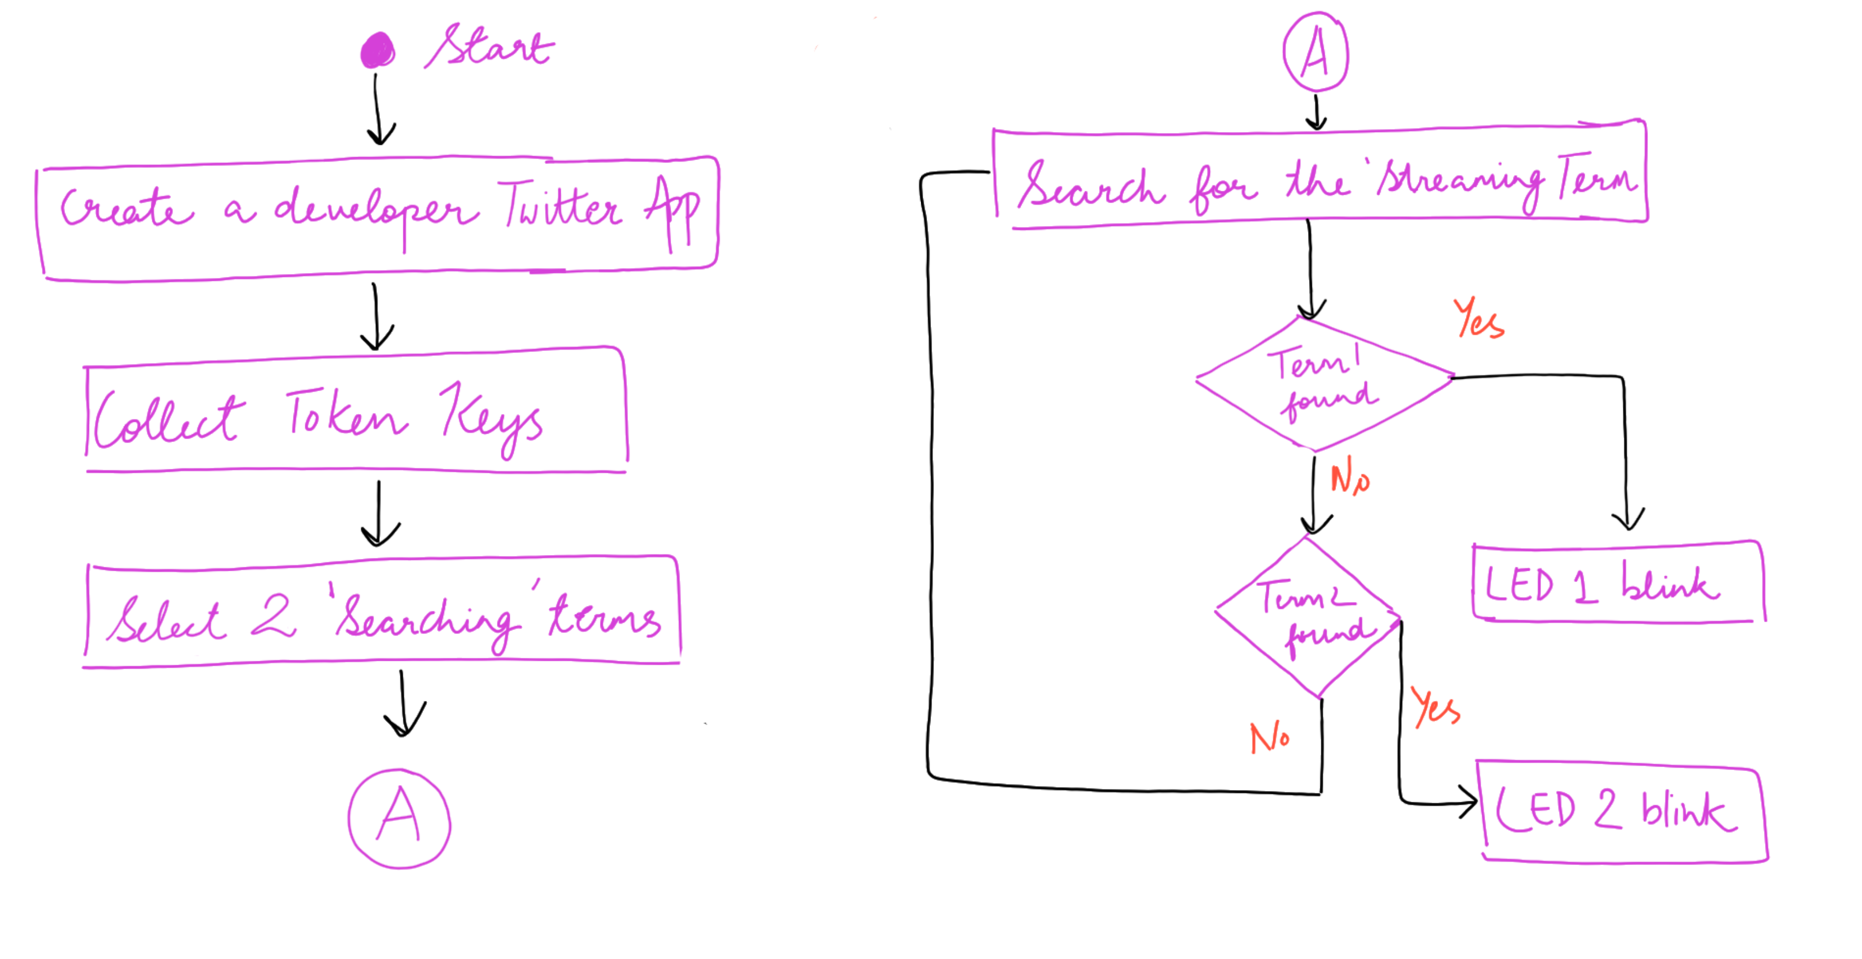
Flowchart

Slide 7
Result
Whenever the user enters the tweet containing term1(in this case ”yes”, the entire comment appears in the output screen and LED1 blinks) and similarly when the user enters the tweet containing the term2(“no”) the LED2 blinks.

