Slide 1

CAPSTONE PROJECT
EMPLOYEE SALARY PREDICTION
USING
MACHINE LEARNING
PRESENTED BY:
AAKANSHA MANWATKAR
MIT AOE PUNE
COMPUTER ENGINEERING

Slide 2
OUTLINE
Problem Statement : Understand the challenge in predicting employee salaries accurately using traditional methods. Discuss the importance of a data-driven approach in the HR domain.
System Development Approach : Explain the tools, programming language (Python), libraries (Pandas, Scikit-learn), and methodology (data preprocessing, model building) used in the project.
Algorithm & Deployment : Detail the step-by-step process: from loading the dataset, cleaning it, analyzing features, building predictive models(Linear Regression, Random Forest), and deploying it using Jupyter Notebook or Streamlit.
Result : Showcase the model performance using metrics like R² Score and RMSE. Include visualizations and screenshots of the code and predicted outputs.
Conclusion : Summarize your key findings, accuracy achieved, and effectiveness of your prediction model. Mention the real-world applicability and benefits to HR departments.
Future Scope : Suggest future improvements such as deploying the model on a website, using deep learning techniques, or adding more real-time data.
Reference : List all the resources—websites, books, datasets, articles, or tools—that helped you complete the project.

Slide 3
PROBLEM STATEMENT
In today’s fast-changing job market, fair and competitive compensation is more important than ever for employee satisfaction and retention. However, predicting the right salary based on role, experience, skills, and education can be complex and subjective. This project uses machine learning to analyze real-world employee data and predict accurate salaries. The goal is to bring transparency and consistency into compensation decisions. By relying on data rather than assumptions, companies can foster fairness and trust in the workplace. Ultimately, it’s about empowering both HR and employees through insight-driven decisions.

Slide 4
SYSTEM APPROACH
1. Platform Used:
Google Colab
Used for coding, running, and visualizing results in the cloud.
Offers GPU support, free access to Jupyter Notebook environment.
2. Programming Language: Python (Version 3.8+)
3. Libraries & Tools Used:
Category
Libraries/Tools
Data Handling
Pandas, numpy
Data Visualization
Matplotlib, seaborn
Machine Learning

Slide 5
4. Dataset Used:
A CSV file with employee details:
Features: Experience, Education Level, Role, Location, etc.
Target: Salary
5. System Requirements:
Hardware: No local installation needed (Colab handles it)
Internet Access: To use Google Colab
Browser: Chrome/Firefox for accessing the notebook
6. Why Google Colab?
No setup required.
Real-time collaboration and sharing.
Free GPU/TPU acceleration.
Easy integration with Google Drive.
7. Workflow Overview:
Upload Dataset to Google Colab or fetch from a URL.
Use pandas to load and explore the data.
Clean the data (handle nulls, encode categories).
Visualize trends using seaborn and matplotlib.
Apply Machine Learning models.
Evaluate results using metrics like R² score and MSE.
Show predictions and plots inline ( cells support it).
Optionally, save model using joblib or pickle.

Slide 6
ALGORITHM & DEPLOYMENT
Data Acquisition: Collect relevant employee records, including factors like job role, education level, years of experience, and current salary.
Data Preprocessing: Clean the dataset by addressing missing entries, eliminating redundant rows, and converting categorical fields using techniques like label or one-hot encoding.
Exploratory Analysis (EDA): Analyze data patterns, spot outliers, and understand variable relationships using visualization libraries such as Seaborn and Matplotlib.
Feature Engineering: Select the most impactful attributes that influence salary predictions for more accurate modeling.
Model Exploration: Experiment with various machine learning algorithms like Linear Regression and Random Forest to identify the best-performing approach.
Training the Model: Divide the dataset into training and test subsets (typically 80/20), then train the selected model on the training data.
Model Assessment: Evaluate the model’s prediction accuracy using metrics such as Root Mean Squared Error (RMSE) and the R-squared (R²) score.
Making Predictions: Input new employee details to forecast their expected salary using the finalized model.
Web Deployment : Create a simple user interface using tools like Streamlit or Flask to allow easy salary predictions online.

Slide 7
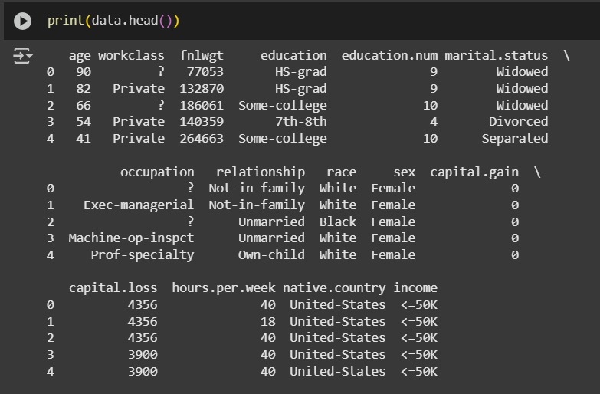
RESULT
RESULT

Slide 8
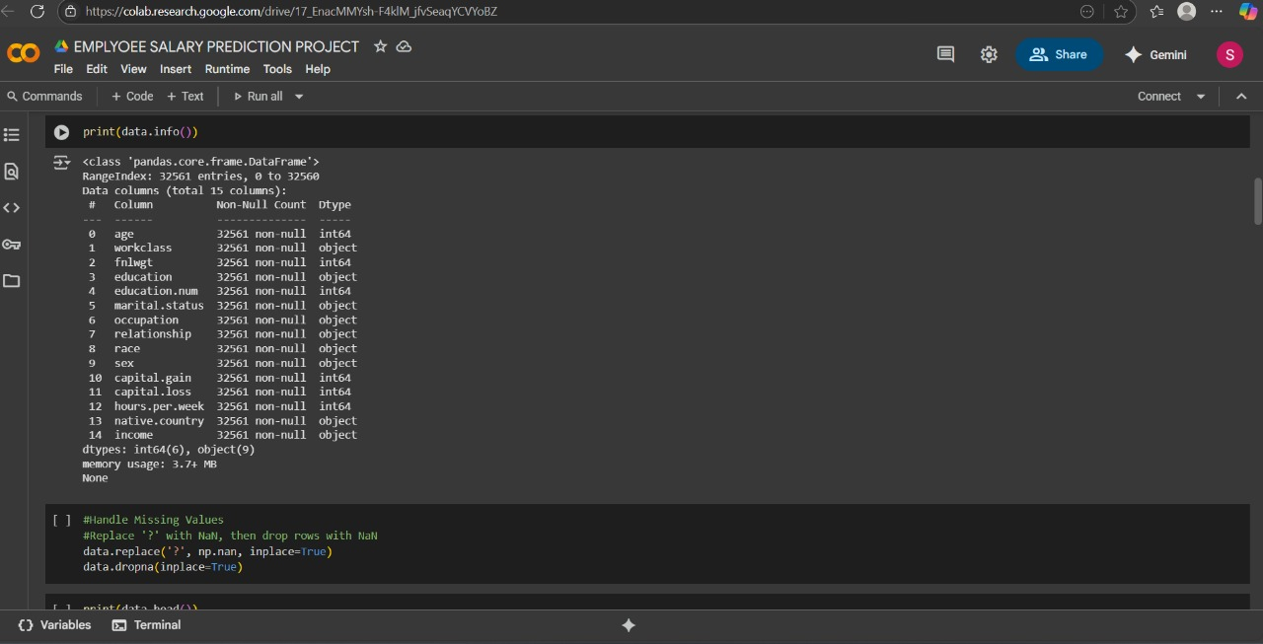

Slide 9
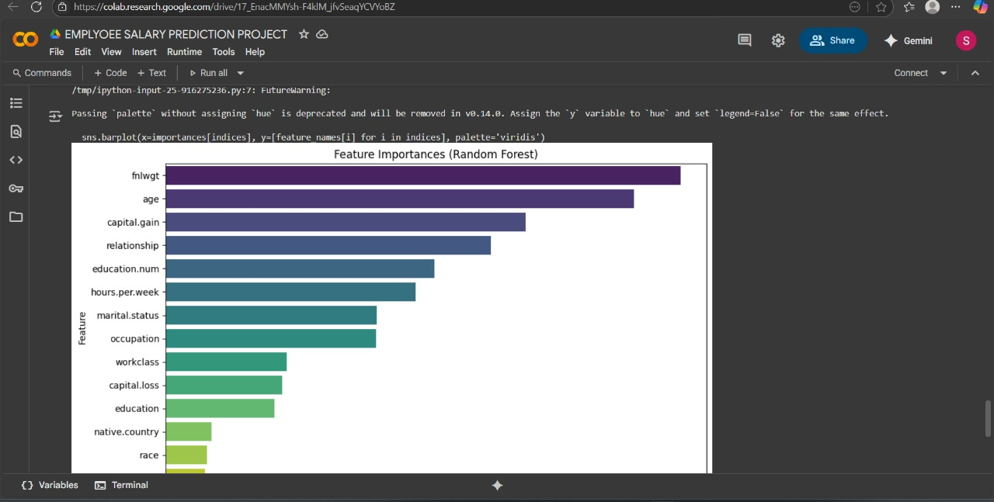

Slide 10
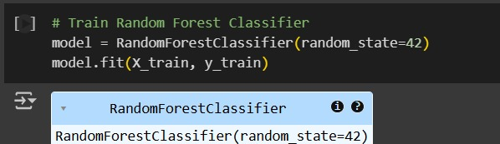

Slide 11
CONCLUSION
The Employee Salary Prediction project successfully demonstrates how machine learning can be leveraged to forecast salaries based on key factors such as experience, education, and job role. By analyzing historical data and identifying important features, the model provides accurate, data-driven salary estimates. This approach not only reduces manual effort but also promotes fairness and transparency in compensation decisions. With further refinement and real-world deployment, the system can become a valuable tool for HR teams to support equitable and competitive salary planning. Overall, this project highlights the power of AI in enhancing organizational efficiency and employee satisfaction.

Slide 12
FUTURE SCOPE
Incorporation of More Variables:
Future models can include additional factors like company size, industry type, location cost indices, performance ratings, and certifications to improve prediction accuracy.
Real-Time Data Integration:
Integrating APIs or HR management systems can allow real-time data flow, enabling continuous model updates and more dynamic salary forecasting.
Model Optimization:
Advanced techniques such as ensemble learning, deep learning, or automated hyperparameter tuning (e.g., Grid Search, Optuna) can be explored for improved performance.
Bias and Fairness Auditing:
Tools can be added to detect and mitigate any bias in salary predictions related to gender, age, or ethnicity, ensuring ethical AI use.
Interactive Dashboard Development:
A more user-friendly and feature-rich interface can be built using tools like Dash, Power BI, or Streamlit, providing HR teams with actionable insights and visualizations.

Slide 13
THANK YOU!!

