Slide 1
GEOG 260-01-F23 Assignment 3
Adeline Akansobe

Slide 2
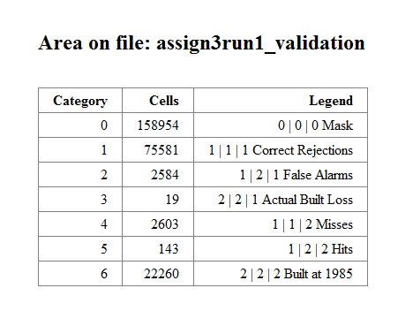
Driver map, Change in Built, and Suitability Map for Run 1
The number of False Alarms being lesser than the number of misses shows that the actual change between 1985 and 1999 is more than what we simulated. This results in us getting a quantity error (false alarms – missed) of -19. Thus, if we pair the False alarms and Misses correctly, we get more Hits.

Slide 3
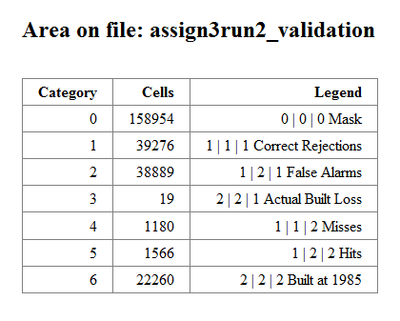
Driver map, Change in Built, and Suitability Map for Run 2
The number of False Alarms is about thirty times greater than the number of Misses. This is due to the quantity we selected for the simulation, which was more than double the quantity we selected for run 1. The increase in False Alarms indicates that in reality there is less change than what we simulated. Increasing the quantity increases the False Alarms errors and decreases errors due to Misses.

Slide 4
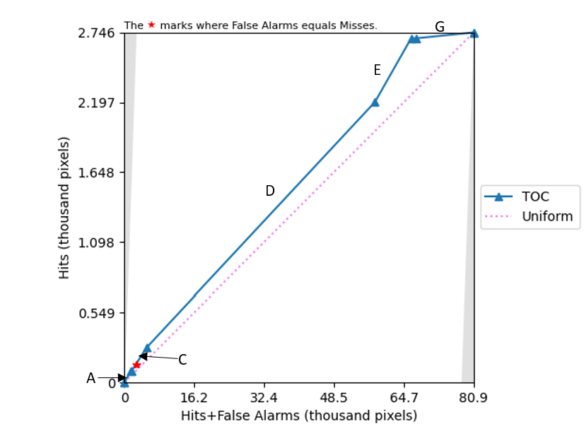
Interpretation of the TOC curve and slope variability
The blue line represents the TOC curve. The segments labeled A to G between each triangle represent a class in the 1971 land use. These classes are open land, mining, pasture, forest, cropland, urban land, and others ranked in order of suitability. Also, the length of each segment represents the number of pixels of the class in the extent (80.9). The curve starts from origin 0 where there are no hits and false alarms, and increases slightly in steepness from the Uniform line between segments A to B(overlapped with A because it has a smaller number of pixels), and C. The curve then increases in length in segment D (Forest) which has the largest quantity of pixels that are candidates for change. Segment E (cropland) has the steepest slope from the uniform line and has the second-highest pixel counts. The curve’s steepness flattens after E to segments F and G, where F is also a class with a small number of pixels hence the overlapping. Also, the red star on the curve represents the correct quantity of change which is in Pasture.
The slope between segments of the curve indicates the intensities at which change of Built or Hits is occurring in each land cover class. For example, Segment E has the steepest slope indicating that change in Built occurs most intensely in class cropland. Also, segment G has the least steep slope indicating change in Built was less targeted in those classes. Segment D’s slope is almost parallel to the uniform line, which shows change is almost random at that segment. The slope from A to C shows a gradual increase in the intensity of change in Built from open land to Pasture.
The TOC curve shows stationarity if the steepness of the slopes between segments is consistent. However, the curve is non-stationary because the pattern of the calibration interval is different from the pattern during the validation interval which is why the TOC curve is steeper with variability in slopes between segments as seen in A to C, and D, E, and F to G.

