Slide 1
GEOG 260-01-F23 Assignment 4
Adeline Akansobe

Slide 2
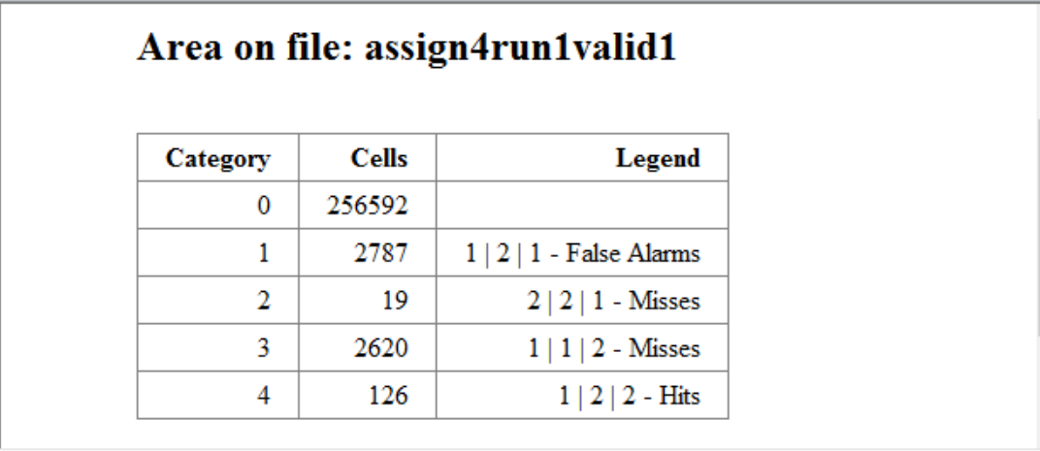
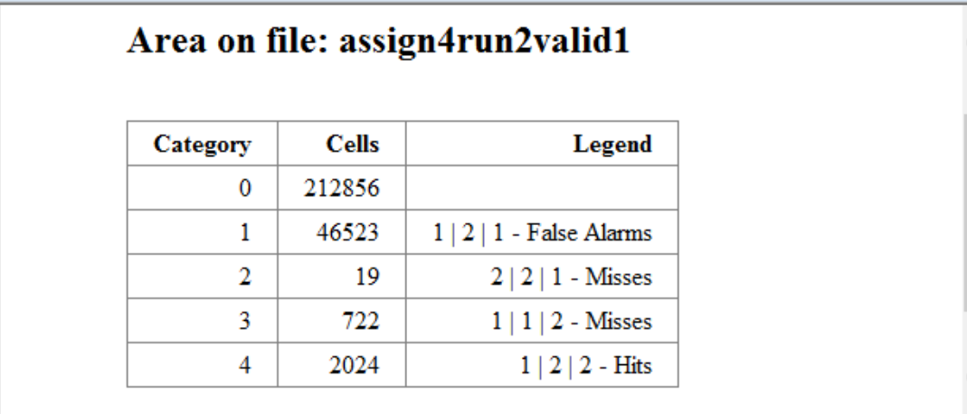
Validation of Simulated Change from 1985 – 19999 using CROSSTAB
The Markov matrix dictates entirely the quantity of change during the simulation. As a result, the Markov matrix also dictates the quantity of Hits, False alarms, and Misses. For example, if we have more False alarms than Misses, then the Markov matrix is overestimating the quantity. There are 167 more False alarms than Misses for Run 1 and 45801 more False alarms than Misses for Run 2, which exemplifies the previous statement. Comparing Runs 1 and 2 on the right table, there is an increase in the number of Hits when we increase the quantity in the Markov matrix. Thus, overstating the quantity presents an opportunity to make more errors, but also increases the number of Hits as shown in the table for Run 2.

Slide 3
Validation of Simulated Change from 1985 – 19999 from LCM
LCM uses two-time points (1971 and 1985) to generate a prediction map of 1999. And then uses this 1985, 1999 predicted map and the actual 1999 map to generate the validation. This results in a map that does not show areas that where Correct Rejections and Persisted in 1999. Additionally, LCM validation maps show two misses which at a glance one will think are the same although they are different. The first Miss 2|2|1 indicates a Miss of Non-Built and the second Miss 1|1|2 shows a miss of Built.

Slide 4
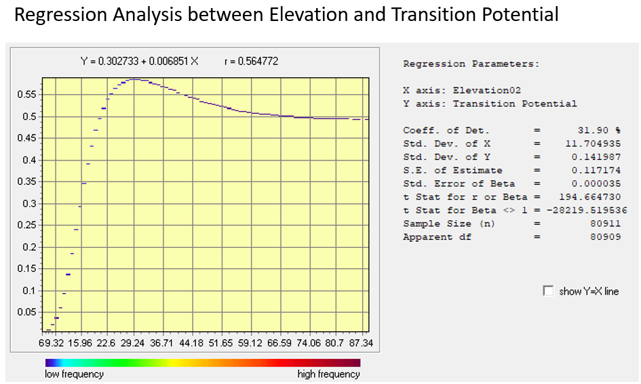
Parameters used for the Regression Analysis
In the regress module, the mask is used to limit the analysis to only pixels that are a subset of the pixels in the extent. The number of pixels of the subset influences the outcome of the relationship between the Elevation and the transition potential map. The built pixels in the 1985 map were used to simulate the suitabilities and, thus, would remain built in 1999 and should be excluded. Thus, we used only the non-Built pixels because these are the pixels that are candidates for change in 1999 and masked the built pixels.
The regress module uses these parameters above to generate a regression plot that shows the relationship between the Elevation and the transition potential map. The plot also shows that Transition potential is highest at about 0.57 at Elevations around 29.42-30m therefore this elevation will be ranked highest or prioritized in the sequence of where the changed pixels are allocated. We can infer that developers avoid elevations 29,42-30 and 6m and rather targeted 59m and above, where the transition values gain a constant value of about 0.5 to 87m.

Slide 5
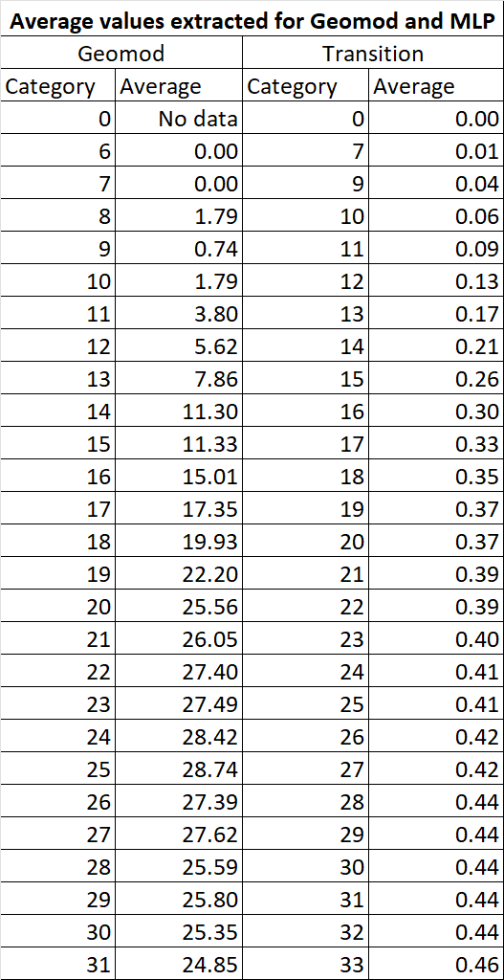
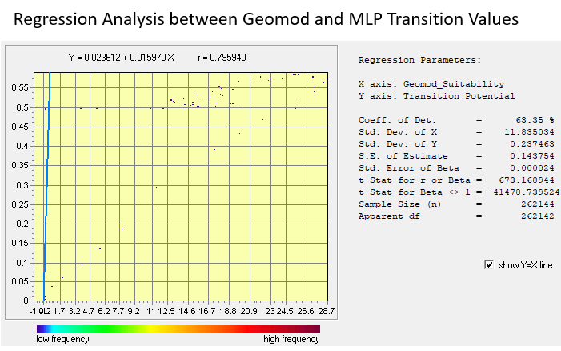
Comparison between Geomod Suitability and Transition Potential Values
Geomod’s suitability values were calculated based on where people had built previously in the calibration year(1985). These values in Geomod are computed in percentages and range from 0-100. The map shows a range of 0-50 because it was rescaled. The highest suitability values are on elevations that were already built. As of 1985, elevation 25 had the highest suitability of 28.55 and the lowest suitability of built of 6 and 7 at 0m. MLP on the other hand derives its transition values from where people built between 1971 and 1985. MLP’s transition values are in a range of 0-1 with the highest suitability on 76m and lowest suitability of 0 on 0m.
Also comparing both Geomod and MLP for elevations 0-33m (in Table), assuming we pick an elevation 25m the suitability from Geomod is 28.74, and at that same elevation the MLP transition value is 0.41.
Additionally, using the regression module if the values are the same, would expect to see a one-to-one relationship. However, when you trace a suitability value of 0.2 in Geomod (x-axis) using the one-to-one line, it intersects an MLP transition value of 0.5 on the y-axis. This indicates the values are different.

