Slide 1
GEOG 260-01-F23 Assignment 5
Adeline Akansobe

Slide 2
Validation of Simulated Change from 1985 – 19999 using CROSSTAB

Slide 3
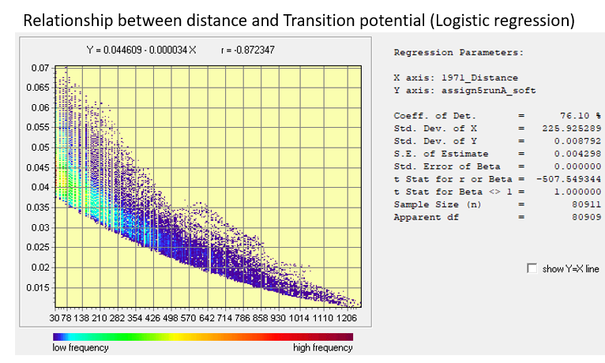
Simulated Change from 1985 – 2085 using Logistic Regression (Run A)
The average transition potential value is 0.036 which is the proportion of the gain of Built that occurred at the calibration, thus 4% of the Non-Built in 1971 became built in 1985.
A larger average transition potential does not indicate a larger quantity of built allocated but only shows the spatial distribution of the gain of built, however, it is Markov’s matrix that dictates the allocation.
In stage 1, 16182 pixels gained built and the same quantity of change of built occurred in stage 2, and the constant quantity of gain is because the LCM is assuming a linear increase in quantity between the two stages (50-year interval) although it should have been a 40% gain of built based on the Markov’s matrix.
LCM uses the transition potential map to allocate the gain of built based on the ranks on the transition potential map, thus combining this and the regress module, LCM allocates pixels first to areas with high transition potential values (higher ranks) and these are at closer distances (30-78m) to areas that were already built while areas with lower potential values (lower rank) that are further away from the Built persistence having persistence of non built.

Slide 4
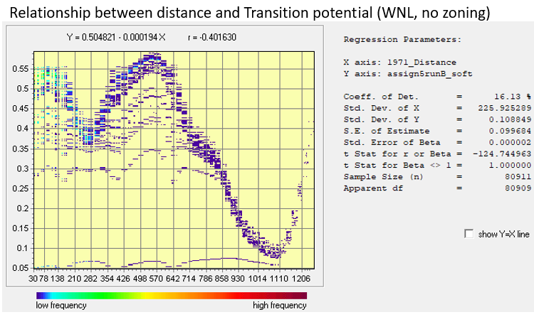
Simulated Change from 1985 – 2085 using WNL and no zoning (Run B)
An average transition potential value of 0.455364 indicates that pixel is a candidate for persistence of Non-Built in 2085 since it is less than 0.5.
A larger average transition potential does not indicate a larger quantity of built allocated but only shows the spatial distribution of the gain of Built, however, it is Markov’s matrix that dictates the allocation, and thus values greater than 0.5 show that they are candidates for the gain of Built.
Similar to Run 1, there was a gain of 16182 pixels built in each stage and this is because LCM is assuming a constant linear increase in quantity between the two stages (50-year interval) although it should have been a 40% gain of built based on the Markov’s matrix.
LCM uses the transition potential map to allocate the gain of built based on the ranks on the transition potential map, thus combining this and the regress module, LCM allocates the gain of built first to areas with high transition potential values (greater than 0.5) which are areas about mid-distance (498-570m) from persistence of built while areas with lower potential values for example 1110m are given non Built persistence.

Slide 5
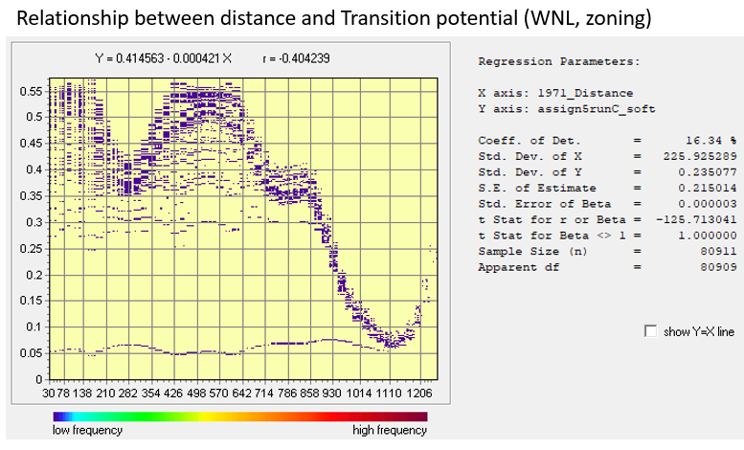
Simulated Change from 1985 – 2085 using WNL, Zoning, and constraints
The average transition potential value is 0.307058 which indicates that pixels with this value will experience persistence of Non-Built in 2085.
A larger average transition potential does not indicate a larger quantity of built allocated but only shows the spatial distribution of the gain of built, however, it is Markov’s matrix that dictates the allocation, and thus values greater than 0.5 show that they are candidates for the gain of Built.
Similar to Run 1, there was a gain of 16182 pixels built in each stage and this is because LCM is assuming a constant linear increase in quantity between the two stages (50-year interval) although it should have been a 40% gain of built based on the Markov’s matrix.
LCM uses the transition potential map to allocate the gain of built based on the ranks on the transition potential map, thus combining this and the regress module, LCM allocates the gain of built to areas with high transition potential values (greater than 0.5) which are areas between 30-120m, and 426-642m, from persistence of built and protected areas while lower transition potential values are given persistence of non Built.

Slide 6
Independent Variables

Slide 7
Transition Potentials and Markov Matrix

Slide 8
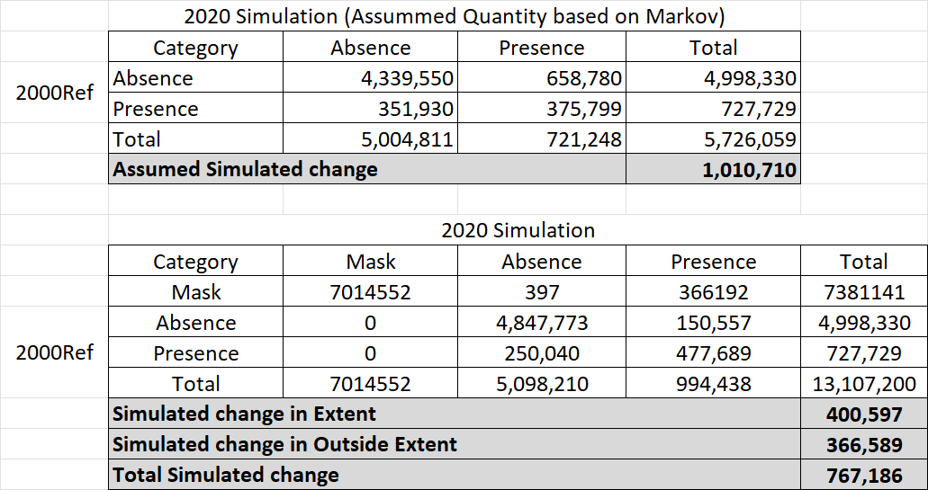
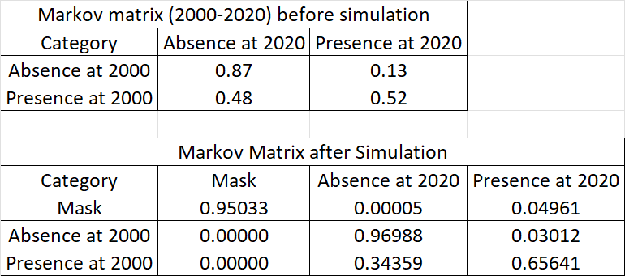
Comparison of Markov Matrix before and after Simulation
Markov matrix based on the default proportion was to simulate 1,010,710 with proportion in table B, with changes within the extent.
Simulated change was 767,186 of which 366,5589 pixels were outside the extent.
A
B

Slide 9
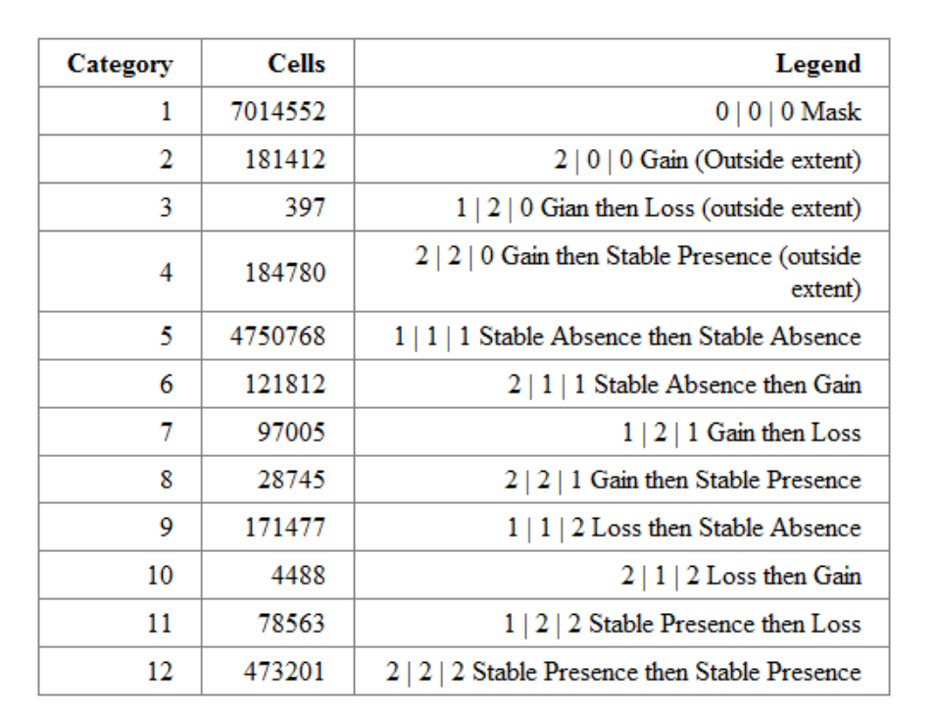
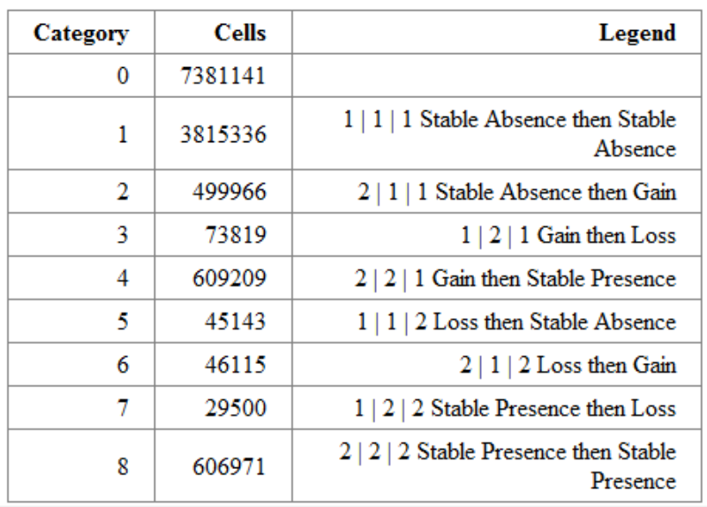
Transition Potentials and Markov Matrix

Slide 10
NEXT STEPS
Investigate why the Land Change Modeler simulates change beyond the extent.

