Slide 1
GEOG 260-01-F23 Assignment 6
Adeline Akansobe

Slide 2
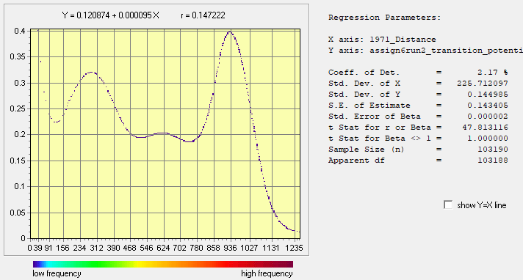
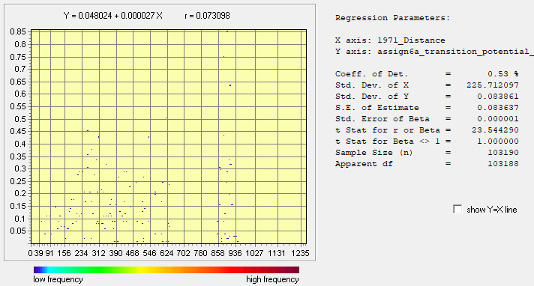
SVM & Decision Forest Transition Potentials & Regress modules( Forest to Other)
Run A
Run B
Relationship between Distance and Transition Potential from 1 to 2 (SVM)
Relationship between Distance and Transition Potential from 1 to 2 (DF)
x = 1971- Distance to Built
y = Transition potential from Forest to Other
x = 1971- Distance to Built
y = Transition potential from Forest to Other

Slide 3
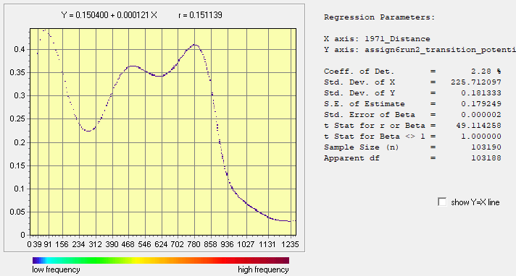

SVM & Decision Forest Transition Potentials & Regress modules( Forest to Built)
Run A
Run B
Relationship between Distance and Transition Potential for 1 to 3(SVM)
Relationship between Distance and Transition Potential for 1 to 3(DF)
x = 1971- Distance to Built
y = Transition potential from Forest to Built
x = 1971- Distance to Built
y = Transition potential from Forest to Built

Slide 4

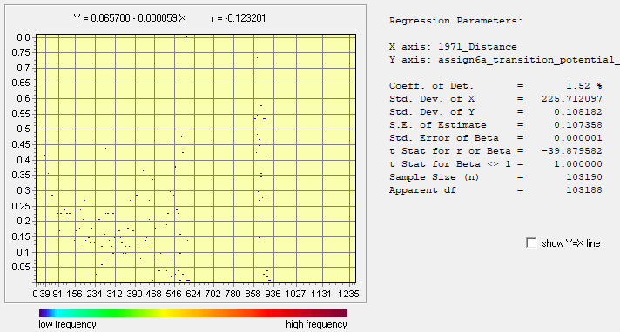
SVM & Decision Forest Transition Potentials & Regress modules(Other to Built)
Run A
Run B
Relationship between Distance and Transition Potential for 2 to 3(SVM)
Relationship between Distance and Transition Potential for 2 to 3(SVM)
x = 1971- Distance to Built
y = Transition potential from Other to Built
x = 1971- Distance to Built
y = Transition potential from Other to Built

Slide 5
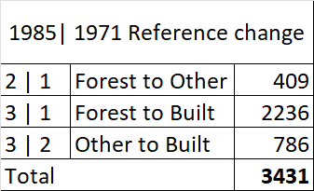
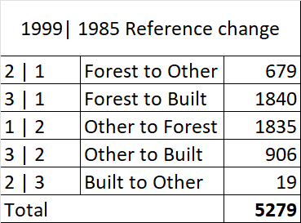
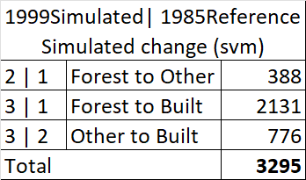
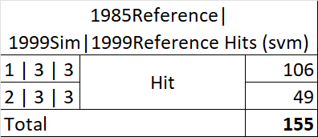
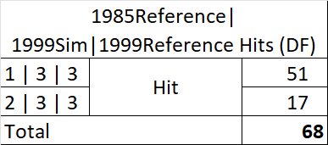
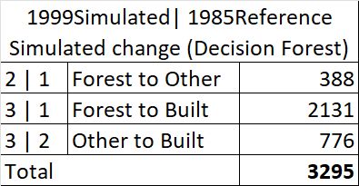
Simulated Change from 1985 – 1999 validation using CrossTab
A
B
C
D
The total number of Hits using SVM is 155 as shown in Table D, of which 106 were simulated as the change from Forest to Built and 49 changed from Other to Built, and were actually Built in the 1999 reference.
During the 1985-1999 time interval, the simulated change is 3295 pixels ( Table C) and the reference change is 5279 pixels as indicated in Table B.
Also applying the crosstab of 1971 and 1985, the total reference change between calibration time is 3431 pixels (Table A). These changes are Forest to Other (409), Forest to Built (2236), and Other to Built (786).
The difference between the change during the calibration and validation time intervals shows that the pattern of change has accelerated. Also, the simulated change is lesser because the inputs that the Land Change Modeler (LCM) uses in the extrapolation is the change from the calibration period and Markov’s matrix and thus does not have any information about the quantity of change in 1999. Also the the simulation based on linear change which in actuality isn’t. Hence the difference in the quantity of change.
Decision Forest on the other hand produced total Hits of 68 as shown in Table E, of which 51 were simulated change from Forest to Built and 17 Other to Built, and were actually Built in the 1999 reference map.
During the 1985-1999 time interval, the simulated change is 3295 pixels ( Table F).
E
F

Slide 6
Factors to consider in choosing an algorithm
Most of the algorithms used in land change modelers to simulate the quantity of change, however, these models for example the Land Change Modeler use inputs that do not include any details or information about the quantity of change during the validation period. This would result in any algorithm used to either overpredict or underpredict the change. Therefore, I would suggest that the researcher chooses an algorithm that the researcher can understand and control, the researcher’s audience can understand, and an algorithm that is relevant to the research question.
Additionally, in choosing an algorithm, there should be adequate documentation about how it operates. The documentation must include information about how the model overfits or underfits relationships to patterns and whether the behavior matches what the documentation states. Thus, if scientists determine that the model behaves as the documentation advertises, then they can conclude that it is verifiable. If the model and algorithm generate a relationship that is specific to the pattern of the calibration data then it is overfitting. Finally, since these models and algorithms are used to simulate the patterns in the data and then to extrapolate into the future, it is important to compare these simulations to real-world occurrences or reference data. It is therefore important to carry out this exercise called validation which can reveal errors in the simulations and ultimately inform the decision about which model and algorithm to select for the research question.

