Slide 1
GEOG 260-01-F23 Assignment 7
Adeline Akansobe

Slide 2
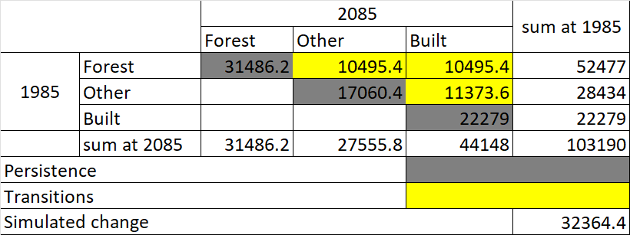
Markov’s Matrix used for Simulated change in 2085
The calculations for the number of pixels of transitions and persistent categories from 1985 to 2085 were based on Markov’s matrix where the Forest row has its 2085 quantity being proportions of 0.6, 0.2, and 0.2 of Forest at 1985. The Other category row also had proportions of 0.0, 0.6, and 0.4 of Other in 1985; and finally Built row had 0.0, 0.0, 1.0.
The three transition categories from 1985 to 2085 are Forest to Other - 10495.4 pixels, Forest to Built - 10495.4 pixels, and Other to Built also 11373.6 pixels.
The categories that persisted are Forest, other, and Bult, with pixels of 31486.2, 17060.4, and 22279 respectively.

Slide 3
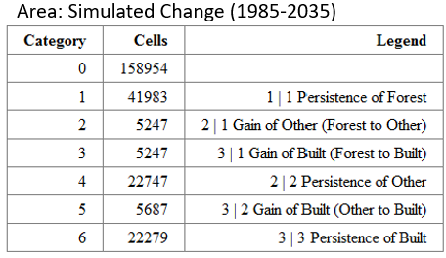
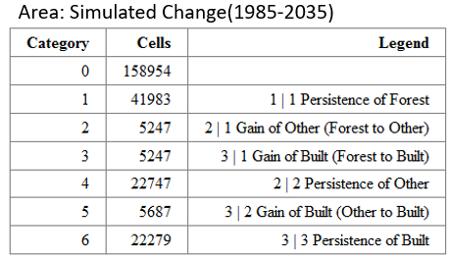
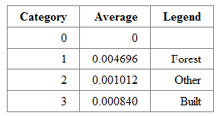
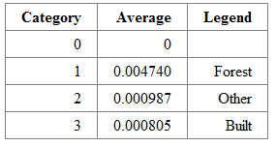
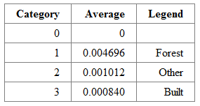
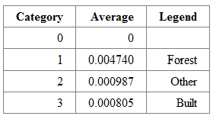
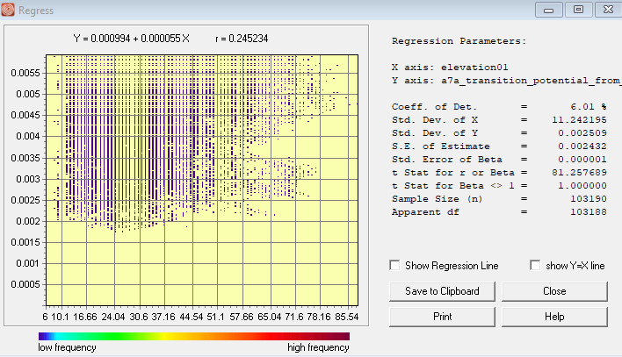
CrossTab of Simulated change from 1985 – 2035 ( 2035| 1985)
Run 1
Run 2
a
d
Average Transition Potential Values on Forest to Other
b
Average Transition Potential Values on Forest to Other
e
5247, 5247, and 5687 pixels transitioned from Forest to Other, Forest to Built, and Other to Built respectively in 2035 as illustrated in table a.
The transition potential maps for Forest to Other and Forest to Built are identical thus the average transition potentials of the two transitions are the same in table b. Therefore, using the Forest to Other transitions, the forest category has the highest average value of 0.004696, pixels will be allocated to these first before the rest, which occurs mostly at elevations from 10m-65m as shown in Figure c.
Run 2 also had the same quantities that transitioned from Forest to Other, Forest to Built, and Other to Built as shown in table d.
Similar to Run 1, The transition potentials for Forest to Other and Forest to Built are the same although this has higher average transition values. Forest has the highest of 0.004740 hence pixels will be allocated to these first to areas from 10m-65m before the rest.
Average Transition Potential Values on Forest to Built
Average Transition Potential Values on Forest to Built
c

Slide 4
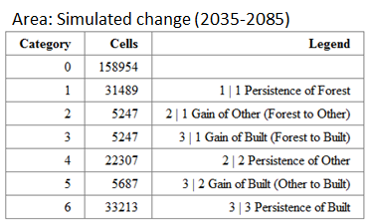
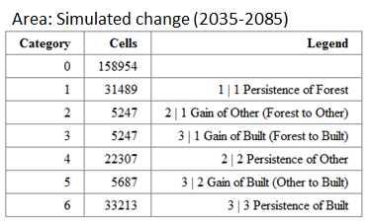
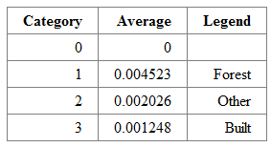
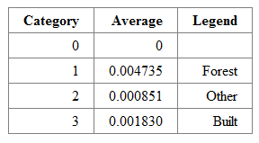
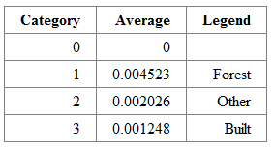
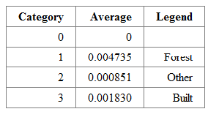
CrossTab of Simulated change from 2035 - 2085 ( 2085| 2035)
Run 1
Run 2
a
e
Average Transition Potential values for Forest to Other
b
f
In Stage 2 of Run 1, the number of pixels that transitioned from Forest to Other, Forest to Built, and Other to Built are 5247, 5247, and 5687 respectively in 2035 as shown in table a.
The transition potential values for Forest to Other and Forest to Built are identical as shown in tables b and c. Therefore, using Table b, the forest category has the highest average value of 0.004523, pixels will be allocated to these first before the rest.
Just like Run 1, Run 2 also had the same quantities that transitioned from Forest to Other, Forest to Built, and Other to Built as shown in table e.
Similar to Run 1, The transition potentials for Forest to Other and Forest to Built are the same although this run has relatively higher average transition values. Forest has the highest of 0.004735 hence pixels will be allocated first to areas of forest around 10m-65m.
Average Transition Potential values for Forest to Other
Average Transition Potential values for Forest to Built
c
Average Transition Potential values for Forest to Other
g

Slide 5
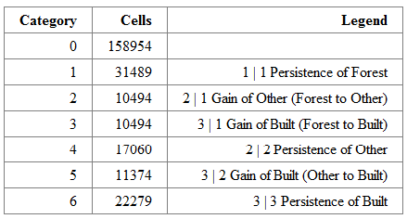
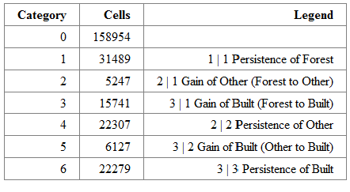
CrossTab of Simulated change from 1985 - 2085 ( 2085| 1985)
Run 1
Run 2
a
b
Area: Simulated Change from 1985-2085
Area: Simulated Change from 1985-2085
From table a, 10494 pixels transitioned from Forest to Other, Forest to Built also had 10494 pixels transitioning, and finally a total of 11374 pixels transitioned from Other to Built in 2085. Thus a total of 32362 pixels transitioned.
From table b, Forest to Other, Forest to Built, and Other to Built had transitions of 5247, 15741, and 6127 respectively in 2085. Therefore, the total transitions in 2085 is 27115.

Slide 6
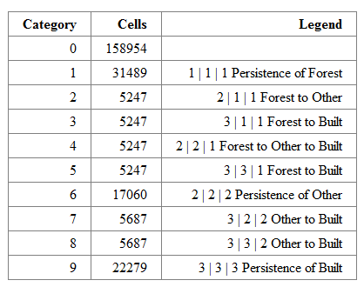
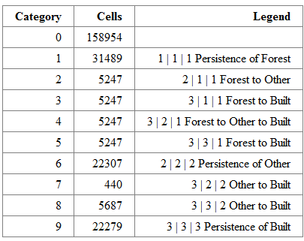
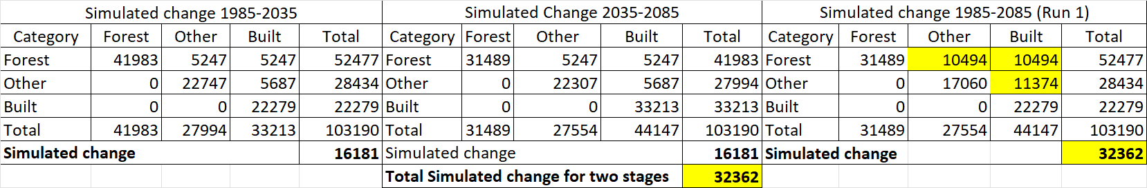

Comparison between Simulated change using Static and Dynamic Logistic Regression
Run 1
Run 2
a
c
b
d
Run 1- Using crosstab of the calibration map of 1985 and simulated 2085 as shown in Table b, a total of 32362 pixels experienced change which tallies with the sum of the simulated changes for the two stages. The similarity in simulated change is because of the Static variable used. This assumes that the pixels that are candidates for change after stage 1 are not considered candidates for change in stage 2.
Also, the Simulated change is almost the same as simulated pixels in Slide 2 although Run 1 is less by 2 pixels. But comparing the portions, it is the same as the proportions used to derive the simulated pixels in slide 2.
While in Run 2, the simulated change between 1985-285 is 27115 which is less than the sum of simulated change for the two stages (32362), and also lesser than the Simulated change of 32364 calculated in Slide 2. The difference in the quantity of change is a result of the Dynamic (Run 2) variable used where pixels that transitioned in stage 1 are used again as candidates for change in stage 2. This results in some pixels transitioning twice as shown in category 3|2|1 in Table c where 5247 pixels of Forest transitioned to Other in 2035 and transitioned again to Built in 2085.

