Slide 1
GEOG 260-01-F23 Assignment 8
Adeline Akansobe

Slide 2
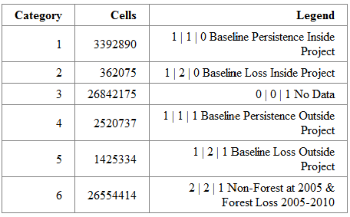
Baseline Simulated Change at 2040 without protect (Run 1)
Area: 2040 Simulated change with constraints
a
Using the 2010 cover| Run1-2040prediction| Boolean of not protected for the 3-way crosstab, the total baseline forest loss (deforestation) inside the project in Table a is 362075. While baseline forest loss outside the project is a total of 1425334.

Slide 3
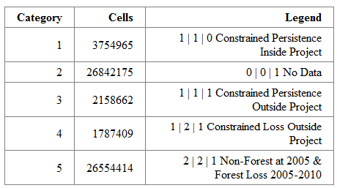
Baseline Simulated Change at 2040 with constraints as Project (Run 2)
Area: 2040 Simulated change with constraints
a
Using the 2010cover| Run2-2040prediction| Boolean of not protected images for the 3-way crosstab, the total constrained forest loss outside the project is a total of 1787409.

Slide 4
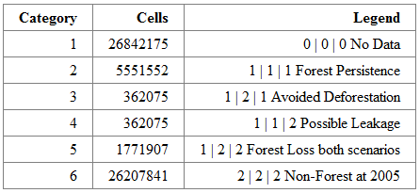
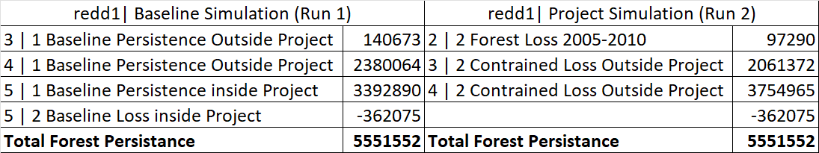
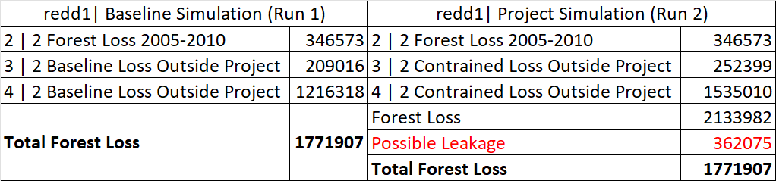
Comparison between Baseline Simulation and Project Simulation at 2040
Area: 2040 Simulated change with constraints
a
b
c
Forest persistence 1| 1| 1 – These are true forest after 2005 in both simulations inside and outside of the project. However, the simulated loss inside the project needs to be taken out as shown in Table b.
Avoided Deforestation 1| 2| 1 – This is 2005 forest that was lost during the 2040 baseline simulation but was retained because the area falls inside the project in the 2040 project simulation.
Possible leakage – Forest in 2005 simulated as forest loss inside the project in the baseline simulation, but because that area becomes a protected area, this loss is allocated to different places outside the project.
Forest Loss in both Scenarios – is the combination of forest loss between 2005-2010, total loss outside the project in the Baseline simulation. This same quantity of forest loss is realized in the constrained 2040 simulation. However, this does not include the possible leakage (362075) of forest loss that was allocated as forest outside the project. A detailed breakdown is shown in Table c.
No Data and Non-Forest in 2005 persisted in both simulations.

Slide 5
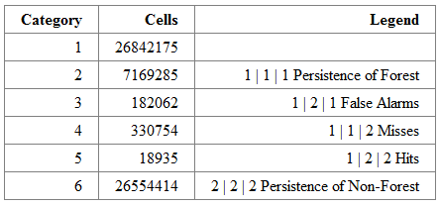
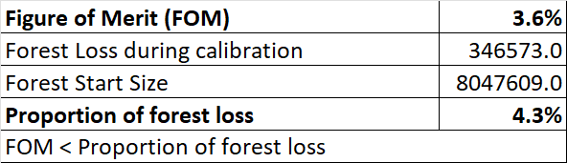
Validation of simulated change in 2013 (Run 3)
Area: validation of Simulated change in 2013
a
b
In Run 3, 182062 False Alarms are pixels that are forest persistence in both calibration and 2013 reference but the model simulated it as the forest loss. 330754 Misses are pixels of true forest loss in the 2013 reference but the model simulated those areas as forest persistence. 18935 Hits are pixels that have true deforestation in the 2013 reference and are true simulated forest loss in 2040. Finally, both persistence of forest and non-forest are true forest and non-forest persistence in the simulation and 2013 reference.
Table b was derived from the Figure of Merit (FOM) formula; FOM = Hits / (Misses + Hits + False Alarms)
For a simulation model qualifies when; FOM > |Forest Loss during calibration|/Forest Start Size
From the calculation in Table b the FOM of 3.6% is less than the proportion of forest loss of 4.3%, therefore project does not qualify.
For FOM to qualify, I would make changes to the main parameters that influence how the simulated change is allocated in the right areas and the right quantity used. Since transition potential maps control the spatial allocation and Markov’s control quantity, I will add more constraints and variables as we did in assignment 5 to constrain the transition potential map. Also, in assignment 6 we compared SVM and Decision Forest (DF) algorithms, where we realized that SVM produced more Hits than DF. Thus, I will also use different algorithms to see which algorithm gives a simulated change with an increased FOM. Thus, I will choose an algorithm with extra variables that gives an increased FOM.

