Slide 1
Agenda for GEOG260/360 GIS & Land Change Models
Today
See grading rubric and ask Questions on Assignment 1
Philosophies of Scenario Modeling versus Predictive Modeling
Discuss https://www.theguardian.com/environment/2023/jan/18/revealed-forest-carbon-offsets-biggest-provider-worthless-verra-aoe and a response at https://www.sylvera.com/blog/guardian-offsets-response
Introduction to Geomod
September 13
Assignment 1 is due at 4pm via Canvas. Each hour late incurs a one percentage point penalty.
Get instructions for Assignment 2
Geomod land change allocation model in TerrSet
September 15 Deadline to declare Pass/Fail Grade

Slide 2
Grading Rubric for Assignment 1
The Excel file is organized into exactly four sheets: ReadMe, Input, Output, and Figure. 5 points
Goal Seek is used to adjust the time points. 25 points
The Scenario Manager is used for storing data in grey cells of the Input sheet. 25 points
The calculations are completed for Exponential, Sigmoidal, and Deviation using Excel techniques in the Output sheet. 20 points
Scatter plot is used to plot the data in Output sheet. 10 points
Necessary chart elements are used to make it informative. 10 points

Slide 3
Sushil Paudel
Sushil Paudel holds a Master of Science in Forestry from Agriculture and Forestry University, Hetauda, Nepal, and a Master of Science in Geographic Information Science and Systems from Salzburg University, Austria. He has been a Forest and GIS Officer at Expert Group Pvt. Ltd, Nepal, and a part-time GIS and Data Science instructor at Broadway Infosys Pvt. Ltd., Subidhanagar, Nepal. He has been involved in several Forest and Environmental assessment projects where he acquired field data and prepared Forest and Environment Management Plans for government agencies. His major interest is developing practicable forest resource inventory and analysis methodology using UAVs and deep-learning models for forest carbon assessment. Sushil has TerrSet working on his Mac laptop.

Slide 4
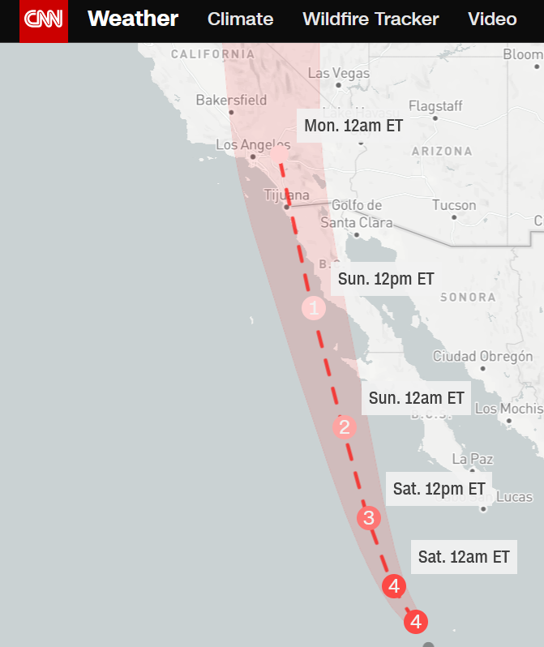
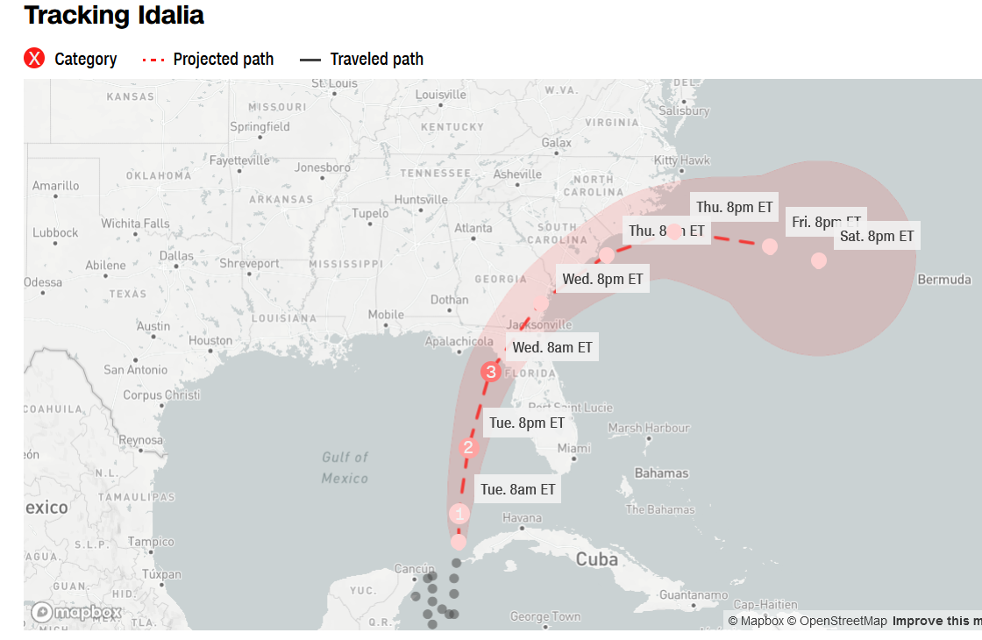
Can humans influence the path of the hurricane? What decisions will people make based on the output of this predictive model?

Slide 5
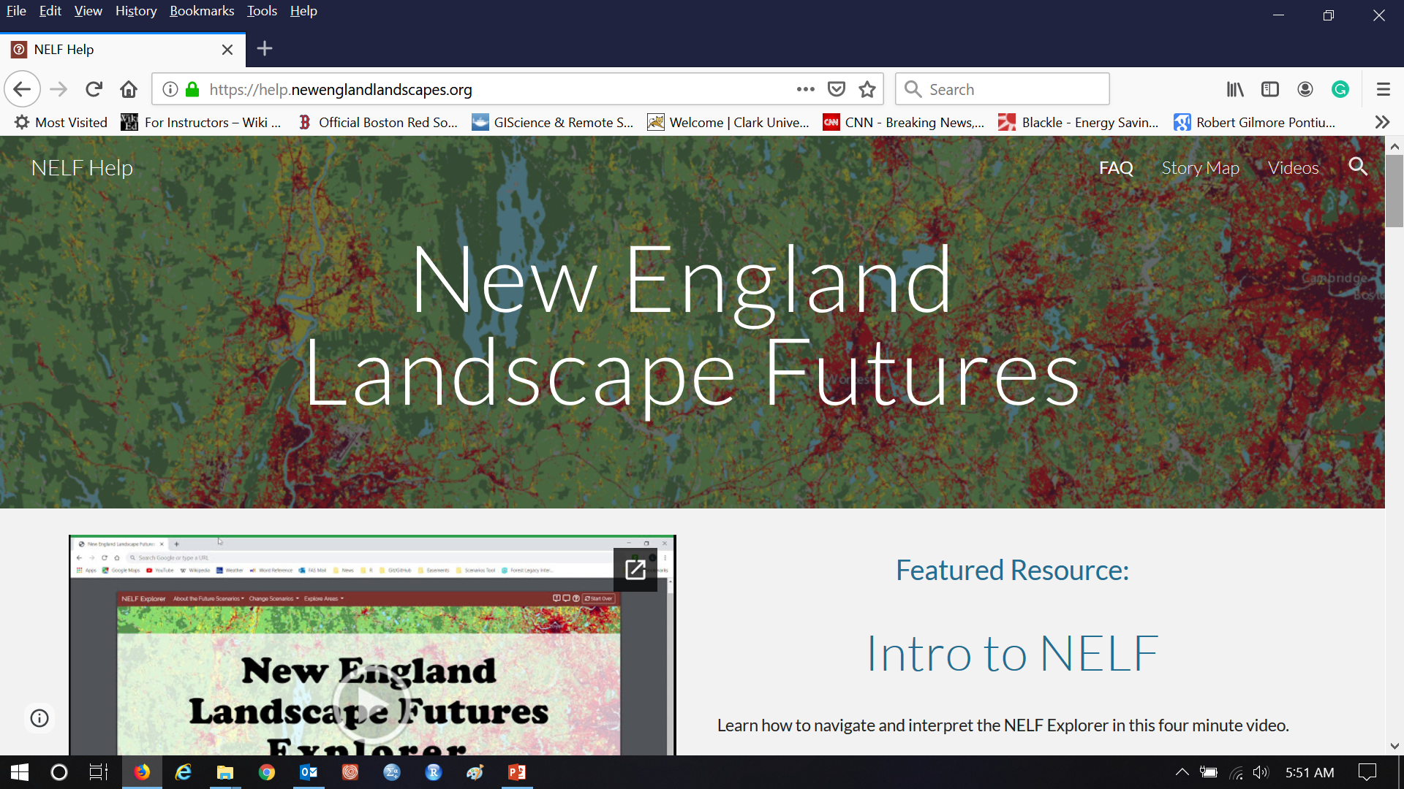
Can humans influence the path of land change? What decisions will people make based on the output of this scenario model?

Slide 6
Vocabulary
A prediction is the one thing that you think will occur.
A scenario is a story told in words, numbers and maps concerning one possible way the future could be.
A Recent Trends Scenario is a story of extrapolation of recent trends in the patterns of the data.
Is a Recent Trends Scenario a prediction?
Is it possible to make a Recent Trends Scenario when you lack knowledge of the processes?
New England Landscape Futures (NELF) has various alternatives to the Recent Trends Scenario. Each Scenario has a storyline concerning distinctive processes. NELF conducted meeting with stakeholders to develop the storylines.

Slide 7
The first step in modeling is to decide the goal.
Predictive modeling
The goal of predictive modeling is to portray the future that is destined to occur.
Model validation helps to understand how much trust we should have in the prediction.
Predictive modeling is helpful when it includes an assessment of the level of trust that the audience should have in the model’s output.
Scenario modeling
The goal of scenario modeling is to facilitate a conversation among stakeholders and decision makers.
Scenarios allow people to see the implications of their storylines assumptions.
Scenarios allow people to prepare for various possible futures.
Scenarios allow people to expand the way they think about the options for how to influence the future.
Scenario modeling is helpful when it allows people to make better decisions concerning how to influence the future.

