Slide 1
Agenda for GEOG260/360 GIS & Land Change Models
October 4
Get instructions for Assignment 5
October 9
No class
October 11
Tanner office hours in the Academic Commons 11am-1pm
Get instructions for Assignment 6
October 12
Tanner office hours in the Academic Commons 11am-1pm
October 13
Submit Assignment 5 by 4pm on Canvas
October 16
Discuss Assignment 6
October 18
Submit Assignment 6 by 4pm on Canvas
Get instructions for Assignment 7

Slide 2
Assignment 5
The purpose of this assignment is to see how LCM converts a combination of independent variables into a transition potential map. Use maps in ForestOtherBuilt2.zip to perform three runs of LCM where Earlier land cover image is 1971Built1 and Later land cover image is 1985Built1. Simulate the single transition from Non-Built to Built. Make a map of distance from pixels that are Built at 1971. Two independent variables are distance from 1971 Built and elevation01. Prediction date is 2085 where the Markov Matrix shows that 40% of Non-Built at 1985 transitions to Built at 2085, while all Built at 1985 remains Built at 2085. Set Recalculation stages to 2 and show intermediate stage images, create soft prediction, but do not create video. After each run, use CROSSTAB with maps of 1985Built1, hard prediction at stage1, hard prediction at 2085, and Mask01 to show the pattern of the hard prediction across two stages: 1985-2035 & 2035-2085.
Run A uses Logistic Regression with no sampling with no Zoning. Run B uses Weighted Normalized Likelihood (WNL) with no Zoning. Run C uses Weighted Normalized Likelihood (WNL) with Zoning that prevents simulated change in the protected areas as entered in the Planning tab.
Submit a PPTX with exactly five slides. Slide 1 is the title slide. Slide 2 shows the five input maps, meaning the earlier image, the later image, the independent variable of distance, the independent variable of elevation, and the Boolean protection map. Slide 3 analyzes run A, slide 4 analyzes run B, and slide 5 analyzes run C. Each of slides 3-5 shows: the soft output map, the CROSSTAB that shows the hard prediction of gain of Built through two stages, and a scatter plot from REGRESS. The scatter plot shows distance from 1971 Built as an independent variable, the soft prediction map as the dependent variable, and a mask to analyze only the pixels that are non-built at 1985.
On each of slides 3-5, include sentences that state the following for each run. State how many pixels gain built during each stage of each run and why. State how LCM uses the transition potential map. Report the average transition potential for each soft prediction map and state whether a larger average transition potential indicates a larger quantity of post-1985 gain of Built.

Slide 3
Rubric for assignment 5
Submit exactly one slide with your name(s). 5 points
Submit exactly one slide which includes the following bullets with a correct caption for each. 15 points
The earlier image. 2 points
The later image. 2 points
The Independent variable of distance. 5 points
The independent variable of elevation. 3 points
The Boolean protection map. 3 points
3. Submit exactly one slide which includes the following bullets for Run A. 25 points
The soft output map. 5 points
The sentence that reports the average transition potential for a soft prediction map. 2 Points
The sentence that states whether a larger average transition potential indicates a larger quantity of post-1985 gain of Built. 2 Points
The CROSSTAB which shows the hard prediction of gain of Built through two stages. 5 points
A scatter plot from REGRESS. 5 points
A sentence that states how many pixels gain built during each stage of each run and why? 3 points
A sentence that states how LCM uses the transition potential map. 3 points
4. Submit exactly one slide which includes the following bullets for Run B. 25 points
The soft output map. 5 points
The sentence that reports the average transition potential for a soft prediction map. 2 Points
The sentence that states whether a larger average transition potential indicates a larger quantity of post-1985 gain of Built. 2 Points
The CROSSTAB which shows the hard prediction of gain of Built through two stages. 5 points
A scatter plot from REGRESS. 5 points
A sentence that states how many pixels gain built during each stage of each run and why? 3 points
A sentence that states how LCM uses the transition potential map. 3 points
5. Submit exactly one slide which includes the following bullets for Run C. 25 points
The soft output map. 5 points
The sentence that reports the average transition potential for a soft prediction map. 2 Points
The sentence that states whether a larger average transition potential indicates a larger quantity of post-1985 gain of Built. 2 Points
The CROSSTAB which shows the hard prediction of gain of Built through two stages. 5 point
A scatter plot from REGRESS. 5 points
A sentence that states how many pixels gain built during each stage of each run and why? 3 points
A sentence that states how LCM uses the transition potential map. 3 points
6. Bonus. 5 points

Slide 4
Assignment 5 Data from ForestOtherBuilt2.zip

Slide 5
You must use the DISTANCE module to create this

Slide 6
Assignment 5 You will make three runs from 1985 to 2085. All runs have the same quantity of Built Gain. Run A uses Logistic Regression and No Zoning. Run B uses Weighted Normalized Likelihood (WNL) with no Zoning. Run C uses Weighted Normalized Likelihood (WNL) with Zoning. Logistic Regression is a popular statistical method that has existed for decades. Weighted Normalized Likelihood (WNL) is a method that was included in TerrSet2020. LCM’s planning tab allows the inclusion of Zoning, which helps users to create scenarios.

Slide 7
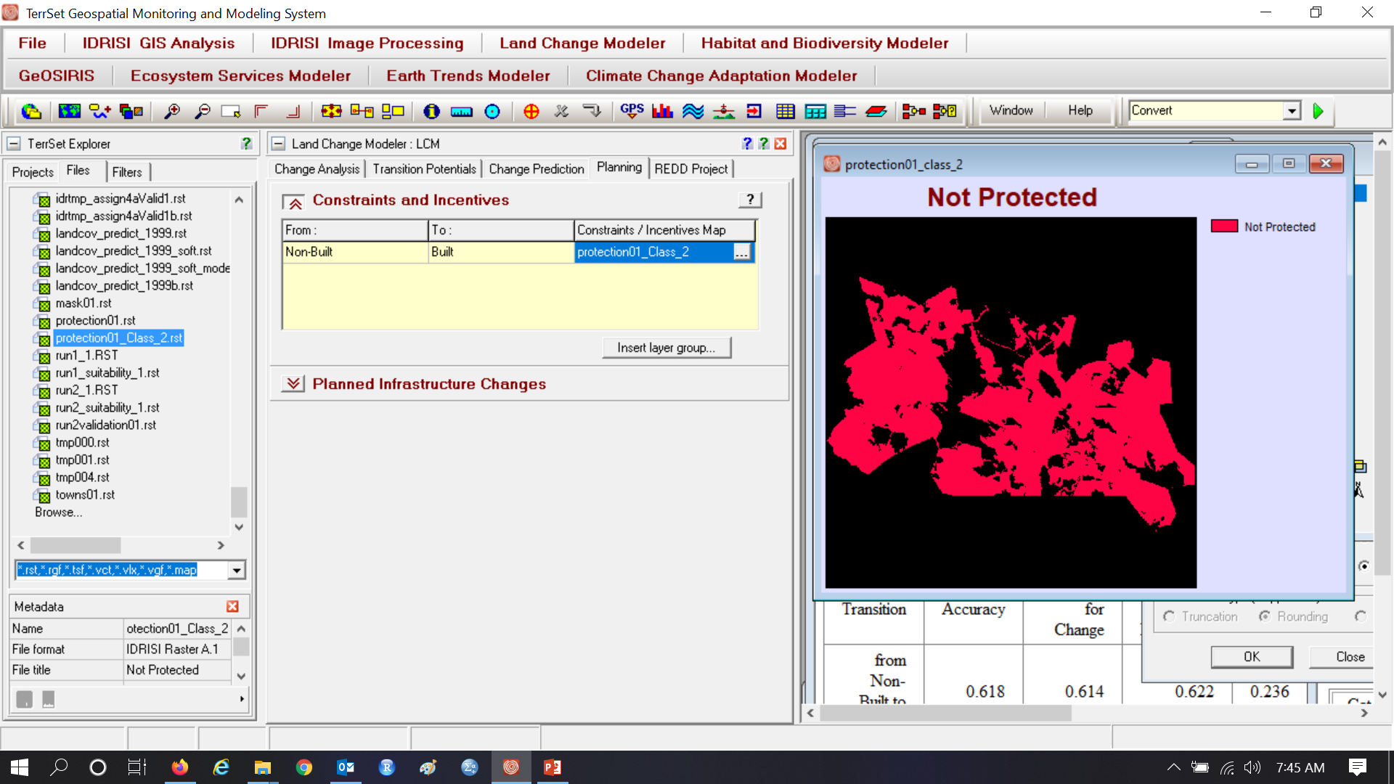
Run C uses the Planning Tab to prevent Gain on protected pixels. How should we use a map to force protected pixels to have zero suitability?

Slide 8
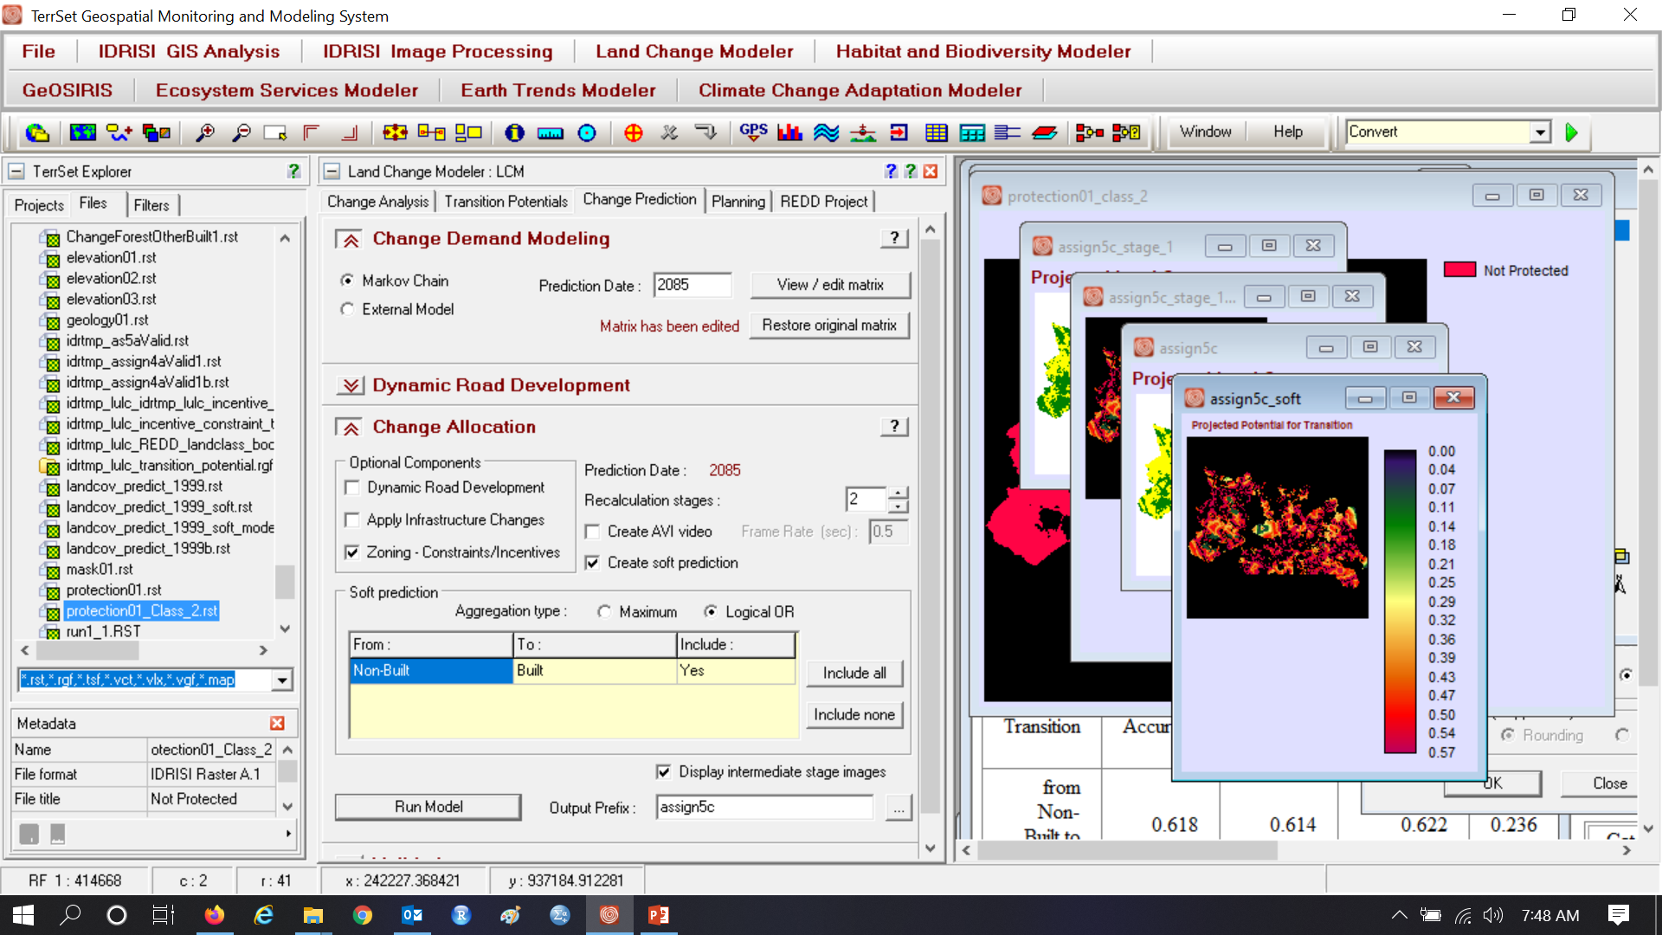
What will you enter for the Markov matrix? Run C incorporates zoning. Use 2 recalculation stages.

Slide 9
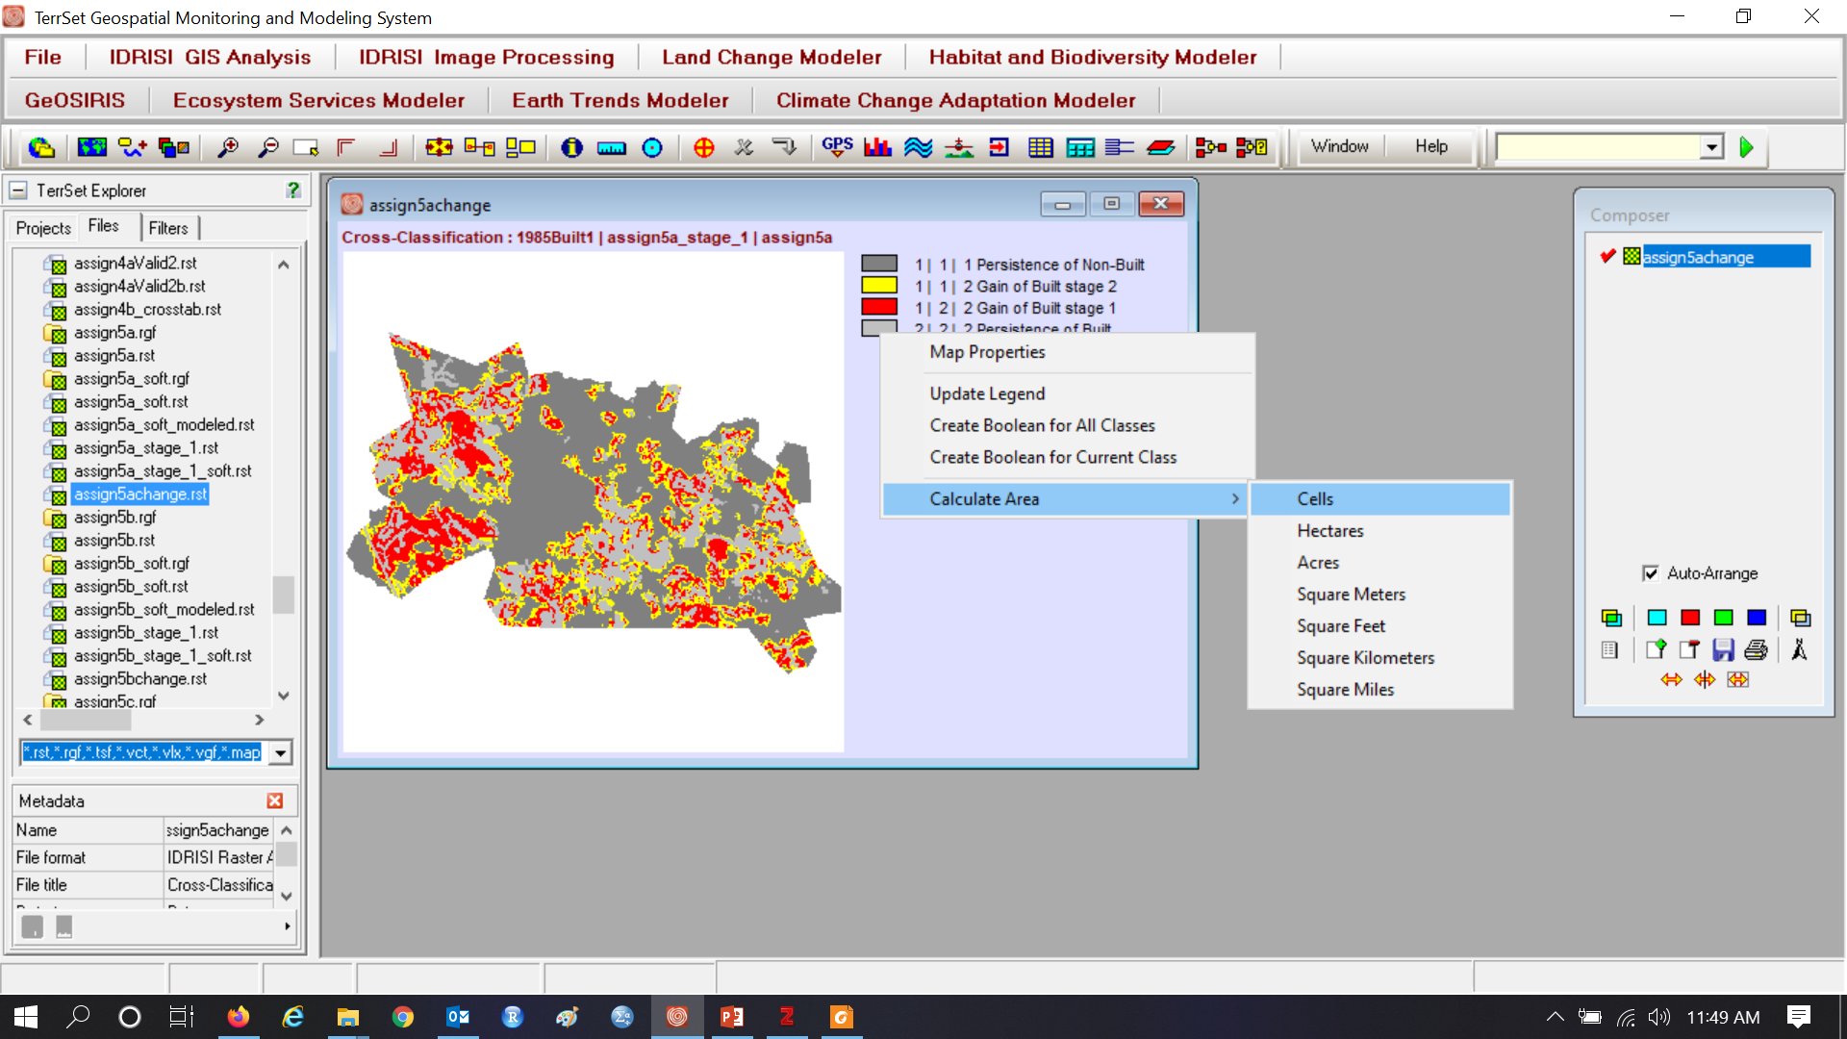
CROSSTAB reference 1985, simulated stage 1, and simulated 2085 simulated. Right click on legend to calculate area.

Slide 10
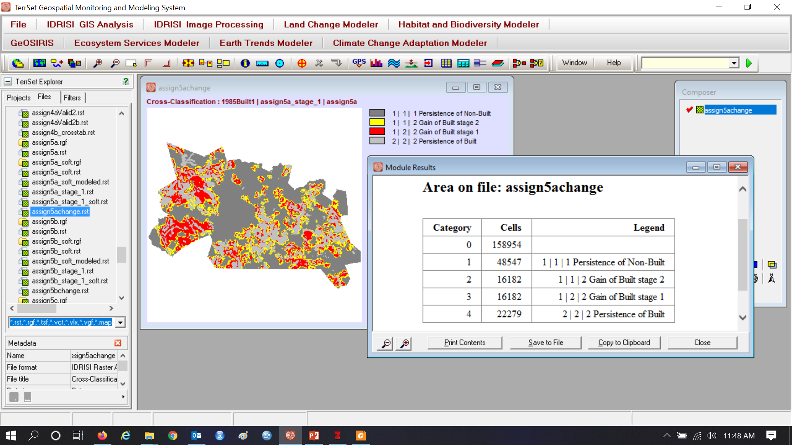
How many pixels gained built during each stage?

Slide 11
What explains the spatial arrangement of stage 1 and stage 2?

Slide 12
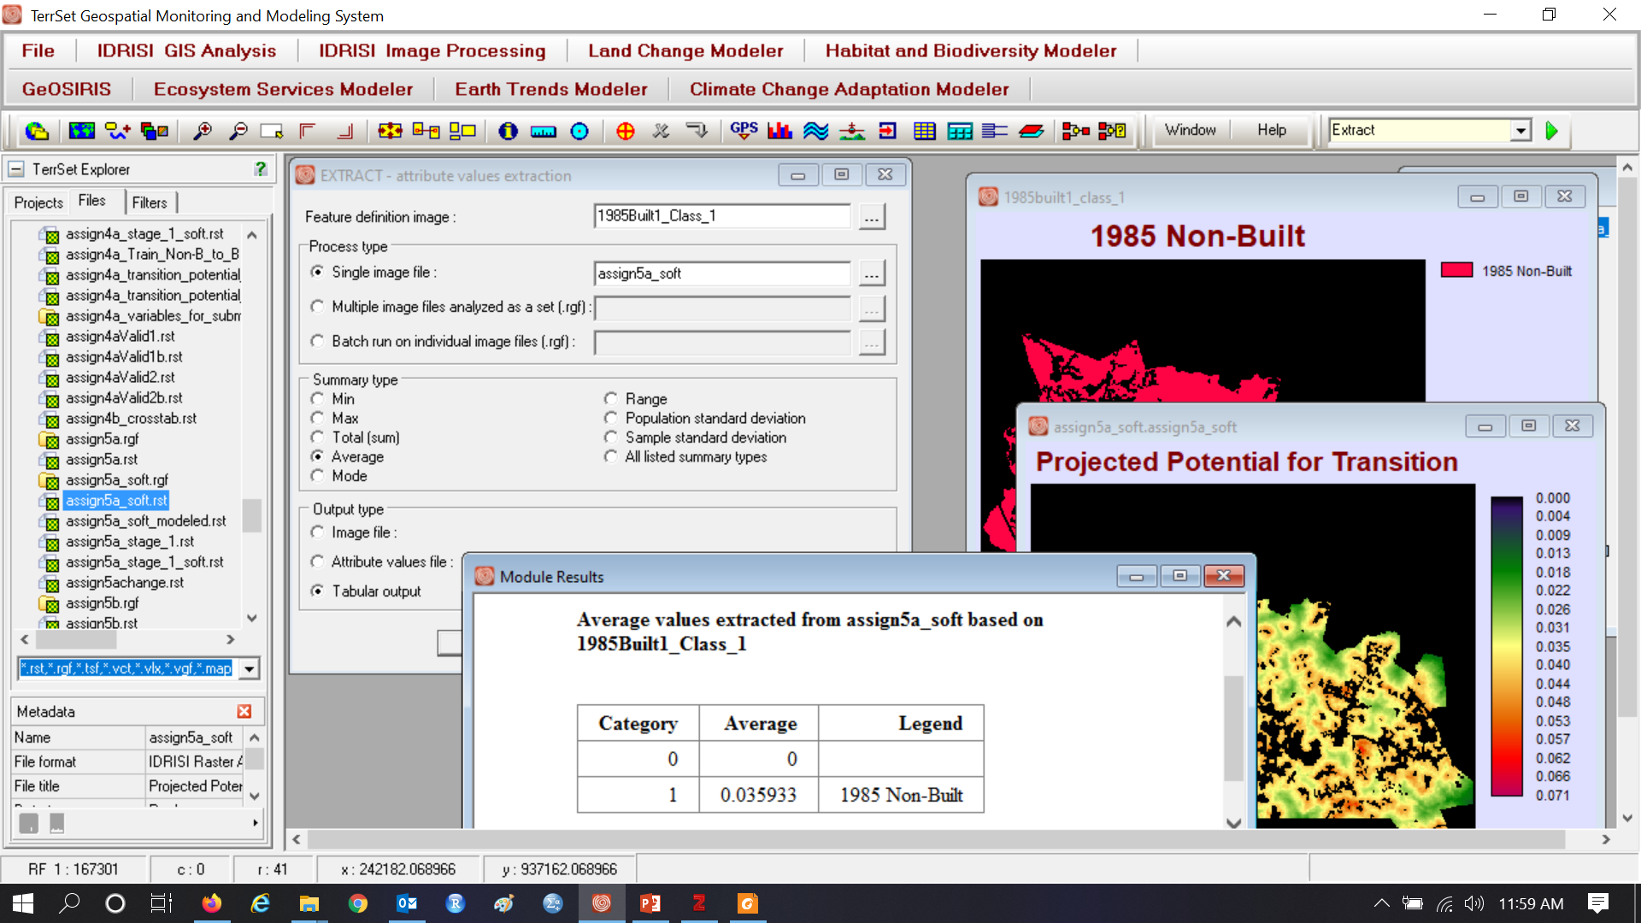
Use EXTRACT to compute average soft prediction for pixels that are non-built at 1985. Will larger transition potential values simulate more change? What determines and how do we interpret the average transition potential value?

Slide 13
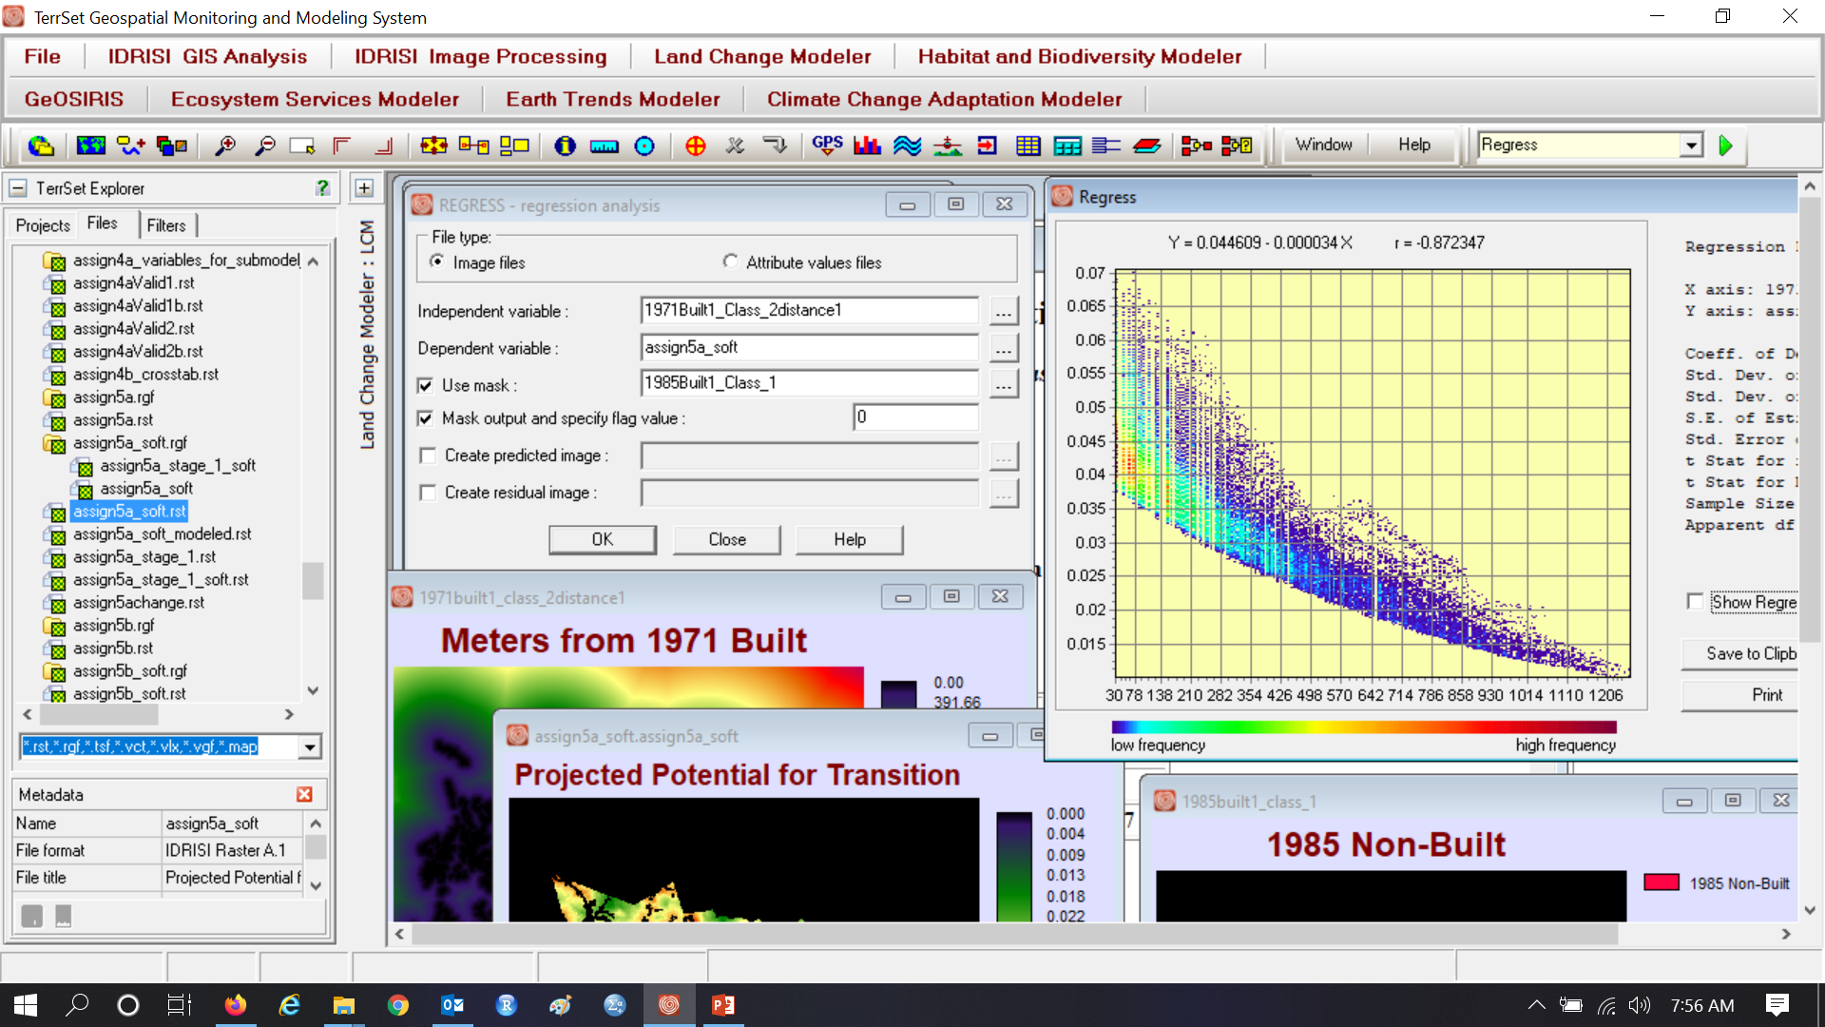
Run A transition potential versus distance from 1985 Built. How can we get more than one Y for each X?

Slide 14
MLP takes a sample of the map on the left to produce the map on the right
Built gain in green is smaller than Non-Built Persistence in red
MLP uses only the red and yellow where number of red = number of yellow

