Slide 1
Agenda for GEOG260/360 GIS & Land Change Models
October 30
Grades for Assignment 7
Discuss Assignment 8 and the Figure of Merit & Kappa
November 1
Submit Assignment 8 by 4pm on Canvas
Get instructions for Project Proposal
November 6
Discuss Project Proposals
November 8
Submit Project Proposal by 4pm on Canvas

Slide 3
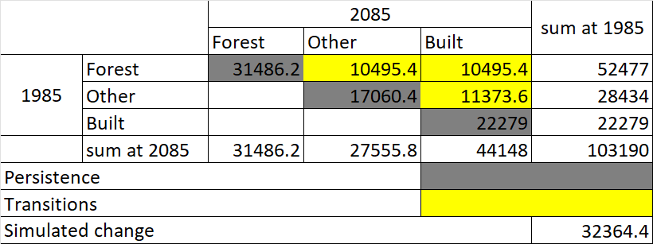
Markov’s Matrix used for Simulated change in 2085
The calculations for the number of pixels of transitions and persistent categories from 1985 to 2085 were based on Markov’s matrix where the Forest row has its 2085 quantity being proportions of 0.6, 0.2, and 0.2 of Forest at 1985. The Other category row also had proportions of 0.0, 0.6, and 0.4 of Other in 1985; and finally Built row had 0.0, 0.0, 1.0.
The three transition categories from 1985 to 2085 are Forest to Other - 10495.4 pixels, Forest to Built - 10495.4 pixels, and Other to Built also 11373.6 pixels.
The categories that persisted are Forest, other, and Bult, with pixels of 31486.2, 17060.4, and 22279 respectively.

Slide 4
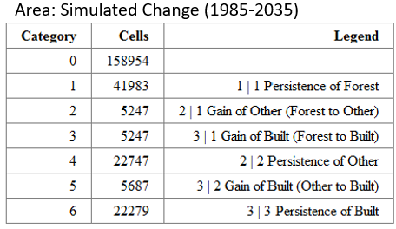
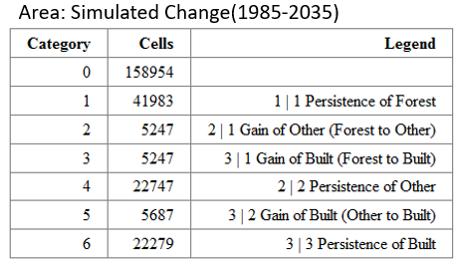
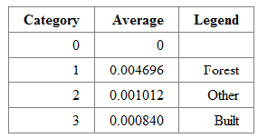
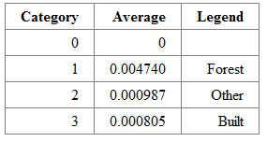
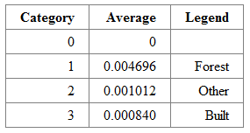
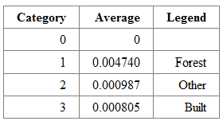
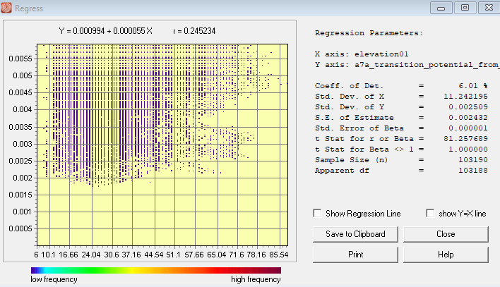
CrossTab of Simulated change from 1985 – 2035 ( 2035| 1985)
Run 1
Run 2
a
d
Average Transition Potential Values on Forest to Other
b
Average Transition Potential Values on Forest to Other
e
5247, 5247, and 5687 pixels transitioned from Forest to Other, Forest to Built, and Other to Built respectively in 2035 as illustrated in table a.
The transition potential maps for Forest to Other and Forest to Built are identical thus the average transition potentials of the two transitions are the same in table b. Therefore, using the Forest to Other transitions, the forest category has the highest average value of 0.004696, pixels will be allocated to these first before the rest, which occurs mostly at elevations from 10m-65m as shown in Figure c.
Run 2 also had the same quantities that transitioned from Forest to Other, Forest to Built, and Other to Built as shown in table d.
Similar to Run 1, The transition potentials for Forest to Other and Forest to Built are the same although this has higher average transition values. Forest has the highest of 0.004740 hence pixels will be allocated to these first to areas from 10m-65m before the rest.
Average Transition Potential Values on Forest to Built
Average Transition Potential Values on Forest to Built
c

Slide 5
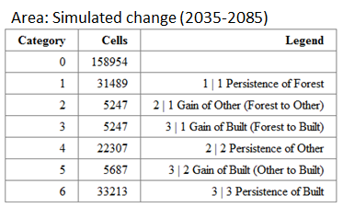
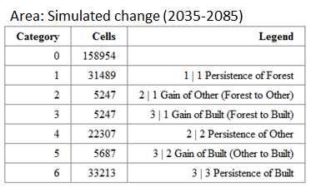
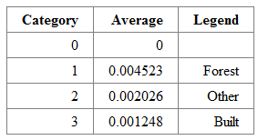
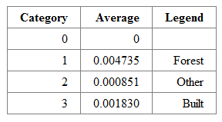
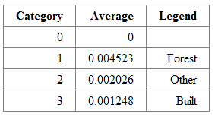
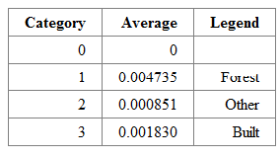
CrossTab of Simulated change from 2035 - 2085 ( 2085| 2035)
Run 1
Run 2
a
e
Average Transition Potential values for Forest to Other
b
f
In Stage 2 of Run 1, the number of pixels that transitioned from Forest to Other, Forest to Built, and Other to Built are 5247, 5247, and 5687 respectively in 2035 as shown in table a.
The transition potential values for Forest to Other and Forest to Built are identical as shown in tables b and c. Therefore, using Table b, the forest category has the highest average value of 0.004523, pixels will be allocated to these first before the rest.
Just like Run 1, Run 2 also had the same quantities that transitioned from Forest to Other, Forest to Built, and Other to Built as shown in table e.
Similar to Run 1, The transition potentials for Forest to Other and Forest to Built are the same although this run has relatively higher average transition values. Forest has the highest of 0.004735 hence pixels will be allocated first to areas of forest around 10m-65m.
Average Transition Potential values for Forest to Other
Average Transition Potential values for Forest to Built
c
Average Transition Potential values for Forest to Other
g

Slide 6
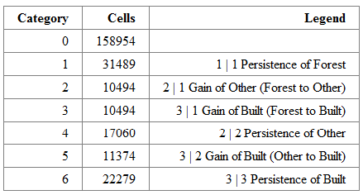
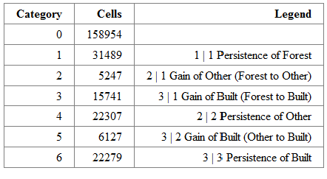
CrossTab of Simulated change from 1985 - 2085 ( 2085| 1985)
Run 1
Run 2
a
b
Area: Simulated Change from 1985-2085
Area: Simulated Change from 1985-2085
From table a, 10494 pixels transitioned from Forest to Other, Forest to Built also had 10494 pixels transitioning, and finally a total of 11374 pixels transitioned from Other to Built in 2085. Thus a total of 32362 pixels transitioned.
From table b, Forest to Other, Forest to Built, and Other to Built had transitions of 5247, 15741, and 6127 respectively in 2085. Therefore, the total transitions in 2085 is 27115.

Slide 7
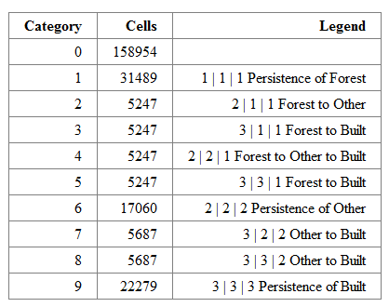
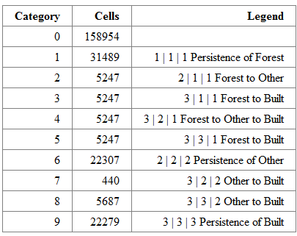
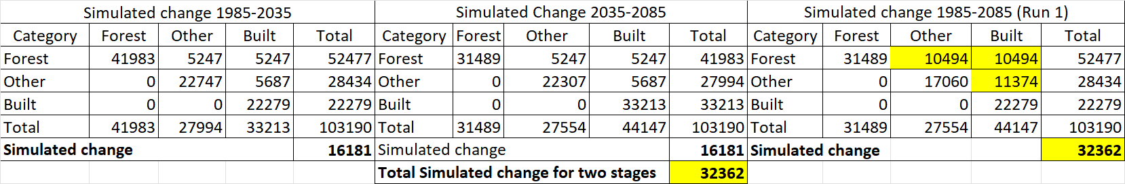

Comparison between Simulated change using Static and Dynamic Logistic Regression
Run 1
Run 2
a
c
b
d
Run 1- Using crosstab of the calibration map of 1985 and simulated 2085 as shown in Table b, a total of 32362 pixels experienced change which tallies with the sum of the simulated changes for the two stages. The similarity in simulated change is because of the Static variable used. This assumes that the pixels that are candidates for change after stage 1 are not considered candidates for change in stage 2.
Also, the Simulated change is almost the same as simulated pixels in Slide 2 although Run 1 is less by 2 pixels. But comparing the portions, it is the same as the proportions used to derive the simulated pixels in slide 2.
While in Run 2, the simulated change between 1985-285 is 27115 which is less than the sum of simulated change for the two stages (32362), and also lesser than the Simulated change of 32364 calculated in Slide 2. The difference in the quantity of change is a result of the Dynamic (Run 2) variable used where pixels that transitioned in stage 1 are used again as candidates for change in stage 2. This results in some pixels transitioning twice as shown in category 3|2|1 in Table c where 5247 pixels of Forest transitioned to Other in 2035 and transitioned again to Built in 2085.

Slide 8
The Voluntary Carbon Standard rule specifies:
“The minimum threshold for the best fit as measured by the Figure of Merit (FOM) shall be defined by the net observed change in the reference region for the calibration period of the model. Net observed change shall be calculated as the total area of change being modeled in reference region during the calibration period as percentage of the total area of the reference region. The FOM value shall be at least equivalent to this value.”
Figure of Merit = FOM = Hits / (Misses + Hits + False Alarms)
The simulation model qualifies when
Figure of Merit > |Forest Loss during calibration|/Forest Start Size

Slide 9
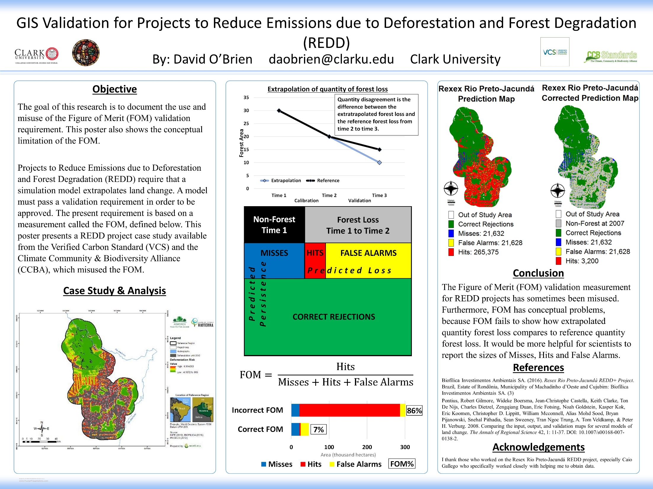
Award-Winning AAG poster Note the excellent ratio of figures to text. If you can understand the figures from this distance, then the poster is effective.

Slide 10
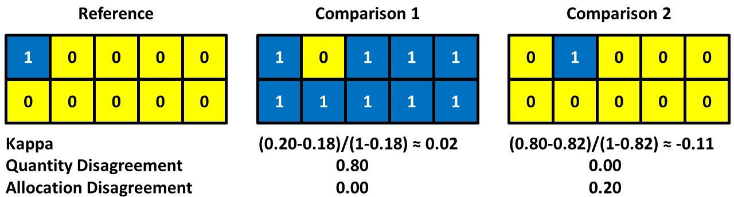
Pop Quiz Does Comparison 1 or Comparison 2 agree more with the Reference?

Slide 11
Pop Quiz Kappa says Comparison 1 agrees more with the Reference?

Slide 12
Quantity and Allocation components explain the disagreement.

Slide 13
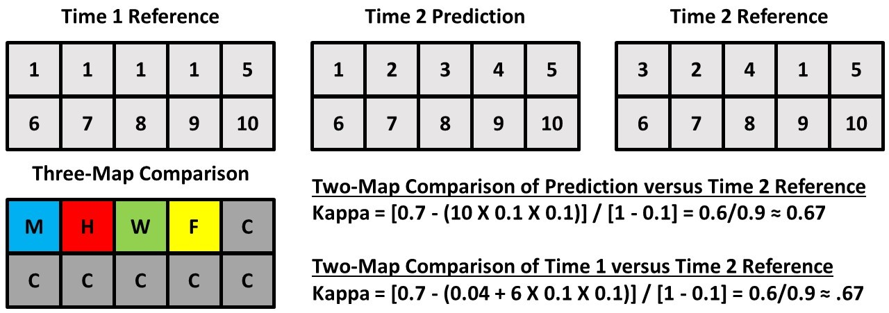
Two-map validation of a prediction shows proportion correct is 0.70 and kappa is 0.67 for ten classes
X
X
X

Slide 14
Three-map validation of a prediction of change shows more error than hits. A null model of zero change also has kappa = 0.67.
The three-map comparison shows helpful assessment in terms of Misses (M), Hits (H), Wrong Hits (W), False Alarms (F), and Correct Rejections (C).

Slide 15
Kappa is an index of agreement that many authors use for validation despite kappa’s flaws. Consider the following:
Zhu et al. (2023) contains the bogus claim that “When the Kappa coefficient is greater than 0.8, it indicates that the model simulation accuracy has reached a satisfactory level of statistical significance [29,74]”, but neither citation 29 nor 74 support Zhu’s claim.
Zhang et al. (2021) obtained a kappa of 0.88 for a simulation model and claimed that “Kappa coefficients greater than 0.8 indicate that the simulation accuracy has reached an ideal state [79]” where citation [79] from the prestigious International Journal of Geographical Information Science is Chen et al. (2014), which does not even contain the word kappa.

Slide 16
Convoluted story of how a flexible FOM became the VCS standard to qualify for REDD
Dr. Sandra Brown asked Pontius decades ago what should be the standard for a REDD project to qualify.
Pontius had assumed the validation would mask out the non-forest at the start of the simulation use the correct quantity of forest loss during the simulation, thus allocation would be the only consideration. So Pontius recommended Kappa because kappa is an index that has a baseline of zero for random allocation and a maximum of one when the quantity and allocation are perfect.
VCS adopted Kappa > 85% as the standard at a meeting where Pontius was absent.
Then Pontius realized severe problems with kappa when the quantity is not perfect, so Pontius informed Brown. Pontius recommended FOM, so the REDD committee did a search & replace from Kappa to FOM. But then no projects qualified because no projects had FOM > 85%.
Then the next thing Pontius saw was that VCS had adopted a FOM that depends on the proportion of deforestation in the reference region during calibration, which shocked Pontius. The justification seemed to be based on Pontius et al. (2008), which did not have REDD in mind. Consequently, some projects can qualify with a FOM smaller than most of the cases in Pontius et al. (2008). Your reading for a future class is a book chapter that is a follow up of Pontius et al. (2008).

Slide 17

https://www.terracarbon.com/team

Slide 18
2021 Message from Gil Pontius to Becky Dickson
I suspect this VCS definition was based on an inappropriate interpretation of the findings of Pontius et al. (2008). This VCS definition has several major problems. First, this definition fails to specify whether the non-forest at the start of the calibration period is included in the computation of net observed change. If the non-forest at the start of the calibration period is included in the reference region, then the user could simply include a large region of non-forest to drive down the percentage of net change, which would lower the required FOM. Second, the definition’s net change does not match the definition in Pontius et al. (2008). The VCS definition of net change is actually gross change. Third, the VCS definition specifies net change, which implies the user should include both forest loss and forest gain, but it seems REDD is designed for only forest loss. The VCS criterion is all messed up for additional reasons described in https://www.mdpi.com/2073-445X/7/3/105

Slide 19
Becky Dickson responds
I have to acknowledge that any error in the FOM language is likely mine! I had to rewrite it about 10 years ago because it was totally wrong initially. I believe Lucio had copied values from a Kappa stat, so it was entirely unrealistic to reach. I reached out to you when we did the re-write, and shared the draft language, but I guess we made additional errors! Let's fix it in the current methodology. I will reach out and see what the current draft language is so that we can review.
The question of reference regions is set in other parts of the methodology so it can't be changed at this point and is defined as the forest area at the start of the historic reference period. I agree it is a low bar, but it seemed to be the only way to set something based on the landscape that was being modeled.
Yes, this is a great example of the challenge of taking this work and putting it into policy without a whole panel of experts to review!!

Slide 20
Pontius’ saga with the Kappa index of agreement
Pontius derived a metric during the 1990s that he later learned was kappa.
Pontius (2000) and Pontius (2002) proposed variations on Kappa to measure particular components of agreement.
Pontius realized during the subsequent decade that Kappa was misleading, so Pontius and Millones published Death to Kappa in 2011, which became Pontius’ most highly cited article.

Slide 21
Abstract of the Death to Kappa paper
This article concludes that these Kappa indices are useless, misleading and/or flawed for the practical applications in remote sensing that we have seen. After more than a decade of working with these indices, we recommend that the profession abandon the use of Kappa indices for purposes of accuracy assessment and map comparison, and instead summarize the cross-tabulation matrix with two much simpler summary parameters: quantity disagreement and allocation disagreement.

Slide 22
Examples of how some authors cited the Death to Kappa paper (Pontius and Millones 2011).
“The Kappa statistics and confusion matrix were calculated for accuracy assessment, which is thought one of the best quantitative measures for image classification accuracy” (Kafy et al., 2020).
“One of the best quantitative measures known as Kappa statistics and the confusion matrix was used for image classification accuracy.” (Abir & Saha, 2021).
“Confusion matrix and Kappa statistics are among the best measures of image classification accuracy” (Iddrisu et al., 2023).

Slide 23
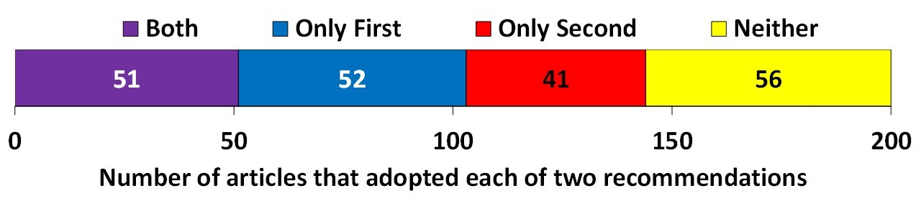
The number of sampled articles classified according to four combinations of using the first recommendation or using the second recommendation of the Death to Kappa paper (Pontius and Millones 2011).
Both means the authors abandoned Kappa and adopted disagreements of quantity and allocation.
Only First means authors abandoned Kappa but did not adopt disagreements of quantity and allocation.
Only Second means authors adopted disagreements of quantity and allocation, but used Kappa.
Neither means authors used Kappa and did not adopt disagreements of quantity and allocation.

