Slide 1
Agenda for GEOG260/360 GIS & Land Change Models
November 13
Practicing Geography Week
Feedback on proposals
To prepare for the exam, see the past exams on Canvas and read the following, which are on Canvas
Exam 2022 Answer Key for Multiple Choice Questions
Exam 2020
2019 exam to serve as a study guide for this year's exam
Zhang et al. - 2023 - A user-friendly assessment of six commonly used ur.pdf
Viana et al. - 2023 - Four Fundamental Questions to Evaluate Land Change.pdf
Brown et al. (2013) Opportunities to improve impact, integration, and evaluation of land change models
Pontius et al. (2018) Lessons and Challenges in Land Change Modeling Derived from Synthesis of Cross-Case Comparisons
Comparison of Three Maps at Multiple Resolutions: A Case Study of Land Change Simulation in Cho Don District, Vietnam
November 15 Deadline for abstracts submitted to https://www.aag.org/events/aag2024/
Exam Preparation & Readings
November 20
In Class Exam
November 27
Adeline, Clio, Esha, & Yu-Yun; Wynnie & Julia; Leo, Aidian, Jason, & Atlas
November 29
Jack, Laura, & Adlai; Lucas & Jeremy R-T; Ryan & Jeremy H-B
December 13
Project PPTX file due
December 20
Project Product due

Slide 2














THE GRADUATE SCHOOL OF GEOGRAPHY & MS-GIS PRESENTS:
PRACTICING GEOGRAPHY WEEK & GIS WEEK 2023
Practicing Geography Week is a week of events centered around Geography, Global Environmental Studies, and Earth System Science. GIS Week is a week of events centered around Geographic Information Science. By partnering together, GIS and Practicing Geography Week, full of various events, gives undergraduate and graduate students many opportunities to learn, connect, and network with peers, faculty, alumni, and experts in the realm of Geography careers and research.
MONDAY, NOVEMBER 13
THROUGH
FRIDAY, NOVEMBER 17
SCHEDULE OF EVENTS
MONDAY 4:15-5:30PM JEFF 218
GEOSPATIAL AI
WITH PROFESSORS LYNDON ESTES AND HAMED ALEMOHAMMAD
WEDNESDAY 5:30-7PM VIA ZOOM
ALUMNI CONNECTIONS
APPLYING GEOGRAPHICAL KNOWLEDGE & LEARNING ABOUT LIFE AFTER CLARK
CO-SPONSORED BY THE CAREER CONNECTIONS CENTER
LIVE VIEWING AVAILABLE. MORE DETAILS TO COME.
TUESDAY 3-4pm VIA ZOOM
MSGIS STUDENT INTERNSHIP AND RESEARCH PRESENTATIONS
TUESDAY 6-8PM GIS LAB JEFF 131
MAPATHON!
IN COLLABORATION WITH NEURISA PROFESSIONAL ASSOCIATION
[NEW ENGLAND URBAN & REGIONAL INFORMATION SYSTEMS ASSOCIATION]
THURSDAY 12:15-1:30PM JEFF 218
GEOSPATIAL ENTREPRENEURSHIP PANEL
DETAILS ON A SEPARATE FLYER
WEDNESDAY 1:30-2:30PM JEFF 218
GEOGRAPHY STUDENT INSIGHT PANEL
APPLE GOULD-SCHULTZ, ESS ‘23 MSGIS ‘24 | LILY KAPLAN, ESS ‘23 ES&P ‘24
SHRADHA BIRDIKA, GEOG ‘24 | ABBY BEILMAN, ESS ‘23 ES&P ‘24
THURSDAY 7:00-9PM TILTON HALL
WALLACE W. ATWOOD LECTURE SERIES PRESENTS:
DR. JENNIFER ROBINSON
DETAILS ON A SEPERATE FLYER
WEDNESDAY 2:30-4pm ASEC 202
MSGIS STUDENT INTERNSHIP AND RESEARCH PRESENTATIONS
FRIDAY 7:00-9PM WANWANG
TRIVIA NIGHT
ypoku@clarku.edu
https://www.clarku.edu/departments/geography/

Slide 3
You should make your projects concern GIS methods, not applications to case studies.
Adeline, Clio, Esha, & Yu-Yun
Modelling Agricultural Land in Bahia, Brazil from 1990 to 2020
Wynnie & Julia
Identifying Significant Patterns and Alternation in Soybean Crop Presence Over Time in Bahia, Brazil using TerrSet’s Land Change Modeler (LCM)
Leo, Aidan, Jason, & Atlas
Developing Methods of Documentation of Key Metrics of Change in the Georgia Coast Ecosystems LTER site
Jack, Laura, & Adlai
Creating Land Change Scenarios with Alternating Classes
Lucas & Jeremy R-T
Impacts of Sea Level Rise on Plum Island Ecosystems
Ryan & Jeremy H-B
Forest Fragmentation and Change Pattern in States of the Atlantic Forest, Brazil

Slide 4
You should make your projects concern GIS methods, not applications to case studies.
Adeline, Clio, Esha, & Yu-Yun
A story map is a good product. Your story map should be more about how to analyze a time series of maps and less about soy bean cultivation in Brazil. The audience is much larger for how to analyze a time series than for soybeans. You should have a GIS product, not a soy bean product. Modify your title accordingly.
Wynnie & Julia
A poster is a good product only if you are going to present the poster someplace. Where will you present the poster? You are proposing to do too many things. You cannot solve the world’s problems in a one-month course project. You should do one thing well that relates to what you learned in this course. I recommend you project land change for each of three decades beyond 2020. Use the word significant if and only if you mean the p-value is less than the alpha level for inferential statistics. You will be projecting, not identifying. Modify your title accordingly.
Leo, Aidan, Jason, & Atlas
A video is a good product. I am confused by the title “Developing Methods of Documentation of Key Metrics of Change in the Georgia Coast Ecosystems LTER site”. You must refine your goal. A clear goal would be to show how to extrapolate alternation using TerrSet’s Land Change Modeler, which is different from documentation of metrics. The application to Georgia is insufficiently important to put in the title. You should have a GIS product, not a Georgia product.
Jack, Laura, & Adlai
Your accurate title is guiding you to a helpful project. The audience will be researchers who will be making scenarios. Those people need to know how to run the software. Thank you for listening so closely in class to what will be helpful
Lucas & Jeremy R-T
A poster is a good product if you are going to present the poster someplace. Where will you present the poster? You say your poster will help developers but I see no plan for you to present this to developers. Do not do a hypothetical project. Do something that will actually influence someone. MassGiS already has projections of sea level rise. I do not see any plans for how you would use the tools in TerrSet. I recommend you make a video on how to use TerrSet to extrapolate Alternation of the Marsh category.
Ryan & Jeremy H-B
You have an important audience in Sangermano. What is the format of the product? Will the product be a PPTX file, or a Word document, or something else? I am very concerned that you have fifteen States, five land cover categories, three time intervals, and no particular metric, thus the number of results will be overwhelming. Consider the tools in TerrSet > Habitat&BiodiversityModeler > LandscapeAnalysis > LandscapeChangeProcessAnalysis. I do not see a plan to limit the scope of the analysis so the audience can digest it.

Slide 5
How to learn to use LCM to simulate Alternation.
Make maps that have 1 = Absence of a class and 2 = Presence of a class.
Assure that the change from the earlier time to the later time shows both loss and gain.
Make an independent variable of distance from edge between presence and absence at the earlier time. This independent variable will have positive distances every place.
Extrapolate for a time interval that has a duration twice the duration of the calibration interval.
Use two stages
Use a dynamic variable of distance to edge.
Interpret the output from a three way CROSSTAB where the first image is the start of the simulation, second image is the simulation at the end of the first stage, third image is the simulation at the end of the second stage. Interpret the number of pixels in each of the 8 possible combinations.

Slide 6
Instructions for exam
This exam has three sections: Multiple-Choice, Short Essay and Long Essay. The Multiple-Choice section is worth 50% of the exam grade. The Short Essay section is worth 20% of the exam grade. The long essay section is worth 30% of the exam grade. Select the single best answer for each multiple-choice question by circling exactly one answer. Respond to all the essay questions in the Blue book, on which you write your name on the back, not the front. Essay responses must use legible, well-written, grammatically-correct, full sentences that are organized into paragraphs. Include citations when appropriate. Your essay responses must demonstrate what you have learned in this course. For the essays, grade of C requires answers that are mostly correct; grade of B requires answers that give correct details and refer to the literature; grade of A requires answers that give correct details, refer to the literature, and communicate efficiently & elegantly. You are allowed to use one page of notes. You are not allowed any electronics. Your work must be entirely your own.

Slide 7
Ask yourself these four questions to decide whether a model is appropriate.
Can you understand the model?
If the model’s documentation is poor, then there is little hope to understand the model.
Can your audience understand the model?
If the audience cannot understand the model, then it will not be helpful for the audience to use the information to make a decision.
Can you control the model?
If you cannot control the quantity and allocation of the land changes, then you will not be able to use it to express scenarios.
If the model’s interface is poorly designed, then you are unlikely to be able to control the model.
If the model does not behave according to the documentation, then you are likely to misinterpret the output.
Is the model relevant to your research question?
If you use a model merely because you have seen other people use the model, then the model will not necessarily be relevant to your research question, because those other people might have a different research question or those other people might not have thought deeply concerning their research question.

Slide 8
Claudia Viana asked Pontius to co-author a paper with the following title: Four fundamental questions to evaluate land change models with an illustration of a Cellular Automata – Markov model
Numerous models exist to simulate land change to facilitate communication with an audience of stakeholders. Our manuscript raises four fundamental questions to help users decide whether to use any model: 1) Can the user understand the model? 2) Can the audience understand the model? 3) Can the user control the model? and 4) Does the model address the goals of the specific application?
Our manuscript applies these questions to a popular Cellular Automata - Markov model using IDRISI’s CA-Markov module. We examine different ways to set the model’s parameters and compare the model’s behavior to the software’s documentation. Moreover, we combine sensitivity analysis with verification for CA-Markov. Results show that the Cellular Automata feature corrupts the Markov feature in ways that the model’s documentation fails to describe. The model’s behavior is likely to cause users to misinterpret the validation metrics and to miscommunicate with audiences. We encourage users to answer our four questions to identify more clearly the characteristics of any simulation model.
Sensitivity Analysis is a procedure to see how variation in the inputs influences variation in the outputs.

Slide 9
Where should we to insert verification into this flow diagram?

Slide 10
Here is how my co-author inserted verification into our flow diagram.

Slide 11
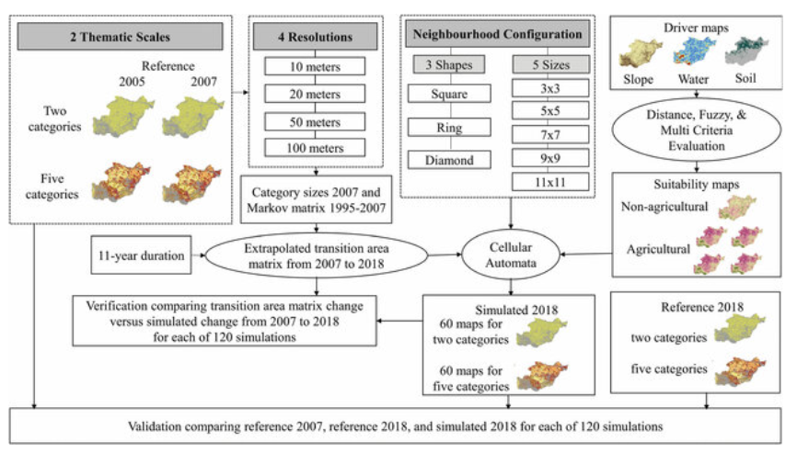
Here is what we published after Pontius’ modifications.

Slide 12
Verification
Verification is the procedure to test whether the behavior of the model matches the model’s documentation.

Slide 13
Interpretation of validation
If the pattern is not stationary from the calibration time interval to the validation time interval, and you calibrate a model during the calibration interval then extrapolate the pattern to the validation interval, then what will the validation results show?

Slide 14
Interpretation of validation
If the pattern is not stationary from the calibration time interval to the validation time interval, and you calibrate a model during the calibration interval then extrapolate the pattern to the validation interval, then what will the validation results show?
The results for the validation will show disagreement between the extrapolation and the data during the validation interval.
Could you have anticipated this result by looking at the data?

Slide 15
Interpretation of validation
If the pattern is not stationary from the calibration time interval to the validation time interval, and you calibrate a model during the calibration interval then extrapolate the pattern to the validation interval, then what will the validation results show?
The results for the validation will show disagreement between the extrapolation and the data during the validation interval.
Could you have anticipated this result by looking at the data?
Yes. If the data show non-stationarity from the calibration to the validation intervals, then an extrapolation will not have predictive power.
Is it possible that an algorithm is verified for all applications but not valid for a particular application?

Slide 16
Interpretation of validation
If the pattern is not stationary from the calibration time interval to the validation time interval, and you calibrate a model during the calibration interval then extrapolate the pattern to the validation interval, then what will the validation results show?
The results for the validation will show disagreement between the extrapolation and the data during the validation interval.
Could you have anticipated this result by looking at the data?
Yes. If the data show non-stationarity from the calibration to the validation intervals, then an extrapolation will not have predictive power.
Is it possible that an algorithm is verified for all applications but not valid for a particular application?
Yes. Verification differs from validation.

Slide 17
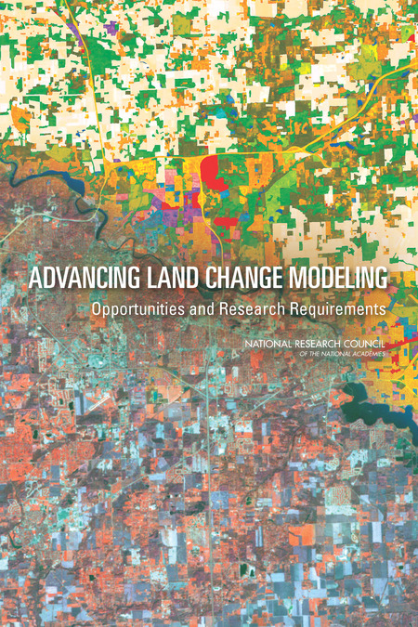
Brown, Daniel G, Lawrence E Band, Kathleen O Green, Elena G Irwin, Atul Jain, Eric F Lambin, Robert G Pontius Jr, Karen C Seto, B L Turner II, Peter H Verburg. 2013. Advancing Land Change Modeling: Opportunities and Research Requirements. The National Academies Press: Washington DC. 145 pages.

Slide 18
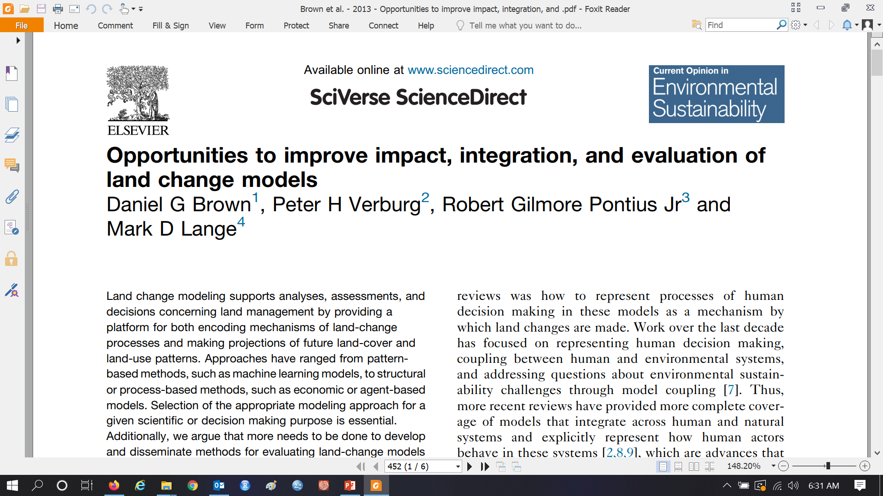
Brown et al. (2013) Opportunities to improve impact, integration, and evaluation of land change models

Slide 19
Terms in Brown et al. (2013)
Positive
The characteristic of being able to be strictly and logically quantified, addressing the question of what is and what will be.
https://philosophyterms.com/positivism/
Normative
The characteristic of being able to address the question of what should be.
Pattern
Description of the change.
Process
Mechanisms that influence the change.
Projection
Portrayal of the future under a specific set of assumptions.
Scenario
A story told in words, numbers and maps concerning one possible way the future could unfold.
Extrapolation
Extension of recent trends into the future.
Prediction
Best guess of what the future will be.
Explanation
Theory to explain why and how land changes.
Stationary
The pattern or process of change is stable across space or time.

Slide 20
Terms in Brown et al. (2013)
Top-down hierarchical model
Global models constrain land areas allocated by more detailed cellular models
Sensitivity Analysis
Examination of variation in model output as a function of variation in model input & characteristics
Pattern Validation
Determination whether the simulated output pattern matches the observed pattern
Structural Validation
Determination whether the simulated process matches the real process
Equifinality
Situation where many different processes create the same pattern
Multifinality
Situation where a single process can generate a variety of patterns
Ex-Ante assessment
Analysis concerning intervention design concerning what policies to adopt based on anticipated changes, meaning assessment of what policies should be started.
Ex-Post assessment
Evaluation concerning the effect of the adopted policies based on past performance, meaning assessment of whether past policies were effective.

Slide 21
Additional Common Terms
Inductive Model
Model that simulates change based on observed patterns.
Deductive Model
Model that simulates change based on assumed processes.
Calibration
Procedure that uses data to determine the parameters of the model
Validation
Procedure to examine how the model simulation compares to data
Path Dependence
A process where the entire sequence of events is very sensitive to the events at each step along the sequence.
Stochastic
Has a random component
Deterministic
Inputs entirely dictate the output, meaning there is no stochastic component
Agent-based model
A simulation model that simulates aggregate processes based on the interactions of numerous individual agents who make decisions
Hard Prediction
Each pixel in the prediction map belongs entirely to exactly one category
Soft Prediction
Each pixel in the prediction map is an index that indicates its membership to a category

Slide 22
Did Brown et al. (2013) claim that scientists should:
align model choices with modeling goals?
integrate LCMs with observational data, across scales, and across positive and normative modeling approaches?
improve and disseminate use of model evaluation approaches?

Slide 23
Did Brown et al. (2013) claim that:
There should be one comprehensive model that everyone should use?
More detail will assure higher predictive ability?
Higher predictive accuracy will assure that models will help to create environmentally sustainable policies?
Higher predictive accuracy should be a goal?

Slide 24
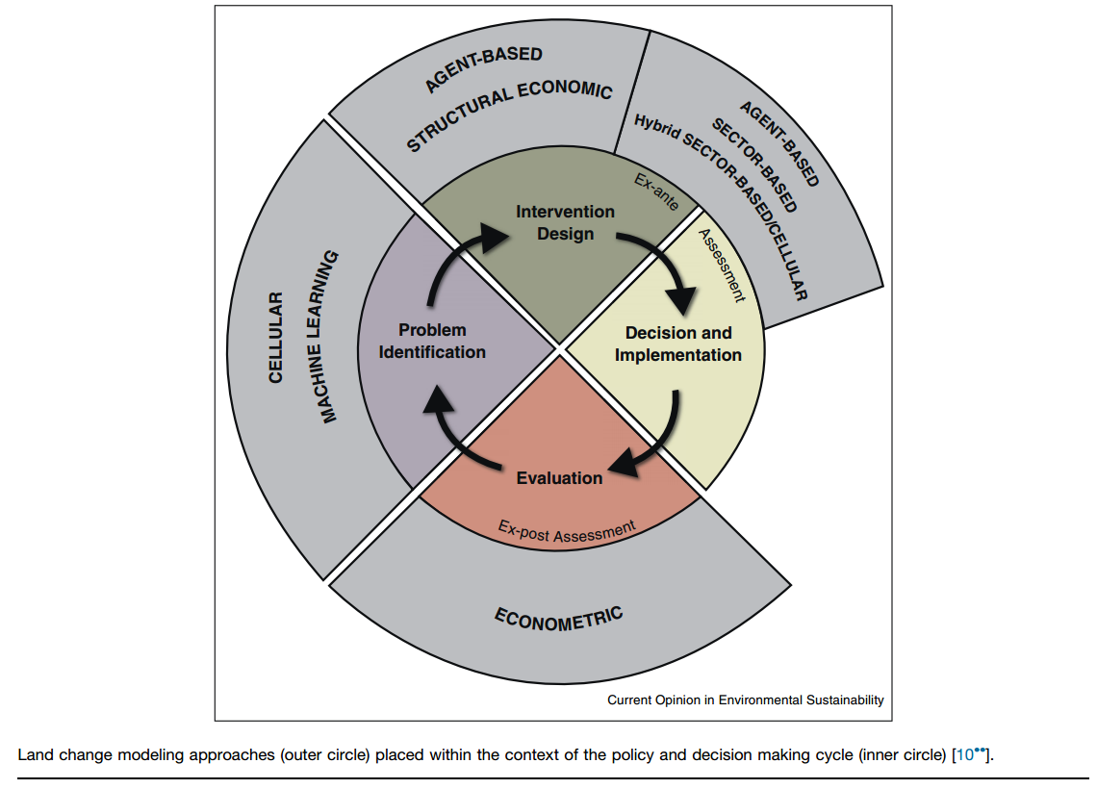
Brown et al. (2013) Opportunities to improve impact, integration, and evaluation of land change models

