Slide 1

EVENT EMITTERS IN NODE.JS

Slide 2
1.
Introduction To Event Emitters

Slide 3
What Is an Event?
An whole software paradigm focuses around events and how they are used. Event-driven architecture is becoming more widespread, as event-driven systems generate, detect, and respond to many types of events.
An event in event-driven programming is the consequence of a single or numerous actions. This might be a user action or a sensor's periodic output, for example.
Event-driven applications can be thought of as publish-subscribe models, in which a publisher initiates events and subscribers listen to them and respond accordingly.
Assume, for example, that we have an image server where users may post images. An action, such as uploading the image, would generate an event in event-driven programming. It would also require 1..n subscribers to that event in order to be used.
Once the upload event is triggered, a subscriber can respond by sending an email to the website's administrator informing them that a user has submitted a photo. Another subscriber may gather data about the activity and store it in a database.
These occurrences are normally independent of one another, yet they may be reliant on one another.

Slide 4
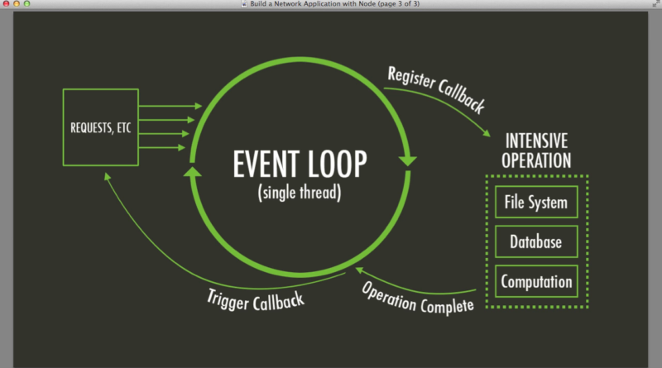
What are Event Emitters?
In Node.js an event can be described simply as a string with a corresponding callback. An event can be "emitted" (or in other words, the corresponding callback be called) multiple times or you can choose to only listen for the first time it is emitted.
Event emitters are objects in Node.js that trigger an event by sending a message to signal that an action was completed. JavaScript developers can write code that listens to events from an event emitter, allowing them to execute functions every time those events are triggered. In this context, events are composed of an identifying string and any data that needs to be passed to the listeners

Slide 5
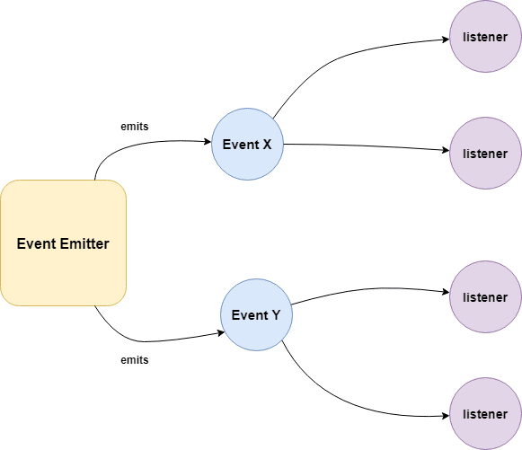
How does it work?
Event Emitter emits the data in an event called message
A Listened is registered on the event message
when the message event emits some data, the listener will get the data.

Slide 6
2.
Methods of an Event Emitter

Slide 7
Methods of the Event Emitter
addListener(event, listener) or on(event, listener)
Adds a listener for the provided event to the end of the listeners array. There are no checks to detect if the listener has already been added. Numerous calls with the same event and listener combination will result in the listener being added multiple times. Returns the emitter, allowing calls to be chained.
once(event, listener)
Adds the event listener only once. Once the event is called for the subsequent event there is no output.
removeListener(event, listener)
Removes a listener from the listener array for the specified event
removeAllListeners([event])
Removes all listeners, of the specified event

Slide 8
Methods of the Event Emitter
setMaxListeners(n)
If more than ten listeners are added to an event, EventEmitters will issue a warning. This is a beneficial default that aids in the detection of memory leaks. Obviously, not all Emitters should be limited to a maximum of ten. This function allows you to boost it. Set to zero to make it infinite.
Listeners(event)
Returns an array of all the events attached to the given event.
emit(event, [arg1], [arg2], [...])
Execute each of the listeners in order with the supplied arguments. Returns true if the event had listeners, false otherwise.

Slide 9
3.
Steps Involved in Making Event Emitters

Slide 10
Step 1 — Emitting Events
In this step, we’ll explore the two most common ways to create an event emitter in Node.js. The first is to use an event emitter object directly, and the second is to create an object that extends the event emitter object.
var events = require("events"),
emitter = new events.EventEmitter(),
username = "admin",
password = "admin";
// an event listener
emitter.on("userAdded", function (username, password) {
console.log("Added user " + username);
});
// Emit an event
emitter.emit("userAdded", username, password);

Slide 11
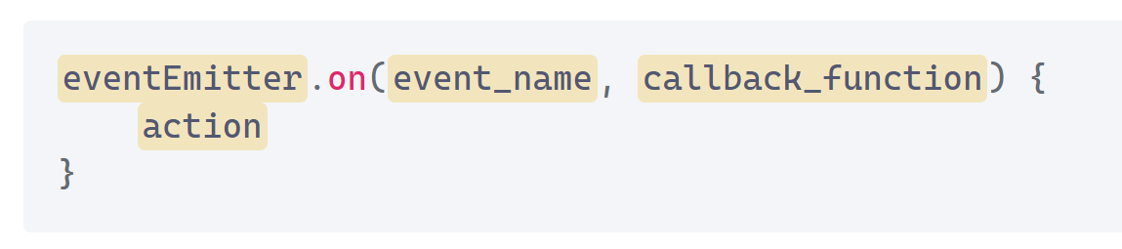
Step 2 — Listening for Events
Node.js allows us to add a listener for an event with the on() function of an event emitter object. This listens for a particular event name and fires a callback when the event is triggered. Adding a listener typically looks like this:
var events = require("events"),
emitter = new events.EventEmitter(),
username = "admin",
password = "admin";
// an event listener
emitter.on("userAdded", function (username, password) {
console.log("Added user " + username);
});
// Emit an event
emitter.emit("userAdded", username, password);

Slide 12
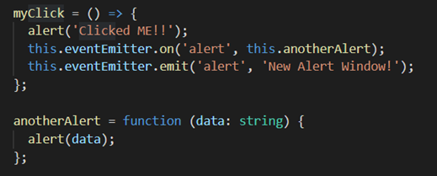
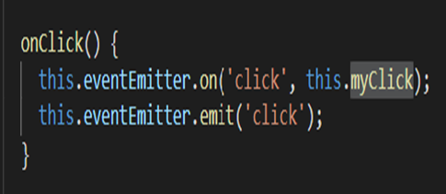
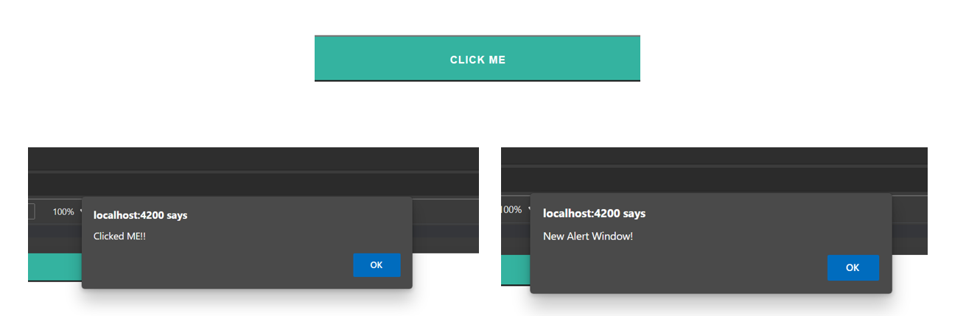
Step 3 — Capturing Event Data
The data is also passed along via the emitted events. Let's look at how we can record the data that comes with an event.

Slide 13
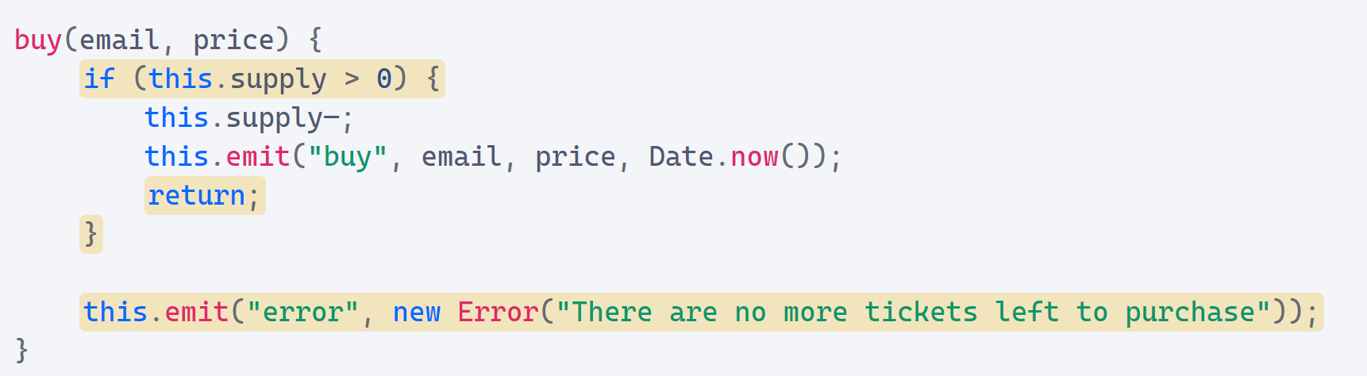
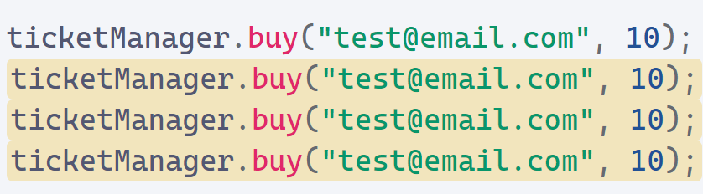
Step 4 — Handling Error Events
If an event emitter is unable to complete its task, it should generate an event to indicate that the task was unsuccessful. An error event is the typical mechanism for an event emitter in Node.js to report failure.

Slide 14
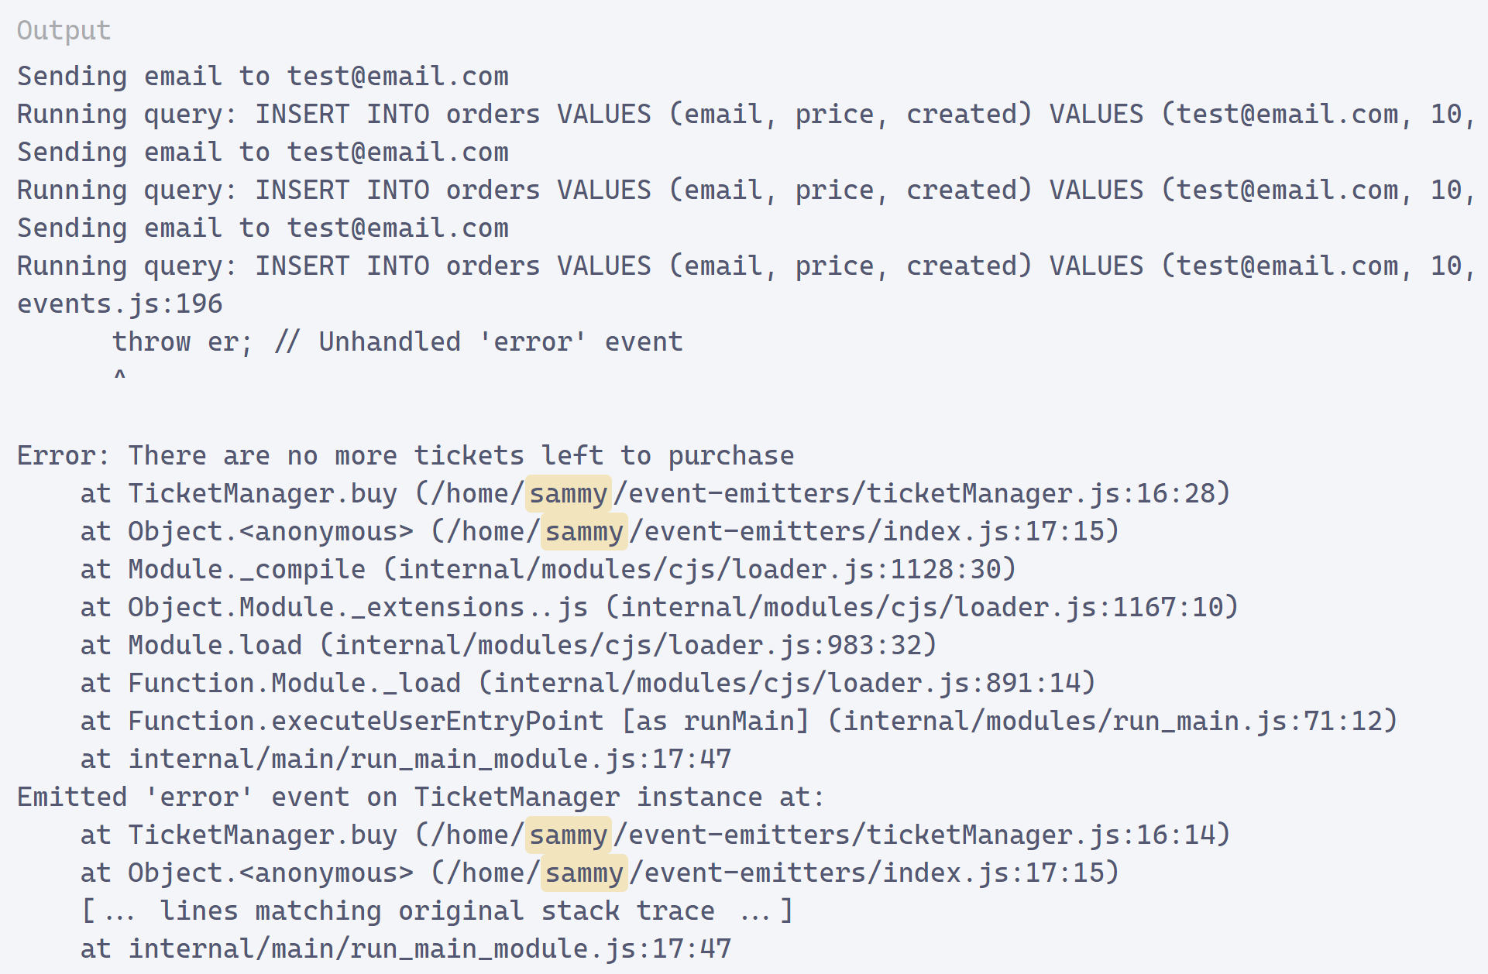
Continuation….

Slide 15
4.
Using Event Emitters in Angular

Slide 16
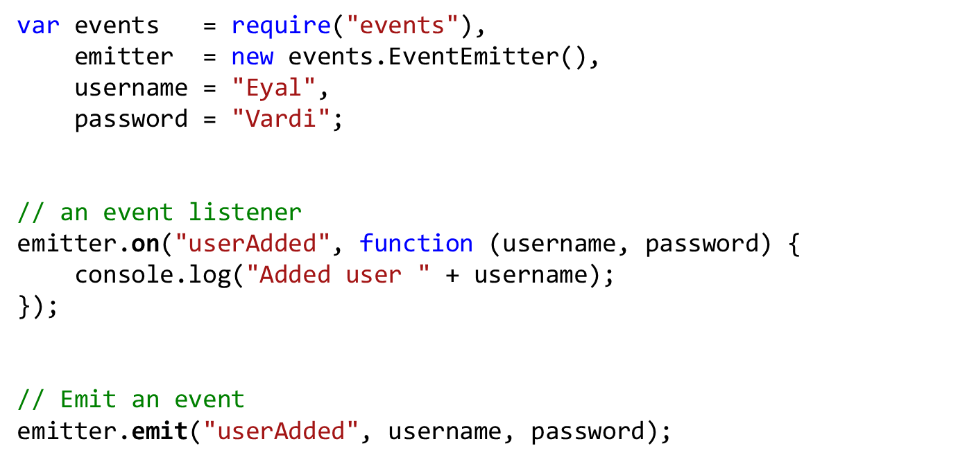
Event Emitter

Slide 17
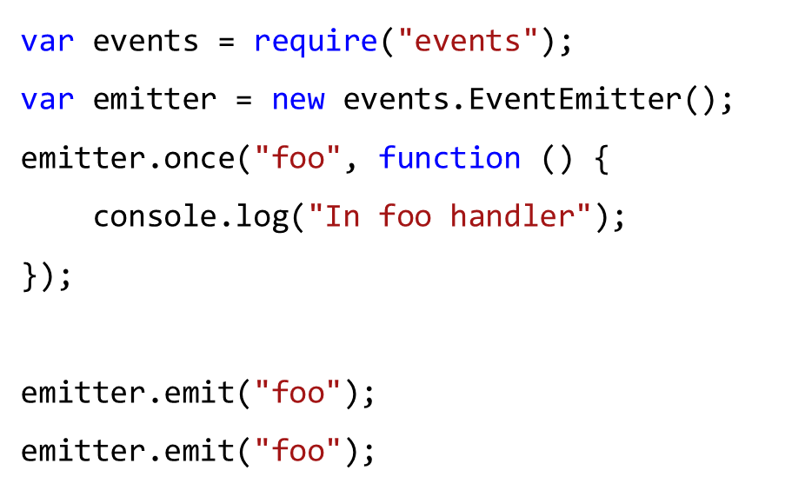
One-Time Event Listeners
Sometimes you may be interested in reacting to an event only the first time it occurs.

Slide 18
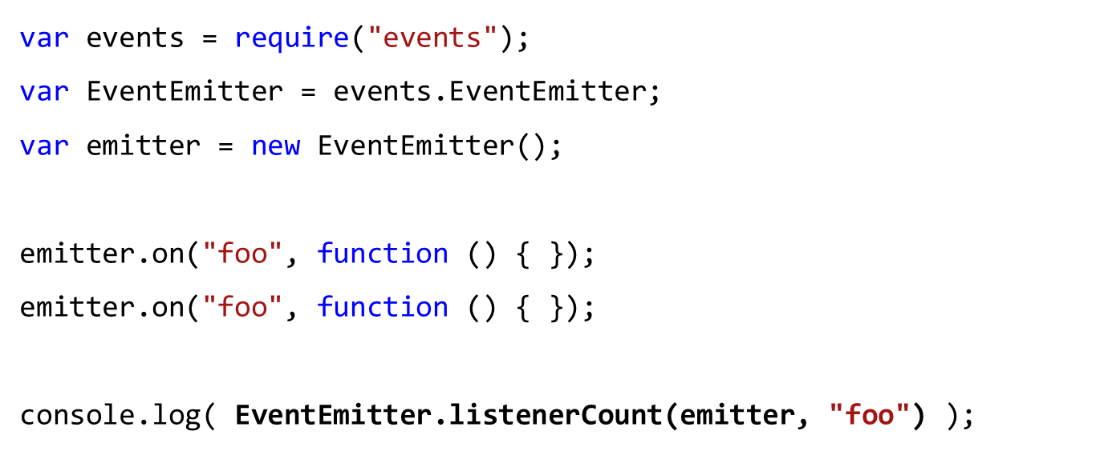
Inspecting Event Listeners

Slide 19
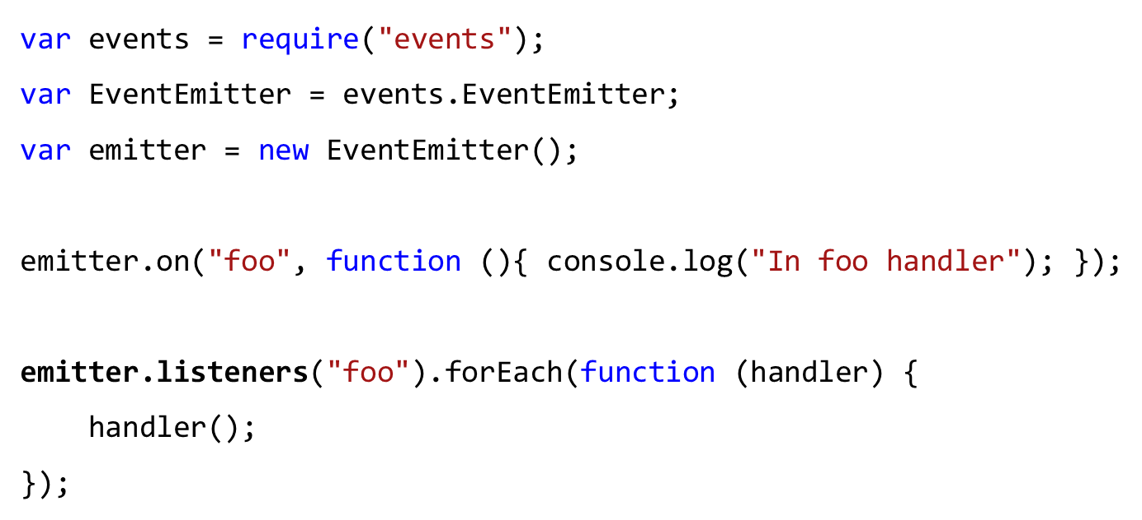
The newListener Event
Each time a new event handler is registered, the event emitter emits a newListener event.

Slide 20
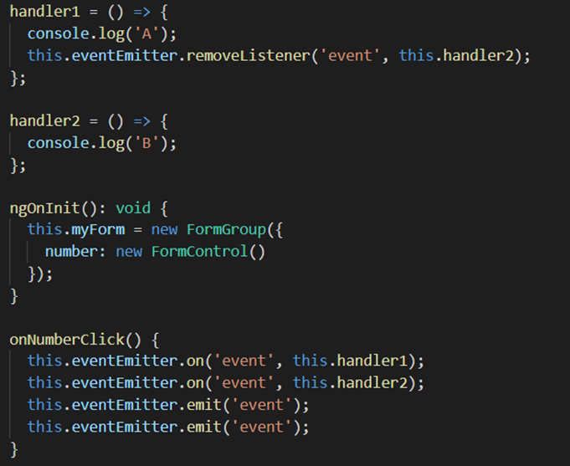
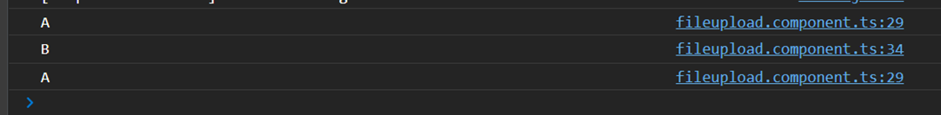
Removing Event Listeners
An event listener can be removed after it’s been attached to an event emitter.
emitter.removeAllListeners([eventName])
emitter.removeListener([eventName],[handler])

Slide 21
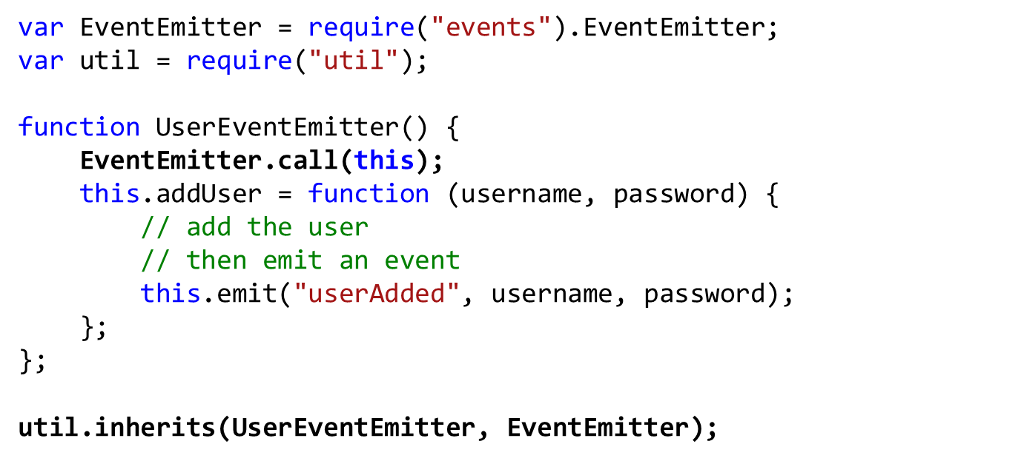
Inheriting from Event Emitters
You can create custom objects that inherit from EventEmitter and include additional application-specific logic.

Slide 22
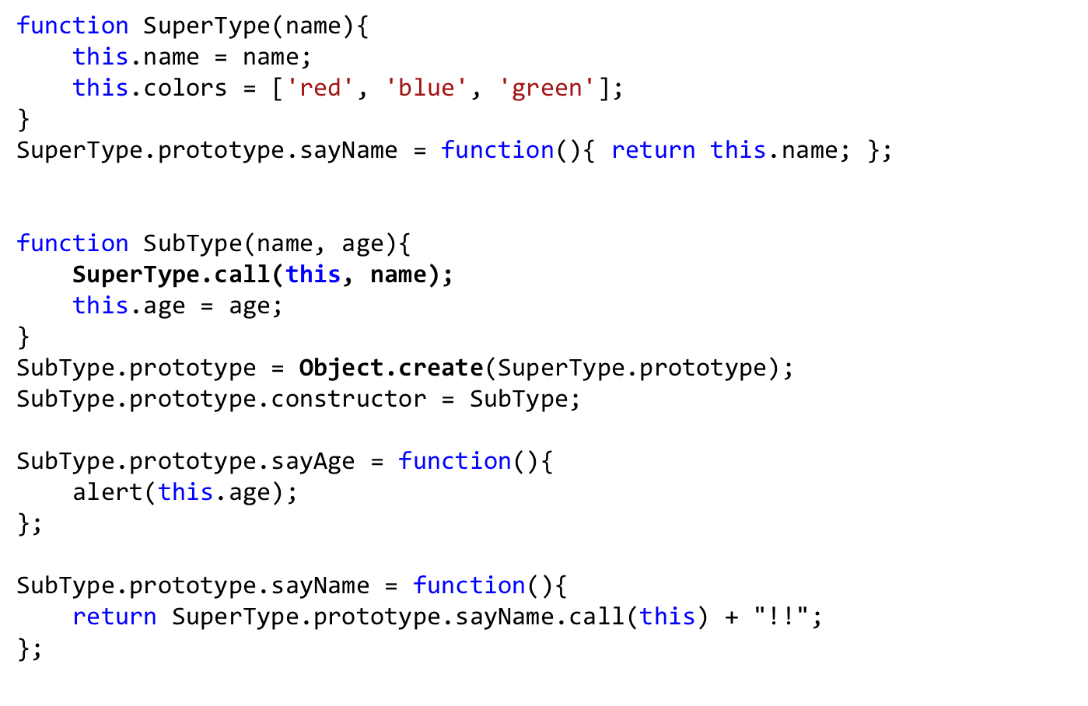
Full Solution Inheritance

Slide 23
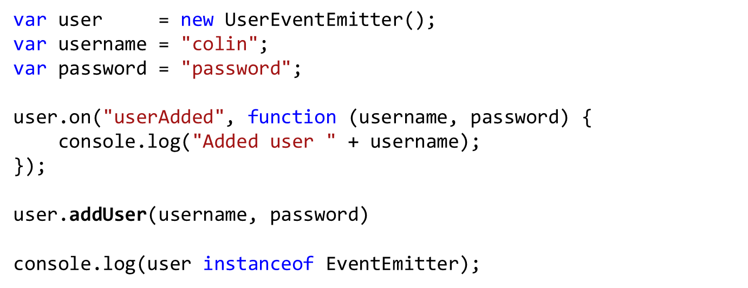
Using a Custom Event Emitter

Slide 24
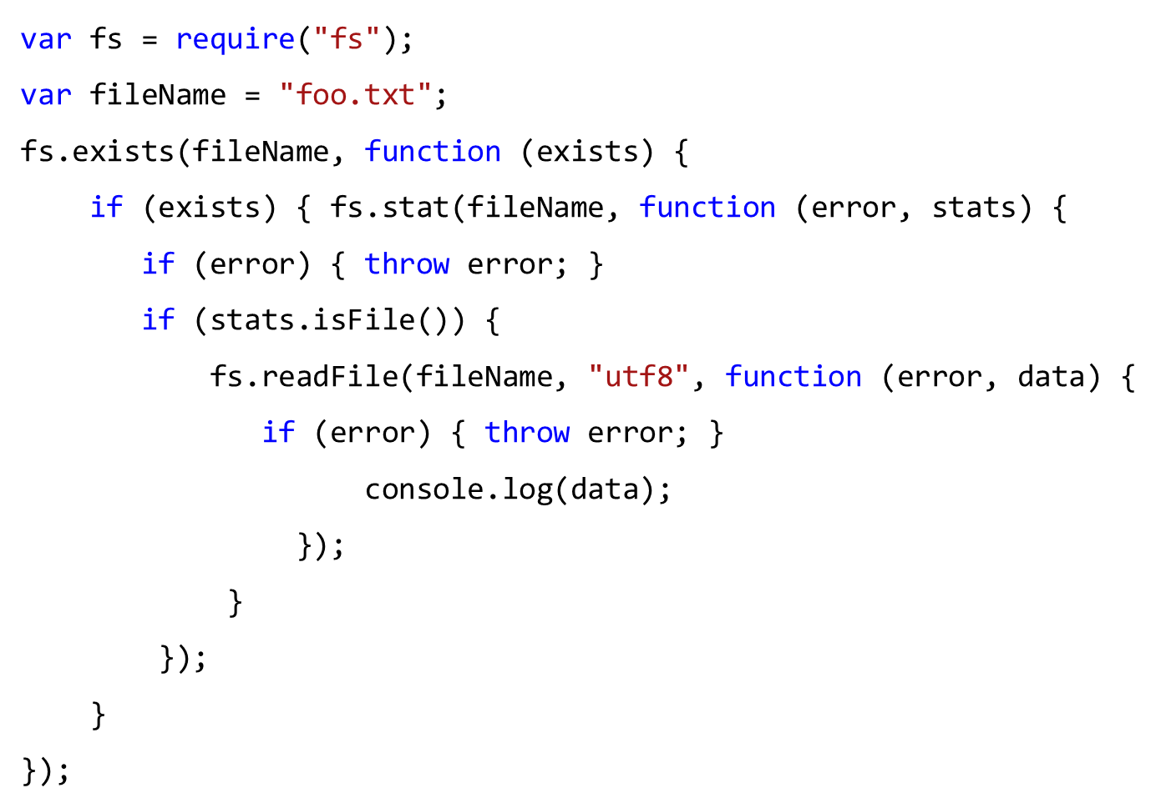
Using Events to Avoid Callback Hell

Slide 25
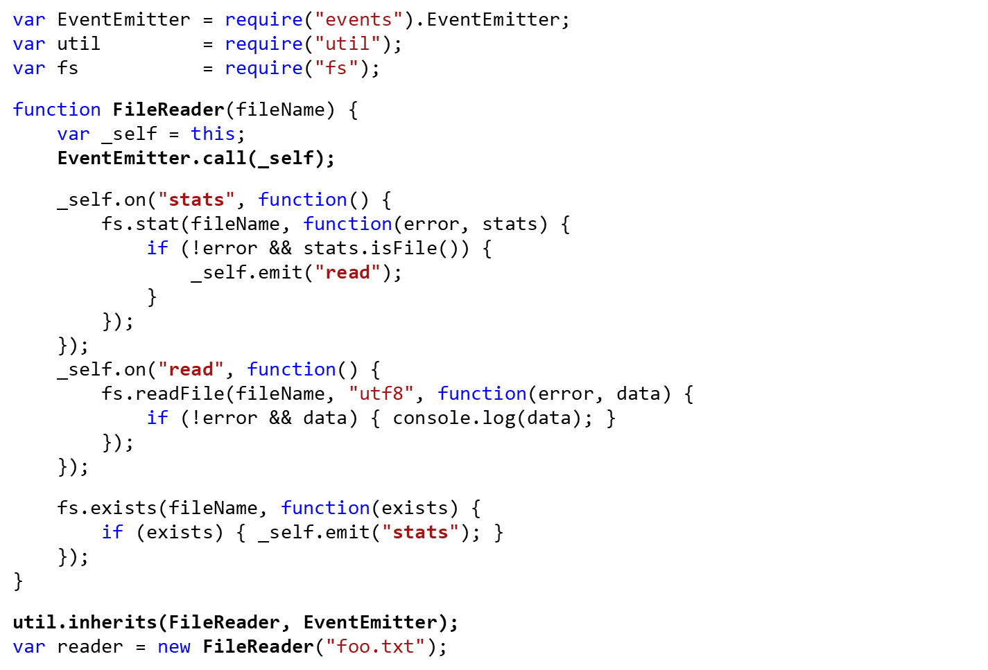
Continuation

Slide 26
Done By
Aakar Mutha, Jason Karter

