Slide 1
PBDA Project YouTube Video Analysis
Group Members
Sagar Patel (sap590)
Aakar Jinwala (adj329)
Sanket Nawale (skn288)

Slide 2
Problem Statement
To find the top trending videos in each category.
To find the trending category based on views of videos.
Analysis of categories.
Average number of Views and average number of Likes for each category.
Identifying Hot Tags for each Category.
Predicting if the new obtained video can feature in the trending video list.

Slide 3




Youtube Data Centres
Architecture Diagram
Youtube API
Kafka Message Queue
MemSQL Data Store
Spark code

Slide 4
Component Breakdown
Youtube Data Centres
Youtube API
Kafka Message Queue
Kafka Message Bus. It enables us to stream real-time data to our spark code to perform the analysis.
There are two topics corresponding to 2 types of data which we receive from the API requests.
The topics currently have 1 partition only. But, we can leverage this parameter to further partition the topics based on categories and so on. This will enable us to parallelize the analysis step further.
Kafka follows a Producer/Consumer Model.

Slide 5
Component Breakdown
Kafka Message Queue
MemSQL Data Store
MemSQL is a real-time data warehouse for cloud and on-premises that delivers immediate insights across live and historical data.
MemSQL is like an in-memory persistent Data Store which has two tables namely Video and Statistics which consume data from Kafka and maintain a persistent storage for the data.
We have used this component since in our use case we could not perform analysis on live streaming data and required a batch or a set of data to be available.
MemSQL pipelines consume data from Kafka and insert it into the Tables.

Slide 6
Component Breakdown
MemSQL Data Store
Spark code
Spark as we know, one the best technologies to work with Big Data. Even though currently we do not have such huge amount of data, but with YouTube Data we can be safe to assume that we will have to deal with Big Data in practical purposes.
We have leveraged the Spark SQL abilities to perform various types of analysis on the data we received out of YouTube.
Spark constantly queries the MemSQL tables to fetch data and perform analysis.
We can also write out results back into some result table in MemSQL.
We have used scala to write spark code.

Slide 7
Architecture Scalability
The complete technology stack that we have implemented in our project is highly and easily scalable to accommodate themselves into machines which have Big Data processing capabilities.
For eg: Kafka and MemSQL can be easily installed and used on the AWS EC2 instances.
Also spark can be used very efficiently on the AWS EMR Cluster.

Slide 8
Visualization 1
Top trending videos of each categories (based on View Count)
Top trending videos of each categories (based on Like Count)

Slide 9
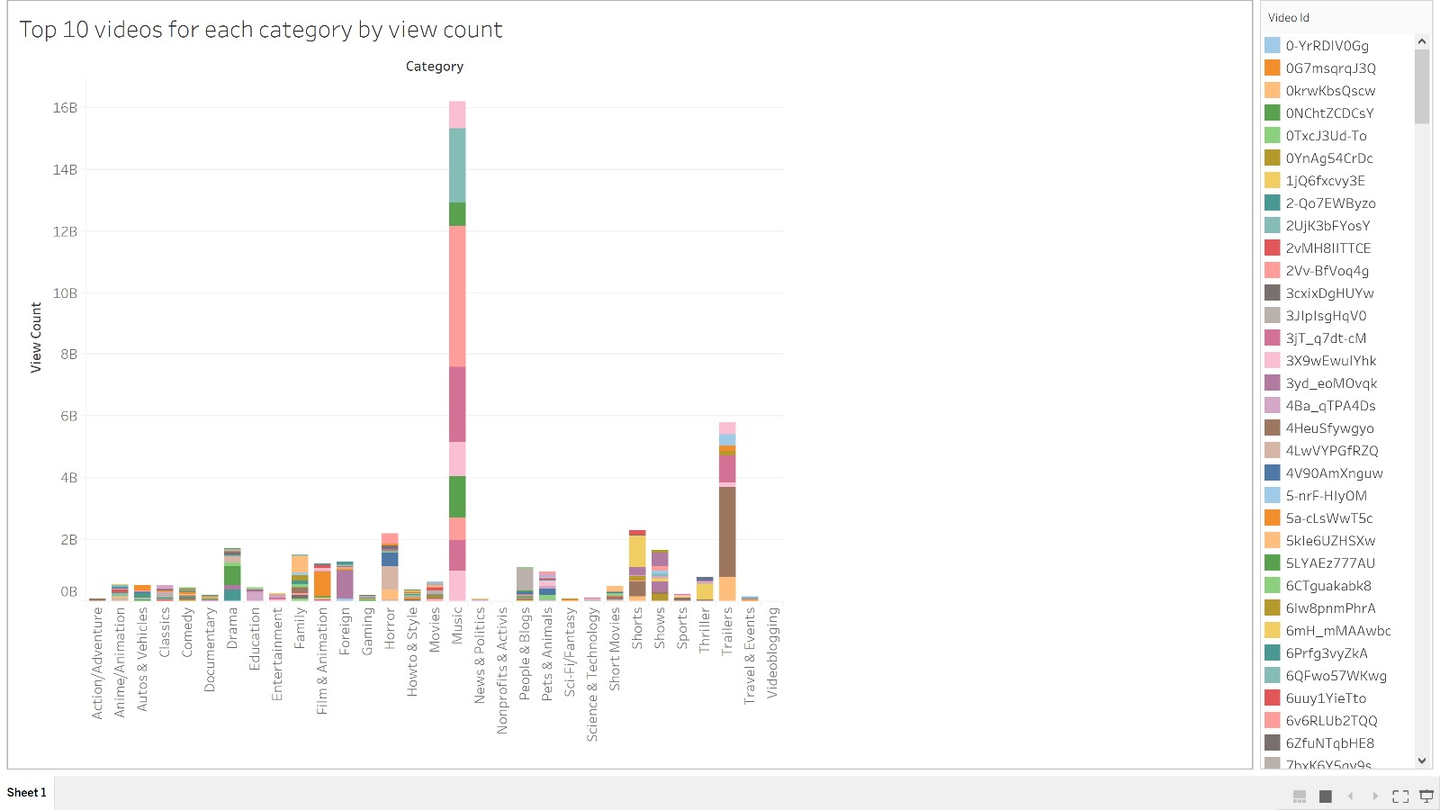
Visualization 1

Slide 10
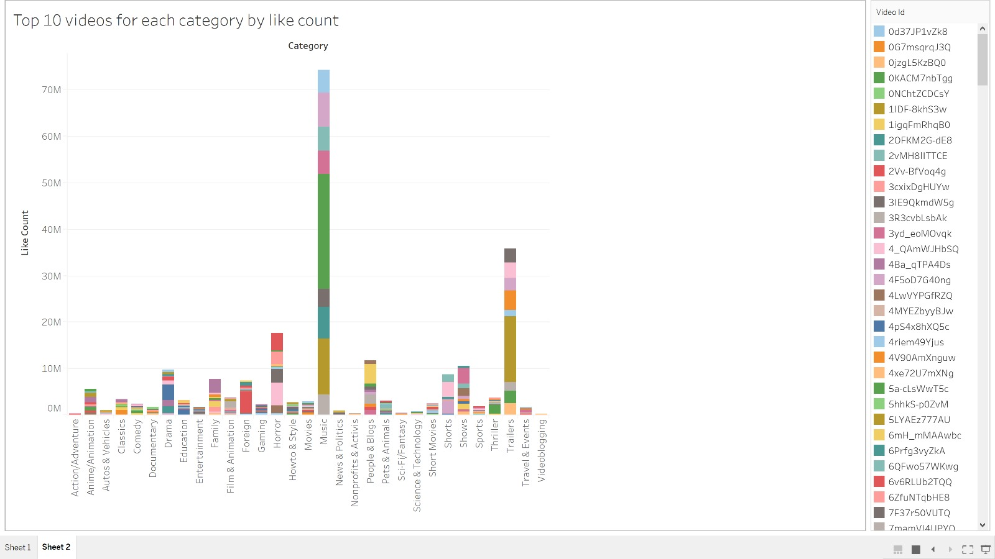
Visualization 1

Slide 11
Visualization 2
Trending Category

Slide 12
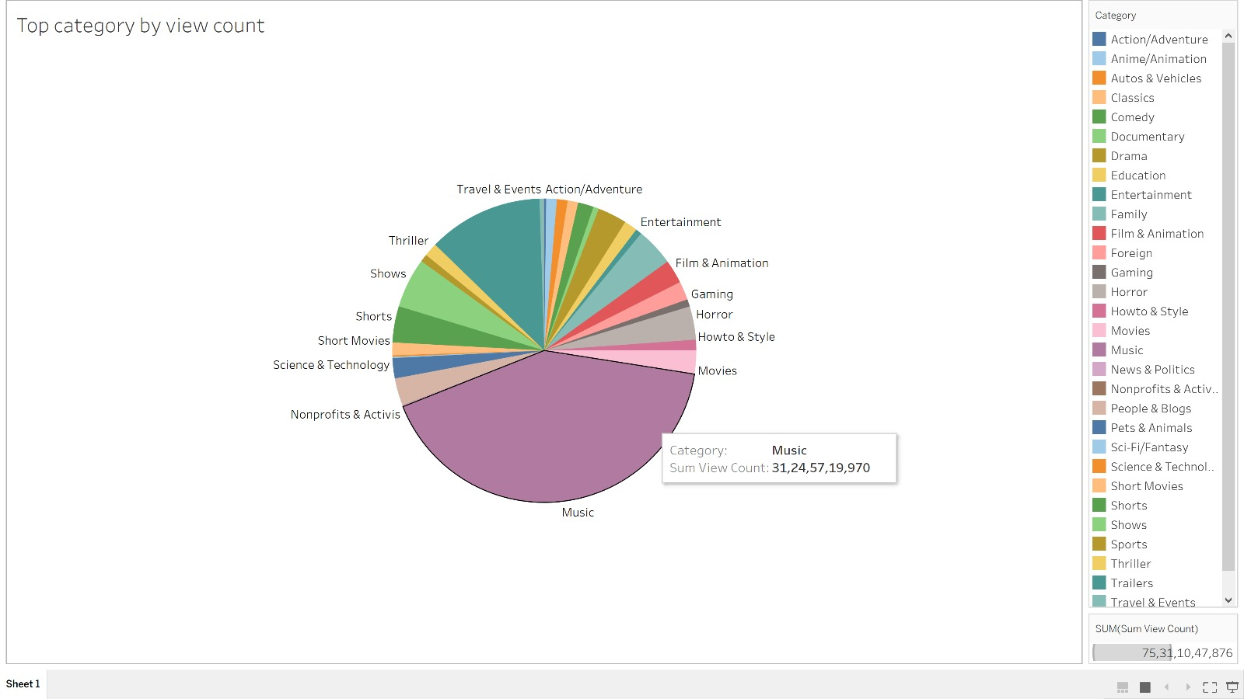
Visualization 2
Trending Category

Slide 13
Visualization 3
Analysis of categories.

Slide 14
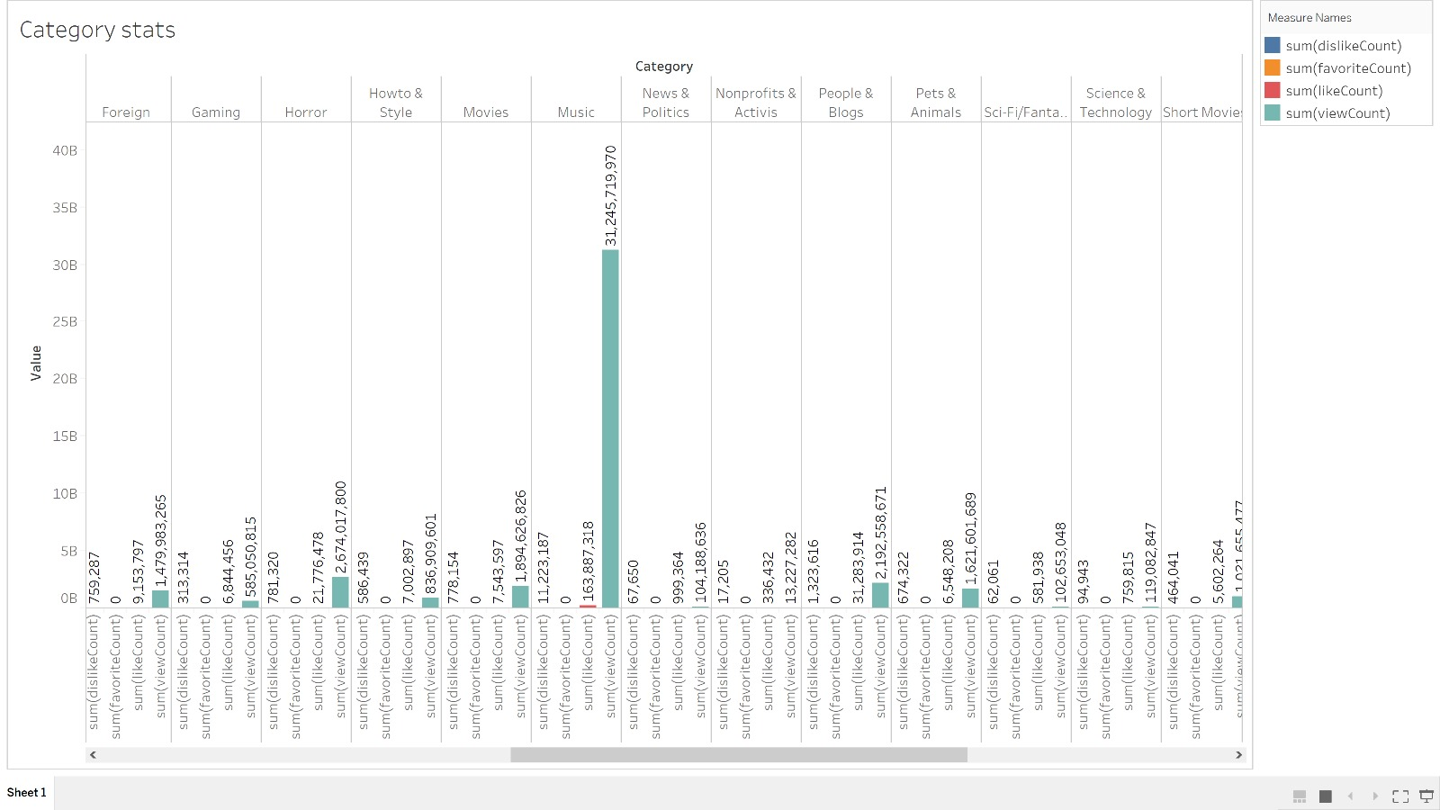
Visualization 3
Analysis of categories.

Slide 15
Visualization 4
Average views and likes across categories.

Slide 16
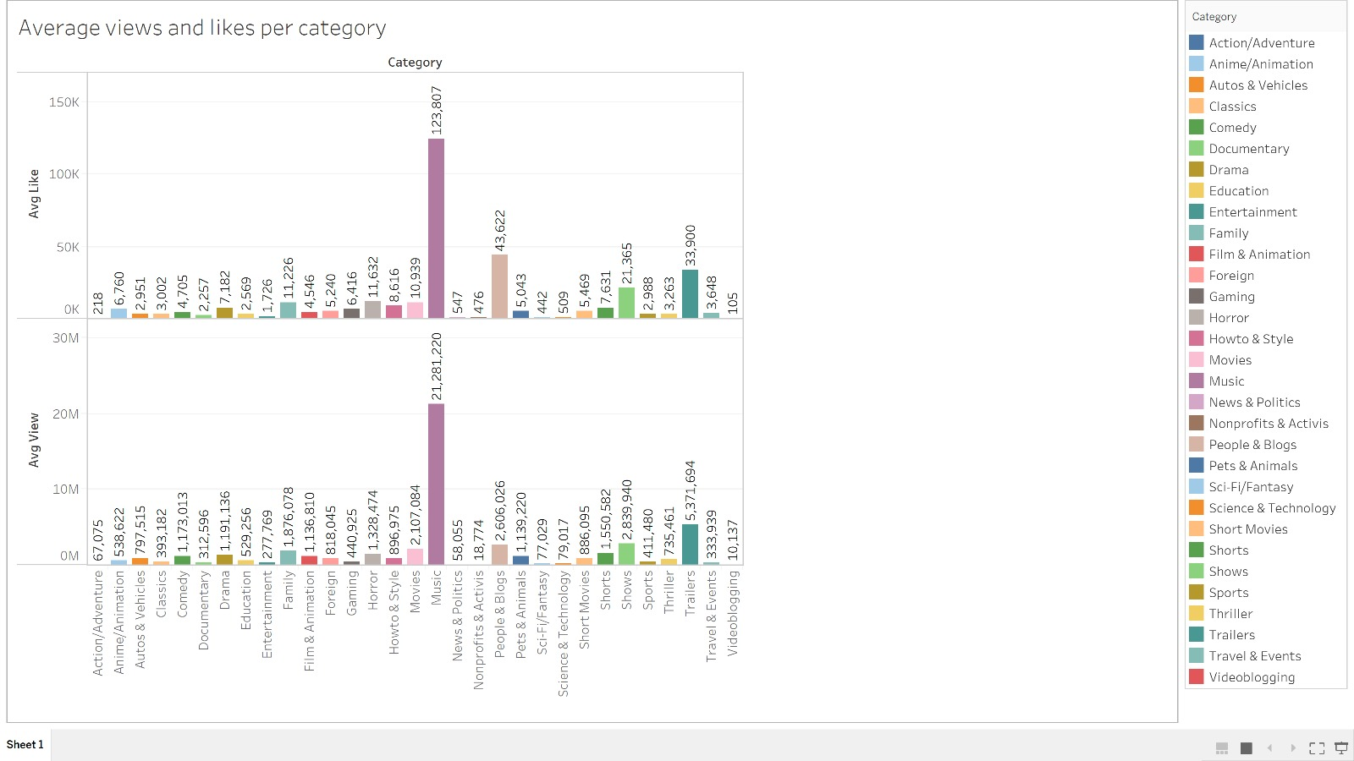
Visualization 4
Average views and likes across categories.

Slide 17
Visualization 5
Identifying Hot Tags for each Category.

Slide 18
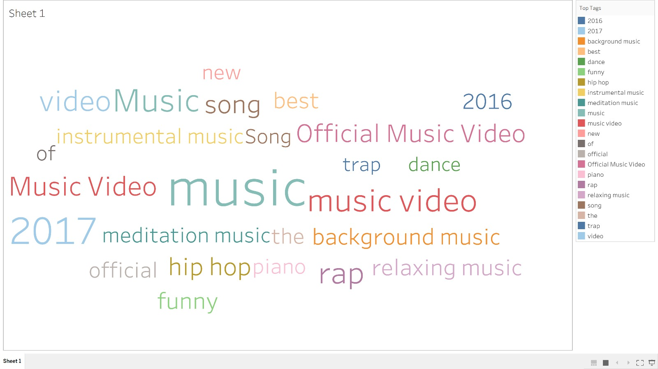
Visualization 5
Identifying Hot Tags for each Category.

Slide 19
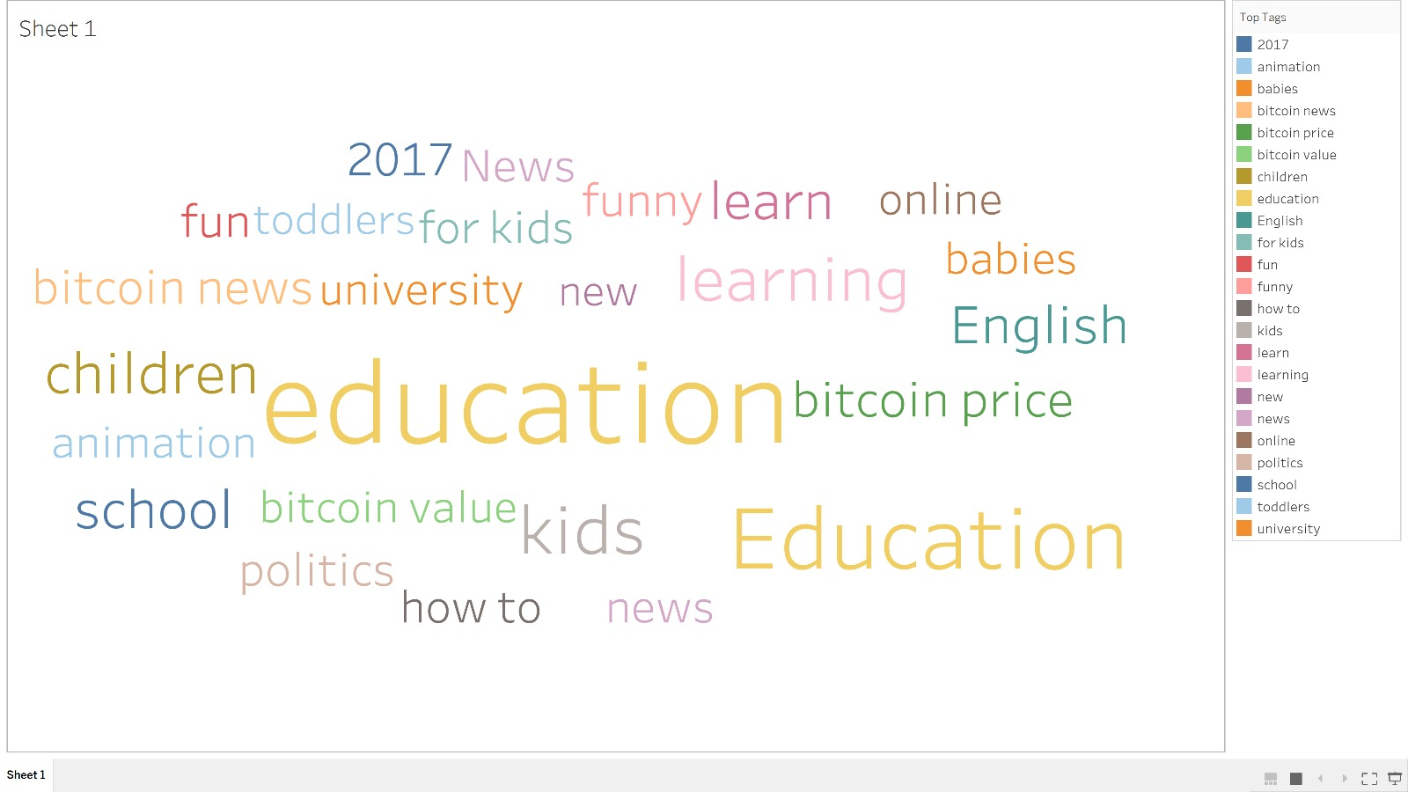
Visualization 5
Identifying Hot Tags for each Category.

Slide 20
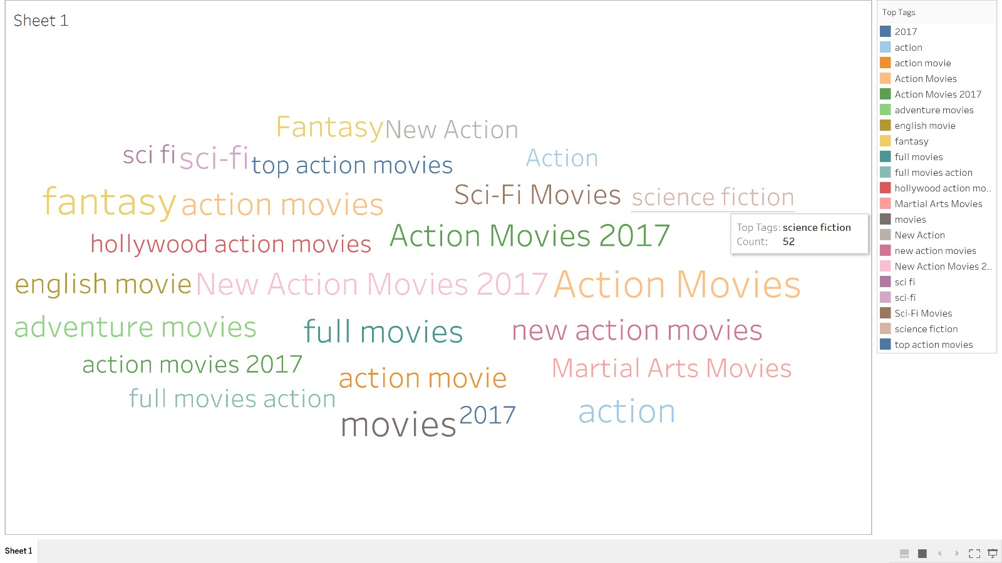
Visualization 5
Identifying Hot Tags for each Category.

Slide 21
Prediction
Predicting whether or not a newly obtained video will feature in any of the categories of our trending videos

Slide 22
Process
Reading
Cleaning
Merging
Pre-processing
Modeling
Performance

Slide 23
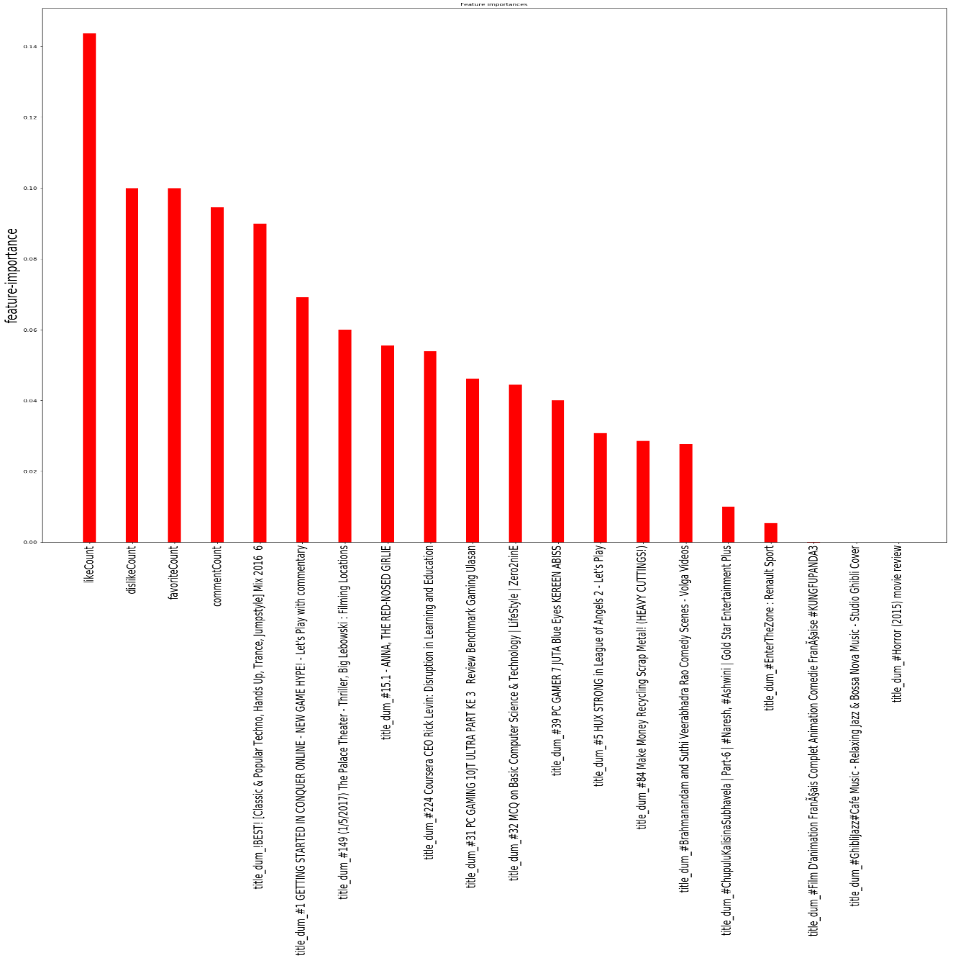
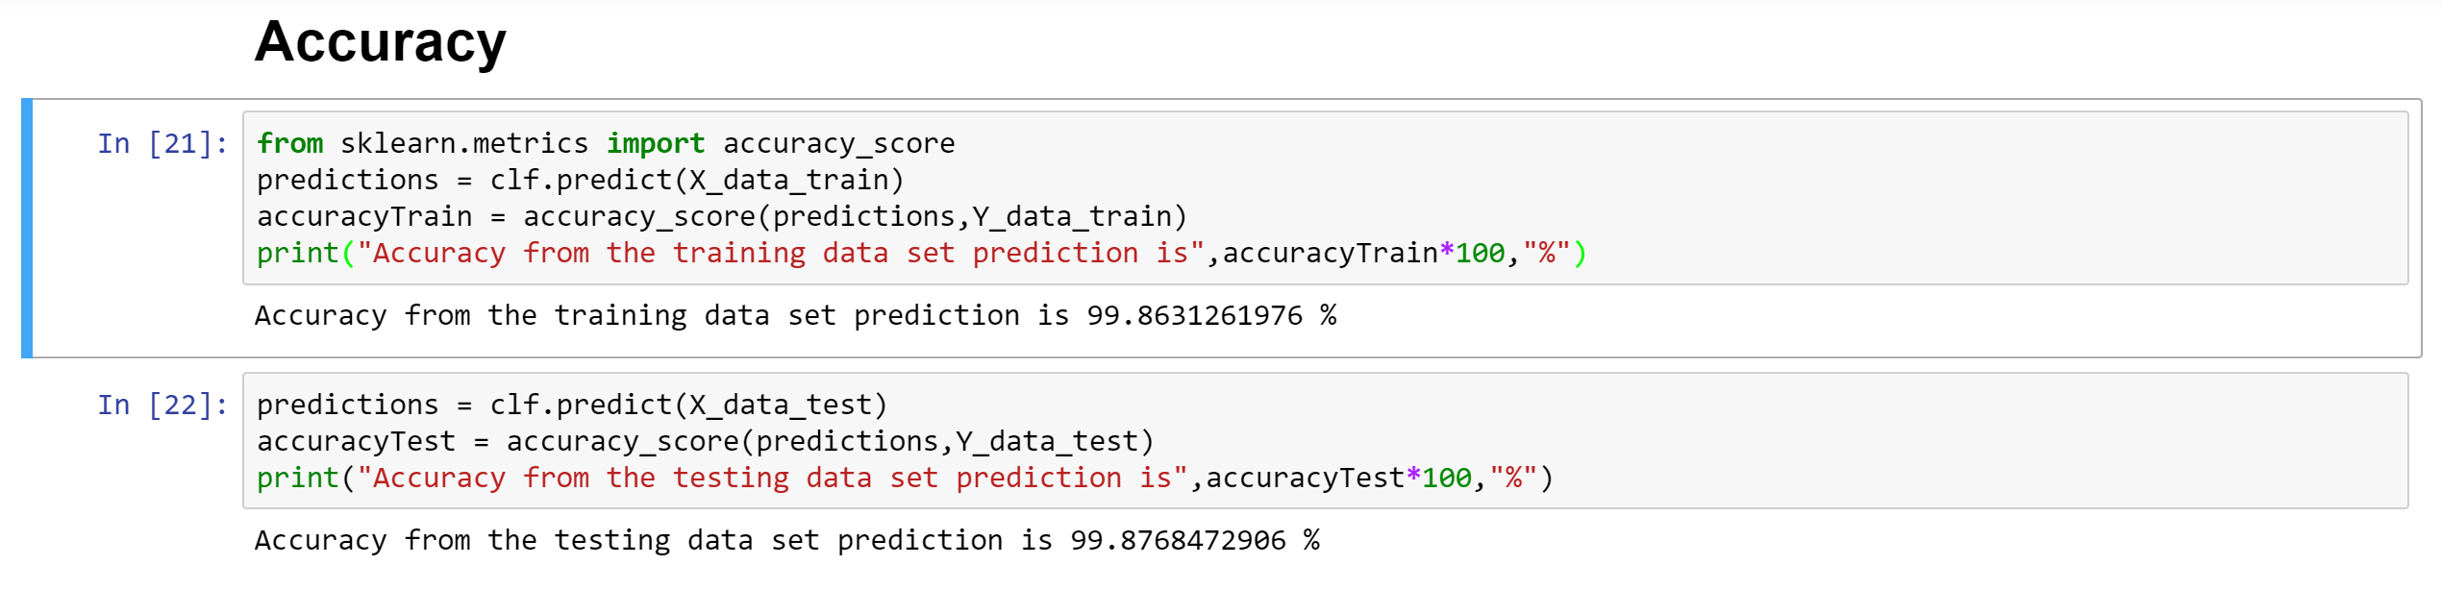
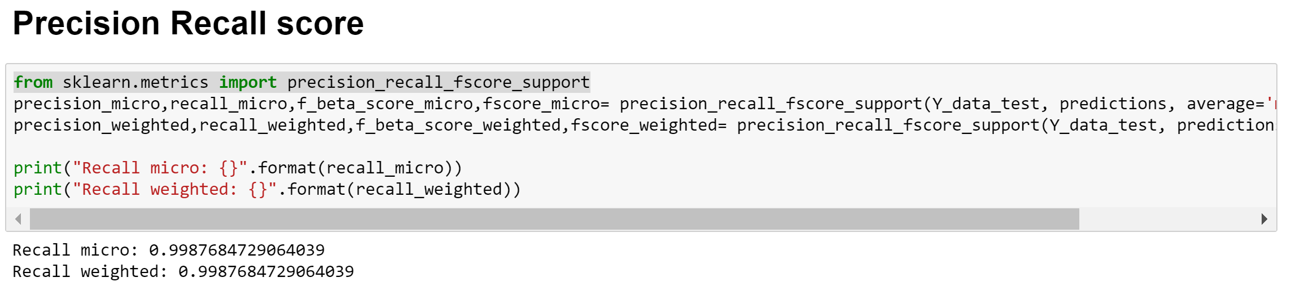

Slide 24
Thank You

