Slide 1
MCOD-FM-RobustBench
01/17
Research-level presentation: paper review, dataset audit, preprocessing, baseline results
Foundation-Model Promptability and Spectral-Degradation Robustness Benchmark
for Multispectral Camouflaged Object Detection
1,527
8
500
11
MSI images
spectral bands
test split
COD baselines
Core claim: RGB camouflage failures are partly spectral failures; MCOD lets us test whether non-visible bands make the object separable and robust.

Slide 2
Paper Review: Problem And Gap
02/17
MCOD: The First Challenging Benchmark for Multispectral Camouflaged Object Detection, ACM MM 2025
Why RGB COD saturates
MCOD intervention
Research implication
Objects share color and texture with their background.
Small targets and extreme illumination trigger missed detections.
Most prior COD datasets are RGB-only.
Existing COD networks are often architecture-heavy but modality-limited.
First public MSI benchmark for COD.
8 registered spectral channels per sample.
High-resolution 1140 x 860 imagery.
Pixel-level masks plus challenge attributes.
Foreground-background discrimination can come from material/spectral response, not just RGB appearance.
The benchmark opens a route for spectral fusion, spectral promptability, and degradation robustness.

Slide 3
Paper Review: Dataset Positioning
03/17
Compared with CHAMELEON, CAMO-COCO, NC4K, COD10K
Dataset
Year
Modality
Channels
Resolution
Attr.
Camo imgs
CHAMELEON
2017
RGB
3
450x300 to 2304x34
-
76
CAMO-COCO
2019
RGB
3
154x156 to 7360x4912
7
1,250
NC4K
2021
RGB
3
354x268 to 1280x960
-
4,121
COD10K
2022
RGB
3
300x199 to 2976x3968
7
5,066
MCOD
2025
MSI
8
1140x860
8
1,527
MCOD trades raw dataset size for richer sensing: calibrated multispectral capture, uniform spatial resolution, pixel masks, and explicit challenge attributes.
Paper statistic to remember: average object area is 0.429% of the image, far below COD10K's reported 8.94%.

Slide 4
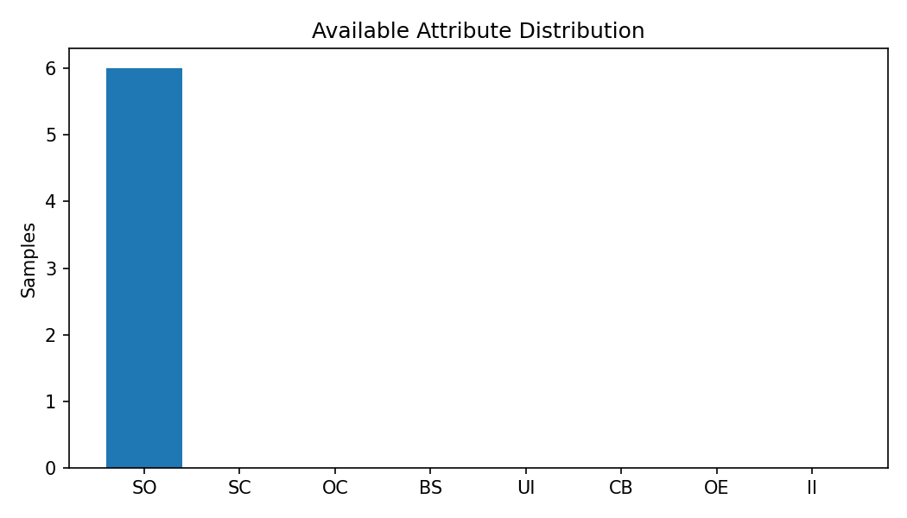
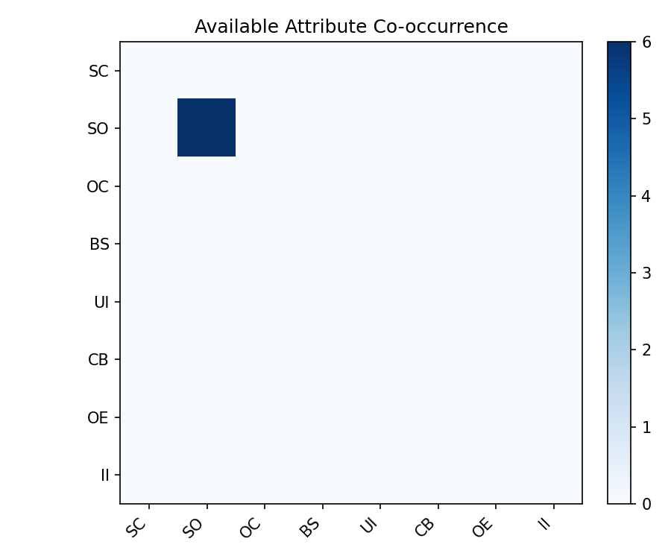
Paper Review: Challenge Attributes
04/17
Eight difficulty labels define targeted evaluation subsets
Code
Meaning
Failure pressure
SC
Shape Complex
irregular boundaries
SO
Small Object
tiny object-to-image ratio
OC
Object Occlusion
partial visibility
BS
Background Similarity
weak RGB contrast
UI/OE/II
Extreme Illumination
lighting instability
CB
Complex Background
distractors and clutter

Slide 5
Paper Review: Official Baseline Results
05/17
11 COD methods adapted from RGB input to 8-channel MSI input
Method
Venue
E up
S up
F up
MAE down
SINet
CVPR 2020
.758
.616
.369
.006
LSR
CVPR 2021
.830
.625
.373
.005
CODCEF
Sensors 2021
.763
.677
.444
.004
C2FNet
IJCAI 2021
.726
.721
.403
.010
C2FNet-V2
TCSVT 2022
.913
.810
.654
.008
SINet-V2
TPAMI 2022
.849
.728
.492
.004
ASBI
CVIU 2023
.684
.675
.370
.014
FIRNet
TVC 2024
.882
.738
.537
.004
PRNet
TCSVT 2024
.926
.826
.698
.002
IdeNet
TIP 2024
.846
.808
.588
.004
PCNet
arXiv 2024
.633
.855
.386
.003
Official reading: PRNet leads E/F/MAE, PCNet leads S-measure; strong scores still coexist with hard failure cases under SO, extreme illumination, BS, and CB.

Slide 6
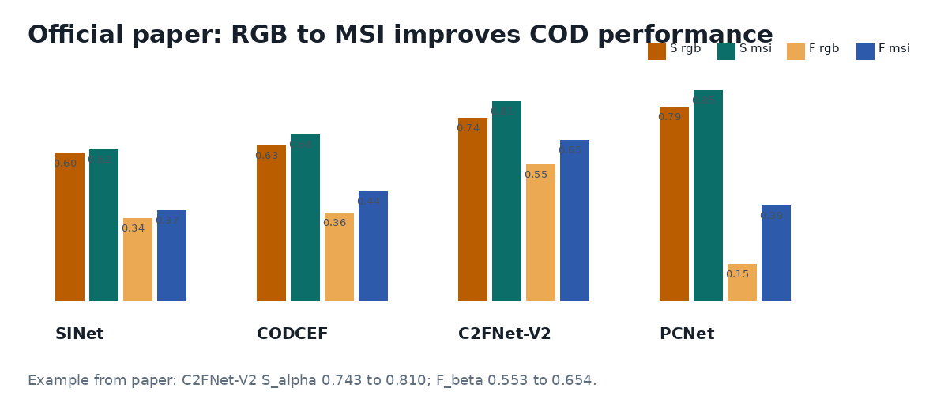
Paper Review: Why Multispectral Helps
06/17
Controlled RGB vs MSI comparison from the official paper
Method
Input
E
S
F
MAE
SINet
RGB
.695
.601
.335
.005
SINet
MSI
.758
.616
.369
.006
C2FNet-V2
RGB
.885
.743
.553
.009
C2FNet-V2
MSI
.913
.810
.654
.008
PCNet
RGB
.397
.788
.149
.005
PCNet
MSI
.633
.855
.386
.003
The key evidence is consistency: MSI improves most metrics across representative architectures.
Paper example: C2FNet-V2 S_alpha improves 0.743 to 0.810; F_beta improves 0.553 to 0.654.

Slide 7
This Repo: Research Objective
07/17
From MCOD benchmark to promptability and robustness benchmark
Question 1
Question 2
Question 3
Can foundation or RGB-trained segmentation models use MSI-derived views to localize camouflaged objects?
Which spectral views preserve detection evidence: false color, red-edge, NIR, PCA projections, or all-8 tensors?
How robust are results when spectral bands are degraded, dropped, perturbed, or misaligned?

Slide 8
Data Organization And Corrections
08/17
Raw MCOD standardized into a clean working dataset
Path
Train
Test
Role
data/MCOD_raw/*/Pcolor
1027
500
official false-color PNG
data/MCOD_raw/*/GT
1027
500
pixel masks
data/MCOD_raw/*/Mat
1027
500
8-band gray cubes
data/MCOD_resized/*/Pcolor
1027
500
uniform 1140x860
data/MCOD_resized/*/GT
1027
500
uniform 1140x860
Resolution repair performed in a separate folder to preserve raw data.
Final resolution summary: Pcolor 1527 at 1140x860; GT 1527 at 1140x860.
Recent code change: process_mask now copies official masks unchanged rather than binarizing label values.

Slide 9
Audit Results: Dataset Integrity
09/17
Quality gates before any model-level claim
Check
Result
Interpretation
Sample count
1527 / 1527
matches official dataset size
Official split
1027 train / 500 test
split is intact
Image-mask-Mat count
all equal per split
sample triples align
Corrupted files
0 rows reported
readability check passed
Missing bands
0 rows reported
8-band completeness passed
Missing masks
0 rows reported
mask linkage passed
Train-test leakage
0 rows reported
no exact leakage reported
Audit files: MCOD_inspection_report/*.csv and data_audit/MCOD/*.csv

Slide 10
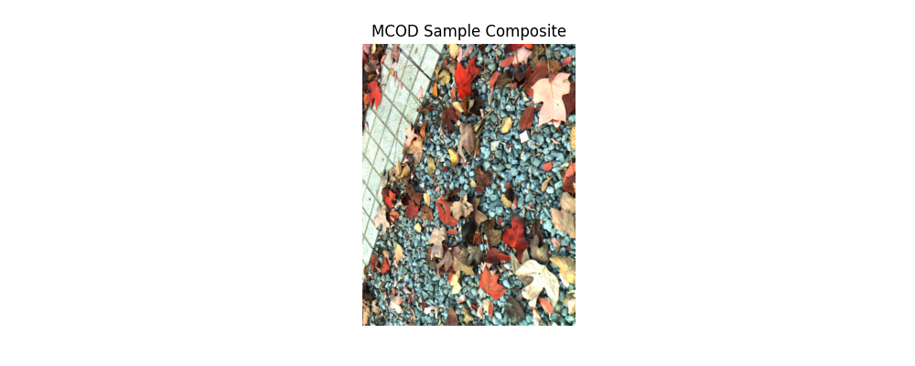
Processing Pipeline: Spectral Views
10/17
process_dataset.py generates model-ready views from each 8-band cube
Output view
Definition
official_false_colour
R=S5, G=S3, B=S2
S6_rededge_gray3
S6 normalized as 3-channel image
S7_nir1_gray3
S7 normalized as 3-channel image
S8_nir2_gray3
S8 normalized as 3-channel image
visible_group_projection
PCA over S1-S5
Processed counts per view: 1027 train + 500 test for all eight output groups, including all8_input tensors and masks.
nir_group_projection
PCA over S6-S8
all8_input
H x W x 8 normalized tensor
ground_truth_mask
official mask copied unchanged

Slide 11
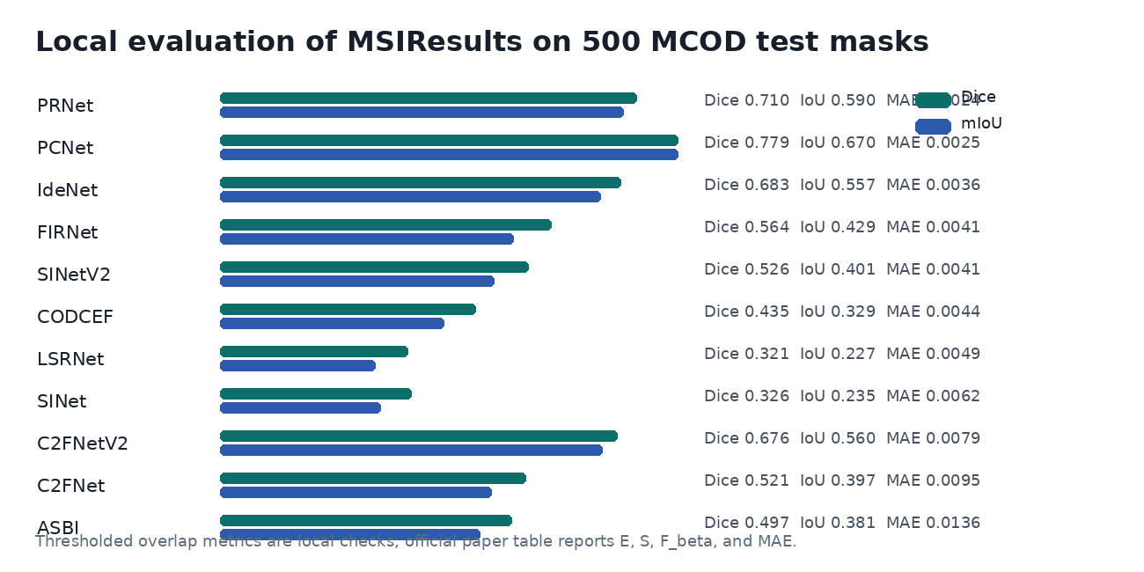
Repo Results: Available Baseline Outputs
11/17
MSIResults contains complete predictions for the 500-image test split
Method folder
Pred masks
PRNet
500
PCNet
500
IdeNet
500
FIRNet
500
SINetV2
500
CODCEF
500
LSRNet
500
SINet
500
C2FNetV2
500
Local check agrees with the paper's broad picture: PRNet has the lowest MAE, PCNet has high overlap/structure behavior, and older baselines degrade strongly.
C2FNet
500
ASBI
500

Slide 12
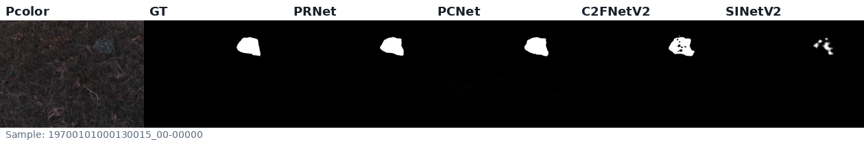
Qualitative Snapshot
12/17
One test image across input, mask, and representative prediction maps
Dense masks often differ in boundary sharpness and small-object recall even when aggregate MAE is low.
This motivates attribute-wise and failure-mode analysis rather than relying only on mean test-set scores.

Slide 13
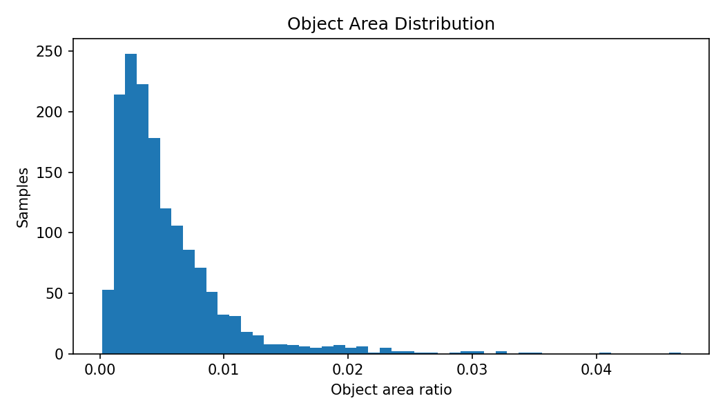
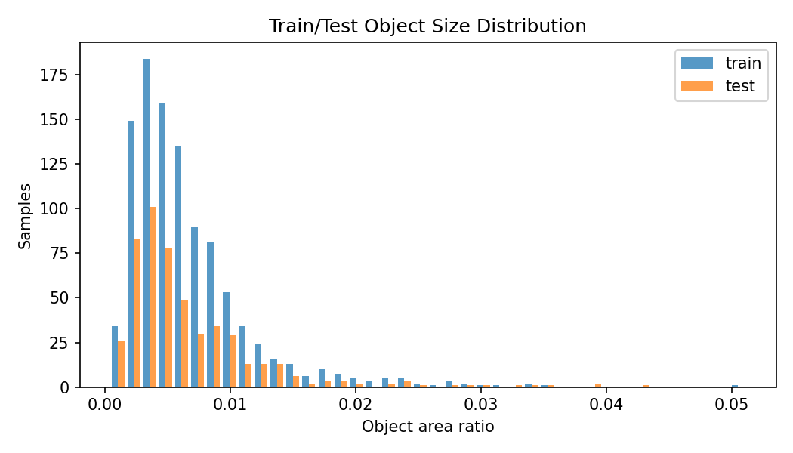
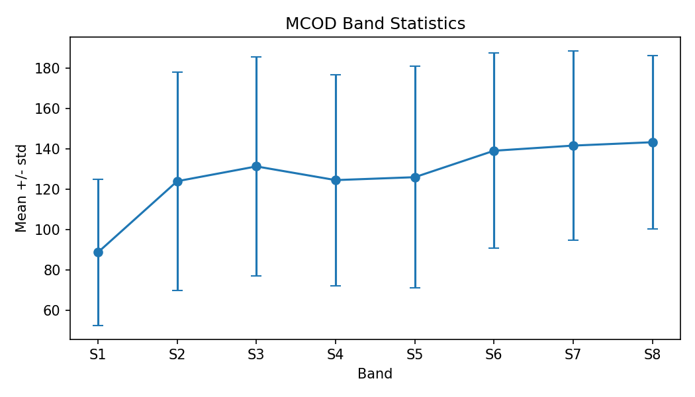
Dataset Statistics From Audit
13/17
Object scale and spectral distribution
Train/test area distributions are nearly matched: mean area ratio 0.00538 in both splits.
Band means and variances show that visible, red-edge, and NIR channels have distinct intensity statistics.

Slide 14
Evaluation Protocol
14/17
Metrics retained for research-grade reporting
Metric
Direction
Why it matters
Reporting rule
S-measure
higher
structural similarity of object map
E-measure
higher
alignment between prediction and GT
Report both aggregate and attribute-wise scores.
State whether masks are official, binarized, resized, or interpolated.
Separate official paper metrics from local verification metrics.
F-measure
higher
precision-recall balance
MAE
lower
pixel-level absolute error
Weighted F
higher
spatially weighted F-score
Dice / mIoU
higher
thresholded overlap
Boundary F
higher
contour quality

Slide 15
Failure Modes To Analyze Next
15/17
Where MCOD remains difficult
Small objects
Lighting extremes
Spectral alignment
Low absolute pixel area can yield deceptively good MAE while missing the object. Need Dice, IoU, boundary, and attribute-specific recall.
UI, OE, and II can collapse visible contrast. MSI should be tested under band drop, noise, and exposure perturbation.
Real sensors can misregister bands. Robustness should include spatial shifts between visible, red-edge, and NIR groups.

Slide 16
Planned Experiment Matrix
16/17
From current repository state to publishable benchmark extension
Stage
Experiment
Main output
1
Manifest and audit finalization
frozen CSV manifest + QC report
2
Baseline reproduction
official metric table on 500 test images
3
Spectral view analysis
false color vs S6/S7/S8 vs PCA views
4
Foundation-model promptability
SAM/SAM2 prompt sensitivity
5
Spectral degradation robustness
band drop/noise/misalignment curves
6
Attribute-wise failure analysis
SO/EI/BS/CB breakdown and examples

Slide 17
Contributions And Takeaway
17/17
What this project can credibly claim now
1. MCOD paper review establishes the research gap: RGB COD lacks spectral evidence.
2. Repo now contains a corrected MCOD_resized working dataset with verified split, counts, masks, and resolution.
3. process_dataset.py creates multiple MSI-to-RGB and tensor-native views for controlled experiments.
4. Existing MSIResults predictions cover all 500 test images for 11 baseline methods.
5. Next research value comes from attribute-wise and spectral-degradation robustness experiments.
One-sentence thesis: MCOD makes camouflage detection a spectral robustness problem, not only an RGB segmentation problem.

