Slide 1
Network Automation Platform

Slide 2
Intent-Based Network Automation:
Intent-Based Networking is the foundation of the new era of networking.
The main principle is that the network takes the business intent and automatically transforms it into network configurations for all the devices.
It reduces manual operation to the minimum. It also monitors continuously and adjusts to ensure alignment, providing an extra level of network visibility.
In intent-based network system, all the network devices will be automatically configured to fulfil this requirement across the network, no matter where the employee is connected.
VLAN, subnet, ACL and all other details will be automatically defined and configured following best practices. The intent has to be defined once in a central management console, and then, the network will continuously assure it, even if there are changes in the network.

Slide 3
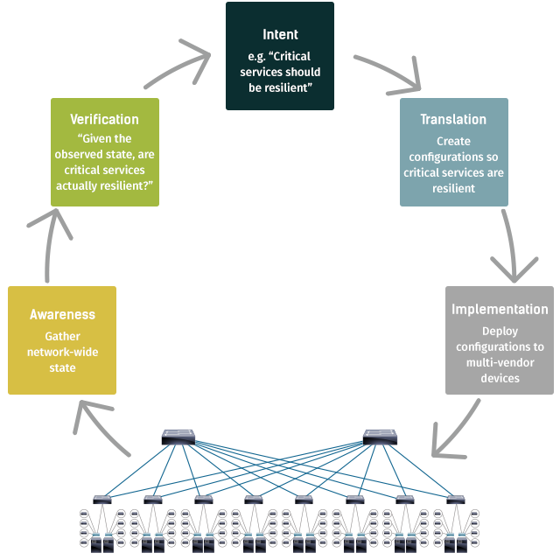

Slide 4
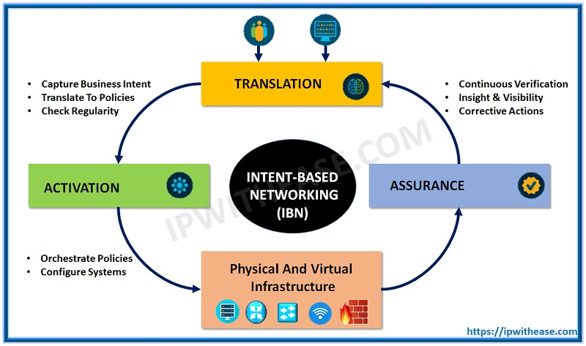
Elements in Intent Based Networking:
For Intent-Based Networking to work, a number of elements must come together.
These include policy, automation, assurance and analytics, network security, and programmable network infrastructure.
If any of these elements are missing or not well integrated, the resulting network will not function as a true Intent-Based Network.

Slide 5
Business policy:
Creates and understands policies associated with identity, access, service levels, security, and compliance and translates them into network requirements.
Automation:
Automates the provisioning, configuration, and repair of the end-to-end network in a simple, orchestrated, and efficient way. Reduces delivery time and configuration effort.
Assurance:
Monitors, gathers, correlates, and presents data from users, network, devices, and applications. Derives deep operational and business insights that provide context and inform business and IT.
Security:
Integrates security into every aspect of the network. Rapidly detects threats and enforces policy anywhere in the enterprise or extended network, even in encrypted traffic.
Programmable network infrastructure:
Offers a portfolio of highly secure, scalable, and programmable network elements (both physical and virtualized). These elements connect devices, transport data, and enable the policy, automation, assurance, and security elements described above.

Slide 6
For Example:
Intent:
You must ensure your finance department receives uninterrupted service levels at month’s end.
Translation:
Build policy which guarantees that finance users and applications are placed on a secure segment that receives the highest priority service.
Activation:
Apply priority-service levels between all users and applications on the finance-reporting segment across all network devices.
Assurance: Use telemetry to monitor and analyze the network against your desired outcome, to remediate, optimize, and correct as appropriate.
For intent-based networking to achieve its full potential, these functions are applied across all networking domains and build on a programmable network infrastructure.

Slide 7





Slide 8
NMAP:
Nmap, short for Network Mapper, is a free, open-source tool for vulnerability scanning and network discovery. Network administrators use Nmap to identify what devices are running on their systems, discovering hosts that are available and the services they offer, finding open ports and detecting security risks.
Nmap can be used to monitor single hosts as well as vast networks that encompass hundreds of thousands of devices and multitudes of subnets.

Slide 9
Mininet:
Mininet is a software emulator for prototyping a large network on a single machine.
Mininet can be used to quickly create a realistic virtual network running actual kernal, switch and software application code on a personal computer. Mininet allows the user to quickly create, interact with, customize and share a software defined Network (SDN) prototype to simulate a network topology that uses Openflow switches.

Slide 10
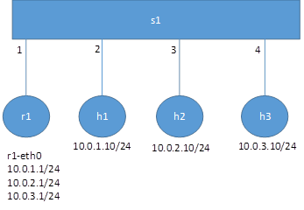
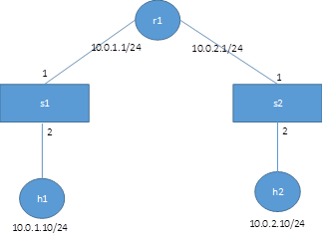
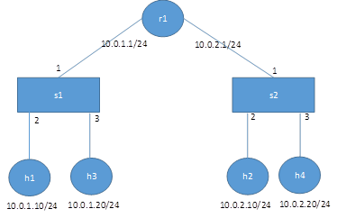
Mininet custom topologies:

Slide 11
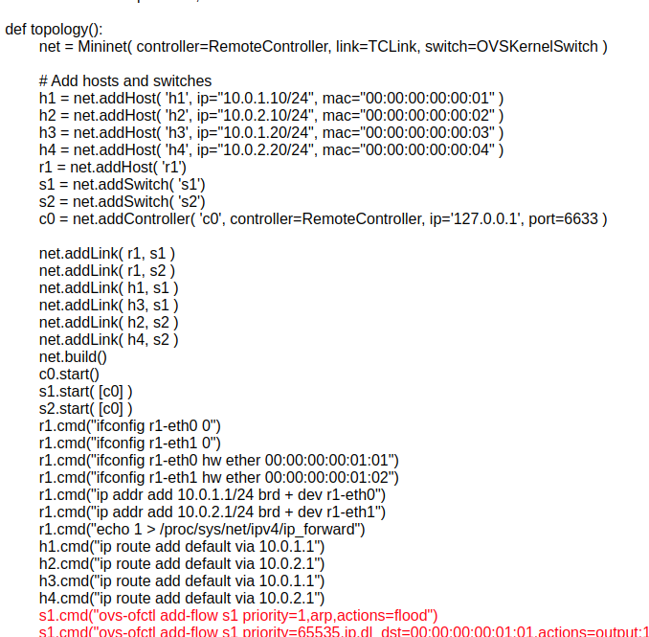

Slide 12
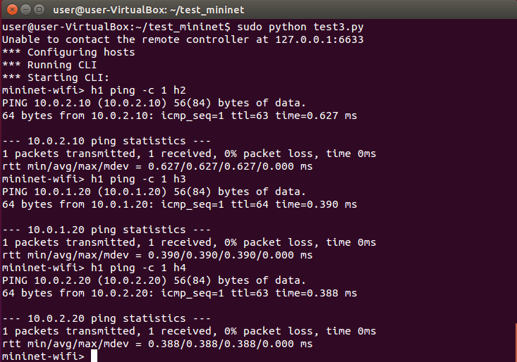

Slide 13
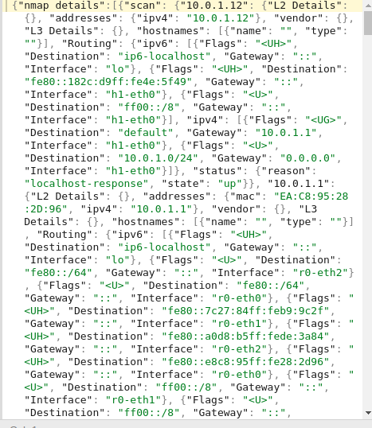
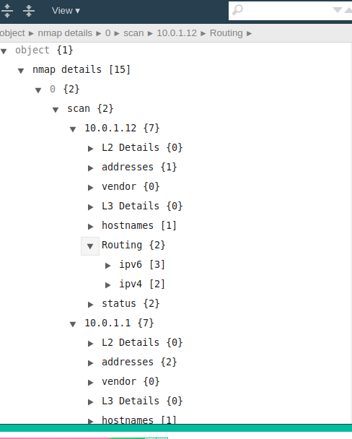

Slide 14
