Slide 1
Network Automation Platform

Slide 2
Intent-Based Network Automation:
Intent-Based Networking is the foundation of the new era of networking.
The main principle is that the network takes the business intent and automatically transforms it into network configurations for all the devices.
It reduces manual operation to the minimum. It also monitors continuously and adjusts to ensure alignment, providing an extra level of network visibility.
In intent-based network system, all the network devices will be automatically configured to fulfil this requirement across the network, no matter where the employee is connected.
VLAN, subnet, ACL and all other details will be automatically defined and configured following best practices. The intent has to be defined once in a central management console, and then, the network will continuously assure it, even if there are changes in the network.

Slide 3
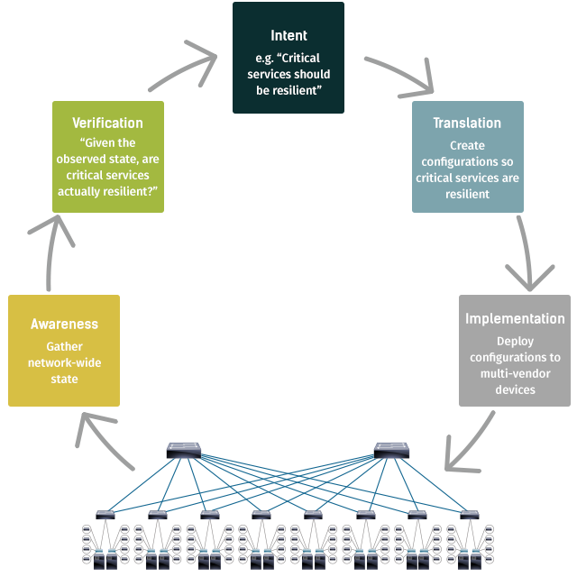

Slide 4
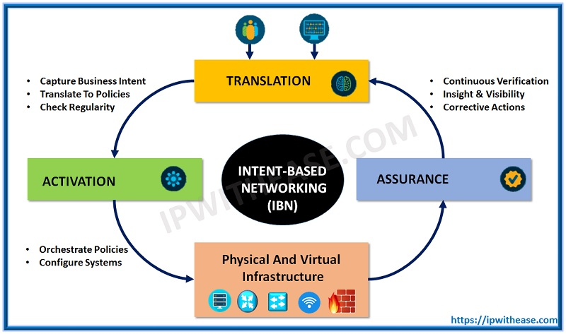
Elements in Intent Based Networking:
For Intent-Based Networking to work, a number of elements must come together.
These include policy, automation, assurance and analytics, network security, and programmable network infrastructure.
If any of these elements are missing or not well integrated, the resulting network will not function as a true Intent-Based Network.

Slide 5
Business policy:
Creates and understands policies associated with identity, access, service levels, security, and compliance and translates them into network requirements.
Automation:
Automates the provisioning, configuration, and repair of the end-to-end network in a simple, orchestrated, and efficient way. Reduces delivery time and configuration effort.
Assurance:
Monitors, gathers, correlates, and presents data from users, network, devices, and applications. Derives deep operational and business insights that provide context and inform business and IT.
Security:
Integrates security into every aspect of the network. Rapidly detects threats and enforces policy anywhere in the enterprise or extended network, even in encrypted traffic.
Programmable network infrastructure:
Offers a portfolio of highly secure, scalable, and programmable network elements (both physical and virtualized). These elements connect devices, transport data, and enable the policy, automation, assurance, and security elements described above.

