Slide 1


Master Thesis: RSS-based localization
using distributed spectrum sensing for 5G networks
10.07.2023
Supervisors:
Student:
Aakarsh Dhariwal
Begin: 1.04. 23
End: 1.10.23
Victor Shatov
Norman Franchi
Lehrstuhl Elektrische Smart City Systeme
Nuremberg Campus of Technology (NCT)
Prof. Dr.-Ing. Norman Franchi
Engineering for Smart Cities

Slide 2
Overview
One chapter on state-of-the-art research
Concept: One chapter describing the overall concept of a dedicated network of sensors (multi-agent system) used for collaborative RF emission sensing. This chapter should already include the basic requirements with respect to timing (update rate of the REM -radio environmental map- described in dependency of the re-scheduling capabilities of a 5G network), synchronization, instantaneous analysis bandwidth, receiver sensitivity, …
Sensor model: One chapter about modelling the PHY of a sensing receiver node based on energy and power detection/analysis + one emitter (potential jammer profile) in MATLAB (Signal Processing chain, how power is transmitted)
Network model: One chapter about modelling a 2D or already 3D scenario with N (maybe initially 3 or 4) sensing receivers, a central node with sensor fusion capabilities (algorithm to build a REM), and one emitter.
Evaluation: One chapter about evaluating the accuracy that can be achieved with varying parameters (frequency, antenna characteristics, N, inter-sensor-distances, emitter power, positions, channel model, etc.)
Lehrstuhl Elektrische Smart City Systeme
<number>

Slide 3
Approximate Time Plan
 | March |  |  |  | April |  |  |  | May |  |  |  | June |  |  |  | July |  |  |  | August
Literature review on Spectrum Sensing (WB, NB)
Dedicated sensor network model concept w.r.t 5G
Sensor modeling, transmitter modeling
Collaborative localization of 1 emitter based on st. prop. methods, REM construction
Evaluation of changes of network parameters
Miscellaneous Tasks
Writing
Defence
Lehrstuhl Elektrische Smart City Systeme
<number>

Slide 4
Additional remarks:
The simulation part of the thesis is based on the paper: ‘Optimised sensor network for transmitter localisation and radio environment mapping’ (Izzati, Taheri, Tugcu, 2016); (already shared)
It would be great (but not critical) to have simulation results from the paper by mid-term defense;
Major innovation: from literature research;
Sensor node design: functional diagram (fft-based) or more? Clarify about the Tx signal to be analysed (WB/NB, or a particular signal...) – OFDM transmitter
Lehrstuhl Elektrische Smart City Systeme
<number>

Slide 5
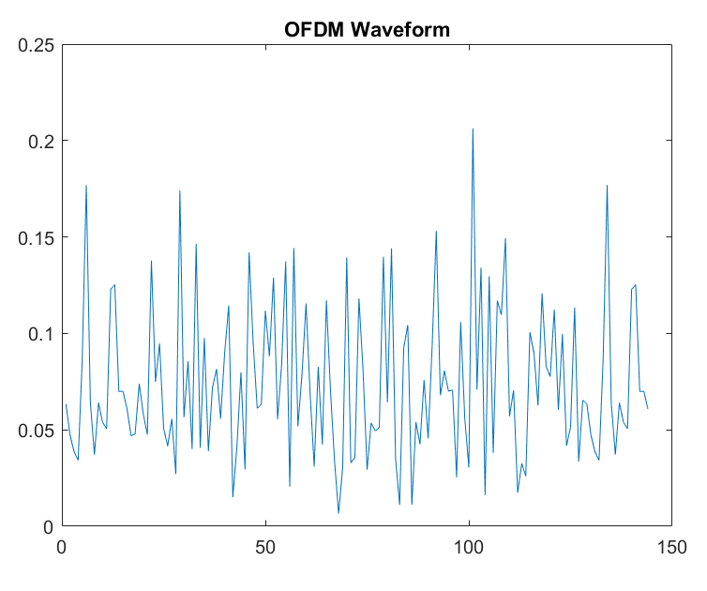
OFDM Waveform for localization
Create a generic OFDM time domain signal.
Employ use of pilots and data symbols using QAM modulation.
Instead of data transmit pilots.
Total Tx power of the OFDM signal or one OFDM symbol is calculated using pilots only.
Theory and future work with OFDM signals is use of numerology framework for 5G NR waveform for TRX localization purposes.
In report write about OFDM waveform generation with a detailed look into 5G frame format.
Lehrstuhl Elektrische Smart City Systeme
24/06/24
<number>
Notes:
<number>

Slide 6
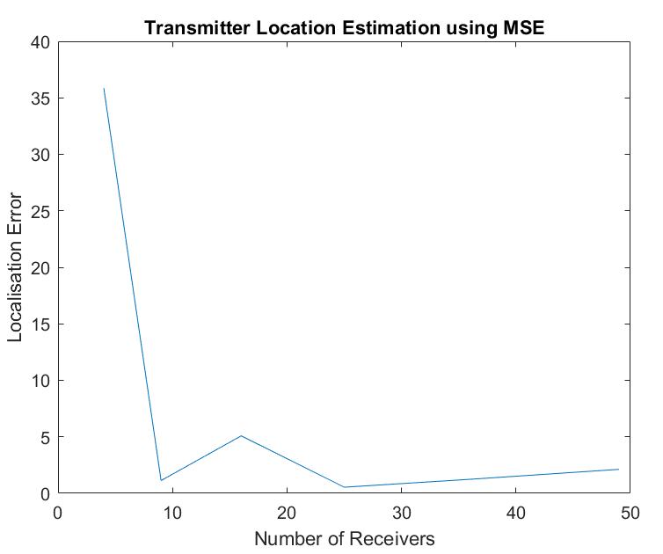
MSE based TRX localization
100 x 100 m grid of sensing nodes.
TX actual position at (18,37).
Localization error in meters from the true Tx location is presented.
MSE works better if the true tx position in path loss for RSS measurements in close to the senor nodes and not far. For example, if the area for localization is large and true Tx position is quite close to a corner then we witness higher loss in localization error.
Lehrstuhl Elektrische Smart City Systeme
24/06/24
<number>

Slide 7
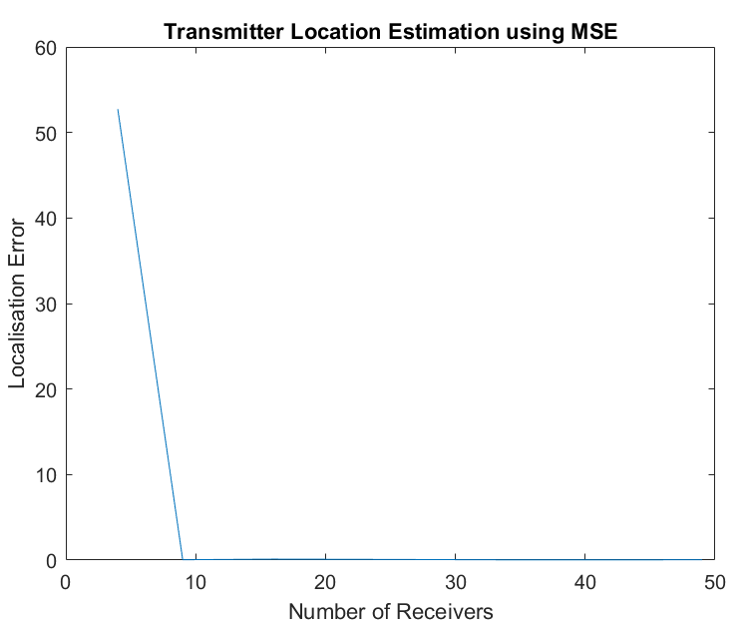
OFDM signal for TRX localization
For a given area of 400 m x 400 m.
We witness that using OFDM signal for localization produces near perfect solution compared to the case of static power even if the area for location estimation is quite large.
Number of OFDM symbols used 28, 2 ms long 2 subframes with pilots allocated in subcarrier.
The real reason behind this result is still not clear.
Lehrstuhl Elektrische Smart City Systeme
24/06/24
<number>

Slide 8
Correlated Shadowing model for localization
Same are of 100m x 100m grid.
Correlated shadowing model with parameters:
Noise standard deviation used is: 0,4,6,8 dB.
Correlation distance to account for correlation between sensor links is 8 m.
As a result the plot with higher noise standard deviation shows higher inaccuracy in terms of localization error.
The plot is in the next slide.
Lehrstuhl Elektrische Smart City Systeme
24/06/24
<number>

Slide 9
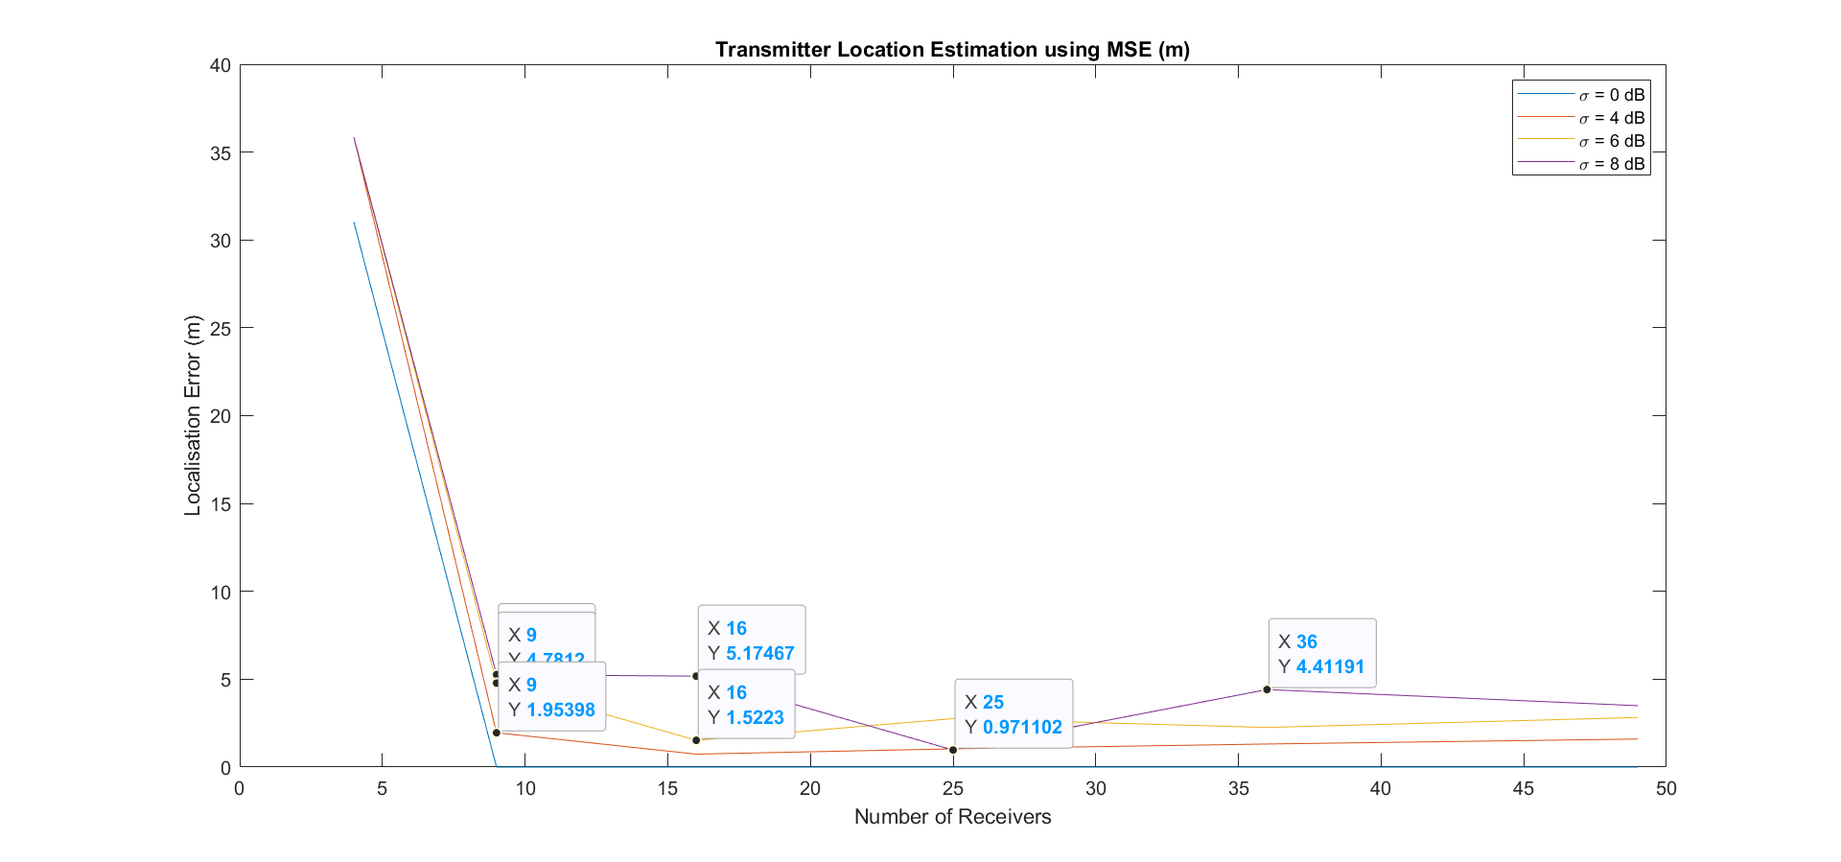
Correlated Shadowing model for localization
Lehrstuhl Elektrische Smart City Systeme
24/06/24
<number>

Slide 10
Correlated Shadowing model for localization
Same are of 100m x 100m grid.
Correlated shadowing model with parameters:
Noise standard deviation used is: 0,4,6,8 dB.
Correlation distance to account for correlation between sensor links is 5 m.
As a result the plot with higher noise standard deviation shows higher inaccuracy in terms of localization error.
The plot is in the next slide.
Lehrstuhl Elektrische Smart City Systeme
24/06/24
<number>

Slide 11
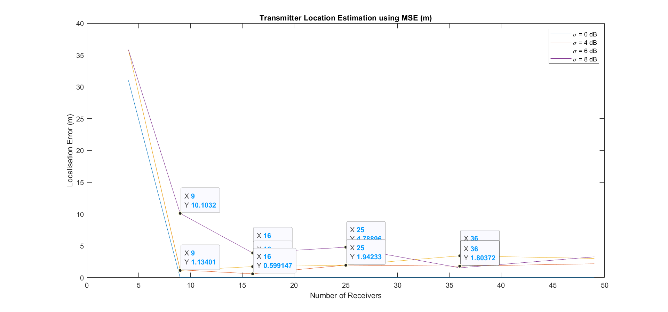
Correlated Shadowing model for localization
Lehrstuhl Elektrische Smart City Systeme
24/06/24
<number>

Slide 12
REM Maps
Tx position (18,37)
True REM with transmit power at -10 dB and area of 100m x 100m.
The REM map shows us the exact location or estimated location of the transmitter with the highest power level at the red hot spot.
Lehrstuhl Elektrische Smart City Systeme
24/06/24
<number>

Slide 13
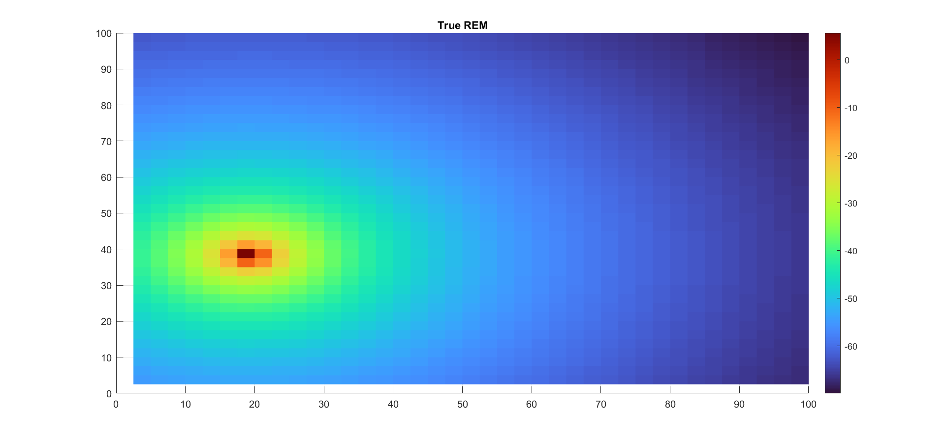
REM Maps
Lehrstuhl Elektrische Smart City Systeme
24/06/24
<number>

Slide 14
REM Maps
Tx position (18,37)
True REM with transmit power at -10 dB and area of 100m x 100m.
REM map with correlated shadowing model for noise standard deviation 8 dB and correlation distance 8 m.
In the REM map with correlated shadowing we see the correlation artifacts in the region of highest power levels.
These correlation artifacts tells us the presence of correlation between sensors and effectively signifies the presence of possible transmitter location in the surrounding region.
Lehrstuhl Elektrische Smart City Systeme
24/06/24
<number>

Slide 15
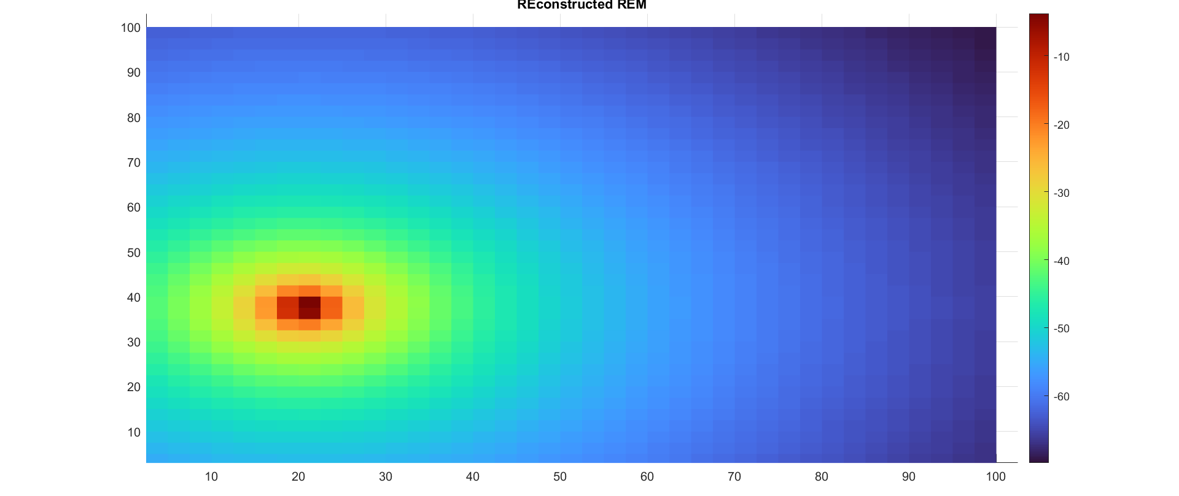
REM Maps
Lehrstuhl Elektrische Smart City Systeme
24/06/24
<number>

Slide 16
Localization
Range based
Lateration
Proximity
Range Free
Angular
RSSI
ToA
TDoA
AoA
Lehrstuhl Elektrische Smart City Systeme
24/06/24
<number>

Slide 17
Fading Channel
Large scale fading
Path loss
Shadowing
Small scale fading
Multi-path fading
Time variance
Frequency selective fading
Flat fading
Fast fading
Slow fading
Lehrstuhl Elektrische Smart City Systeme
24/06/24
<number>

