Slide 1


Monthly Students Meeting (MSM) –
RSS-based transmitter localization using distributed spectrum sensing in 5G networks
Aakarsh Dhariwal
Lehrstuhl Elektrische Smart City Systeme
Nuremberg Campus of Technology (NCT)
Prof. Dr.-Ing. Norman Franchi
Engineering for Smart Cities

Slide 2
Motivation and Goals
Motivation:
RSS-based transmitter localization is important for WSN-based applications such as security, spectrum monitoring, and robotics.
Evaluation of two RSS based methods.
Main goal:
Localizing an active transmitter and estimating power.
→ Estimating power to construct a REM.
Submission deadline:
02.10.2023 → !! 2 days left !!
Current goal:
Submission on Monday and a bit of relief.

Slide 3
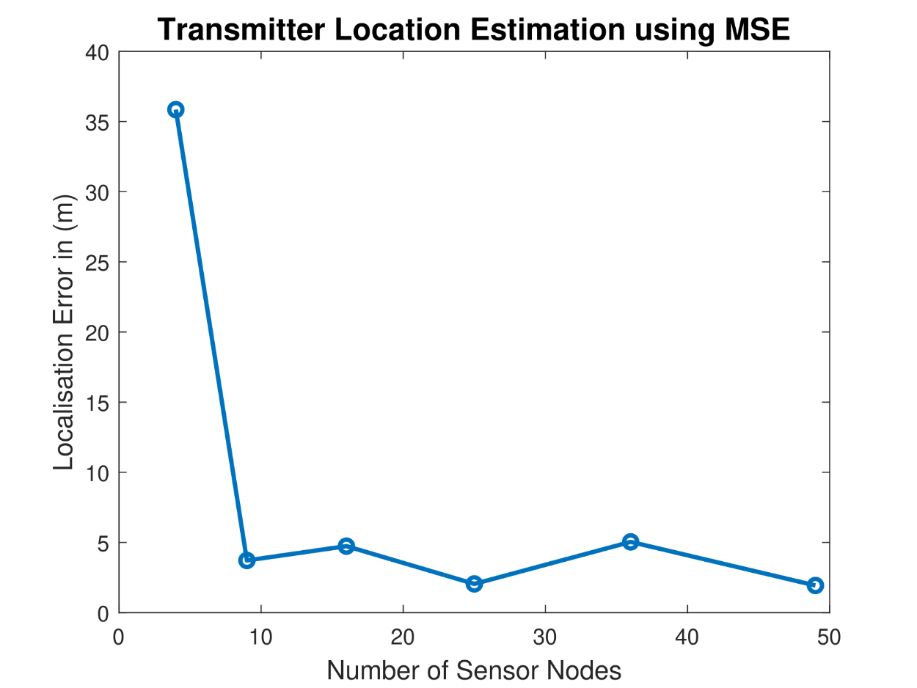
Algorithms
First approach: Implementing MSE and LIvE based localization methods
Result:
          Choosing appropriate path-loss model.
          Localization error for MSE against number of sensors.
I was stuck at implementing LIvE method and finding the solution to
solve its non-linear constraints.
Simulations performed using MATLAB.

Slide 4
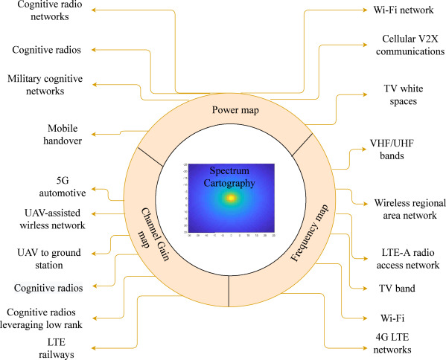
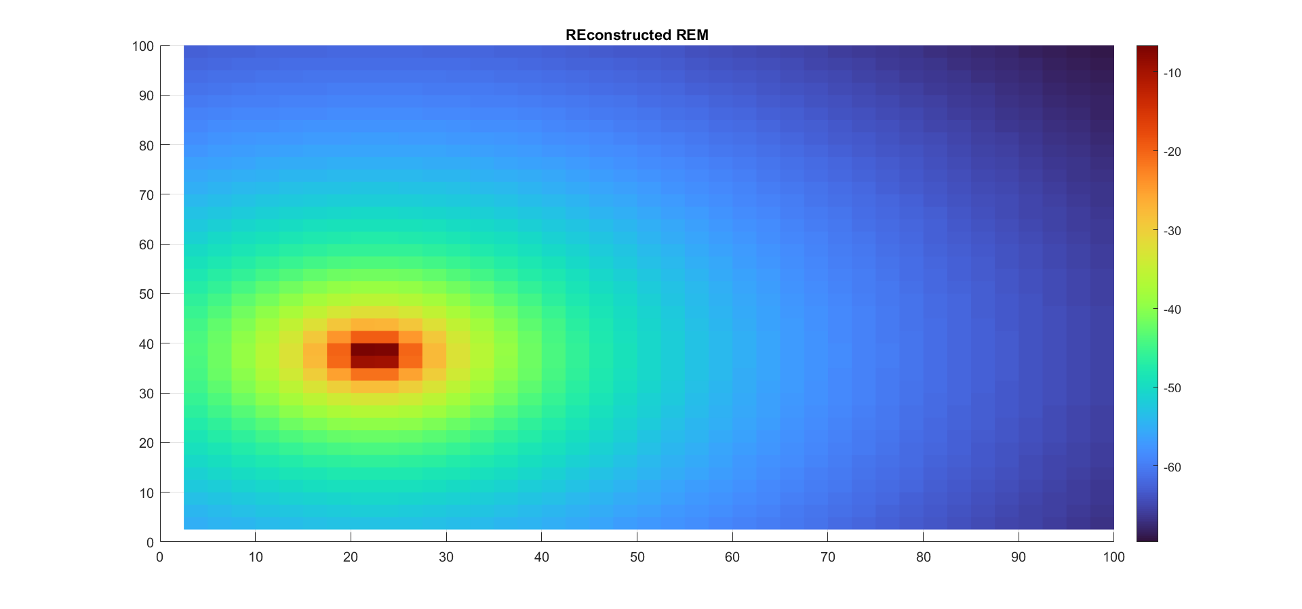
Last achieved
What I‘ve been doing the last 2 months
Finishing up the report.
Constructing REM based on results from localization methods.
Literature review on relevance and benefits of REMs in 5G
use cases.

