Slide 1


Master Thesis: RSS-based localization using distributed spectrum sensing for 5G networks
10.07.2023
Supervisors:
Student:
Aakarsh Dhariwal
Begin: 1.04. 23
End: 2.10.23
Victor Shatov
Norman Franchi
Lehrstuhl Elektrische Smart City Systeme
Nuremberg Campus of Technology (NCT)
Prof. Dr.-Ing. Norman Franchi
Engineering for Smart Cities

Slide 2
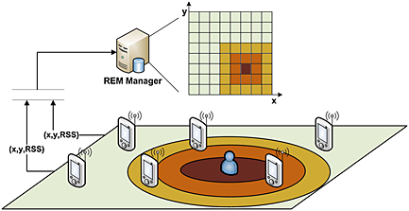
Motivation and objective

Slide 3
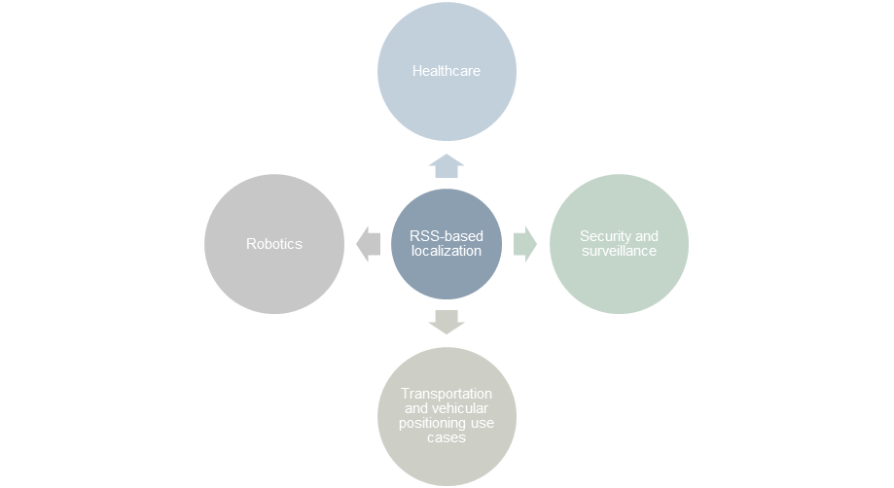
Introduction

Slide 4
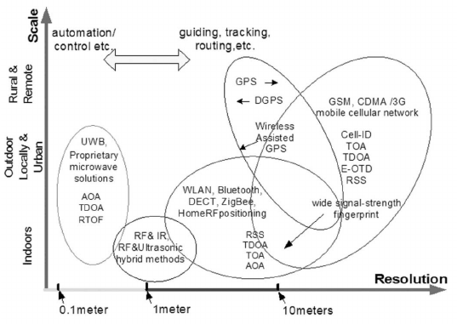
Motivation and objective

Slide 5
Outline
1.
Introduction
7.
System Model
2.
REM Data Model
8.
Results
3.
Applications of REM Construction
9.
Conclusion
4.
RSS Based Transmitter Localization Model
10.
Challenges Remaining
5.
REM Construction Techniques: Indirect Method
11.
References
6.
Network Sensor Area

Slide 6
Main contributions
Implementing and evaluating the performance of MSE and LIvE methods for localization.
Evaluating performance of MSE-based method using OFDM signal as a transmit signal.
Modeling correlated shadowing and evaluating performance using varying standard deviation of shadowing noise.
Constructing estimated and true REM from MSE-based method.
REM as enabler in 5G use cases.

Slide 7
Methodology

Slide 8
(Use this when introducing REM)

Slide 9

Introduction
CR
Distributed Spectrum Sensing
REM
Figure 1: Project motivation and introduction.

Slide 10
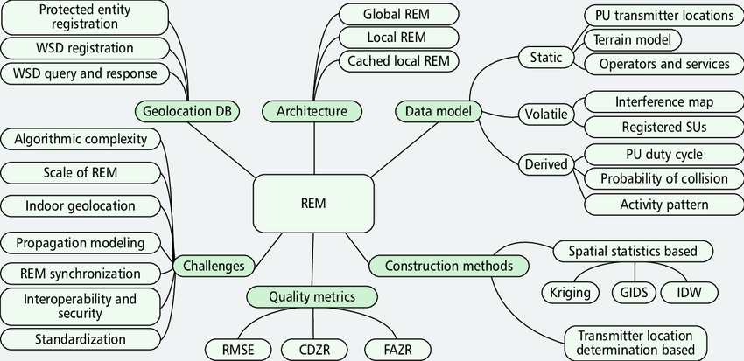
REM Data Model
Figure 2 : REM Architecture [4].

Slide 11
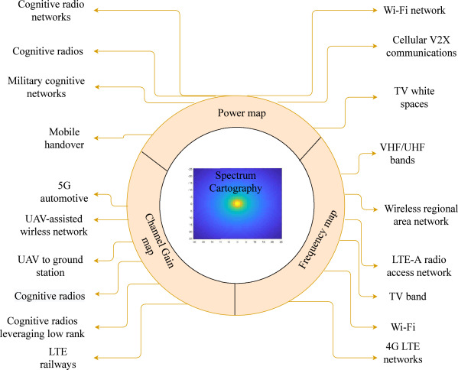
Applications of REM Construction
Figure 3 : REM applications use cases [5]

Slide 12
RSS Based Transmitter Localization Model
The received power levels at the sensor nodes in a network are the input measurements.
The operation network area where we perform Tx localization consists of several important characteristics of radio environment.
The characteristics to model RF area are:
          Propagation channel model (Path Loss model),.
          Positioning of Tx and sensor nodes.
          Frequency of transmission.
          Small Scale or Large Scale fading, static or mobile scenario.
          Number of active Transmitters and Sensors deployed.

Slide 13
REM Construction Techniques: Indirect Method
The direct methods for Tx localization such as Kriging, IDW, Kalman filtering, and Nearest Neighbours.
To localize and compare the performances we use three indirect methods:
Indirect Methods
Adaptive Iterative
MSE
LIvE
Notes:
Spatial statistics or direct method requires information such as measurement data, statistics of the area which is a complex problem.

Slide 14
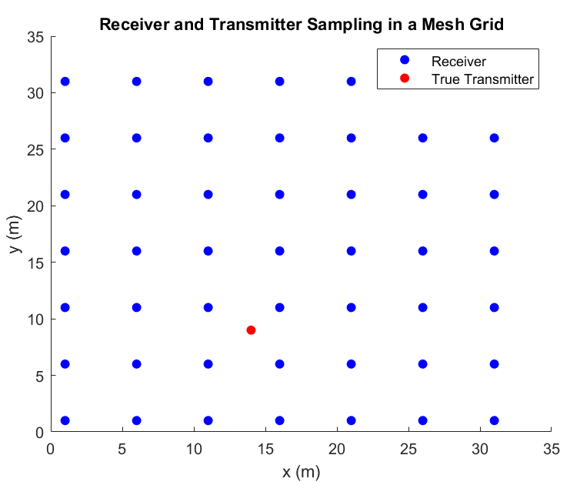
Network Sensor Area
The network consists of 49 sensor nodes sampled in a grid like area [1].
The sampling used here is uniform and distance between each sensor is 5 meters [1].
The sensors deployed are isotropic and modeled as point sources with single antenna components.
These dedicated sensors receive signal power and we use them for localization and Spectrum Sensing.
Figure 4: Rx and Tx in mesh grid.

Slide 15
System Model
The arrangement of sensor nodes in the previous figure are lying in an operation area where we collect the RSS values.
RSS values depend on the propagation environment, and spatial arrangement of the sensors.
We consider the simplistic path loss model with shadowing for channel analysis.
The network consists of static transceivers as point sources that operate in single channel and frequency in operation.
We consider a single frequency channel to avoid interference [2].

Slide 16
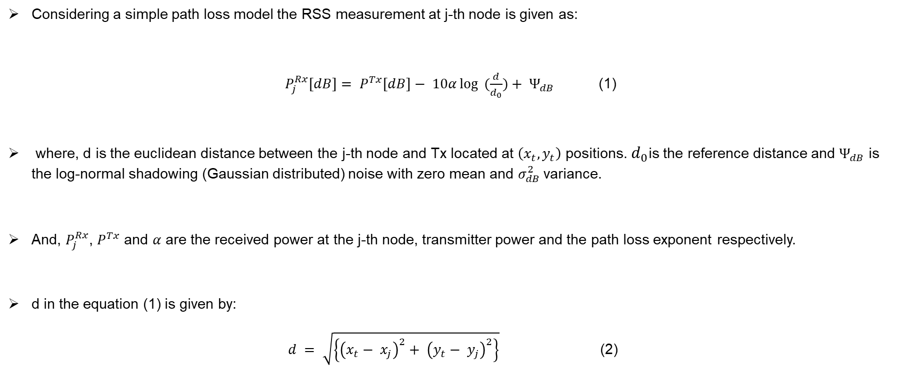
System Model
Considering a simple path loss model the RSS measurement at j-th node is given as:
$P_{j}^{Rx}[dB]= P^{Tx}[dB]− 10α\log{ (\frac{d}{d_{0}})}+ Ψ_{dB}$ (1)
where, d is the euclidean distance between the j-th node and Tx located at $\left(x_{t},y_{t}\right)$ positions. $d_{0}$is the reference distance and $Ψ_{dB}$ is the log-normal shadowing (Gaussian distributed) noise with zero mean and $σ_{dB}^{2}$variance.
And, $P_{j}^{Rx}$, $P^{Tx}$ and $α$ are the received power at the j-th node, transmitter power and the path loss exponent respectively.
d in the equation (1) is given by:
$d = \sqrt{\left\{{\left(x_{t}− x_{j}\right)}^{2}+ {\left(y_{t}− y_{j}\right)}^{2}\right\}}$ (2)

Slide 17

System Model: Adaptive Iterative and MSE Based Methods
Replacing d and after some manipulations of the received power formulation, we get:
$x_{j}^{2}+ y_{j}^{2}= 2x_{j}x_{t}+ 2 y_{j}y_{t}− x_{t}^{2}− y_{t}^{2}+ {10}^{\frac{\left(P^{Tx}− P_{j}^{Rx}\right)}{5α}}$ (3)
The linear regression equation is given as:
$Aθ=b$ (4)
The input parameter matrix (A), squared sensor coordinates vector b and parameter consisting Tx positions and Tx power is vector $θ$.
4 sensors measurements are used to perform localization.

Slide 18

System Model: Adaptive Iterative and MSE Based Methods
The equation to calculate the unknown Tx positions for Adaptive Iterative in the parameter $θ$is given by:
$θ_{i+1}=θ_{i}+μA^{T}e_{i}$ (6)
Where $μ$ is the step size.
$e_{i} = b_{i} − A_{i}θ_{i}$ is the instantaneous error.
The solution to estimate the Tx positions using MSE based method is given by:
${ θ}_{opt}= \left(\frac{∑A_{i}^{T}b_{i}}{∑A_{i}^{T}A_{i}}\right)$ (7)

Slide 19

System Model: LIvE Method
  The optimal solution for LIvE is given as:
  $\hat{θ}= argmin\left\|Aθ−b\right\|$
  ${ r}^{T}θ+θ^{T}Pθ=0$ (8)
The constrained optimization problem is solved using the dual Lagrange problem:
$L(θ,λ) = {(A θ−b)}^{T} (A θ−b) + λ(r^{T}θ+ θ^{T}Pθ)$ (9)

Slide 20

Results and Discussions
The grid area consists of 4 sensors each with 5m separation [1].
Path loss exponent, reference distance $d_{0}$, and shadowing variance $σ_{dB}^{2}$ of the channel are 3.5, 2 m and 8 [dB] respectively [2].
The operating frequency band is 720 MHz [1].
Tx power is -10 dB with 1 static transmitter.

Slide 21
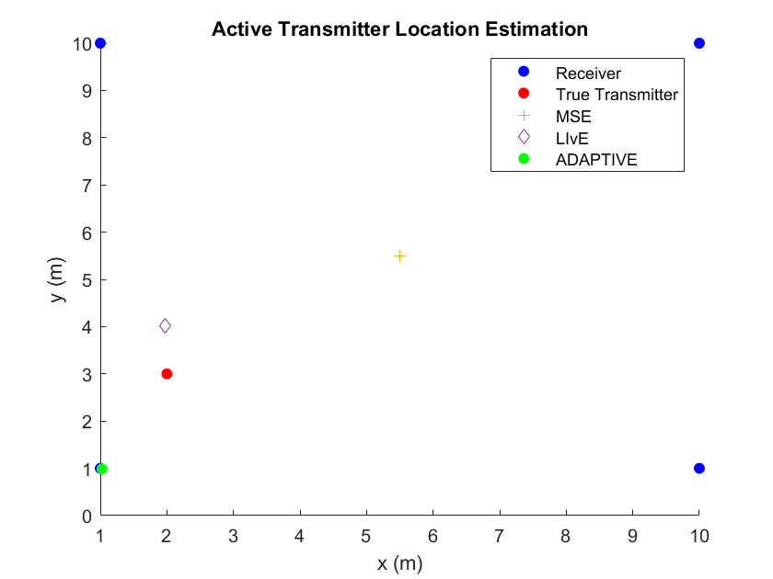
Results and Discussion
Figure 5: The images shows us the performance comparison of the three methods with 1 Tx positions [2,3], 4 Rx's. The system parameters remain same with step size being ${10}^{−12}$.

Slide 22
Conclusion
We conclude that the LIvE and MSE algorithms show better performance as the number of sensors are increased. The threshold for the LIvE and MSE performance measure is around 25-30 sensors.
LIvE > MSE > Adaptive iterative. The localization error for the algorithms is less than 5m.
In terms of complexity Adaptive Iterative > LIvE > MSE.
The limitation for Adaptive Iterative method is its non-adaptive step size and failure to adapt as number of sensors are increased.
The limitation of LIvE algorithm is the real floating point input which leads to input parameter matrix becoming singular for very noisy measurements.

Slide 23
Project Goals Accomplished
Comparison of Tx’s location estimation methods for REM construction using received signal strength methods (RSS).
Sampling of sensor networks (uniform sampling, grid based and hybrid or random design).
Analyze the performance for these methods using performance metrics : localization errors, deviation from actual positions, performance against number of sensor nodes required, complexity, number of measurements.

Slide 24
Challenges Remaining
Construct REM maps using estimated Tx locations and estimated powers in a given area of interest.
Dynamic nature of REM (refresh rate ) for changing environments.
Impact of spatially correlated shadowing in Tx localization.
Modeling of transmission signal (static or waveform) using signal processing for example OFDM signal and compare REM update rate.

Slide 25
References
Ezzati, Nematollah, Hasan Taheri, and Tuna Tugcu. "Optimised sensor network for transmitter localisation and radio environment mapping." IET Communications 10.16 (2016): 2170-2178. Location estimation-based radio environment map construction in fading channels.
Yilmaz, Huseyin Birkan, and Tuna Tugcu. "Location estimation‐based radio environment map construction in fading channels." Wireless communications and mobile computing 15.3 (2015): 561-570.
Yilmaz, H. Birkan, et al. "Radio environment map as enabler for practical cognitive radio networks." IEEE Communications Magazine 51.12 (2013): 162-169.
Phillips, Caleb, et al. "Practical radio environment mapping with geostatistics." 2012 IEEE International Symposium on Dynamic Spectrum Access Networks. IEEE, 2012.
Reddy, Yeduri Sreenivasa, et al. "Spectrum cartography techniques, challenges, opportunities, and applications: A survey." Pervasive and Mobile Computing 79 (2022): 101511.

Slide 26
References
6. Reddy, Yeduri Sreenivasa, et al. "Spectrum cartography techniques, challenges, opportunities, and applications: A survey." Pervasive and Mobile Computing 79 (2022): 101511.
7. De Almeida, Ivo Bizon Franco, et al. "Blind transmitter localization in wireless sensor networks: A deep learning approach." 2021 IEEE 32nd Annual International Symposium on Personal, Indoor and Mobile Radio Communications (PIMRC). IEEE, 2021.

Slide 27
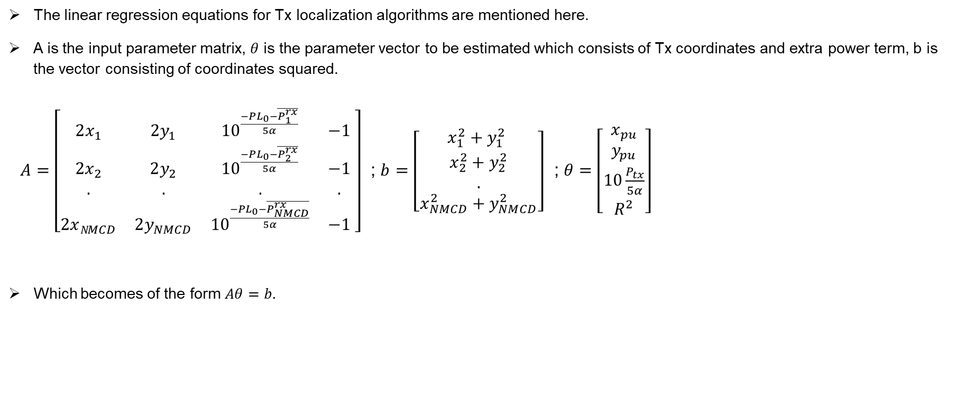
Appendix 1
The linear regression equations for Tx localization algorithms are mentioned here.
A is the input parameter matrix, $θ$ is the parameter vector to be estimated which consists of Tx coordinates and extra power term, b is the vector consisting of coordinates squared.
$A=\left[\begin{matrix}2x_{1} & 2y_{1} & {10}^{\frac{−PL_{0}−\overline{P_{1}^{rx}}}{5α}} & −1 \\ 2x_{2} & 2y_{2} & {10}^{\frac{−PL_{0}−\overline{P_{2}^{rx}}}{5α}} & −1 \\ . & . & . & . \\ 2xN_{MCD} & 2y_{NMCD} & {10}^{\frac{−PL_{0}−\overline{P_{NMCD}^{rx}}}{5α}} & −1\end{matrix} \right]$ ; $b$ $=\left[\begin{matrix}x_{1}^{2}+y_{1}^{2} \\ x_{2}^{2}+y_{2}^{2} \\ . \\ x_{NMCD}^{2}+y_{NMCD}^{2}\end{matrix}\right]$ ; $θ=\left[\begin{matrix}x_{pu} \\ y_{pu} \\ 10\frac{P_{tx}}{5α} \\ R^{2}\end{matrix}\right]$
Which becomes of the form $Aθ=b$.

Slide 28
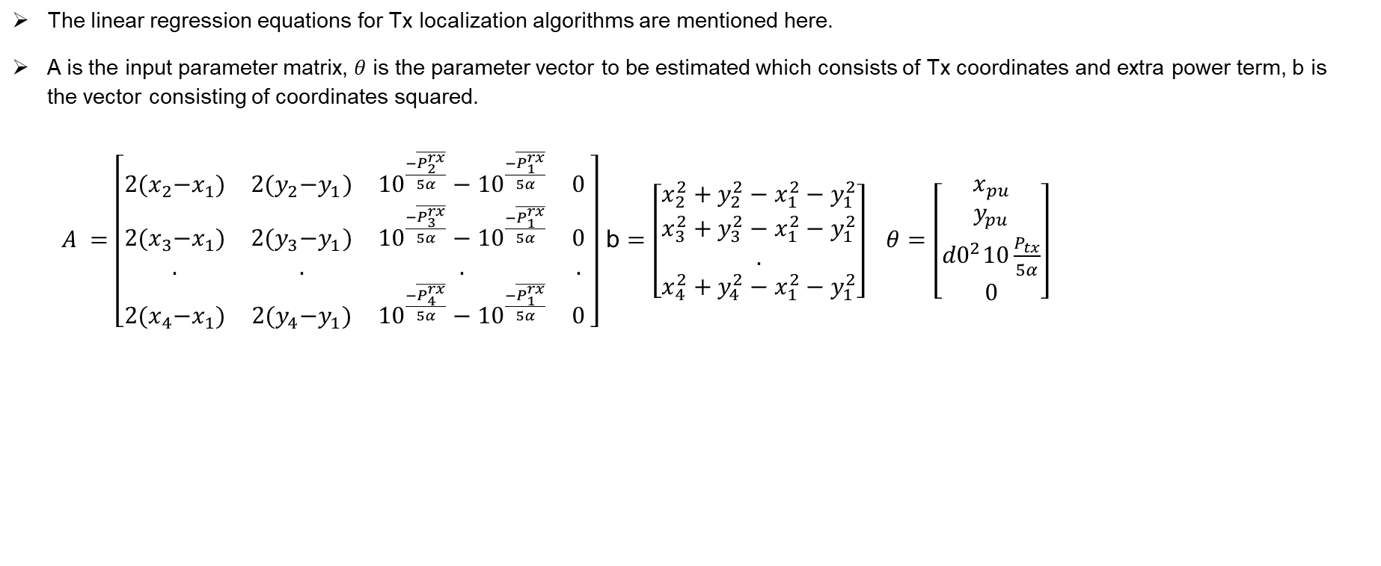
Appendix 2
The linear regression equations for Tx localization algorithms are mentioned here.
A is the input parameter matrix, $θ$ is the parameter vector to be estimated which consists of Tx coordinates and extra power term, b is the vector consisting of coordinates squared.
$A =\left[\begin{matrix}2{(x}_{2}−x_{1}) & 2{(y}_{2}−y_{1}) & {10}^{\frac{−\overline{P_{2}^{rx}}}{5α}}−{10}^{\frac{−\overline{P_{1}^{rx}}}{5α}} & 0 \\ 2{(x}_{3}−x_{1}) & 2{(y}_{3}−y_{1}) & {10}^{\frac{−\overline{P_{3}^{rx}}}{5α}}−{10}^{\frac{−\overline{P_{1}^{rx}}}{5α}} & 0 \\ . & . & . & . \\ 2{(x}_{4}−x_{1}) & 2{(y}_{4}−y_{1}) & {10}^{\frac{−\overline{P_{4}^{rx}}}{5α}}−{10}^{\frac{−\overline{P_{1}^{rx}}}{5α}} & 0\end{matrix} \right]$ b $=\left[\begin{matrix}x_{2}^{2}+y_{2}^{2}−x_{1}^{2}−y_{1}^{2} \\ x_{3}^{2}+y_{3}^{2}−x_{1}^{2}−y_{1}^{2} \\ . \\ x_{4}^{2}+y_{4}^{2}−x_{1}^{2}−y_{1}^{2}\end{matrix}\right] θ=\left[\begin{matrix}x_{pu} \\ y_{pu} \\ {d0}^{2}10\frac{P_{tx}}{5α} \\ 0\end{matrix}\right]$

Slide 29
RSS-based localization
Healthcare
Security and surveillance
Transportation and vehicular positioning use cases
Robotics

