Slide 1


Master Thesis: RSS-based localization using distributed spectrum sensing for 5G networks
19.10.2023
Supervisors:
Student:
Aakarsh Dhariwal
Begin: 1.04. 23
End: 2.10.23
Victor Shatov
Norman Franchi
Lehrstuhl Elektrische Smart City Systeme
Nuremberg Campus of Technology (NCT)
Prof. Dr.-Ing. Norman Franchi
Engineering for Smart Cities

Slide 2
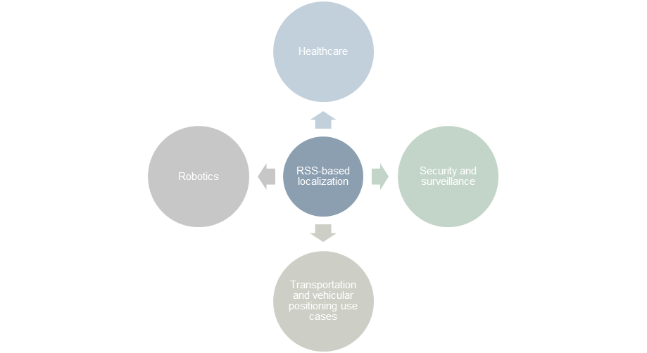
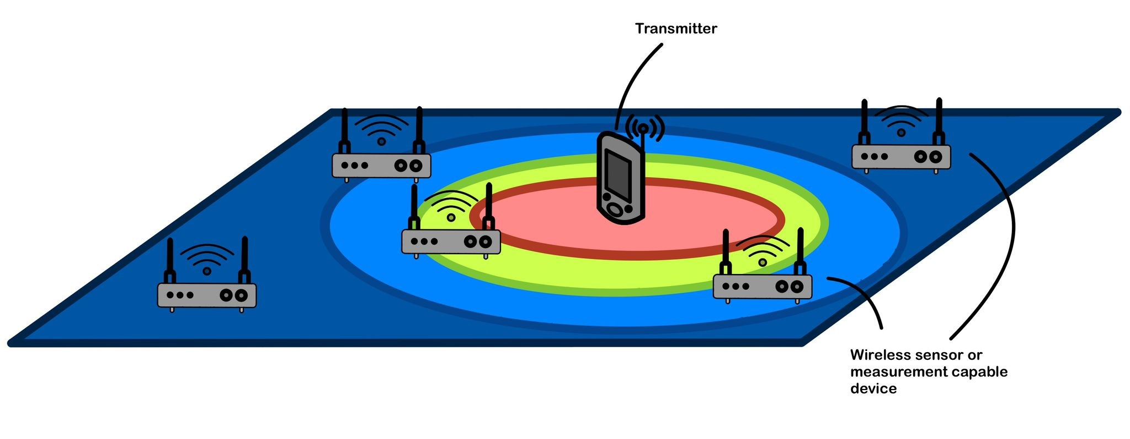
Motivation and objective
Figure 1: Exemplary scenario for localization [1].
Dedicated sensor network.
Received signal strength (RSS) measurements captured from sensors as a means to perform localization.

Slide 3
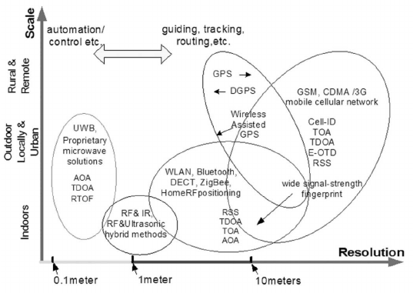
RSS as a promising technology for localization
Figure 2: Motivation for using RSS measurements for localization [6].

Slide 4
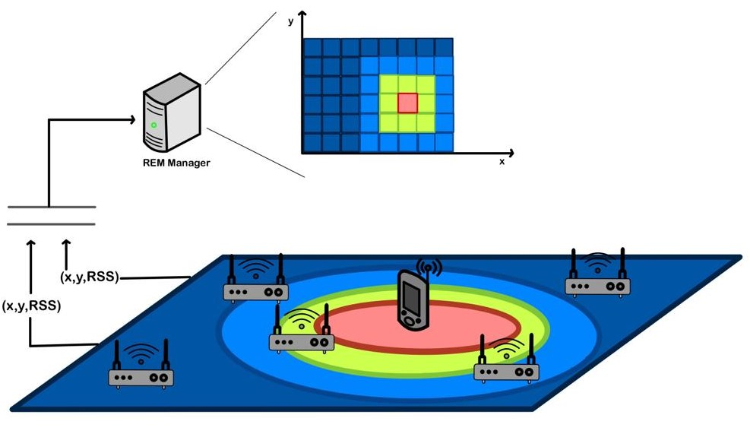
Radio environment map (REM) [1],[2]
Figure 3: Scenario for localization using dedicated sensor network [1], [2] and REM construction.

Slide 5
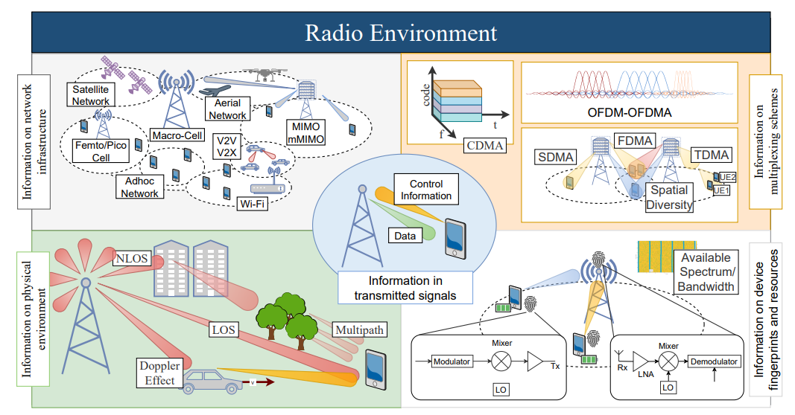
REM applications
Figure 4: REM applications and use cases [8].

Slide 6
Goals of the thesis
Comparing and evaluating the localization performance of MSE and LIvE methods.
  Using OFDM as a transmit signal and evaluating performance of MSE method.
  Using correlated shadowing and evaluating the localization error using varying standard deviation of shadowing.
Constructing radio environment map (REM) from results of MSE localization method.

Slide 7
Methodology and overall process
Fusion center
System model and parameter settings
MSE method
Sensor arrangement
RSS measurements collection
RSS-based localization
Evaluation
LIvE method
OFDM transmit signal
REM construction
Correlated shadowing
Figure 5: Methodology and flow diagram.

Slide 8
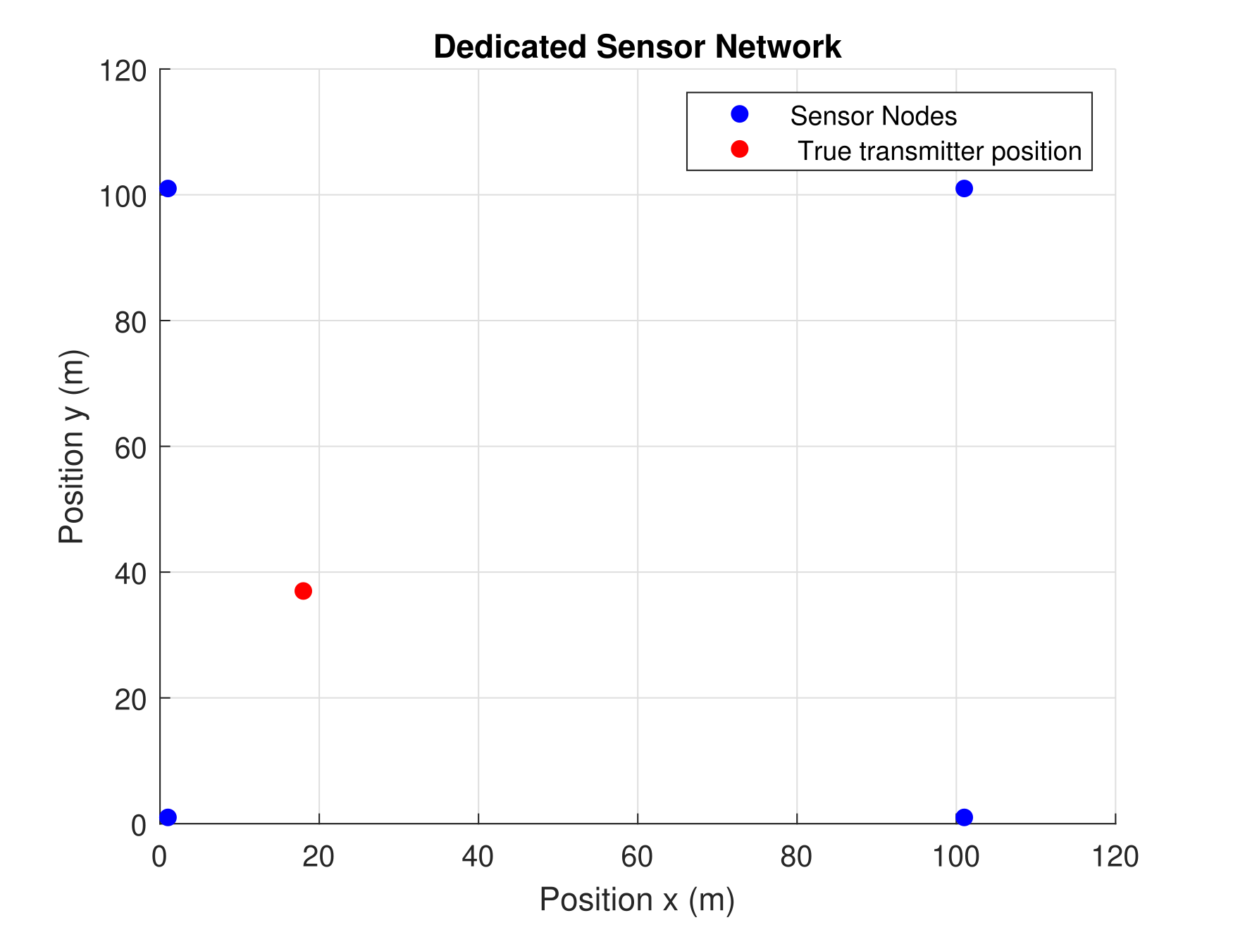
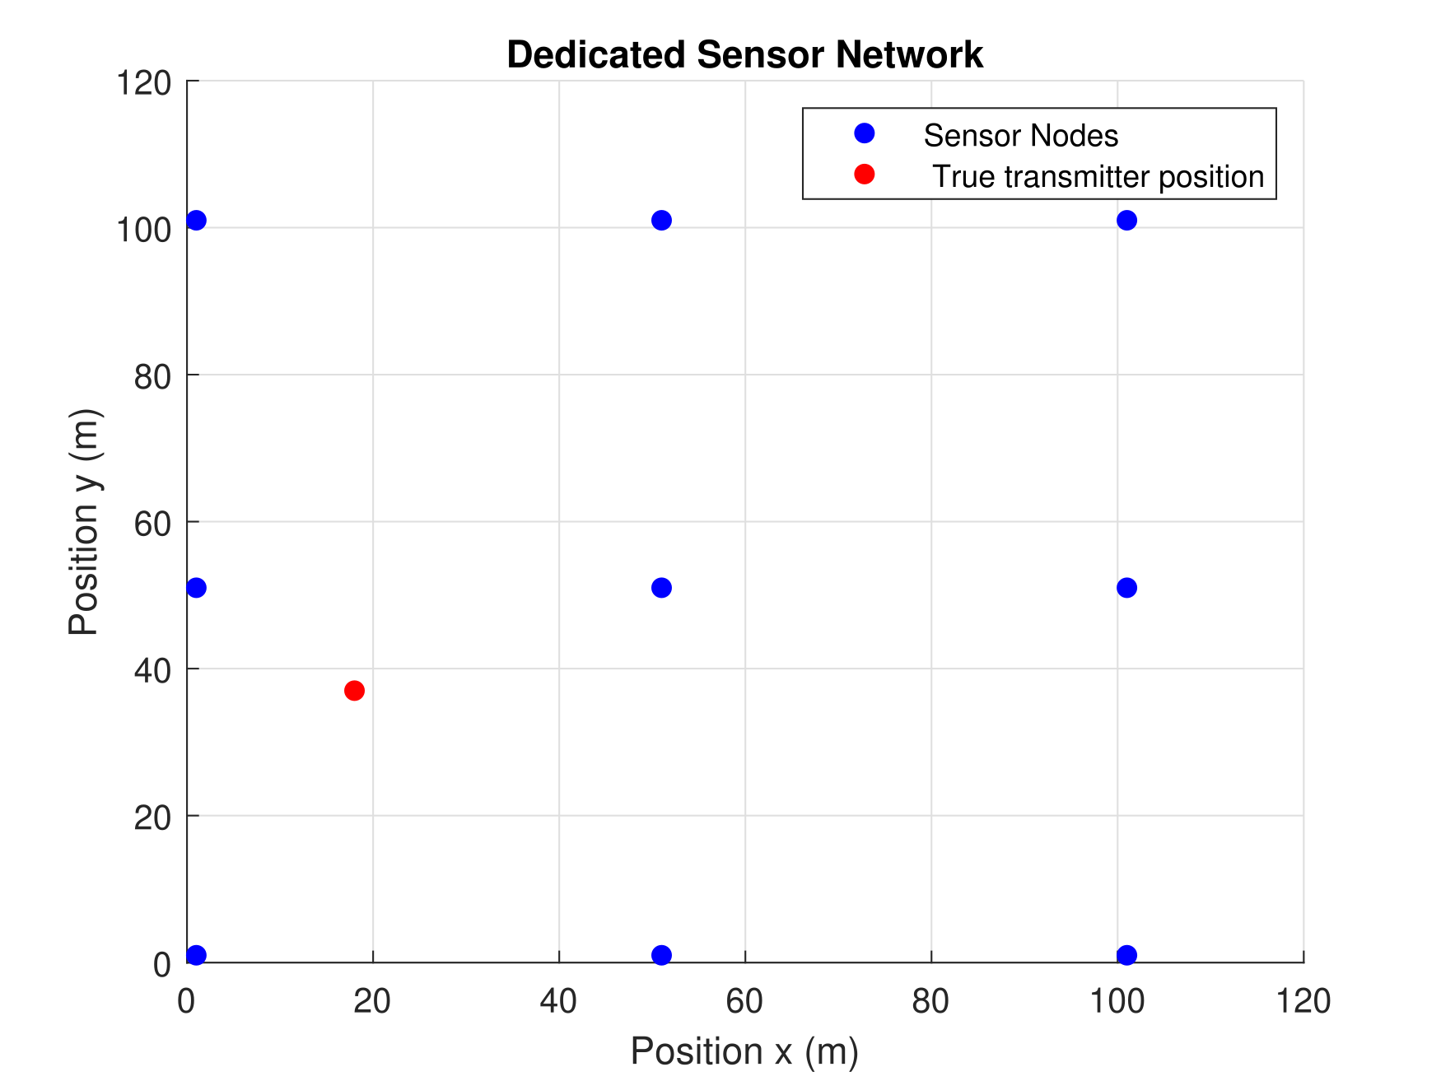
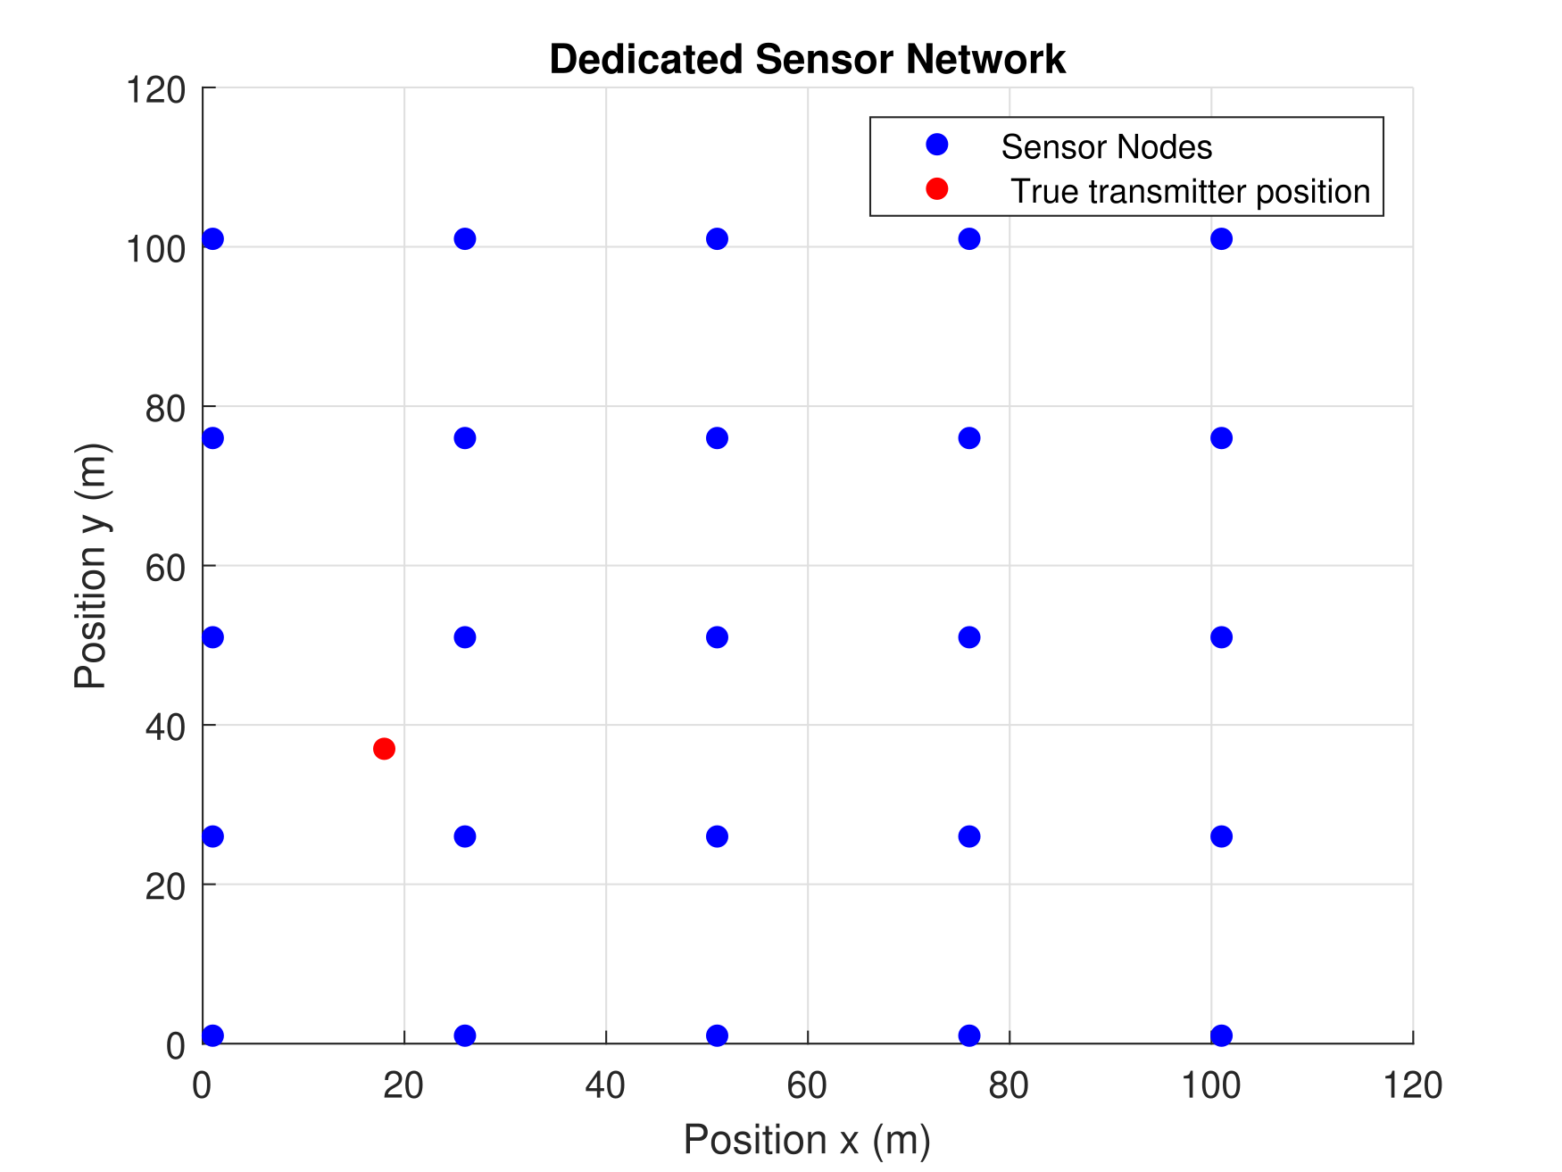
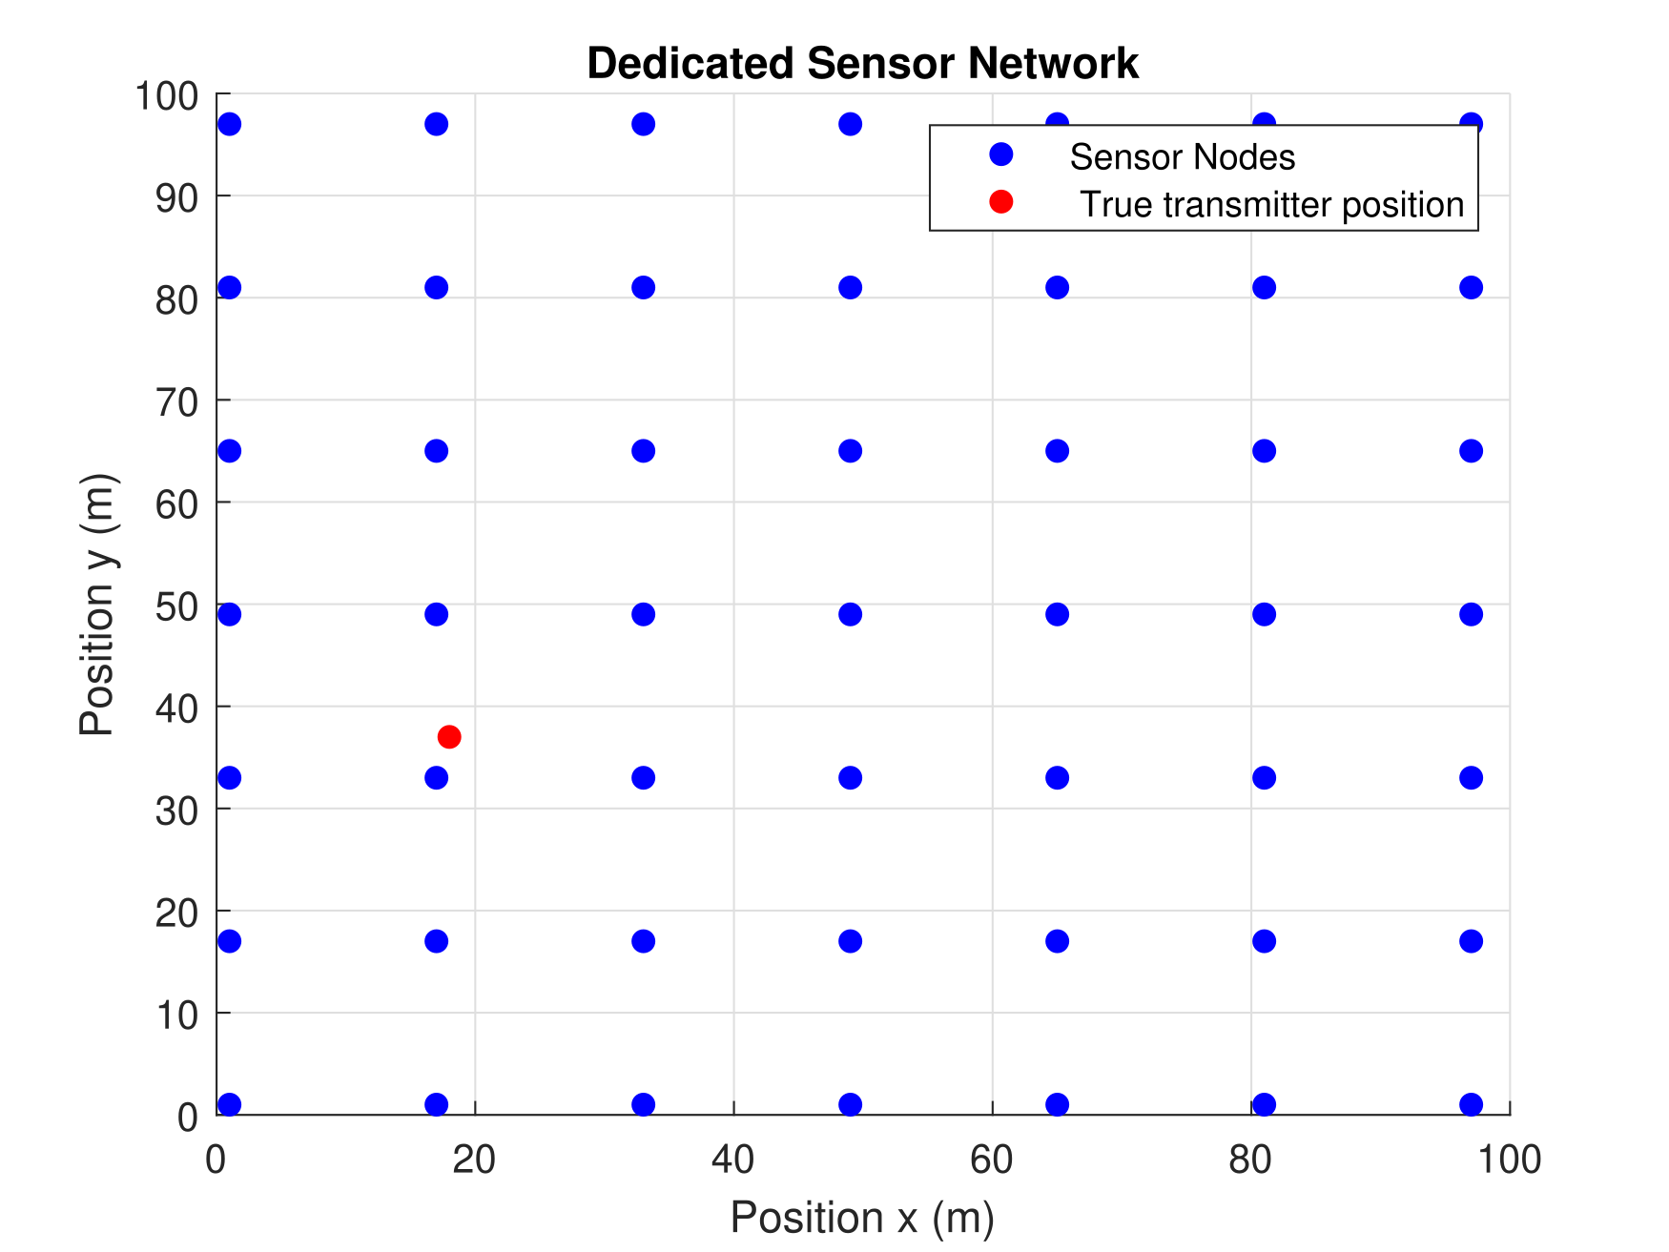
Dedicated sensor network
Sensor arrangement
8
9. Oktober 2023
Figure 6: Placement of dedicated sensor network 4, 9, 25 and 49 sensors with true transmitter position [18 m, 37 m] in a grid of [100 m, 100 m] [1].

Slide 9
System model and parameter setting
Fusion center
System model and parameter settings
MSE method
Sensor arrangement
RSS measurements collection
RSS-based localization
Evaluation
LIvE method
OFDM transmit signal
REM construction
Correlated shadowing
Figure 7: System model and parameters setting.

Slide 10






System Model [1],[2]
Considering a simple path loss model the RSS measurement at j-th node is given as [2]:
$P_{j}^{Rx}\left[dB\right]= P^{Tx}\left[dB\right]+PL_{0}[dB]− 10α\log{ (\frac{d}{d_{0}})}+ Ψ_{dB}$ (1)
d in the equation (1) is given by:
$d = \sqrt{\left\{{\left(x_{t}− x_{j}\right)}^{2}+ {\left(y_{t}− y_{j}\right)}^{2}\right\}}$ (2)
$$P_{j}^{Rx}:received signal strength.$$
$PL_{0}:$ reference path loss.
$α:$path loss exponent..
$d_{0}$: reference distance.
$P^{Tx}$: transmit power.
$Ψ_{dB}$: Shadowing

Slide 11
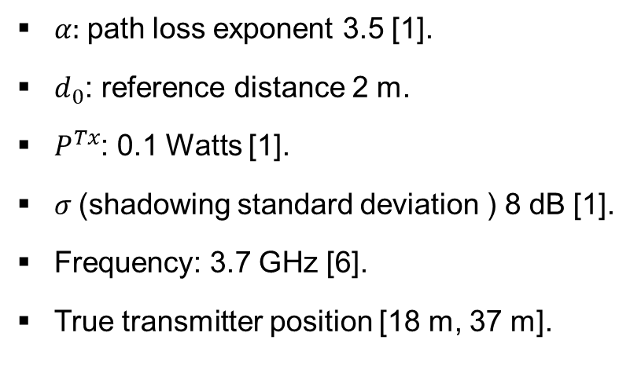
System model parameters
$α:$path loss exponent 3.5 [1].
$d_{0}$: reference distance 2 m.
$P^{Tx}$: 0.1 Watts [1].
$σ$(shadowing standard deviation ) 8 dB [1].
Frequency: 3.7 GHz [6].
True transmitter position [18 m, 37 m].
System model and parameter settings
Sensor arrangement

Slide 12
RSS measurement collection
Fusion center
System model and parameter settings
MSE method
Sensor arrangement
RSS measurements collection
RSS-based localization
Evaluation
LIvE method
OFDM transmit signal
REM construction
Correlated shadowing
Figure 8: RSS measurements calculation.

Slide 13
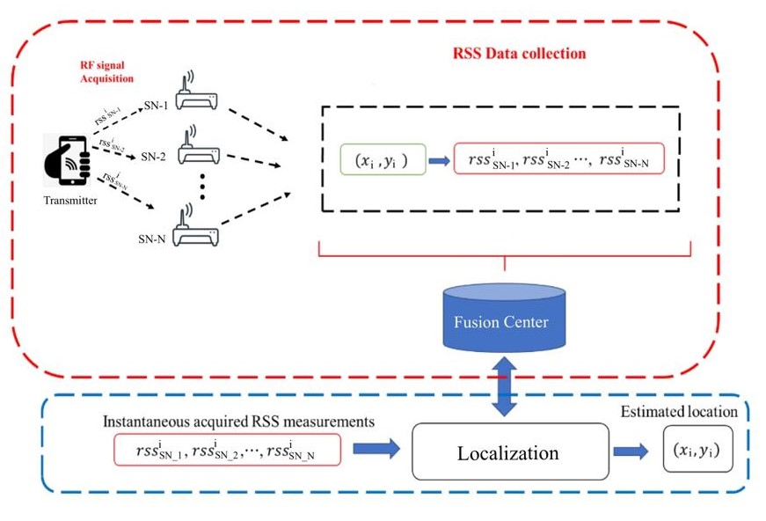
Collection of RSS measurements
Figure 9: Calculating RSS measurements and performing localization [5].

Slide 14
MSE method for localization
Fusion center
System model and parameter settings
MSE method
Sensor arrangement
RSS measurements collection
RSS-based localization
Evaluation
LIvE method
OFDM transmit signal
REM construction
Correlated shadowing
Figure 10: RSS-based localization

Slide 15

MSE-based localization[1]
Problem formulation
$Aθ=b$ (3)
𝐴𝜃=𝑏 (3)
MSE solution
Result
${C^{N}}_{4}$ random combinations of sensors.
〖𝐶^𝑁〗_4 random combinations of sensors.
A: input parameter matrix
$θ:$unknown parameter
𝜃: unknown parameter
b: output parameter vector
${ θ}_{opt}= \left(\frac{∑A_{i}^{T}b_{i}}{∑A_{i}^{T}A_{i}}\right)$ (4)
〖 𝜃〗_𝑜𝑝𝑡= ((∑𝐴_𝑖^𝑇 𝑏_𝑖)/(∑𝐴_𝑖^𝑇 𝐴_𝑖 )) (4)
$$\hat{θ}= argmin\left\|Aθ−b\right\|$$

Slide 16
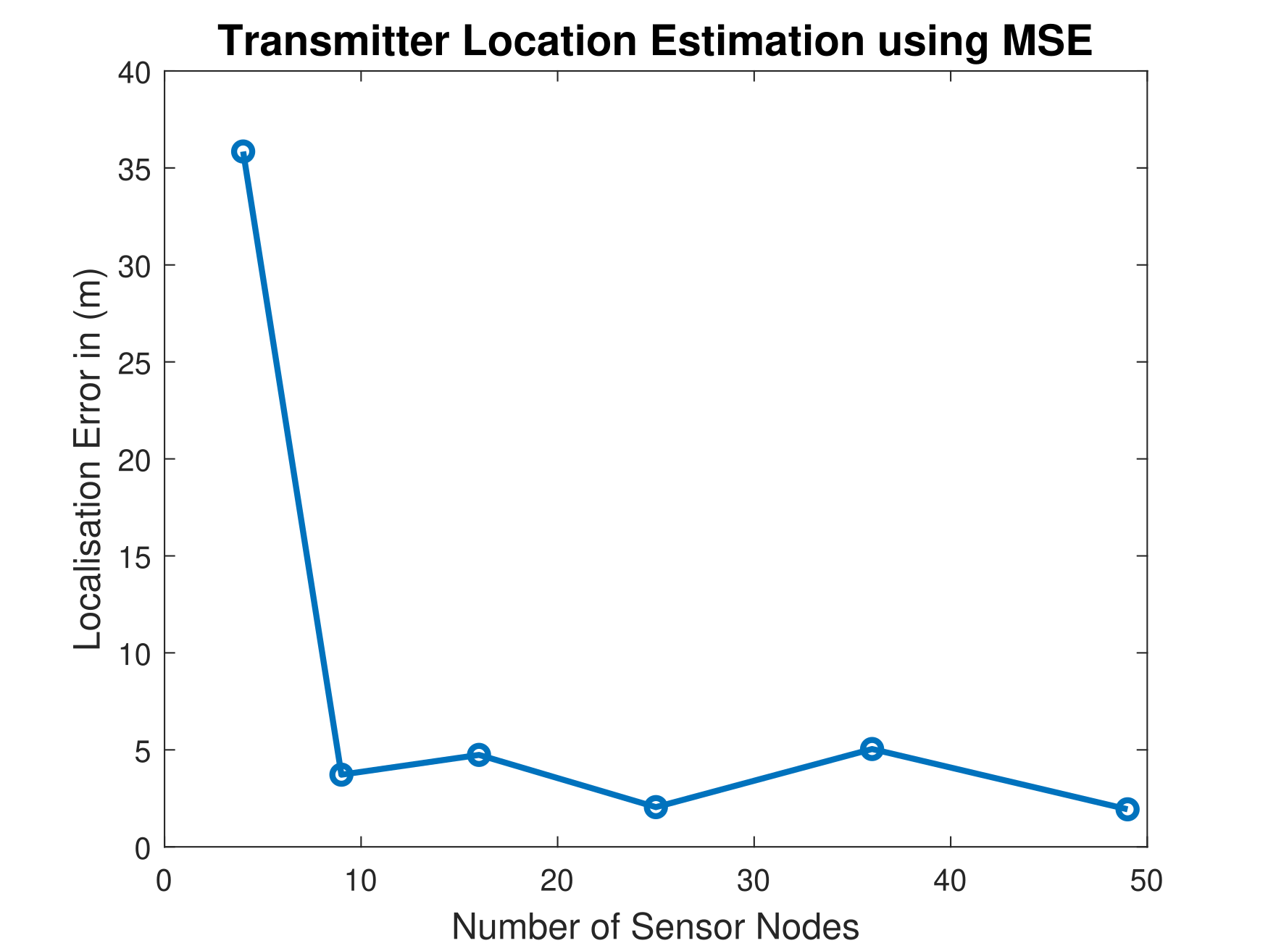
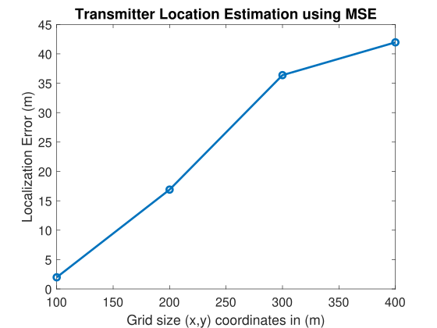
Simulation result
Figure 11: Localization error for MSE method.
Figure 12: Localization error with 36 sensors.

Slide 17
LIvE method for localization
Fusion center
System model and parameter settings
MSE method
Sensor arrangement
RSS measurements collection
RSS-based localization
Evaluation
LIvE method
OFDM transmit signal
REM construction
Correlated shadowing
Figure 13: LIvE method for localization.

Slide 18

LIvE-based localization[3]
Problem formulation
$Aθ=b$ (3)
𝐴𝜃=𝑏 (3)
LIvE solution
$L(θ,λ) = {(A θ−b)}^{T} (A θ−b) + λ(r^{T}θ+ θ^{T}Pθ)$ (7)
𝐿(𝜃,𝜆) = 〖(𝐴 𝜃−𝑏)〗^𝑇 (𝐴 𝜃−𝑏) + 𝜆(𝑟^𝑇 𝜃+ 𝜃^𝑇 𝑃𝜃) (7)
Result
Formulating linear regression problem as in equation (3) with data from the N sensor configuration.
A: input parameter matrix
$θ:$unknown parameter
𝜃: unknown parameter
b: output parameter vector
$$\hat{θ}= argmin\left\|Aθ−b\right\|$$
${ r}^{T}θ+θ^{T}Pθ=0$ (6)

Slide 19
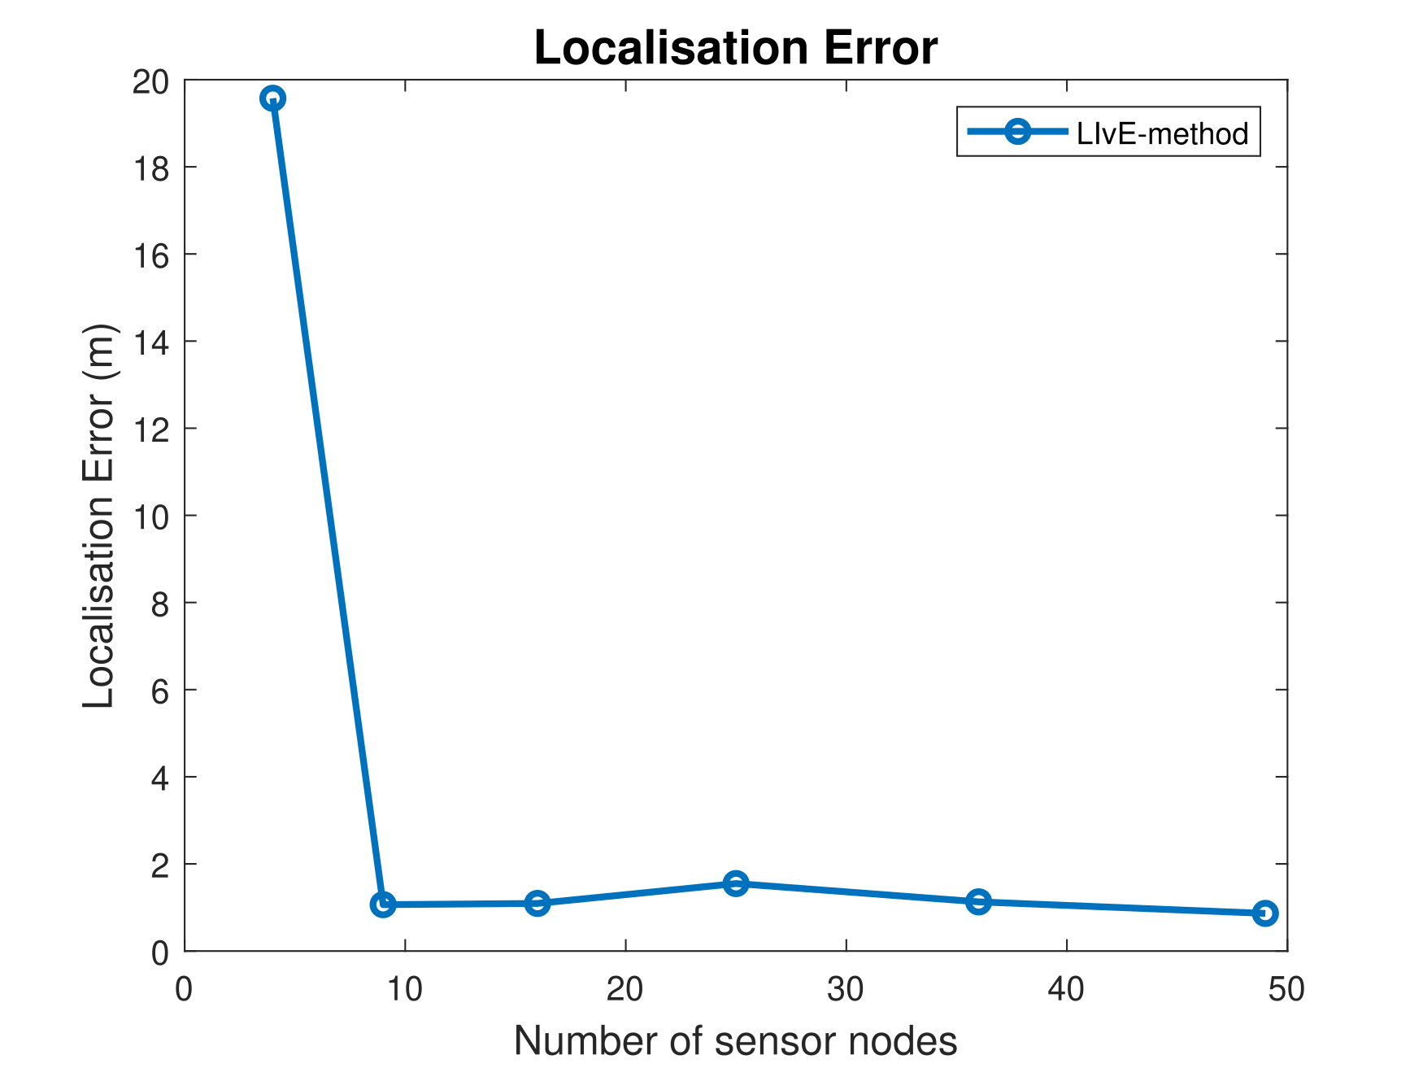
Simulation result
Convergence starts around 9-16 sensors.
No improvement in localization error after 16 sensors for the particular grid size.
Figure 14: Localization error for LIvE method.

Slide 20
RSS-based localization
Fusion center
System model and parameter settings
MSE method
Sensor arrangement
RSS measurements collection
RSS-based localization
Evaluation
LIvE method
OFDM transmit signal
REM construction
Correlated shadowing
Figure 15: Localization accuracy evaluation of the MSE and LIvE methods.

Slide 21
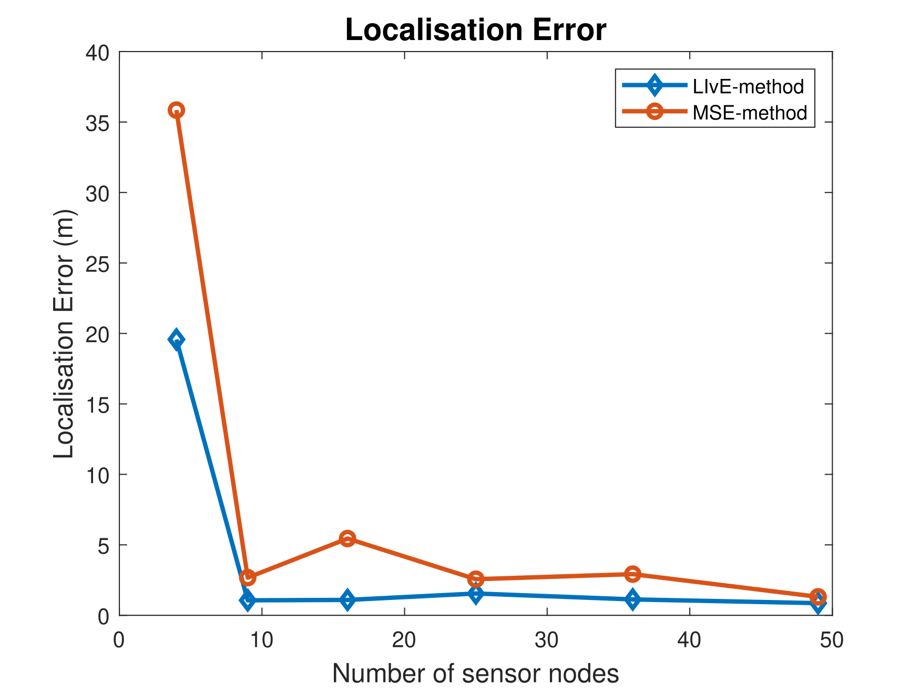
Evaluation
Infeasible point problem with optimization constraints in LIvE.
Trade-off between better localization accuracy (approx. 1-2 m) and complexity in solving non-linear constraints.
So for ease of implementation in real time we accept such trade-off and use MSE for REM construction.
Limitations
Figure 16: Evaluation of localization accuracy of the MSE and LIvE methods.

Slide 22
Extension of system model: OFDM transmit signal
Fusion center
System model and parameter settings
MSE method
Sensor arrangement
RSS measurements collection
RSS-based localization
Evaluation
LIvE method
OFDM transmit signal
REM construction
Correlated shadowing
Figure 17: Employing use of OFDM as a transmit signal for localization.

Slide 23
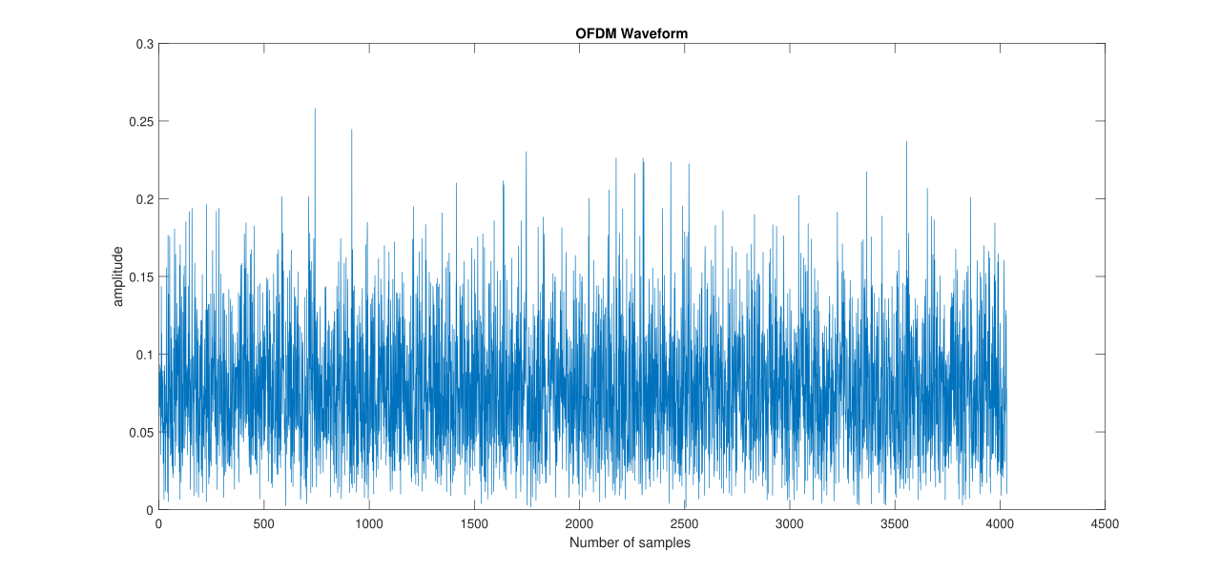
OFDM waveform generation and system parameters
2 subframes from numerology 0.
28 OFDM symbols
FFT size 128
Frequency 3.7 GHz [4].
Cyclic prefix 16
Figure 18: Generated OFDM waveform.

Slide 24
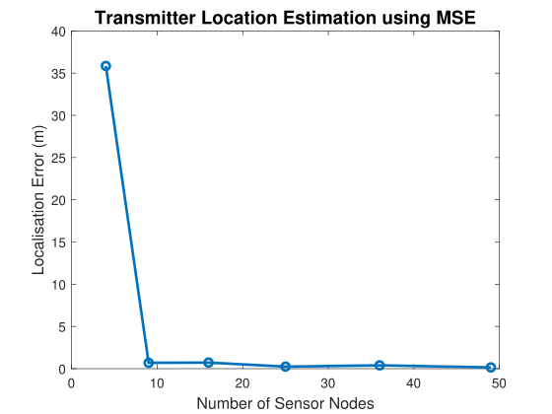
Simulation result
Convergence of localization error at 9 sensors.
Occurs as a result of high PAPR OFDM samples.
Figure 19: Localization accuracy for OFDM signal using MSE method.

Slide 25
Extension of system model: Correlated shadowing
Fusion center
System model and parameter settings
MSE method
Sensor arrangement
RSS measurements collection
RSS-based localization
Evaluation
LIvE method
OFDM transmit signal
REM construction
Correlated shadowing
Figure 20: Employing use of OFDM as a transmit signal for localization.

Slide 26

Extension of system model: Correlated shadowing
Gudmundson model for correlated shadowing is given by the equation [9]:
$\sum_{\left\{i,j\right\}}{=} σ^{2} e^{\left(\frac{− \left|u_{i}− u_{j}\right|}{d_{corr}}\right)}$ (8)
System parameters used:
                Standard deviation $σ$ : [0, 4, 8] dB.
                Correlation distance $d_{corr}$ : 8 m [7].
covariance matrix
Distance between the sensors

Slide 27
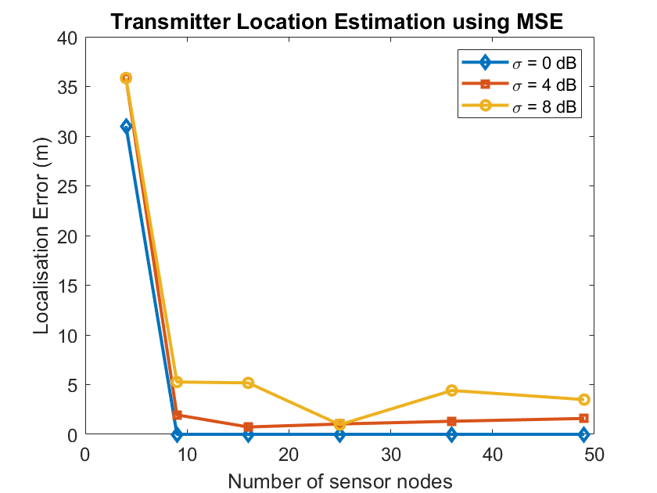
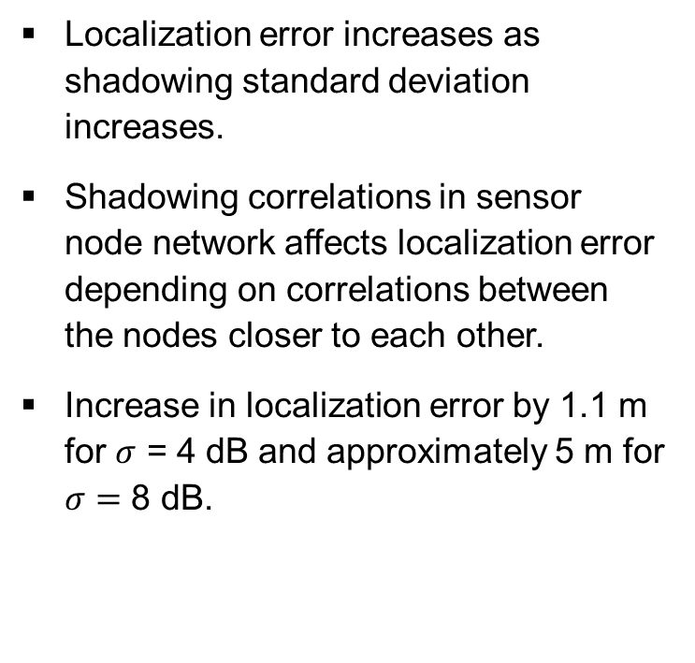
Simulation results
Localization error increases as shadowing standard deviation increases.
Shadowing correlations in sensor node network affects localization error depending on correlations between the nodes closer to each other.
Increase in localization error by 1.1 m for $σ$ = 4 dB and approximately 5 m for $σ=$ 8 dB.
Figure 21: Localization error using MSE method with standard deviation of shadowing [0,4,8] dB.

Slide 28
REM construction
Fusion center
System model and parameter settings
MSE method
Sensor arrangement
RSS measurements collection
RSS-based localization
Evaluation
LIvE method
OFDM transmit signal
REM construction
Correlated shadowing
Figure 22: Localization accuracy evaluation of the MSE and LIvE methods.

Slide 29
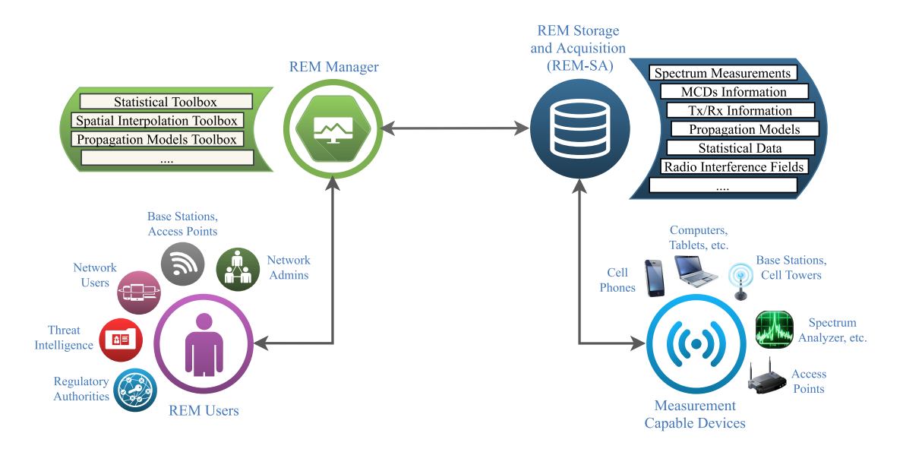
REM flow diagram
Figure 23: REM data flow and model [4].

Slide 30
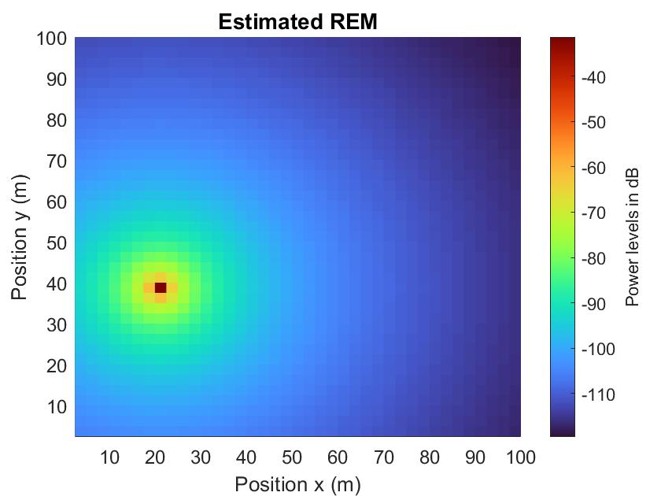
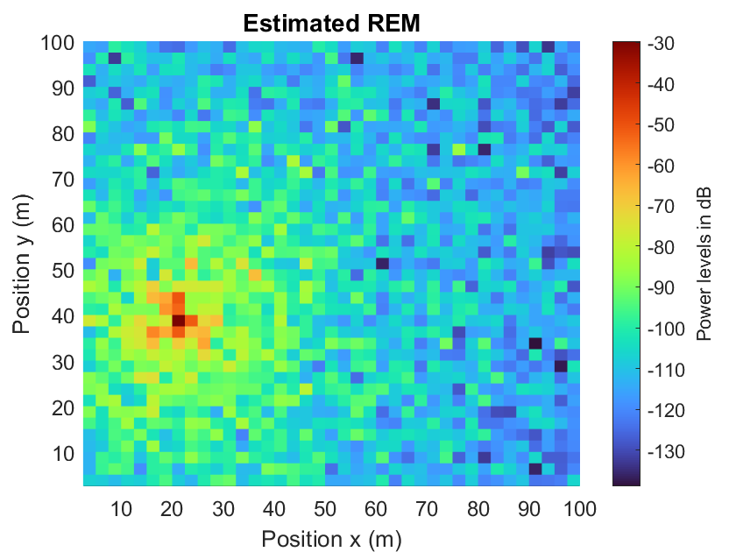
True and estimated power maps or REM
without shadowing
Figure 24: Estimated REM using the results of localization from MSE method in a grid of size (100 m, 100 m) with and without shadowing.

Slide 31

Goals of the thesis
Comparing and evaluating the localization accuracy of MSE and LIvE methods.
  Using OFDM signal as a transmit signal and evaluating performance of MSE method.
  Using correlated shadowing and evaluating the localization error using varying standard deviation of shadowing.
Constructing radio environment map(REM) from results of MSE localization method.

Slide 32
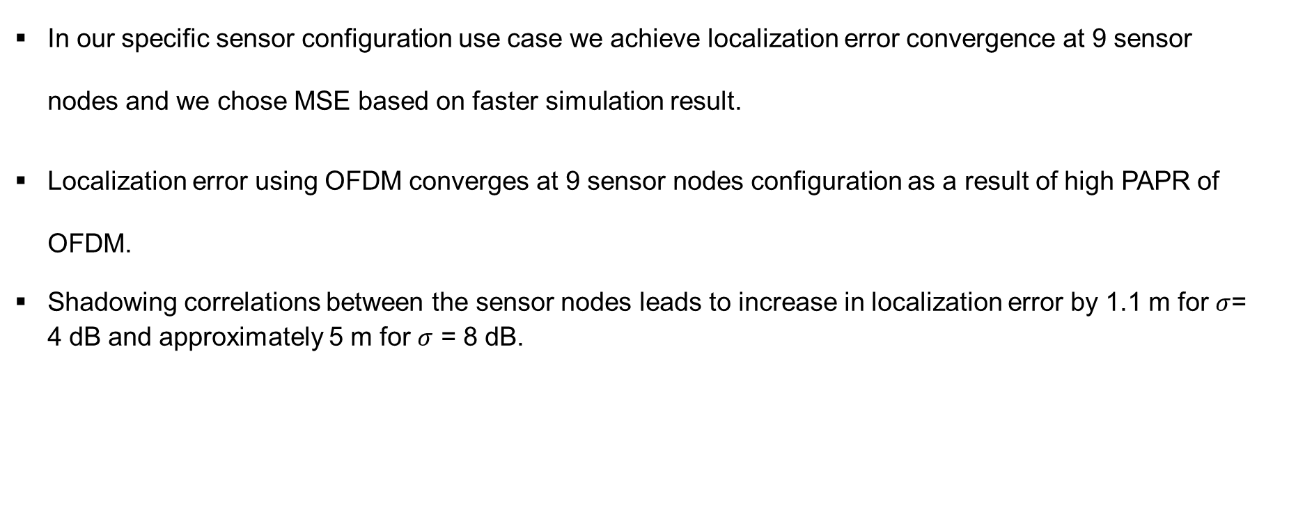
Conclusion
In our specific sensor configuration use case we achieve localization error convergence at 9 sensor nodes and we chose MSE based on faster simulation result.
Localization error using OFDM converges at 9 sensor nodes configuration as a result of high PAPR of OFDM.
Shadowing correlations between the sensor nodes leads to increase in localization error by 1.1 m for $σ$= 4 dB and approximately 5 m for $σ$ = 8 dB.

Slide 33
Future Work
Effect of fast fading, change of sensor placement, multiple transmitters and channel models to get more out of localization methods.
Finding a robust algorithm for localization that also suffices mobility of transmitter or sensor nodes and accuracy to the resolution of 0.1 m for V2X and autonomous driving cases.
Constructing REM with consideration of sensors power levels.

Slide 34
References
Ezzati, Nematollah, Hasan Taheri, and Tuna Tugcu. "Optimised sensor network for transmitter localisation and radio environment mapping." IET Communications 10.16 (2016): 2170-2178. Location estimation-based radio environment map construction in fading channels.
Yilmaz, Huseyin Birkan, and Tuna Tugcu. "Location estimation‐based radio environment map construction in fading channels." Wireless communications and mobile computing 15.3 (2015): 561-570.
Yilmaz, H. Birkan, et al. "Radio environment map as enabler for practical cognitive radio networks." IEEE Communications Magazine 51.12 (2013): 162-169.
Phillips, Caleb, et al. "Practical radio environment mapping with geostatistics." 2012 IEEE International Symposium on Dynamic Spectrum Access Networks. IEEE, 2012.
Reddy, Yeduri Sreenivasa, et al. "Spectrum cartography techniques, challenges, opportunities, and applications: A survey." Pervasive and Mobile Computing 79 (2022): 101511.

Slide 35
References
Reddy, Yeduri Sreenivasa, et al. "Spectrum cartography techniques, challenges, opportunities, and applications: A survey." Pervasive and Mobile Computing 79 (2022): 101511.
De Almeida, Ivo Bizon Franco, et al. "Blind transmitter localization in wireless sensor networks: A deep learning approach." 2021 IEEE 32nd Annual International Symposium on Personal, Indoor and Mobile Radio Communications (PIMRC). IEEE, 2021.
Turkmen, H., Solaija, M. S. J., Furqan, H. M., & Arslan, H. (2020). Generalized Radio Environment Monitoring for Next Generation Wireless Networks. arXiv preprint arXiv:2008.06203.
Kulkarni, K., Franchi, N., & Fettweis, G. (2019, February). Real-time cooperative spectrum sensing: Reliable localization of unknown interferers in shared spectrum. In SCC 2019; 12th International ITG Conference on Systems, Communications and Coding (pp. 1-6). VDE.

Slide 36
Thank you for your attention!

Slide 37
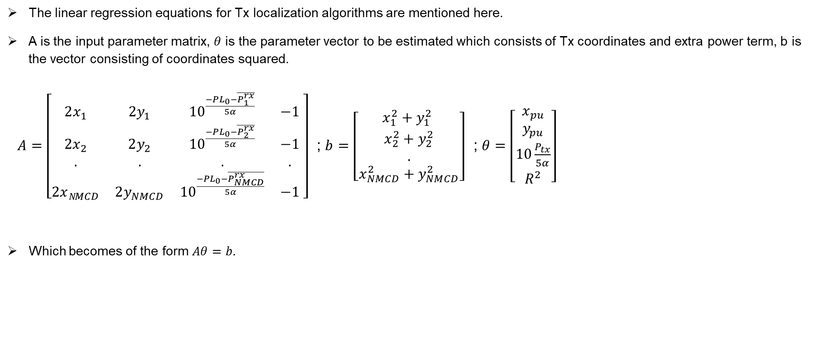
Appendix 1
The linear regression equations for Tx localization algorithms are mentioned here.
A is the input parameter matrix, $θ$ is the parameter vector to be estimated which consists of Tx coordinates and extra power term, b is the vector consisting of coordinates squared.
$A=\left[\begin{matrix}2x_{1} & 2y_{1} & {10}^{\frac{−PL_{0}−\overline{P_{1}^{rx}}}{5α}} & −1 \\ 2x_{2} & 2y_{2} & {10}^{\frac{−PL_{0}−\overline{P_{2}^{rx}}}{5α}} & −1 \\ . & . & . & . \\ 2xN_{MCD} & 2y_{NMCD} & {10}^{\frac{−PL_{0}−\overline{P_{NMCD}^{rx}}}{5α}} & −1\end{matrix} \right]$ ; $b$ $=\left[\begin{matrix}x_{1}^{2}+y_{1}^{2} \\ x_{2}^{2}+y_{2}^{2} \\ . \\ x_{NMCD}^{2}+y_{NMCD}^{2}\end{matrix}\right]$ ; $θ=\left[\begin{matrix}x_{pu} \\ y_{pu} \\ 10\frac{P_{tx}}{5α} \\ R^{2}\end{matrix}\right]$
Which becomes of the form $Aθ=b$.

Slide 38
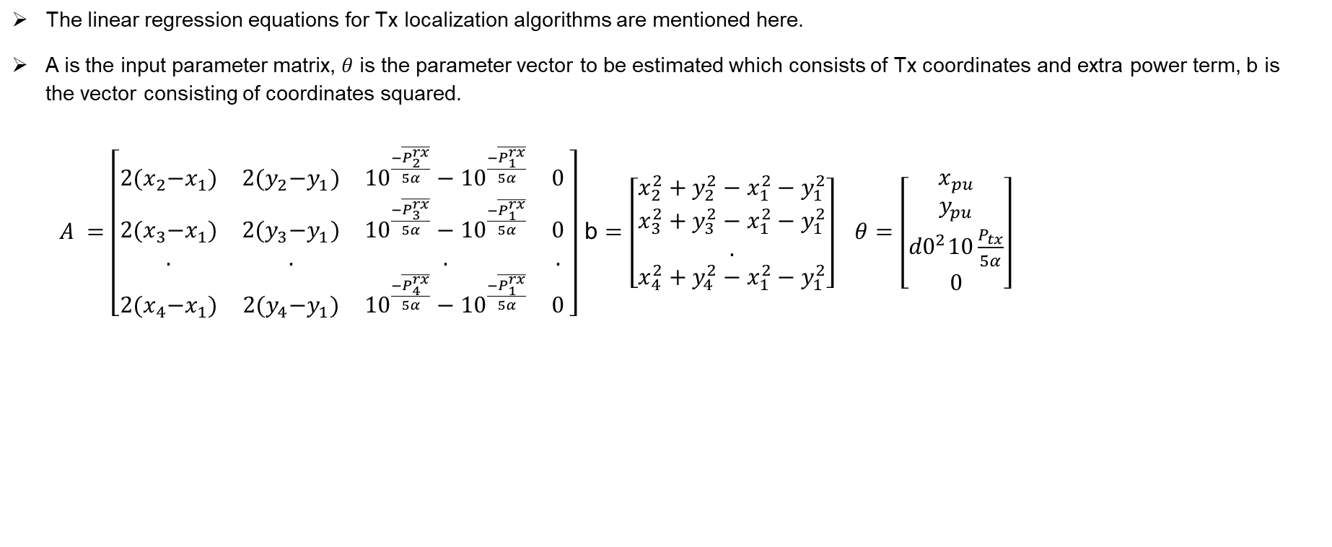
Appendix 2
The linear regression equations for Tx localization algorithms are mentioned here.
A is the input parameter matrix, $θ$ is the parameter vector to be estimated which consists of Tx coordinates and extra power term, b is the vector consisting of coordinates squared.
$A =\left[\begin{matrix}2{(x}_{2}−x_{1}) & 2{(y}_{2}−y_{1}) & {10}^{\frac{−\overline{P_{2}^{rx}}}{5α}}−{10}^{\frac{−\overline{P_{1}^{rx}}}{5α}} & 0 \\ 2{(x}_{3}−x_{1}) & 2{(y}_{3}−y_{1}) & {10}^{\frac{−\overline{P_{3}^{rx}}}{5α}}−{10}^{\frac{−\overline{P_{1}^{rx}}}{5α}} & 0 \\ . & . & . & . \\ 2{(x}_{4}−x_{1}) & 2{(y}_{4}−y_{1}) & {10}^{\frac{−\overline{P_{4}^{rx}}}{5α}}−{10}^{\frac{−\overline{P_{1}^{rx}}}{5α}} & 0\end{matrix} \right]$ b $=\left[\begin{matrix}x_{2}^{2}+y_{2}^{2}−x_{1}^{2}−y_{1}^{2} \\ x_{3}^{2}+y_{3}^{2}−x_{1}^{2}−y_{1}^{2} \\ . \\ x_{4}^{2}+y_{4}^{2}−x_{1}^{2}−y_{1}^{2}\end{matrix}\right] θ=\left[\begin{matrix}x_{pu} \\ y_{pu} \\ {d0}^{2}10\frac{P_{tx}}{5α} \\ 0\end{matrix}\right]$

