Slide 1


Master Thesis: RSS-based localization using distributed spectrum sensing for 5G networks
19.10.2023
Supervisors:
Student:
Aakarsh Dhariwal
Begin: 1.04. 23
End: 2.10.23
Victor Shatov
Norman Franchi
Lehrstuhl Elektrische Smart City Systeme
Nuremberg Campus of Technology (NCT)
Prof. Dr.-Ing. Norman Franchi
Engineering for Smart Cities

Slide 2
Outline
1
Motivation and objective
4
REM construction
2
Introduction
5
Conclusion
3
Methodology
6
References
4
5

Slide 3
Motivation and objective
Localization of active transmitter supports many location based services and applications such as security, spectrum occupancy.
Received signal strength (RSS) measurements captured from sensors as a means to perform localization.
Using the estimated position to estimate power map or radio environment map (REM) of the transmitter.
In a certain area

Slide 4
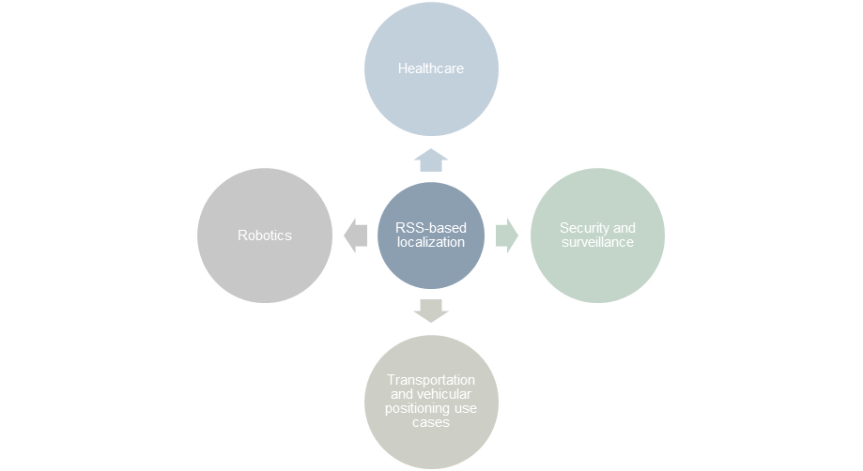
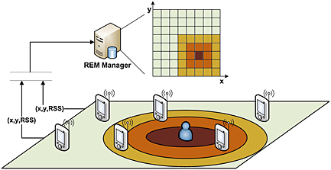
Motivation and objective
Fit under the line when there’s
enough space
Some explaining text on the right?
Slide look too empty
Figure 1: Applications of localization [2], [4].

Slide 5
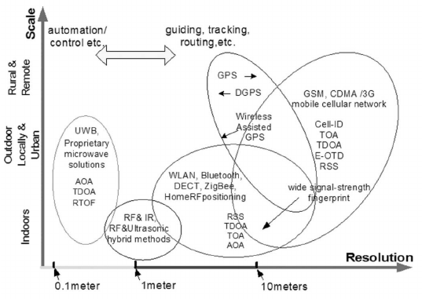
RSS as a suitable technology for localization
Figure 2: Motivation for using RSS measurements for localization [6].

Slide 6
Introduction and Proposed scenario [1],[2]
Some text +
to make the figure smaller?
Would also mask
rather poor resolution...
Figure 3: Scenario for localization using dedicated sensor network [1], [2] and REM construction.

Slide 7
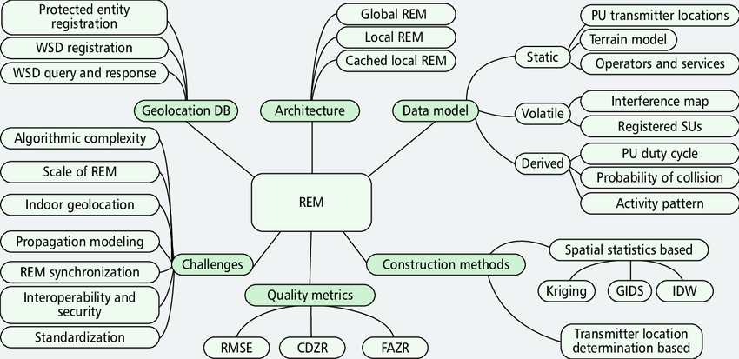
REM Data Model
Figure 4 : REM architecture [4].
Is it just the architecture, or smth more?..

Slide 8
Goals of the thesis
Comparing and evaluating the localization accuracy of MSE and LIvE methods.
Assuming OFDM signal as a transmit signal and evaluating performance of MSE method.
Assuming correlated shadowing and evaluating the localization error using varying standard deviation of shadowing.
Constructing estimated and true REM using results of localization from MSE-based method.
REM as a emerging tool for 5G use cases such as ultra low latency, mobility, dynamic changes in channel.

Slide 9
Methodology and overall process
No output further from the fusion center to the signal processing chain?
Fusion center
System model and parameter settings
RSS-based localization
MSE method
Sensor arrangement
RSS measurements calculations
Evaluation
LIvE method
OFDM transmit signal
Maybe use more colors to make it look prettier?
REM construction
Correlated shadowing
Figure 5: Methodology flow diagram.

Slide 10
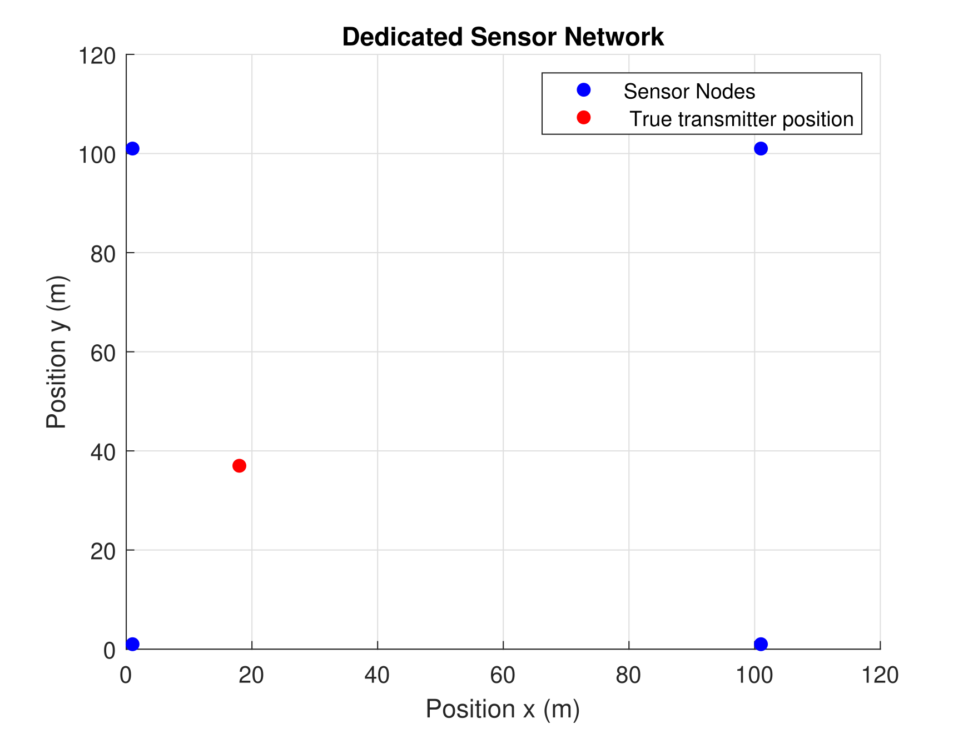
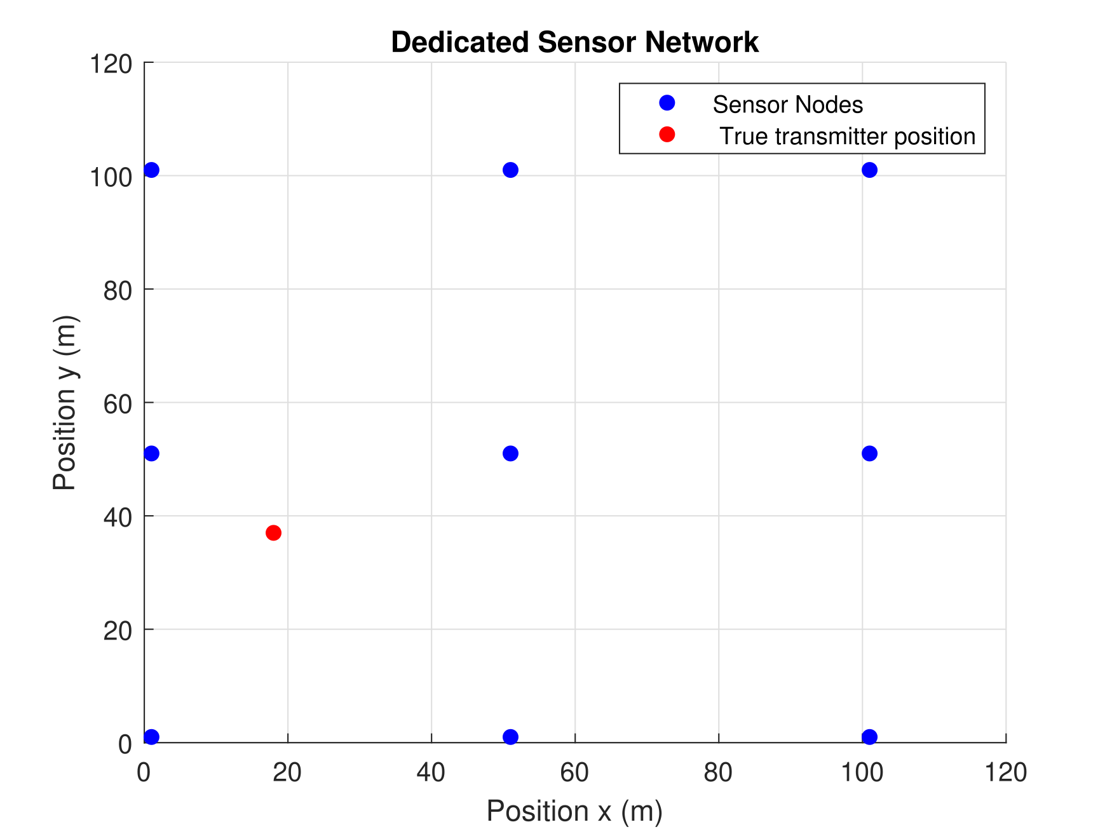
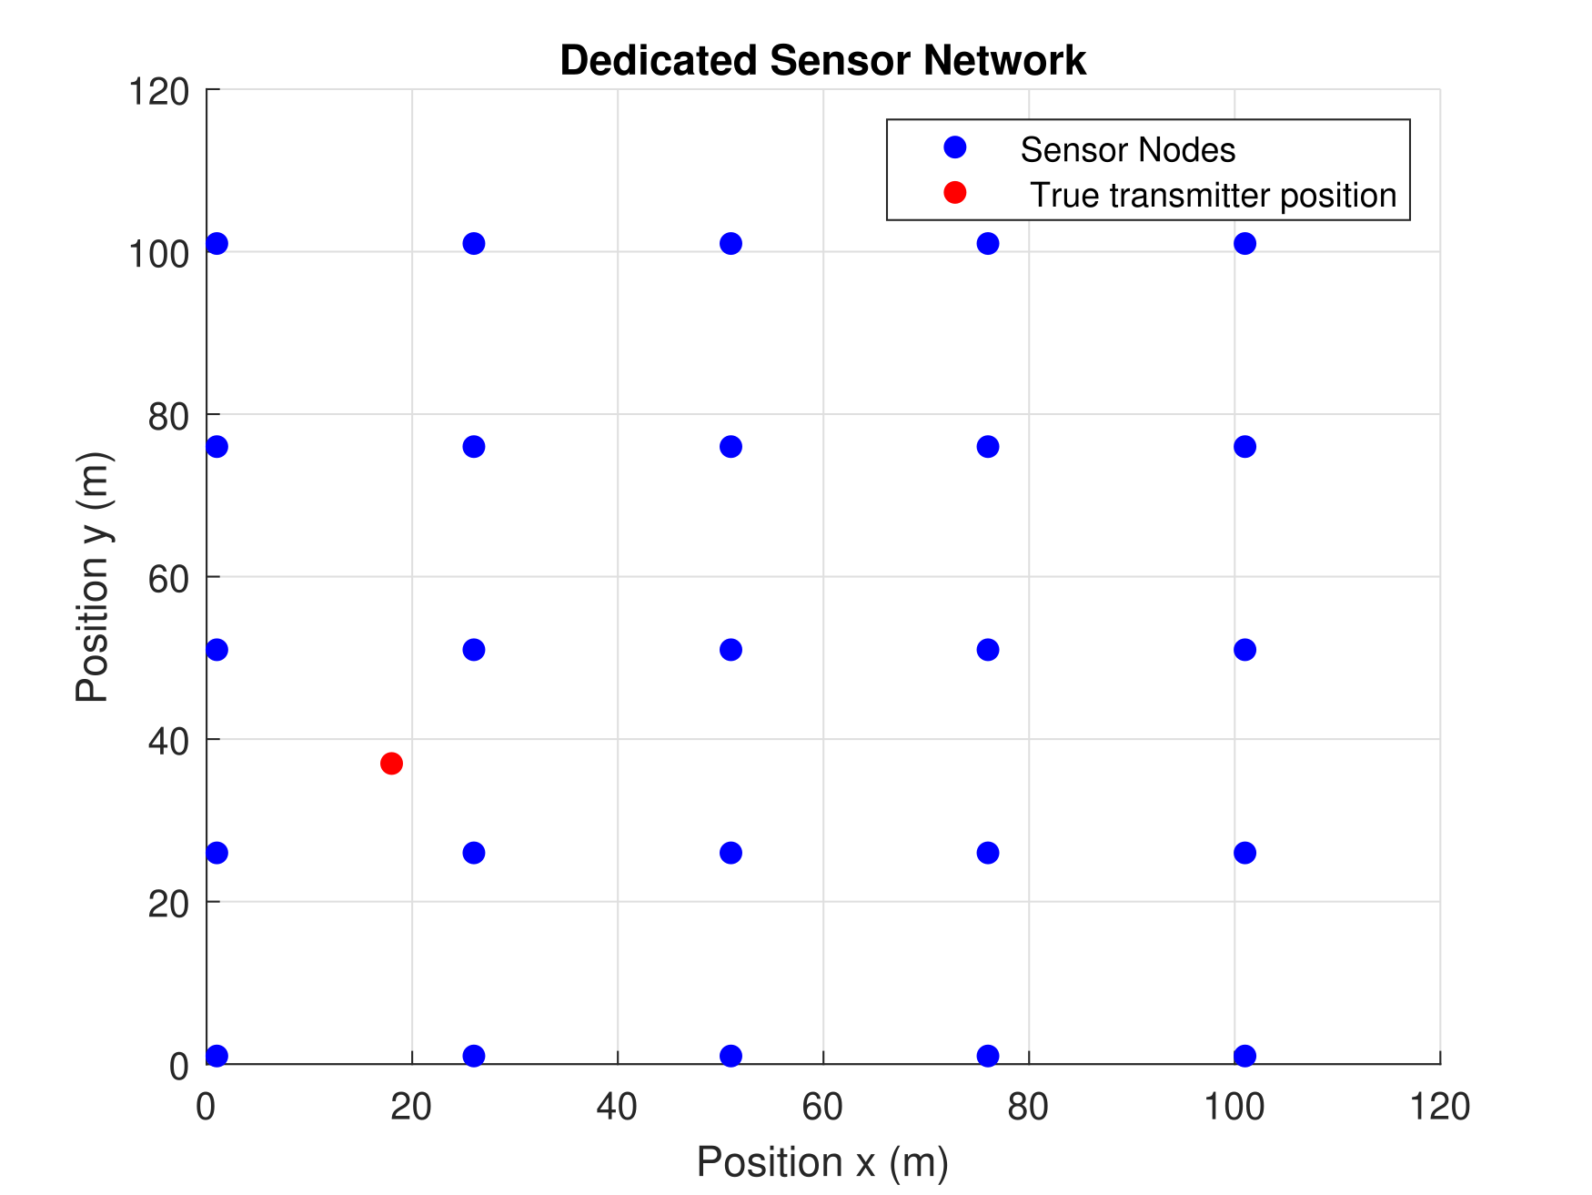
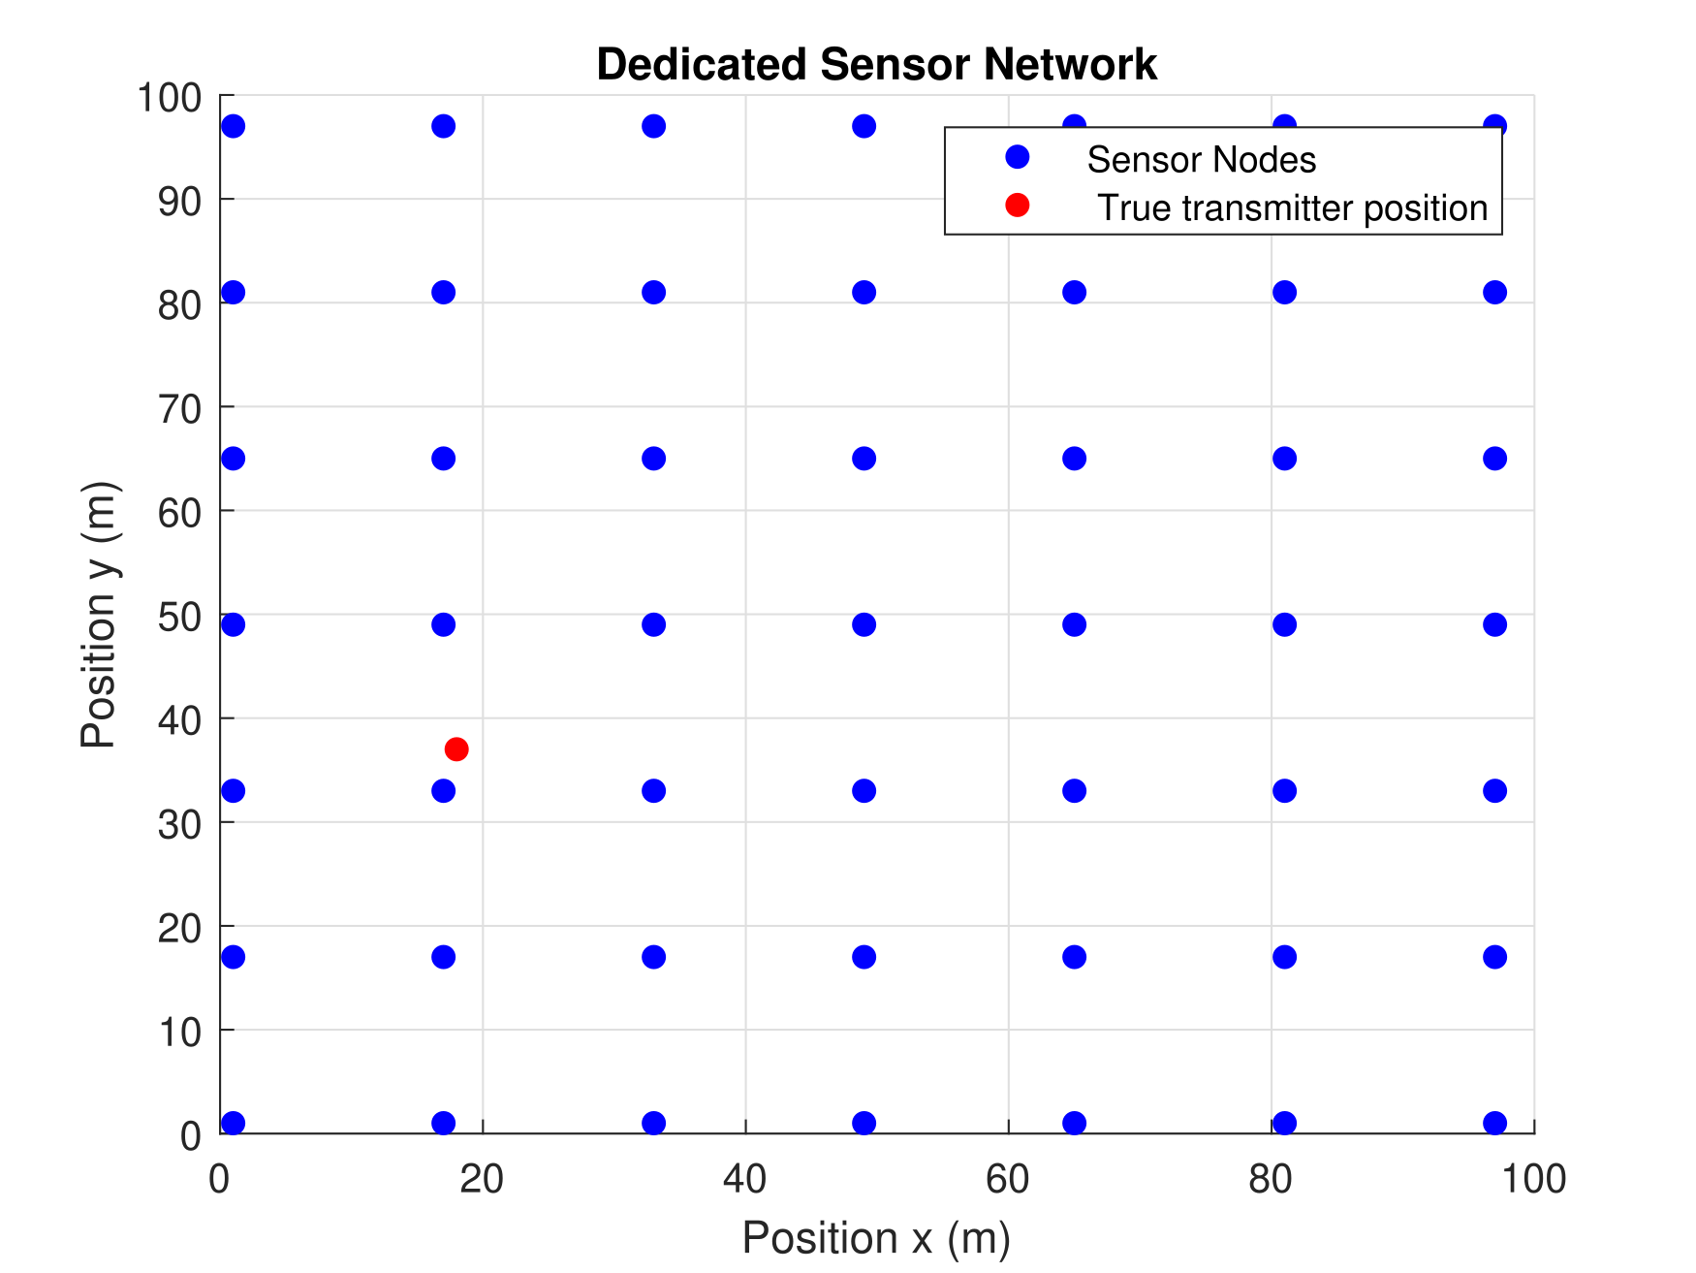
Dedicated sensor network
Sensor arrangement
Figures are visibly stretched
horisontally
8
9. Oktober 2023
Figure 6: Placement of dedicated sensor network 4,9,25 and sensors with true transmitter position [18 m, 37 m] in a grid of [100 m, 100 m] [1].

Slide 11
Methodology and overall process
If there’s nothing except for figure,
maybe better to place it in the center?
Fusion center
System model and parameter settings
RSS-based localization
MSE method
Sensor arrangement
RSS measurements calculations
Evaluation
LIvE method
OFDM transmit signal
REM construction
Correlated shadowing
Figure 7:System model and parameters modeling.
space

Slide 12





System Model
Considering a simple path loss model the RSS measurement at j-th node is given as [2]:
$P_{j}^{Rx}\left[dB\right]= P^{Tx}\left[dB\right]+PL_{0}[dB]− 10α\log{ (\frac{d}{d_{0}})}+ Ψ_{dB}$ (1)
PL₀
$$P_{j}^{Rx}:received signal strength$$
PL_0: reference path loss
$α:$path loss exponent.
$d_{0}$: reference distance
$Ψ_{dB }:$Shadowing
$P^{Tx}$: transmit power
Why do you introduce variables
above and below the equation?...

Slide 13





System Model [1],[2]
Considering a simple path loss model the RSS measurement at j-th node is given as [2]:
$P_{j}^{Rx}\left[dB\right]= P^{Tx}\left[dB\right]+PL_{0}[dB]− 10α\log{ (\frac{d}{d_{0}})}+ Ψ_{dB}$ (1)
d $d$ in the equation (1) is given by:
$d = \sqrt{\left\{{\left(x_{t}− x_{j}\right)}^{2}+ {\left(y_{t}− y_{j}\right)}^{2}\right\}}$ (2)
$$P_{j}^{Rx}:received signal strength.$$
$PL_{0}$ reference path loss.
$α:$path loss exponent..
$d_{0}$: reference distance.
Shadowing
$P^{Tx}$: transmit power.
The same comment from previous slide

Slide 14
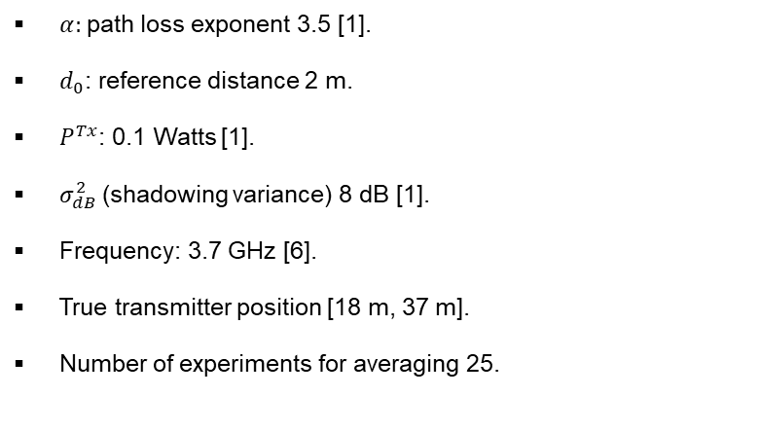
System model parameters
System model and parameter settings
$α:$path loss exponent 3.5 [1].
$d_{0}$: reference distance 2 m.
$P^{Tx}$: 0.1 Watts [1].
$σ_{dB}^{2}$(shadowing variance) 8 dB [1].
Frequency: 3.7 GHz [6].
True transmitter position [18 m, 37 m].
Number of experiments for averaging 25.
Sensor arrangement

Slide 15
Methodology and overall process
Fusion center
System model and parameter settings
RSS-based localization
MSE method
Sensor arrangement
RSS measurements calculations
Evaluation
LIvE method
OFDM transmit signal
REM construction
Correlated shadowing
Figure 8: RSS measurements calculation.

Slide 16
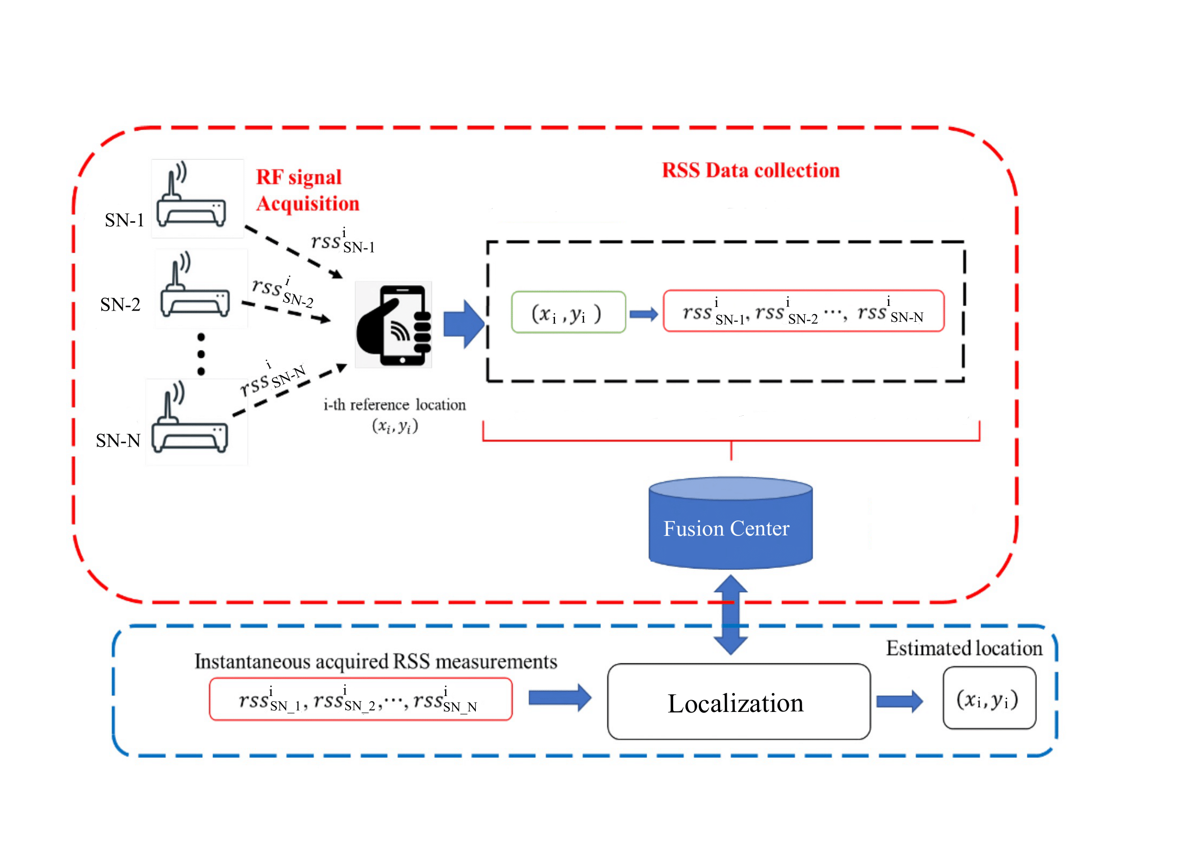
Collection of RSS measurements
Figure 9: Calculating RSS measurements and performing localization [5].

Slide 17
MSE method for localization
Fusion center
System model and parameter settings
RSS-based localization
MSE method
Sensor arrangement
RSS measurements calculations
Performance Evaluation
LIvE method
OFDM transmit signal
REM construction
Correlated shadowing
Figure 10: Methodology and flow diagram.

Slide 18

MSE-based localization[1]
Problem formulation
$Aθ=b$ (3)
𝐴𝜃=𝑏 (3)
MSE solution
${ θ}_{opt}= \left(\frac{∑A_{i}^{T}b_{i}}{∑A_{i}^{T}A_{i}}\right)$ (4)
〖 𝜃〗_𝑜𝑝𝑡= ((∑𝐴_𝑖^𝑇 𝑏_𝑖)/(∑𝐴_𝑖^𝑇 𝐴_𝑖 )) (4)
RESULT
${C^{N}}_{4}$ combinations of sensors.
〖𝐶^𝑁〗_4 combinations of sensors.
Perform the operations for 25 experiments to average the result
A: input parameter matrix
$θ:$unknown parameter
𝜃: unknown parameter
b: output parameter vector
$$\hat{θ}= argmin\left\|Aθ−b\right\|$$

Slide 19
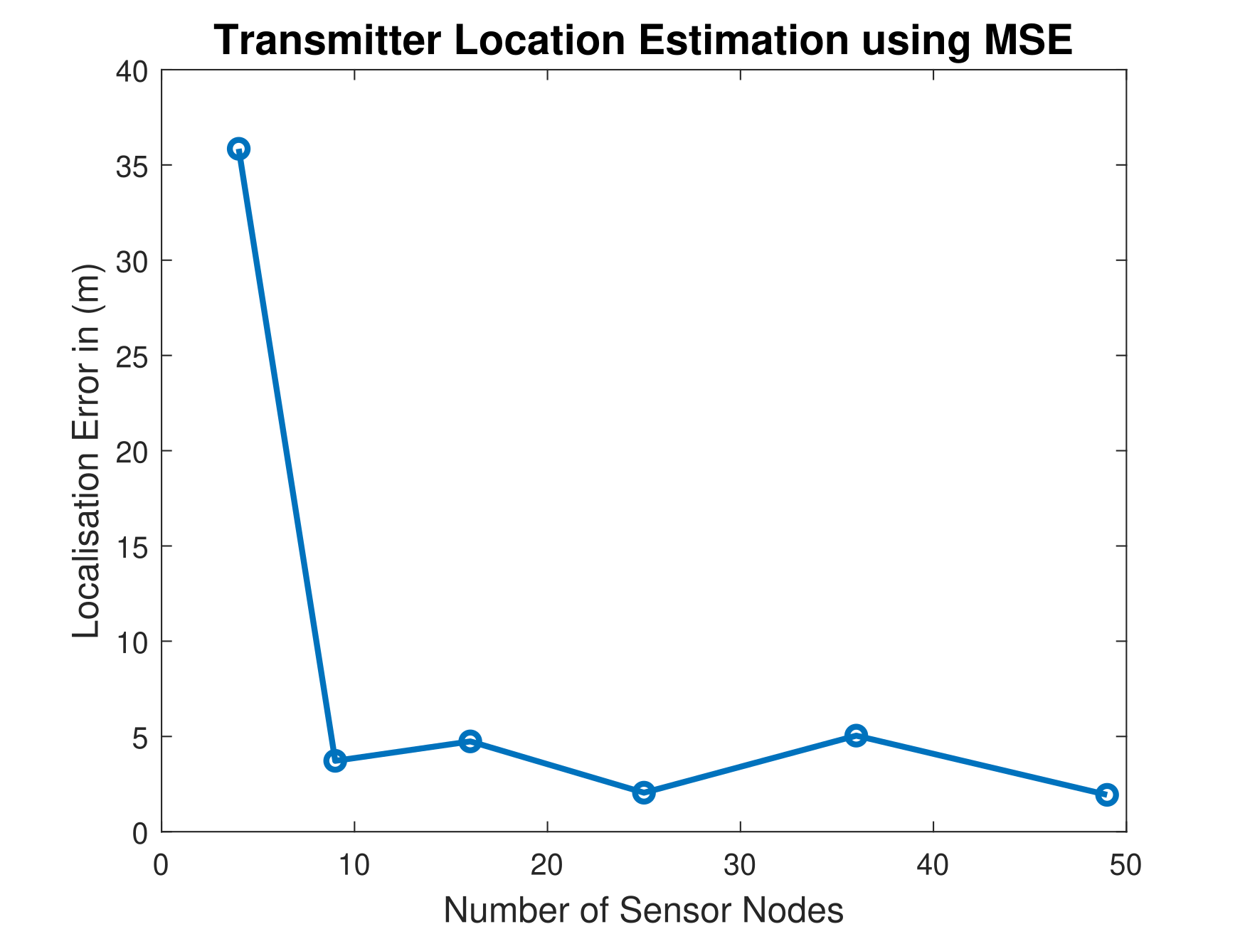
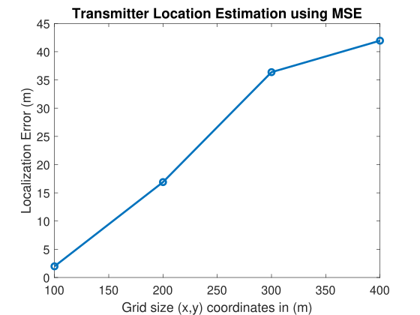
Simulation result
Figure 11: Localization error for MSE method.
Figure 12: Localization error against increasing grid size.

Slide 20
LIvE method for localization
Fusion center
System model and parameter settings
RSS-based localization
MSE method
Sensor arrangement
RSS measurements calculations
Evaluation
LIvE method
OFDM transmit signal
REM construction
Correlated shadowing
Figure 13: Methodology and flow diagram.

Slide 21
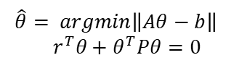
LIvE-based localization[3]
Problem formulation:
$Aθ=b$
𝐴𝜃=𝑏
LIvE solution
$L(θ,λ) = {(A θ−b)}^{T} (A θ−b) + λ(r^{T}θ+ θ^{T}Pθ)$ (5)
𝐿(𝜃,𝜆) = 〖(𝐴 𝜃−𝑏)〗^𝑇 (𝐴 𝜃−𝑏) + 𝜆(𝑟^𝑇 𝜃+ 𝜃^𝑇 𝑃𝜃) (5)
RESULT
Perform the operations for 25 experiments to average the result
A: input parameter matrix
$θ:$unknown parameter
𝜃: unknown parameter
b: output parameter vector
(5)
$$\hat{θ}= argmin\left\|Aθ−b\right\|$$
$${ r}^{T}θ+θ^{T}Pθ=0$$

Slide 22
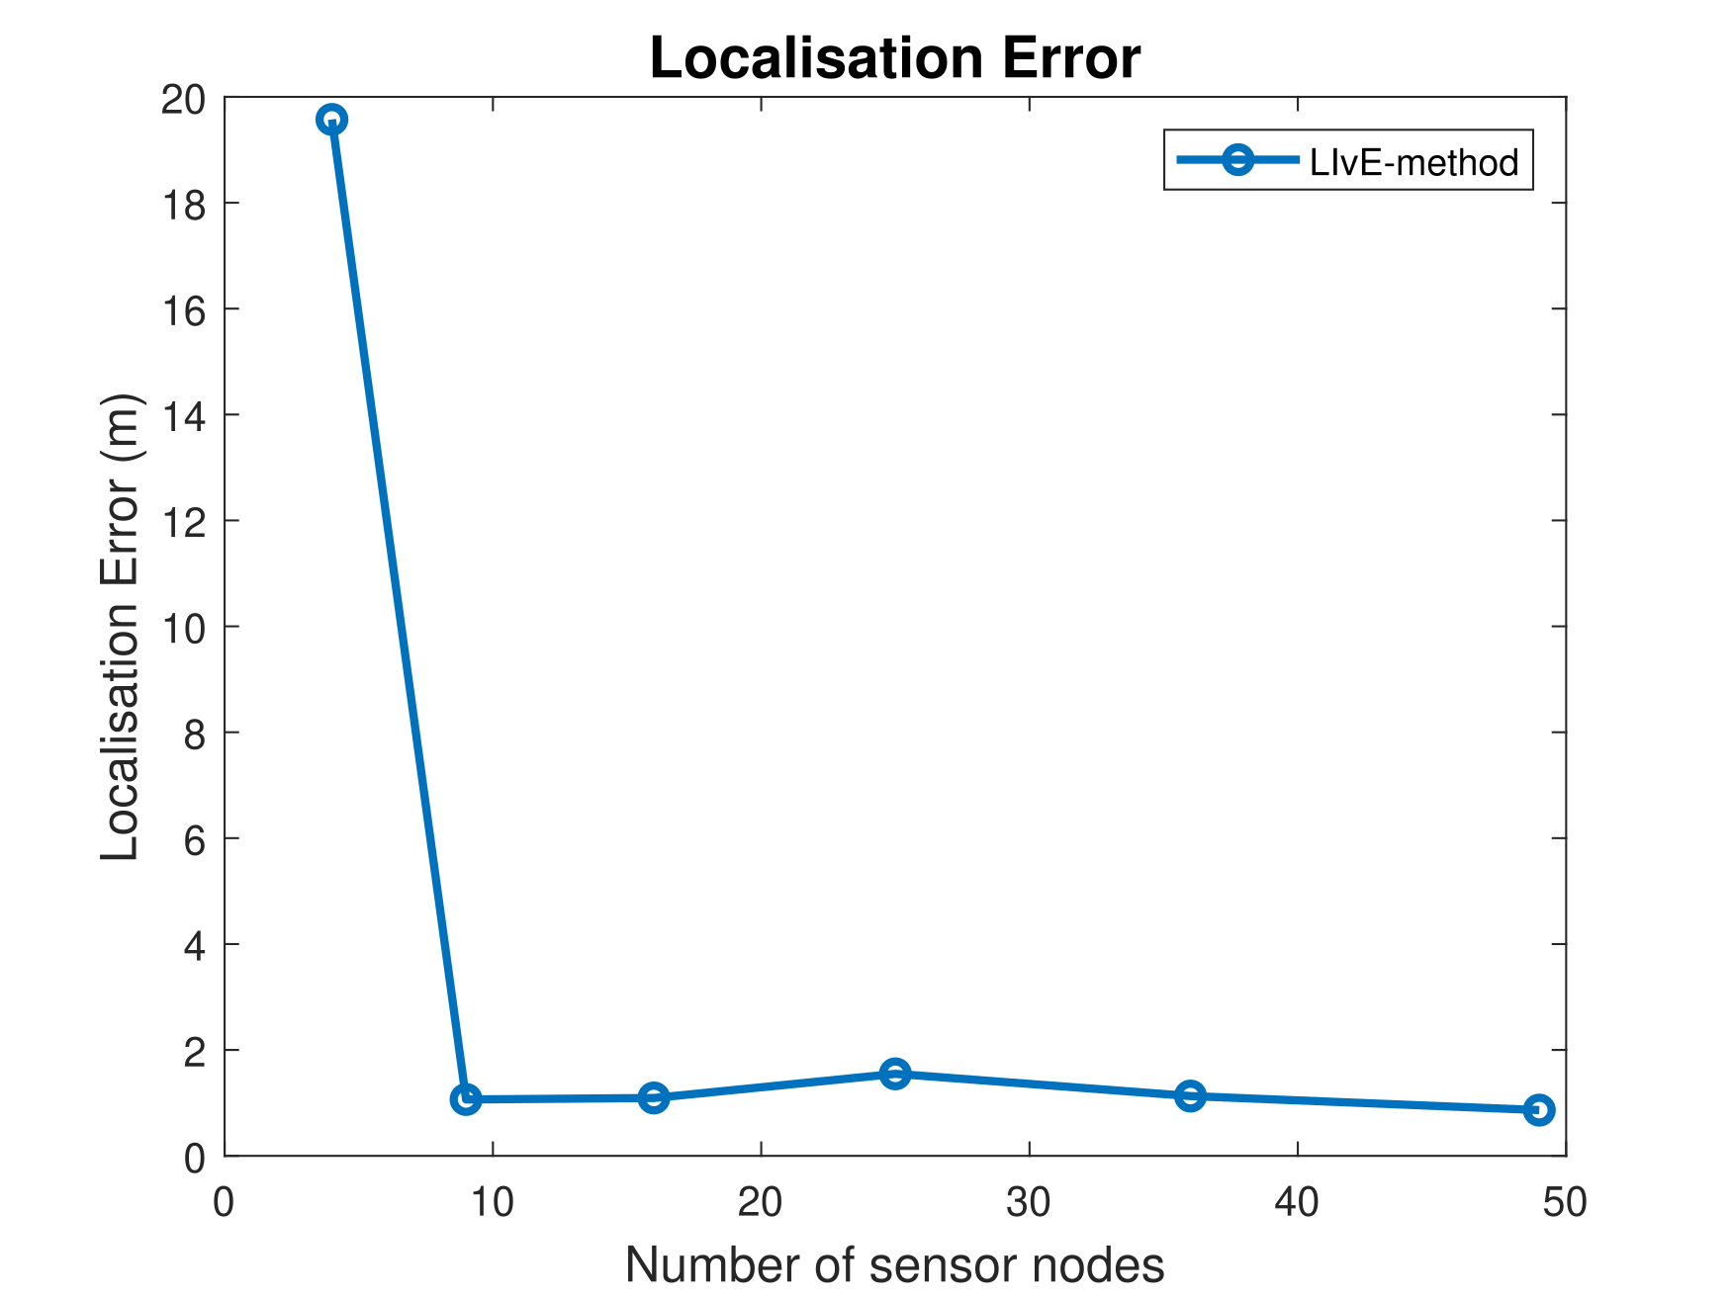
Simulation result
Figure 14: Localization error for LIvE method.

Slide 23
Localization accuracy evaluation
Fusion center
System model and parameter settings
RSS-based localization
MSE method
Sensor arrangement
RSS measurements calculations
Evaluation
LIvE method
OFDM transmit signal
REM construction
Correlated shadowing
Figure 15: Localization accuracy evaluation of the MSE and LIvE methods.

Slide 24
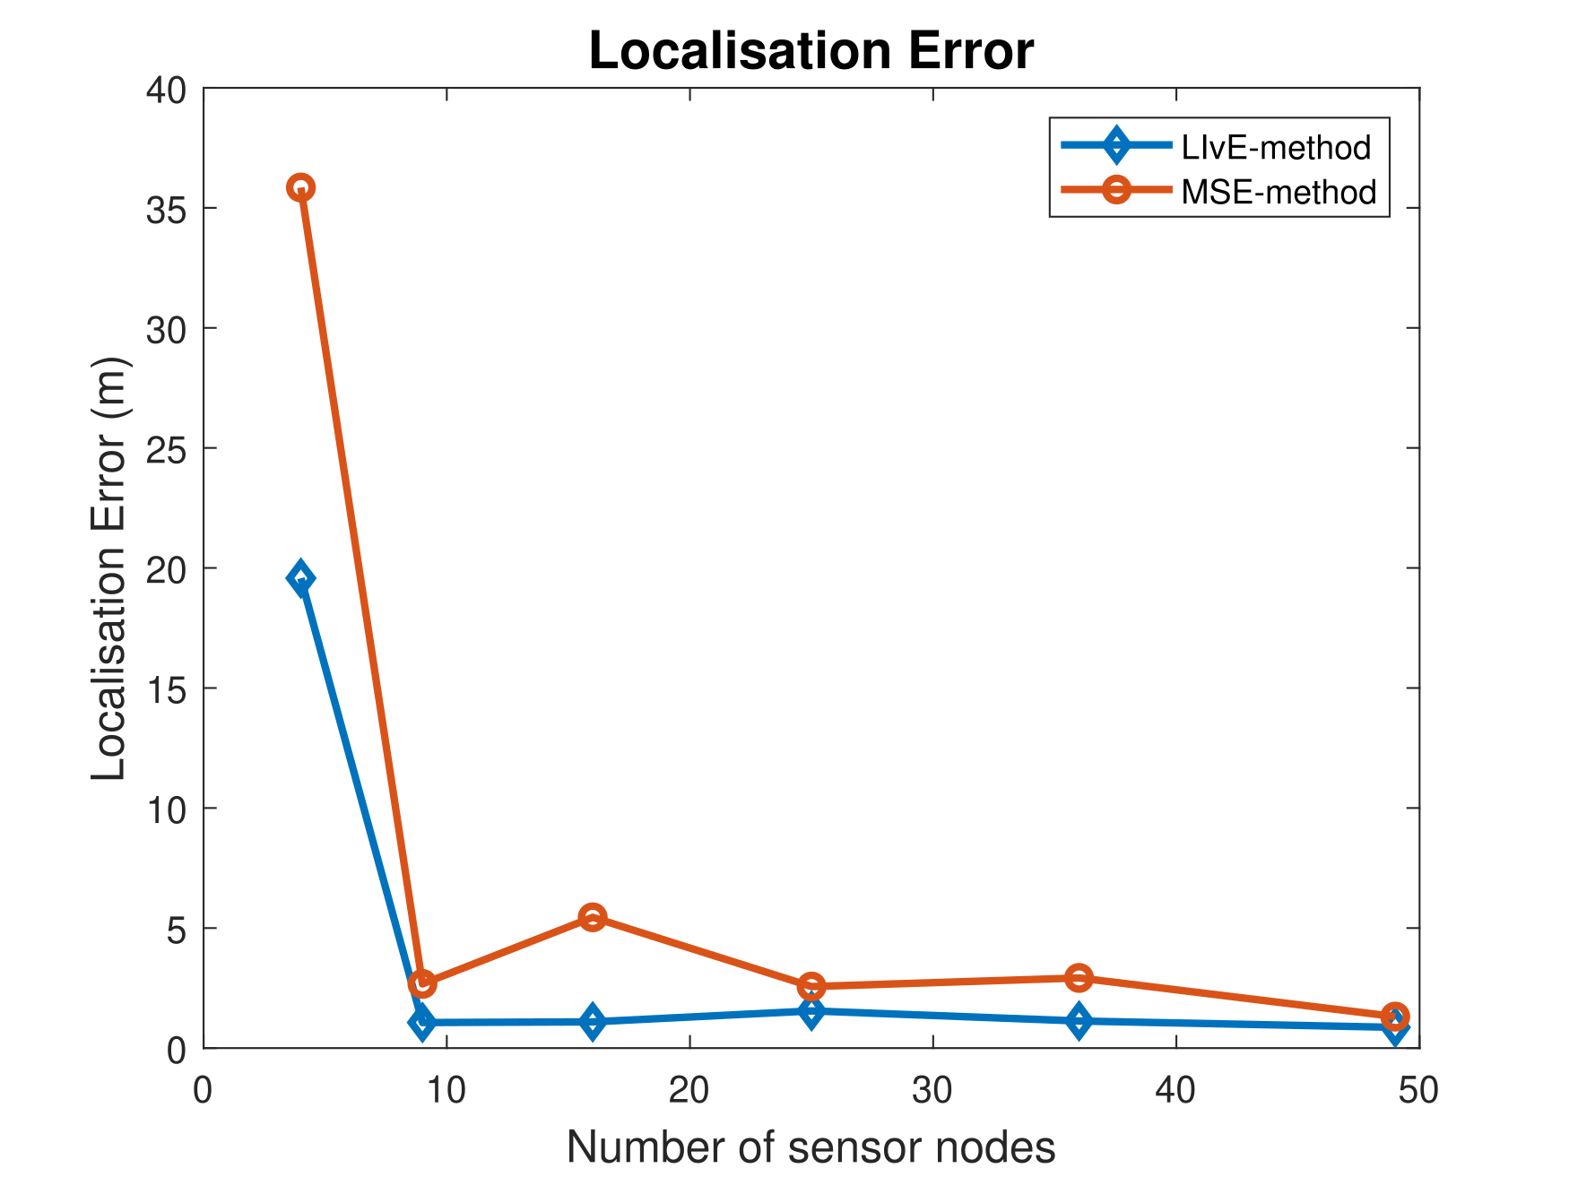
Performance Evaluation
Infeasible point problem with optimization constraints in LIvE.
Tadeoff between better localization accuracy and complexity in solving non-linear constraints.
So for ease of implementation in real time we accept such tradeoff and use MSE for REM construction.
Limitations
Figure 16: Localization accuracy evaluation of the MSE and LIvE methods

Slide 25
Extension of system model: OFDM transmit signal
Fusion center
System model and parameter settings
RSS-based localization
MSE method
Sensor arrangement
RSS measurements calculations
Evaluation
LIvE method
OFDM transmit signal
REM construction
Correlated shadowing
Figure 17: Employing use of OFDM as a transmit signal for localization.

Slide 26
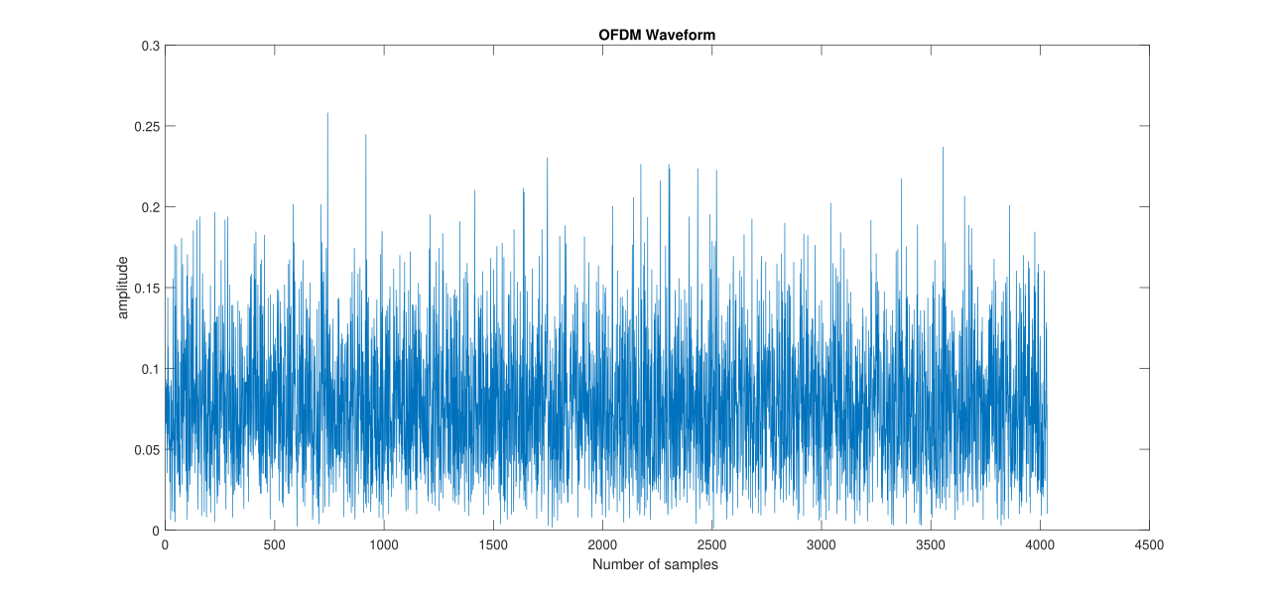
OFDM waveform generation and system parameters
28 OFDM symbols.
FFT size: 128 samples.
Cyclic prefix length 16.
Frequency 3.7 GHz [4].
2 subframes from numerology 0.
Figure 18: Generated OFDM waveform.

Slide 27
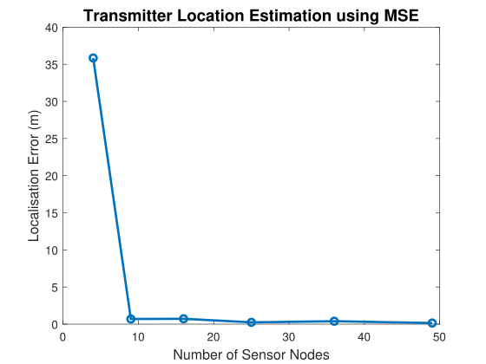
Simulation result
Figure 19: Localization accuracy for OFDM signal using MSE method.

Slide 28
Extension of system model: Correlated shadowing
Fusion center
System model and parameter settings
RSS-based localization
MSE method
Sensor arrangement
RSS measurements calculations
Evaluation
LIvE method
OFDM transmit signal
REM construction
Correlated shadowing
Figure 20: Employing use of OFDM as a transmit signal for localization.

Slide 29

Extension of system model: Correlated shadowing
Gudmundson model for correlated shadowing is given by the equation [9]:
$\sum_{\left\{i,j\right\}}{=} σ^{2} e^{\left(\frac{− \left|u_{i}− u_{j}\right|}{d_{corr}}\right)}$ (6)
System parameters used:
                Standard deviation $σ$ : [0,4,8] dB.
                Correlation distance $d_{corr}$ : 8 m [7].
covariance matrix
Distance between the sensors

Slide 30
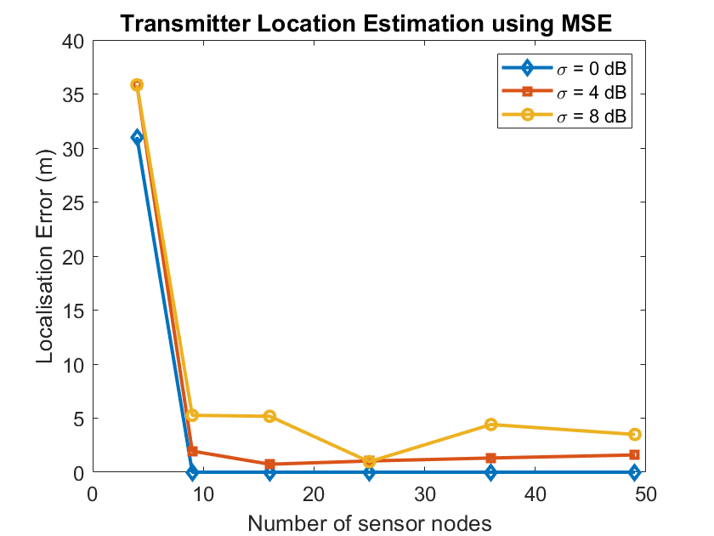
Simulation results
Figure 21: Localization error using MSE method with standard deviation of shadowing [0,4,8] dB.

Slide 31
REM construction
Fusion center
System model and parameter settings
RSS-based localization
MSE method
Sensor arrangement
RSS measurements calculations
Evaluation
LIvE method
OFDM transmit signal
REM construction
Correlated shadowing
Figure 22: Localization accuracy evaluation of the MSE and LIvE methods.

Slide 32
REM construction
(Some) explanatory text would fit good
And the fig. resolution is rather low...
Figure 23: REM construction using active transmitter estimated and true location [1].

Slide 33
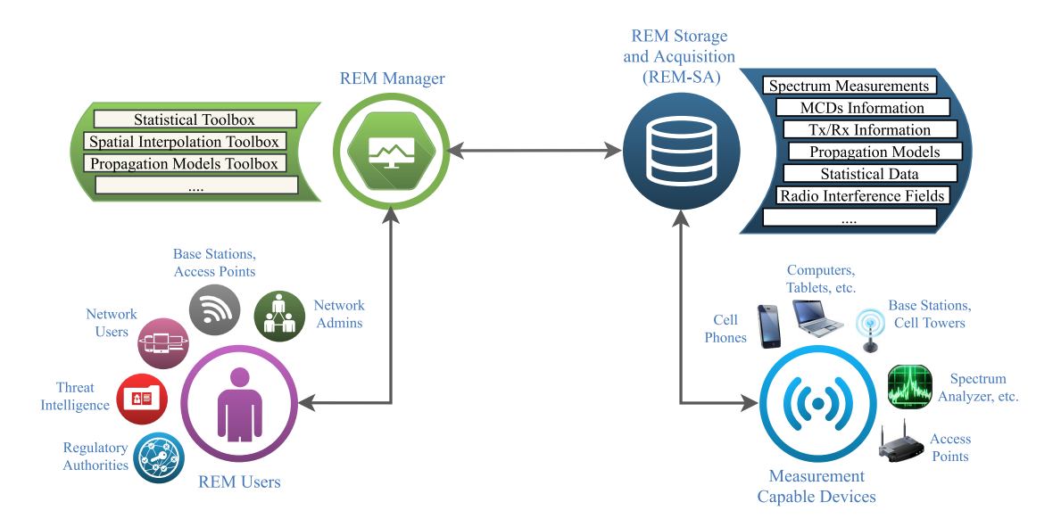
REM flow diagram
Finally a very nice and neat figure ☺
Figure 24: REM data flow and model [4].

Slide 34
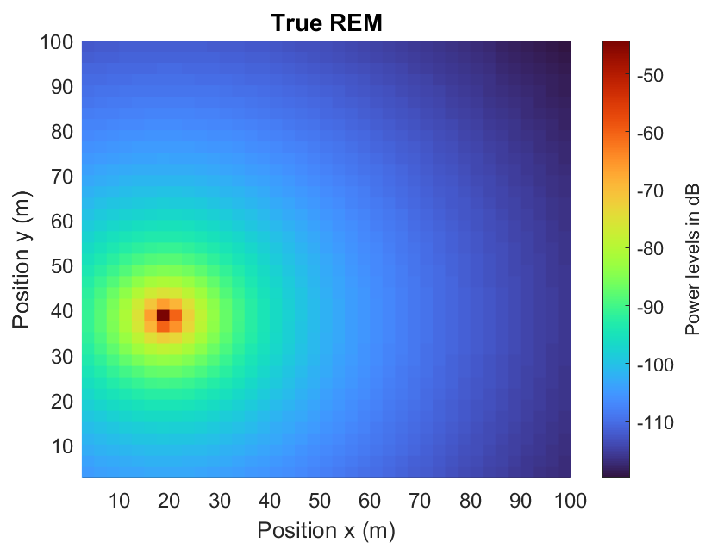
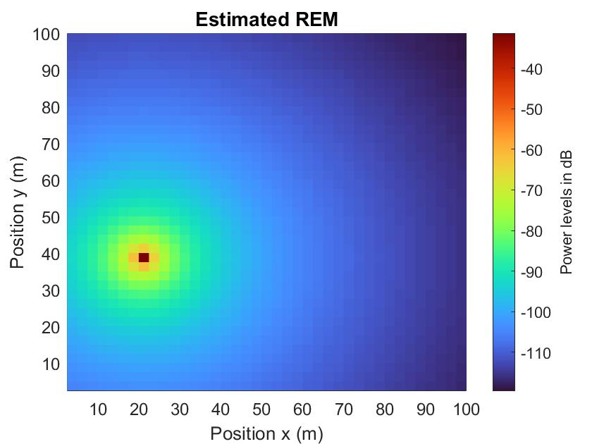
True and estimated power maps
Figure 25: True and estimated REM using the estimated location from MSE method in a grid of size (100 m, 100m).

Slide 35
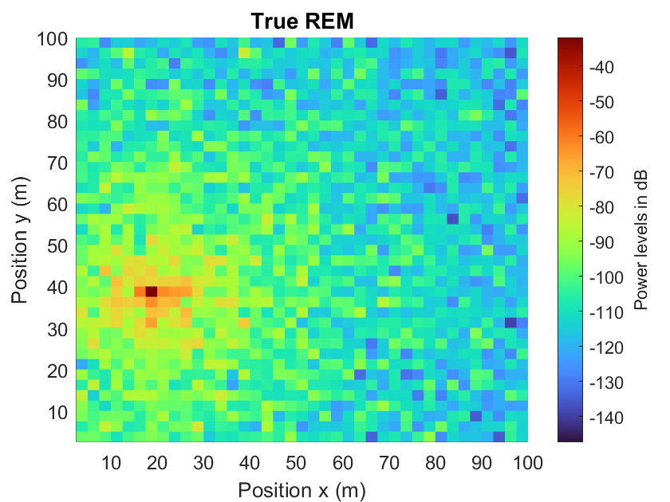
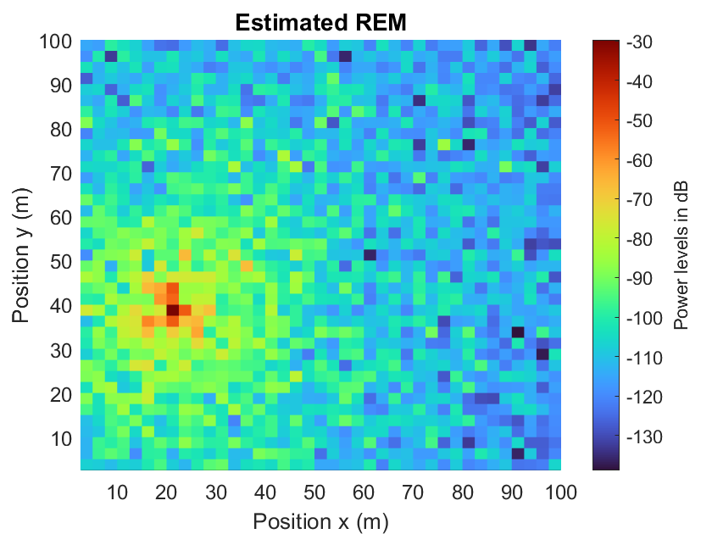
True and estimated power maps
With additive log-normal shadowing
Figure 26: True and estimated REM using the estimated location from MSE method in a grid of size (100 m, 100m).

Slide 36
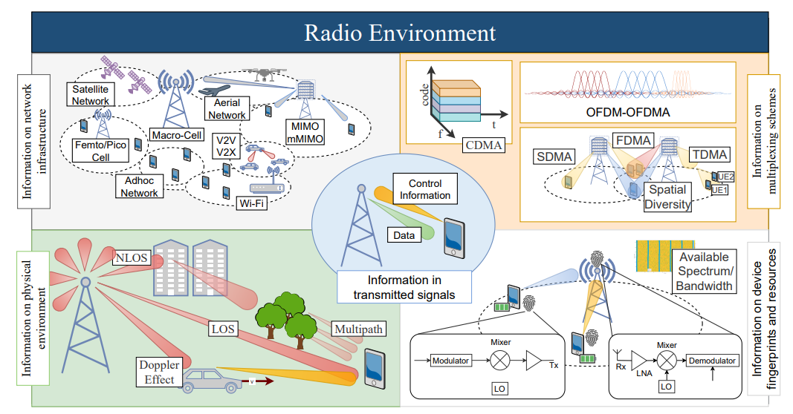
REM applications
Figure 27: REM applications and use cases [8].

Slide 37

Main contributions
Comparing and evaluating the localization accuracy of MSE and LIvE methods.
Assuming OFDM signal as a transmit signal and evaluating performance of MSE method.
Assuming correlated shadowing and evaluating the localization error using varying standard deviation of shadowing.
Constructing estimated and true REM using results of localization from MSE-based method.
REM as a emerging tool for 5G use cases such as ultra low latency, mobility, dynamic changes in channel.

Slide 38
Conclusion
Evaluating MSE and LIvE methods we don’t see much convergence in terms of localization error from 25 sensor nodes while the convergence.
Using OFDM as a transmit signal for localization converges close to true transmitter position after 9 sensor nodes leaving the use of more sensor nodes redundant.
Shadowing correlations between the sensor nodes leads to increase in localization error as the shadowing standard deviation increases which increases correlations between the sensor nodes.
We choose MSE over LIvE method in terms of complexity in solving non-linear constraints and higher simulation run time.
Using results of MSE method for localization we get as close to true REM.

Slide 39
Future Work
Effect of multipath fading, change of sensor placement and channel models to get more out of localization methods.
Finding an algorithm that also suffices mobility of transmitter and accuracy to the resolution of 0.1 m for V2X and autonomous driving cases.
Detailed analysis of OFDM waveform’s performance in terms of localization accuracy varying parameters and channel models.
Mobile scenarios instead of static scenario to evaluate localization and REM construction.

Slide 40
References
Ezzati, Nematollah, Hasan Taheri, and Tuna Tugcu. "Optimised sensor network for transmitter localisation and radio environment mapping." IET Communications 10.16 (2016): 2170-2178. Location estimation-based radio environment map construction in fading channels.
Yilmaz, Huseyin Birkan, and Tuna Tugcu. "Location estimation‐based radio environment map construction in fading channels." Wireless communications and mobile computing 15.3 (2015): 561-570.
Yilmaz, H. Birkan, et al. "Radio environment map as enabler for practical cognitive radio networks." IEEE Communications Magazine 51.12 (2013): 162-169.
Phillips, Caleb, et al. "Practical radio environment mapping with geostatistics." 2012 IEEE International Symposium on Dynamic Spectrum Access Networks. IEEE, 2012.
Reddy, Yeduri Sreenivasa, et al. "Spectrum cartography techniques, challenges, opportunities, and applications: A survey." Pervasive and Mobile Computing 79 (2022): 101511.

Slide 41
References
Reddy, Yeduri Sreenivasa, et al. "Spectrum cartography techniques, challenges, opportunities, and applications: A survey." Pervasive and Mobile Computing 79 (2022): 101511.
De Almeida, Ivo Bizon Franco, et al. "Blind transmitter localization in wireless sensor networks: A deep learning approach." 2021 IEEE 32nd Annual International Symposium on Personal, Indoor and Mobile Radio Communications (PIMRC). IEEE, 2021.
Turkmen, H., Solaija, M. S. J., Furqan, H. M., & Arslan, H. (2020). Generalized Radio Environment Monitoring for Next Generation Wireless Networks. arXiv preprint arXiv:2008.06203.
Kulkarni, K., Franchi, N., & Fettweis, G. (2019, February). Real-time cooperative spectrum sensing: Reliable localization of unknown interferers in shared spectrum. In SCC 2019; 12th International ITG Conference on Systems, Communications and Coding (pp. 1-6). VDE.

Slide 42
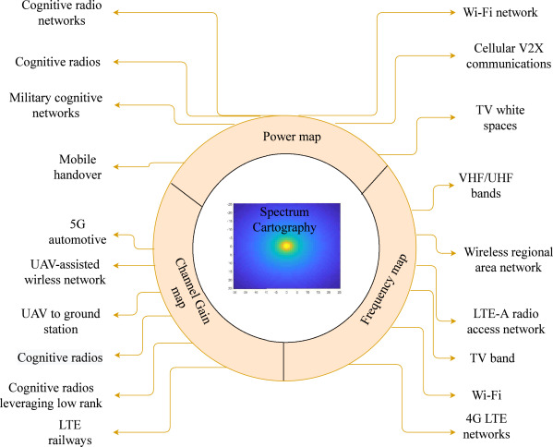
Applications of REM Construction
Figure 3 : REM applications use cases [5]

Slide 43
RSS Based Transmitter Localization Model
The received power levels at the sensor nodes in a network are the input measurements.
The operation network area where we perform Tx localization consists of several important characteristics of radio environment.
The characteristics to model RF area are:
          Propagation channel model (Path Loss model),.
          Positioning of Tx and sensor nodes.
          Frequency of transmission.
          Small Scale or Large Scale fading, static or mobile scenario.
          Number of active Transmitters and Sensors deployed.

Slide 44
System Model
The arrangement of sensor nodes in the previous figure are lying in an operation area where we collect the RSS values.
RSS values depend on the propagation environment, and spatial arrangement of the sensors.
We consider the simplistic path loss model with shadowing for channel analysis.
The network consists of static transceivers as point sources that operate in single channel and frequency in operation.
We consider a single frequency channel to avoid interference [2].

Slide 45
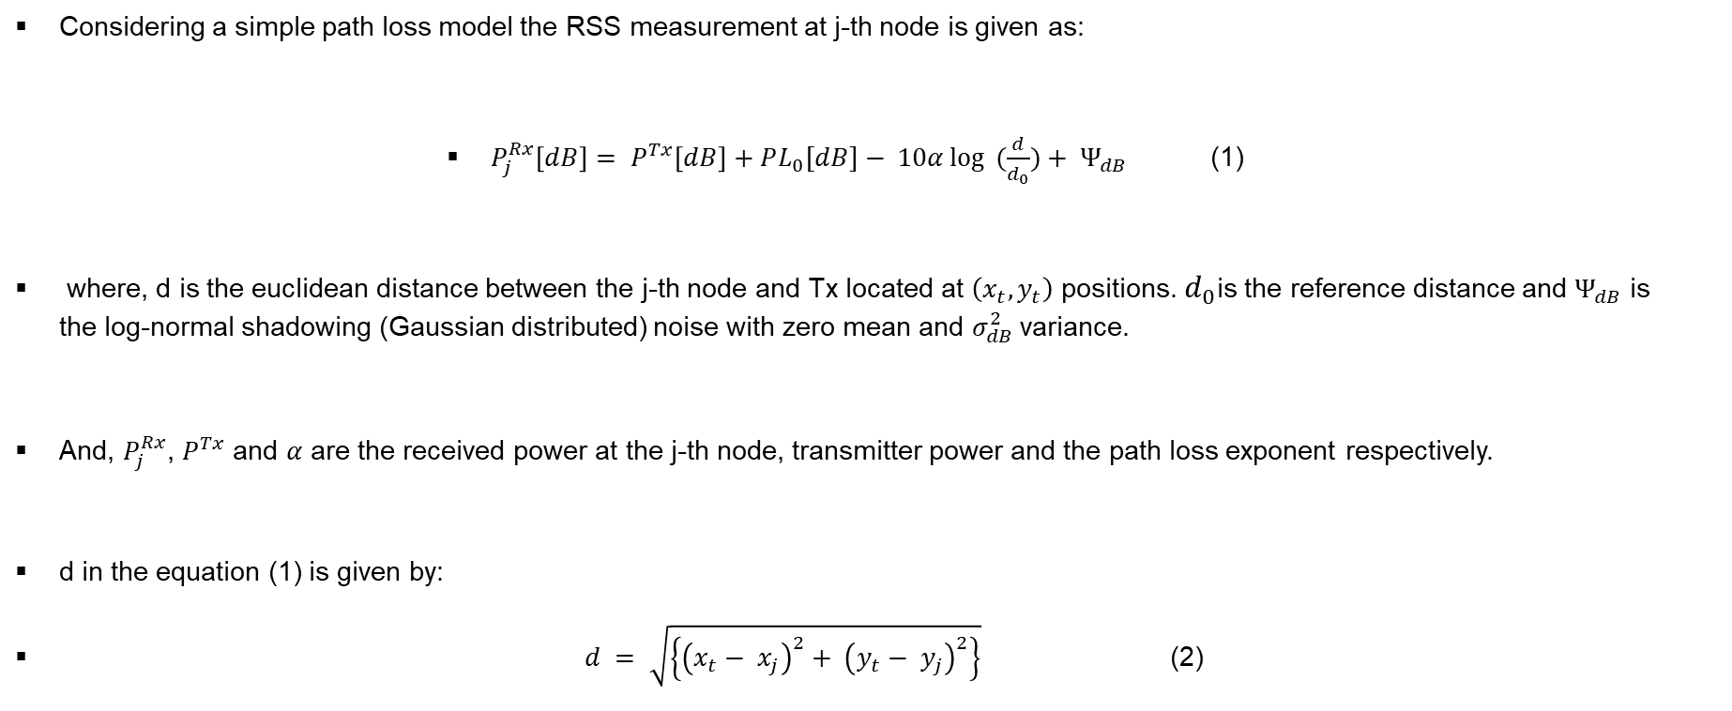
System Model
Considering a simple path loss model the RSS measurement at j-th node is given as:
$P_{j}^{Rx}\left[dB\right]= P^{Tx}\left[dB\right]+PL_{0}[dB]− 10α\log{ (\frac{d}{d_{0}})}+ Ψ_{dB}$ (1)
where, d is the euclidean distance between the j-th node and Tx located at $\left(x_{t},y_{t}\right)$ positions. $d_{0}$is the reference distance and $Ψ_{dB}$ is the log-normal shadowing (Gaussian distributed) noise with zero mean and $σ_{dB}^{2}$variance.
And, $P_{j}^{Rx}$, $P^{Tx}$ and $α$ are the received power at the j-th node, transmitter power and the path loss exponent respectively.
d in the equation (1) is given by:
$d = \sqrt{\left\{{\left(x_{t}− x_{j}\right)}^{2}+ {\left(y_{t}− y_{j}\right)}^{2}\right\}}$ (2)

Slide 46

System Model: Adaptive Iterative and MSE Based Methods
Replacing d and after some manipulations of the received power formulation, we get:
$x_{j}^{2}+ y_{j}^{2}= 2x_{j}x_{t}+ 2 y_{j}y_{t}− x_{t}^{2}− y_{t}^{2}+ {10}^{\frac{\left(P^{Tx}− P_{j}^{Rx}\right)}{5α}}$ (3)
The linear regression equation is given as:
$Aθ=b$ (4)
The input parameter matrix (A), squared sensor coordinates vector b and parameter consisting Tx positions and Tx power is vector $θ$.
4 sensors measurements are used to perform localization.

Slide 47

System Model: Adaptive Iterative and MSE Based Methods
The equation to calculate the unknown Tx positions for Adaptive Iterative in the parameter $θ$is given by:
$θ_{i+1}=θ_{i}+μA^{T}e_{i}$ (6)
Where $μ$ is the step size.
$e_{i} = b_{i} − A_{i}θ_{i}$ is the instantaneous error.
The solution to estimate the Tx positions using MSE based method is given by:
${ θ}_{opt}= \left(\frac{∑A_{i}^{T}b_{i}}{∑A_{i}^{T}A_{i}}\right)$ (7)

Slide 48

System Model: LIvE Method
  The optimal solution for LIvE is given as:
  $\hat{θ}= argmin\left\|Aθ−b\right\|$
  ${ r}^{T}θ+θ^{T}Pθ=0$ (8)
The constrained optimization problem is solved using the dual Lagrange problem:
$L(θ,λ) = {(A θ−b)}^{T} (A θ−b) + λ(r^{T}θ+ θ^{T}Pθ)$ (9)

Slide 49
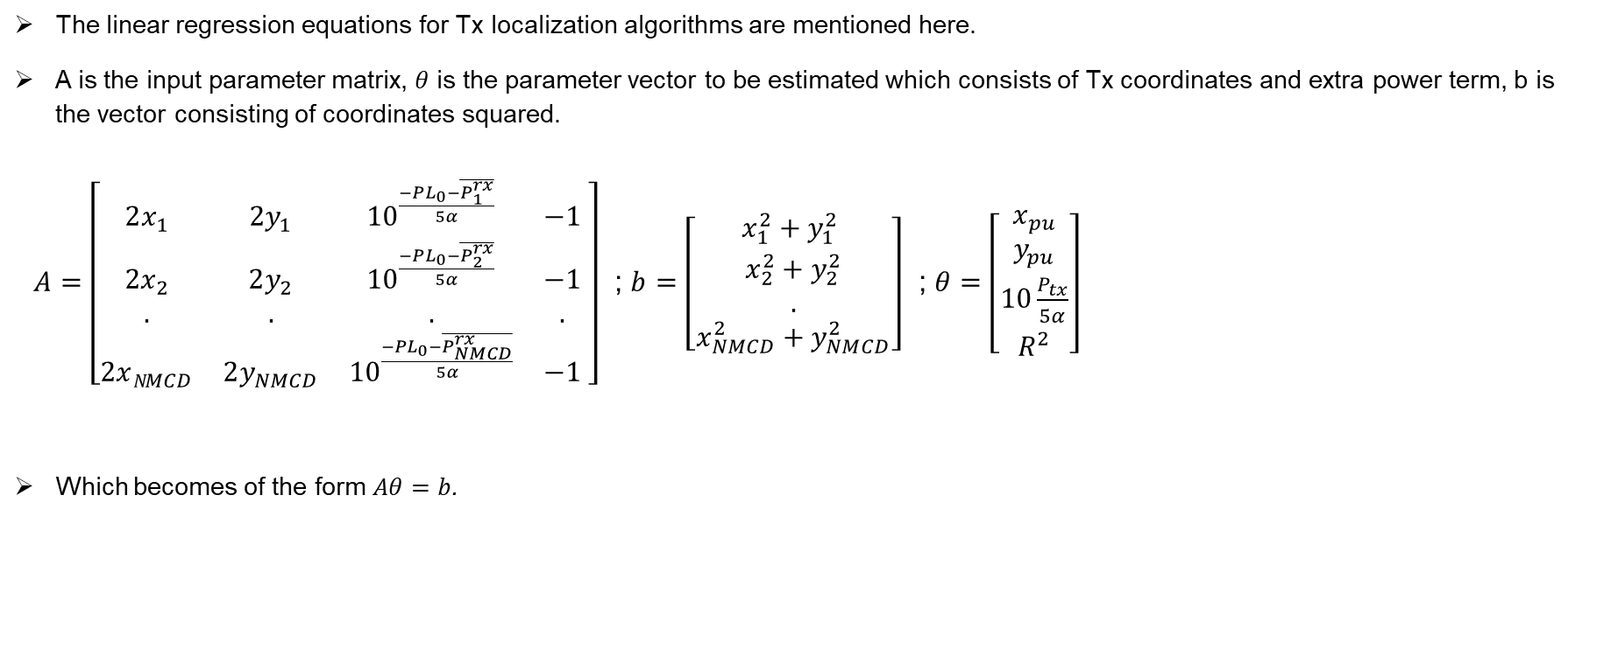
Appendix 1
The linear regression equations for Tx localization algorithms are mentioned here.
A is the input parameter matrix, $θ$ is the parameter vector to be estimated which consists of Tx coordinates and extra power term, b is the vector consisting of coordinates squared.
$A=\left[\begin{matrix}2x_{1} & 2y_{1} & {10}^{\frac{−PL_{0}−\overline{P_{1}^{rx}}}{5α}} & −1 \\ 2x_{2} & 2y_{2} & {10}^{\frac{−PL_{0}−\overline{P_{2}^{rx}}}{5α}} & −1 \\ . & . & . & . \\ 2xN_{MCD} & 2y_{NMCD} & {10}^{\frac{−PL_{0}−\overline{P_{NMCD}^{rx}}}{5α}} & −1\end{matrix} \right]$ ; $b$ $=\left[\begin{matrix}x_{1}^{2}+y_{1}^{2} \\ x_{2}^{2}+y_{2}^{2} \\ . \\ x_{NMCD}^{2}+y_{NMCD}^{2}\end{matrix}\right]$ ; $θ=\left[\begin{matrix}x_{pu} \\ y_{pu} \\ 10\frac{P_{tx}}{5α} \\ R^{2}\end{matrix}\right]$
Which becomes of the form $Aθ=b$.

Slide 50
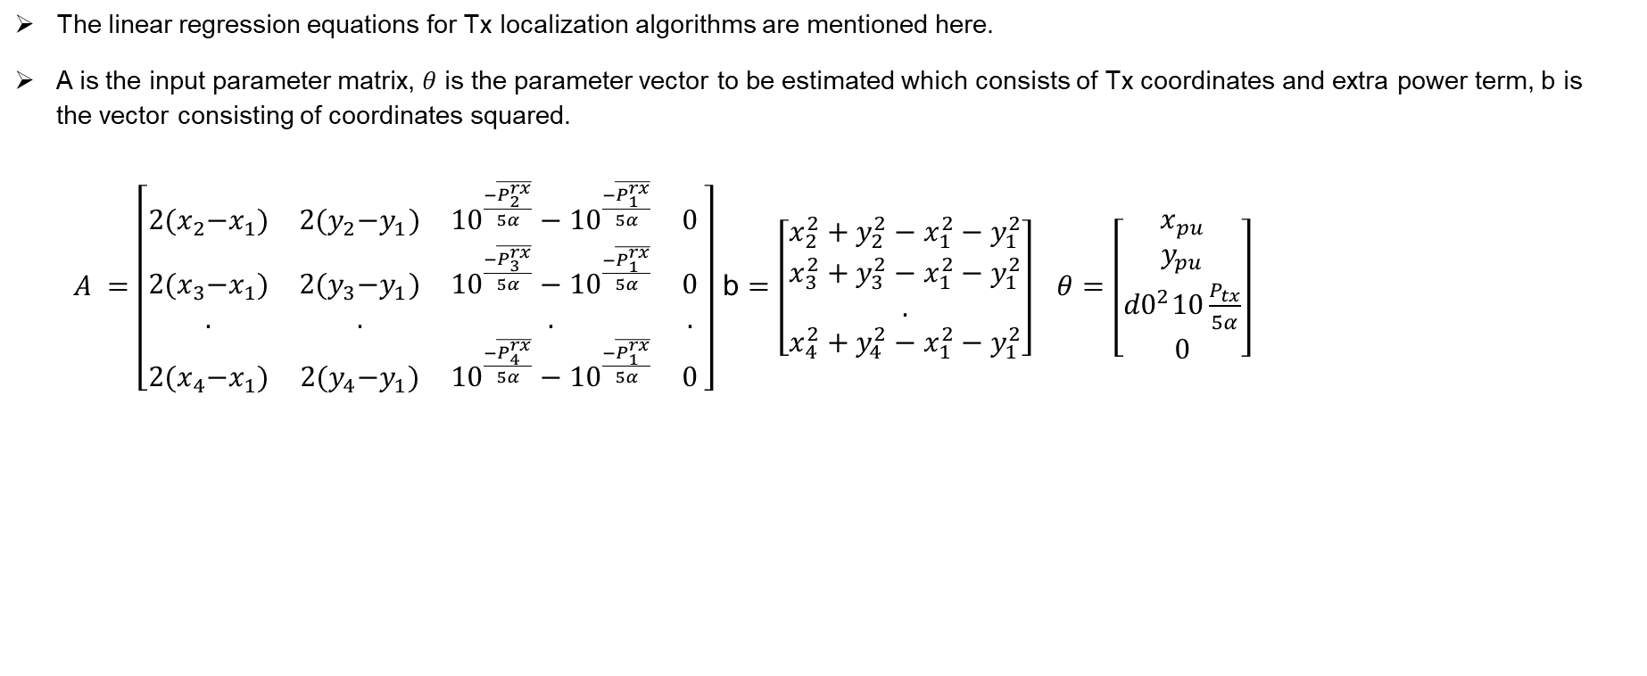
Appendix 2
The linear regression equations for Tx localization algorithms are mentioned here.
A is the input parameter matrix, $θ$ is the parameter vector to be estimated which consists of Tx coordinates and extra power term, b is the vector consisting of coordinates squared.
$A =\left[\begin{matrix}2{(x}_{2}−x_{1}) & 2{(y}_{2}−y_{1}) & {10}^{\frac{−\overline{P_{2}^{rx}}}{5α}}−{10}^{\frac{−\overline{P_{1}^{rx}}}{5α}} & 0 \\ 2{(x}_{3}−x_{1}) & 2{(y}_{3}−y_{1}) & {10}^{\frac{−\overline{P_{3}^{rx}}}{5α}}−{10}^{\frac{−\overline{P_{1}^{rx}}}{5α}} & 0 \\ . & . & . & . \\ 2{(x}_{4}−x_{1}) & 2{(y}_{4}−y_{1}) & {10}^{\frac{−\overline{P_{4}^{rx}}}{5α}}−{10}^{\frac{−\overline{P_{1}^{rx}}}{5α}} & 0\end{matrix} \right]$ b $=\left[\begin{matrix}x_{2}^{2}+y_{2}^{2}−x_{1}^{2}−y_{1}^{2} \\ x_{3}^{2}+y_{3}^{2}−x_{1}^{2}−y_{1}^{2} \\ . \\ x_{4}^{2}+y_{4}^{2}−x_{1}^{2}−y_{1}^{2}\end{matrix}\right] θ=\left[\begin{matrix}x_{pu} \\ y_{pu} \\ {d0}^{2}10\frac{P_{tx}}{5α} \\ 0\end{matrix}\right]$

