Slide 1

Understanding and Implementing Big Data Concepts using Stack Overflow Data
Yashwanth Reddy
Aakarsh Nadella
Manjusha Kottala
Adithya Morampudi

Slide 2
Project Overview
Purpose of the project is to understand and implement big data techniques learnt in this coursework, considering large data
To be able to deal with large dataset and to handle and organize a dataset efficiently so that it is easy for querying, extracting and understanding the insights of the data present.
Dataset used: Stackoverflow data

Slide 3
Dataset Overview
Dataset is collected from Stack Exchange Internet Archive
Data dump is in XML format and contains 8 files in total – Posts, PostLinks, Badges, Comments, Tags, Users, PostHistory, Votes
Total size of the dump is around 75 Gb
This dataset contains information for the past 10 years
Most part of the data gives insight about the posts posted by different users and it also gives a good insight about the comments posted by different users.
Attributes from Posts file
Id, Post Type Id(question or answer), Parent Id(only present if the post is an answer), Accepted answer Id(present if the post type is a question), Creation Date, Score, ViewCount, Body, Owner UserId, Tags, Title, Answer Count, Comment Count, Favourite count, Last Activity Date, Last Editor date

Slide 4
Approach
How are we approaching to clean and use the dataset?
We are writing a data parser using PySpark to covert the XML data into more structured form(CSV)
As there are many attributes in each file, we will use data preprocessing techniques such as dimensionality reduction to improve efficiency
Data cleaning by removing incomplete and inappropriate content
Data organization and Storage – using Aspen, AWS
Tools/techniques used for managing and accessing
Apache Spark
Apache Pig
Visualization – using Tableau

Slide 5
Approach- Analysis
Tags file
Which tags have seen an increment in the questions over the past 10 years
Which tags are are decreasing over years
Which tags are getting better scores
Correlation of scores to tags
Speed at which questions are answered
Comments file
Finding the Top ten users who have posted maximum no of comments
Top ten comments with highest scores
Comments which were posted long back and still active

Slide 6
Approach- Analysis(contd)
Posts file
Top Questions posted in each category or tag
Questions that have maximum number of answers
Questions with no answers or not at all addressed
Posts with top 10 maximum scores/positive response
Time taken for a post to be answered
Users File
Top most active users in stack overflow
Number of Dead accounts
Users who are capable of solving questions of particular type
Number of new accounts created from time to time
Users who are in the top ten Reputation list

Slide 7
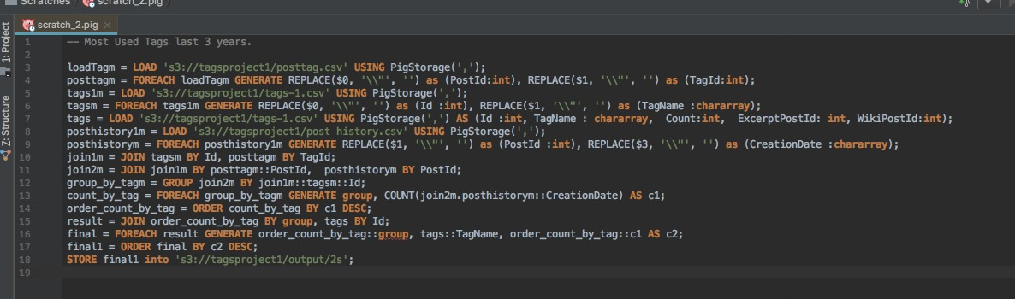
Sample Pig Script

Slide 8
Demo/Visualization
https://youtu.be/f5HeWgNMlzU
https://cs.iupui.edu/~mkottala/BigdataAnalysis.html

Slide 9
Challenges
Handling such huge data is a big challenge
Stuck with Java heap space error/Garbage collector error
To get a proper result, each query takes at least 2 hours on Posts data
Joining of multiple data files

Slide 10
Role
Total of 8 xml data dumps *
Data Preprocessing – Data Cleaning, Sampling*
XML Parser – to CSV
Querying using Spark and Pig*
Visualization
Report *
* Each team member has contributed equally for this task

