Slide 1

LIGHTNING SESSION ON Basics of LLM and getting to know Llama2
Meet Turakhia
Craig Albuquerque
Aakarsh Surendra

Slide 2
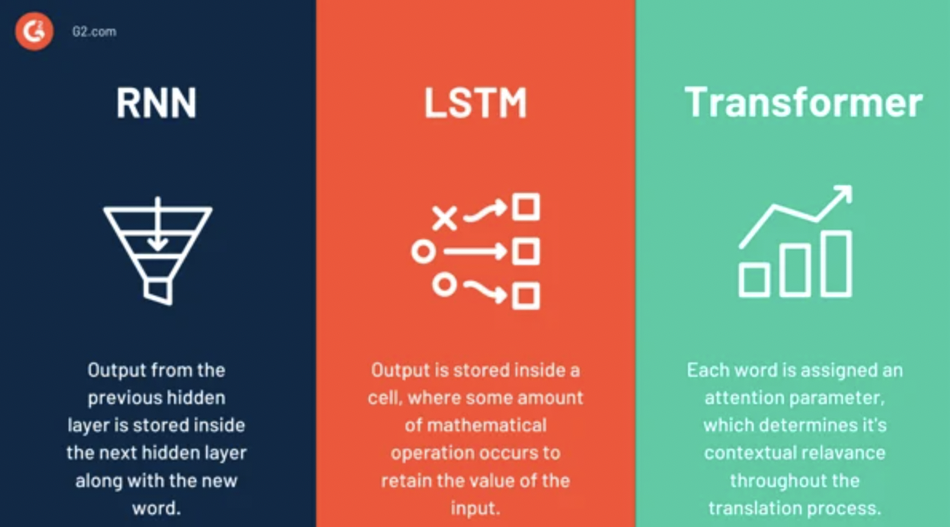
RNN vs. LSTM vs. Transformer
Image source : https://www.g2.com/articles/transformer-models

Slide 3
Transformers in use
In 2017, a team at Google Brain introduced an advanced artificial intelligence (AI) deep learning model called the Transformer
Google uses BERT to enhance its search engine by better understanding users’ search queries
GPT family of models from OpenAI generate human-like text and images

Slide 4
What are Large language models?
LLMs are AI models that are derived from Transformer architecture
Designed to understand and generate human language, code, and much more
Language modeling is a subfield of NLP that involves the creation of statistical/deep learning models for predicting a sequence of tokens in specified vocabulary
A token is the smallest unit of semantic meaning, created by breaking down a sentence or a piece of text into smaller units – it is an essential input for an LLM.

Slide 5
Token comparison
LLM | PARAMETERS
GPT-1 | 110 Million
GPT-2 | 1.5 Billion
GPT-3 | 175 Billion
GPT-4 | 1.76 Trillion
BERT-LARGE | 340 Million
T5 | 11 Billion
RoBERTa-LARGE | 355 Million
ELECTRA-LARGE | 335 Million

Slide 6
Key characteristics of LLMs
The transformer model is a sequence-to-sequence model
It has 2 components – Encoder, Decoder
Encoder is tasked with taking in raw text, splitting it up into its core components, converting those components into vectors, and using attention to understand the context of the text.
Decoder – which excels at generating text by using a modified type of attention to predict the next best token

Slide 7
LLMs categories
Autoregressive models – such as GPT, predict the next token in the sentence based on previous tokens.
Autoencoding models – such as BERT, a bidirectional representation of sentence by masking some of the input tokens and predicting from the remaining ones
Combinations of both autoregressive and autoencoding, such as T5, can use the encoder and decoder to be more versatile and flexible in generating text.

Slide 8
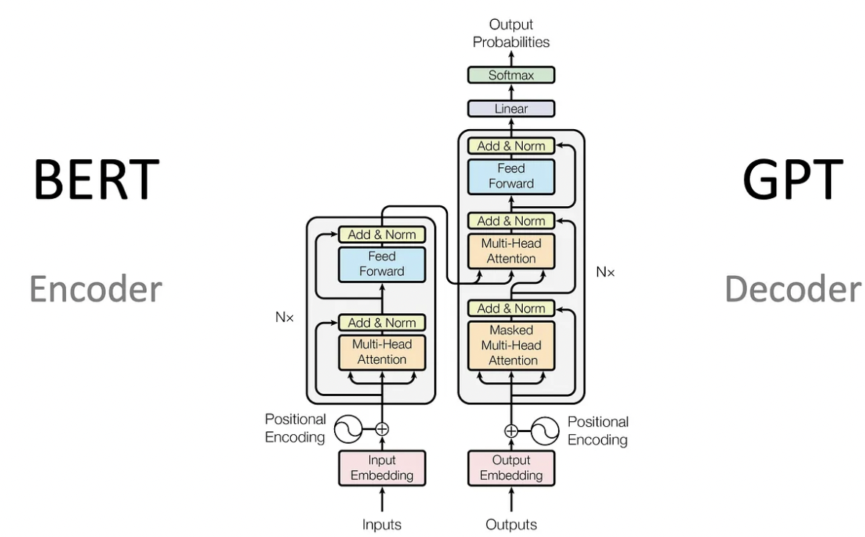
Encoder vs. Decoder

Slide 9
Attention
The title of the original paper that introduced transformer is “Attention is All You Need.”
Attention is a mechanism used in deep learning models (not just transformers) that assigns different weights to different parts of the input
It allows the model to prioritize and emphasize the most critical information while performing tasks like translation or summarization.

Slide 10
Reinforcement learning from human feedback (RLHF)
Alignment in language models refers to how well the model can respond to input prompts that match the user’s expectations
RLHF is one popular method of aligning pre-training LLMs that uses Human Feedback to enhance their performance
It allows LLM to learn from relatively small, high-quality batches of human feedback on its outputs
Reinforcement Learning is sometimes painful, due to its unstable procedures, a technique to save this painful moment is DPO (Direct Preference Optimization)

Slide 11
Langchain
Langchain is a framework for developing applications powered by language models.
It enables developers to create applications that can understand and respond to natural language, generate creative formats, and translate languages.
Key features of Langchain:
Modular: Developers can add key features and capabilities to their applications
Extensible: Developers can integrate with other tools and frameworks
Open source
Use cases: Document analysis and summarization, chatbots, code analysis, creative writing

Slide 12

hallucination
Hallucination refers to the model generating texts that are incorrect, nonsensical, and not actual.
Hallucinations can occur due to various factors, including:
Limited Training Data
Pattern Recognition and extrapolation
Overfitting
Detection: Put Humans in Loop – looping human judges into the evaluation process to manually identify hallucinations
Efforts to mitigate: Improved training data, Fact-Checking Algorithms, User Awareness, Effective Prompt Enginnering

Slide 13

Prompt Engineering
Involved in crafting inputs to LLMs that effectively communicate the task at hand to the LLM, leading to the return of accurate and useful outputs
It is a skill that involves understanding nuances of language, specific domains being worked on, and capabilities and limitations of LLM being used.
System Prompts- special instructions that are provided to LLM to control its behavior and inform it about the context of a conversation

Slide 14
Prompt Engineering
Feature | Zero-shot learning | Few-shot learning
Number of labeled examples for new task or class | 0 | Few
Reliance on additional information | Yes | Yes, but to a lesser extent
Generalizability | Limited | More generalizable
Effectiveness | Less effective | More effective
In-Context Learning – Zero-Shot and Few Shot
Zero-Shot – The most extreme form of low-data learning, where the model is not provided with any labeled examples of new task/class
Few-Shot – Provides the model with a small number of examples, it allows the model to learn specific characteristics of new task

Slide 15
POPULAR MODERN LLMs
BERT – Bidirectional Encoder Representation from Transformer
Developed by Google
Uses attention to build a bidirectional representation of a sentence
Uses the encoder of the Transformer and ignores the decoder to become exceedingly good at processing/understanding massive amounts of text very quickly
Widely used and highly regarded LLM in the NLP community

Slide 16
POPULAR MODERN LLMs
GPT-3 and ChatGPT – Unlike BERT, it is an autoregressive model that uses attention to predict the next token in a sequence based on the previous token.
GPT family of algorithms (ChatGPT) is primarily used for text generation and has been known for its ability to generate natural-sounding, human-like text
It relies on the decoder portion of the transformer

Slide 17
POPULAR MODERN LLMs
T5 (Text-to-Text Transfer Transformer)– It is a pure encoder/decoder Transformer model that was designed to perform NLP tasks
Highly versatile in both processing and generating text
No fine-tuning is required
Ideal for applications that require both the ability to process and understand text and generate text freely.

Slide 18
POPULAR MODERN LLMs
Llama and Llama2 (Large Language Model Meta AI)– Developed by Meta AI and Microsoft
Modular, Extensive and Open-Source
Llama was introduced in 2022 with 540 Billion parameters
Llama2 was introduced in 2023 with 3 different options of parameters: 137 Billion, 340 Billion, and 70 Billion
Both Llama and Llama2 have dataset of 1.56 TB
Code generation and summarization are additional features of Llama2

Slide 19
Replicate API
Replicate.com provides an easy, fast way for anyone to run generative AI models in the cloud
Thousands of models are ready to use
It lets users use machine learning models in a standard, production-ready container and makes it easy to deploy machine learning models at scale.
Prerequisite: Github account

Slide 20

Let’s build a LLM model

Slide 21
References
https://arxiv.org/abs/2305.18290

