Slide 1
PROBLEM 25 · SECURITY OPERATIONS
3,000 alerts.
One analyst.
Utopia SOC
Transparent grouping. Human decisions. Measured coverage.
Imagine Utopia · Team 239 · Microsoft Innovate 2026
01

Slide 2
PROBLEM & USERS
The analyst needs an investigation,
not another wall of signals.
CONNECT
PRIORITIZE
VERIFY
Bring entity and time evidence together across identity, endpoint, and network alerts.
Expose asset context, behavior progression, and each risk component.
Measure how many attack episodes become visible for a given review budget.
A research prototype; no claim that triage alone prevents a breach.
02

Slide 3
SOLUTION & ARCHITECTURE
Security decisions stay deterministic.
Validate → deduplicate → correlate → ATT&CK map → classify → score → rank
Every source alert is retained. Every accepted link has a reason.
Simulation truth → evaluation only. No labels in engine inputs.
Facts packet → verified template / optional model brief.
Analyst decision → versioned state + SHA-256 audit chain.
One shared TypeScript engine · React · local SQLite / hosted D1 · FastAPI adapter
03

Slide 4
CONTROLLED SIMULATION
Raw events → detectors → validated alerts.
FICTIONAL ENTERPRISE
FOUR ATTACK FAMILIES
DIFFICULTY CONTROLS
120 hosts · 160 users · 72-hour alert batch. Causal state prerequisites and seeded raw events.
Phishing / exfiltration · identity compromise · ransomware · command and control.
Sensor dropout · duplicates · missing entities · shared hubs · concurrency · timing and severity noise.
Controlled ATT&CK v17.1 mappings, validated against the official STIX bundle.
04

Slide 5
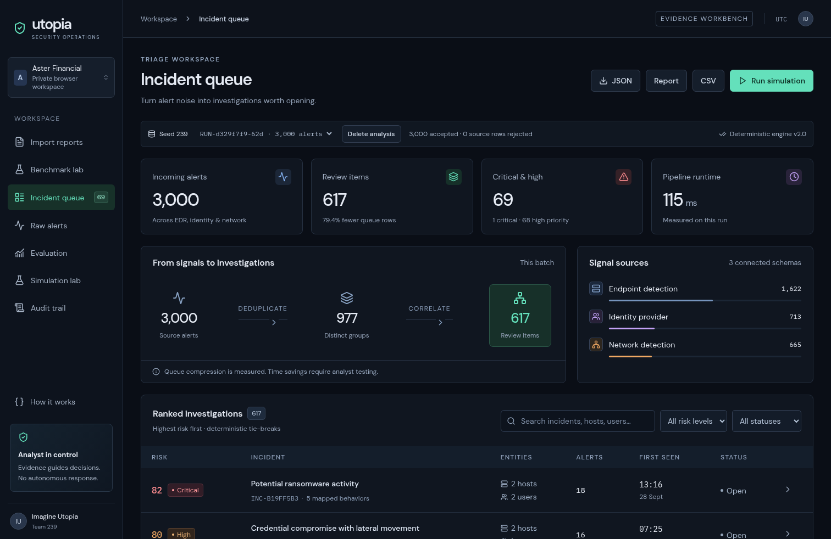
WORKING ANALYST INTERFACE
A queue that opens into evidence.
Live workflow: ranked queue → source timeline → graph reasons → score → human disposition
05

Slide 6
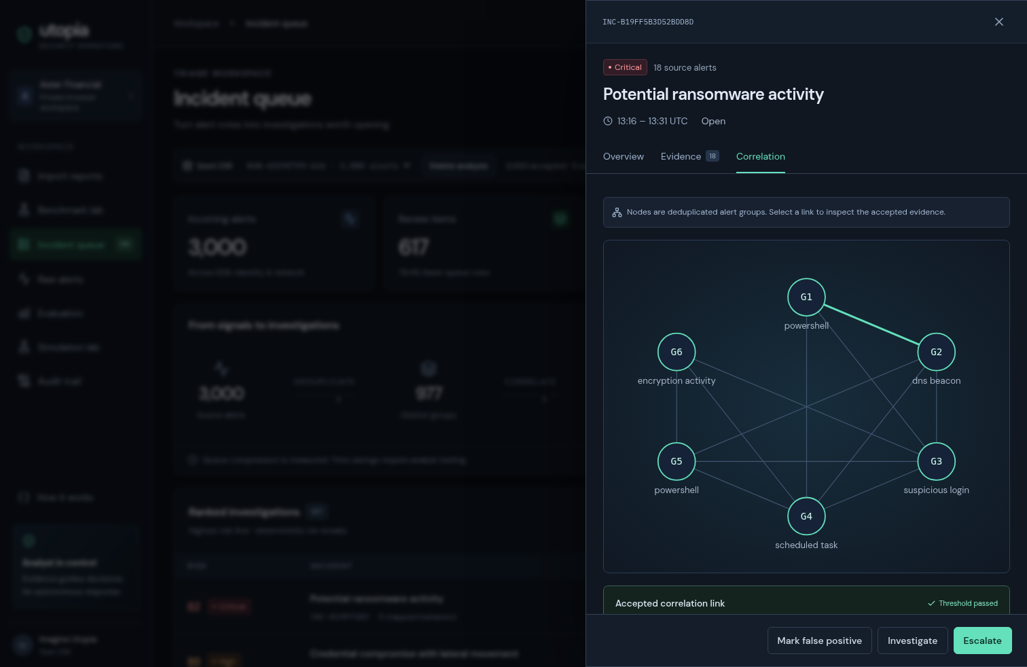
EXPLAINABILITY & HUMAN CONTROL
Open the relationship. Inspect the reason.
Link contributions, original alert IDs, controlled ATT&CK mappings, and reasoned decisions.
06

Slide 7
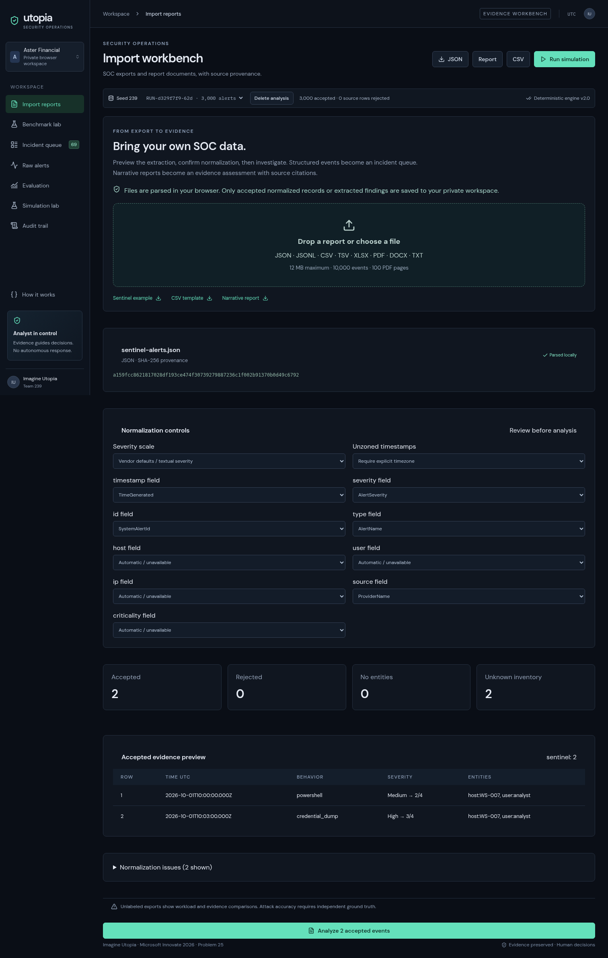
SOC IMPORT WORKBENCH
Bring reports. Keep the evidence.
Browser-only parsing · structured event triage / cited narrative assessment · explicit rejection and severity controls
07

Slide 8
FAIR EVALUATION
Same inputs. Same labels. Same metric code.
B0 Severity only — one alert per review item
B1 Host / 30-minute buckets
B2 Exact typed-entity sets / time buckets
B3 Contextual per-alert ranking
UT Contextual entity graph + deterministic score
Episode surfaced = at least one of its alerts in an opened item.
Pairwise grouping quality separately measures reconstruction.
Educational baseline implementations. No vendor product benchmark.
08

Slide 9
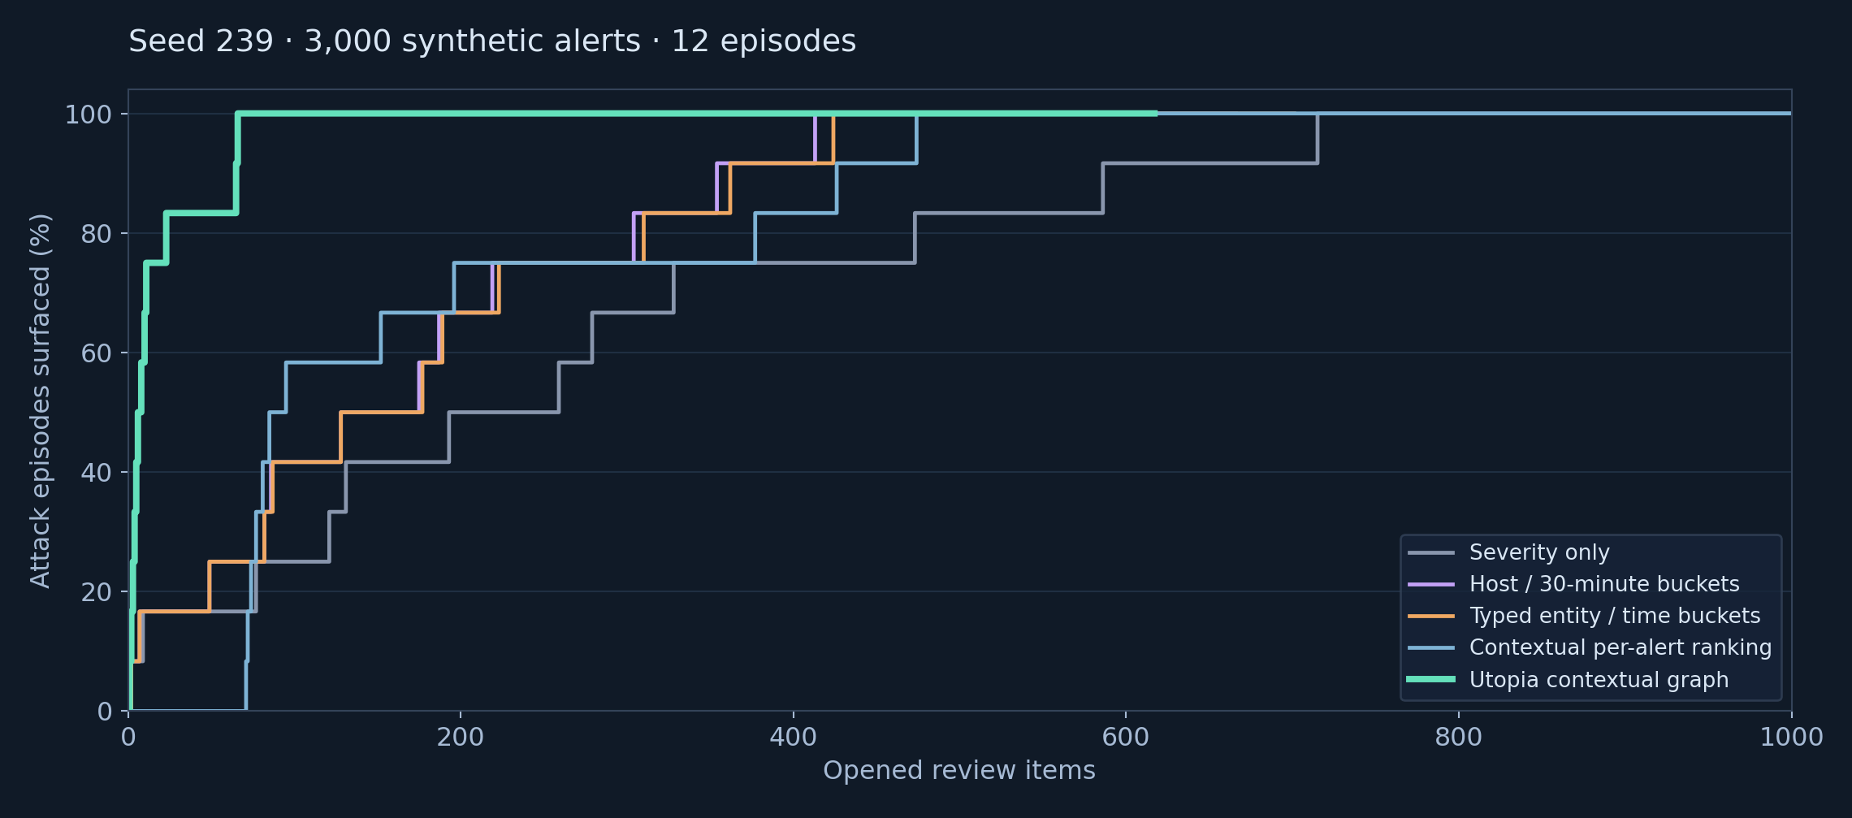
MEASURED DEMO · SEED 239
3,000 alerts → 617 review items.
Full episode coverage: Utopia 66 opened items; severity-only 715. Synthetic only; not analyst-time savings.
09

Slide 10
HELD-OUT EVIDENCE
Twenty held-out seeds at each scale.
80.0% RECALL @25
54.9 ITEMS TO FULL COVERAGE
25.6% GROUPING F1
Utopia mean across held-out 3,000-alert runs. B0 mean: 17%.
Utopia mean. Severity-only: 589.8 items. Total Utopia queue: 624.8.
Mean benign contamination: 3.7%. Surfacing is not full reconstruction.
60 holdouts · 40 stress runs · 80 ablations · paired bootstrap intervals · no test-seed tuning
10

Slide 11
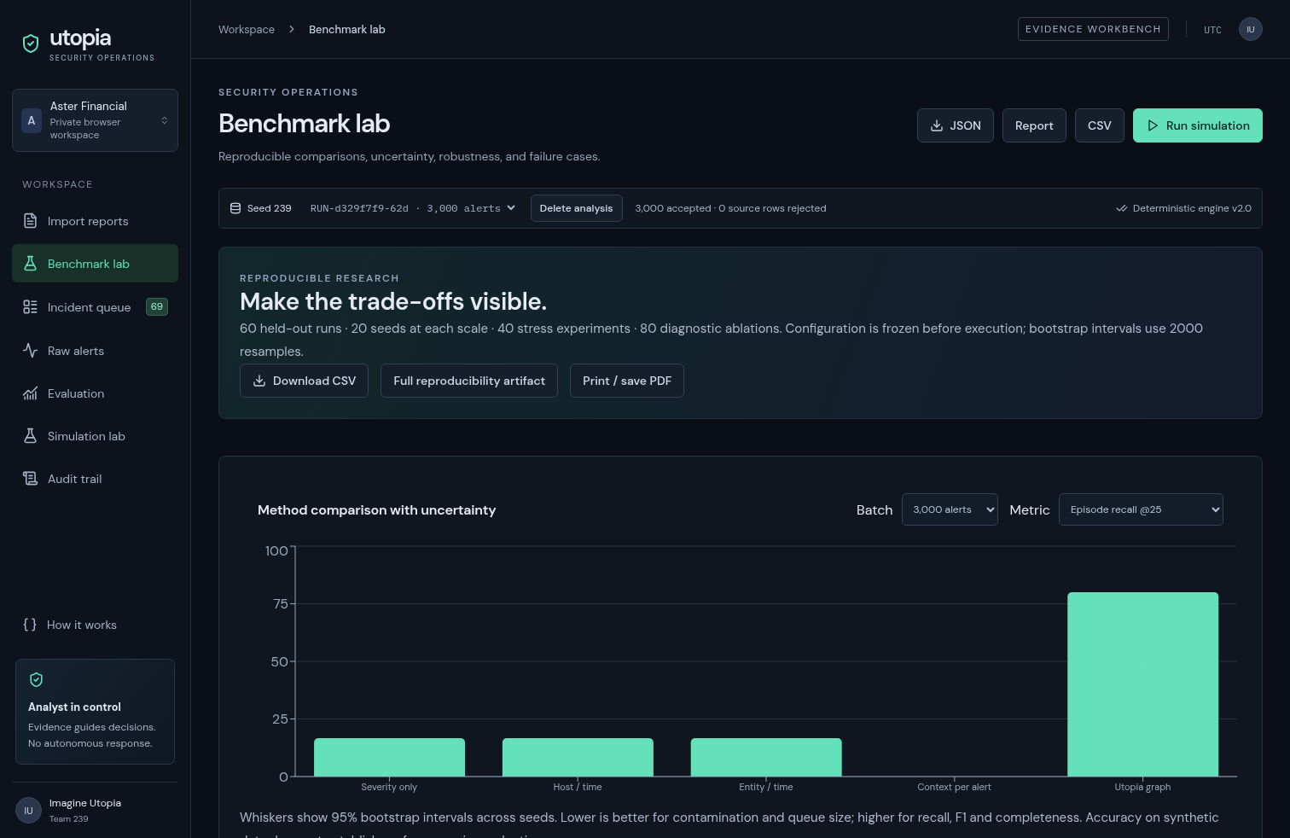
RESEARCH EXPLORER
Show uncertainty, not just a winning seed.
Paired comparisons · seed distributions · stress conditions · ablations · temporal replay misses
11

Slide 12
OBSERVED FAILURE CASE
Long gaps fragment the chain.
80-MINUTE STEP GAPS
16.7% RECALL @25
NEXT EXPERIMENT
Seed 801, 3,000 alerts. Frozen entity windows no longer connect many stages.
Pairwise recall: 17.8%. Full coverage takes 267 items.
Measure wider windows, contamination, and segmentation on separate tuning data; never hide the trade-off.
This is an actual measured stress result, not a hypothetical caveat.
12

Slide 13
IMPLEMENTATION & LIMITS
Complete workflow. Honest boundaries.
Implemented: simulation, ingest, correlation, evidence, scoring, dashboard, decisions, audit, baselines, benchmarks.
Live brief: deterministic template; optional model adapter is in source.
AIT-ADS check: checksum verified; 3,000 Wazuh records accepted / 400 AMiner rejected. No gold attack accuracy inferred.
Audit: trusted-head tamper evidence; no external anchoring.
No autonomous response, compliance guarantee, or production accuracy claim.
Tests cover reproducibility, label rejection, preservation, concurrency, owner isolation, and tampering.
13

Slide 14
CONTRIBUTION & NEXT STEP
Make the trade-off visible.
Can transparent grouping surface attack episodes with fewer opened review items?
Synthetic evidence: improved episode visibility, with declining recall and modest grouping F1 as scale increases.
Next: independently labeled external data, a real analyst study, and measured review effort.
Imagine Utopia · Team 239 · Source, benchmark artifacts, and demo supplied
14

