Slide 1
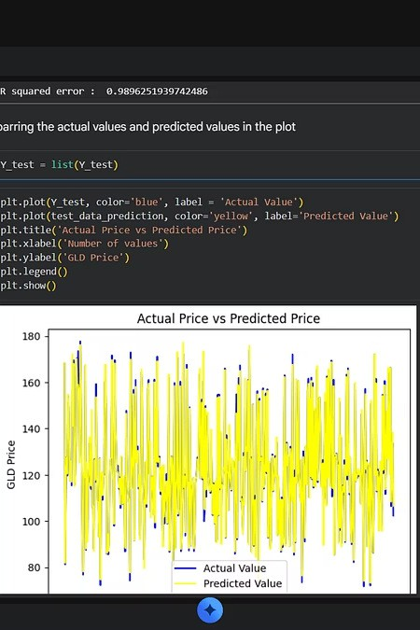

Gold Price Prediction Using Machine Learning
Aakash Kumar Singh | B.Tech CSE AIML
Shri Shankaracharya Technical Campus

Slide 2
Project Overview & Problem Statement
The Challenge
Gold prices fluctuate due to many economic factors. Manual prediction is difficult, and investors require data-driven predictions to make informed decisions.
Real-World Use
Investment strategy & risk management
ML Approach
Regression on structured financial data
Our Objective
Predict future gold prices using historical data Apply Machine Learning for regression analysis Evaluate prediction accuracy

Slide 3


Objectives, Dataset & Technologies
Project Objectives
01
Collect Data
Historical gold price dataset
02
Preprocess
Clean and prepare features
03
Analyze
Explore feature relationships
04
Train & Predict
Build ML model, evaluate accuracy
Dataset & Tools
Source: Kaggle | Target: Gold Price (GLD) No missing values. Data cleaning performed.
Python & Colab
Core environment
Pandas & NumPy
Data manipulation
Matplotlib & Seaborn
Visualization
Scikit-learn
Machine Learning

Slide 4

Project Workflow
Dataset
Cleaning
EDA
Features
Train/Test
A structured pipeline from raw data to evaluated predictions ensures reliable model performance.

Slide 5
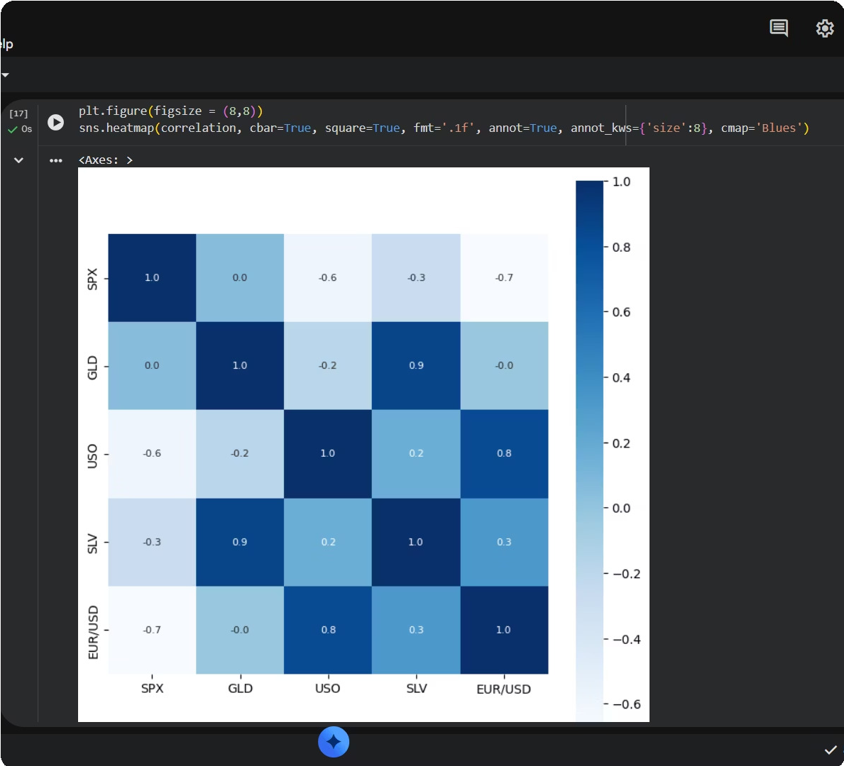
Exploratory Data Analysis
Key Insights
Feature Correlations
Strong positive correlation between GLD and silver (SLV)
Data Distribution
Distribution plots reveal skewness in price features
Trends
Identified temporal trends across economic indicators

Slide 6
Data Visualization
Heatmaps and distribution graphs generated directly from Google Colab reveal feature relationships and data spread.

Slide 7
Machine Learning Model
Random Forest Regressor
Handles non-linear relationships High prediction accuracy
Less overfitting vs. single decision tree Works well on structured datasets
X_train, X_test, Y_train, Y_test = train_test_split(X, Y, test_size=0.2, random_state=2)
Training Results
Train-Test Split: 80:20
0.989
R² Score
Excellent model fit
The model achieved an R² score of 0.9896, demonstrating exceptional predictive performance on test data.

Slide 8
Prediction & Advantages
Fast Prediction
Real-time price estimation
Data-Driven
Removes human bias
Investor Support
Informed decision making
Scalable
Updatable with new data

Slide 9

Limitations & Future Scope
Current Limitations
Future Enhancements
2
Depends on historical data patterns
Cannot predict unexpected global events
1
Deep Learning
LSTM models for time-series
Real-Time API
Live gold price integration
Market volatility affects accuracy
Limited feature set
3
Deployment
Web & mobile applications

Slide 10
Conclusion
Successfully built a gold price prediction model achieving an R² score of 0.9896, demonstrating the power of Machine Learning in financial forecasting.
Thank You
Questions? | Contact: +91-7223008945

