Slide 1
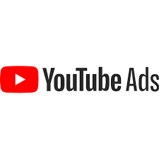

AdOpt: Optimised Fit for YouTube Ads
Aakash Mahindreker (1002027304)

Slide 2
Index
1. Introduction
2. Benefits
3. AdOpt Design
4. AdOpt Performance
5. Limitations
6. Requirements
7. Conclusion
8. References

Slide 3
Introduction
AdOpt is a YouTube Advertisement Optimizer which uses sentiment analysis, cohesion values and coherence values to generate the video links for a given advertisement category.
The generated video links are the best spaces to post advertisements to reach the right audience.
Advertisers can post text ads through comments of the generated video ids either manually or by developing a software.
Alternative ways include posting video ads for non-premium users through third party applications like Google Ad Manager or Adsense.

Slide 4
Benefits
Improves the performance of advertisements.
Time Efficient:
  More customers in less time.
  More business.
  More profit.
Cost Efficient:
  Avoids advertisers from overspending, ensuring the best value.

Slide 5
AdOpt Design
Step 1: Search in YouTube based on query, using YouTube Data API.
Step 2: Gather video ids from search results.
Step 3: Get the title, description and comments with replies having certain number of likes.
Step 4: Compare the title + description vs comments and their replies.
Step 5: Calculate coherence score, cohesion score, overall sentiment of comments with certain amount of confidence value.
Step 6: It will structure all the details of specific videos in a data frame for the user to take decision.

Slide 6
AdOpt Design
Query
Input
YouTube Data API
YouTube
Number of Videos
AdOpt Model
Minimum likes on comments and replies
Sentiment Intensity Analyzer
Results
Cohesion and Coherence Calculator
Output Data Gathering

Slide 7
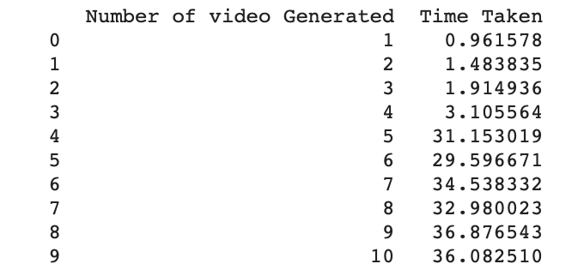
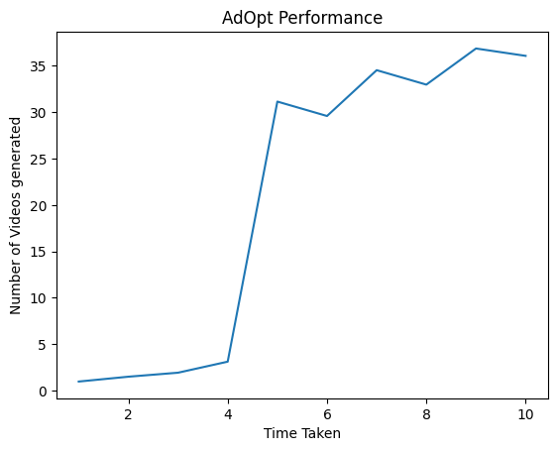
Adopt Performance
The time taken to generated the videos depend on the length of the description, the comments used for sentiment analysis, and number of videos to be generated.
  Example:
    Query: Artificial Intelligence, Number of videos: 1 to 10 , Minimum likes on comments: 100

Slide 8
Limitations
AdOpt is developed only for generating the best fit of an advertisement on YouTube.
The connection times out when any one of the resulting video has its comments disabled or the number of videos to be generated is greater than retrieved videos through YouTube API i.e., if the video is deleted when AdOpt is running.
Time taken to generate the list of videos depends on the minimum number of likes specified, length of the video description and number of videos to be generated.
Viewers of advertisements are the non-subscribers of YouTube.
YouTube API allows 10,000 units (costs) per day, although enough for a project but not scalable.
For cost details visit: https://developers.google.com/youtube/v3/determine_quota_cost

Slide 9
Requirements
Hardware requirements:
  OS: Windows, MacOs or Linux
  Minimum RAM: 4GB.
Software Requirements:
  Visual Studio
  Web Browser
  Python 3.2 with flask, pandas, numpy, nltk, genism, re, and seaborn
  YouTube Data API

Slide 10
Conclusion
AdOpt allows small or medium scale business advertisers to post ads in a cost-efficient way.
The aim of an advertisement is achieved much faster.
Process time may vary depending upon the inputs given.

Slide 11
References
Pradhan, R., 2021, November. Extracting Sentiments from YouTube Comments. In 2021 Sixth International Conference on Image Information Processing (ICIIP) (Vol. 6, pp. 1-4). IEEE.
Malik, H. and Tian, Z., 2017. A framework for collecting youtube meta-data. Procedia computer science, 113, pp.194-201.
Zhang, A., 2015. Judging YouTube by its covers. Department of Computer Science and Engineering, University of California, San Diego, Tech. Rep.
Coromina, O., Matamoros-Fernández, A. and Rieder, B., 2020. Follow the Money: a Large-scale Investigation of Monetization and Optimization on YouTube. AoIR Selected Papers of Internet Research.

Slide 12
Thank You!

