Slide 1
Bézier
Curves

Slide 2
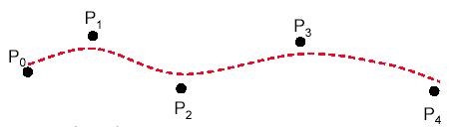
Bézier Curves
Developed by Pierre Bezier for use in design of automobile bodies
useful and convenient for curve design
easy to implement
Widely used in Cad system, graphic package, drawing and painting packages.

Slide 3
Cubic
Bézier Curves

Slide 4
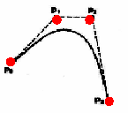
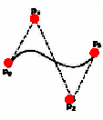
Cubic Bézier Curves
Cubic Bézier(n=3) curves defined by 4 control points(n+1) P0,P1,P2,P3
Curver begins at first control point and ends at fourth control point

Slide 5
Cubic Bézier Curves
We observe that start(end) of the curve is tangent to the to the line connecting 1st and 2nd (3rd and 4th )control point
To join 2 bezier curves smoothly we have to make 3rd and 4th control point of first curve as 1st and 2nd control point of second curve

Slide 6
Cubic Bézier Curves
The curve starts at P0 going towards P1 and arrives at P3 coming from the direction of P2

Slide 7
Mathematical Representation
n
B(u) = ∑ p_{i}b_{n,i}(u)
Where
b_{n,i}(u) = . n!. u^{i}(1-u)^{n-i}
i!(n-i)! 0<= u<= 1
b_{n,i}(u) is known as the i_{th} n_{th} order Berstein basis polynomial or blending function points p_{i} are called as control points for Beizier curve.
i=0

Slide 8
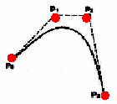
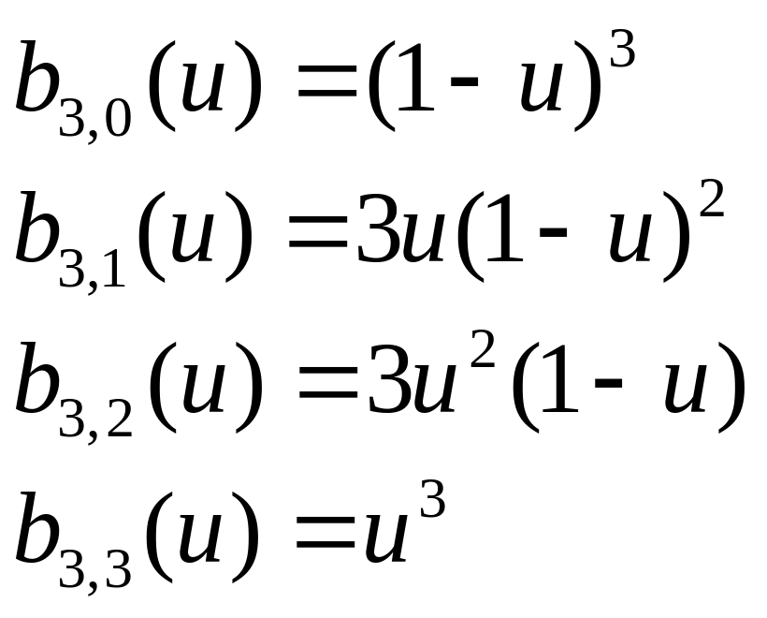
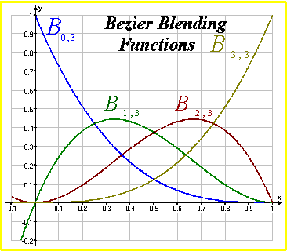

Cubic Bézier Curves
Cubic Bézier curves are generated with four control points.
The four blending functions for cubic Bézier curves (n=3):

Slide 9
Cubic Bézier Curves
For 3 control points, n = 2
P(u) = (1-u)2p0 + 2u(1-u) p1+ u2p2
For four control points, n = 3
P(u) = (1-u)3p0 + 3u(1-u) 2 p1 + 3u 2 (1-u)p2 + u3p3

Slide 10
Sub-Dividing Bezier Curves
Step 1: Find the midpoints of the lines joining the original control vertices. Call them M₀₁, M₁₂, M₂₃
Step 2: Find the midpoints of the lines joining M₀₁, M₁₂ and M₁₂, M₂₃. Call them M₀₁₂, M₁₂₃
Step 3: Find the midpoint of the line joining M₀₁₂, M₁₂₃. Call it M₀₁₂₃
The curve with control points P₀, M₀₁, M₀₁₂ and M₀₁₂₃ exactly follows the original curve from the point with t=0 to the point with t=0.5
The curve with control points M₀₁₂₃ , M₁₂₃ , M₂₃ and P₃ exactly follows the original curve from the point with t=0.5 to the point with t=1

Slide 11
Sub-Dividing Bezier Curves
M₁₂
P₁
P₂
M₀₁₂
M₀₁₂₃
M₁₂₃
M₀₁
M₂₃
P₀
P₃

Slide 12
Sub-Dividing Bezier Curves
P₁
P₂
P₀
P₃

Slide 13
de Casteljau Algorithm
p₁₂
p₀₁₂
p₂
1-t
p₁₂₃
p₀₁₂₃
  p₀₁ = (1-t) p₀ + t p₁
  p₁₂ = (1-t) p₁ + t p₂
  p₂₃ = (1-t) p₂ + t p₃
  p₀₁₂ = (1-t) p₀₁ + t p₁₂
  p₁₂₃ = (1-t) p₁₂ + t p₂₃
  p₀₁₂₃ = (1-t) p₀₁₂ + t p₁₂₃
Subdivides curve at p₀₁₂₃
  p₀ p₀₁ p₀₁₂ p₀₁₂₃
  p₀₁₂₃ p₁₂₃ p₂₃ p₃
Repeated subdivision converges to curve
p₀₁
t
p₂₃
p₀
p₃
coordinate
free!

Slide 14
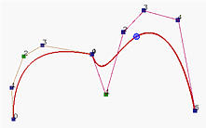
Bézier Curves
In general, a Bézier curve section can be fitted to any number of control points.
The number of control points to be approximated and their relative position determine the degree of the Bézier polynomial.

Slide 15
Properties
of
Bézier ‍Curves

Slide 16
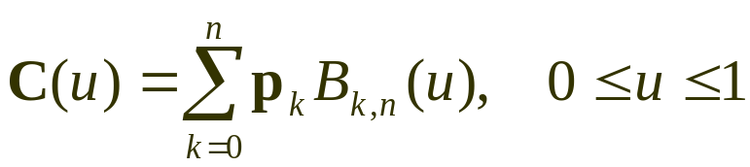
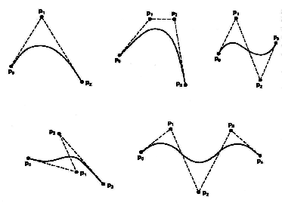
Properties of a Bézier ‍Curve
The degree of a Bézier curve defined by n+1 control points is n:
Parabola Curve
Cubic Curve
Cubic Curve
Cubic Curve

Slide 17
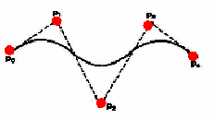
Properties of a Bézier ‍Curve
The curve passes though the first and the last control point C(u) passes through P₀ and P_{n}.

Slide 18
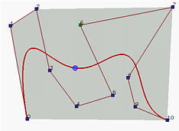
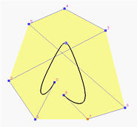
Properties of a Bézier ‍‍‍Curve
Bézier curves are tangent to their first and last edges of control polyline.
2
7
4
6
5
1
3
3
8
2
0
5
8
9
6
0
4
10
1
7

Slide 19
Properties of a Bézier Curve
The Bézier curve lies completely in the convex hull of the given control polygon.

Slide 20
Properties of a Bézier Curve
The Bézier curve is invariant under affine transformation.
Let us discuss a practical aspect of affine invariance. Suppose we plot a cubic curve (t) by evaluating a 100 points and then plotting the resulting point array. Suppose now that we would like to plot the curve after a rotation has been applied to it. We can take the 100 computed points, apply the rotation to each of them, and plot. Or, we can apply the rotation to the 4-control points, then evaluate a 100 times and plot. The first method needs 100 applications of the rotation, while the second needs only 4!

Slide 21
Properties of a Bézier Curve
6.The curve exhibits variation diminishing property which states that the curve does not wiggle more than the control polygon
p₁
p₃
p₀
p₂

Slide 22
Properties of a Bézier Curve
The curve is a straight line if and only if all the control points are collinear.
The curve generally follows the shape of the defining polygon
The basis function are real (non-negative)

Slide 23
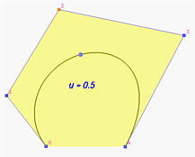
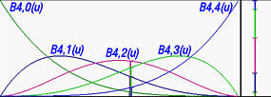
Properties of a Bézier Curve
All basis functions are positive and their sum is always 1

Slide 24
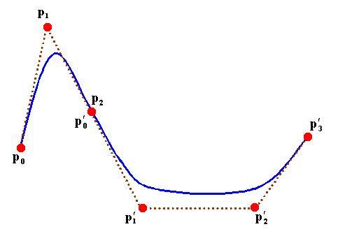
Design Techniques Using Bézier ‍Curve
(Complicated curves)
When complicated curves are to be generated, they can be formed by piecing several Bézier sections of lower degree together.
Piecing together smaller sections gives us better control over the shape of the curve in small region.

