Slide 1
Computer Graphics 4:
Bresenham Line
Drawing Algorithm,
Circle Drawing &
Polygon Filling
By:Kanwarjeet Singh

Slide 2
Contents
In today’s lecture we’ll have a look at:
  Bresenham’s line drawing algorithm
  Line drawing algorithm comparisons
  Circle drawing algorithms
    A simple technique
    The mid-point circle algorithm
  Polygon fill algorithms
  Summary of raster drawing algorithms

Slide 3
DDA
Digital differential analyser
Y=mx+c
For m<1
∆y=m∆x
For m>1
∆x=∆y/m

Slide 4
Question
A line has two end points at (10,10) and (20,30). Plot the intermediate points using DDA algorithm.

Slide 5
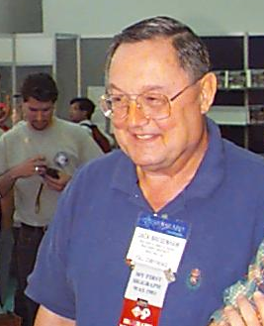
The Bresenham Line Algorithm
The Bresenham algorithm is another incremental scan conversion algorithm
The big advantage of this algorithm is that it uses only integer calculations
Jack Bresenham worked for 27 years at IBM before entering academia. Bresenham developed his famous algorithms at IBM in the early 1960s

Slide 6
The Big Idea
Move across the x axis in unit intervals and at each step choose between two different y coordinates
For example, from position (2, 3) we have to choose between (3, 3) and (3, 4)
We would like the point that is closer to the original line
5
(x_{k}+1, y_{k}+1)
4
(x_{k}, y_{k})
3
(x_{k}+1, y_{k})
2
2
3
4
5

Slide 7
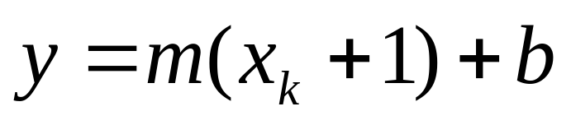
Deriving The Bresenham Line Algorithm
At sample position x_{k}+1 the vertical separations from the mathematical line are labelled d_{upper} and d_{lower}
y_{k+1}
d_{upper}
y
d_{lower}
y_{k}
x_{k}+1
The y coordinate on the mathematical line at x_{k}+1 is:

Slide 8
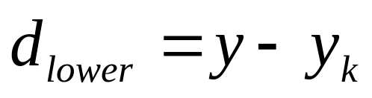
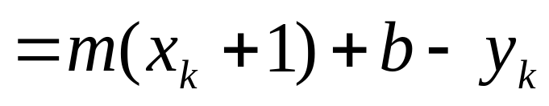
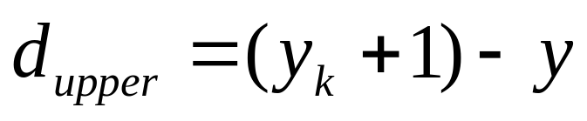
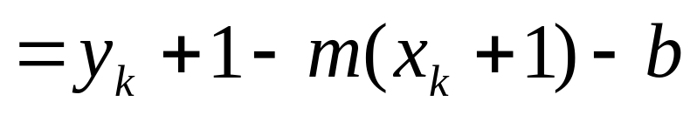
Deriving The Bresenham Line Algorithm (cont…)
So, d_{upper} and d_{lower} are given as follows:
and:
We can use these to make a simple decision about which pixel is closer to the mathematical line

Slide 9
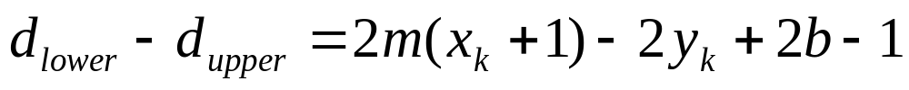
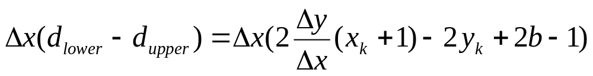
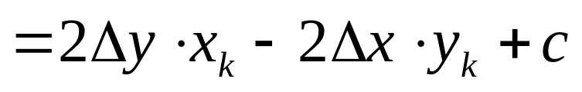
Deriving The Bresenham Line Algorithm (cont…)
This simple decision is based on the difference between the two pixel positions:
Let’s substitute m with ∆y/∆x where ∆x and
∆y are the differences between the end-points:

Slide 10
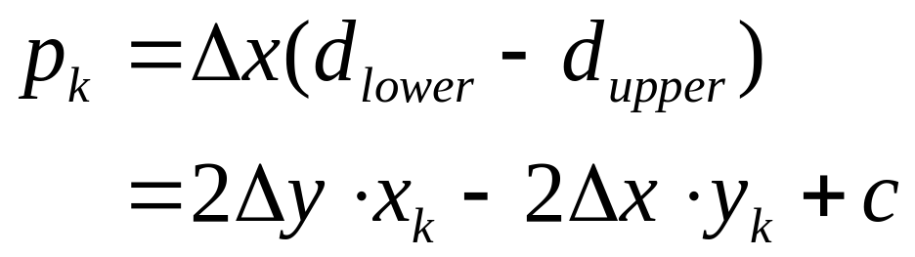
Deriving The Bresenham Line Algorithm (cont…)
So, a decision parameter p_{k} for the kth step along a line is given by:
The sign of the decision parameter p_{k} is the same as that of d_{lower} – d_{upper}
If p_{k} is negative, then we choose the lower pixel, otherwise we choose the upper pixel

Slide 11
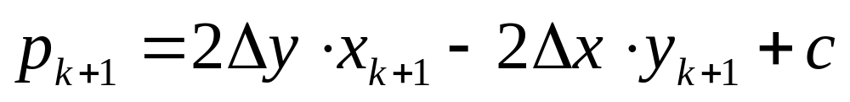
Deriving The Bresenham Line Algorithm (cont…)
Remember coordinate changes occur along the x axis in unit steps so we can do everything with integer calculations
At step k+1 the decision parameter is given as:
Subtracting p_{k} from this we get:

Slide 12
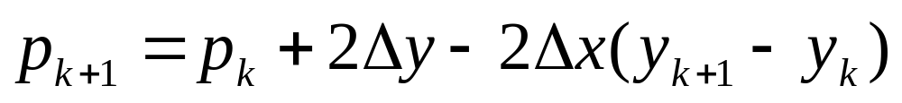
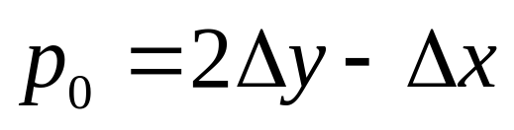
Deriving The Bresenham Line Algorithm (cont…)
But, x_{k+1} is the same as x_{k}+1 so:
where y_{k+1} - y_{k} is either 0 or 1 depending on the sign of p_{k}
The first decision parameter p0 is evaluated at (x0, y0) is given as:

Slide 13

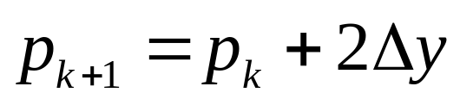
The Bresenham Line Algorithm
BRESENHAM’S LINE DRAWING ALGORITHM
(for |m| < 1.0)
Input the two line end-points, storing the left end-point in (x₀, y₀)
Plot the point (x₀, y₀)
Calculate the constants Δx, Δy, 2Δy, and (2Δy - 2Δx) and get the first value for the decision parameter as:
At each x_{k} along the line, starting at k = 0, perform the following test. If p_{k} < 0, the next point to plot is
(x_{k}+1, y_{k}) and:

Slide 14
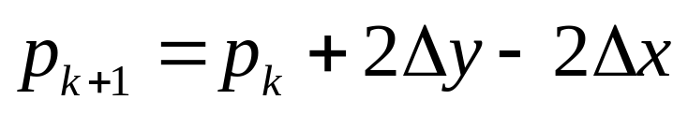
The Bresenham Line Algorithm (cont…)
Otherwise, the next point to plot is (x_{k}+1, y_{k}+1) and:
Repeat step 4 (Δx – 1) times
ACHTUNG! The algorithm and derivation above assumes slopes are less than 1. for other slopes we need to adjust the algorithm slightly.

Slide 15
Adjustment
For m>1, we will find whether we will increment x while incrementing y each time.
After solving, the equation for decision parameter p_{k} will be very similar, just the x and y in the equation will get interchanged.

Slide 16
Bresenham Example
Let’s have a go at this
Let’s plot the line from (20, 10) to (30, 18)
First off calculate all of the constants:
  Δx: 10
  Δy: 8
  2Δy: 16
  2Δy - 2Δx: -4
Calculate the initial decision parameter p₀:
  p0 = 2Δy – Δx = 6

Slide 17
Bresenham Example (cont…)
k | p_{k} | (x_{k+1},y_{k+1})
0 1 2 3 4 5 6 7 8 9
18
17
16
15
14
13
12
11
10
20
21
22
23
24
25
26
27
28
29
30

Slide 18
Bresenham Exercise
Go through the steps of the Bresenham line drawing algorithm for a line going from (21,12) to (29,16)

Slide 19
Bresenham Exercise (cont…)
k | p_{k} | (x_{k+1},y_{k+1})
0 1 2 3 4 5 6 7 8
18
17
16
15
14
13
12
11
10
20
21
22
23
24
25
26
27
28
29
30

Slide 20
Bresenham Line Algorithm Summary
The Bresenham line algorithm has the following advantages:
  An fast incremental algorithm
  Uses only integer calculations
Comparing this to the DDA algorithm, DDA has the following problems:
  Accumulation of round-off errors can make the pixelated line drift away from what was intended
  The rounding operations and floating point arithmetic involved are time consuming

Slide 21
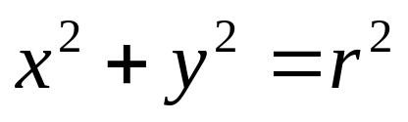
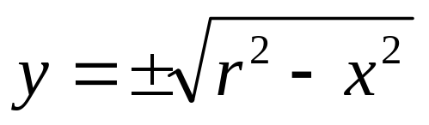
A Simple Circle Drawing Algorithm
The equation for a circle is:
where r is the radius of the circle
So, we can write a simple circle drawing algorithm by solving the equation for y at unit x intervals using:

Slide 22
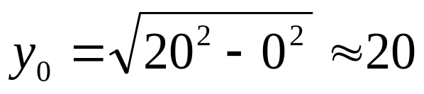
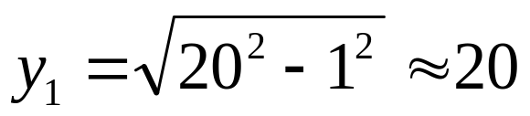
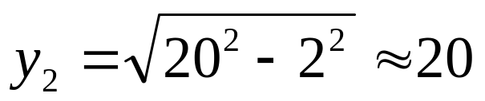
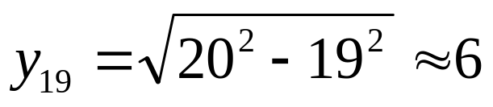
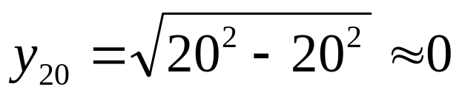
A Simple Circle Drawing Algorithm (cont…)

Slide 23
A Simple Circle Drawing Algorithm (cont…)
However, unsurprisingly this is not a brilliant solution!
Firstly, the resulting circle has large gaps where the slope approaches the vertical
Secondly, the calculations are not very efficient
  The square (multiply) operations
  The square root operation – try really hard to avoid these!
We need a more efficient, more accurate solution

Slide 24
Polar coordinates
X=r*cosθ+x_{c}
Y=r*sinθ+y_{c}
0º≤θ≤360º
Or
0 ≤ θ ≤6.28(2*π)
Problem:
  Deciding the increment in θ
  Cos, sin calculations

Slide 25

Eight-Way Symmetry
The first thing we can notice to make our circle drawing algorithm more efficient is that circles centred at (0, 0) have eight-way symmetry
(-x, y)
(x, y)
(-y, x)
(y, x)
(-y, -x)
(y, -x)
(-x, -y)
(x, -y)

Slide 26
Mid-Point Circle Algorithm
Similarly to the case with lines, there is an incremental algorithm for drawing circles – the mid-point circle algorithm
In the mid-point circle algorithm we use eight-way symmetry so only ever calculate the points for the top right eighth of a circle, and then use symmetry to get the rest of the points
The mid-point circle algorithm was developed by Jack Bresenham, who we heard about earlier. Bresenham’s patent for the algorithm can be viewed here.

Slide 27
Mid-Point Circle Algorithm (cont…)
6
5
4
3
1
2
3
4

Slide 28
Mid-Point Circle Algorithm (cont…)
6
M
5
4
3
1
2
3
4

Slide 29
Mid-Point Circle Algorithm (cont…)
6
M
5
4
3
1
2
3
4

Slide 30
Mid-Point Circle Algorithm (cont…)
Assume that we have
just plotted point (x_{k}, y_{k})
The next point is a
choice between (x_{k}+1, y_{k})
and (x_{k}+1, y_{k}-1)
We would like to choose
the point that is nearest to
the actual circle
So how do we make this choice?
(x_{k}, y_{k})
(x_{k}+1, y_{k})
(x_{k}+1, y_{k}-1)

Slide 31
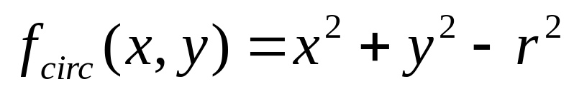
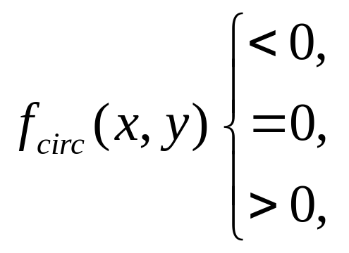
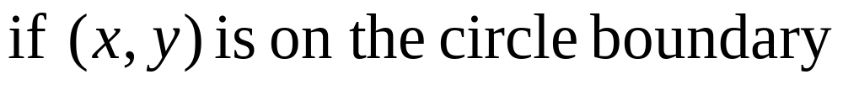
Mid-Point Circle Algorithm (cont…)
Let’s see the equation of the circle:
The equation evaluates as follows:
By evaluating this function at the midpoint between the candidate pixels we can make our decision

Slide 32
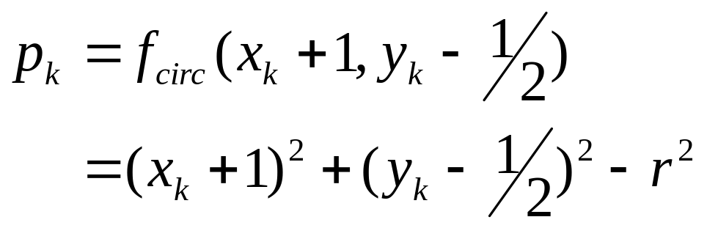
Mid-Point Circle Algorithm (cont…)
Assuming we have just plotted the pixel at (x_{k},y_{k}) so we need to choose between (x_{k}+1,y_{k}) and (x_{k}+1,y_{k}-1)
Our decision variable can be defined as:
If p_{k} < 0 the midpoint is inside the circle and and the pixel at y_{k} is closer to the circle
Otherwise the midpoint is outside and y_{k}-1 is closer

Slide 33
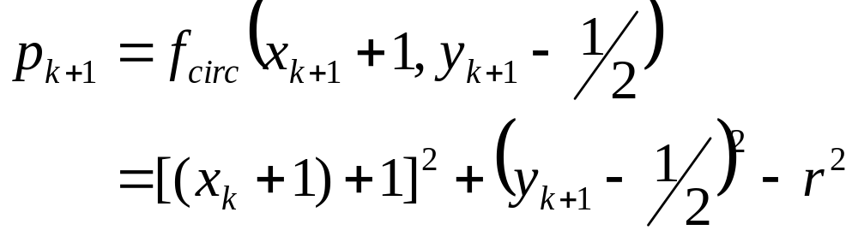
Mid-Point Circle Algorithm (cont…)
To ensure things are as efficient as possible we can do all of our calculations incrementally
First consider:
or:
where y_{k+1} is either y_{k} or y_{k}-1 depending on the sign of p_{k}

Slide 34
p_{k+1} - p_{k=} (( x_{k+1})²+1)² + (y_{k+1}-1/2)²-r²-(x_{k+1})²-(y_{k}-1/2)²+r²
=( x_{k+1})² +2(x_{k+1})1+1+y²+1-2(y_{k+1})1/2+1/4-(x_{k+1})²-(y²_{k}-2y_{k}*1/2+1/4)
=2( x_{k+1})+ ( y²_{k+1} - y²_{k} ) – ( y_{k+1} - y_{k} )+1
p_{k+1}= p_{k}+2(x_{k}+1)+(y²_{k+1}-y²_{k})-(y_{k+1}-y_{k})+1

Slide 35
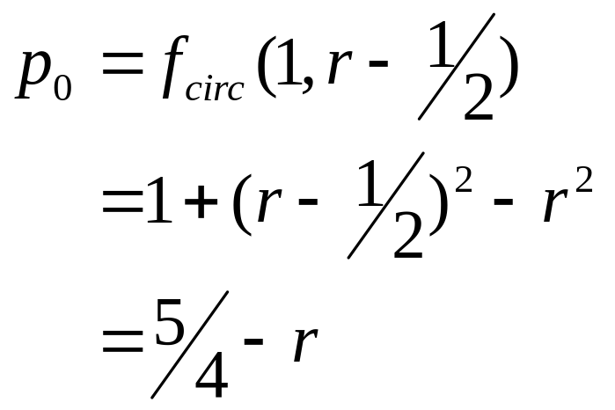
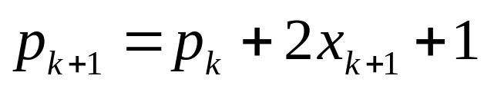
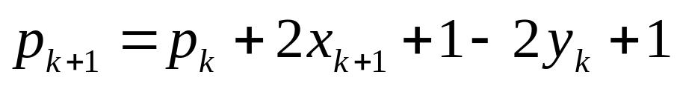
Mid-Point Circle Algorithm (cont…)
The first decision variable is given as:
Then if p_{k} < 0 then the next decision variable is given as:
If p_{k} > 0 then the decision variable is:

Slide 36
The initial decision parameter is obtained by evaluating the circle function
(x₀,y₀)=(0,r)
P_{o}=f_{circle}(x_{0,}y₀)=(0,r)
P_{k}=(k_{k+1,}y_{k-1/2})
P₀=(1,r-1/2)
=(1)²+(r-1/2)²-r²
=1²+r²-2r*1/2+1/4-r²
=1-r+1/4
=1+1/4-r
=5/4-r
P₀ =5/4-r

Slide 37
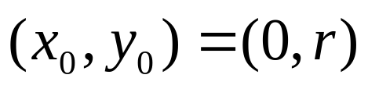
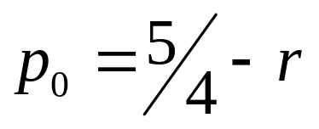
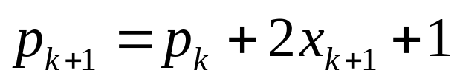
The Mid-Point Circle Algorithm
MID-POINT CIRCLE ALGORITHM
Input radius r and circle centre (x_{c}, y_{c}), then set the coordinates for the first point on the circumference of a circle centred on the origin as:
Calculate the initial value of the decision parameter as:
Starting with k = 0 at each position x_{k}, perform the following test. If p_{k} < 0, the next point along the circle centred on (0, 0) is (x_{k}+1, y_{k}) and:

Slide 38
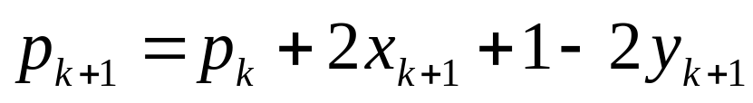
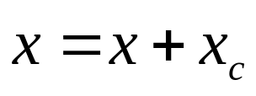
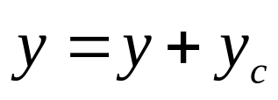
The Mid-Point Circle Algorithm (cont…)
Otherwise the next point along the circle is (x_{k}+1, y_{k}-1) and:
Determine symmetry points in the other seven octants
Move each calculated pixel position (x, y) onto the circular path centred at (x_{c}, y_{c}) to plot the coordinate values:
Repeat steps 3 to 5 until x >= y

Slide 39
Mid-Point Circle Algorithm Example
To see the mid-point circle algorithm in action lets use it to draw a circle centred at (0,0) with radius 10

Slide 40
Mid-Point Circle Algorithm Example (cont…)
10
k | p_{k} | (x_{k+1},y_{k+1}) | 2x_{k+1} | 2y_{k+1}
0 1 2 3 4 5 6
9
8
7
6
5
4
3
2
1
0
0
1
2
3
4
5
6
7
8
9
10

Slide 41
Mid-Point Circle Algorithm Exercise
Use the mid-point circle algorithm to draw the circle centred at (0,0) with radius 15

Slide 42
Mid-Point Circle Algorithm Example (cont…)
16
k | p_{k} | (x_{k+1},y_{k+1}) | 2x_{k+1} | 2y_{k+1}
0 1 2 3 4 5 6 7 8 9 10 11 12
15
14
13
12
11
10
9
8
7
6
5
4
3
2
1
0
0
1
2
3
4
5
6
7
8
9
10
11
12
13
14
15
16

Slide 43
Mid-Point Circle Algorithm Summary
The key insights in the mid-point circle algorithm are:
  Eight-way symmetry can hugely reduce the work in drawing a circle
  Moving in unit steps along the x axis at each point along the circle’s edge we need to choose between two possible y coordinates

Slide 44
Filling Polygons
So we can figure out how to draw lines and circles
How do we go about drawing polygons?
We use an incremental algorithm known as the scan-line algorithm

Slide 45
Scan-Line Polygon Fill Algorithm
10
Scan Line
8
6
4
2
0
2
4
6
8
10
12
14
16

Slide 46
Scan-Line Polygon Fill Algorithm
The basic scan-line algorithm is as follows:
  Find the intersections of the scan line with all edges of the polygon
  Sort the intersections by increasing x coordinate
  Fill in all pixels between pairs of intersections that lie interior to the polygon

Slide 47
Scan-Line Polygon Fill Algorithm (cont…)

Slide 48
Line Drawing Summary
Over the last couple of lectures we have looked at the idea of scan converting lines
The key thing to remember is this has to be FAST
For lines we have either DDA or Bresenham
For circles the mid-point algorithm

Slide 49
Blank Grid

Slide 50
Blank Grid

Slide 51
Blank Grid
10
9
8
7
6
5
4
3
2
1
0
0
1
2
3
4
5
6
7
8
9
10

Slide 52
Blank Grid

