Slide 1
Book: Cyber Security Understanding Cyber Crimes, Computer Forensics and Legal Perspective - By Nina Godbole, Sunit Belapure
Chapter 4
Tools and Methods Used in Cybercrime

Slide 2
Content
Introduction
Proxy Server and Anonymizers
Phishing
Password Cracking
Keyloggers and Spywares
Virus and Worms
Trojan Horses and Backdoors
Steganography
DoS and DDoS Attacks
SQL Injection
Buffer Overflow
Attacks on Wireless Networks

Slide 3
Introduction
Various tools and techniques used to launch attacks against the target
Scareware
Malvertising
Clickjacking
Ransomware

Slide 4
Cont…
Basic stages of an attack are described here to understand how an attacker can compromise a network here:
1. Initial uncovering:
Two steps involved: 1) Reconnaissance
2) Attacker uncovers information
2. Network Probe
3. Crossing the line toward E-crime
4. Capturing the network
5. Grab the data
6. Covering tracks

Slide 5
Proxy Server and Anonymizer
Proxy server is computer on a network which acts as an intermediary for connections with other computers on that network
1st attacker connects to proxy server
Proxy server can allow an attacker to hide ID

Slide 6
Cont…
Purpose of proxy server:
Keep the system behind the curtain
Speed up access to resource
Specialized proxy servers are used to filter unwanted content such as advertisement
Proxy server can be used as IP address multiplexer to enable to connect no. of computers on the Internet

Slide 7
Cont…
An anonymizer or an anonymous proxy is a tool that attempts to make activity on the Internet untraceable
It accesses the Internet user’s behalf, protecting personal information by hiding the source computer’s identifying information

Slide 8
Phishing
Introduced in 1996
Fake E-Mail using other reputed companies or individual’s identity
People associate phishing with E-Mail message that spoof or mimic banks, credit card companies or other business such as Amazon and eBay

Slide 9
How Phishing works?
Phishers works as follows
Planning: decide the target & determine how to get E-Mail address
Setup: create methods for delivering the message & to collect the data about the target
Attack: sends a phony message that appears to be from a reputable source
Collection: record the information of victims entering into web pages or pop-up window
Identify theft and fraud: use information that they have gathered to make illegal purchases and commit fraud

Slide 10
Virus and Worms
Computer virus is a program that can “infect” legitimate programs by modifying them to include a possibly “evolved” copy of itself.
Viruses spread themselves, without the knowledge or permission of the users
Contains malicious instructions
A virus can start on event driven effects, time driven effects, or can occur random.

Slide 11
Cont…
Viruses can take some actions:
Display a message to prompt an action into which viruses enter
Scramble data on hard disk
Delete files inside the system
Cause erratic screen behavior
Halt the PC
Replicate themselves

Slide 12
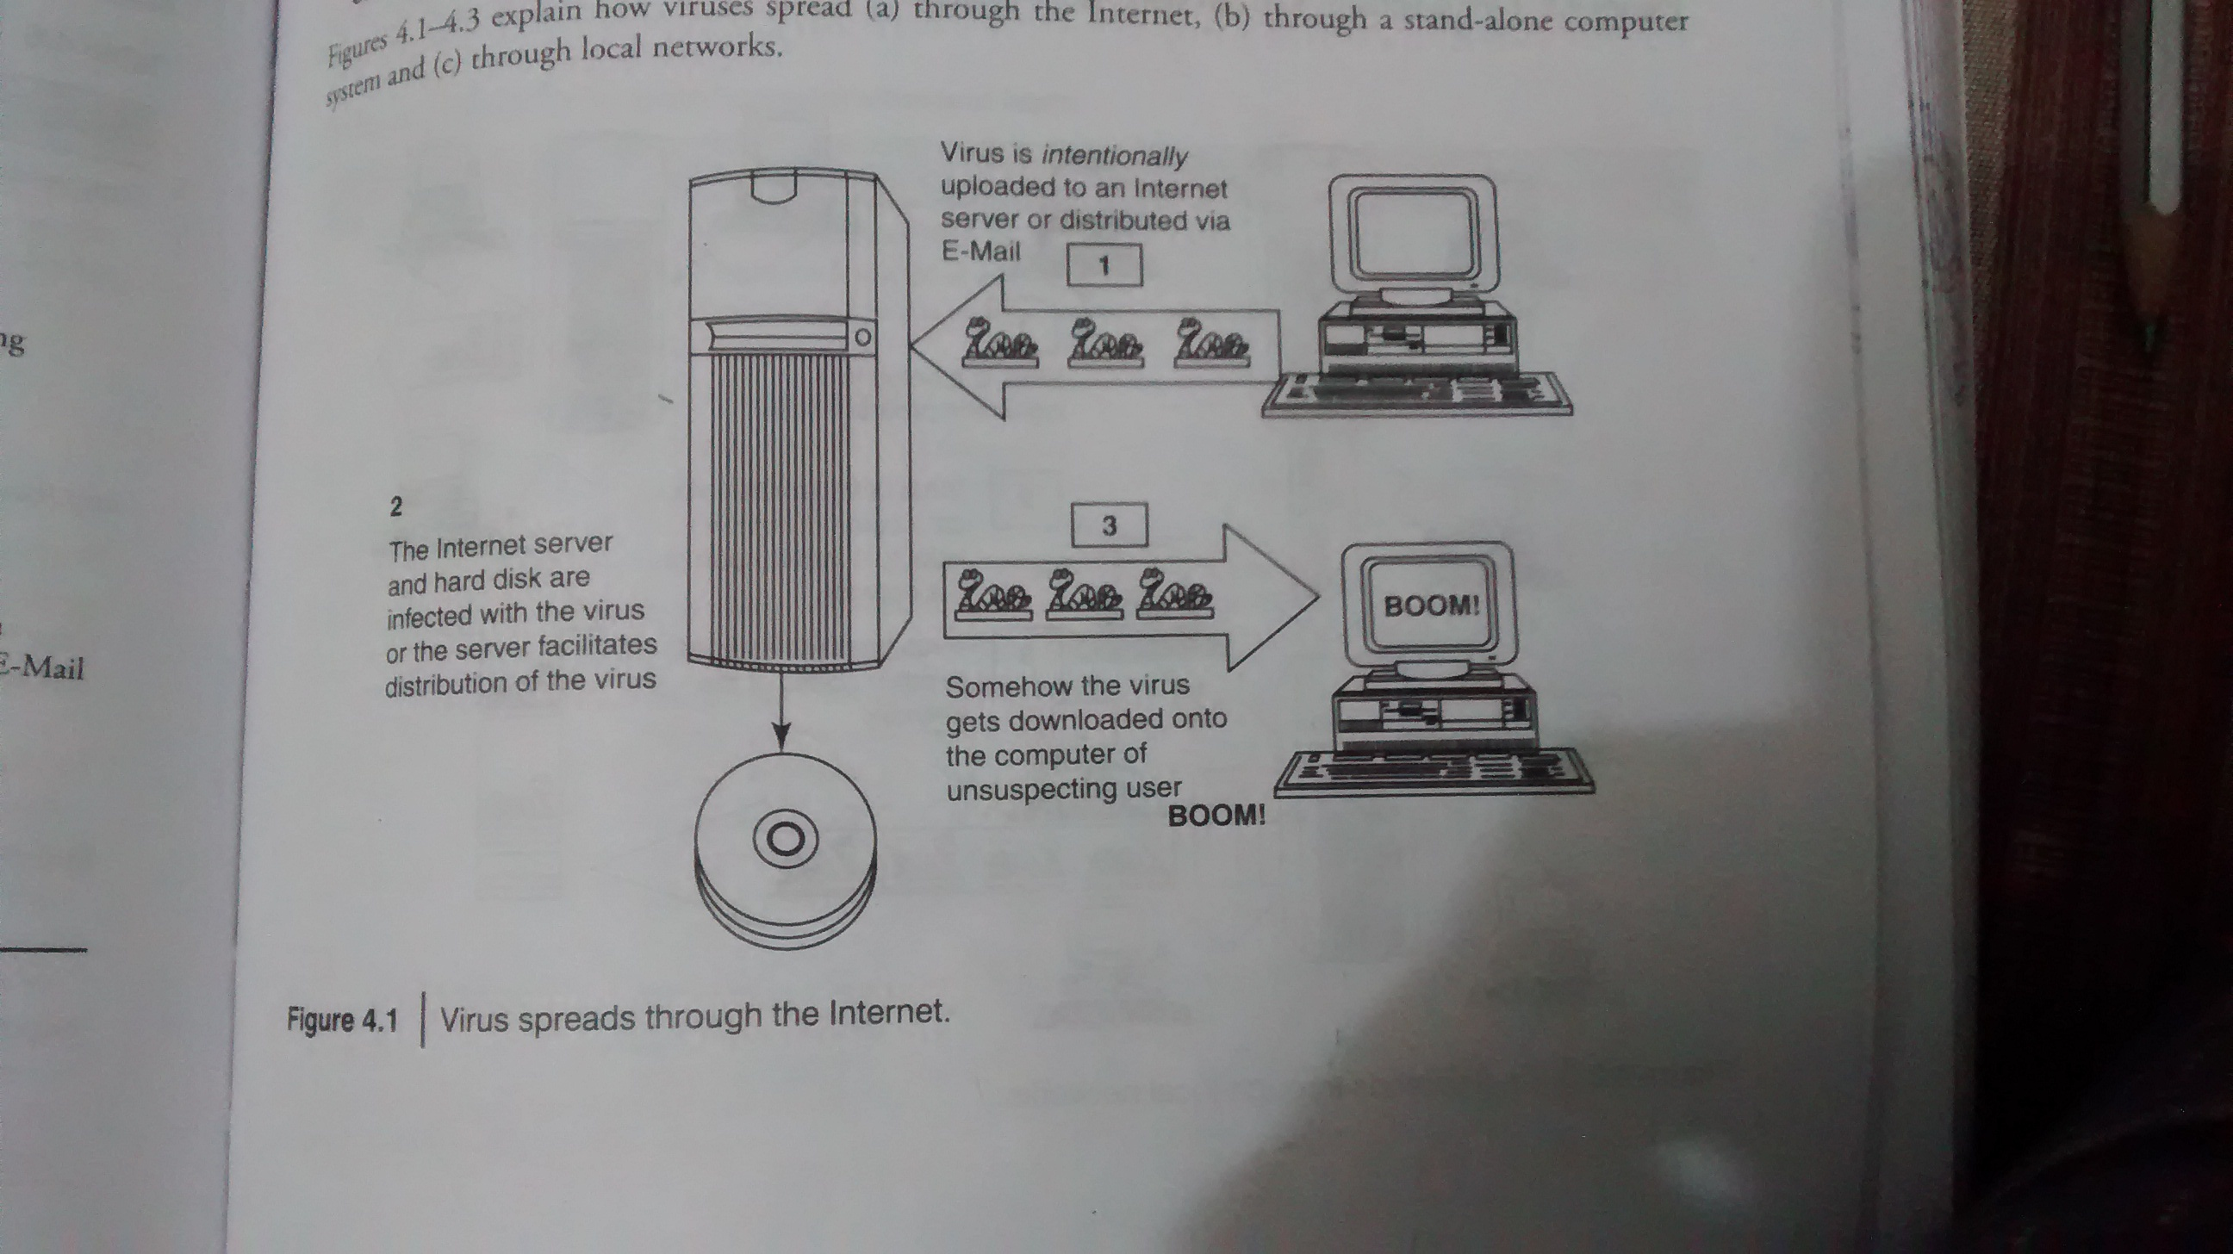
How virus spread

Slide 13
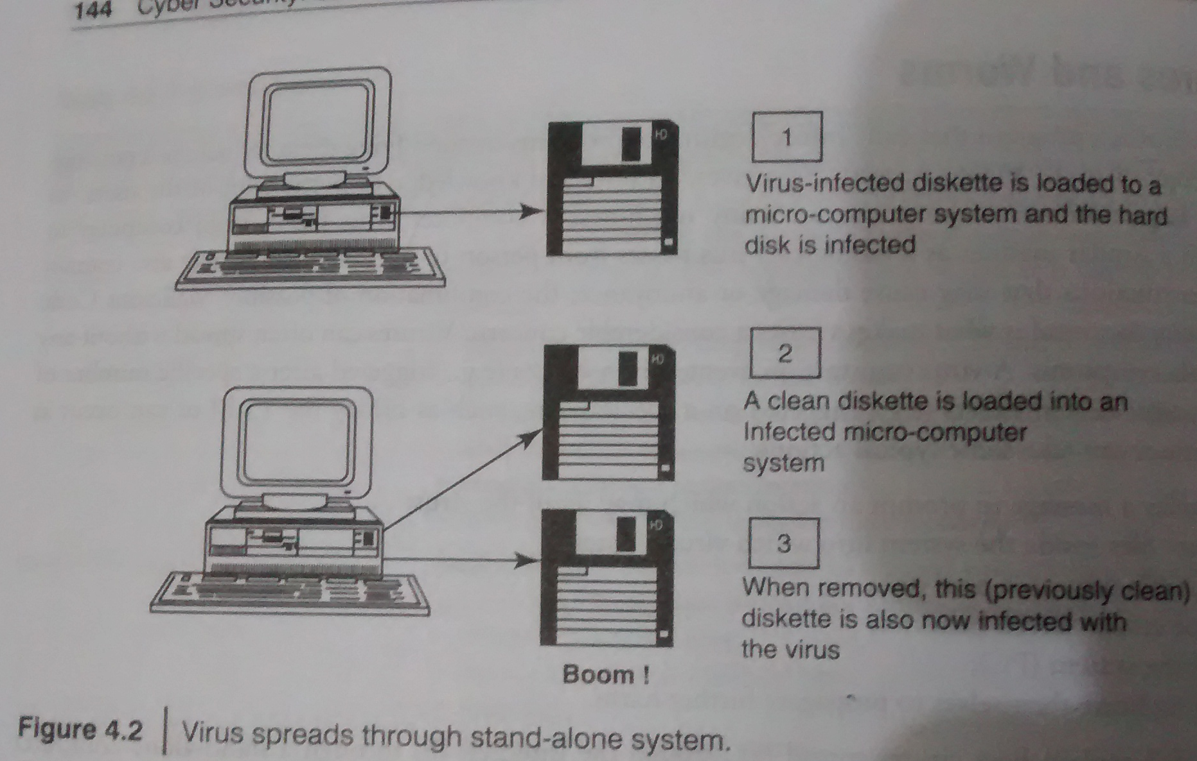
Cont…

Slide 14
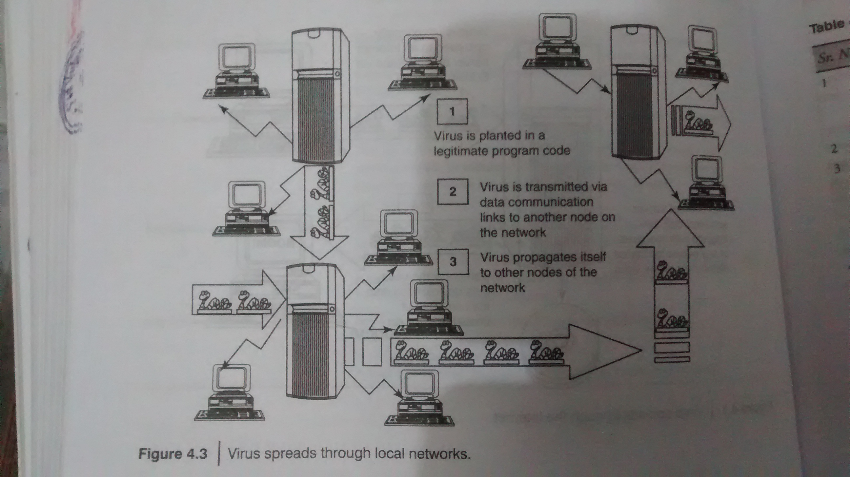
Cont…

Slide 15
Cont…
True virus can only spread from one system to another
A worm spreads itself automatically to other computers through networks by exploiting security vulnerabilities

Slide 16
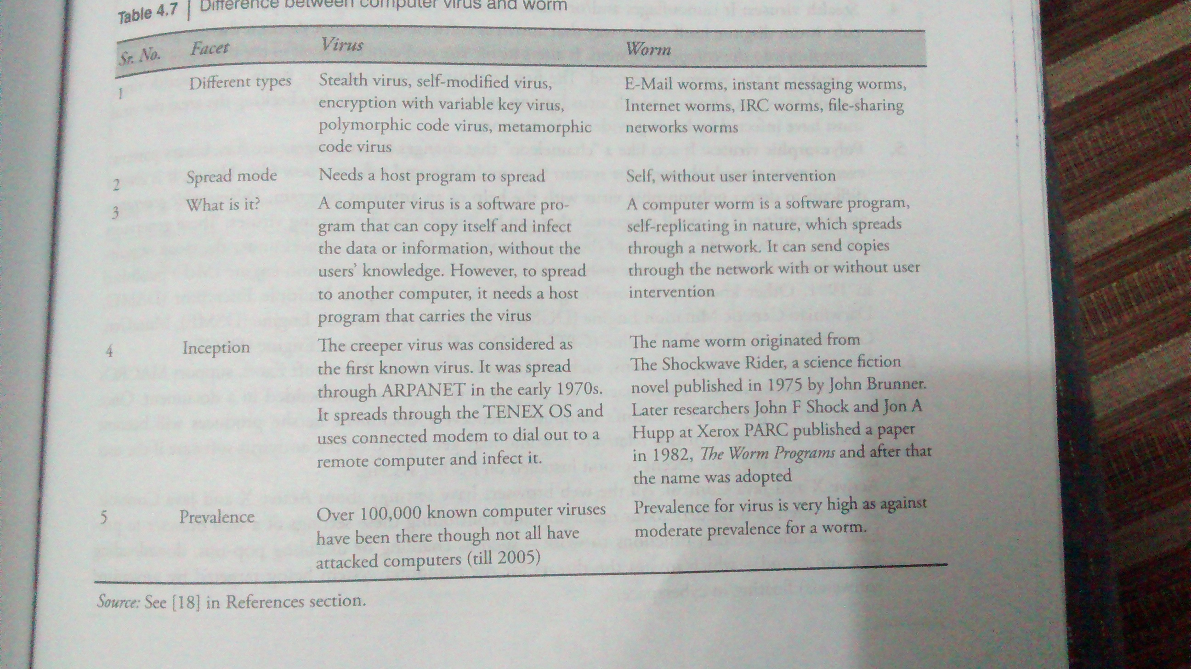
Difference between virus and worm

Slide 17
Types of Viruses
Categorized based on attacks on various element of the system
Boot sector viruses:
Infects the storage media on which OS is stored and which is used to start the computer system
Spread to other systems when shared infected disks & pirated software(s) are used
Program viruses:
Active when program file(usually with extensions .bin, .com, .exe, .ovl, .drv) is executed
Makes copy of itself

Slide 18
Cont…
Multipartite Viruses:
Hybrid of a boot sector and program viruses
Stealth viruses:
Masks itself
Antivirus S/W also cannot detect
Alter its file system and hide in the computer memory to remain in the system undetected
1st computer virus named as Brain

Slide 19
Cont…
Polymorphic viruses:
Like “chameleon” that changes its virus signature (i.e., binary pattern) every time it spread through the system (i.e., multiplies & infect a new file)
Polymorphic generators are routines that can be linked with the existing viruses
Generators are not viruses but purpose to hide actual viruses under the cloak of polymorphism

Slide 20
Cont…
Macroviruses:
Infect documents produced by victims computer
Active X and Java control:

Slide 21
Trojan Horses
Trojan horse is a program in which malicious or harmful code is contained inside apparently harmless programming or data in such a way that it can get control and cause harm
Get into system from no. of ways, including web browser, via E-Mail, or with S/W download from the Internet

Slide 22
Cont..
Trojans do not replicate themselves but they can be equally destructive
Examples of threats by Trojans:
Erase, overwrite or corrupt data on computer
Help to spread other malware
Deactivate or interfere with antivirus and firewall
Allow to remote access to your computer
Upload and download files without user knowledge
Gather E-Mail address and use them for spam
Slow down , restart or shutdown the system
Reinstall themselves after being disable
Disable task manager or control panel
Copy fake links to false websites, display porno sites, play sounds/videos and display images
Log keystrokes to steal info such as password or credit card no.

Slide 23
Backdoor
It means of access to a computer program that bypass security mechanisms
Programmer use it for troubleshooting
Attackers often use backdoors that they detect or install themselves as part of an exploit
Works in background and hides from user
Most dangerous parasite, as it allows a malicious person to perform any possible action
Programmer sometimes leave such backdoor in their software for diagnostic and troubleshooting purpose. Attacker discover these undocumented features and use them

Slide 24
What a backdoor does?
Allow an attacker to create, delete, rename, copy or edit any file; change any system setting, alter window registry; run, control and terminate application; install arbitrary software
To control computer hardware devices, modify related setting, shutdown or restart a computer without asking for user permission
Steals sensitive personal information, logs user activity, tracks web browsing habits
Record keystrokes
Sends all gathered data to predefined E-Mail address
Infects files, corrupts installed app & damage entire system
Distributes infected files to remote computers and perform attack against hacker-defined remote hosts
Installed hidden FTP server that can be used by malicious person
Degrade Internet connection speed and overall system performance
Provide uninstall feature and hides processes, files and other objects to compliacate its removal as much as possible

Slide 25
Examples of Backdoor Trojans
Back orifice:
Enable user to control a computer running the Microsoft Windows OS from remote location
Bifrost:
Infect Windows 95 through Vista
SAP backdoors
Onapsis Bizploit

Slide 26
How to protect from Trojan Horses and Backdoors
Stay away from suspect websites/ web links
Surf on the web cautiously
Install antivirus/ Trojan remover software

Slide 27
Steganography
Greek word that means “Sheltered writing”
Comes from 2 Greek words:
Steganos means “covered”
Graphein means “to write” or “concealed writing”
Steganalysis:
Detecting messages that are hidden in images, audio/video files using steganography

Slide 28
Dos and DDoS Attack
An attempt to make a computer resources unavailable to its intended users
DoS attack:
Attacker floods the BW of the victim’s N/W or fills his E-Mail box with Spam mail depriving him of the services he is entitled to access or provide
Attacker typically target sites or services hosted on high-profile web servers such as banks, credit card payment gateways, mobile phone networks and even root name servers

Slide 29
DoS Attack
Buffer overflow technique is employed to commit such kind of criminal attack
Attacker spoofs the IP address and floods the N/W of victim with repeated requests
As the IP address is fake, the victim machine keeps waiting for response from the attacker’s machine for each request
This consumes the BW of the N/W which then fails to server the legitimate responses and ultimately breaks down

Slide 30
Symptoms of DoS attack
US Computer Emergency Response defines it:
Unusually slow n/w performance(opening file or accessing websites)
Unavailability of a particular website
Inability to access ay website
Dramatic increase in the no. of Spam E-Mails received

Slide 31
What DoS attack does?
Goal of DoS is not to gain unauthorized access to systems or data, but to prevents intended users of a service from using it.
Activity done by DoS
Flood a n/w with traffic
Disrupt connection between 2 systems
Prevent a particular individual from accessing service
Disrupt service to a specific system or person

Slide 32
Classification of DoS attacks
Bandwidth attacks
Consuming all the bandwidth of site
Logic attack
Exploit vulnerabilities in n/w s/w such as web server or TCP/IP stack
Protocol attacks
Exploit specific feature or implementation bug of some protocol installed at victim’s system to consume excess amount of its resources
Unintentional DoS attack

Slide 33
Types or levels of DoS attacks
Flood attack: (Ping flood)
Attacker sending no. of ping packets, using “ping” command, which result into more traffic than victim can handle
This requires the attacker to have faster n/w connection than the victim
Prevention is difficult
Ping of death attack:
Sends oversized ICMP packets
Receiving this packet, will crash, freeze or reboot system

Slide 34
Cont…
3. SYN attack: (TCP SYN flooding)

Slide 35
Cont…
4. Teardrop attack:
Attack where fragmented packets are forged to overlap each other when the receiving host tries to reassemble them
IP’s packet fragmentation algo is used to send corrupted packets to confuse the victim and may hang the system
Windows 3.1x, 95 and NT , Linux versions 2.0.32, 2.1.63 are vulnerable to this attack

Slide 36
Cont…
5. Smurf attack
Generating significant computer n/w traffic on victim n/w, using floods via spoofed broadcast ping message
Attack consists of a host sending ICMP echo request to n/w broadcast ping address
Every host receive this packet & send back ICMP echo response
Internet relay chat(IRC)servers are primarily victim of smurf attack

Slide 37
Cont…
6. Nuke:
An old DoS attack against computer n/w s consisting of fragmented or otherwise invalid ICMP packets sent to target
Achieved by using a modified ping utility to repeatedly send this corrupt data, thus slowing down the affected computer until it comes to complete stop
Eg. WinNuke, which is exploited the vulnerability in the NetBIOS handler in windows 95. A string of out-of-band data was sent to TCP port 139 of victim’s machine, causing it to lock up and display Blue Screen Of Death(BSOD)

Slide 38
Tools used to launch DoS attack
Jolt2: attack against window based machine- consume 100% of CPU time on processing of illegal packets
Nemesy: generates random packets of spoofed source IP
Targa: used to run 8 different DoS attack
Crazy Pinger: send large packets of ICMP
SomeTrouble: remote flooder and bomber– developed in Delphi

Slide 39
Blended threat
It is a more sophisticated attack that bundles some of the worst aspects of viruses, worms, Trojan Horses and Malicious code into one single threat
Use server & Internet vulnerabilities to initiate, transmit and thereafter spread attack
Characteristics:
Cause harm to the infected system or n/w
Propagate using multiple methods as attack may come from multiple point
Exploit vulnerability
Serve multiple attacks in one payload
To use multiple mode of transport
Rather than a specific attack on predetermined “.exe” files, it could do multiple malicious acts, such as modify your “.exe” files, HTML files and registry keys

Slide 40
Permanent DoS attack
Damages a system so badly that it requires replacement or reinstallation of h/w
Pure h/w sabotage
PhlashDance is a tool created by Rich Smith who detected and demonstrated PDoS

Slide 41
DDoS Attack
Attacker use your computer to attack another computer
By taking advantage of security vulnerabilities or weaknesses, an attacker could tack control of your computer, then force your computer to send huge amounts of data to a website or send spam to particular E-Mail addresses
The attack is “distributed” because the attacker is using multiple computers to launch the DoS attack
Large no. of zombie systems are synchronized to attack a particular system. Zombie systems are called “secondary victims” and main target is called “primary victim”

Slide 42
How to protect from DoS/DDoS Attack
Implement router filter
If such filters are available in your system, install patches to guard against TCP SYN flooding
Disable any unused or inessential n/w service
Observe your system performance and establish baselines for ordinary activity
Routinely examine your physical security
Use tools to detect changes in configuration info or other files
Invest and maintain “hot spares”
Invest in redundant and fault-tolerant n/w configuration
Establish and maintain regular backup schedules and policies
Establish and maintain appropriate password policies

Slide 43
SQL Injection
It is a code injection technique that exploits a security vulnerability occurring in DB layer of application
Also known as SQL insertion attacks
Target the SQL servers
Objective : “to obtain the info while accessing a DB table that may contain personal info”
Malicious code is inserted into a web form field or the website’s code to make a system execute a command shell or other arbitrary commands

Slide 44
Steps for SQL Injection
Attacker looks for the WebPages that allow submitting data, that is login page, search or feedback page etc. Also looks HTML commands such as POST and GET by checking the site’s source code
Checks the source code of HTML and looks for “FORM” tag.
Inputs a single quote under the textbox provided on the webpage to accept the username and password. This checks whether the user-input variable is sanitized or interpreted literally by the server. If the response is an error message then the website is found to be susceptible to an SQL injection
Uses SQL commands such as SELECT or INSERT

Slide 45
Cont…
Using SQL injection, attacker can:
Obtain some basic info if the purpose of the attack is reconnaissance
To get directory listing
To ping an IP address
May gain access to the DB by obtaining username & password
To get user listing: SELECT * FROM users WHERE name= “OR ‘1’=‘1’.”
Add new data to the DB
Execute INSERT command
Modify data currently in the DB
Execute UPDATE command

Slide 46
Blind SQL Injection
It is used when a web application is vulnerable to SQL injection but the results of the injection are not visible to the attacker

Slide 47
How to prevent SQL Injection Attack
Attack occur due to poor websites administration and coding
Steps to prevent from attack:
1) Input validation:
Replace all single quotes to 2 single quotes
Sanitize the input: user inputs needs to be checked and cleaned of any characters or strings that could possibly be used maliciously
Numeric value should be checked
Keep all text boxes and form fields as short as possible to limit the length of user input

Slide 48
Cont…
2) Modify error reports
SQL error should not be displayed to outside users
3) Other preventions
SQL server 2000 never be used
Isolate DB server & web server. Both should reside in different machine
Extended stored procedures are not used or have unused triggers, stored procedures, user defined functions etc., then these should moved to an isolated server

Slide 49
Buffer Overflow
Buffer overflow or buffer overrun, is an anomaly(irregularity) where a process stores data in a buffer outside the memory the programmer has set aside for it
Extra data may result in erratic program behavior, including memory access errors, incorrect result, program termination, or a breach of system security
It can be triggered by inputs that are designed to execute code or alter way the program operates
Programming language associated with it including C, C++, which provide no built- in protection against accessing or overwriting data in any part of memory
Security attack on data integrity

Slide 50
Types of Buffer Overflow
Stack- Based Buffer Overflow:
occurs when a program writes to memory address on the program’s call stack outside the intended data structure- usually fixed length buffer
Characteristic of stack based programming:
“Stack” is a memory space in which automatic variables are allocated
Function parameters are allocated on stack & are not automatically initialized by the system
Once function has completed its cycle, the reference to the variable inn the stack is removed

Slide 51
Cont…
Stack- Based Buffer Overflow:
The attacker may exploit stack-based buffer overflows to manipulate the program in various ways by overwriting:
A local variable that is near the buffer in memory on the stack to change the behavior of the program that may benefit the attacker
Return address in a stack. Once the function returns, execution will resume at the return address as specified by the attacker, usually input-filled buffer
A function pointer, or execution handler, which is subsequently executed
Factors that contribute to overcome the exploits are:
Null bytes in address
Variability in the location of shellcode
Differences between environments

Slide 52
Cont…
NOPs:
It is an assembly language instruction/ command that effectively does nothing at all
NOP allows code to execute when the exact value of the instruction pointer is indeterminate
It helps to know/locate the exact address of the buffer by effectively increasing the size of the target stack buffer area
Attacker can increase the odds of findings the right memory address by padding his/her code with NOP operation.
To do this, much larger sections of the stack are corrupted with NOOP machine instruction
At the end of the attacker- supplied data, after the NOOP, an instruction is placed to perform a relative jump to the top of buffer where shellcode is located

Slide 53
Cont…
Heap Buffer Overflow:
Occurs in the heap data area and may be introduced accidentally by an application programmer or it may result from a deliberate exploit

Slide 54
How to minimize Buffer Overflow
Assessment of secure code manually
Disable stack execution
Compiler tools
Dynamic run-time checks
Various tools are used to detect/defend buffer overflow: for eg. StackGuard, ProPolice, LibSafe

Slide 55
Attacks on wireless network
In security breaches, penetration of a wireless network through unauthorized access termed as wireless cracking
Traditional techniques:
Sniffing
Spoofing
DoS
Man-in-the-middle attack
Encryption cracking

Slide 56
How to secure the wireless n/w
Change the default settings of all the equipments/ components of wireless network
Enable WPA/WEP encryption
Change the default SSID
Enable MAC address filtering
Disable remote login
Disable SSID broadcast
Disable the features that are not used in AP
Avoid providing the n/w a name which can be easily identified
Connect only to secured wireless n/w
Upgrade router’s firmware periodically
Assign static IP address to devices
Enable firewalls on each computer & the router
Position the router or AP safely
Turn off the n/w during extended periods when not in use
Periodic and regular monitor wireless n/w security

