Slide 1
Facial Emotion Recognition
1911001 - Aakash Saroop
1911003 - Bhairav Narkhede

Slide 2
Problem definition
The application makes the computer understand the current emotional state of its user.
This can take the human computer interaction to the next level.
The application of this ranges from product recommendations, mental health therapy, behaviour analysis etc

Slide 3
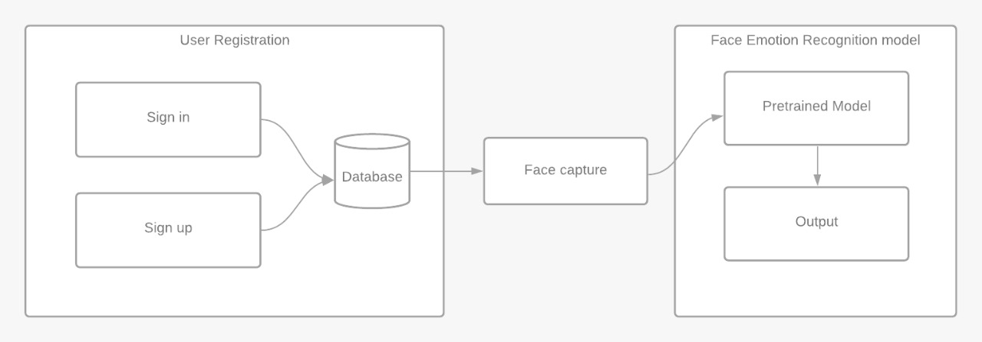
Component Diagram

Slide 4
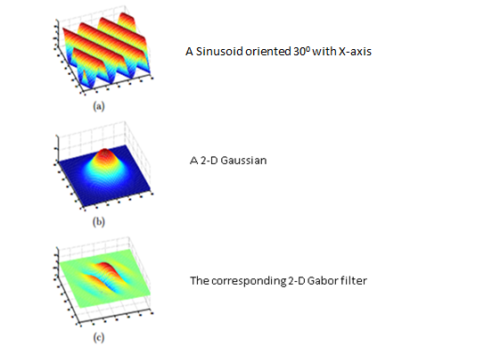
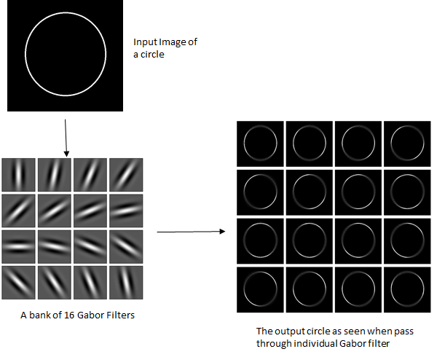
Prerequisite: Gabor filters

Slide 5
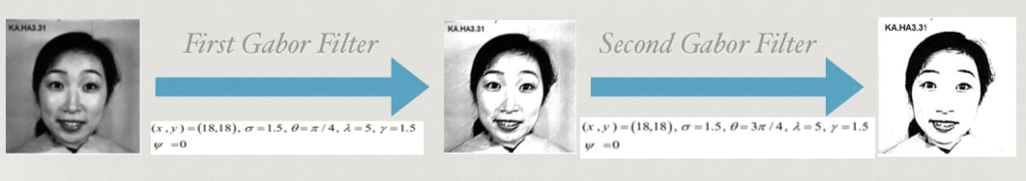
Problem definition
Image pre-processing
We use two Gabor filters for the image pre-processing.

Slide 6
Problem definition
Deep learning
The image is then passed onto the CNN model.
Trained on the FER dataset of 35k images.
Gives a cross validation accuracy of 83%.
Using callbacks ReduceOnPlateau and EarlyStopping.

Slide 7
Project scope
User Registration is required to check your facial emotion status.
The user can get instant response on the their current emotional state.
Classifies the human emotion into four discrete categories: happy, sad, angry and surprised.
The user can get another response, without restarting the application, any number of times.

Slide 8
Packages and APIs
Tkinter: To develop the front end of the application
PIL: To handle the incoming data, in the form of images
Opencv: To access the webcam
Numpy: To convert the image data into pixel values for the DL model
Tensorflow: To train, save and load the model
Keras: API to efficiently interact with Tensorflow

Slide 9
Problems faced
Tensorflow and Keras version
The model was trained on Google colab
When using the model in the application, it was giving an error when loaded on the laptop.
The error was stating that certain initialisers defined in the model are not defined.
After searching for the error on github, we found that it is due to an older version of Tensorflow & Keras on the laptop

Slide 10
Limitations
There needs to be adequate lighting conditions in the room.
The light source should not be directly behind the user.
The user cannot be very far away from the laptop’s camera.

Slide 11
Team work
Aakash Saroop: Training the DL model, Tkinter and presentation
Bhairav Narkhede: Database connectivity, login/logout tkinter, report and presentation.

Slide 12
Thank you!

