Slide 1
Distributed and Cloud Computing
K. Hwang, G. Fox and J. Dongarra
Chapter 4: Cloud Platform Architecture over Virtualized Datacenters
(suggested for use in 5 lectures in 250 minutes)
Prepared by Kai Hwang
University of Southern California
April 3, 2012

Slide 2
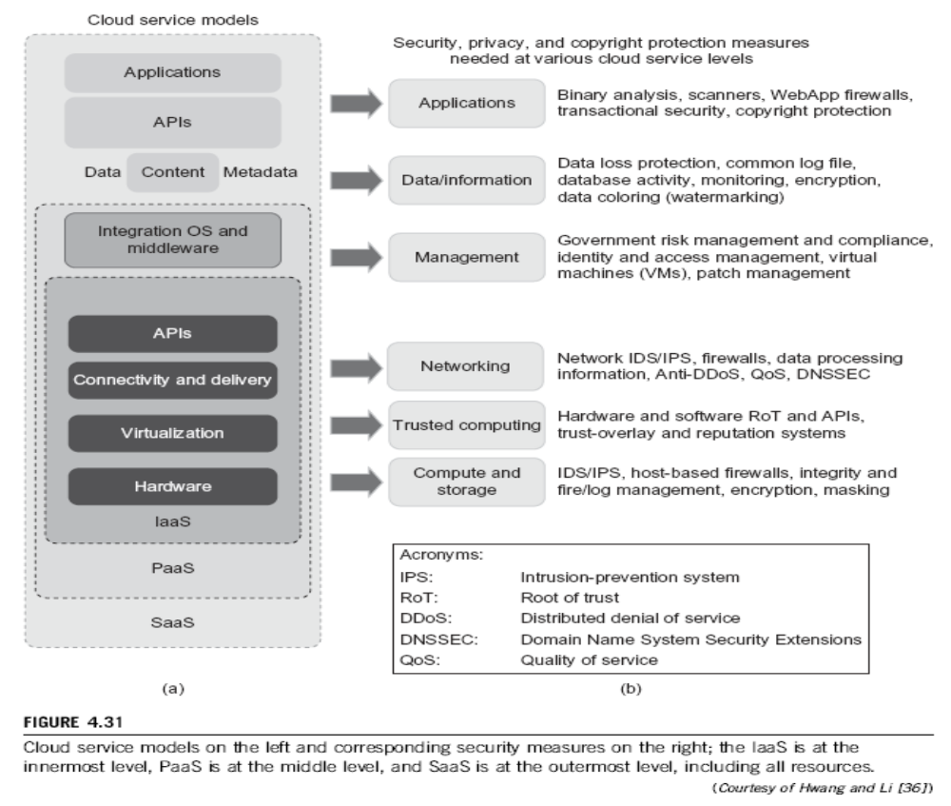

Slide 3
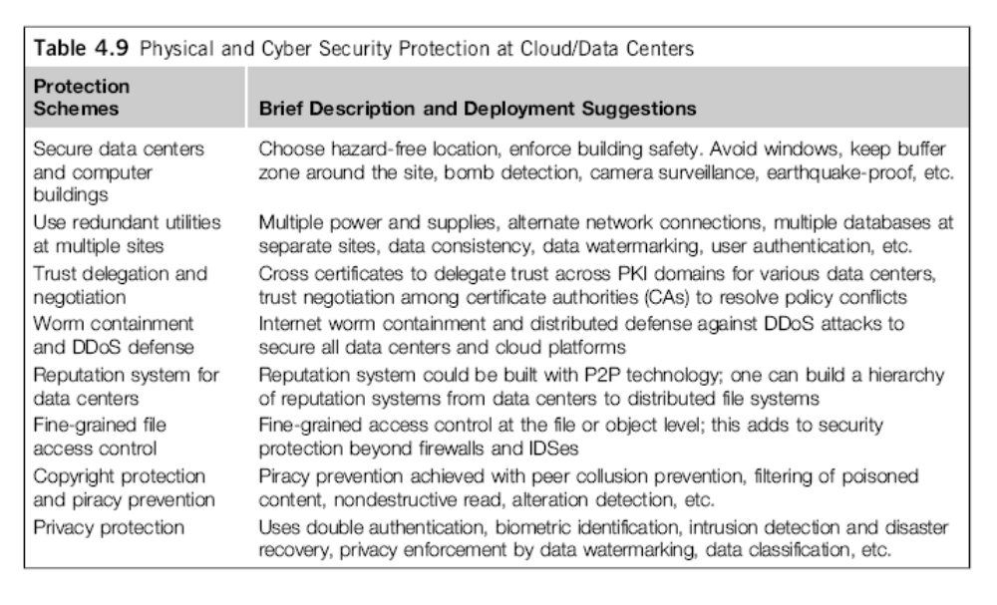

Slide 5
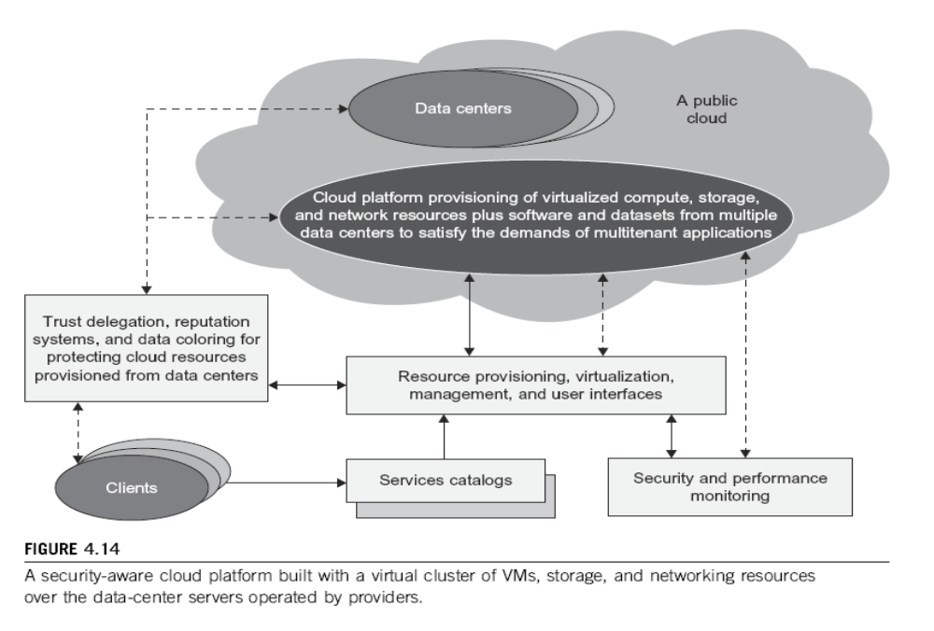

Slide 6












Trusted Zones for VM Insulation
Insulate infrastructure from Malware, Trojans and cybercriminals
Anti-malware
Federate identities with public clouds
Identity federation
Cybercrime intelligence
Strong authentication
APP
APP
Tenant #2
OS
OS
Control and isolate VM in the virtual infrastructure
Virtual Infrastructure
Insulate information
from other tenants
Virtual network security
Data loss prevention
APP
APP
Tenant #1
OS
OS
Virtual Infrastructure
Insulate information from cloud providers’ employees
Encryption & key mgmt
Access Mgmt
Segregate and control user access
Cloud Provider
Tokenization
Security Info. & Event Mgmt
Physical Infrastructure
Physical Infrastructure
GRC
Enable end to end view of security events
and compliance across infrastructures
October 26, 2011

Slide 7
Security Issues on VMs
Access Control is discretionary. Fine-grained multilevel controls are needed (Iitegrity lock architecture)
Secure Boot – The boot process needs to be secured. Proper attestation methods desired. More robust logging is needed.
Component Isolation – Dom0 in XEN supports networking, disk I/O, VM boot loading, hardware emulation and workload balancing, all need to be decomposed into components
Logging –Introspection – a VM running security software is allowed to look inside the memory of another VM. Software such as IPS and antriviruses, using introspection should be safe from tampering.
Avoiding man-in-the-middle attack on VMs during VM migration.
October 26, 2011
Prof. Kai Hwang, USC/THU

Slide 8
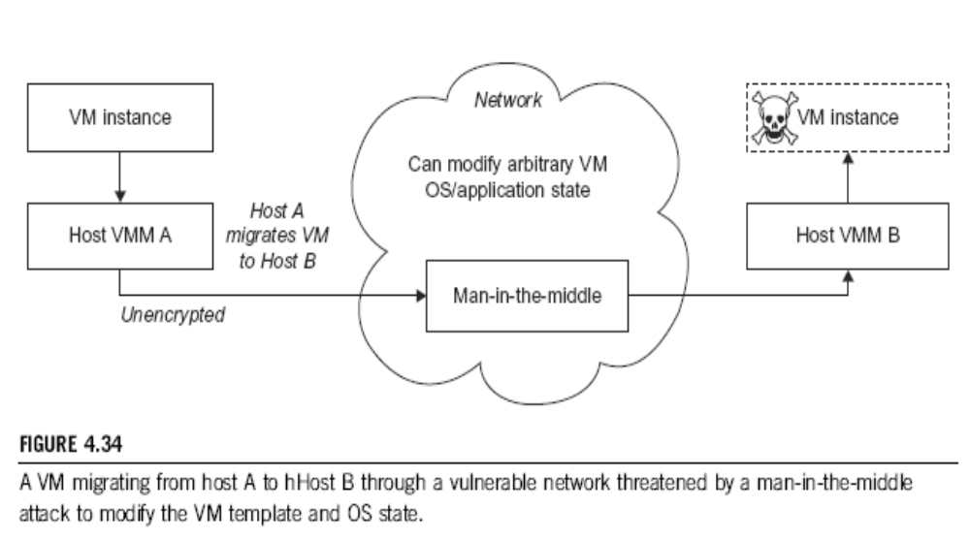

Slide 9
Fine-grained Access Control with Hive
Hive is a data warehouse infrastructure built on top of Hadoop that provides tools to enable easy data summarization, adhoc querying and analysis of large datasets stored in Hadoop files. It provides a mechanism to put structure on this data with a simple query language called Hive QL based on SQL.
Policies include content dependent access control, association based access control, time-dependent access control
Table/View definition and loading,
  Users create tables as well as load data into tables. Further, they
  can also upload XACML policies for the table they are creating.
  Users can also create XACML policies for tables/views.
  Users define views only if they have permissions for all tables
  Specifing in the query to create the view, they can create XACML
  policies for the views defined.

Slide 10

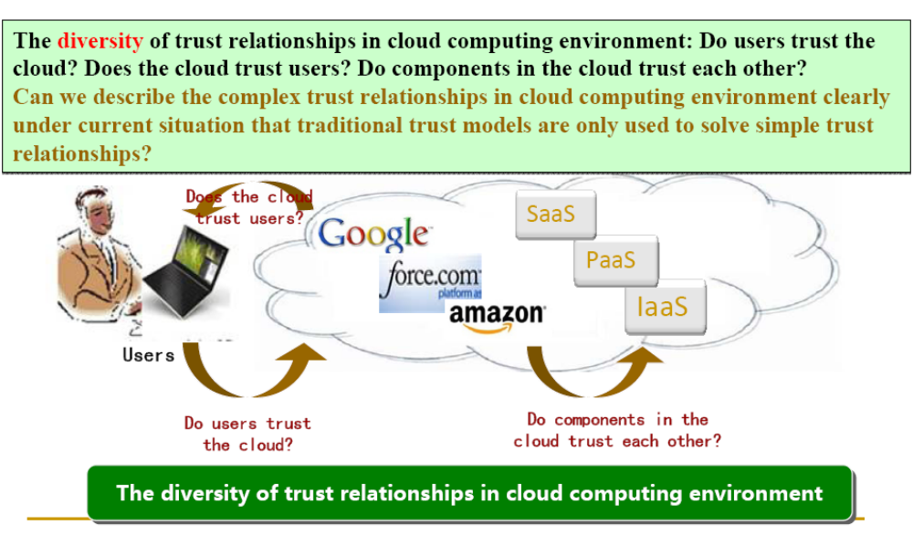
(Courtesy of Hai Jin, 2012)

Slide 11

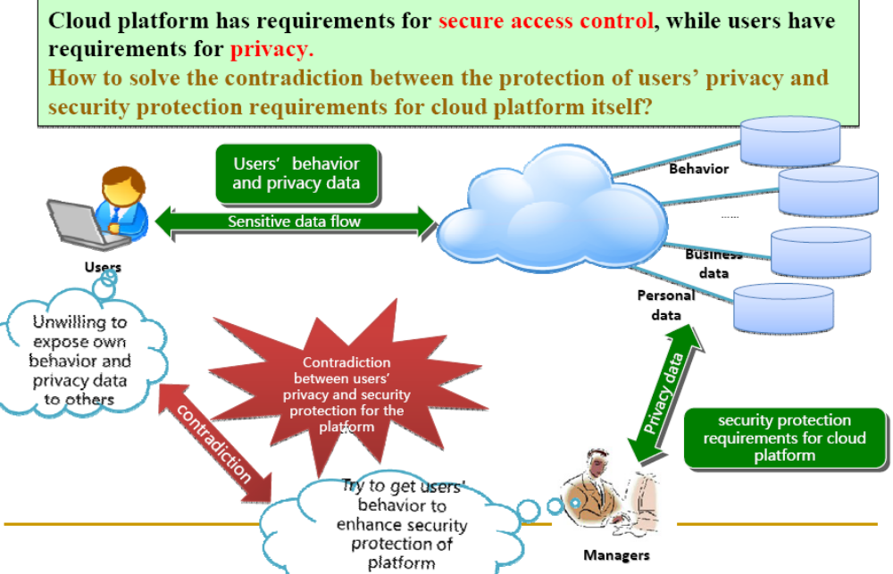
(Courtesy of Hai Jin, 2012)

Slide 12

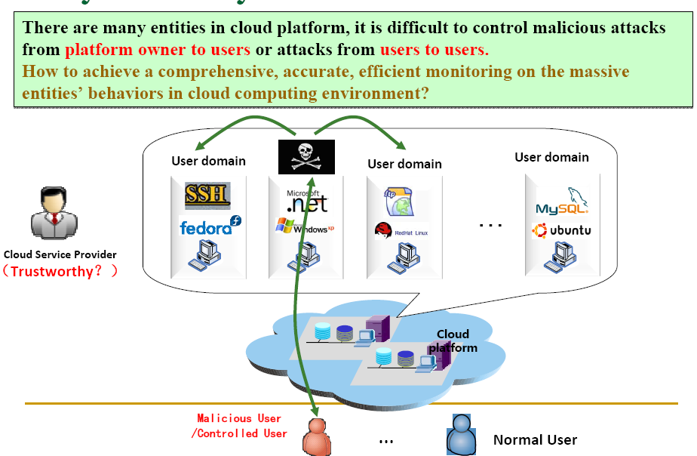
(Courtesy of Hai Jin, 2012)

Slide 13
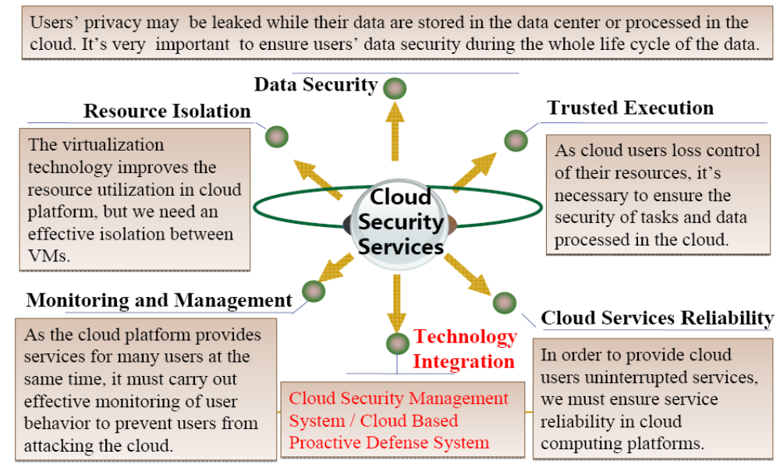
(Courtesy of Hai Jin, 2012)

Slide 14
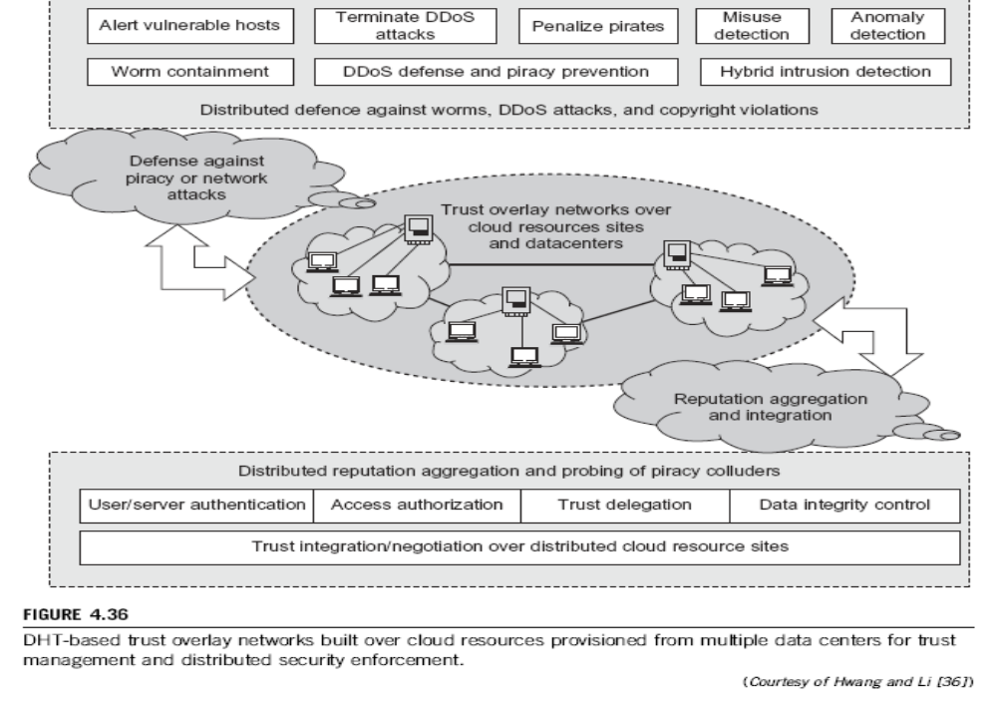

Slide 15
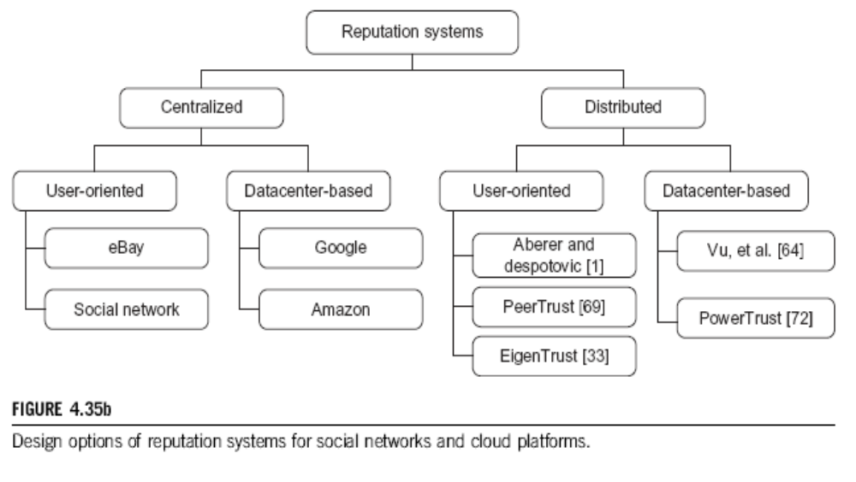
Reputation Systems for Social Networks and Cloud Systems

Slide 16
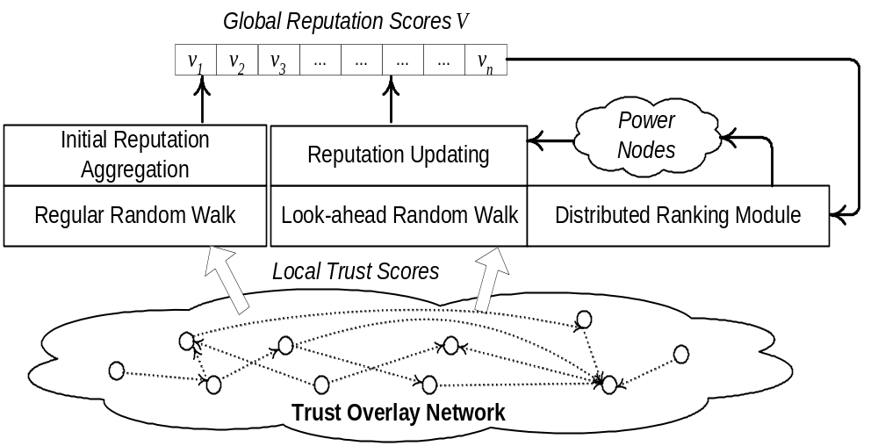
PowerTrust Built over A Trust Overlay Network
(Courtesy of R. Zhou and K. Hwang, “PowerTrust : A scalable and robust reputation system for structured P2P networks”, IEEE-TPDS, May 2007)

Slide 17
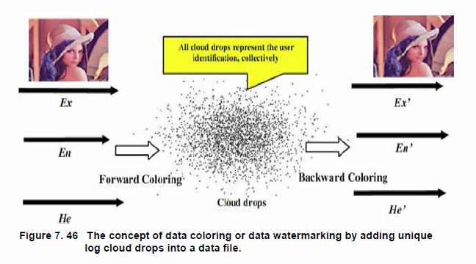
Data Coloring for Cloud Privacy Protection

Slide 18
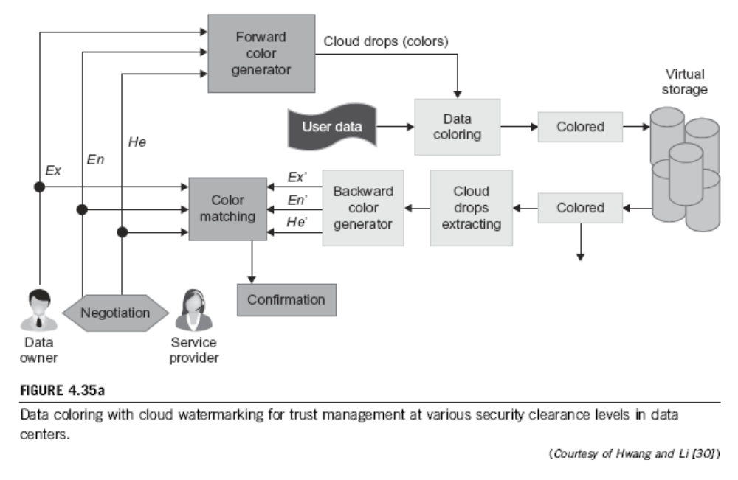

Slide 19
Clouds vs. Job Opportunities
Clouds forming a major industry thrust that IDC estimates will grow to $44.2 billion investment in 2013 while 15% of IT investment in 2011 was related to cloud systems.
Gartner rates cloud computing high on list of critical emerging technologies that are transformational (their highest rating for impact) in the next 2 - 5 years.
There are many opportunities for new jobs in cloud computing with a recent European study estimating 2.4 million new cloud computing jobs in Europe alone by 2015.
Cloud computing spans research and economy and so attractive component of curriculum for students that mix “going on to PhD” or “graduating and working in industry”
(Courtesy of Geoffrey Fox, 2012)

Slide 20
Conclusions:
Computing clouds are changing the whole IT , service industry, and global economy. Clearly, cloud computing demands ubiquity, efficiency, security, and trustworthiness.
Cloud computing has become a common practice in business,
government, education, and entertainment leveraging 50 millions
of servers globally installed at thousands of datacenters today.
Private clouds will become widespread in addition to using a few
public clouds, that are under heavy competition among Google, MS, Amazon, Intel, EMC, IBM, SGI, VMWare, Saleforce.com, etc.
Effective trust management, guaranteed security, user privacy,
data integrity, mobility support, and copyright protection are crucial to the universal acceptance of cloud as a ubiquitous service.

Slide 21
Basic Papers to Read:
M. Armbrust, et al, “Above the Clouds: A Berkeley View of Cloud Computing”, Technical Report, UCB/EECS-2009-28, Feb.2009.
K. Hwang and D. Li, “ Trusted Cloud Computing with Secure Resources and Data Coloring”, IEEE Internet Computing, Sept. 2010.
M. Rosenblum and T. Garfinkel, “Virtual Machine Monitors: Current Technology and Future Trends”, IEEE Computer, May 2005, pp.39-47.
B. Sotomayor, R. Montero, and I. Foster, “Virtual Infrastructure Management in Private and Hybrid Clouds”, IEEE Internet Computing, Sept. 2009

